Slide 2
Prediction
Prediction
Prediction
Trained
Classifier
Trained
Classifier
New Classifier
(random initialization)
Trained CNN
Base
Trained CNN
Base
Trained CNN
Base
(frozen)
Input
Input
Input

Slide 3
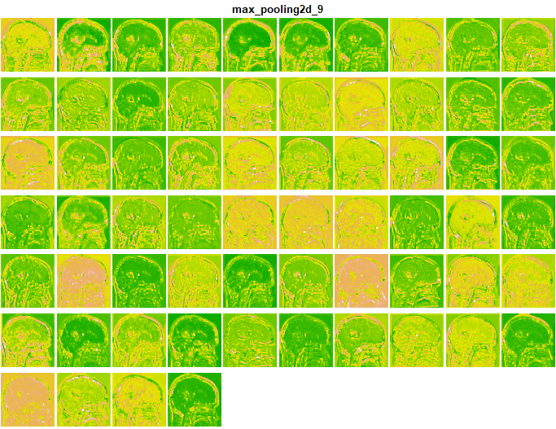
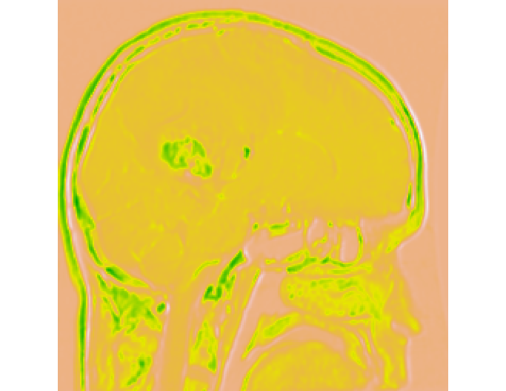
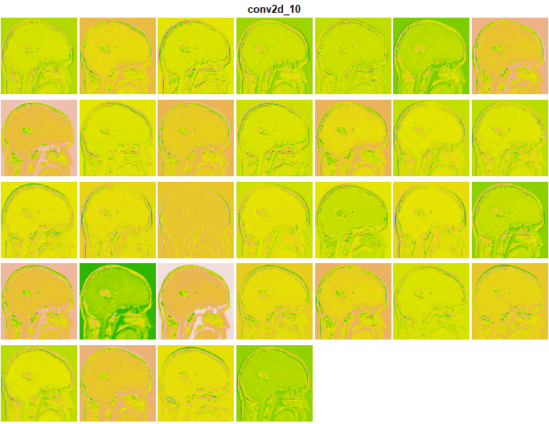
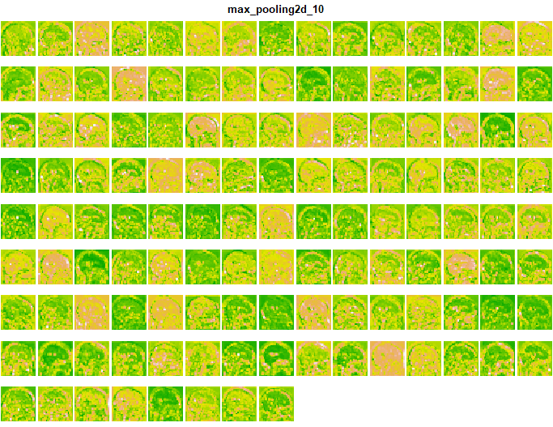

Slide 4
