Slide 1
Implementing Remote Procedure Calls (RPC) ACM TOCS, 1984 by ANDREW D. BIRRELL and BRUCE JAY NELSON Xerox PARC

Slide 2
background
Programming model that combines Network programming + high-level programming language
before the era of IPv4 (IPv4 on ARPANET was 1983, and this paper is on 1984)
4.2 BSD UNIX supports TCP/IP, 1982
Some historic background around the timeline
Network programming without abstractions – not so easy, but possible
No TCP/IP protocol stack
High-level programming – C / C++, common lisp, BASIC
http://www.masterraghu.com/subjects/np/introduction/unix_network_programming_v1.3/ch01lev1sec8.html

Slide 3
RPC advantages
when RPC is invoked
calling environment is suspended
parameters are passed across the network to the execution environment (callee)
procedure is executed on the callee side
when procedure is finished, the results are passed back to the calling environment
Advantages
clean and simple semantics
procedure calls like single machine procedure call, but operate over a network
efficiency
procedure calls simple enough for communication to be rapid
generality
procedures are the most important mechanism for communication between parts of the algorithm

Slide 4
Problems in the RPC (at the time)
Precise semantics of a call in the presence of machine and communication failures
the semantics of the address-containing arguments in the absence of a shared address space
integration of remote calls into existing programming systems
binding (how a caller determines the location and identity of the callee)
suitable protocols for transfer of data and control between caller and callee
how to provide data integrity and security in an open communication network

Slide 5
Environment (at the time)
As a part of Cedar project, developing a programming environment
powerful, convenient for building experimental systems
uniform, highly interactive user interface
ease of construction and debugging of programs
Dorados (computers used for Cedar)
very powerful machine :)
24-bit virtual address space (16-bit word)
80Mib disk
Algol-style call and return takes less than 10 microseconds
3Mbps Ethernet connected (some are 10Mbps), leased telephone and satellite link bandwidth of 4800 bps, 56000 bps
Most communication is on local Ethernet, and network is not overloaded

Slide 6
Goals
Primary goal was to make distributed computation easy
network programming was not so easy; only by a few expert members
Two secondary goals
Make RPC communication highly efficient
avoid unnecessary communications
Make the semantics of RPC package as powerful as possible, without loss of simplicity and efficiency
design trade-offs between powerful semantics and efficiency
final major goal is to provide secure communication with RPC

Slide 7
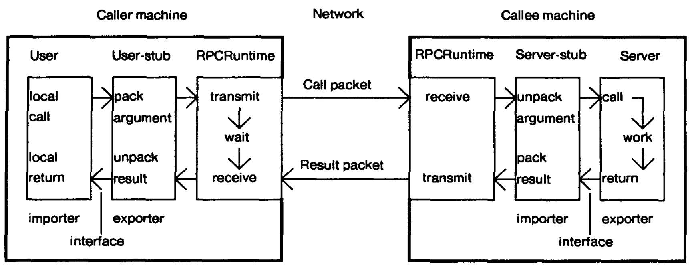
Structure
user, user-stub, RPCRuntime,
server, server-stub

Slide 8
user/server, user-stub/server-stub
user/server: written as distributed application
normal call to –stub code
-stub: automatically generated file
user-stub is responsible for placing a specification of the target procedure and arguments into one or more packets
server-stub is responsible for unpacking them and makes a normal call to the server
written in interface definition language (Lupine)
Interface module/import/export required; but as a programmer, they just focus on the application logic, rather than networking details
RPCRuntime
is responsible for retransmission, acknowledgements, packet routing, and encryption

Slide 9
Binding (naming/location)
naming: how does a client of the binding mechanism specify what he wants to be bound to?
importer interface is bound to the exporter interface
calls made by the importer invokes procedures implemented by the remote exporter
name consists of
Type: to specify which interface the caller expects the callee to implement (e.g. mail server)
Instance: to specify which particular implementor of an abstract interface is desired (e.g. specific mail server)
location: how does a caller determine the machine address of the callee and specify to the callee procedure to be invoked?
in the next slide

Slide 10
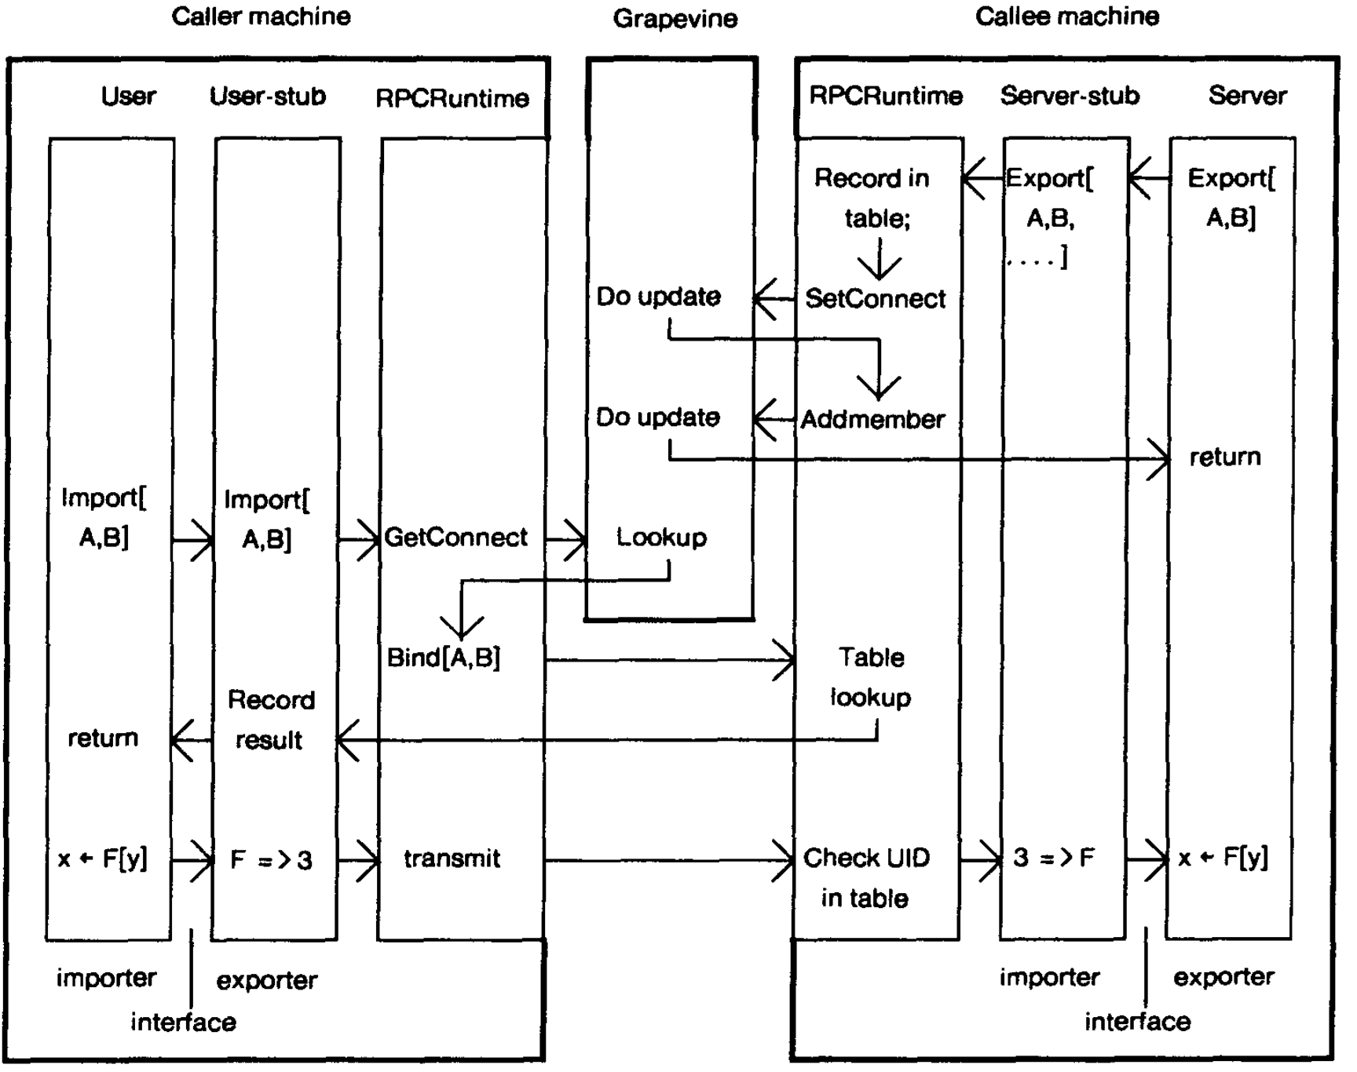
Locating an appropriate exporter
Grapevine: distributed database
Callee machine needs to register before actual use

Slide 11
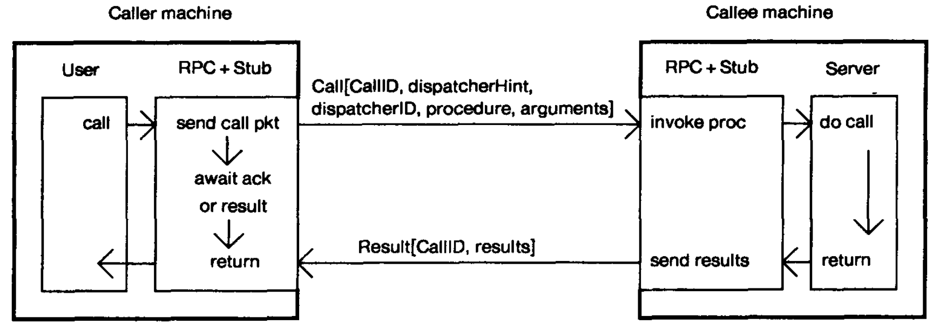
Packet level transfer
a simple call

Slide 12
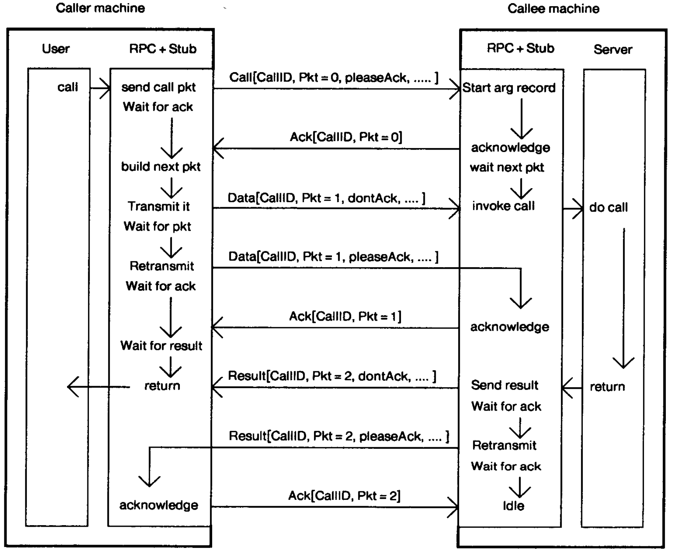
Complicated call
Ack/retransmission for reliable transmission

Slide 13
Exception handling
Mesa programming language has a unique runtime
signal-catch structure support
similar to try-catch in modern PL
RPCRuntime handles exception packet – catch phrase can handle it

