Slide 1
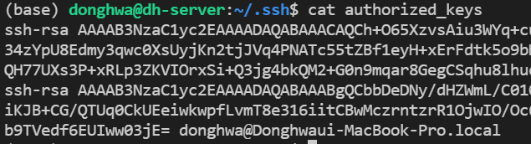

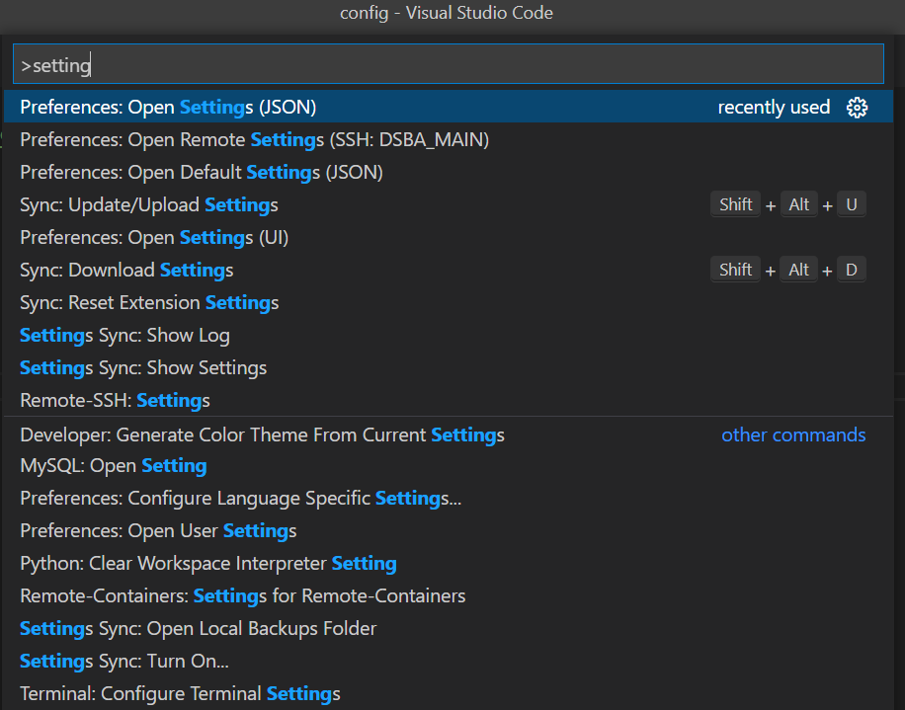
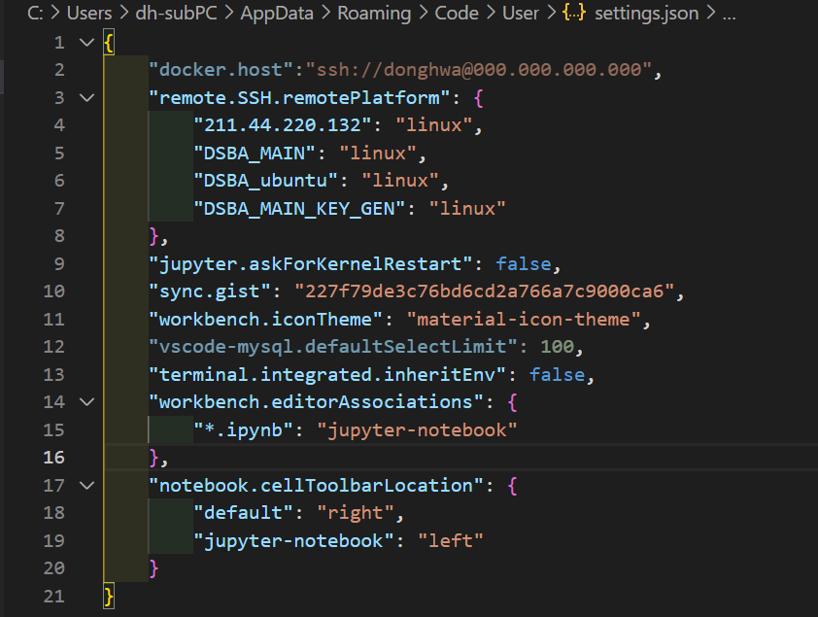
Host server
(Docker env)
Local 1
SSH-keygen
Host DSBA_MAIN_KEY_GEN
HostName 000.000.000.000
User donghwa
IdentityFile ~/.ssh/id_rsa
Local 1
Local 2
Host server
(Docker env)
Local
Docker.host 추가

