Slide 1
Literature review for
the NeuroTree project
Donghyun Kang

Slide 2
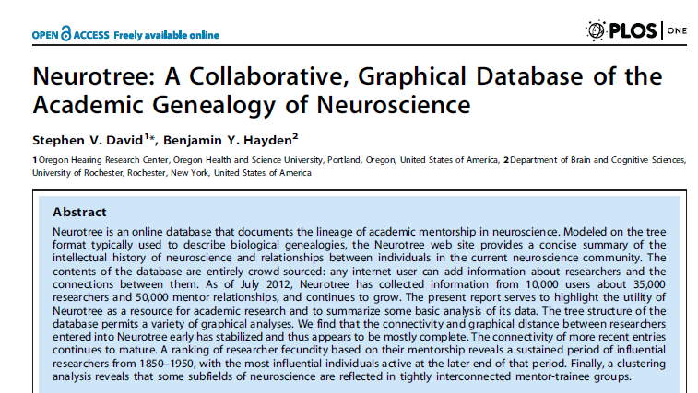
The first article should be cited when we use NeuroTree data.
We can see that that size of data grew a lot comparing to the time when the data was first published.
I decided to check the articles citing this piece.
David, Stephen V., and Benjamin Y. Hayden. "Neurotree: A collaborative, graphical database of the academic genealogy of neuroscience." PloS one 7, no. 10 (2012): e46608.

Slide 3
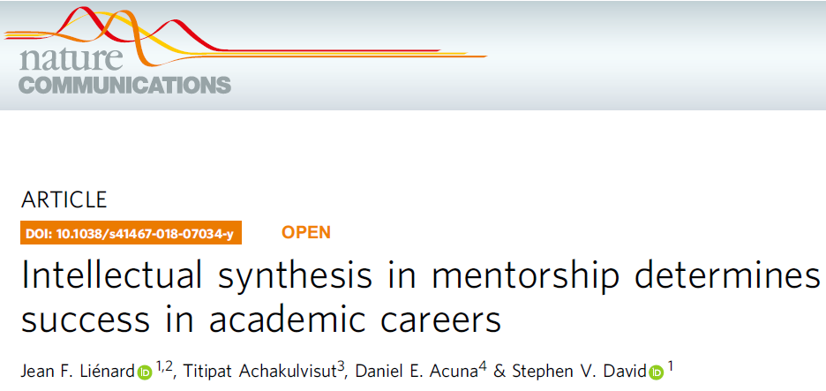
50+ disciplines, 500,000+ life science researchers mainly focusing on the field of neuroscience, linking the genealogy into publication records.
Argument
*1) Trainees under productive mentor become productive
* 2) Trainees who successfully synthesize their previous mentor's disparate expertise become successful while maintaining some level of similarity. (related to the theory of weak ties ?)
Lienard, Jean F., Titipat Achakulvisut, Daniel E. Acuna, and Stephen V. David. "Intellectual synthesis in mentorship determines success in academic careers." Nature communications 9, no. 1 (2018): 4840.

Slide 4
Measures based on the triplets (trainees, graduate mentors, postdoctoral mentors)
* Academic proliferation: the average number of researchers trained
* The similarity of intellectual output: based on the term-document frequency matrix drawing upon non-coauthored paper before the end of postdoc training, a latent semantic analysis (basically PCA) was performed. The cosine distances of the averaged vector between pairs of scientists were computed.
Missing date inference
* p. 10. Check the method section to infer the missing end and the start date of training.
Lienard, Jean F., Titipat Achakulvisut, Daniel E. Acuna, and Stephen V. David. "Intellectual synthesis in mentorship determines success in academic careers." Nature communications 9, no. 1 (2018): 4840.

Slide 5
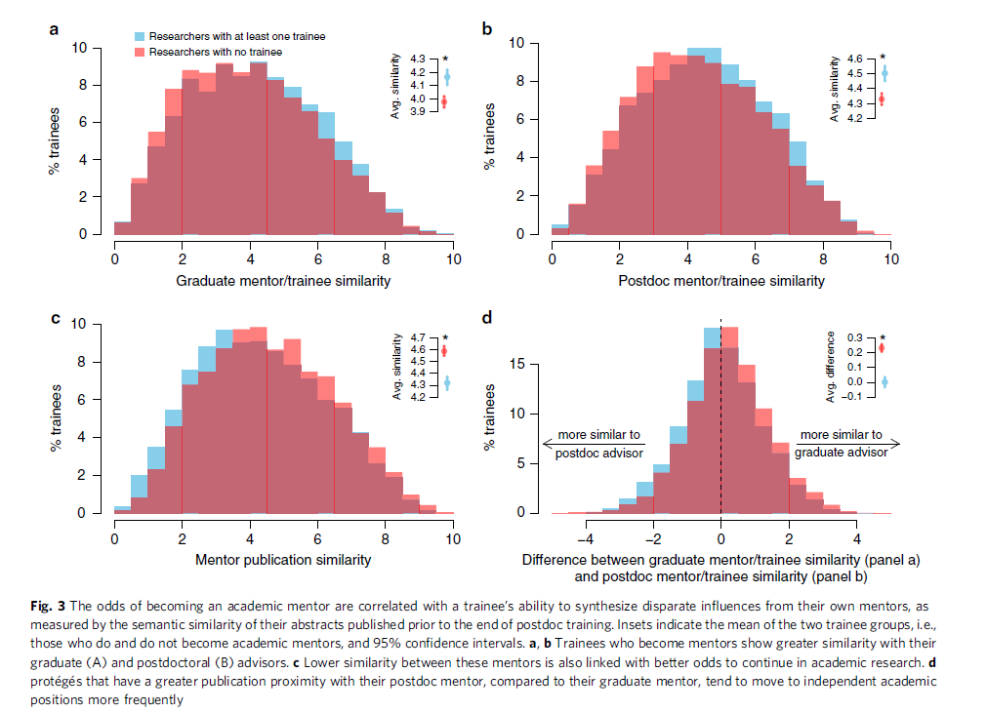
Thought: Is the difference really meaningful, beyond the statistical significance?
Lienard, Jean F., Titipat Achakulvisut, Daniel E. Acuna, and Stephen V. David. "Intellectual synthesis in mentorship determines success in academic careers." Nature communications 9, no. 1 (2018): 4840.

Slide 6
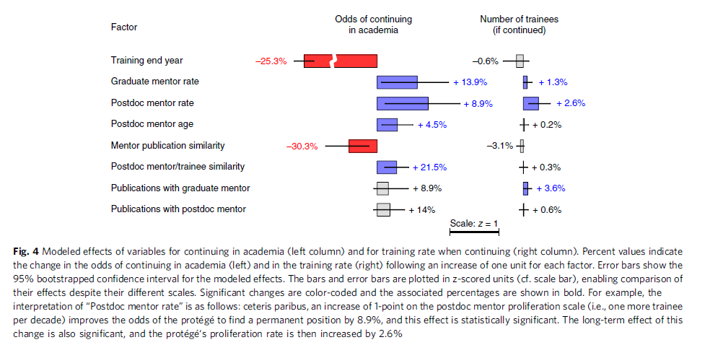
Lienard, Jean F., Titipat Achakulvisut, Daniel E. Acuna, and Stephen V. David. "Intellectual synthesis in mentorship determines success in academic careers." Nature communications 9, no. 1 (2018): 4840.

Slide 7
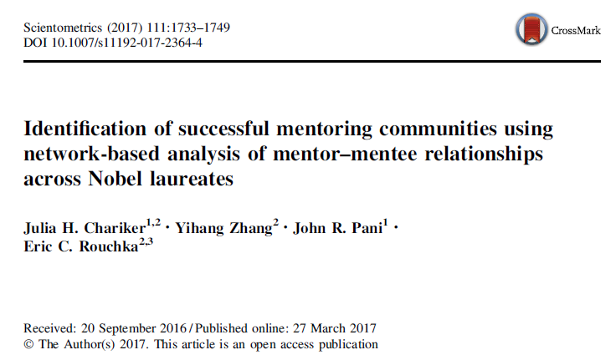
- We can basically identify successful communities of scientists in which produce Nobel laureates.
-
Chariker, Julia H., Yihang Zhang, John R. Pani, and Eric C. Rouchka. "Identification of successful mentoring communities using network-based analysis of mentor–mentee relationships across Nobel laureates." Scientometrics 111, no. 3 (2017): 1733-1749.

Slide 8
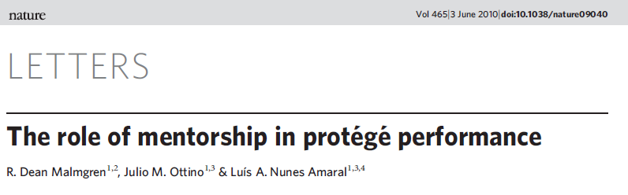
Malmgren, R. Dean, Julio M. Ottino, and Luís A. Nunes Amaral. "The role of mentorship in protégé performance." Nature 465, no. 7298 (2010): 622.

