Slide 1
Literature review for
the NeuroTree project
Donghyun Kang

Slide 2
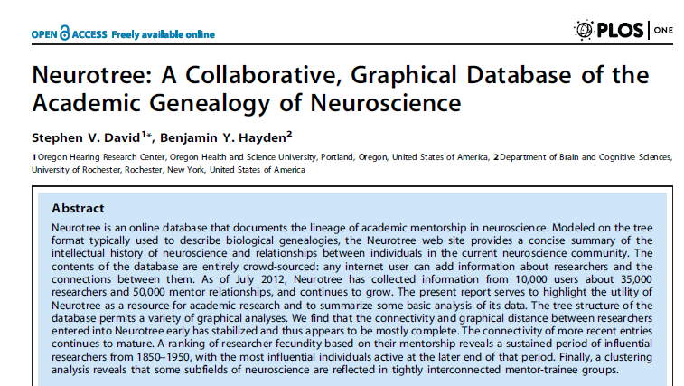
The first article should be cited when we use NeuroTree data.
We can see that that size of data grew a lot comparing to the time when the data was first published.
I decided to check the articles citing this piece.
David, Stephen V., and Benjamin Y. Hayden. "Neurotree: A collaborative, graphical database of the academic genealogy of neuroscience." PloS one 7, no. 10 (2012): e46608.

Slide 3
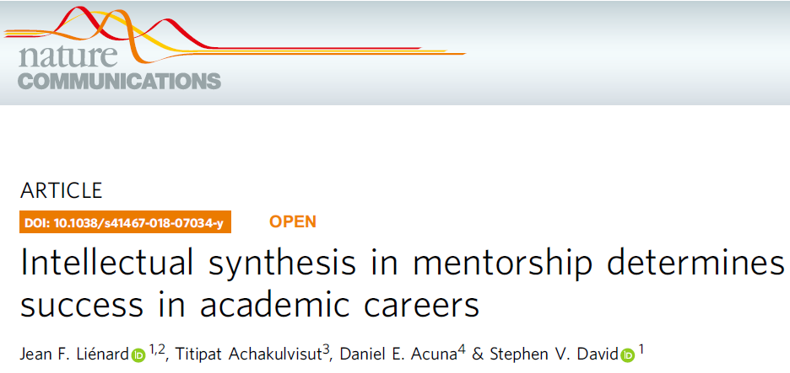
50+ disciplines, 500,000+ life science researchers mainly focusing on the field of neuroscience, linking the genealogy into publication records.
Argument
*1) Trainees under productive mentor become productive
* 2) Trainees who successfully synthesize their previous mentor's disparate expertise become successful while maintaining some level of similarity. (related to the theory of weak ties ?)
Lienard, Jean F., Titipat Achakulvisut, Daniel E. Acuna, and Stephen V. David. "Intellectual synthesis in mentorship determines success in academic careers." Nature communications 9, no. 1 (2018): 4840.

Slide 4
Measures based on the triplets (trainees, graduate mentors, postdoctoral mentors)
* Academic proliferation: the average number of researchers trained
* The similarity of intellectual output: based on the term-document frequency matrix drawing upon non-coauthored paper before the end of postdoc training, a latent semantic analysis (basically PCA) was performed. The cosine distances of the averaged vector between pairs of scientists were computed.
Missing date inference
* p. 10. Check the method section to infer the missing end and the start date of training.
Lienard, Jean F., Titipat Achakulvisut, Daniel E. Acuna, and Stephen V. David. "Intellectual synthesis in mentorship determines success in academic careers." Nature communications 9, no. 1 (2018): 4840.

Slide 5
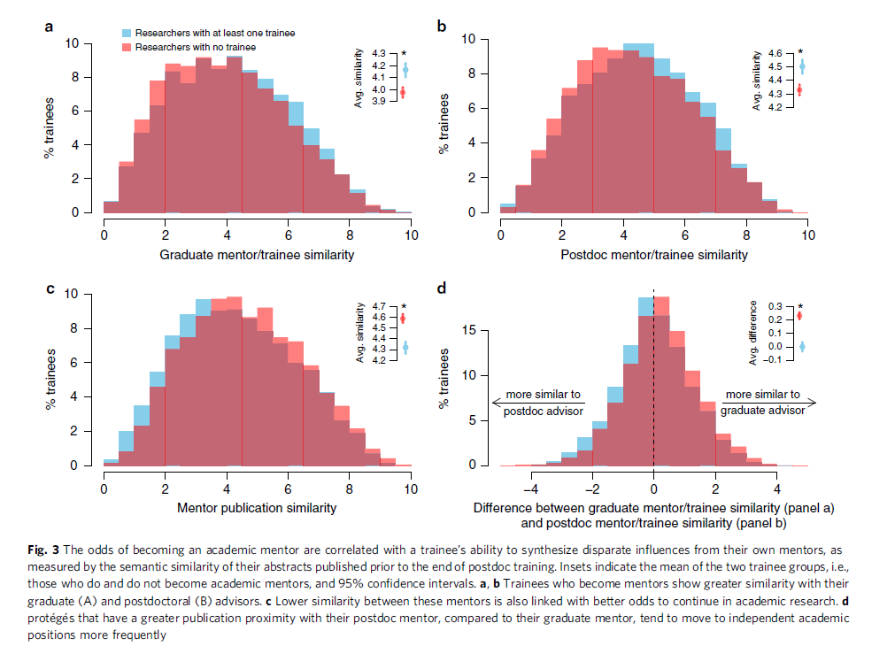
Thought: Is the difference really meaningful, beyond the statistical significance?
Lienard, Jean F., Titipat Achakulvisut, Daniel E. Acuna, and Stephen V. David. "Intellectual synthesis in mentorship determines success in academic careers." Nature communications 9, no. 1 (2018): 4840.

Slide 6
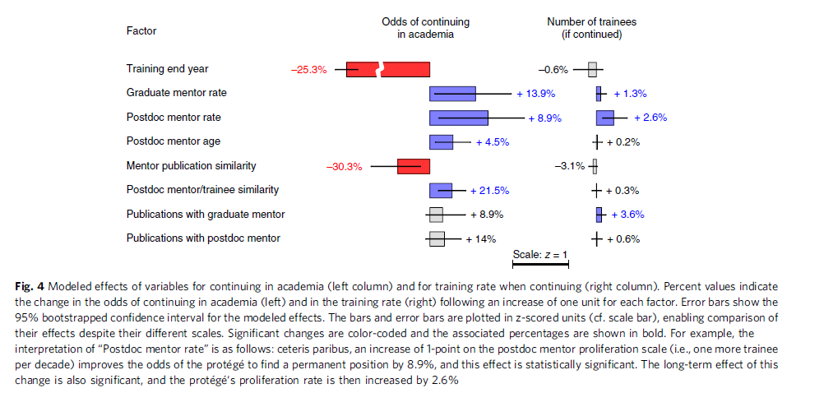
Lienard, Jean F., Titipat Achakulvisut, Daniel E. Acuna, and Stephen V. David. "Intellectual synthesis in mentorship determines success in academic careers." Nature communications 9, no. 1 (2018): 4840.

Slide 7
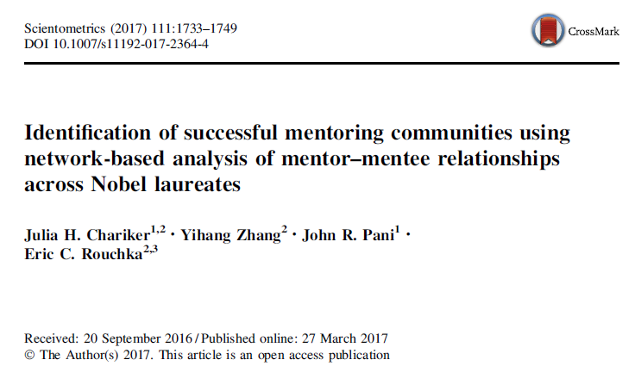
Argument: We can basically identify successful scientific communities which produced Nobel Prize winners in terms of doctoral mentor-mentee relationships.
This piece only focuses on network structure of Nobel Prize winners.
Chariker, Julia H., Yihang Zhang, John R. Pani, and Eric C. Rouchka. "Identification of successful mentoring communities using network-based analysis of mentor–mentee relationships across Nobel laureates." Scientometrics 111, no. 3 (2017): 1733-1749.

Slide 8
Sociological background
Zuckerman (1977): “pattern of assortative collaboration”
Data: The academic family tree
As of 2015. The original data has 114,949 individuals with 484 Nobel Prize winners
The data was restricted to the strongly connected components with 57,831 individuals (402 Nobel laureates)
Focusing on chemistry, physics, physiology, medicine. Peace, economics, literature were not included.
Method
Rejected ERGM, community detection, and main path analysis
Random permutation using C++ to generate topologically same network to calculate p-value (did not fully understand it).
Negative binomial regression + zero inflated model to take into account zero outcomes (of Nobel prize winners in a graph)
Chariker, Julia H., Yihang Zhang, John R. Pani, and Eric C. Rouchka. "Identification of successful mentoring communities using network-based analysis of mentor–mentee relationships across Nobel laureates." Scientometrics 111, no. 3 (2017): 1733-1749.

Slide 9
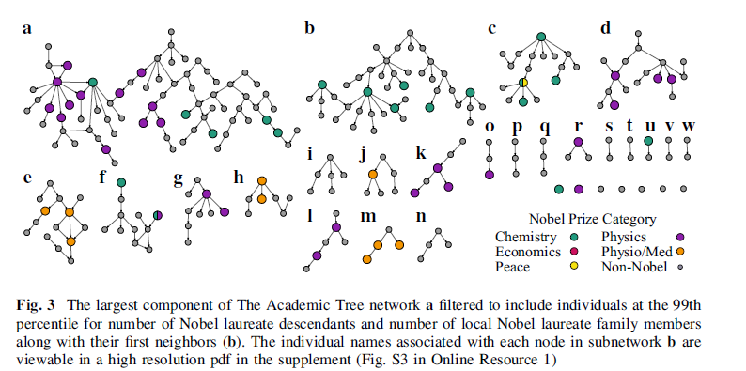
For visualization, the network was again restricted to the individuals who have more or equal to 4 prize winners in their family trees and at least 1 Nobel laureate descendants (the 99th percent quantile)
Chariker, Julia H., Yihang Zhang, John R. Pani, and Eric C. Rouchka. "Identification of successful mentoring communities using network-based analysis of mentor–mentee relationships across Nobel laureates." Scientometrics 111, no. 3 (2017): 1733-1749.

Slide 10
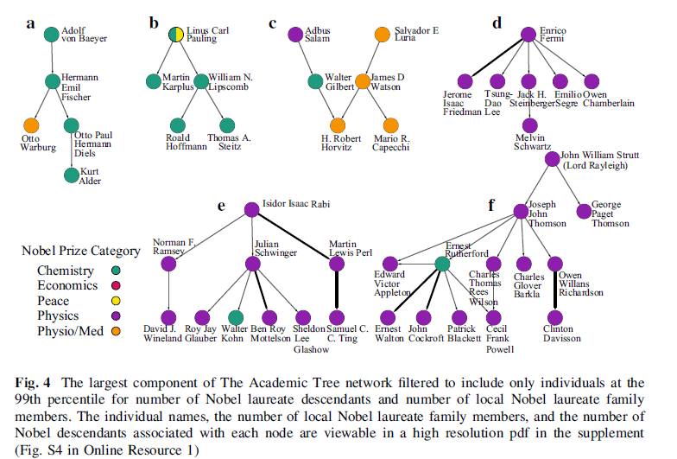
When all non-Nobel laureates were removed, 142 individuals have at least one connection with each other. The heterogeneity of fields are measured by eq. (1) on p. 1738. (maybe IQV would be a better measure…)
The result shows a significant positive relation between heterogeneity and the number of Nobel Laureates in subgraphs.
Chariker, Julia H., Yihang Zhang, John R. Pani, and Eric C. Rouchka. "Identification of successful mentoring communities using network-based analysis of mentor–mentee relationships across Nobel laureates." Scientometrics 111, no. 3 (2017): 1733-1749.

Slide 11
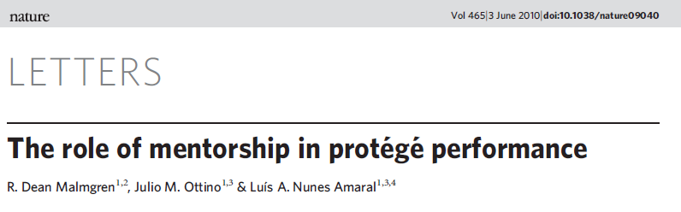
Focusing on mentorship relation in the field of mathematics. (using the Mathematics Genealogy Project data): 1900 – 1960. 7,259 protégé + publication records of 4,447 individuals.
“Fecundity” ~ other measures for academic success (publication, a membership status). “Rising star hypothesis”
Some articles related to the mentorship in the journals in the field of management are cited in this article. (e.g., Higgins, M. C. & Kram, K. E. Reconceptualizing mentoring at work: a developmental network perspective. Acad. Manage. Rev. 26, 264–283 (2001).)
Malmgren, R. Dean, Julio M. Ottino, and Luís A. Nunes Amaral. "The role of mentorship in protégé performance." Nature 465, no. 7298 (2010): 622.

Slide 12
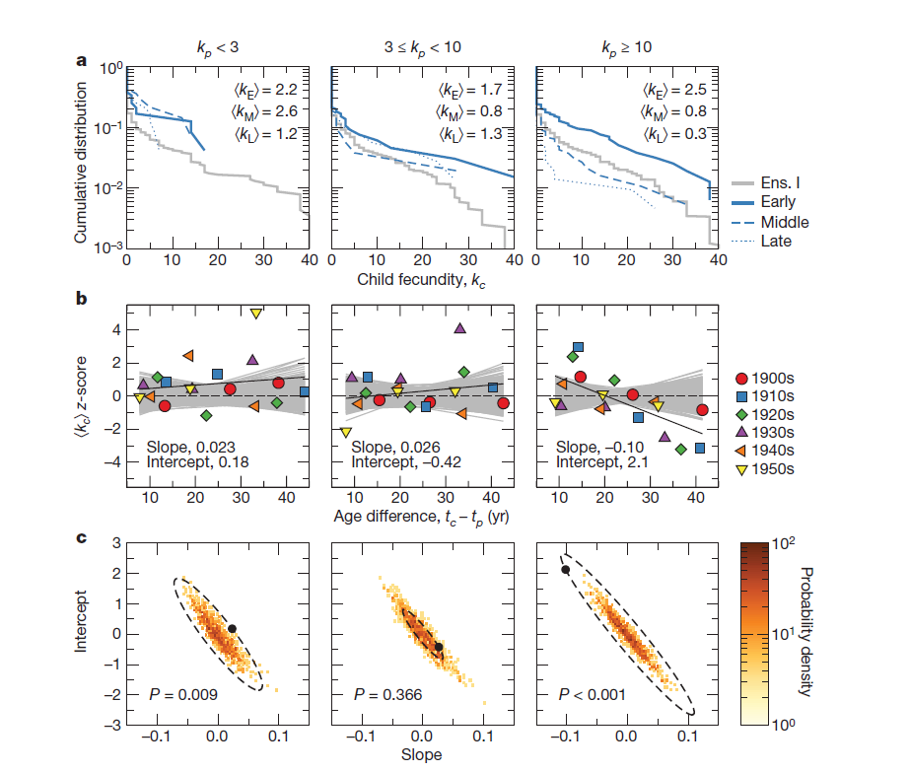
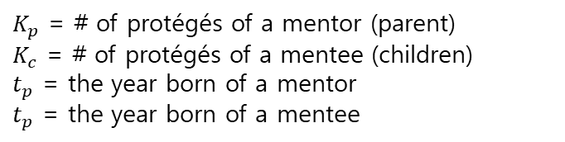
Fig 4.
The three groups of mathematicians, based on the number of children (or protégé), produced different types of protégé in terms of fecundity. The protégé of the least fecund mentors tended to have more protégé than expected, whereas the protégé of the most fecund mentor group tend to be less productive than expected.
Thoughts: could it be just a phenomenon which can be explained by “regression towards mean”??
$K_{p}$ = # of protégés of a mentor (parent)
$K_{c}$ = # of protégés of a mentee (children)
$t_{p}$ = the year born of a mentor
$t_{p}$ = the year born of a mentee
Malmgren, R. Dean, Julio M. Ottino, and Luís A. Nunes Amaral. "The role of mentorship in protégé performance." Nature 465, no. 7298 (2010): 622.

Slide 13
Fig 4.
-“First, mentors with low mentorship fecundities train protégés that go on to have mentorship fecundities
37% higher than expected. Second, in the first third of their careers, mentors with high fecundities train protégés that go on to have fecundities 29% higher than expected. Finally, in the last third of their careers, mentors with high fecundities train protégés that go on to have fecundities 31% lower than expected.” (p. 624)
Thoughts: could it be just a phenomenon which can be explained by “regression towards mean”??
$K_{p}$ = # of protégés of a mentor (parent)
$K_{c}$ = # of protégés of a mentee (children)
$t_{p}$ = the year born of a mentor
$t_{p}$ = the year born of a mentee
Malmgren, R. Dean, Julio M. Ottino, and Luís A. Nunes Amaral. "The role of mentorship in protégé performance." Nature 465, no. 7298 (2010): 622.

