Slide 1


Reducing the Memory Footprint of IFDS-based Data-Flow Analyses Using Fine-Grained Garbage Collection
Dongjie He¹, Yujiang Gui¹, Yaoqing Gao², Jingling Xue¹
¹School of Computer Science and Engineering
University of New South Wales
²Huawei Toronto Research Center
Presenter: Yujiang Gui
32nd ISSTA, July 2023
ISSTA 2023
1
Notes:
Hello everyone, I’m Yujiang Gui, and I come from the University of New South Wales. Today I will be presenting our work: Reducing the Memory Footprint of IFDS-based Data-Flow Analyses Using Fine-Grained Garbage Collection. 0:14

Slide 2




The IFDS Algorithm
Transforms an analysis into a graph-reachability problem
Solves a wide range of data-flow analyses
Compiler optimization
Bug detection (ASE’18)
Taint analysis (PLDI’14, FSE’14)
Pointer analysis (ECOOP’16, ASE’21, TSE’23)
Typestate-like analysis (OOPSLA’08, PLDI’14)
…
Has been implemented in many tools
Reps, Thomas, Susan Horwitz, and Mooly Sagiv. “Precise Interprocedural Dataflow Analysis via Graph Reachability.”, POPL’95.
ISSTA 2023
2
Notes:
Let me first introduce the IFDS algorithm. The IFDS algorithm solves a data flow analysis by transforming it into a graph reachability problem. It can be used to solve a range of problems and has been implemented in many program analysis and compiler frameworks, such as LLVM, Soot and WALA. 0:37

Slide 3
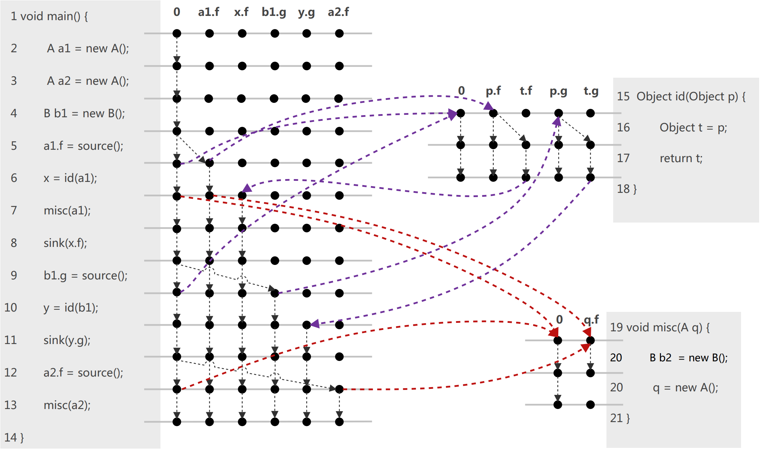
A Running Example: Taint Analysis
ISSTA 2023
3
Notes:
It can also be used to solve a taint analysis problem. A taint analysis tracks whether sensitive information from a source may reach a sink. Here is a running example. 0:50

Slide 4
A Running Example: Taint Analysis
Path Edge
ISSTA 2023
3
Notes:
Let's focus on the first source and sink. At first, the variable a1.f is tainted by the source method at line 5, so a path edge is generated. 1:00

Slide 5
A Running Example: Taint Analysis
Path Edge
ISSTA 2023
3
Notes:
Next, we have a method call. We map the argument to the parameter, so p.f is tainted at the start point of the id method. 1:14

Slide 6
A Running Example: Taint Analysis
Path Edge
ISSTA 2023
3
Notes:
After that, we have an assignment from p to t, so we generate a new data fact t.f after the assignment. 1:24

Slide 7
A Running Example: Taint Analysis
Path Edge
ISSTA 2023
3
Notes:
Finally, we have a return statement, we map the result to the return value. 1:30

Slide 8
A Running Example: Taint Analysis
Path Edge
ISSTA 2023
3
Notes:
That means x.f is tainted after the method call. 1:35

Slide 9
A Running Example: Taint Analysis
Path Edge
ISSTA 2023
3
Notes:
Like this, the algorithm extends the path edges on the graph. 1:42

Slide 10
A Running Example: Taint Analysis
Path Edge
ISSTA 2023
3
Notes:
Now we know that x.f is tainted after line 8, which is a sink, so the algorithm reports that there is a data leak. 1:50

Slide 11





The Drawback: Memory-Intensive
Maintains a huge number of path edges
ISSTA 2023
4
Notes:
To solve a data flow analysis, the framework needs to maintain a huge number of path edges. When using the IFDS-based taint analysis tool FlowDroid to analyze Android applications, we can see for a small application, it need to maintain over five hundred million path edges, which consumes over a hundred GB of RAM. 2:14

Slide 12
The Drawback: Memory-Intensive
Maintains a huge number of path edges
Fails to solve taint analysis on some Android apps
Even on a server with 730GB RAM
Slows down the analysis
Frequent re-hashing operations
ISSTA 2023
4
Notes:
It can fail to analyze some applications on a powerful server. Maintaining too many path edges can also slow down the analysis, because they can cause frequent re-hashing of a HashMap. 2:31

Slide 13
Objective
Improving the Scalability and Efficiency
ISSTA 2023
5
Notes:
In this work, our objective is to improve the scalability and efficiency of the IFDS-based data flow analyses. 2:41

Slide 14
Objective
Improving the Scalability and Efficiency
Discovers facts only at some program points
Taint analysis
ISSTA 2023
5
Notes:
We noticed that most analyses aim to discover facts only at some program points. Take taint analysis as an example, it reports data leaks on the fly, and it will not revisit previous path edges. 3:00

Slide 15
Objective
Improving the Scalability and Efficiency
Discovers facts only at some program points
Taint analysis
Non-live path edges
Visited only once (86.97%)
Waste memory resources
ISSTA 2023
5
Notes:
We call them non-live path edges. In practice, most path edges are non-live, maintaining them in memory is just a waste of resource. 3:11

Slide 16
Objective
Improving the Scalability and Efficiency
Discovers facts only at some program points
Taint analysis
Non-live path edges
Visited only once (86.97%)
Waste memory resources
Garbage collection! But how to…
Preserve important properties
Correctness
Precision
Termination
Avoid redundant computations
ISSTA 2023
5
Notes:
We can use garbage collection to collect non-live path edges. Applying garbage collection is non-trivial since we need to preserve some important properties and avoid redundant computations. 3:25

Slide 17
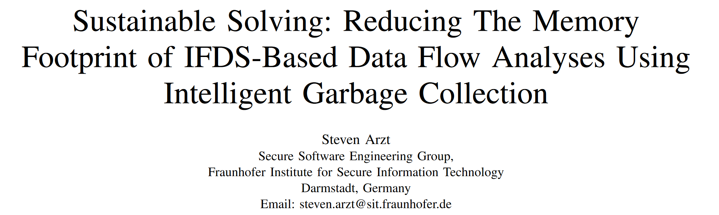
Existing Approach
CleanDroid (ICSE’21)
With 2 major limitations
Coarse-grained
Allows redundant computations
ISSTA 2023
6
Notes:
CleanDroid employs garbage collection in IFDS-based data flow analyses to reduce the memory usage. I will show you its 2 major limitations and how we solve them. 3:39

Slide 18
Limitation 1: Coarse Granularity
Running garbage collection just before line 10…
ISSTA 2023
7
Notes:
The first limitation is its coarse granularity. Let's consider one specific GC point, the moment that line 10 is about to be analyzed. At this point, the id method has been analyzed once at line 6. (3:55

Slide 19
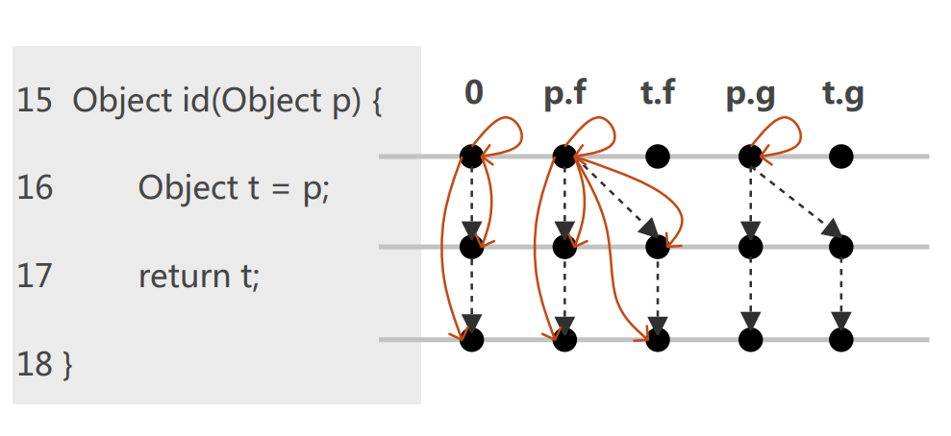
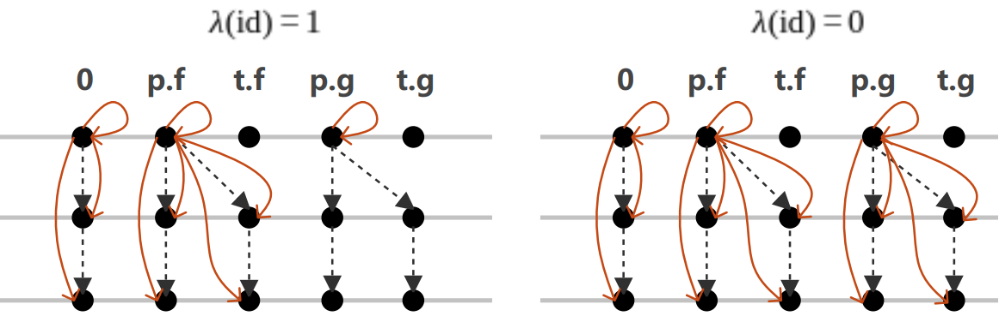
Limitation 1: Coarse Granularity
(a) before GC
(b) after GC
(c) after the analysis
Maximum #PathEdge maintained: 13.
ISSTA 2023
8
Notes:
It’s what looks like before the GC point. If we run the CleanDroid at this point, we will have no path edge collected. And after the analysis, the maximum number of path edges maintained is 13. 4:14

Slide 20
Limitation 1: Coarse Granularity
(a) before GC
(b) after GC
(c) after the analysis
Method-Level: Coarse-Grained
ISSTA 2023
9
Notes:
The reason is that CleanDroid performs collection at the method level, which means it cannot collect if any path edges have not been processed in the method or its transitive callees. 4:29

Slide 21
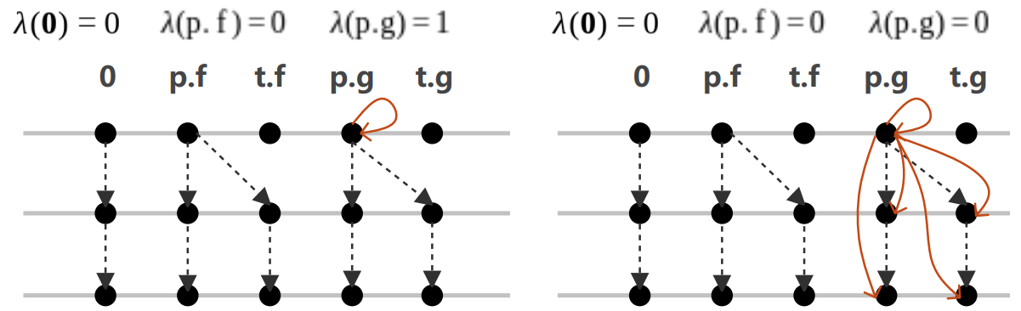
Fine-Grained Data-Fact-Level GC
Observation 1: The path edges with different anchor sites are handled independently.
(a) before GC
(b) after GC
(c) after the analysis
Maximum #PathEdge maintained: 9.
ISSTA 2023
10
Notes:
We noticed that the path edges with different anchor sites are handled independently. An anchor site of a path edge is its start point. Based on this observation, we can collect more path edges at data fact level. After the analysis, the maximum number of path edges maintained is 9. (4:53

Slide 22
Limitation 2: Redundant Computations
Running garbage collection just before line 10…
ISSTA 2023
11
Notes:
The second limitation of CleanDroid is that it allows redundant computations. We consider the misc method at the same GC point as before. There are some path edges generated for it because it has been analyzed once at line 7. (5:10

Slide 23
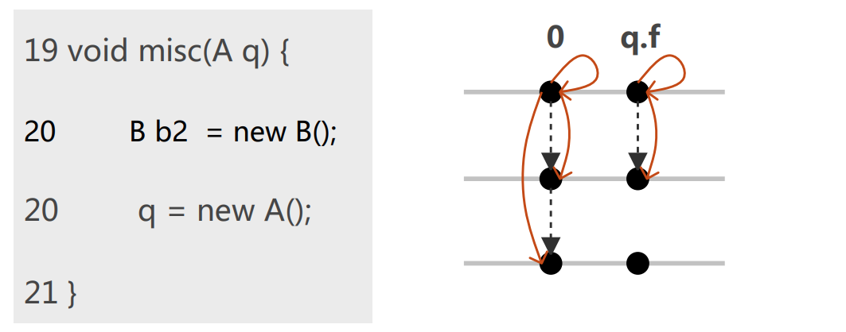
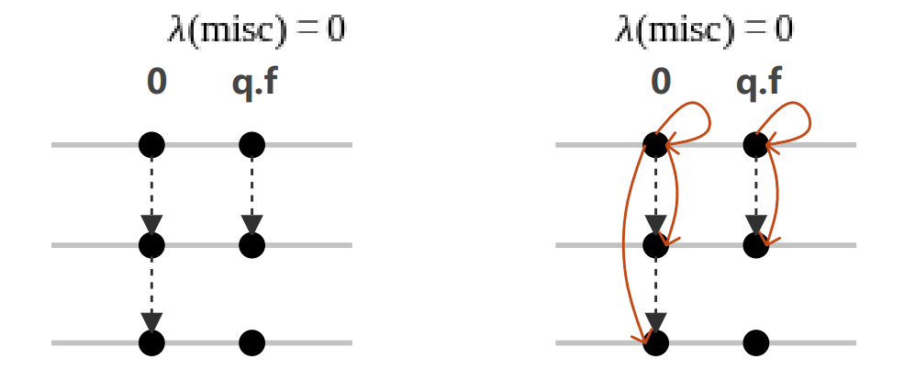
Limitation 2: Redundant Computations
(a) before GC
(b) after GC
(c) after the analysis
The method misc() is analyzed redundantly.
ISSTA 2023
12
Notes:
It's what looks like before the GC point. CleanDroid will collect all path edges in this method. However, it will be analyzed once again at line 13, That means all collected path edges will be computed again. 5:28

Slide 24
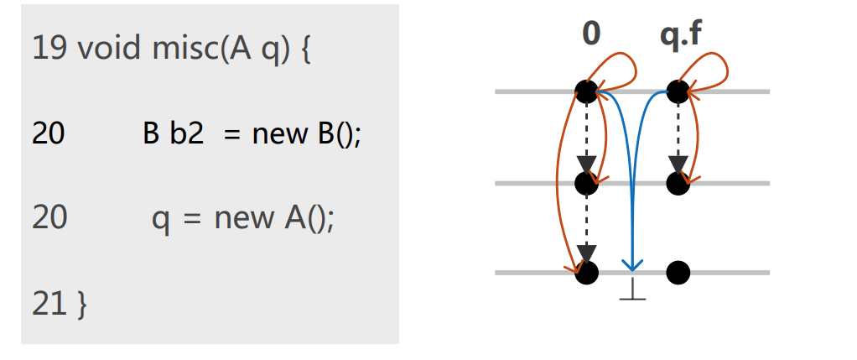
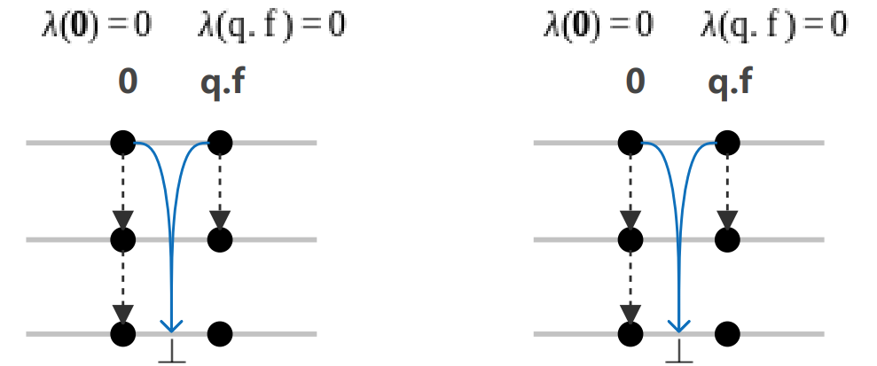
Avoiding Redundant Computations
Observation 2: All path edges sharing the same anchor site are generated from the same self-loop path edge.
(a) before GC
(b) after GC
(c) after the analysis
With redundancy-avoiding edges, the method misc() is analyzed only once.
ISSTA 2023
13
Notes:
We noticed all path edges sharing the same anchor site are generated from the same self-loop path edge. Based on this observation, we introduced the redundancy-avoiding edges. If a redundancy-avoiding edge exists for a self loop path edge, we don’t need to do any computation for it, which avoid redundancy. 5:55

Slide 25
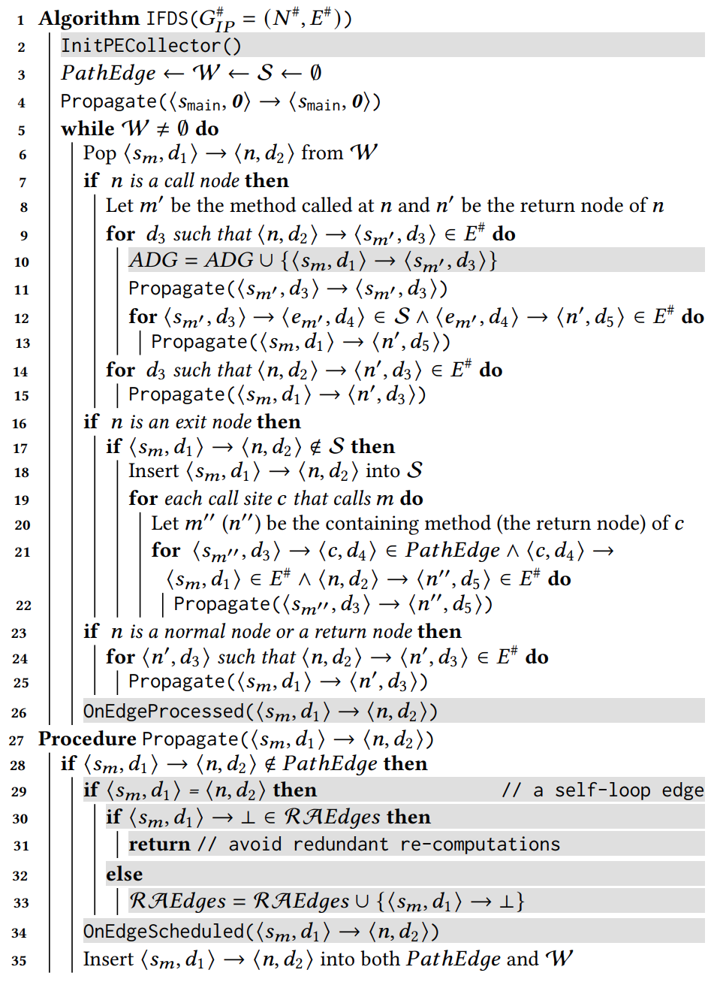
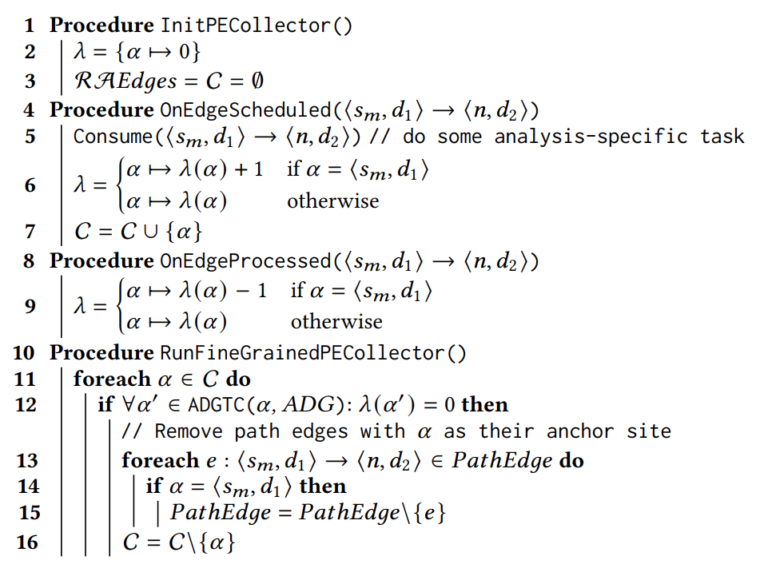
Data-Fact-Level Path-Edge GC Algorithm
ISSTA 2023
15
Notes:
Here is an overview of our algorithm.

Slide 26
Our Approach: FPC
Using a fine-grained path edge garbage collector
Data-fact-level
Light-weight
Efficient
No redundancy
ISSTA 2023
14
Notes:
To sum up, we proposed FPC, a fine-grained, lightweight and efficient path edge collector for IFDS based data flow analyses, with no redundant computations.

Slide 27

Implementation
Implemented in FlowDroid (PLDI’14) to compare with CleanDroid (ICSE’21)
In about 600 lines of Java code
Has been merged into FlowDroid
Available at https://github.com/DongjieHe/FPC
ISSTA 2023
16
Notes:
We implemented our algorithm on top of FlowDroid in about 600 lines of code, which has been merged into FlowDroid. 6:10

Slide 28
Evaluation
Benchmark
58 apps from 2 previous papers: ASE’19 and CGO’21
Evaluate on 2 metrics
Memory usage
Analysis time
Evaluate under varying GC intervals
Default: 1-second
ISSTA 2023
17
Notes:
To evaluate our algorithm against CleanDroid, we used a set of applications from previous papers. And we evaluated both tools on memory usage and analysis time. We also ran experiments under different GC intervals. 6:40

Slide 29
RQ1: Memory Usage
Memory budget: 200 GB per app
FPC can reduce the peak memory usage by 1.4× on average and can scale 3 more apps than baseline.
ISSTA 2023
18
Notes:
To demonstrate memory reduction, we recorded the maximum memory used during the analysis. As we can see, FPC can reduce peak memory usage by 1.4 times on average. And it can scale 3 more applications that running out of memory by CleanDroid. 7:00

Slide 30
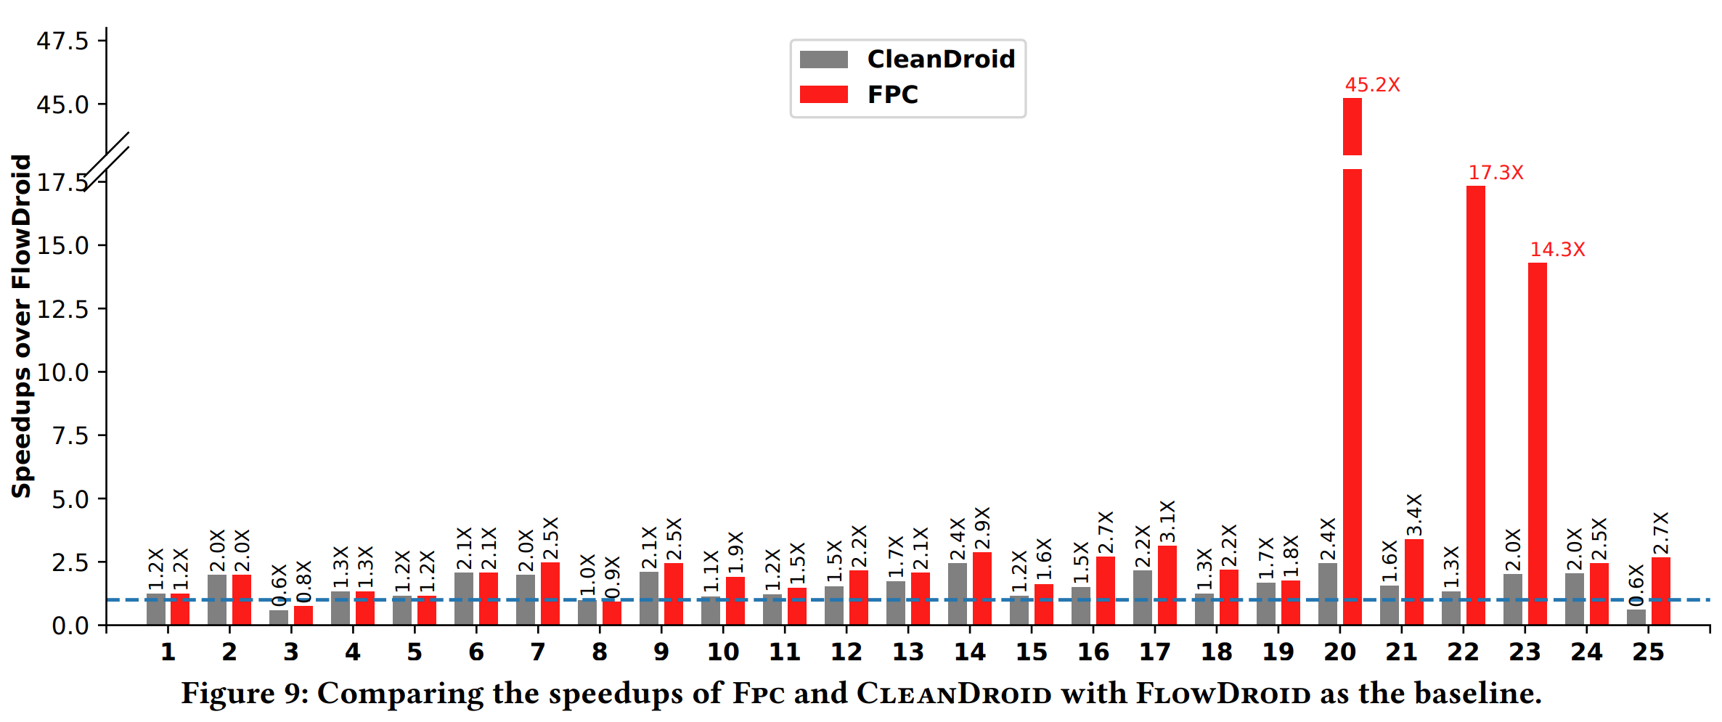
RQ2: Analysis Time
Time budget: 3 hours per app
FPC can improve both the scalability and efficiency of CleanDroid, the speedups range from 0.9× to 18.5× with an average of 1.7×.
ISSTA 2023
19
Notes:
FPC can also improve the efficiency of CleanDroid. As we can see, FPC can speed up CleanDroid up to eighteen point five times. 7:10

Slide 31
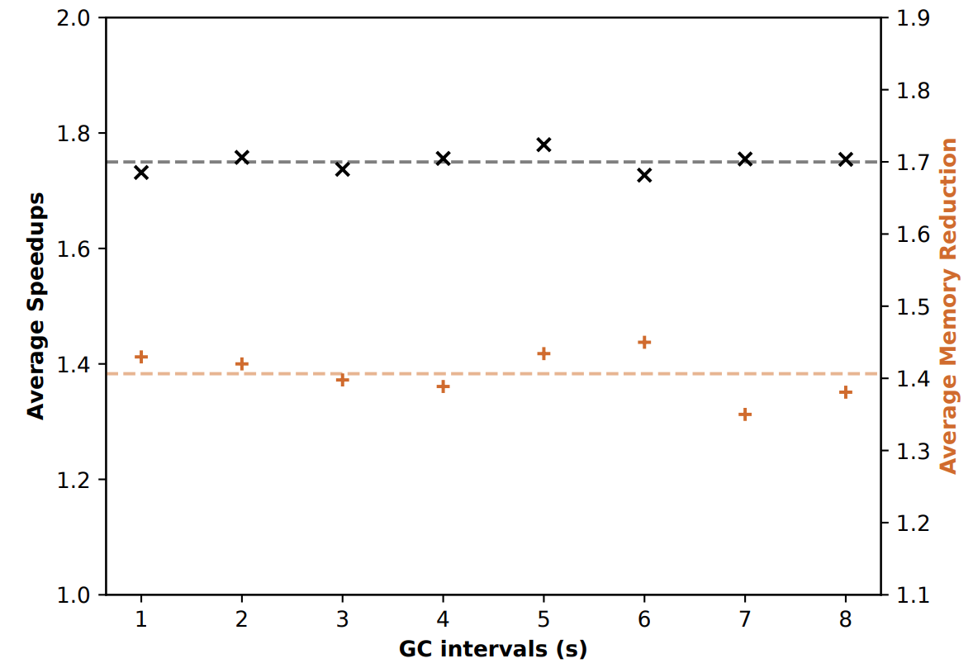
RQ3: Varying GC Intervals
FPC has improved CleanDroid by an average of 1.40× ±0.03 for the memory usage, and 1.74× ±0.02 for the analysis time. The result obtained using 1-second GC interval is reliable.
ISSTA 2023
20
Notes:
Finally, we evaluated both tools under different GC intervals. We can see that FPC can improve the performance of CleanDroid under all these intervals, so we can conclude that our results are reliable.

Slide 32
Q & A
Thank you!
Dongjie He: dongjieh@cse.unsw.edu.au
Yujiang Gui: yujiang.gui@unsw.edu.au
ISSTA 2023
21

