Slide 1


Accelerating Object-Sensitive Pointer Analysis by Exploiting Object Containment and Reachability
ECOOP 2021 virtual
Dongjie He¹, Jingbo Lu¹, Yaoqing Gao², and Jingling Xue¹
Notes:
Hi everyone, this is Dongjie He, from the university of new South Wales. Today, I will represent our co-authors to give a presentation for our work. The title is
“Accelerating Object-Sensitive Pointer Analysis by Exploiting Object Containment and Reachability”.

Slide 2
A new Pointer Analysis Technique for Object-Oriented Programs
Notes:
This is a new pointer analysis technique for object-oriented programs.

Slide 3
Pointer Analysis
Statically determines
“possible runtime values of a variable?”
Notes:
First, what is pointer analysis ? Pointer analysis is trying to answer the following question: “what are possible runtime values of a variable?” statically without really executing the programs.

Slide 4




Uses of Pointer Analysis
Foundation of many clients
Call-graph construction
Security analysis
Bug detection
Compiler optimization
Program understanding
…
Many tools available
Notes:
It is widely used in many clients, like …
And also implemented in many tools…

Slide 5
Uses of Pointer Analysis
Foundation of many clients
Call-graph construction
Security analysis
Bug detection
Compiler optimization
Program understanding
…
Many tools available
A precise and efficient pointer analysis benefits all above clients & tools.
Notes:
Thus,

Slide 6
Context Sensitivity
One of the most successful techniques in developing highly precise pointer analysis for OO programs
Distinguish variables/objects in a method by different calling contexts

Slide 7
Context Sensitivity
Call-site Sensitivity (kCFA)
Object Sensitivity (kOBJ)
Type Sensitivity (kType)
…
Arguably the best context abstraction for OO programs

Slide 8
Object Sensitivity: Example
class A {
Object id(Object p) {
return p;
}
}
static void main() {
A a1 = new A(); // A1
v1 = a1.id(“s1”);
A a2 = new A(); // A2
v2 = a2.id(“s2”);
}

Slide 9
Object Sensitivity: Example
class A {
Object id(Object p) {
return p;
}
}
static void main() {
A a1 = new A(); // A1
v1 = a1.id(“s1”);
A a2 = new A(); // A2
v2 = a2.id(“s2”);
}
Variable | Object
p | “s1”, “s2”
v1 | “s1”, “s2”
v2 | “s1”, “s2”
Context-Insensitivity

Slide 10
Object Sensitivity: Example
class A {
Object id(Object p) {
return p;
}
}
static void main() {
A a1 = new A(); // A1
v1 = a1.id(“s1”);
A a2 = new A(); // A2
v2 = a2.id(“s2”);
}
Variable | Object
p | “s1”, “s2”
v1 | “s1”, “s2”
v2 | “s1”, “s2”
Context-Insensitivity

Slide 11
Object Sensitivity: Example
class A {
Object id(Object p) {
return p;
}
}
static void main() {
A a1 = new A(); // A1
v1 = a1.id(“s1”);
A a2 = new A(); // A2
v2 = a2.id(“s2”);
}
“s1”
“s2”
p, [A1]
p, [A2]
Context | Variable | Object
[A1] | p | “s1”
[A2] | p | “s2”
[ ] | v1 | “s1”
[ ] | v2 | “s2”
v1
v2
Variable | Object
p | “s1”, “s2”
v1 | “s1”, “s2”
v2 | “s1”, “s2”
1-Object-sensitivity
Context-Insensitivity
Notes:
In a 1-OBJ, id will be analyzed in two different context,

Slide 12

Object Sensitivity: Example
class A {
Object id(Object p) {
return p;
}
}
static void main() {
A a1 = new A(); // A1
v1 = a1.id(“s1”);
A a2 = new A(); // A2
v2 = a2.id(“s2”);
}
“s1”
“s2”
p, [A1]
p, [A2]
Context | Variable | Object
[A1] | p | “s1”
[A2] | p | “s2”
[ ] | v1 | “s1”
[ ] | v2 | “s2”
v1
v2
Variable | Object
p | “s1”, “s2”
v1 | “s1”, “s2”
v2 | “s1”, “s2”
Precise
1-Object-sensitivity
Context-Insensitivity

Slide 13


Problem with Object Sensitivity (kOBJ)
Inefficient & Unscalable
Out of Memory (512GB)

Slide 14
Problem with Object Sensitivity (kOBJ)
Traditional: apply contexts to
all variables/objects

Slide 15
Problem with Object Sensitivity (kOBJ)
Tranditional: apply contexts to
all variables/objects
Beneficiaries
(precision gain )
Non-beneficiaries
(no precision gain)

Slide 16
Our Goal
Identify precision-critical variables/objects
Traditional: apply contexts to
all variables/objects
Beneficiaries
(precision gain)
Non-beneficiaries
(no precision gain)
C.S.
Precision-critical variables/objects
C.I.

Slide 17
Challenge
“s1”
“s2”
[A1]
[A2]
Enter method
Object id(Object p) {
return p;
}
[1][2][3]
v
L_{F}: field sensitivity
L_{C}: context sensitivity
[A1]
[A2]
v1
v2
Exit method
[1] Manu Sridharan and Rastislav Bodík. Refinement-based context-sensitive points-to analysis for Java. In PLDI 2006.
[2] Jingbo Lu and Jingling Xue. Precision-Preserving Yet Fast Object-Sensitive Pointer Analysis with Partial Context Sensitivity. In OOPSLA 2019.
[3] Jingbo Lu, Dongjie He and Jingling Xue. Eagle: CFL-Reachability-based Precision-Preserving Acceleration of Object-Sensitive Pointer Analysis with Partial Context Sensitivity. In TOSEM 2021.
Notes:
This kinds of value flow could be formally described by the intersection of two context-free languages: L_F and L_C. L_F is to ensure field sensitivity and L_C is to ensure context sensitivity.
Thus, identifying precision-critical variables and objects is identical to reason about the LFC language. We extract this concrete example to this abstract one.

Slide 18
Challenge
“s1”
“s2”
Undecidable
problem
[4]
[A1]
[A2]
Enter method
Object id(Object p) {
return p;
}
[1][2][3]
v
L_{F}: field sensitivity
L_{C}: context sensitivity
[A1]
[A2]
v1
v2
Exit method
[1] Manu Sridharan and Rastislav Bodík. Refinement-based context-sensitive points-to analysis for Java. In PLDI 2006.
[2] Jingbo Lu and Jingling Xue. Precision-Preserving Yet Fast Object-Sensitive Pointer Analysis with Partial Context Sensitivity. In OOPSLA 2019.
[3] Jingbo Lu, Dongjie He and Jingling Xue. Eagle: CFL-Reachability-based Precision-Preserving Acceleration of Object-Sensitive Pointer Analysis with Partial Context Sensitivity. In TOSEM 2021.
[4] Thomas Reps. Undecidability of context-sensitive data-dependence analysis. In TOPLAS 2000.
Notes:
But unfortunately, reasoning LFC language has been proven to be an undecidable problem.

Slide 19
Existing Solutions
Eagle^{[2][3]}：over-approximation (based on CFL reachability)
Inter-procedural
Precision-preserving
C.S.
C.I.
Precise but less efficient
[2] Jingbo Lu and Jingling Xue. Precision-Preserving Yet Fast Object-Sensitive Pointer Analysis with Partial Context Sensitivity. In OOPSLA 2019.
[3] Jingbo Lu, Dongjie He and Jingling Xue. Eagle: CFL-Reachability-based Precision-Preserving Acceleration of Object-Sensitive Pointer Analysis with Partial Context Sensitivity. In TOSEM 2021.
Notes:
Our previous work named Eagle, solve this problem by over-approximating the L_F language with a regular language, L_R.
so Eagle could identify all precision-critical variables and objects. And it also falsely identifies many precision-uncritical variables and objects to be precision-critical.
As a result, it is very precise but not enough efficient.

Slide 20
Existing Solutions
Zipper^{[5][6]}: patterns-based
Enter from param
Enter from param
Exit from param
Enter method
v
v
Exit from return
v
Exit from param
v
See details in Figure 1 of our Paper
v
Exit method
Exit from return
Enter from return
Enter from return
[5] Yue Li, Tian Tan, Anders Møller, and Yannis Smaragdakis. Precision-Guided Context Sensitivity for Pointer Analysis. In OOPSLA 2018.
[6] Yue Li, Tian Tan, Anders Møller, and Yannis Smaragdakis. A Principled Approach to Selective Context Sensitivity for Pointer Analysis. In TOPLAS 2020.
Notes:
Another previous work try to identify precision-critical variables by patterns. The value flow in the left part is consist of four sub-patterns: (1) enter from parameter and then exit from a return variable (2) param to param
(3) Return to param (4) return to return.
Context-sensitive value flows could be classified into four sub-patterns.

Slide 21
Existing Solutions
Zipper^{[5][6]}: patterns-based
Enter from param
Enter from param
Exit from param
Enter method
v
v
Exit from return
v
Exit from param
v
v
Exit method
Exit from return
Enter from return
Enter from return
[5] Yue Li, Tian Tan, Anders Møller, and Yannis Smaragdakis. Precision-Guided Context Sensitivity for Pointer Analysis. In OOPSLA 2018.
[6] Yue Li, Tian Tan, Anders Møller, and Yannis Smaragdakis. A Principled Approach to Selective Context Sensitivity for Pointer Analysis. In TOPLAS 2020.
Notes:
But Zipper is designed to identify this two patterns

Slide 22
Existing Solutions
Zipper^{[5][6]}: patterns-based
C.S.
C.I.
Very efficient but less precise
[5] Yue Li, Tian Tan, Anders Møller, and Yannis Smaragdakis. Precision-Guided Context Sensitivity for Pointer Analysis. In OOPSLA 2018.
[6] Yue Li, Tian Tan, Anders Møller, and Yannis Smaragdakis. A Principled Approach to Selective Context Sensitivity for Pointer Analysis. In TOPLAS 2020.

Slide 23
Our Solution: Turner
C.S.
C.S.
C.S.
C.I.
C.I.
C.I.
Eagle: precise but less efficient
Zipper: efficient but less precise
Turner: precise and efficient

Slide 24
Our Solution: Turner
Stage 1: Object Containment Analysis
Stage 2: Object Reachability Analysis

Slide 25
Our Solution: Turner
A motivating example:
1. class Integer { int v; }
2. class ArrayList {
3. Object[] d;
4. ArrayList() {
5. Object[] t = new Object[10]; // O[]
6. this.d = t;
7. }}
7. class Client {
8. void foo(Integer p) {
9. ArrayList a = new ArrayList(); // AL
10. a.d[0] = p;
11. …
12. print(a.d[0]);
13. }
14. static void main() {
15. Client c = new Client(); // C
16. Integer t = new Integer(1000); // I
17. c.foo(t);
18. }}

Slide 26
Turner: Object Containment Analysis
1. class Integer { int v; }
2. class ArrayList {
3. Object[] d;
4. ArrayList() {
5. Object[] t = new Object[10]; // O[]
6. this.d = t;
7. }}
AL
d
O[]
8. class Client {
9. void foo(Integer p) {
10. ArrayList a = new ArrayList(); // AL
11. a.d[0] = p;
12. …
13. print(a.d[0]);
14. }
15. static void main() {
16. Client c = new Client(); // C
17. Integer t = new Integer(1000); // I
18. c.foo(t);
19. }}
arr
C
I
Object Containment Graph

Slide 27
Turner: Object Containment Analysis
Top Container
often used locally
1. class Integer { int v; }
2. class ArrayList {
3. Object[] d;
4. ArrayList() {
5. Object[] t = new Object[10]; // O[]
6. this.d = t;
7. }}
AL
d
O[]
8. class Client {
9. void foo(Integer p) {
10. ArrayList a = new ArrayList(); // AL
11. a.d[0] = p;
12. …
13. print(a.d[0]);
14. }
15. static void main() {
16. Client c = new Client(); // C
17. Integer t = new Integer(1000); // I
18. c.foo(t);
19. }}
arr
C
Bottom Container
Often encapsulating primitive data,
e.g., Long, Integer, String, etc.
I
Object Containment Graph

Slide 28
Turner: Object Containment Analysis
Top Container
often used locally
1. class Integer { int v; }
2. class ArrayList {
3. Object[] d;
4. ArrayList() {
5. Object[] t = new Object[10]; // O[]
6. this.d = t;
7. }}
AL
d
O[]
8. class Client {
9. void foo(Integer p) {
10. ArrayList a = new ArrayList(); // AL
11. a.d[0] = p;
12. …
13. print(a.d[0]);
14. }
15. static void main() {
16. Client c = new Client(); // C
17. Integer t = new Integer(1000); // I
18. c.foo(t);
19. }}
arr
C
Bottom Container
Often encapsulating primitive data,
e.g., Long, Integer, String, etc.
I
Object Containment Graph
Observation: objects in Top/Bottom Containers are unlikely to be context-sensitive.

Slide 29
Turner: Object Reachability Analysis
Basic Idea
Define a language L
Cheaper than
Effective than L_{RC}
Consider all 4 sub-patterns.
Eliminate context-insensitive value flows.
Exploit Object Containment Analysis
Over-approximate (context-sensitive) value flows.
Select precision-critical variables/objects via L
Enter method
v
Exit method

Slide 30
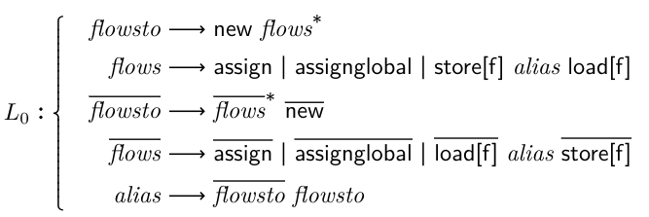
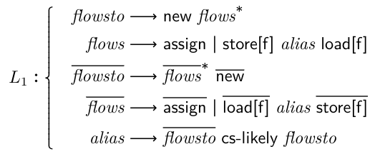
Turner: Object Reachability Analysis
from L₀^{[1][7]} to L₁: eliminate context-insensitive value flows
remove global edges (e.g., assignglobal)
cs-likely edges are added only for objects not in Top/Bottom Containers (e.g. O[]).
introduce negligible precision loss
[1] Manu Sridharan and Rastislav Bodík. Refinement-based context-sensitive points-to analysis for Java. In PLDI 2006.
[7] Manu Sridharan, Denis Gopan, Lexin Shan, and Rastislav Bodík. Demand-driven points-to analysis for Java. In OOPSLA 2005.

Slide 31
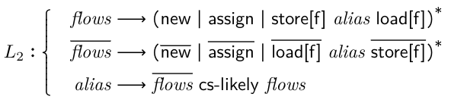
Turner: Object Reachability Analysis
from L₁ to L₂: enable to reason about reachability from variables
do not distinguish flowsto and flows

Slide 32
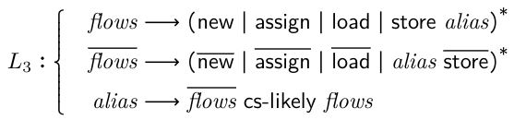
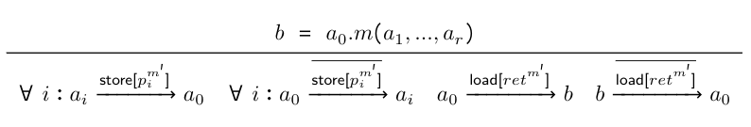
Turner: Object Reachability Analysis
from L₂ to L₃: enable intra-procedural analysis.
1-limited access path.
a_{i} could reach a_{j} as long as a₀ points to a cs-likely object. (making inter-procedural analysis unnecessary)

Slide 33

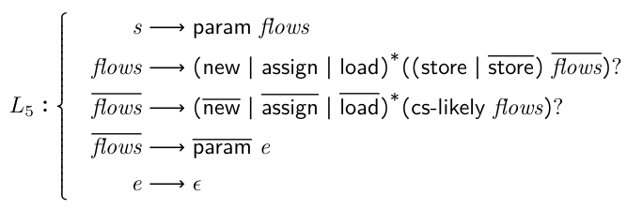
Turner: Object Reachability Analysis
from L₃ to L₄: Regularization.
From L₄ to L₅: enforce reasoning from parameters/return variables

Slide 34

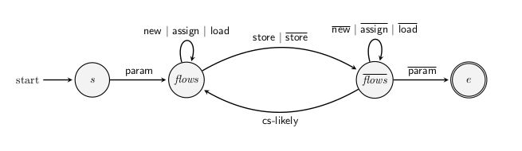
Turner: Object Reachability Analysis
DFA (equivalent to L₅): over-approximate intra-procedural value flow
v is on a path from s to e v should be C.S.
Precision-preserving if objects selected in stage 1 are indeed context-insensitive.

Slide 35
Turner: Object Reachability Analysis
1. class Integer { int v; }
2. class ArrayList {
3. Object[] d;
4. ArrayList() {
5. Object[] t = new Object[10]; // O[]
6. this.d = t;
7. }}
1. this, t, and O[] are precision-critical
Notes:
The O[] is neither a top container nor a bottom container

Slide 36



Turner: Object Reachability Analysis
1. class Integer { int v; }
2. class ArrayList {
3. Object[] d;
4. ArrayList() {
5. Object[] t = new Object[10]; // O[]
6. this.d = t;
7. }}
1. this, t, and O[] are precision-critical
s
flows
$$\overline{flows}$$
$$\overline{flows}$$
flows
flows
$$\overline{flows}$$
e
Notes:
The O[] is neither a top container nor a bottom container

Slide 37
Turner: Object Reachability Analysis
1. class Integer { int v; }
2. class ArrayList {
3. Object[] d;
4. ArrayList() {
5. Object[] t = new Object[10]; // O[]
6. this.d = t;
7. }}
1. this, t, and O[] are precision-critical
s
flows
$$\overline{flows}$$
$$\overline{flows}$$
flows
flows
$$\overline{flows}$$
e
Other variables/objects could be verified similarly!
Notes:
The O[] is neither a top container nor a bottom container

Slide 38
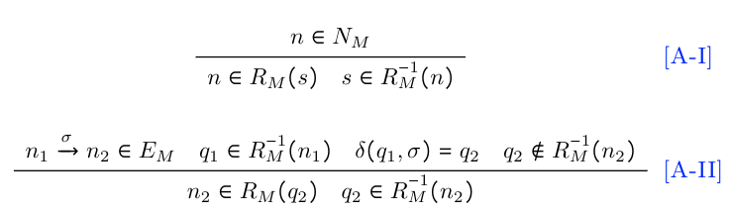



Turner: Algorithm
Exploit antisymmetric property of DFA
Criterion:
Time complexity: linear to the number of statements
s
flows
$$\overline{flows}$$
$$\overline{flows}$$
flows
flows
$$\overline{flows}$$
e

Slide 39


Implementation
Written in Java (~ 1000 LOC)
Artifact is deployed on Docker Hub: https://hub.docker.com/r/hdjay2013/turner_artifact
Open source: http://www.cse.unsw.edu.au/~corg/turner/
Notes:
Turner is implemented in Java in about 1000 lines of code.
We have deployed our artifact on docker hub. You can have fun with this artifact via this link.
Turner will be open-sourced in this address.

Slide 40




Evaluation
12 large Java Programs
9 DaCapo benchmarks
3 popular real-world applications
JPC

Slide 41
Evaluation
4 metrics
May-fail casting
De-virtualization
Call graph construction
Average points-to size
Widely-used metrics to evaluate pointer analysis’s precision
e.g., OOPSLA’19, OOPSLA’18, PLDI’17, OOPSLA’17, PLDI’14, PLDI’13, POPL’11

Slide 42
RQ1: precise

Slide 43
RQ2: efficient
Average Speedups
Scalability
Zipper and Turner have the same scalability (10 benchmarks when k = 3).
Scale 1 more benchmarks than Eagle, 2 more than baseline.

Slide 44

RQ2: efficient
Very efficient as a pre-analysis.

Slide 45
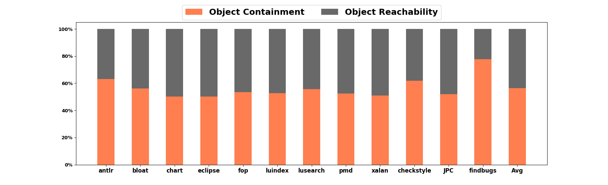
RQ3: effective
Both object containment and object reachability are effective.
Notes:
We try to understand the effectiveness of the two stages of Turner. This figure shows their percentage contributions to speedups.

Slide 46
Conclusion
Turner: Object Containment + Object Reachability
first intra-procedural technique.
linear to number of statements.
Implementation
open source: http://www.cse.unsw.edu.au/~corg/turner/
artifact: https://hub.docker.com/r/hdjay2013/turner_artifact
Evaluation
very precise (preserves almost all the precision)
very efficient (not only in guiding pointer analysis but also as a pre-analysis)

Slide 47

Q & A
Please refer to our paper for technical details!
Contact: @hdjay20131
This presentation and recording belong to the authors.
No distribution is allowed without the authors’ permission.
Notes:
If you have interests in our topic and have any problems with our work, welcome to contact me on twitter.

