Slide 1

Merge-Replay: Efficient IFDS-Based Taint Analysis
by Consolidating Equivalent Value Flows
Yujiang Gui*, Dongjie He*† and Jingling Xue†
School of Computer Science and Engineering
University of New South Wales
Presenter: Yujiang Gui
38th ASE, September 2023
∗, † The first two authors contributed equally and are listed in alphabetical order by their last names, while the last two authors share corresponding authorship.
ASE 2023
1
Notes:
Good afternoon, everyone. I am Yujiang Gui, and I come from the University of New South Wales. Today I will be presenting our work: …

Slide 2
Static Taint Analysis
Exposes potential sensitive data leaks ahead of time
Private messages
Location information
Financial details
…
ASE 2023
2
Notes:
Let me first introduce static taint analysis. Software applications are everywhere, they can read, store and transmit our sensitive information, such as…

Slide 3
Static Taint Analysis
Exposes potential sensitive data leaks ahead of time
Private messages
Location information
Financial details
…
Tracks the flows of tainted data to observe if they can reach sink
x = getPassword(); // source
p = q;
...
p.f = x;
sendMessage(q.f); // sink
x
q.f
store[f]
load[f]
p
q
assign
ASE 2023
2
Notes:
Static analysis tracks the flows of tainted data from sources to observe if they can reach to sink. Here is a tiny program and its graph representation. If we follow the flow of tainted data x, we can conclude that there is a data leak in this program.

Slide 4
Static Taint Analysis
Exposes potential sensitive data leaks ahead of time
Private messages
Location information
Financial details
…
Tracks the flows of tainted data to observe if they can reach sink
An active research area
Security analysis for web apps (ASE’14, ISSTA’23)
Taint analysis for Android apps (PLDI’14, ISSTA’15, OOPSLA’18, ICSE’20)
Memory leak detection (CGO’21, ICSE’21, ISSTA’23)
…
x = getPassword(); // source
p = q;
...
p.f = x;
sendMessage(q.f); // sink
x
q.f
store[f]
load[f]
p
q
assign
ASE 2023
2
Notes:
Static taint analysis is an active research area, it can be used to ensure security for web applications, prevent information leaks on Android platform, and detect memory leaks.

Slide 5
IFDS-Based Taint Analysis
Utilizes the IFDS framework*
Solves a class of interprocedural distributive analyses
Transforms an analysis into a graph-reachability problem
Context- and flow-sensitive
*Reps, Thomas, Susan Horwitz, and Mooly Sagiv. “Precise Interprocedural Dataflow Analysis via Graph Reachability.”, POPL’95.
ASE 2023
3
Notes:
Static taint analysis can be modeled and solved in different ways. Now we only focus on IFDS-Based taint analysis.
It utilizes the IFDS framework, which can solve a large class of interprocedural distributive analyses by transforming them into graph reachability problems. It is highly precise because it ensures both context and flow sensitivity.

Slide 6
IFDS-Based Taint Analysis
Utilizes the IFDS framework*
Solves a class of interprocedural distributive analyses
Transforms an analysis into a graph-reachability problem
Context- and flow-sensitive
Employs two mutually iterative passes
Identify taints forwards
Detect aliases backwards
0 | x | p.f | q.f
 |  |  | 
x = getPassword(); // source
p = q;
...
p.f = x;
sendMessage(q.f); // sink
 |  |  | 
forward
backward
interaction
 |  |  | 
 |  |  | 
*Reps, Thomas, Susan Horwitz, and Mooly Sagiv. “Precise Interprocedural Dataflow Analysis via Graph Reachability.”, POPL’95.
ASE 2023
3
Notes:
The IFDS-Based taint analysis employs two mutually iterative passes. One for identifying taints forwards, and another one for detecting aliases backwards.
Let’s see how it works by running this example. From now on, we use blue arrows, red arrows and dashed arrows to represent forward analysis, backward analysis, and the interactions between analyses, respectively. We can see when x is stored into p.f, a backward alias analysis is triggered for searching aliases of p.f. And when q.f is found, it is propagated forwards and a data leak is reported.

Slide 7
Maintaining Flow Sensitivity with Activation Statements
Loss of flow sensitivity during the interactions of solvers
FlowDroid*
Recovers flow sensitivity with activation statements
③
q.f
1 p = q;
2 sendMessage(q.f); // sink/1
3 x = getPassword(); // source
...
4 p.f = x;
5 sendMessage(q.f); // sink/2
p.f
②
①
④
q.f
③
q.f ∥ 4
1 p = q;
2 sendMessage(q.f); // sink/1
3 x = getPassword(); // source
...
4 p.f = x;
5 sendMessage(q.f); // sink/2
p.f ∥ 4
②
①
q.f
④
*Arzt, Steven, Siegfried Rasthofer, Christian Fritz, Eric Bodden, Alexandre Bartel, Jacques Klein, Yves Le Traon, Damien Octeau, and Patrick D. McDaniel. “FlowDroid: Precise Context, Flow, Field, Object-Sensitive and Lifecycle-Aware Taint Analysis for Android Apps.”, PLDI’14.
ASE 2023
4
Notes:
However, the flow sensitivity may be lost during the interactions of the interleaved solvers. This program looks like the previous one, we just added a new sink and reordered some statements. First, x is tainted, an alias analysis is triggered, and then we found q.f aliases with p.f, and finally, the analysis reports 2 leaks, one at line 2 and one at line 5, the one at line 2 is a false positive. This is because at line 2, q.f aliases with p.f, but x is yet to be tainted.
FlowDroid recovers flow sensitivity between the interleaved solvers by introducing activation statements. Whenever an alias analysis is triggered, the data fact is decorated by the current statement, which is called activation statement. In this example, p.f is decorated with line 4, and q.f is also decorated with line 4. This time, q.f at line 2 will not be reported as a leak, because q.f will only be activated and become a real taint at line 4.
Although this mechanism achieves a highly precise taint analysis, it has two limitations.

Slide 8
Limitation 1: Redundant Propagation
1 class A {}
2 class B { A f; }
3 void main() {
4 B q = new B();
5 B p = q;
6 B r = new B();
7 bar(q);
8 foo(p, q, r);
9 }
19 void bar(q) {
20 B p = new B();
21 B r = q;
22 foo(p, q, r);
23 }
q.f ∥ 14
q.f ∥ 12
②
③
②
p.f ∥ 12
③
p.f ∥ 14
①
10 void foo(p, q, r) {
11 if (…) {
12 p.f = <taint/1>;
13 } else {
14 p.f = <taint/2>;
15 sink(q.f);
16 }
17 sink(r.f);
18 }
ASE 2023
5
Notes:
The first limitation is that it allows redundant propagation. When the data facts with the same data abstraction but with different activation statements propagated from a callee to its caller, all propagation in the transitive callers is redundant. Which is detrimental to the performance of the analysis.

Slide 9
Limitation 2: Overlooking Context
1 class A {}
2 class B { A f; }
3 void main() {
4 B q = new B();
5 B p = q;
6 B r = new B();
7 bar(q);
8 foo(p, q, r);
9 }
19 void bar(q) {
20 B p = new B();
21 B r = q;
22 foo(p, q, r);
23 }
r.f ∥ 14
r.f ∥ 12
q.f ∥ 14
q.f ∥ 12
10 void foo(p, q, r) {
11 if (…) {
12 p.f = <taint/1>;
13 } else {
14 p.f = <taint/2>;
15 sink(q.f);
16 }
17 sink(r.f);
18 }
False alarm!
ASE 2023
6
Notes:
The second limitation is that it overlooks contexts of activation statements. In this example, the method foo is invoked under 2 different contexts. When it is called at line 8, p aliases with q, so there is a leak at line 15. However, when it is called at line 22, r aliases with q, but neither r nor q aliases with p, so there is no data leak at line 17. Because the contexts of activation statements are overlooked in FlowDroid, q.f under context <main, foo> can be propagated into method bar, so it will report a data leak at line 17, which is a false positive.

Slide 10
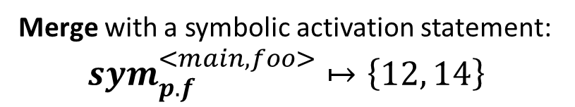
The Merge-Replay Strategy
1 class A {}
2 class B { A f; }
3 void main() {
4 B q = new B();
5 B p = q;
6 B r = new B();
7 bar(q);
8 foo(p, q, r);
9 }
19 void bar(q) {
20 B p = new B();
21 B r = q;
22 foo(p, q, r);
23 }
q.f ∥ sym^{<main, foo>}
p.f ∥ 12
②
③
p.f ∥ sym^{<main, foo>}
p.f ∥ 14
①
10 void foo(p, q, r) {
11 if (…) {
12 p.f = <taint/1>;
13 } else {
14 p.f = <taint/2>;
15 sink(q.f);
16 }
17 sink(r.f);
18 }
Merge with a symbolic activation statement:
$${sym}_{p.f}^{<main, foo>}↦\left\{12, 14\right\}$$
ASE 2023
7
Notes:
To overcome these 2 limitations, we proposed a merge-and-replay strategy. When multiple data facts with the same data abstraction but different activation statements propagated from callee to into caller, we introduce a symbolic activation statement for the data abstraction under the current context. In this way, these data facts can be reduced to a single symbolic data fact, therefore, the equivalent value flows are merged in all transitive callers and the redundant propagation is reduced.

Slide 11
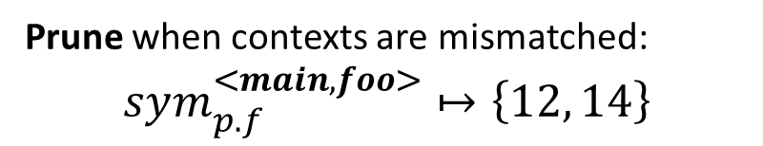
The Merge-Replay Strategy
q.f ∥ GAS
1 class A {}
2 class B { A f; }
3 void main() {
4 B q = new B();
5 B p = q;
6 B r = new B();
7 bar(q);
8 foo(p, q, r);
9 }
19 void bar(q) {
20 B p = new B();
21 B r = q;
22 foo(p, q, r);
23 }
q.f ∥ sym^{<main, foo>}
p.f ∥ 12
r.f ∥ GAS
②
③
p.f ∥ sym^{<main, foo>}
p.f ∥ 14
①
10 void foo(p, q, r) {
11 if (…) {
12 p.f = <taint/1>;
13 } else {
14 p.f = <taint/2>;
15 sink(q.f);
16 }
17 sink(r.f);
18 }
Prune when contexts are mismatched:
$$sym_{p.f}^{<main, foo>}↦\left\{12, 14\right\}$$
r.f ∥ GAS
ASE 2023
8
Notes:
During the forward analysis, before propagating a data fact decorated with a symbolic activation statement from caller to callee, we match the context of the symbolic activation statement with current context, here, the context of symbolic activation statement is <main, foo>, and the current context is <main, bar>, so the two contexts are mismatched. In this case, we generate a data fact decorated with the globally unique symbolic activation statement, GAS, to continue the propagation. The data facts decorated with GAS are used to compute summaries for the analysis. They will not be activated, so the false positive at line 17 will not be reported.

Slide 12
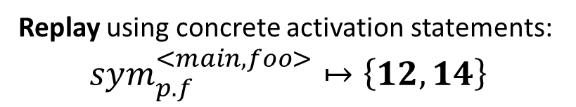
The Merge-Replay Strategy
1 class A {}
2 class B { A f; }
3 void main() {
4 B q = new B();
5 B p = q;
6 B r = new B();
7 bar(q);
8 foo(p, q, r);
9 }
19 void bar(q) {
20 B p = new B();
21 B r = q;
22 foo(p, q, r);
23 }
①
②
q.f ∥ sym^{<main, foo>}
10 void foo(p, q, r) {
11 if (…) {
12 p.f = <taint/1>;
13 } else {
14 p.f = <taint/2>;
15 sink(q.f);
16 }
17 sink(r.f);
18 }
q.f ∥ 12
q.f ∥ 14
Replay using concrete activation statements:
$$sym_{p.f}^{<main, foo>}↦\left\{12, 14\right\}$$
ASE 2023
9
Notes:
In the method main, we continue to propagate q.f. At line 8, it will be mapped into method foo. We noticed that this symbolic activation statement was introduced for method foo, so we replay the value flows by using the saved concrete activation statements to continue the propagation. In this way, all data facts can be activated properly.

Slide 13
Summary
Reduce redundant propagation
Enhance precision
Boost overall performance
Conceptually simple
ASE 2023
10
Notes:
To summary, we proposed a conceptually simple merge-and-replay strategy. It can reduce redundant propagation by consolidating equivalent value flows and enhance the precision by pruning spurious value flows. By merging and pruning, the overall performance of the analysis can be boosted.

Slide 14
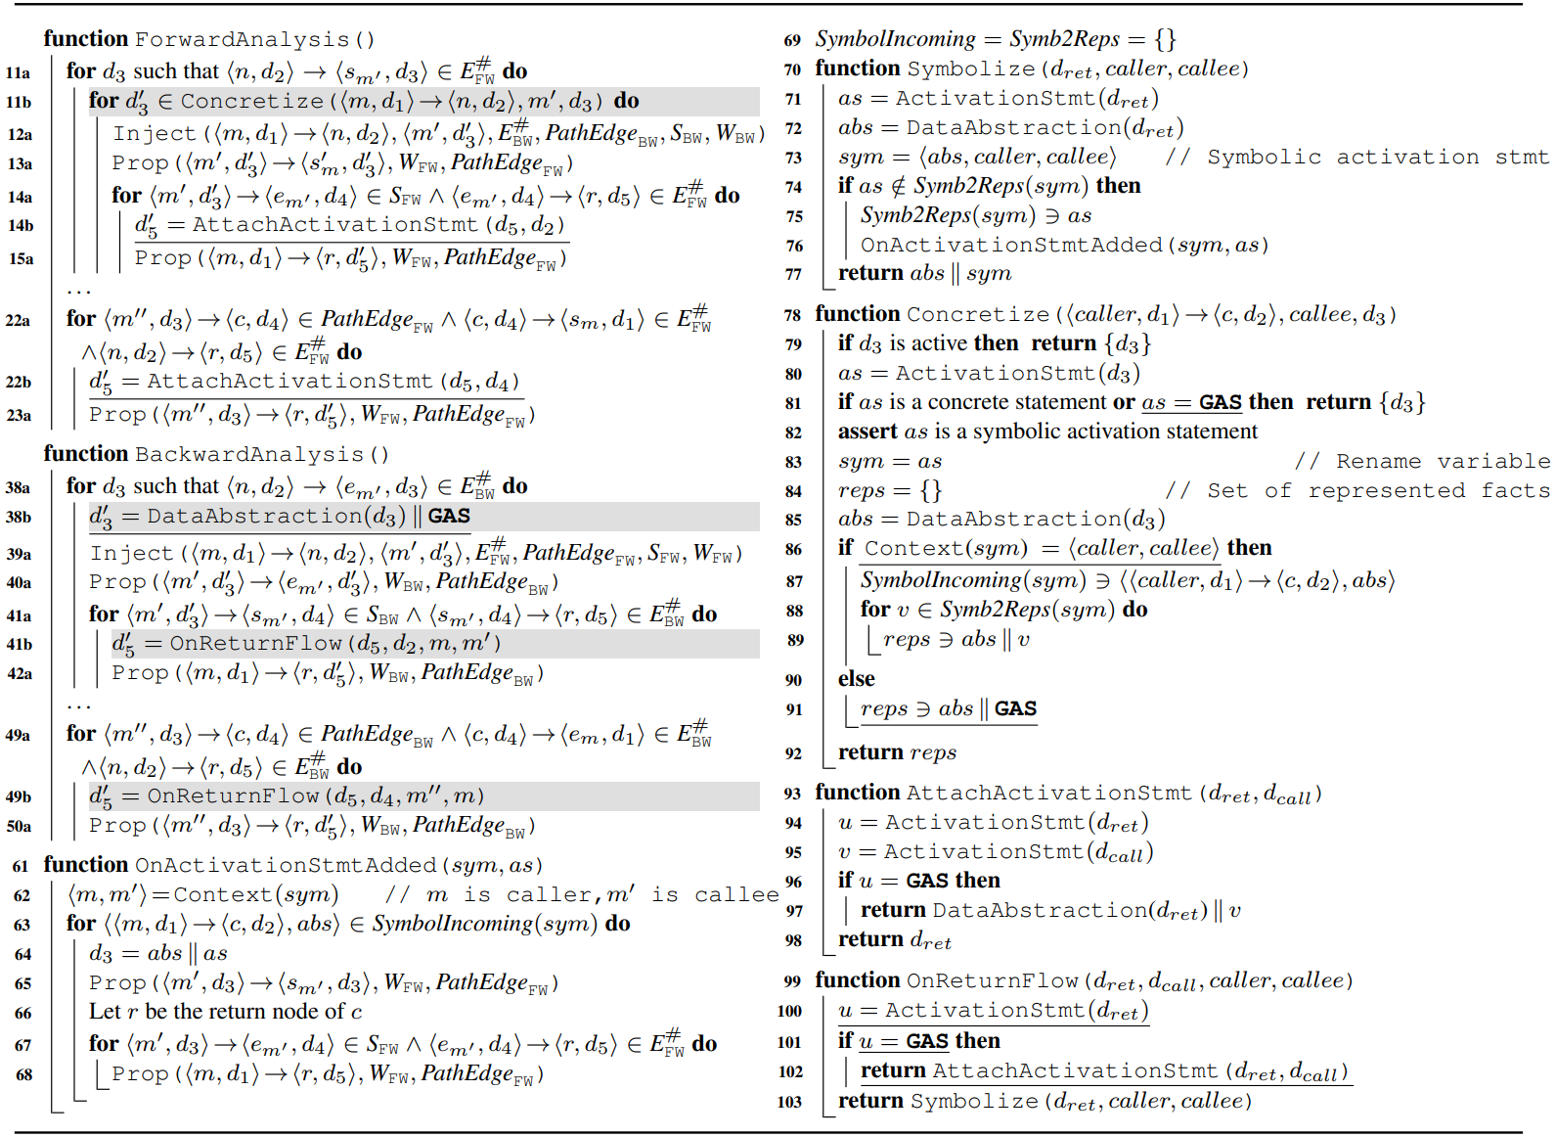
The MergeDroid Algorithm
ASE 2023
11
Notes:
We formalized the merge and replay strategy into the mergedroid algorithm. Here is an overview.

Slide 15
Implementation
Implemented on top of FlowDroid (PLDI’14)
In about 400 lines of Java code
Available at https://www.cse.unsw.edu.au/∼corg/MergeDroid
ASE 2023
12
Notes:
We implemented our algorithm on top of FlowDroid in about 400 lines of Java code. The source code is available at this site.

Slide 16
Evaluation
Benchmark (40 apps)
From previous papers (ASE’19 and CGO’21)
From F-Droid
Analysis budget
3 hours and 256GB per app
Metrics
Precision
Analysis time
Memory usage
ASE 2023
13
Notes:
To evaluate MergeDroid against FlowDroid, we used a set of applications from both previous papers and f-droid, an open-source application catalog for Android platform. For each application, we allocated a 3-hour time budget and 256 GB memory budget. And we evaluated both tools on precision, analysis time and memory usage.

Slide 17
RQ1: Precision
Validated correctness using
DroidBench
TaintBench
MergeDroid reduces false positives by decreasing reported leak warnings by FlowDroid by 19.2% on average.
ASE 2023
14
Notes:
We validated the correctness of the implementation using 2 benchmarks with ground truth. For the 34 apps that can be analyzed by both tools, MergeDroid reduces the number of leak warnings reported by FlowDroid by 19.2 percent on average.

Slide 18
RQ2: Speedups
MergeDroid improves the efficiency of FlowDroid, and scales 6 more apps. The speedups range from 0.8× to 137.9× with an average of 9.0×.
ASE 2023
15
Notes:
MergeDroid can improve the efficiency of FlowDroid. As we can see, it can speed up up to 137.9 times, And it can scale 6 more applications that running out of time by FlowDroid.

Slide 19
RQ3: Memory Requirements
MergeDroid uses less memory than FlowDroid for all apps analyzed, the ratio range from 1.0× to 83.6× with an average of 5.2×.
ASE 2023
16
Notes:
To demonstrate memory reduction, we recorded the maximum memory used during the analysis. As we can see, it can reduce the peak memory usage by 5.2 times on average.

Slide 20
Q & A
Thank you!
ASE 2023
17

