Slide 1
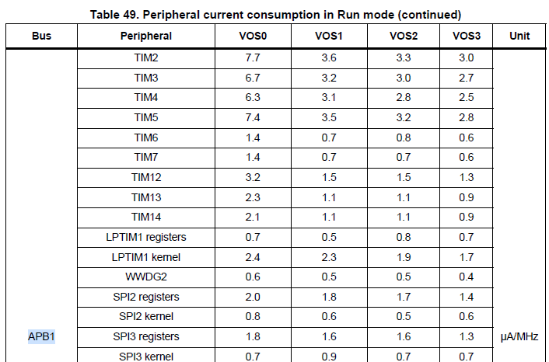

Slide 2
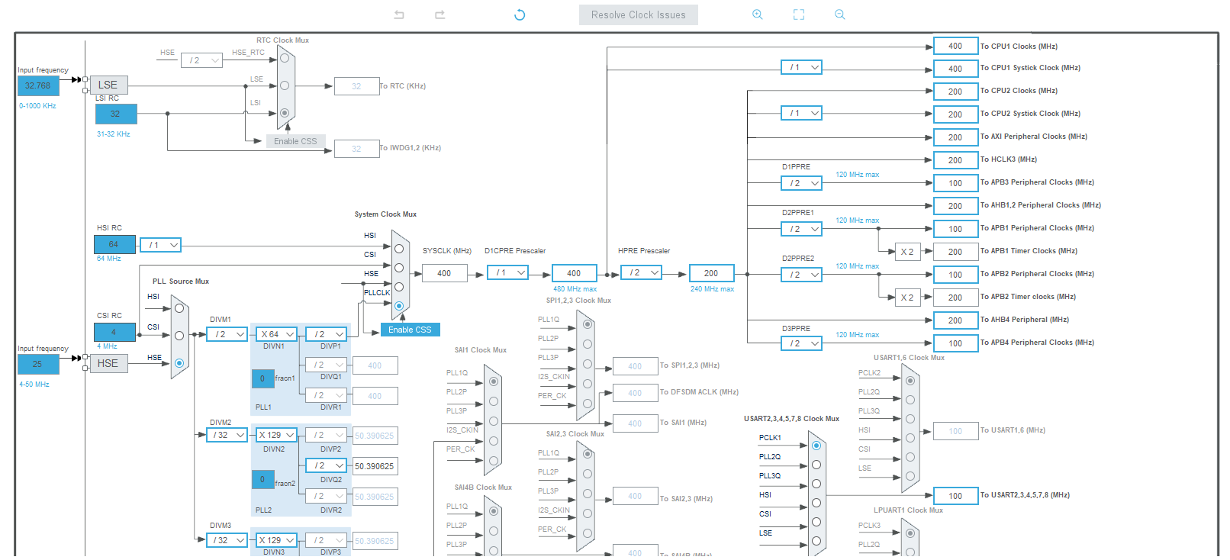

Slide 3
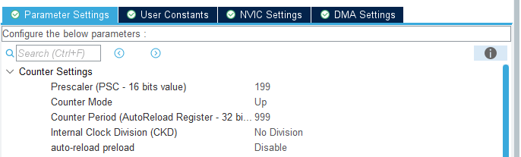

$$\frac{200MHz}{\left(Prescaer 199+1\right)(Counter Period 999+1)}=1KHz$$

Slide 4
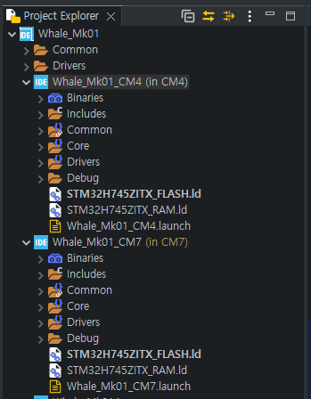
Whale Mk1
Common
Cortex-M4
Coretex-M7

Slide 5

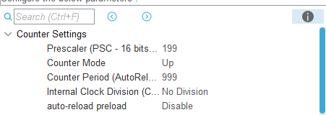
Start Tick
Function
End Tick – Start Tick = x us
End Tick

Slide 6
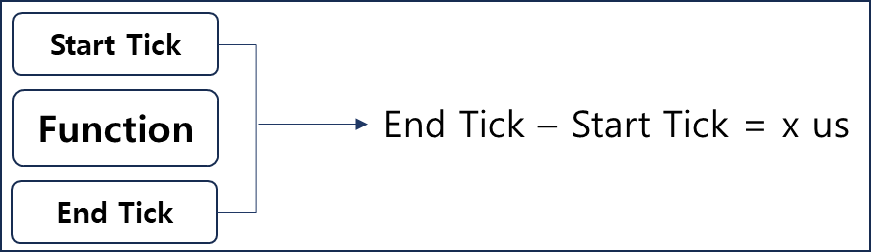
∑(Function Exe Time) / 1000 * 100
= CPU Load [%]

