Slide 1
OpenStack Multi Node Installation

Slide 2
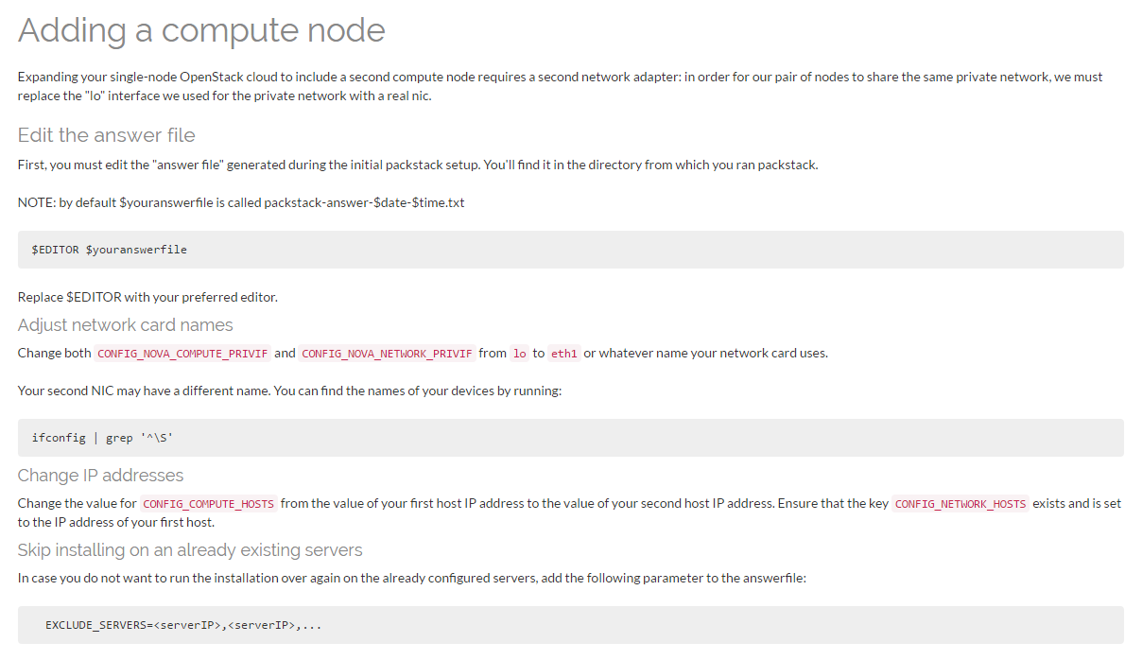
참고자료
참고 자료
. https://www.rdoproject.org/install/adding-a-compute-node/

Slide 3
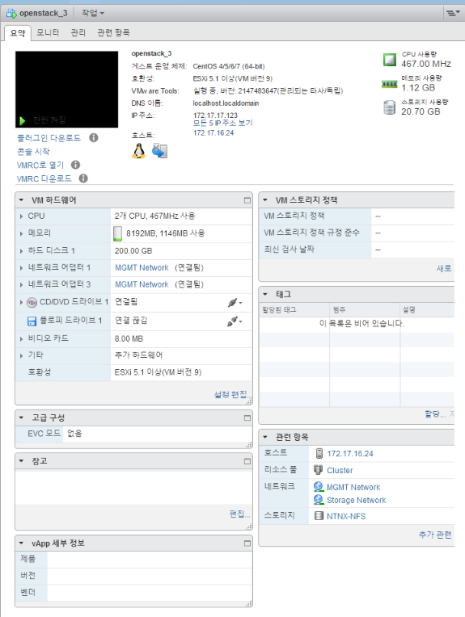
사전 준비 사항
사양
. 2CPU/8G/200G Disk(SSD)/Vmware vSphere 5.5 환경

Slide 4
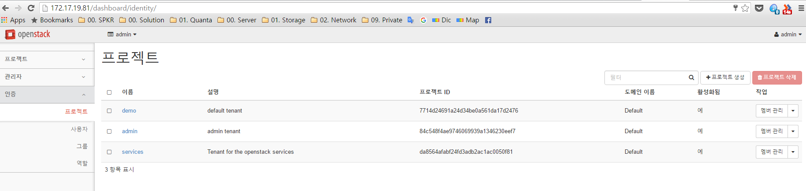
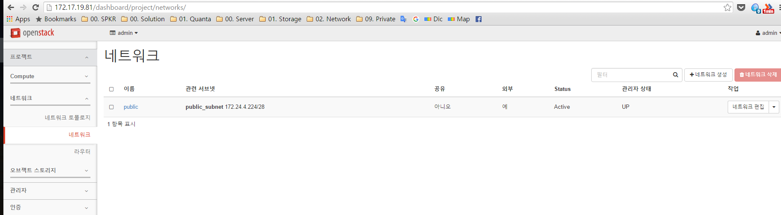
사전 준비 사항
Single Node Installation 완료 . IP : 172.17.19.81

Slide 5
사전 준비 사항
Multinode 준비
sudo yum update –y
[root@localhost ~]# yum update -y
Loaded plugins: fastestmirror, langpacks
Repodata is over 2 weeks old. Install yum-cron? Or run: yum makecache fast
base | 3.6 kB 00:00
^Chttp://mirror.centos.org/centos/7/storage/x86_64/ceph-hammer/repodata/repomd.xml: [Errno 14] curl#56 - "Network error recv()"
Trying other mirror.
[root@localhost ~]# yum makecache fast
Loaded plugins: fastestmirror, langpacks
base | 3.6 kB 00:00
centos-ceph-hammer | 2.9 kB 00:00
centos-openstack-mitaka | 2.9 kB 00:00
centos-qemu-ev | 2.9 kB 00:00
extras | 3.4 kB 00:00
updates | 3.4 kB 00:00

Slide 6
사전 준비 사항
Multinode 준비
SELinux Off [root@localhost ~]# getenforce
Enforcing
sudo vi /etc/selinux/config
Change like following line
SELINUX=disabled
Reboot
sudo service NetworkManager stop
sudo chkconfig NetworkManager off
[root@localhost ~]# chkconfig NetworkManager off
Note: Forwarding request to 'systemctl disable NetworkManager.service'.
Removed symlink /etc/systemd/system/multi-user.target.wants/NetworkManager.service.
Removed symlink /etc/systemd/system/dbus-org.freedesktop.NetworkManager.service.
Removed symlink /etc/systemd/system/dbus-org.freedesktop.nm-dispatcher.service.

Slide 7
사전 준비 사항
2대 서버 준비 for Compute Node
. 172.17.17.104, 172.17.17.113
[root@localhost ~]# ip addr show ens32
2: ens32: <BROADCAST,MULTICAST,UP,LOWER_UP> mtu 1500 qdisc pfifo_fast state UP qlen 1000
link/ether 00:50:56:9a:67:a9 brd ff:ff:ff:ff:ff:ff
inet 172.17.17.104/22 brd 172.17.19.255 scope global dynamic ens32
valid_lft 13945sec preferred_lft 13945sec
inet6 fe80::250:56ff:fe9a:67a9/64 scope link
valid_lft forever preferred_lft forever
[root@localhost ~]# ip a show ens32
2: ens32: <BROADCAST,MULTICAST,UP,LOWER_UP> mtu 1500 qdisc pfifo_fast state UP qlen 1000
link/ether 00:50:56:9a:84:92 brd ff:ff:ff:ff:ff:ff
inet 172.17.17.113/22 brd 172.17.19.255 scope global dynamic ens32
valid_lft 14272sec preferred_lft 14272sec
inet6 fe80::250:56ff:fe9a:8492/64 scope link
valid_lft forever preferred_lft forever

Slide 8
사전 준비 사항
Packstack file 수정
[root@localhost ~]# vim packstack-answers-20160519-091615.txt
…
# List the servers on which to install the Compute service.
CONFIG_COMPUTE_HOSTS=172.17.17.104,172.17.17.113
명령어 수행
[root@localhost ~]# packstack --answer-file=packstack-answers-20160519-091615.txt
Welcome to the Packstack setup utility
The installation log file is available at: /var/tmp/packstack/20160526-100711-hUbD6E/openstack-setup.log
Installing:
Clean Up [ DONE ]
Discovering ip protocol version [ DONE ]
root@172.17.17.104's password:
root@172.17.17.113's password:
Setting up ssh keys [ DONE ]
Preparing servers [ DONE ]
(시간 소요)

Slide 9
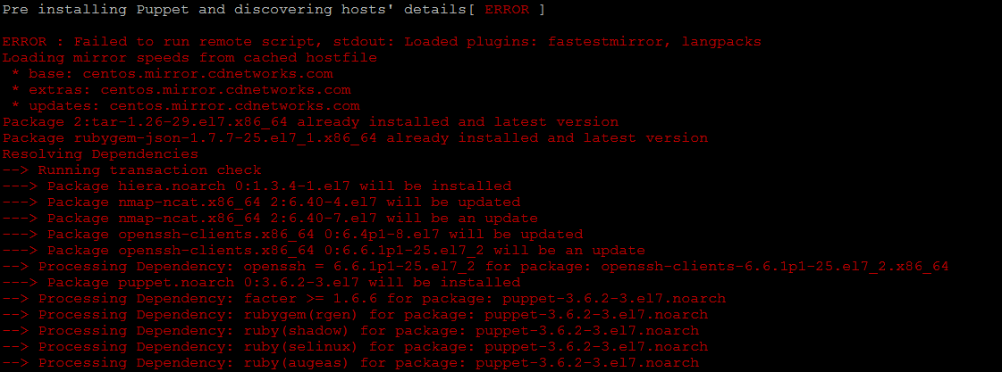
설치 중 에러
Multinode 설치 에러
설치 실패

Slide 10
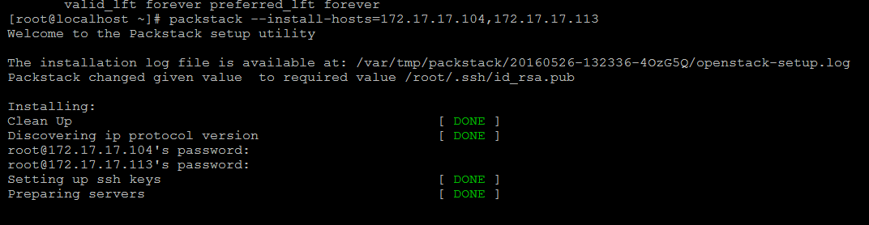
설치 중 에러-2
Multinode 다른 방법으로 시도
From :
https://access.redhat.com/documentation/en-US/Red_Hat_Enterprise_Linux_OpenStack_Platform/2/html/Getting_Started_Guide/chap-Running_PackStack.html

Slide 11
설치 중 에러
Answer-file 확인 시 동일한 결과

Slide 12

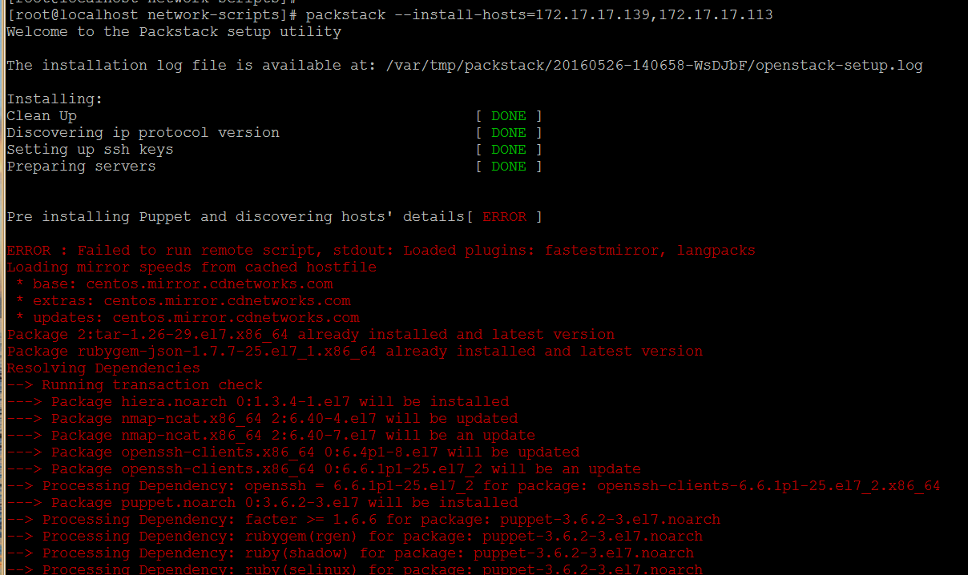
에러 메세지
시스템 복제 후 Multinode 테스트
동일 에러
https://ask.openstack.org/en/question/55696/failed-to-run-remote-script/

Slide 13
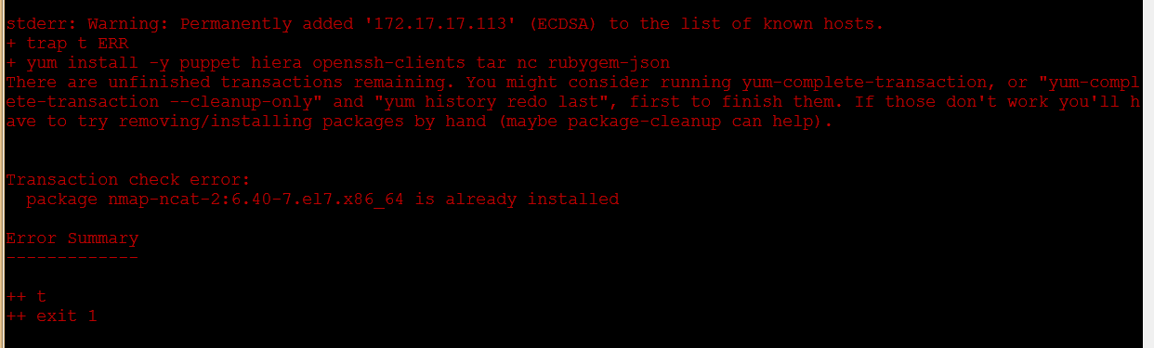
에러 메세지

Slide 14
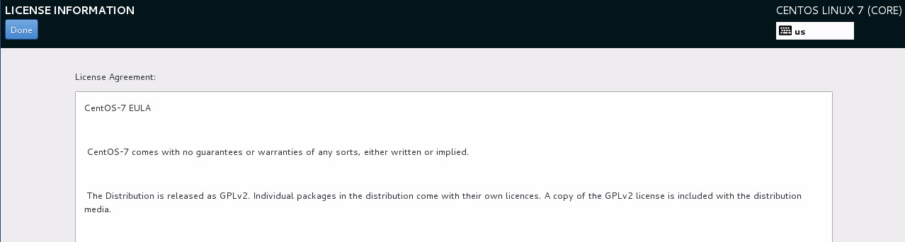
다시 시도
OS 재설치

Slide 15
다시 시도
[root@localhost ~]# yum install -y centos-release-openstack-mitaka
[root@localhost ~]# yum -y update
[root@localhost ~]# yum install -y openstack-packstack
스냅샷 생성
OS Down
가상 시스템 복제
. ~ About 30min 시간 소요
[root@localhost ~]# yum install -y centos-release-openstack-mitaka
Loaded plugins: fastestmirror, langpacks
Loading mirror speeds from cached hostfile
* base: mirror.navercorp.com
* extras: mirror.navercorp.com
* updates: mirror.navercorp.com
Package centos-release-openstack-mitaka-1-2.el7.centos.noarch already installed and latest version
Nothing to do
[root@localhost ~]#
[root@localhost ~]# yum update -y
Loaded plugins: fastestmirror, langpacks
Loading mirror speeds from cached hostfile
* base: mirror.navercorp.com
* extras: mirror.navercorp.com
* updates: mirror.navercorp.com
No packages marked for update
[root@localhost ~]#
[root@localhost ~]#
[root@localhost ~]# yum install -y openstack-packstack
Loaded plugins: fastestmirror, langpacks
Loading mirror speeds from cached hostfile
* base: mirror.navercorp.com
* extras: mirror.navercorp.com
* updates: mirror.navercorp.com
Package openstack-packstack-8.0.0-1.el7.noarch already installed and latest version

Slide 16
다시 시도
vi /etc/selinux/config
Change like following line
SELINUX=disabled
Reboot
[root@localhost ~]# packstack --install-hosts=172.17.17.167,172.17.17.108
Welcome to the Packstack setup utility
The installation log file is available at: /var/tmp/packstack/20160526-160259-W6rC7V/openstack-setup.log
Packstack changed given value to required value /root/.ssh/id_rsa.pub
Installing:
Clean Up [ DONE ]
Discovering ip protocol version [ DONE ]
root@172.17.17.108's password:
root@172.17.17.167's password:
Setting up ssh keys [ DONE ]
Preparing servers [ DONE ]
(시간 소요)

Slide 17
다시 시도
… 넘어감 …
Pre installing Puppet and discovering hosts' details [ DONE ]
Adding pre install manifest entries [ DONE ]
Setting up CACERT [ DONE ]
Adding AMQP manifest entries [ DONE ]
Adding MariaDB manifest entries [ DONE ]
Adding Apache manifest entries [ DONE ]
Fixing Keystone LDAP config parameters to be undef if empty[ DONE ]
Adding Keystone manifest entries [ DONE ]
Adding Glance Keystone manifest entries [ DONE ]
Adding Glance manifest entries [ DONE ]
Adding Cinder Keystone manifest entries [ DONE ]
Checking if the Cinder server has a cinder-volumes vg[ DONE ]
Adding Cinder manifest entries [ DONE ]
Adding Nova API manifest entries [ DONE ]
Adding Nova Keystone manifest entries [ DONE ]
Adding Nova Cert manifest entries [ DONE ]
Adding Nova Conductor manifest entries [ DONE ]
Creating ssh keys for Nova migration [ DONE ]
Gathering ssh host keys for Nova migration [ DONE ]
Adding Nova Compute manifest entries [ DONE ]
Adding Nova Scheduler manifest entries [ DONE ]
Adding Nova VNC Proxy manifest entries [ DONE ]

Slide 18
다시 시도
Hang……
172.17.17.167_api_nova.pp: [ DONE ]
Applying 172.17.17.167_nova.pp
Applying 172.17.17.108_nova.pp
172.17.17.167_nova.pp: [ DONE ]
Testing if puppet apply is finished: 172.17.17.108_nova.pp [ \ ]
Testing if puppet apply is finished: 172.17.17.108_nova.pp [ - ]
Testing if puppet apply is finished: 172.17.17.108_nova.pp [ - ]
Testing if puppet apply is finished: 172.17.17.108_nova.pp [ / ]
Testing if puppet apply is finished: 172.17.17.108_nova.pp [ / ]
Testing if puppet apply is finished: 172.17.17.108_nova.pp [ \ ]
Testing if puppet apply is finished: 172.17.17.108_nova.pp [ - ]
Testing if puppet apply is finished: 172.17.17.108_nova.pp [ - ]
Testing if puppet apply is finished: 172.17.17.108_nova.pp [ / ]
Testing if puppet apply is finished: 172.17.17.108_nova.pp [ - ]
(1시간 이상….)

Slide 19
다시 시도
설치 중 에러
-> Ctrl+C, 강제 종료
* To use Nagios, browse to http://172.17.17.167/nagios username: nagiosadmin, password: 086308099f3e4442
Traceback (most recent call last):
File "/usr/bin/packstack", line 15, in <module>
run_setup.main()
File "/usr/lib/python2.7/site-packages/packstack/installer/run_setup.py", line 996, in main
single_step_install(options, logFile)
File "/usr/lib/python2.7/site-packages/packstack/installer/run_setup.py", line 791, in single_step_install
_main(options, answerfilepath, logFile)
File "/usr/lib/python2.7/site-packages/packstack/installer/run_setup.py", line 660, in _main
runSequences()
File "/usr/lib/python2.7/site-packages/packstack/installer/run_setup.py", line 627, in runSequences
controller.runAllSequences()
File "/usr/lib/python2.7/site-packages/packstack/installer/setup_controller.py", line 81, in runAllSequences
sequence.run(config=self.CONF, messages=self.MESSAGES)
File "/usr/lib/python2.7/site-packages/packstack/installer/core/sequences.py", line 109, in run
step.run(config=config, messages=messages)
File "/usr/lib/python2.7/site-packages/packstack/installer/core/sequences.py", line 50, in run
self.function(config, messages)
File "/usr/lib/python2.7/site-packages/packstack/plugins/puppet_950.py", line 209, in apply_puppet_manifest
wait_for_puppet(currently_running, messages)
File "/usr/lib/python2.7/site-packages/packstack/plugins/puppet_950.py", line 114, in wait_for_puppet
time.sleep(3)
KeyboardInterrupt

Slide 20
설정 파일 확인
설정 파일 확인
# Server on which to install OpenStack services specific to the
# controller role (for example, API servers or dashboard).
CONFIG_CONTROLLER_HOST=172.17.17.167
# List the servers on which to install the Compute service.
CONFIG_COMPUTE_HOSTS=172.17.17.108
# List of servers on which to install the network service such as
# Compute networking (nova network) or OpenStack Networking (neutron).
CONFIG_NETWORK_HOSTS=172.17.17.167

Slide 21
Allinone 테스트
다른 장비 준비
. [root@localhost ~]# yum install -y centos-release-openstack-mitaka
. [root@localhost ~]# yum -y update
. [root@localhost ~]# yum install -y openstack-packstack
. [root@localhost ~]# getenforce
Disabled
. [root@localhost ~]# packstack --allinone
16:53
Testing if puppet apply is finished: 172.17.17.139_nova.pp [ / ]
. hang

Slide 22
죄송합니다 -.-

