Slide 1
0 | 0 | 0 | 0 | 0 | 0 | 0 | 0 | 0 | 0 | 0 | 0 | 0 | 0 | 0 | 0 | 0 | 0 | 0 | 0
0 | 0 | 0 | 0 | 0 | 0 | 0 | 0 | 0 | 0 | 0 | 0 | 0 | 0 | 0 | 0 | 0 | 0 | 0 | 0
0 | 0 | 0 | 0 | 0 | 0 | 0 | 0 | 0 | 0 | 0 | 0 | 0 | 0 | 1 | 1 | 1 | 1 | 0 | 0
0 | 0 | 0 | 1 | 1 | 1 | 1 | 1 | 0 | 0 | 0 | 0 | 0 | 1 | 1 | 1 | 1 | 1 | 0 | 0
0 | 0 | 0 | 0 | 1 | 1 | 1 | 1 | 1 | 1 | 1 | 1 | 1 | 1 | 1 | 1 | 1 | 1 | 0 | 0
0 | 0 | 0 | 0 | 0 | 0 | 1 | 1 | 1 | 1 | 1 | 1 | 1 | 1 | 1 | 1 | 1 | 0 | 0 | 0
0 | 0 | 0 | 0 | 0 | 0 | 0 | 0 | 1 | 1 | 1 | 1 | 1 | 1 | 1 | 1 | 0 | 0 | 0 | 0
0 | 0 | 0 | 0 | 0 | 0 | 0 | 0 | 0 | 1 | 1 | 1 | 1 | 1 | 1 | 0 | 0 | 0 | 0 | 0
0 | 0 | 0 | 0 | 0 | 0 | 0 | 0 | 0 | 1 | 1 | 1 | 1 | 1 | 1 | 1 | 0 | 0 | 0 | 0
0 | 0 | 0 | 0 | 0 | 0 | 0 | 0 | 1 | 1 | 1 | 1 | 1 | 1 | 1 | 1 | 0 | 0 | 0 | 0
0 | 0 | 0 | 0 | 0 | 0 | 0 | 1 | 1 | 1 | 1 | 1 | 0 | 1 | 1 | 1 | 0 | 0 | 0 | 0
0 | 0 | 0 | 0 | 0 | 0 | 0 | 1 | 1 | 1 | 1 | 0 | 0 | 1 | 1 | 1 | 1 | 0 | 0 | 0
0 | 1 | 1 | 1 | 1 | 0 | 1 | 1 | 1 | 1 | 0 | 0 | 0 | 0 | 1 | 1 | 1 | 0 | 0 | 0
0 | 0 | 1 | 1 | 1 | 1 | 1 | 1 | 1 | 0 | 0 | 0 | 0 | 0 | 0 | 1 | 1 | 0 | 0 | 0
0 | 0 | 0 | 0 | 1 | 1 | 1 | 1 | 0 | 0 | 0 | 0 | 0 | 0 | 0 | 0 | 1 | 1 | 0 | 0
0 | 0 | 0 | 0 | 0 | 0 | 1 | 1 | 0 | 0 | 0 | 0 | 0 | 0 | 0 | 0 | 0 | 1 | 0 | 0
0 | 0 | 0 | 0 | 0 | 0 | 1 | 1 | 1 | 0 | 0 | 0 | 0 | 0 | 0 | 0 | 0 | 0 | 0 | 0
0 | 0 | 0 | 0 | 0 | 0 | 0 | 1 | 1 | 0 | 0 | 0 | 0 | 0 | 0 | 0 | 0 | 0 | 0 | 0
0 | 0 | 0 | 0 | 0 | 0 | 0 | 0 | 1 | 0 | 0 | 0 | 0 | 0 | 0 | 0 | 0 | 0 | 0 | 0
0 | 0 | 0 | 0 | 0 | 0 | 0 | 0 | 0 | 0 | 0 | 0 | 0 | 0 | 0 | 0 | 0 | 0 | 0 | 0
0 | 0 | 0 | 0 | 0 | 0 | 0 | 0 | 0 | 0 | 0 | 0 | 0 | 0 | 0 | 0 | 0 | 0 | 0 | 0
0 | 0 | 0 | 0 | 0 | 0 | 0 | 0 | 0 | 0 | 0 | 0 | 0 | 0 | 0 | 0 | 0 | 0 | 0 | 0
0 | 0 | 0 | 0 | 0 | 0 | 0 | 0 | 0 | 0 | 0 | 0 | 0 | 0 | 1 | 1 | 1 | 1 | 0 | 0
0 | 0 | 0 | 1 | 1 | 1 | 1 | 1 | 0 | 0 | 0 | 0 | 0 | 1 | 1 | 1 | 1 | 1 | 0 | 0
0 | 0 | 0 | 0 | 1 | 1 | 1 | 1 | 1 | 1 | 1 | 1 | 1 | 1 | 1 | 1 | 1 | 1 | 0 | 0
0 | 0 | 0 | 0 | 0 | 0 | 1 | 1 | 1 | 1 | 1 | 1 | 1 | 1 | 1 | 1 | 1 | 0 | 0 | 0
0 | 0 | 0 | 0 | 0 | 0 | 0 | 0 | 1 | 1 | 1 | 1 | 1 | 1 | 1 | 1 | 0 | 0 | 0 | 0
0 | 0 | 0 | 0 | 0 | 0 | 0 | 0 | 0 | 1 | 1 | 1 | 1 | 1 | 1 | 0 | 0 | 0 | 0 | 0
0 | 0 | 0 | 0 | 0 | 0 | 0 | 0 | 0 | 1 | 1 | 1 | 1 | 1 | 1 | 1 | 0 | 0 | 0 | 0
0 | 0 | 0 | 0 | 0 | 0 | 0 | 0 | 1 | 1 | 1 | 1 | 1 | 1 | 1 | 1 | 0 | 0 | 0 | 0
0 | 0 | 0 | 0 | 0 | 0 | 0 | 1 | 1 | 1 | 1 | 1 | 0 | 1 | 1 | 1 | 0 | 0 | 0 | 0
0 | 0 | 0 | 0 | 0 | 0 | 0 | 1 | 1 | 1 | 1 | 0 | 0 | 1 | 1 | 1 | 1 | 0 | 0 | 0
0 | 1 | 1 | 1 | 1 | 0 | 1 | 1 | 1 | 1 | 0 | 0 | 0 | 0 | 1 | 1 | 1 | 0 | 0 | 0
0 | 0 | 1 | 1 | 1 | 1 | 1 | 1 | 1 | 0 | 0 | 0 | 0 | 0 | 0 | 1 | 1 | 0 | 0 | 0
0 | 0 | 0 | 0 | 1 | 1 | 1 | 1 | 0 | 0 | 0 | 0 | 0 | 0 | 0 | 0 | 1 | 1 | 0 | 0
0 | 0 | 0 | 0 | 0 | 0 | 1 | 1 | 0 | 0 | 0 | 0 | 0 | 0 | 0 | 0 | 0 | 1 | 0 | 0
0 | 0 | 0 | 0 | 0 | 0 | 1 | 1 | 1 | 0 | 0 | 0 | 0 | 0 | 0 | 0 | 0 | 0 | 0 | 0
0 | 0 | 0 | 0 | 0 | 0 | 0 | 1 | 1 | 0 | 0 | 0 | 0 | 0 | 0 | 0 | 0 | 0 | 0 | 0
0 | 0 | 0 | 0 | 0 | 0 | 0 | 0 | 1 | 0 | 0 | 0 | 0 | 0 | 0 | 0 | 0 | 0 | 0 | 0
0 | 0 | 0 | 0 | 0 | 0 | 0 | 0 | 0 | 0 | 0 | 0 | 0 | 0 | 0 | 0 | 0 | 0 | 0 | 0

Slide 2
0 | 0 | 0 | 0 | 0 | 0 | 0 | 0 | 0 | 0 | 0 | 0 | 0 | 0 | 0 | 0 | 0 | 0 | 0 | 0
0 | 0 | 0 | 0 | 0 | 0 | 0 | 0 | 0 | 0 | 0 | 0 | 0 | 0 | 0 | 0 | 0 | 0 | 0 | 0
0 | 0 | 0 | 0 | 0 | 0 | 0 | 0 | 0 | 0 | 0 | 0 | 0 | 0 | 1 | 1 | 1 | 1 | 0 | 0
0 | 0 | 0 | 1 | 1 | 1 | 1 | 1 | 0 | 0 | 0 | 0 | 0 | 1 | 1 | 1 | 1 | 1 | 0 | 0
0 | 0 | 0 | 0 | 1 | 1 | 1 | 1 | 1 | 1 | 1 | 1 | 1 | 1 | 1 | 1 | 1 | 1 | 0 | 0
0 | 0 | 0 | 0 | 0 | 0 | 1 | 1 | 1 | 1 | 1 | 1 | 1 | 1 | 1 | 1 | 1 | 0 | 0 | 0
0 | 0 | 0 | 0 | 0 | 0 | 0 | 0 | 1 | 1 | 1 | 1 | 1 | 1 | 1 | 1 | 0 | 0 | 0 | 0
0 | 0 | 0 | 0 | 0 | 0 | 0 | 0 | 0 | 1 | 1 | 1 | 1 | 1 | 1 | 0 | 0 | 0 | 0 | 0
0 | 0 | 0 | 0 | 0 | 0 | 0 | 0 | 0 | 1 | 1 | 1 | 1 | 1 | 1 | 1 | 0 | 0 | 0 | 0
0 | 0 | 0 | 0 | 0 | 0 | 0 | 0 | 1 | 1 | 1 | 1 | 1 | 1 | 1 | 1 | 0 | 0 | 0 | 0
0 | 0 | 0 | 0 | 0 | 0 | 0 | 1 | 1 | 1 | 1 | 1 | 0 | 1 | 1 | 1 | 0 | 0 | 0 | 0
0 | 0 | 0 | 0 | 0 | 0 | 0 | 1 | 1 | 1 | 1 | 0 | 0 | 1 | 1 | 1 | 1 | 0 | 0 | 0
0 | 1 | 1 | 1 | 1 | 0 | 1 | 1 | 1 | 1 | 0 | 0 | 0 | 0 | 1 | 1 | 1 | 0 | 0 | 0
0 | 0 | 1 | 1 | 1 | 1 | 1 | 1 | 1 | 0 | 0 | 0 | 0 | 0 | 0 | 1 | 1 | 0 | 0 | 0
0 | 0 | 0 | 0 | 1 | 1 | 1 | 1 | 0 | 0 | 0 | 0 | 0 | 0 | 0 | 0 | 1 | 1 | 0 | 0
0 | 0 | 0 | 0 | 0 | 0 | 1 | 1 | 0 | 0 | 0 | 0 | 0 | 0 | 0 | 0 | 0 | 1 | 0 | 0
0 | 0 | 0 | 0 | 0 | 0 | 1 | 1 | 1 | 0 | 0 | 0 | 0 | 0 | 0 | 0 | 0 | 0 | 0 | 0
0 | 0 | 0 | 0 | 0 | 0 | 0 | 1 | 1 | 0 | 0 | 0 | 0 | 0 | 0 | 0 | 0 | 0 | 0 | 0
0 | 0 | 0 | 0 | 0 | 0 | 0 | 0 | 1 | 0 | 0 | 0 | 0 | 0 | 0 | 0 | 0 | 0 | 0 | 0
0 | 0 | 0 | 0 | 0 | 0 | 0 | 0 | 0 | 0 | 0 | 0 | 0 | 0 | 0 | 0 | 0 | 0 | 0 | 0

Slide 3

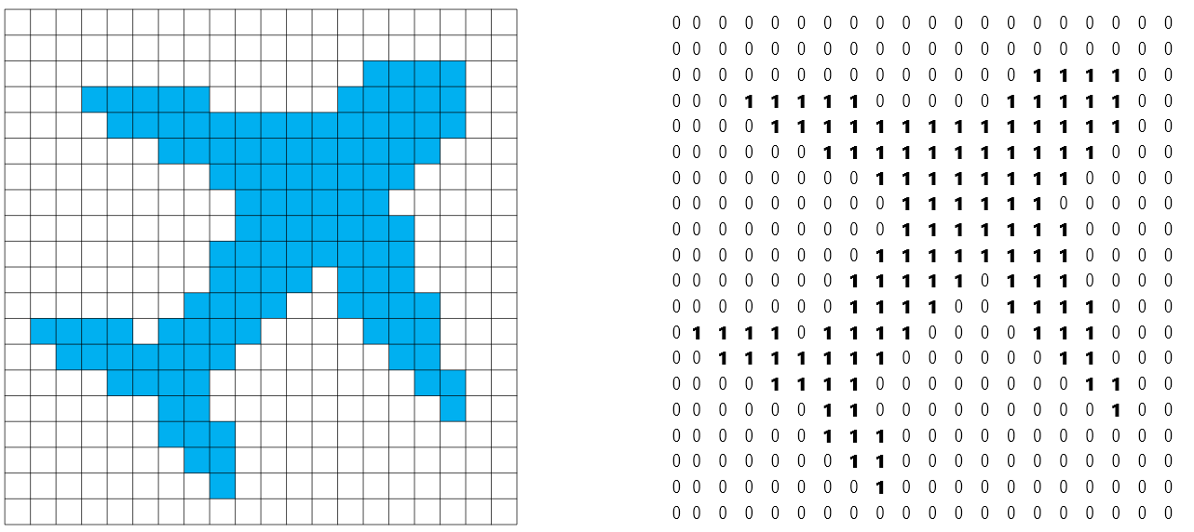
Geometry
Cartesian grid
Artificial image

