Slide 1
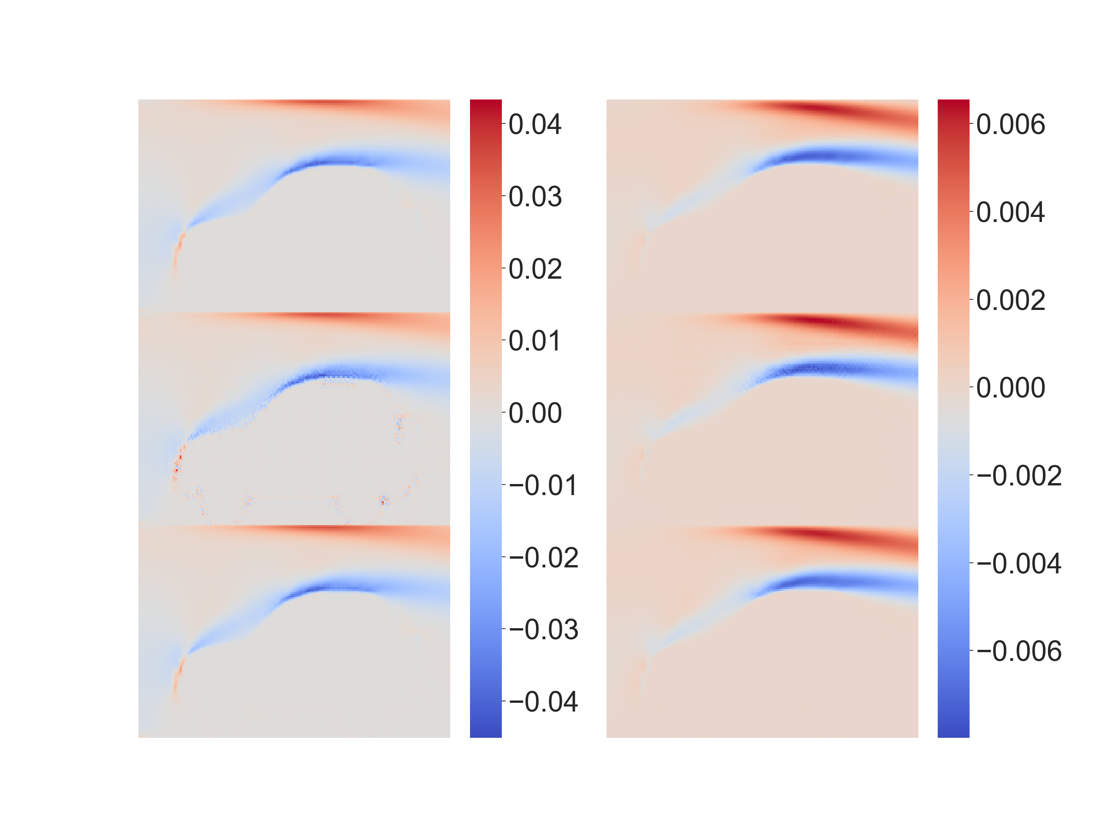


Ground
Truth
$$L_{1}$$
$$L_{physical}$$
∆mass
∆momentum

