Slide 1
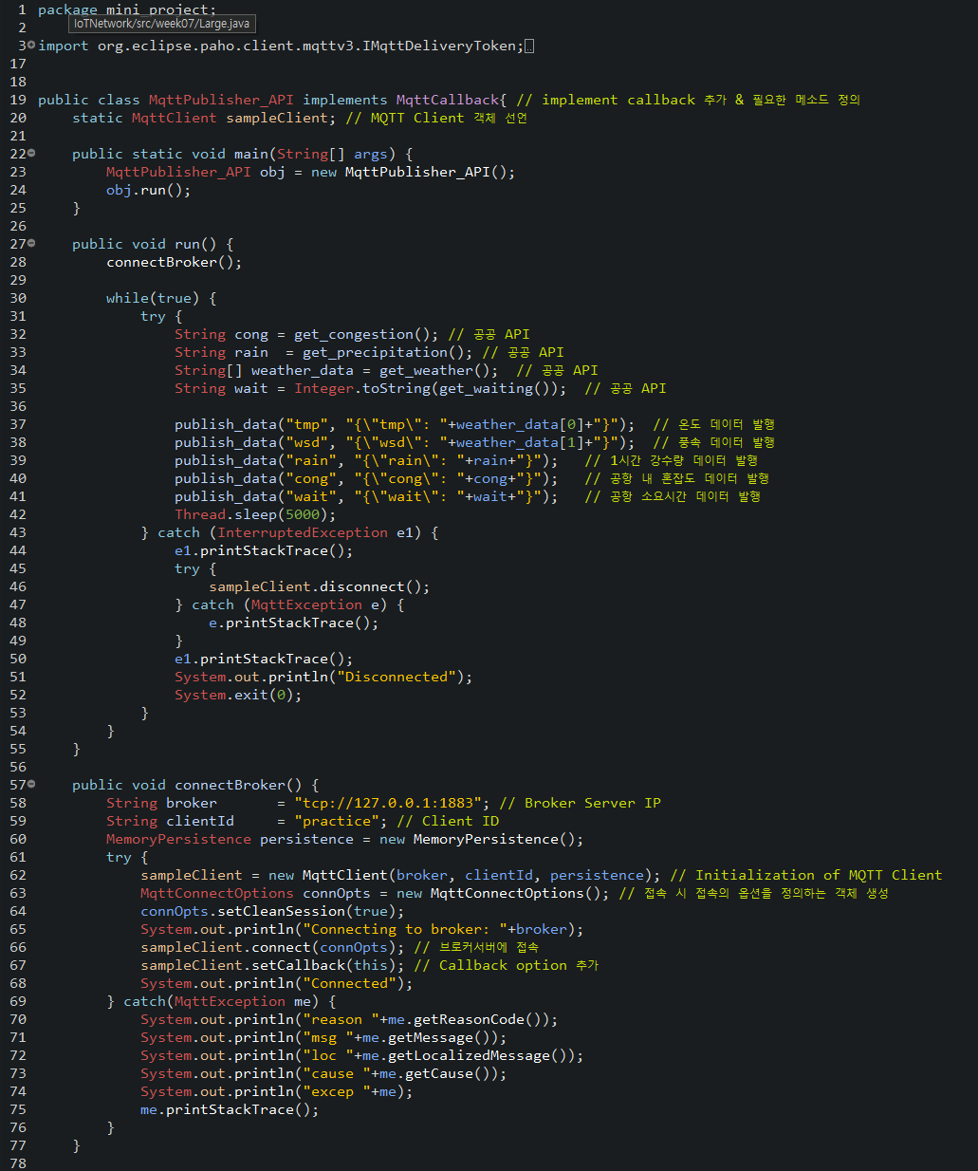
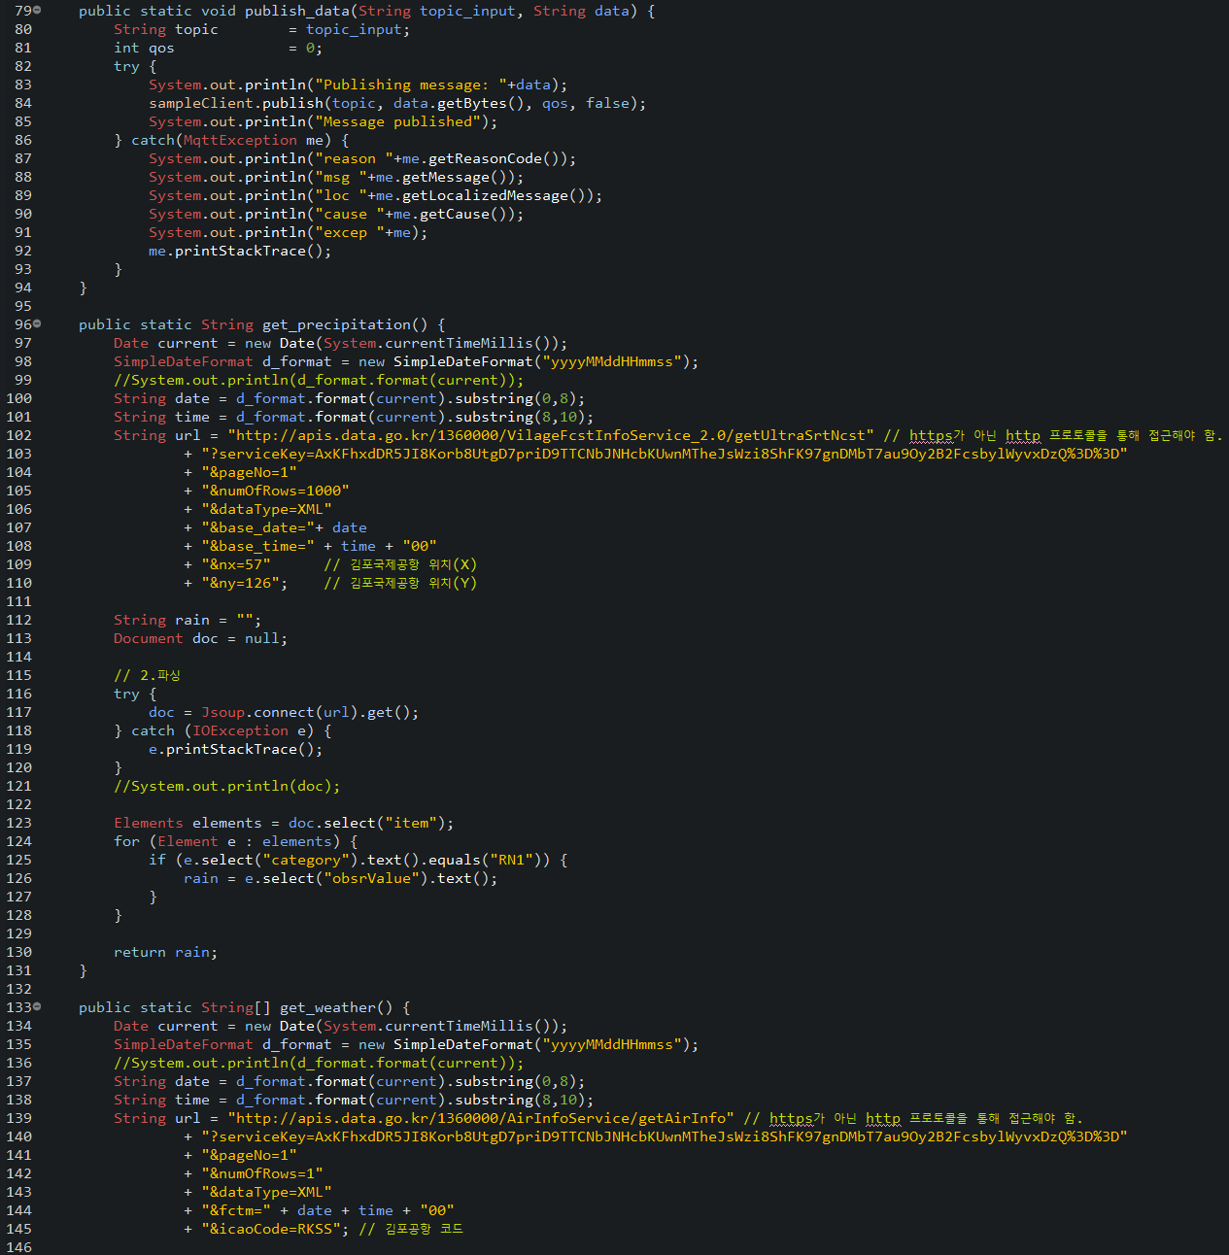
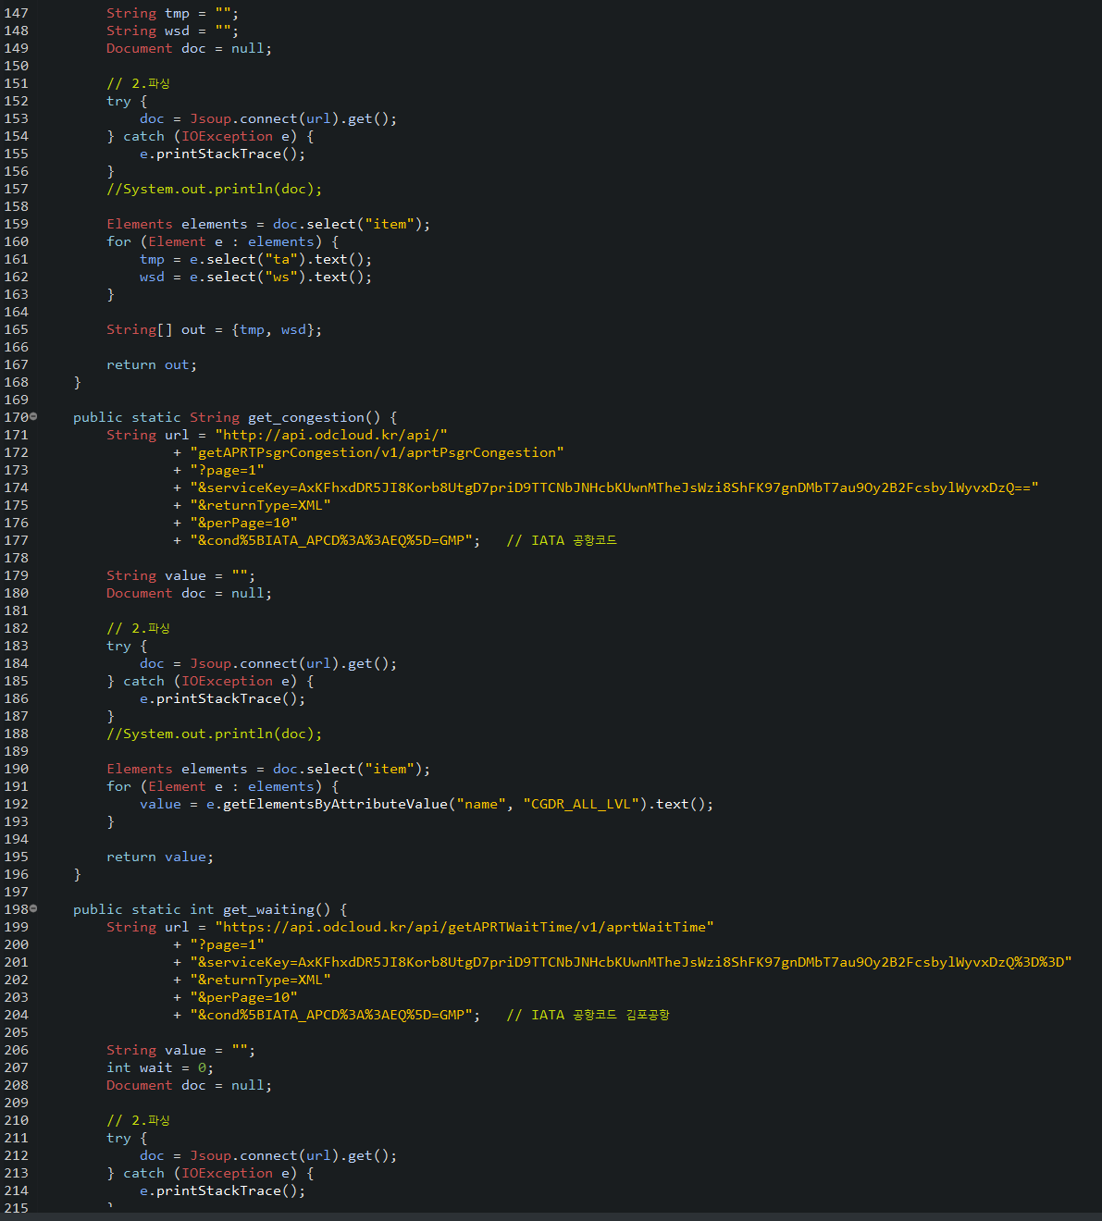
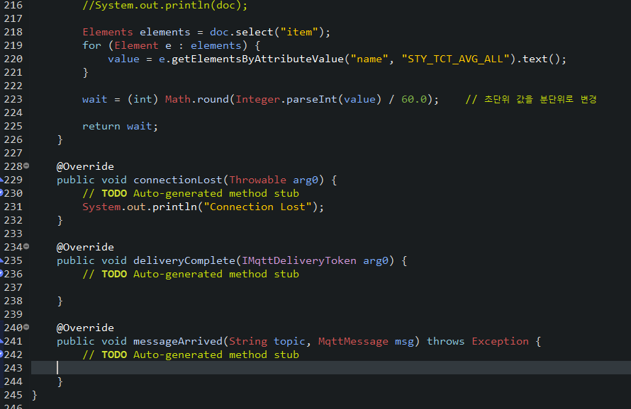
MqttPublisher_API.java
Notes:
package mini_project;
import org.eclipse.paho.client.mqttv3.IMqttDeliveryToken;
import org.eclipse.paho.client.mqttv3.MqttCallback;
import org.eclipse.paho.client.mqttv3.MqttClient;
import org.eclipse.paho.client.mqttv3.MqttConnectOptions;
import org.eclipse.paho.client.mqttv3.MqttException;
import org.eclipse.paho.client.mqttv3.MqttMessage;
import org.eclipse.paho.client.mqttv3.persist.MemoryPersistence;
import java.io.IOException;
import java.text.SimpleDateFormat;
import java.util.Date;
import org.jsoup.Jsoup;
import org.jsoup.nodes.Document;
import org.jsoup.nodes.Element;
import org.jsoup.select.Elements;
public class MqttPublisher_API implements MqttCallback{ // implement callback 추가 & 필요한 메소드 정의
static MqttClient sampleClient; // MQTT Client 객체 선언
public static void main(String[] args) {
MqttPublisher_API obj = new MqttPublisher_API();
obj.run();
}
public void run() {
connectBroker();
while(true) {
try {
String cong = get_congestion(); // 공공 API
String rain = get_precipitation(); // 공공 API
String[] weather_data = get_weather(); // 공공 API
String wait = Integer.toString(get_waiting()); // 공공 API
publish_data("tmp", "{\"tmp\": "+weather_data[0]+"}"); // 온도 데이터 발행
publish_data("wsd", "{\"wsd\": "+weather_data[1]+"}"); // 풍속 데이터 발행
publish_data("rain", "{\"rain\": "+rain+"}"); // 1시간 강수량 데이터 발행
publish_data("cong", "{\"cong\": "+cong+"}"); // 공항 내 혼잡도 데이터 발행
publish_data("wait", "{\"wait\": "+wait+"}"); // 공항 소요시간 데이터 발행
Thread.sleep(5000);
} catch (InterruptedException e1) {
e1.printStackTrace();
try {
sampleClient.disconnect();
} catch (MqttException e) {
e.printStackTrace();
}
e1.printStackTrace();
System.out.println("Disconnected");
System.exit(0);
}
}
}
public void connectBroker() {
String broker = "tcp://127.0.0.1:1883"; // Broker Server IP
String clientId = "practice"; // Client ID
MemoryPersistence persistence = new MemoryPersistence();
try {
sampleClient = new MqttClient(broker, clientId, persistence); // Initialization of MQTT Client
MqttConnectOptions connOpts = new MqttConnectOptions(); // 접속 시 접속의 옵션을 정의하는 객체 생성
connOpts.setCleanSession(true);
System.out.println("Connecting to broker: "+broker);
sampleClient.connect(connOpts); // 브로커서버에 접속
sampleClient.setCallback(this); // Callback option 추가
System.out.println("Connected");
} catch(MqttException me) {
System.out.println("reason "+me.getReasonCode());
System.out.println("msg "+me.getMessage());
System.out.println("loc "+me.getLocalizedMessage());
System.out.println("cause "+me.getCause());
System.out.println("excep "+me);
me.printStackTrace();
}
}
public static void publish_data(String topic_input, String data) {
String topic = topic_input;
int qos = 0;
try {
System.out.println("Publishing message: "+data);
sampleClient.publish(topic, data.getBytes(), qos, false);
System.out.println("Message published");
} catch(MqttException me) {
System.out.println("reason "+me.getReasonCode());
System.out.println("msg "+me.getMessage());
System.out.println("loc "+me.getLocalizedMessage());
System.out.println("cause "+me.getCause());
System.out.println("excep "+me);
me.printStackTrace();
}
}
public static String get_precipitation() {
Date current = new Date(System.currentTimeMillis());
SimpleDateFormat d_format = new SimpleDateFormat("yyyyMMddHHmmss");
//System.out.println(d_format.format(current));
String date = d_format.format(current).substring(0,8);
String time = d_format.format(current).substring(8,10);
String url = "http://apis.data.go.kr/1360000/VilageFcstInfoService_2.0/getUltraSrtNcst" // https가 아닌 http 프로토콜을 통해 접근해야 함.
+ "?serviceKey=AxKFhxdDR5JI8Korb8UtgD7priD9TTCNbJNHcbKUwnMTheJsWzi8ShFK97gnDMbT7au9Oy2B2FcsbylWyvxDzQ%3D%3D"
+ "&pageNo=1"
+ "&numOfRows=1000"
+ "&dataType=XML"
+ "&base_date="+ date
+ "&base_time=" + time + "00"
+ "&nx=57" // 김포국제공항 위치(X)
+ "&ny=126"; // 김포국제공항 위치(Y)
String rain = "";
Document doc = null;
// 2.파싱
try {
doc = Jsoup.connect(url).get();
} catch (IOException e) {
e.printStackTrace();
}
//System.out.println(doc);
Elements elements = doc.select("item");
for (Element e : elements) {
if (e.select("category").text().equals("RN1")) {
rain = e.select("obsrValue").text();
}
}
return rain;
}
public static String[] get_weather() {
Date current = new Date(System.currentTimeMillis());
SimpleDateFormat d_format = new SimpleDateFormat("yyyyMMddHHmmss");
//System.out.println(d_format.format(current));
String date = d_format.format(current).substring(0,8);
String time = d_format.format(current).substring(8,10);
String url = "http://apis.data.go.kr/1360000/AirInfoService/getAirInfo" // https가 아닌 http 프로토콜을 통해 접근해야 함.
+ "?serviceKey=AxKFhxdDR5JI8Korb8UtgD7priD9TTCNbJNHcbKUwnMTheJsWzi8ShFK97gnDMbT7au9Oy2B2FcsbylWyvxDzQ%3D%3D"
+ "&pageNo=1"
+ "&numOfRows=1"
+ "&dataType=XML"
+ "&fctm=" + date + time + "00"
+ "&icaoCode=RKSS"; // 김포공항 코드
String tmp = "";
String wsd = "";
Document doc = null;
// 2.파싱
try {
doc = Jsoup.connect(url).get();
} catch (IOException e) {
e.printStackTrace();
}
//System.out.println(doc);
Elements elements = doc.select("item");
for (Element e : elements) {
tmp = e.select("ta").text();
wsd = e.select("ws").text();
}
String[] out = {tmp, wsd};
return out;
}
public static String get_congestion() {
String url = "http://api.odcloud.kr/api/"
+ "getAPRTPsgrCongestion/v1/aprtPsgrCongestion​"
+ "?page=1"
+ "&serviceKey=AxKFhxdDR5JI8Korb8UtgD7priD9TTCNbJNHcbKUwnMTheJsWzi8ShFK97gnDMbT7au9Oy2B2FcsbylWyvxDzQ=="
+ "&returnType=XML"
+ "&perPage=10"
+ "&cond%5BIATA_APCD%3A%3AEQ%5D=GMP"; // IATA 공항코드
String value = "";
Document doc = null;
// 2.파싱
try {
doc = Jsoup.connect(url).get();
} catch (IOException e) {
e.printStackTrace();
}
//System.out.println(doc);
Elements elements = doc.select("item");
for (Element e : elements) {
value = e.getElementsByAttributeValue("name", "CGDR_ALL_LVL").text();
}
return value;
}
public static int get_waiting() {
String url = "http://api.odcloud.kr/api/getAPRTWaitTime/v1/aprtWaitTime"
+ "?page=1"
+ "&serviceKey=AxKFhxdDR5JI8Korb8UtgD7priD9TTCNbJNHcbKUwnMTheJsWzi8ShFK97gnDMbT7au9Oy2B2FcsbylWyvxDzQ%3D%3D"
+ "&returnType=XML"
+ "&perPage=10"
+ "&cond%5BIATA_APCD%3A%3AEQ%5D=GMP"; // IATA 공항코드 김포공항
String value = "";
int wait = 0;
Document doc = null;
// 2.파싱
try {
doc = Jsoup.connect(url).get();
} catch (IOException e) {
e.printStackTrace();
}
//System.out.println(doc);
Elements elements = doc.select("item");
for (Element e : elements) {
value = e.getElementsByAttributeValue("name", "STY_TCT_AVG_ALL").text();
}
wait = (int) Math.round(Integer.parseInt(value) / 60.0); // 초단위 값을 분단위로 변경
return wait;
}
@Override
public void connectionLost(Throwable arg0) {
// TODO Auto-generated method stub
System.out.println("Connection Lost");
}
@Override
public void deliveryComplete(IMqttDeliveryToken arg0) {
// TODO Auto-generated method stub
}
@Override
public void messageArrived(String topic, MqttMessage msg) throws Exception {
// TODO Auto-generated method stub
}
}

Slide 2
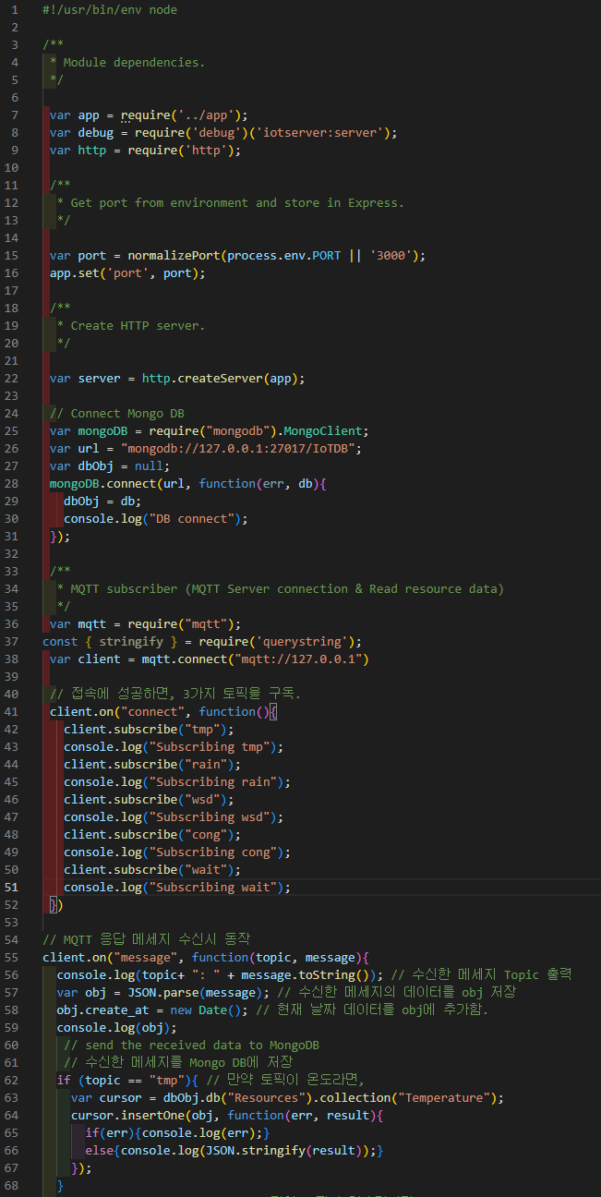
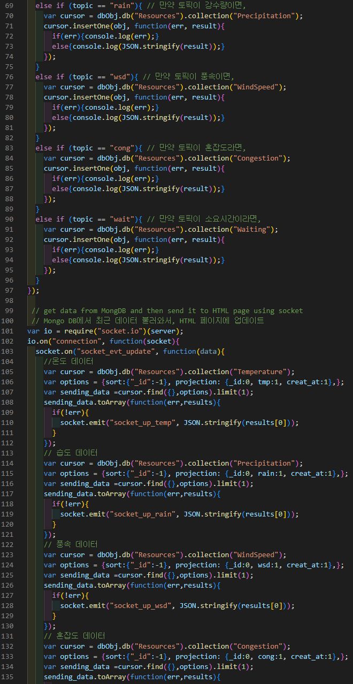
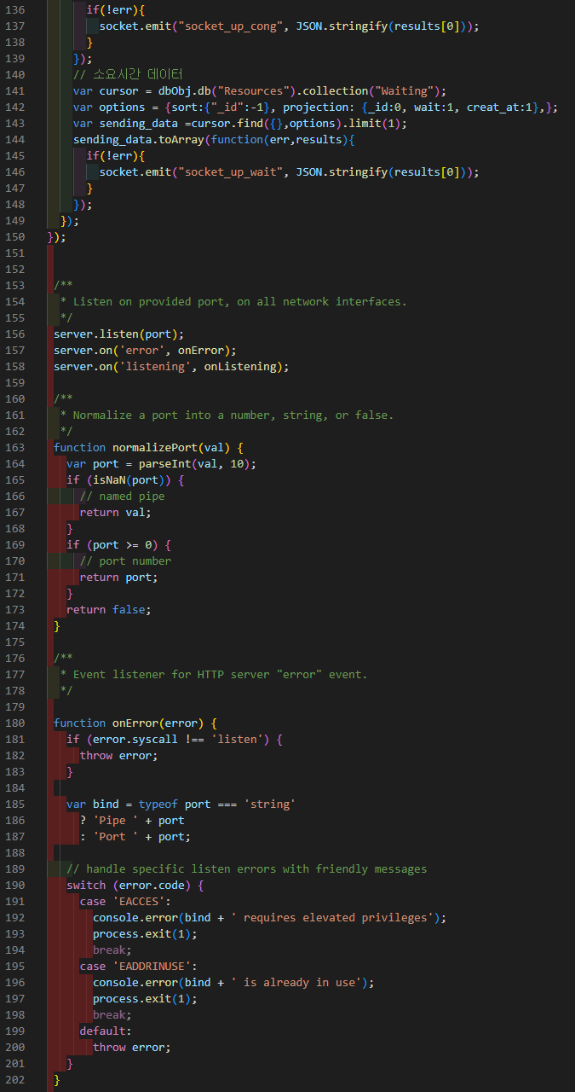
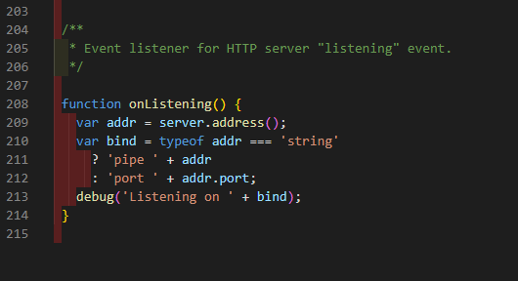
www
Notes:
#!/usr/bin/env node
/**
* Module dependencies.
*/
var app = require('../app');
var debug = require('debug')('iotserver:server');
var http = require('http');
/**
* Get port from environment and store in Express.
*/
var port = normalizePort(process.env.PORT || '3000');
app.set('port', port);
/**
* Create HTTP server.
*/
var server = http.createServer(app);
// Connect Mongo DB
var mongoDB = require("mongodb").MongoClient;
var url = "mongodb://127.0.0.1:27017/IoTDB";
var dbObj = null;
mongoDB.connect(url, function(err, db){
dbObj = db;
console.log("DB connect");
});
/**
* MQTT subscriber (MQTT Server connection & Read resource data)
*/
var mqtt = require("mqtt");
const { stringify } = require('querystring');
var client = mqtt.connect("mqtt://127.0.0.1")
// 접속에 성공하면, 5가지 토픽을 구독.
client.on("connect", function(){
client.subscribe("tmp");
console.log("Subscribing tmp");
client.subscribe("rain");
console.log("Subscribing rain");
client.subscribe("wsd");
console.log("Subscribing wsd");
client.subscribe("cong");
console.log("Subscribing cong");
client.subscribe("wait");
console.log("Subscribing wait");
})
// MQTT 응답 메세지 수신시 동작
client.on("message", function(topic, message){
console.log(topic+ ": " + message.toString()); // 수신한 메세지 Topic 출력
var obj = JSON.parse(message); // 수신한 메세지의 데이터를 obj 저장
obj.create_at = new Date(); // 현재 날짜 데이터를 obj에 추가함.
console.log(obj);
// send the received data to MongoDB
// 수신한 메세지를 Mongo DB에 저장
if (topic == "tmp"){ // 만약 토픽이 온도라면,
var cursor = dbObj.db("Resources").collection("Temperature");
cursor.insertOne(obj, function(err, result){
if(err){console.log(err);}
else{console.log(JSON.stringify(result));}
});
}
else if (topic == "rain"){ // 만약 토픽이 강수량이면,
var cursor = dbObj.db("Resources").collection("Precipitation");
cursor.insertOne(obj, function(err, result){
if(err){console.log(err);}
else{console.log(JSON.stringify(result));}
});
}
else if (topic == "wsd"){ // 만약 토픽이 풍속이면,
var cursor = dbObj.db("Resources").collection("WindSpeed");
cursor.insertOne(obj, function(err, result){
if(err){console.log(err);}
else{console.log(JSON.stringify(result));}
});
}
else if (topic == "cong"){ // 만약 토픽이 혼잡도라면,
var cursor = dbObj.db("Resources").collection("Congestion");
cursor.insertOne(obj, function(err, result){
if(err){console.log(err);}
else{console.log(JSON.stringify(result));}
});
}
else if (topic == "wait"){ // 만약 토픽이 소요시간이라면,
var cursor = dbObj.db("Resources").collection("Waiting");
cursor.insertOne(obj, function(err, result){
if(err){console.log(err);}
else{console.log(JSON.stringify(result));}
});
}
});
// get data from MongDB and then send it to HTML page using socket
// Mongo DB에서 최근 데이터 불러와서, HTML 페이지에 업데이트
var io = require("socket.io")(server);
io.on("connection", function(socket){
socket.on("socket_evt_update", function(data){
//온도 데이터
var cursor = dbObj.db("Resources").collection("Temperature");
var options = {sort:{"_id":-1}, projection: {_id:0, tmp:1, creat_at:1},};
var sending_data =cursor.find({},options).limit(1);
sending_data.toArray(function(err,results){
if(!err){
socket.emit("socket_up_temp", JSON.stringify(results[0]));
}
});
// 습도 데이터
var cursor = dbObj.db("Resources").collection("Precipitation");
var options = {sort:{"_id":-1}, projection: {_id:0, rain:1, creat_at:1},};
var sending_data =cursor.find({},options).limit(1);
sending_data.toArray(function(err,results){
if(!err){
socket.emit("socket_up_rain", JSON.stringify(results[0]));
}
});
// 풍속 데이터
var cursor = dbObj.db("Resources").collection("WindSpeed");
var options = {sort:{"_id":-1}, projection: {_id:0, wsd:1, creat_at:1},};
var sending_data =cursor.find({},options).limit(1);
sending_data.toArray(function(err,results){
if(!err){
socket.emit("socket_up_wsd", JSON.stringify(results[0]));
}
});
// 혼잡도 데이터
var cursor = dbObj.db("Resources").collection("Congestion");
var options = {sort:{"_id":-1}, projection: {_id:0, cong:1, creat_at:1},};
var sending_data =cursor.find({},options).limit(1);
sending_data.toArray(function(err,results){
if(!err){
socket.emit("socket_up_cong", JSON.stringify(results[0]));
}
});
// 소요시간 데이터
var cursor = dbObj.db("Resources").collection("Waiting");
var options = {sort:{"_id":-1}, projection: {_id:0, wait:1, creat_at:1},};
var sending_data =cursor.find({},options).limit(1);
sending_data.toArray(function(err,results){
if(!err){
socket.emit("socket_up_wait", JSON.stringify(results[0]));
}
});
});
});
/**
* Listen on provided port, on all network interfaces.
*/
server.listen(port);
server.on('error', onError);
server.on('listening', onListening);
/**
* Normalize a port into a number, string, or false.
*/
function normalizePort(val) {
var port = parseInt(val, 10);
if (isNaN(port)) {
// named pipe
return val;
}
if (port >= 0) {
// port number
return port;
}
return false;
}
/**
* Event listener for HTTP server "error" event.
*/
function onError(error) {
if (error.syscall !== 'listen') {
throw error;
}
var bind = typeof port === 'string'
? 'Pipe ' + port
: 'Port ' + port;
// handle specific listen errors with friendly messages
switch (error.code) {
case 'EACCES':
console.error(bind + ' requires elevated privileges');
process.exit(1);
break;
case 'EADDRINUSE':
console.error(bind + ' is already in use');
process.exit(1);
break;
default:
throw error;
}
}
/**
* Event listener for HTTP server "listening" event.
*/
function onListening() {
var addr = server.address();
var bind = typeof addr === 'string'
? 'pipe ' + addr
: 'port ' + addr.port;
debug('Listening on ' + bind);
}

Slide 3
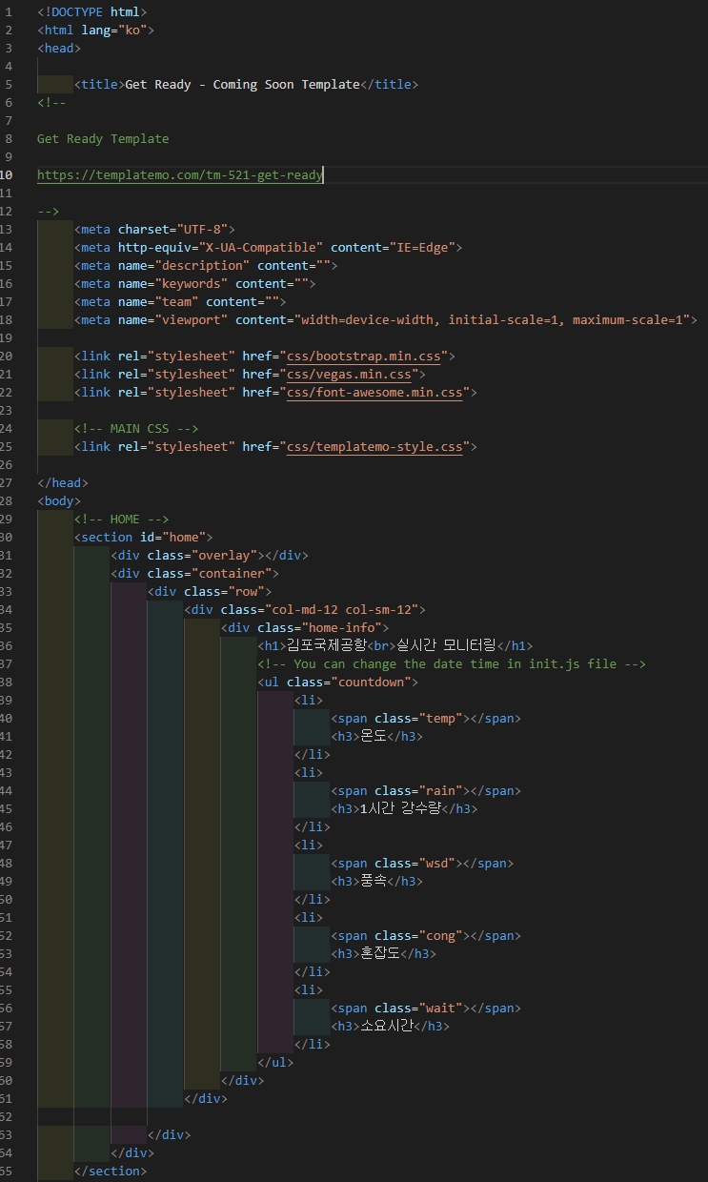
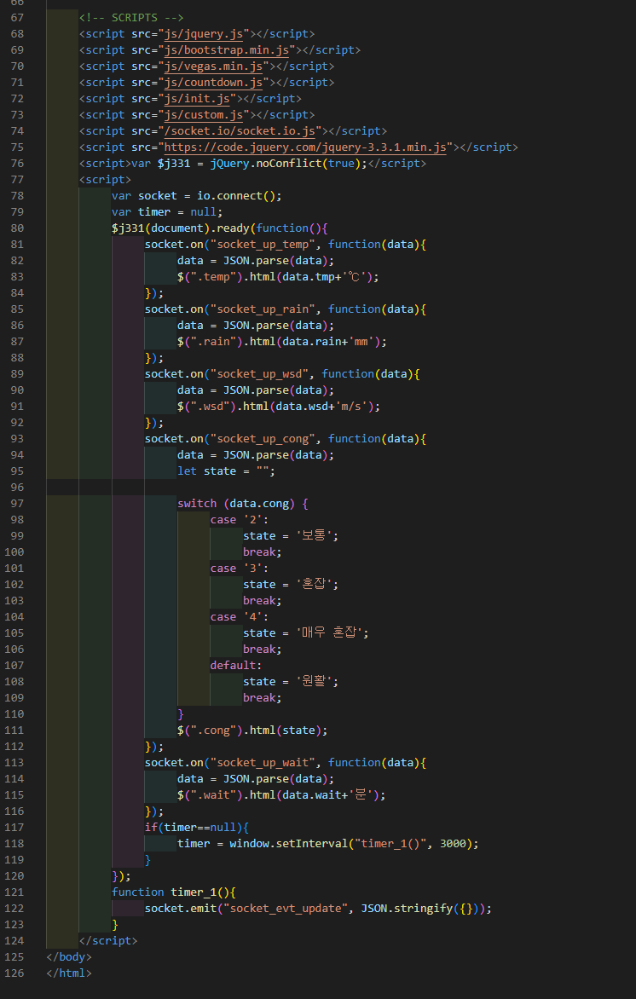
Monitoring.html
Notes:
<!DOCTYPE html>
<html lang="ko">
<head>
<title>Get Ready - Coming Soon Template</title>
<!--
Get Ready Template
https://templatemo.com/tm-521-get-ready
-->
<meta charset="UTF-8">
<meta http-equiv="X-UA-Compatible" content="IE=Edge">
<meta name="description" content="">
<meta name="keywords" content="">
<meta name="team" content="">
<meta name="viewport" content="width=device-width, initial-scale=1, maximum-scale=1">
<link rel="stylesheet" href="css/bootstrap.min.css">
<link rel="stylesheet" href="css/vegas.min.css">
<link rel="stylesheet" href="css/font-awesome.min.css">
<!-- MAIN CSS -->
<link rel="stylesheet" href="css/templatemo-style.css">
</head>
<body>
<!-- HOME -->
<section id="home">
<div class="overlay"></div>
<div class="container">
<div class="row">
<div class="col-md-12 col-sm-12">
<div class="home-info">
<h1>김포국제공항<br>실시간 모니터링</h1>
<!-- You can change the date time in init.js file -->
<ul class="countdown">
<li>
<span class="temp"></span>
<h3>온도</h3>
</li>
<li>
<span class="rain"></span>
<h3>1시간 강수량</h3>
</li>
<li>
<span class="wsd"></span>
<h3>풍속</h3>
</li>
<li>
<span class="cong"></span>
<h3>혼잡도</h3>
</li>
<li>
<span class="wait"></span>
<h3>소요시간</h3>
</li>
</ul>
</div>
</div>
</div>
</div>
</section>
<!-- SCRIPTS -->
<script src="js/jquery.js"></script>
<script src="js/bootstrap.min.js"></script>
<script src="js/vegas.min.js"></script>
<script src="js/countdown.js"></script>
<script src="js/init.js"></script>
<script src="js/custom.js"></script>
<script src="/socket.io/socket.io.js"></script>
<script src="https://code.jquery.com/jquery-3.3.1.min.js"></script>
<script>var $j331 = jQuery.noConflict(true);</script>
<script>
var socket = io.connect();
var timer = null;
$j331(document).ready(function(){
socket.on("socket_up_temp", function(data){
data = JSON.parse(data);
$(".temp").html(data.tmp+'℃');
});
socket.on("socket_up_rain", function(data){
data = JSON.parse(data);
$(".rain").html(data.rain+'mm');
});
socket.on("socket_up_wsd", function(data){
data = JSON.parse(data);
$(".wsd").html(data.wsd+'m/s');
});
socket.on("socket_up_cong", function(data){
data = JSON.parse(data);
let state = "";
switch (data.cong) {
case '2':
state = '보통';
break;
case '3':
state = '혼잡';
break;
case '4':
state = '매우 혼잡';
break;
default:
state = '원활';
break;
}
$(".cong").html(state);
});
socket.on("socket_up_wait", function(data){
data = JSON.parse(data);
$(".wait").html(data.wait+'분');
});
if(timer==null){
timer = window.setInterval("timer_1()", 3000);
}
});
function timer_1(){
socket.emit("socket_evt_update", JSON.stringify({}));
}
</script>
</body>
</html>

