Slide 1
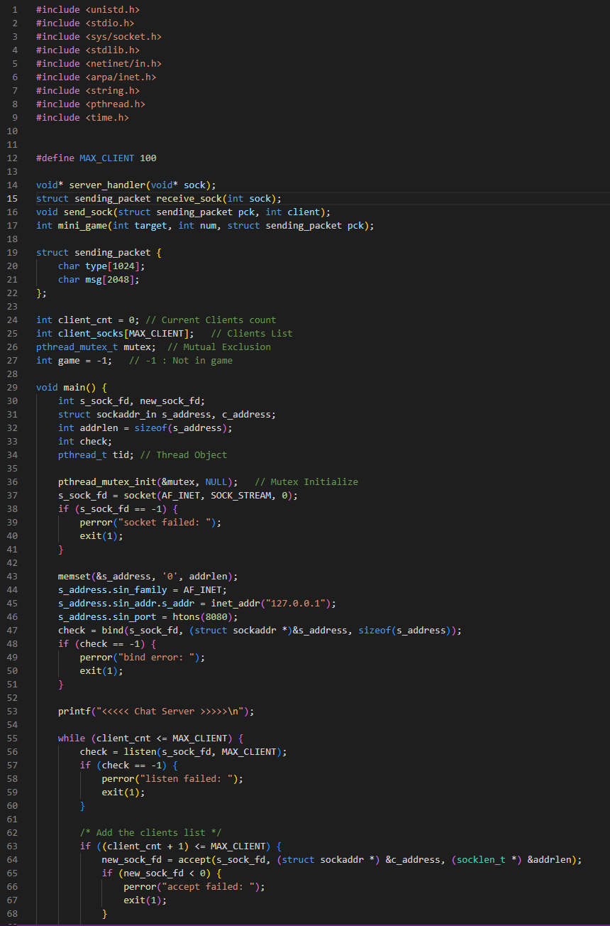
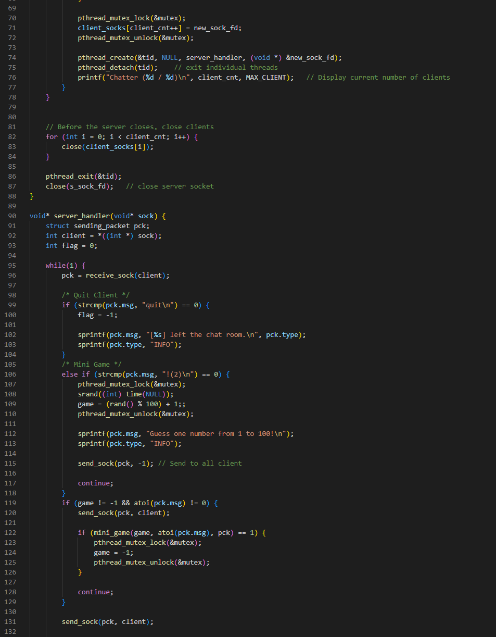
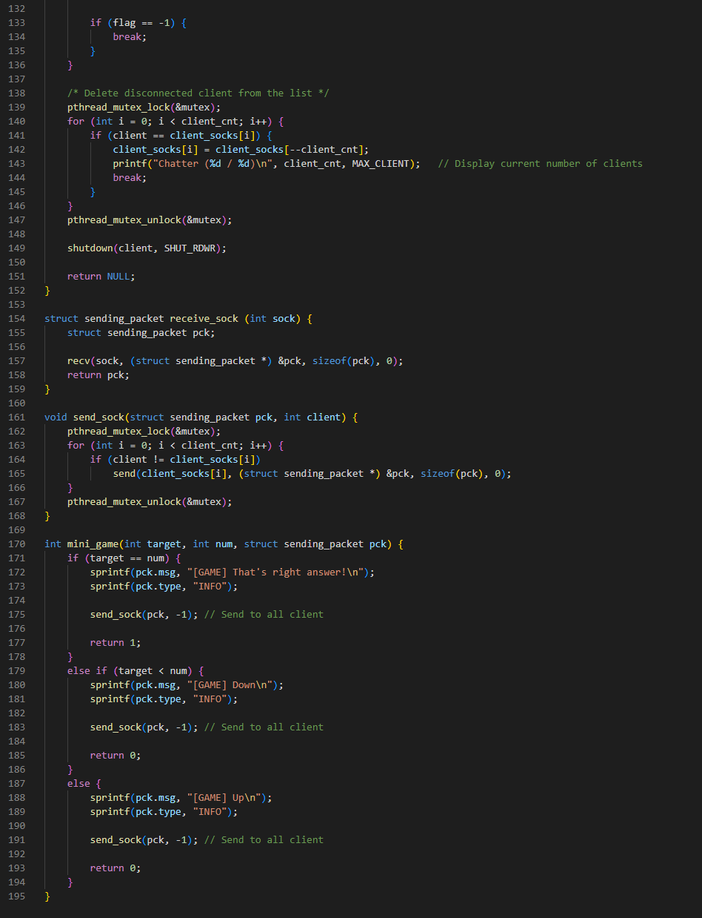
Server 소스 코드
Notes:
#include <unistd.h>
#include <stdio.h>
#include <sys/socket.h>
#include <stdlib.h>
#include <netinet/in.h>
#include <arpa/inet.h>
#include <string.h>
#include <pthread.h>
#include <time.h>
#define MAX_CLIENT 100
void* server_handler(void* sock);
struct sending_packet receive_sock(int sock);
void send_sock(struct sending_packet pck, int client);
int mini_game(int target, int num, struct sending_packet pck);
struct sending_packet {
char type[1024];
char msg[2048];
};
int client_cnt = 0; // Current Clients count
int client_socks[MAX_CLIENT]; // Clients List
pthread_mutex_t mutex; // Mutual Exclusion
int game = -1; // -1 : Not in game
void main() {
int s_sock_fd, new_sock_fd;
struct sockaddr_in s_address, c_address;
int addrlen = sizeof(s_address);
int check;
pthread_t tid; // Thread Object
pthread_mutex_init(&mutex, NULL); // Mutex Initialize
s_sock_fd = socket(AF_INET, SOCK_STREAM, 0);
if (s_sock_fd == -1) {
perror("socket failed: ");
exit(1);
}
memset(&s_address, '0', addrlen);
s_address.sin_family = AF_INET;
s_address.sin_addr.s_addr = inet_addr("127.0.0.1");
s_address.sin_port = htons(8080);
check = bind(s_sock_fd, (struct sockaddr *)&s_address, sizeof(s_address));
if (check == -1) {
perror("bind error: ");
exit(1);
}
printf("<<<<< Chat Server >>>>>\n");
while (client_cnt <= MAX_CLIENT) {
check = listen(s_sock_fd, MAX_CLIENT);
if (check == -1) {
perror("listen failed: ");
exit(1);
}
/* Add the clients list */
if ((client_cnt + 1) <= MAX_CLIENT) {
new_sock_fd = accept(s_sock_fd, (struct sockaddr *) &c_address, (socklen_t *) &addrlen);
if (new_sock_fd < 0) {
perror("accept failed: ");
exit(1);
}
pthread_mutex_lock(&mutex);
client_socks[client_cnt++] = new_sock_fd;
pthread_mutex_unlock(&mutex);
pthread_create(&tid, NULL, server_handler, (void *) &new_sock_fd);
pthread_detach(tid); // exit individual threads
printf("Chatter (%d / %d)\n", client_cnt, MAX_CLIENT); // Display current number of clients
}
}
// Before the server closes, close clients
for (int i = 0; i < client_cnt; i++) {
close(client_socks[i]);
}
pthread_exit(&tid);
close(s_sock_fd); // close server socket
}
void* server_handler(void* sock) {
struct sending_packet pck;
int client = *((int *) sock);
int flag = 0;
while(1) {
pck = receive_sock(client);
/* Quit Client */
if (strcmp(pck.msg, "quit\n") == 0) {
flag = -1;
sprintf(pck.msg, "[%s] left the chat room.\n", pck.type);
sprintf(pck.type, "INFO");
}
/* Mini Game */
else if (strcmp(pck.msg, "!(2)\n") == 0) {
pthread_mutex_lock(&mutex);
srand((int) time(NULL));
game = (rand() % 100) + 1;;
pthread_mutex_unlock(&mutex);
sprintf(pck.msg, "Guess one number from 1 to 100!\n");
sprintf(pck.type, "INFO");
send_sock(pck, -1); // Send to all client
continue;
}
if (game != -1 && atoi(pck.msg) != 0) {
send_sock(pck, client);
if (mini_game(game, atoi(pck.msg), pck) == 1) {
pthread_mutex_lock(&mutex);
game = -1;
pthread_mutex_unlock(&mutex);
}
continue;
}
send_sock(pck, client);
if (flag == -1) {
break;
}
}
/* Delete disconnected client from the list */
pthread_mutex_lock(&mutex);
for (int i = 0; i < client_cnt; i++) {
if (client == client_socks[i]) {
client_socks[i] = client_socks[--client_cnt];
printf("Chatter (%d / %d)\n", client_cnt, MAX_CLIENT); // Display current number of clients
break;
}
}
pthread_mutex_unlock(&mutex);
shutdown(client, SHUT_RDWR);
return NULL;
}
struct sending_packet receive_sock (int sock) {
struct sending_packet pck;
recv(sock, (struct sending_packet *) &pck, sizeof(pck), 0);
return pck;
}
void send_sock(struct sending_packet pck, int client) {
pthread_mutex_lock(&mutex);
for (int i = 0; i < client_cnt; i++) {
if (client != client_socks[i])
send(client_socks[i], (struct sending_packet *) &pck, sizeof(pck), 0);
}
pthread_mutex_unlock(&mutex);
}
int mini_game(int target, int num, struct sending_packet pck) {
if (target == num) {
sprintf(pck.msg, "[GAME] That's right answer!\n");
sprintf(pck.type, "INFO");
send_sock(pck, -1); // Send to all client
return 1;
}
else if (target < num) {
sprintf(pck.msg, "[GAME] Down\n");
sprintf(pck.type, "INFO");
send_sock(pck, -1); // Send to all client
return 0;
}
else {
sprintf(pck.msg, "[GAME] Up\n");
sprintf(pck.type, "INFO");
send_sock(pck, -1); // Send to all client
return 0;
}
}

Slide 2
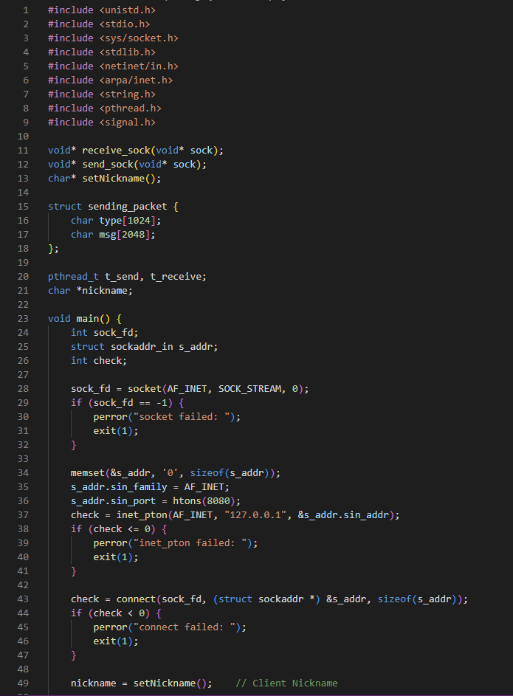
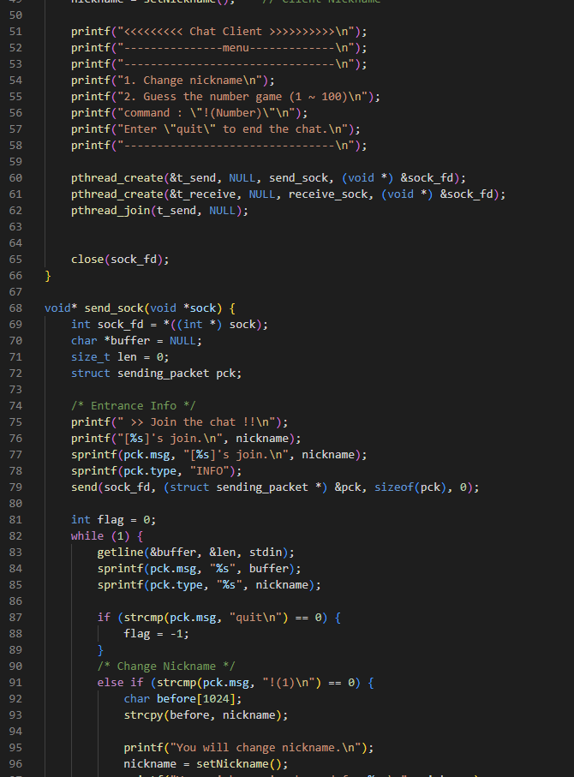
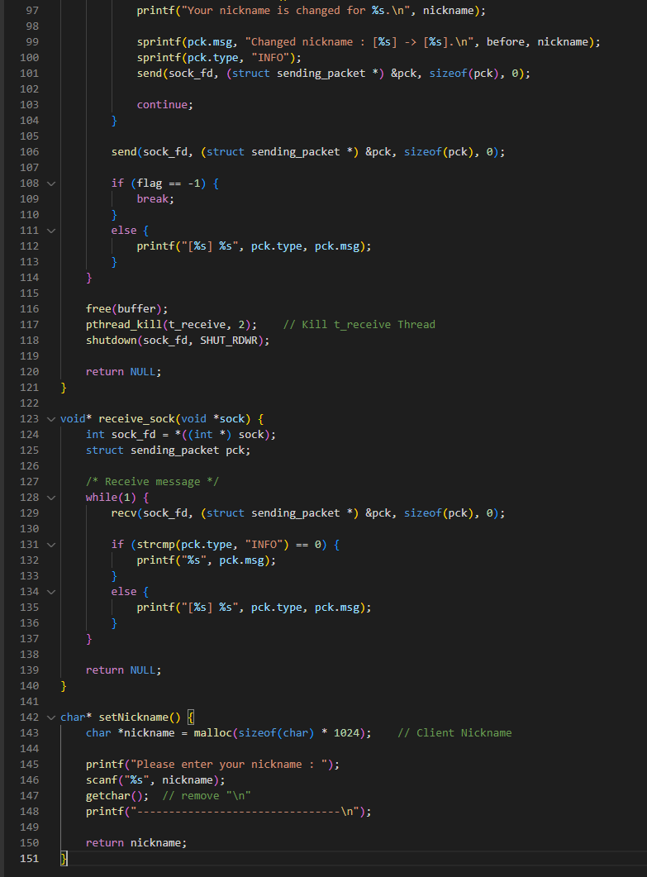
Client 소스 코드
Notes:
#include <unistd.h>
#include <stdio.h>
#include <sys/socket.h>
#include <stdlib.h>
#include <netinet/in.h>
#include <arpa/inet.h>
#include <string.h>
#include <pthread.h>
#include <signal.h>
void* receive_sock(void* sock);
void* send_sock(void* sock);
char* setNickname();
struct sending_packet {
char type[1024];
char msg[2048];
};
pthread_t t_send, t_receive;
char *nickname;
void main() {
int sock_fd;
struct sockaddr_in s_addr;
int check;
sock_fd = socket(AF_INET, SOCK_STREAM, 0);
if (sock_fd == -1) {
perror("socket failed: ");
exit(1);
}
memset(&s_addr, '0', sizeof(s_addr));
s_addr.sin_family = AF_INET;
s_addr.sin_port = htons(8080);
check = inet_pton(AF_INET, "127.0.0.1", &s_addr.sin_addr);
if (check <= 0) {
perror("inet_pton failed: ");
exit(1);
}
check = connect(sock_fd, (struct sockaddr *) &s_addr, sizeof(s_addr));
if (check < 0) {
perror("connect failed: ");
exit(1);
}
nickname = setNickname(); // Client Nickname
printf("<<<<<<<<< Chat Client >>>>>>>>>>\n");
printf("---------------menu-------------\n");
printf("--------------------------------\n");
printf("1. Change nickname\n");
printf("2. Guess the number game (1 ~ 100)\n");
printf("command : \"!(Number)\"\n");
printf("Enter \"quit\" to end the chat.\n");
printf("--------------------------------\n");
pthread_create(&t_send, NULL, send_sock, (void *) &sock_fd);
pthread_create(&t_receive, NULL, receive_sock, (void *) &sock_fd);
pthread_join(t_send, NULL);
close(sock_fd);
}
void* send_sock(void *sock) {
int sock_fd = *((int *) sock);
char *buffer = NULL;
size_t len = 0;
struct sending_packet pck;
/* Entrance Info */
printf(" >> Join the chat !!\n");
printf("[%s]'s join.\n", nickname);
sprintf(pck.msg, "[%s]'s join.\n", nickname);
sprintf(pck.type, "INFO");
send(sock_fd, (struct sending_packet *) &pck, sizeof(pck), 0);
int flag = 0;
while (1) {
getline(&buffer, &len, stdin);
sprintf(pck.msg, "%s", buffer);
sprintf(pck.type, "%s", nickname);
if (strcmp(pck.msg, "quit\n") == 0) {
flag = -1;
}
/* Change Nickname */
else if (strcmp(pck.msg, "!(1)\n") == 0) {
char before[1024];
strcpy(before, nickname);
printf("You will change nickname.\n");
nickname = setNickname();
printf("Your nickname is changed for %s.\n", nickname);
sprintf(pck.msg, "Changed nickname : [%s] -> [%s].\n", before, nickname);
sprintf(pck.type, "INFO");
send(sock_fd, (struct sending_packet *) &pck, sizeof(pck), 0);
continue;
}
send(sock_fd, (struct sending_packet *) &pck, sizeof(pck), 0);
if (flag == -1) {
break;
}
else {
printf("[%s] %s", pck.type, pck.msg);
}
}
free(buffer);
pthread_kill(t_receive, 2); // Kill t_receive Thread
shutdown(sock_fd, SHUT_RDWR);
return NULL;
}
void* receive_sock(void *sock) {
int sock_fd = *((int *) sock);
struct sending_packet pck;
/* Receive message */
while(1) {
recv(sock_fd, (struct sending_packet *) &pck, sizeof(pck), 0);
if (strcmp(pck.type, "INFO") == 0) {
printf("%s", pck.msg);
}
else {
printf("[%s] %s", pck.type, pck.msg);
}
}
return NULL;
}
char* setNickname() {
char *nickname = malloc(sizeof(char) * 1024); // Client Nickname
printf("Please enter your nickname : ");
scanf("%s", nickname);
getchar(); // remove "\n"
printf("--------------------------------\n");
return nickname;
}

