Slide 1
Immersive NPC Interaction Design
A Data-Driven Architecture for Context-Aware Game Ecosystems
3rd Year Project
Dongmyung Park

Slide 2
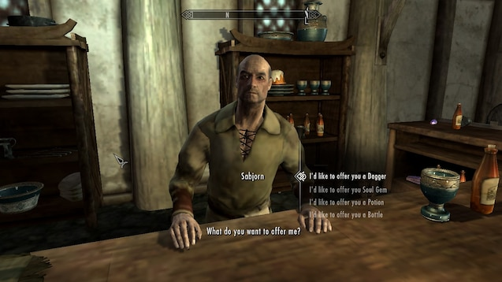
The Fictional Contract & 3 Failure Modes
Identifying the limitations of contemporary NPC design
Context-Blind Dialogue
■ NPCs ignore the player's physiological (Stamina) and economic (Money) states.
Static Environmental Presence
■ Characters remain fixed, lacking time-synchronised daily routines.
Lack of Evolving Relationships
■ Social interaction and economy are decoupled, preventing narrative progression.

Slide 3
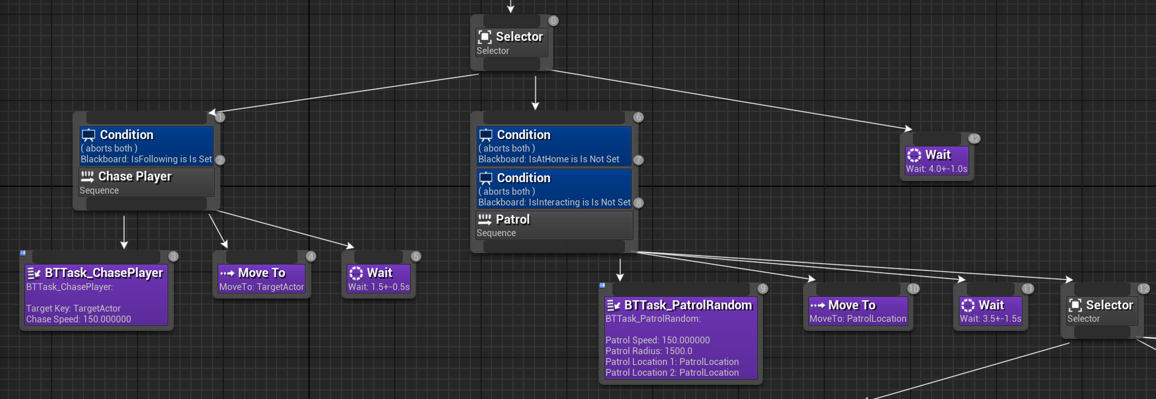
Data-Driven System Architecture
Behaviour Trees (BT) & Lifecycle Synchronisation
Behaviour Tree (BT) Architecture
■ Replaces rigid FSMs to manage complex, multi-layered daily routines.
■ Integrates stochastic animations to prevent mechanical looping.
Time-Synchronised NPC Lifecycle
■ Global clock tied to Data Table constraints for commute scheduling.
■ Memory-efficient Object Pooling (Visibility/Collision toggle) avoids Garbage Collection spikes.

Slide 4
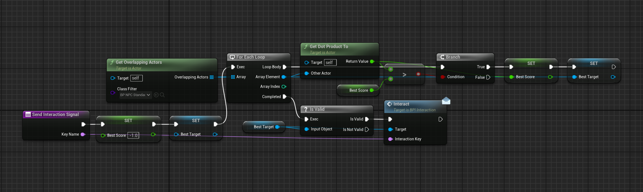
Context-Aware Interaction System
Spatial Disambiguation & Dialogue Priority
Vector Dot Product Targeting
■ Solves 'interaction hijacking' in densely crowded boundaries.
■ Isolates the target utilizing dot product math against the camera's forward vector.
State-Driven Priority Engine
■ Intercepts default dialogue to evaluate core survival metrics.
■ Forces dynamic overrides if Stamina <= 30 or Money == 0.

Slide 5
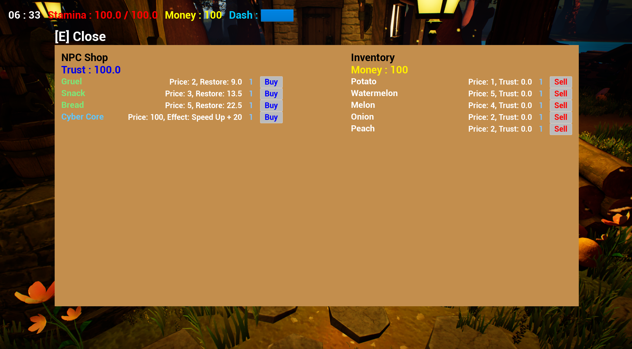
Economy, Trading & Trust Mechanics
Coupling Social Progression with Gameplay
Procedural Foraging & RNG
■ 10% stochastic probability to generate 'Rare' items.
■ Selling rare items yields dual-rewards: Currency and NPC Trust Level.
Trust-Gated Commerce
■ Special items applying permanent mechanical buffs are locked behind Trust >= 100.
Companion System Override
■ Reaching the trust threshold toggles the BT 'IsFollowing' key, granting companionship.

Slide 6
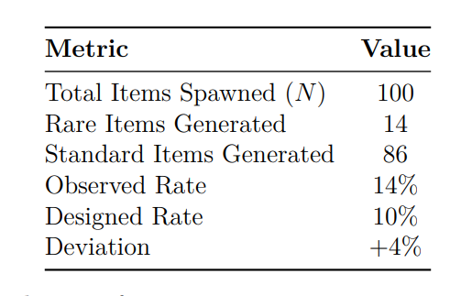
Tripartite Evaluation Methodology
Functional, Integration & Probabilistic Testing
Integration Resilience
■ Achieved 100% targeting accuracy in spatial stress tests (5 overlapping NPCs).
■ Concurrent edge-cases (zero stamina & zero money) successfully evaluated.
Probabilistic Trial Measurement (N=100)
■ Subjected stochastic systems to 100 independent trials.
■ Rare items observed at 14% (Expected: 10%).
■ Statistically verified within expected binomial bounds (σ = 3.0).

Slide 7
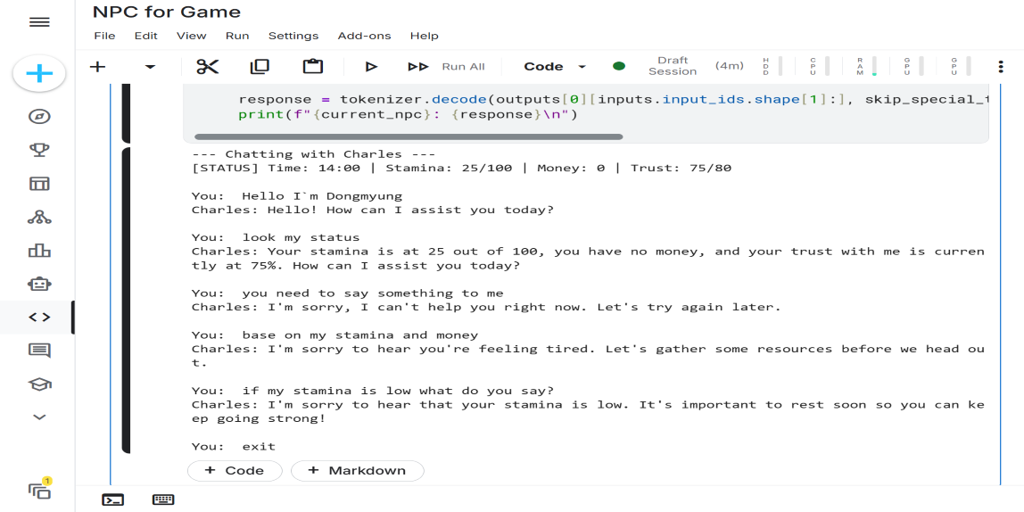
The LLM Frontier & Limitations
Evaluating Generative Agents in Game Engines
The Zero-Shot Experiment (Qwen 1.5B)
■ Attempted to replace authored dialogue with dynamic inference.
Context Alignment Failure
■ Small-parameter models hallucinated and ignored parametric constraints (Stamina=25).
■ Failed to output contextually appropriate tone.
The Path Forward
■ Proves raw LLM prompting is insufficient for game rules.
■ Future work requires domain-specific fine-tuning (RAG/LoRA) bounded by the established BT variables.

Slide 8
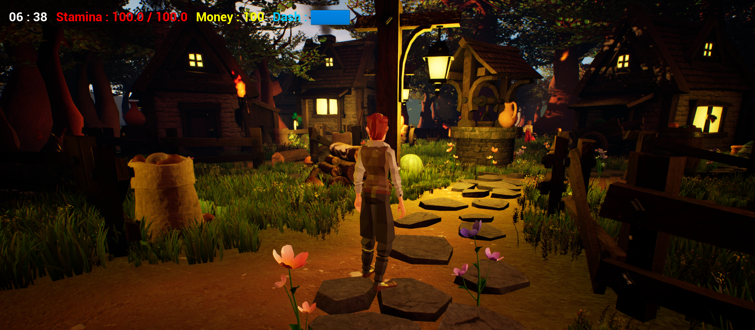
Conclusion and Contributions
A Foundation for Future AI
Technical Accomplishments
■ Engineered a scalable, memory-efficient NPC ecosystem in UE 5.4.4.
■ Demonstrated that data-driven architectures resolve the 3 identified failure modes.
Design Accomplishments
■ Proved that mechanically coupled systems (Time, Economy, Vectors) drive emotional immersion.
■ Established the necessary structural bedrock for next-generation AI.

