Slide 1
Lab 0
User Management

Slide 2
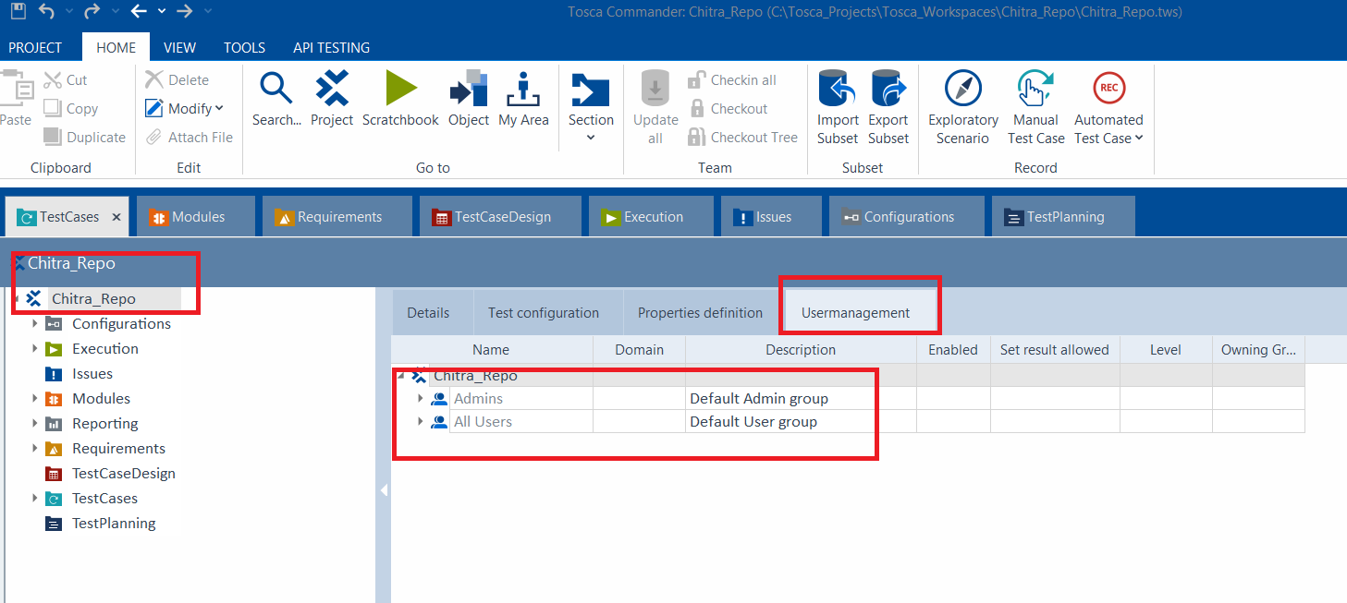
Create a New User

Slide 3
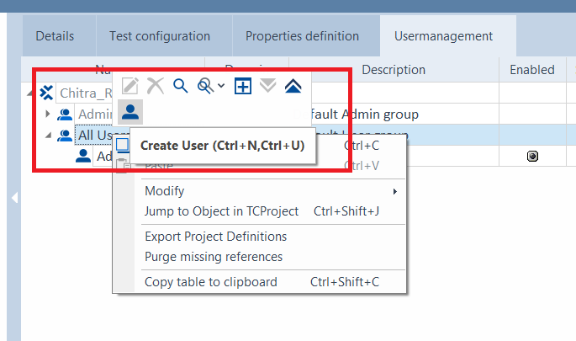
Create a New User
All Users → Right click and select → Create User

Slide 4
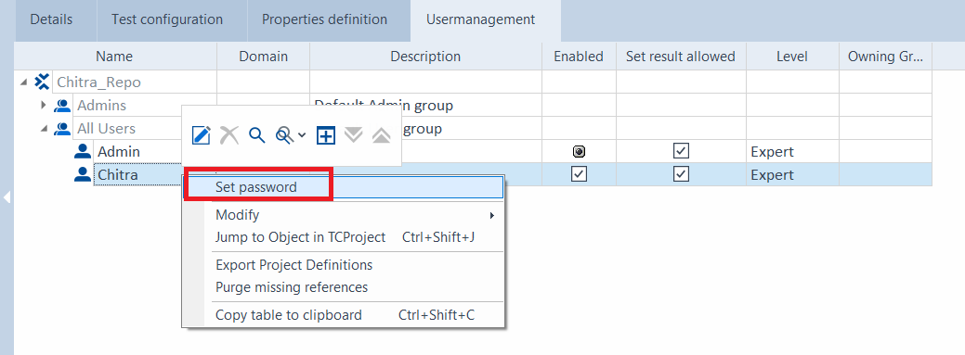
Create a New User
Enter a new user name. Enter.
Right click and select → Set password

Slide 5
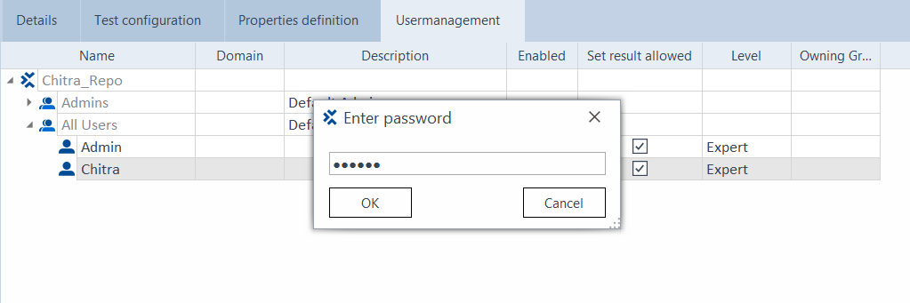
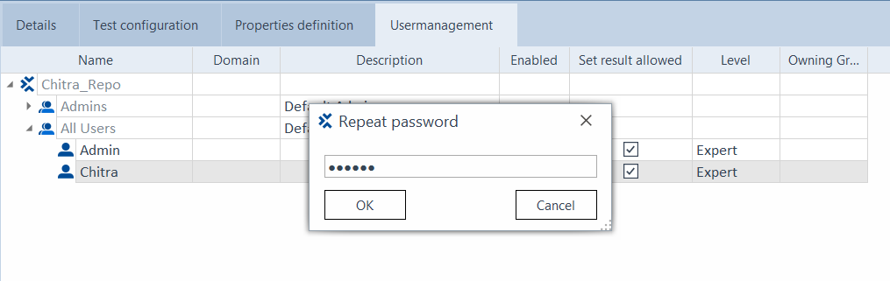
Set password for the New User
Enter the password twice.

Slide 6
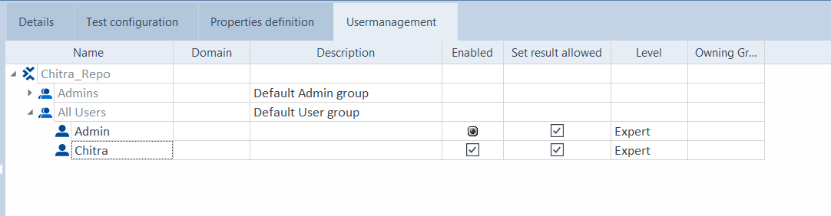
Set password for the New User
View User.

Slide 7
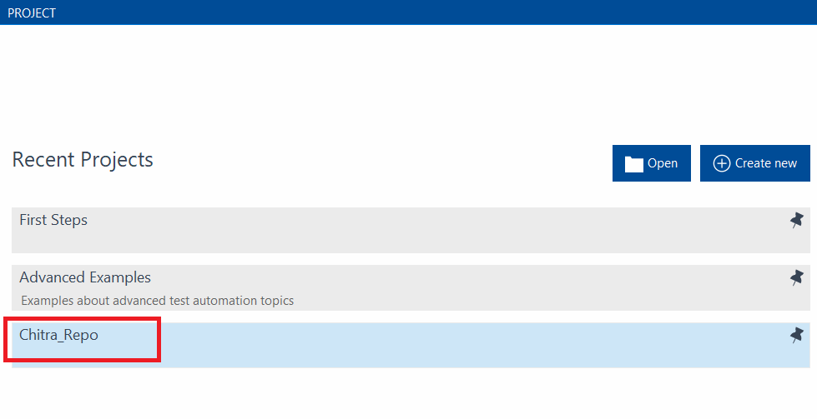
Login as the New User
Close Project. Save all changes.
Launch TOSCA Commander again. Click on the Project.

Slide 8
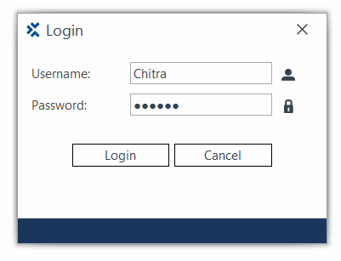
Login as the New User
Enter the new user credentials. Click on Login.

Slide 9
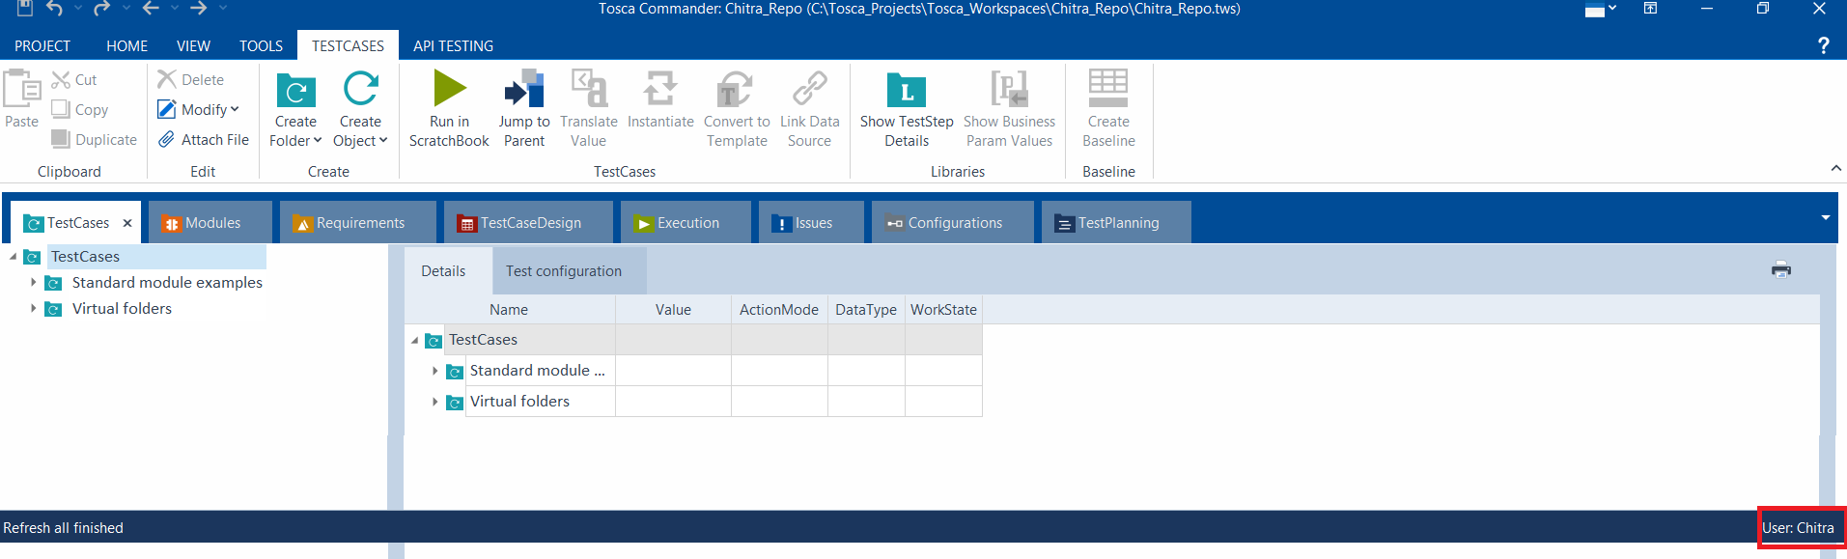
Login as the New User
Observe the new User at the bottom of the screen.

Slide 10
Thank You

