Slide 1
Lab 3
ActionModes

Slide 2
Buffer

Slide 3
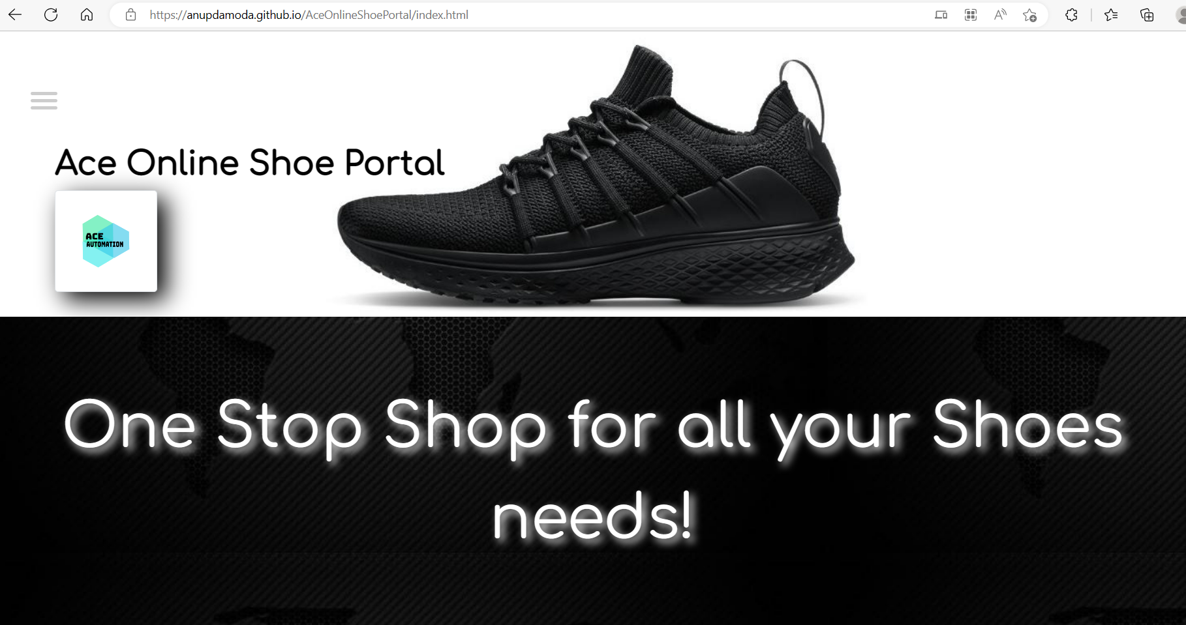
Application Under Test
Ace Online Shoe Portal (anupdamoda.github.io)

Slide 4
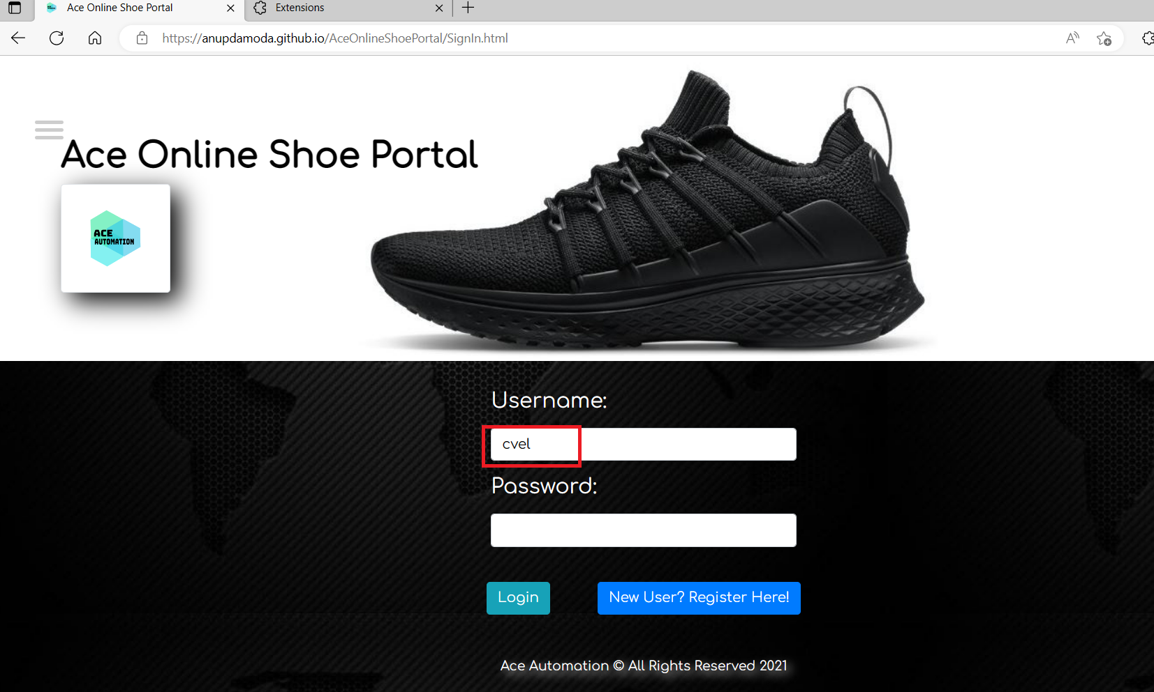
Login Page – To capture the username in buffer

Slide 5
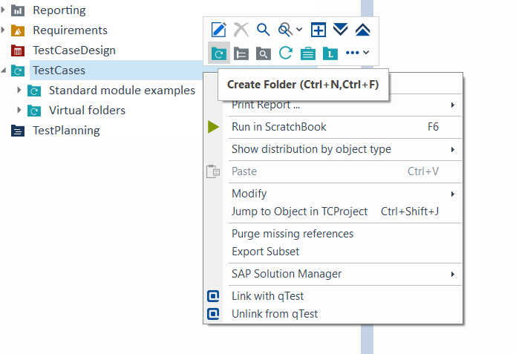
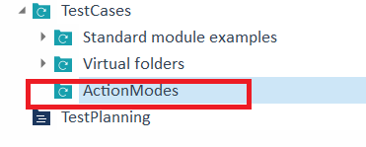
Create TestCase Folder - ActionModes

Slide 6
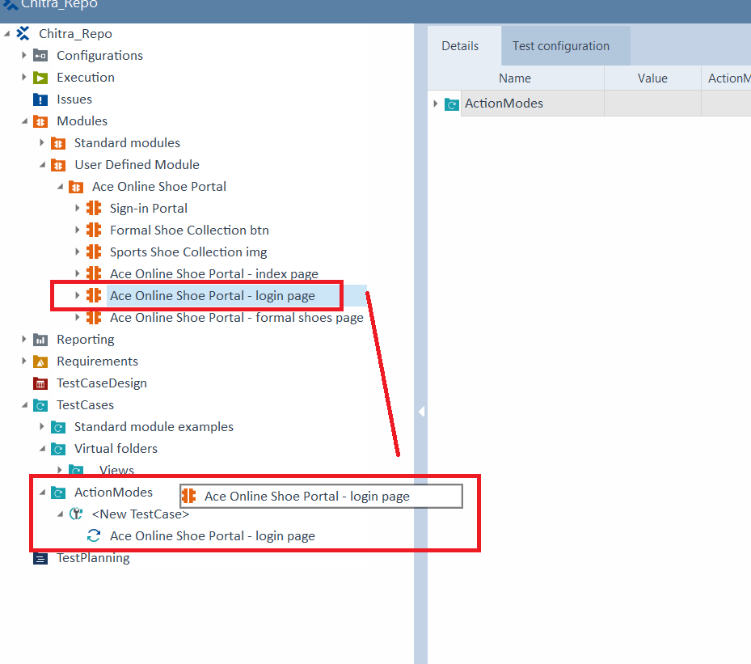
Move Login Module to ActionModes TestCase
Drag and drop the Login Module
into the TestCase - ActionModes Folder.
It is now a TestCase.

Slide 7
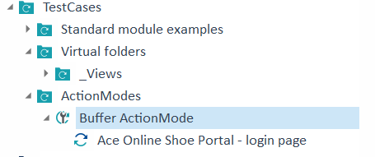
Rename TestCase

Slide 8
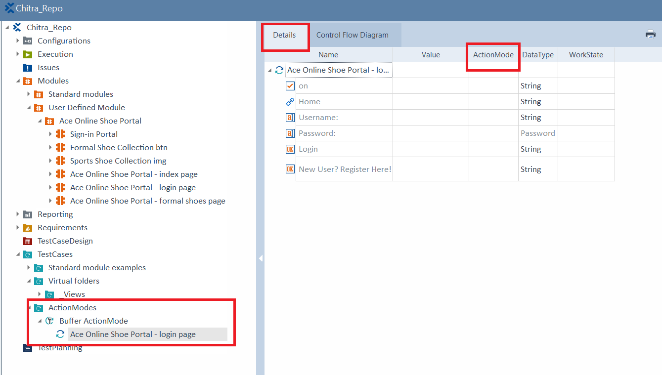
View the Details of TestCase
Observe ActionMode column is empty.

Slide 9
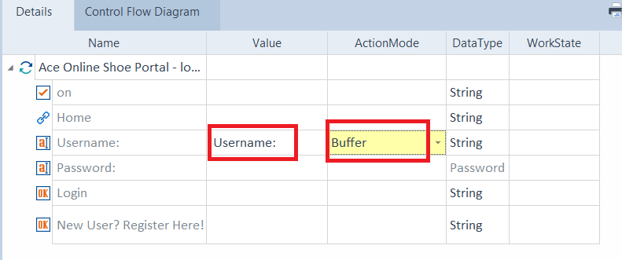
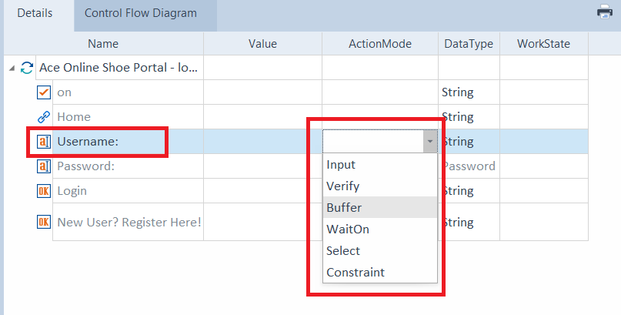
ActionModes of Username
Click on the Username ActionMode. Observe the dropdown. Select Buffer.
The username variable is “username”.

Slide 10
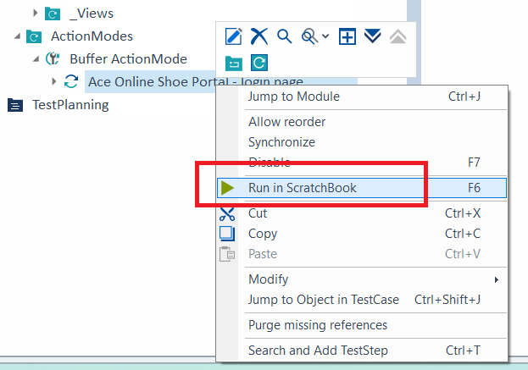

Run the TestCase
The username variable is “username”.

Slide 11
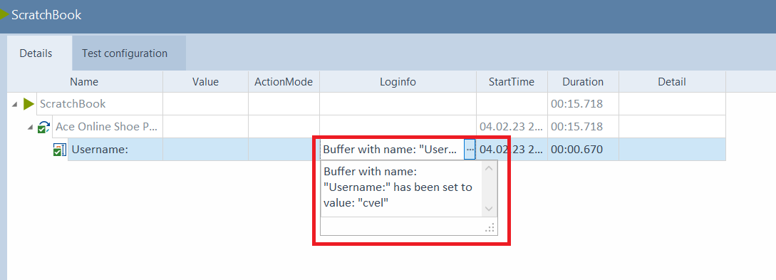
Run the TestCase
The TestExecution was green i.e. Success.
Observe the Username buffer variable is now “cvel”

Slide 12
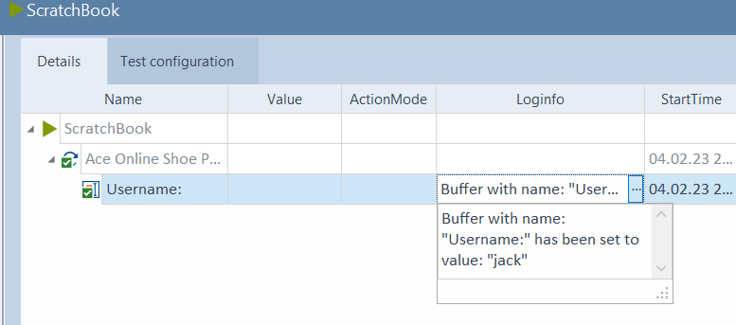
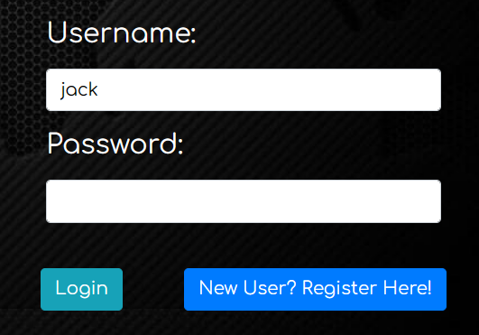
Re-Run the TestCase
Change the Username to “Jack”.
Observe the Username buffer variable is now “Jack”

Slide 13
Select

Slide 14
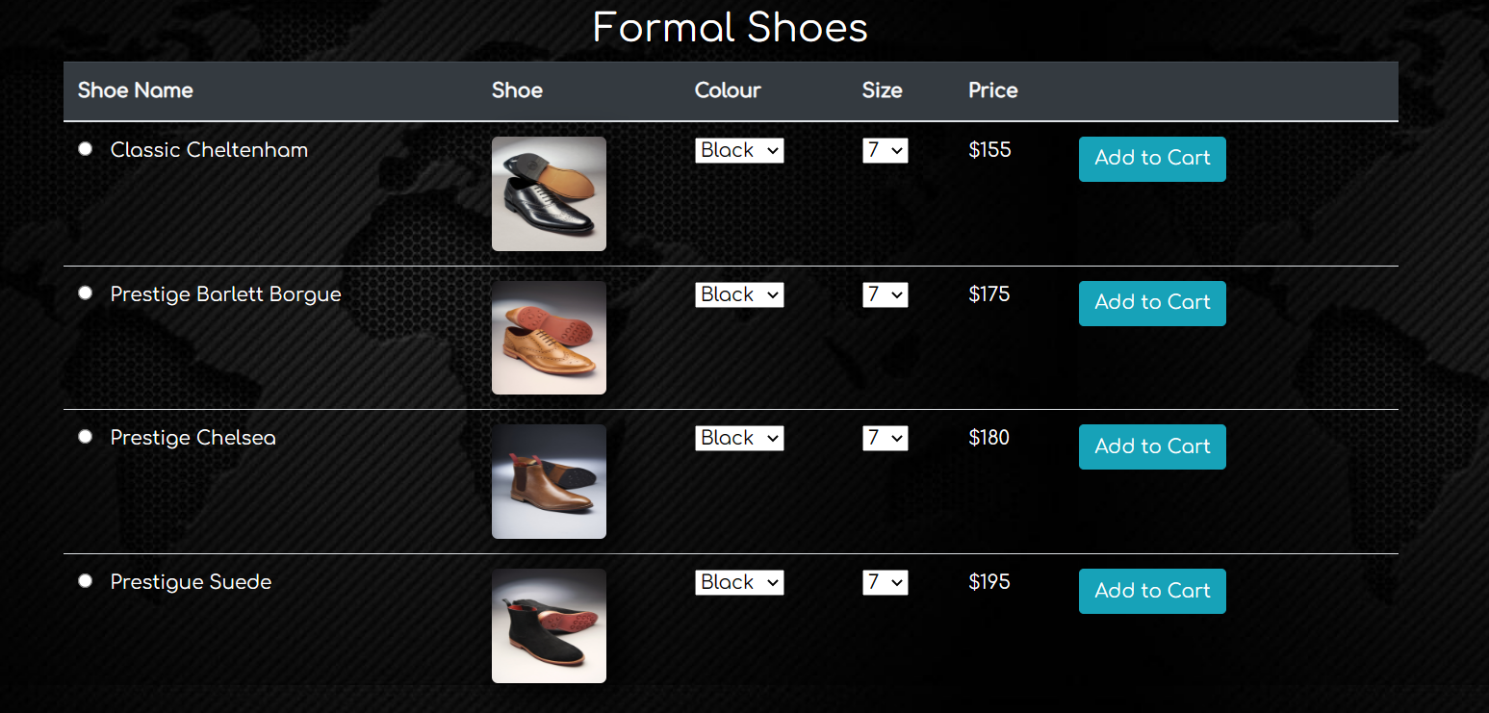
Formal Shoes Page - Select is used to denote a parent object.

Slide 15
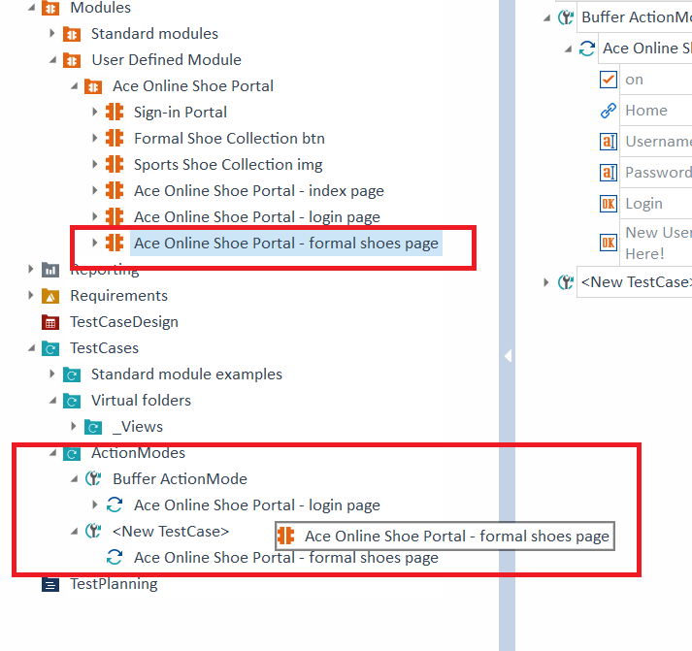
Move “Formal Shoes Module” to ActionMode TestCase
Drag and drop the Formal Shoes Module
into the TestCase – ActionModes Folder.
It is now a TestCase.

Slide 16
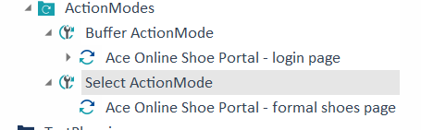
Rename TestCase

Slide 17
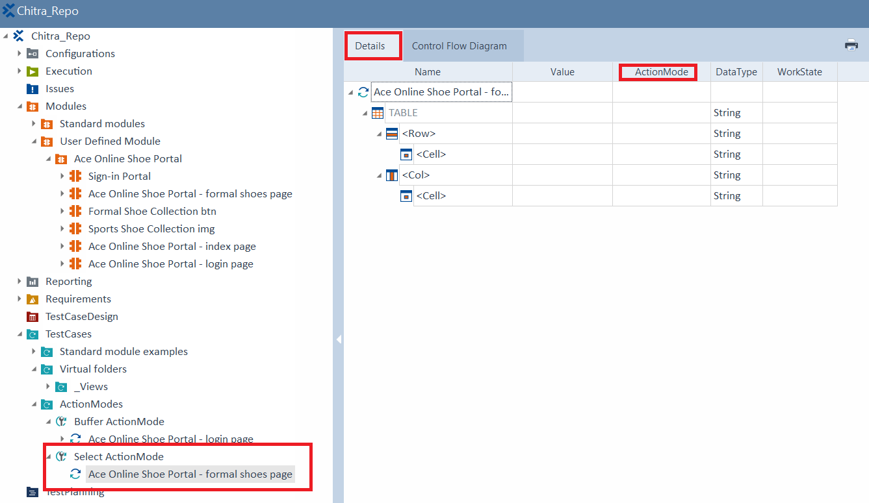
View the Details of TestCase
Observe ActionMode column is empty.

Slide 18
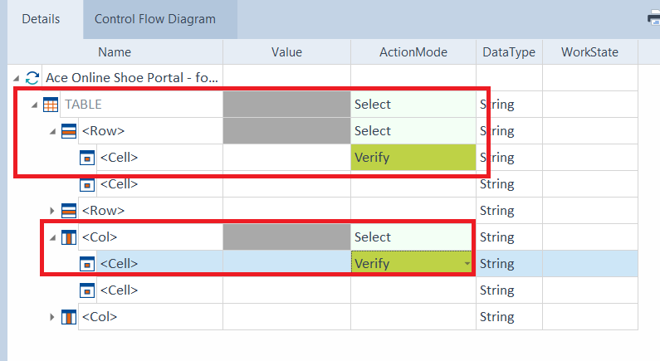
ActionModes of Table
Click on the Table ActionMode. Observe the dropdown. Select “Select” for Table, Row and Col.
Select “Verify” for Row and Col Cell.
Note: Extra Row and Col is created. Its not needed. CrtlZ works.

Slide 19
Verify

Slide 20
Formal Shoes Page – Verify the first row of table

Slide 21
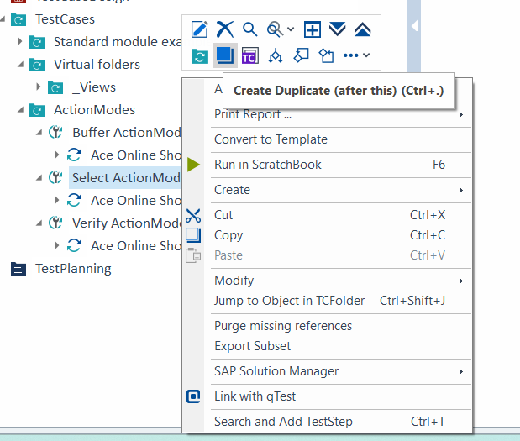
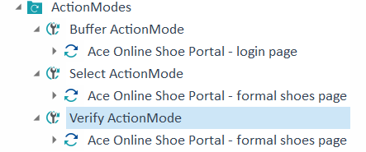
Duplicate Select ActionMode and Rename to Verify ActionMode

Slide 22
View the Details of TestCase

Slide 23

Test the values in the first row of Table

Slide 24
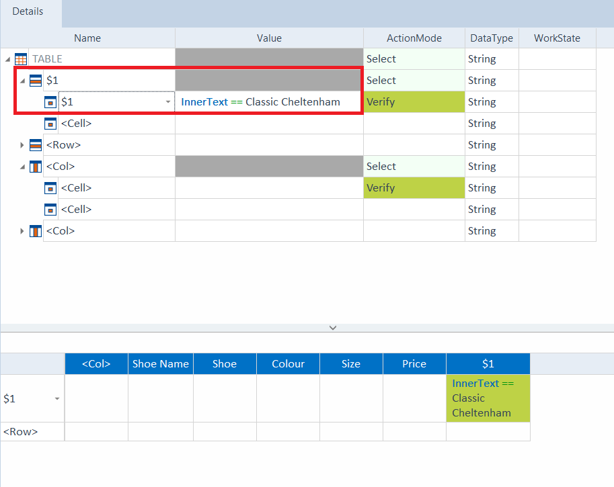
Enter $1 for Row and Cell. It is the first coordinate of the row.
Choose the InnerText for Value and type in “Classic Cheltenham”

Slide 25
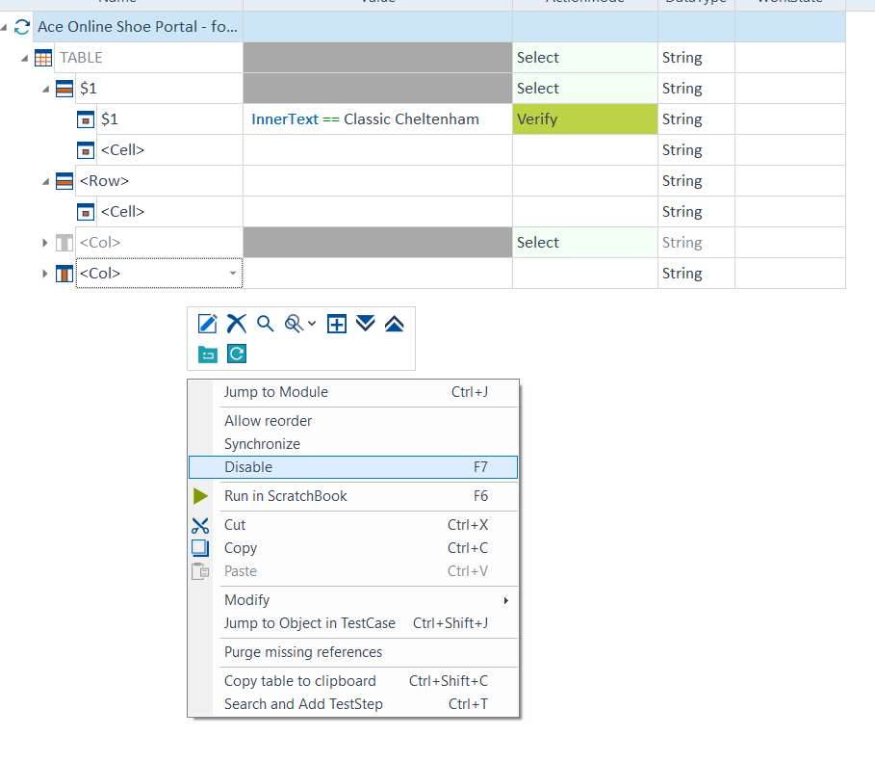
Disable the Col.

Slide 26
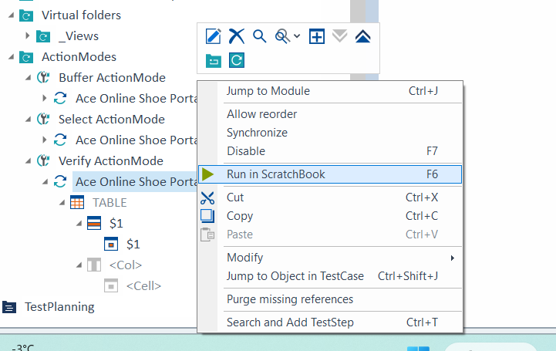
Run the TestCase

Slide 27
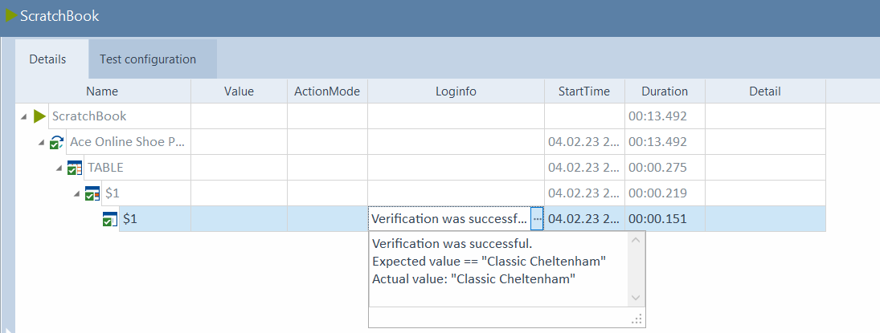
Run the TestCase

Slide 28
Input

Slide 29
Index Page - Input

Slide 30
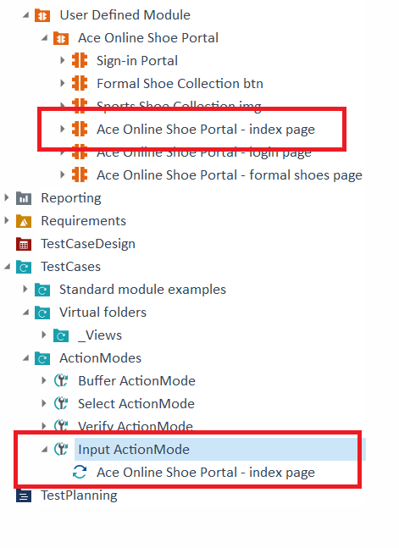
Create Input ActionMode TestCase and Rename

Slide 31
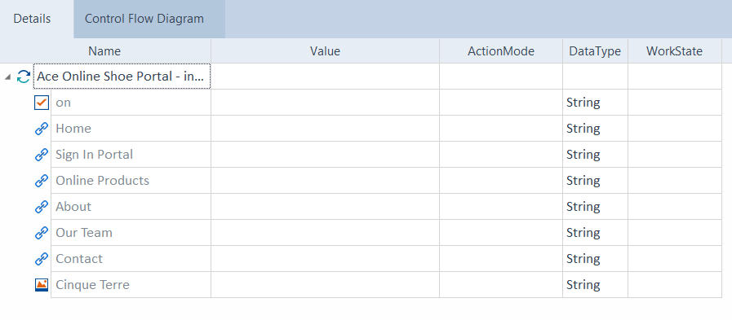
View the Details of TestCase

Slide 32
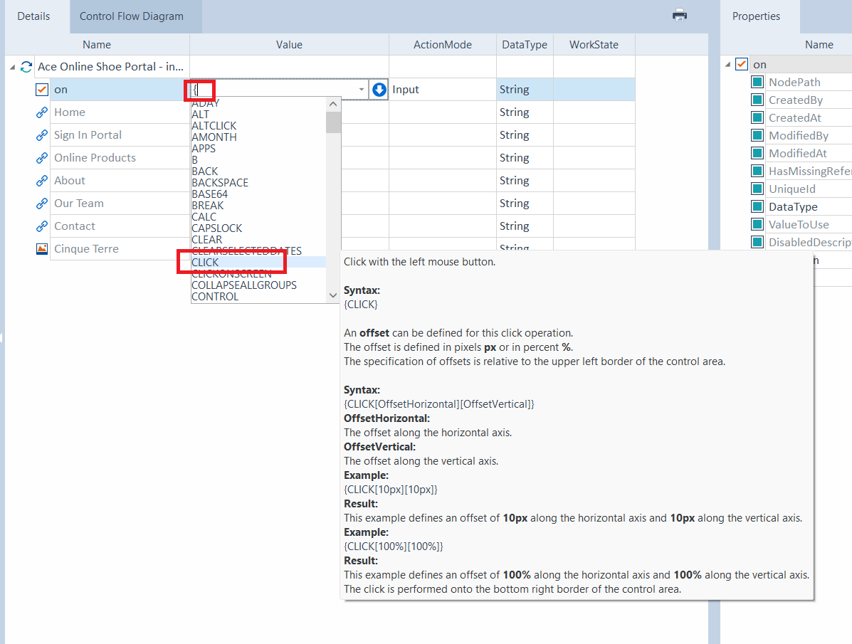
The Input ActionMode is {CLICK}

Slide 33
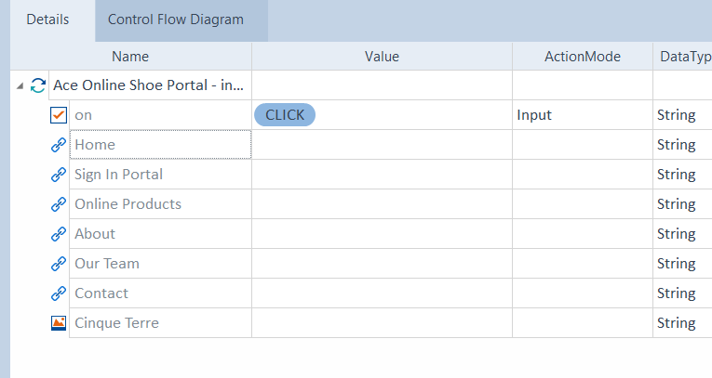

Slide 34
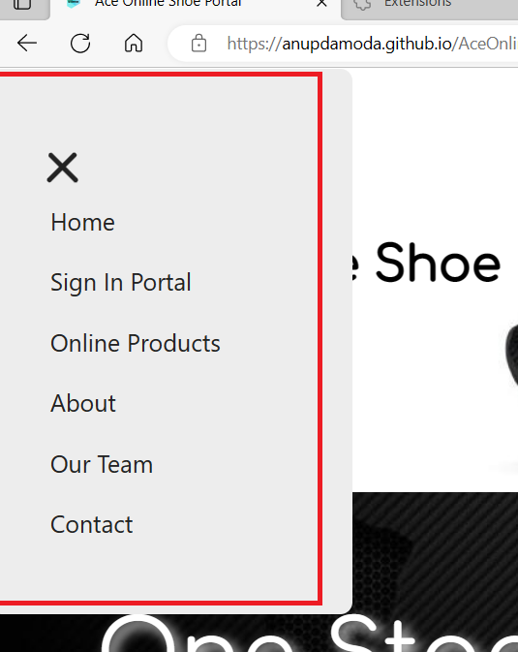
Test if the Menu widget is displayed

Slide 35
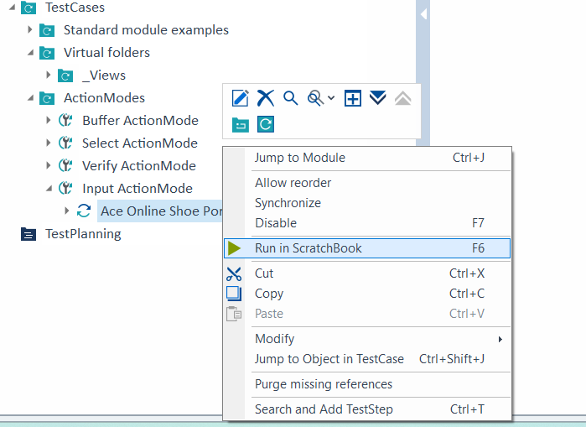
Run the TestCase

Slide 36
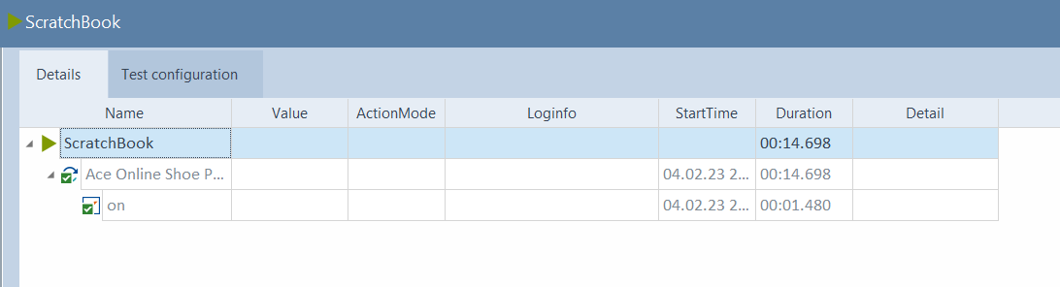
Run the TestCase

Slide 37
WaitOn

Slide 38
Index Page - WaitOn

Slide 39
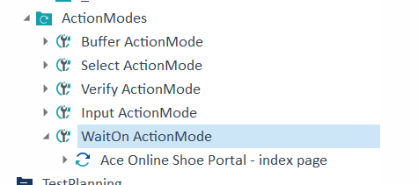
Copy and Paste Input ActionMode TestCase and Rename

Slide 40
View the Details of TestCase

Slide 41
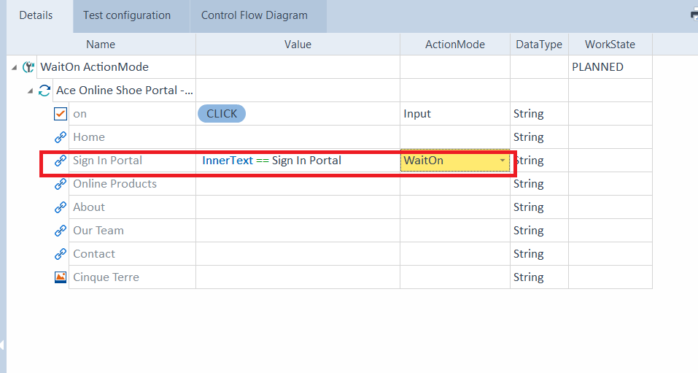
The WaitOn ActionMode for Sign in Portal

Slide 42
Test if TOSCA waits for Sign In Portal to appear

Slide 43
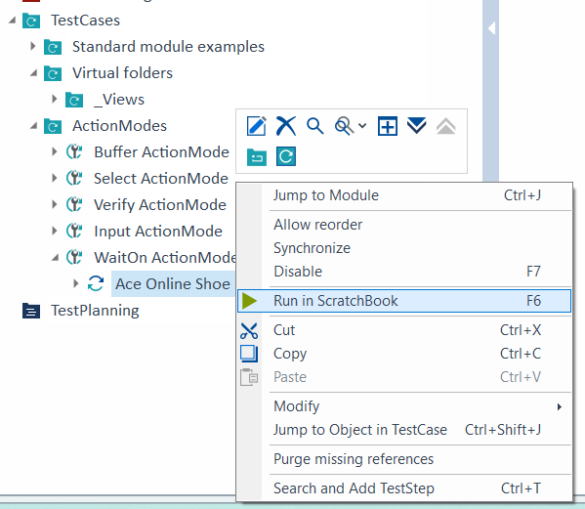
Run the TestCase

Slide 44
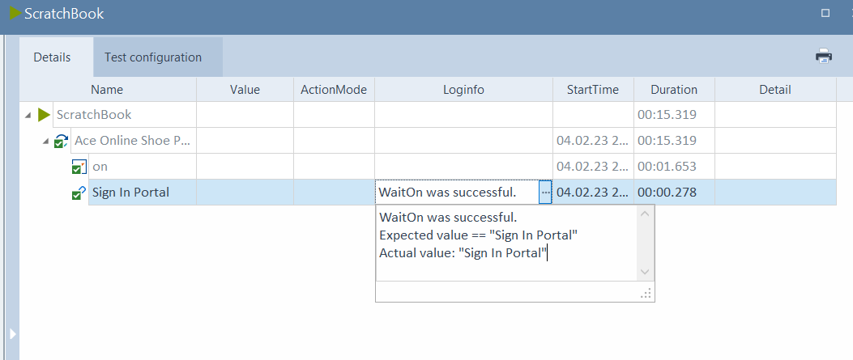
Run the TestCase

