Slide 1
Lab 4
Test Configuration Parameter

Slide 2
TCP

Slide 3
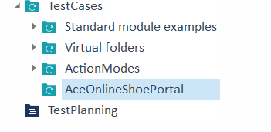
Create a TestCase Folder

Slide 4
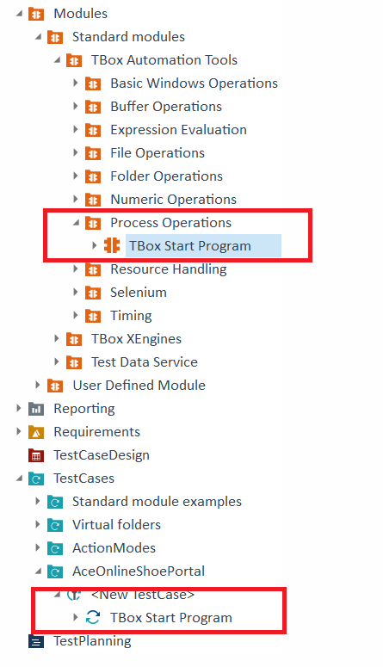

Tbox Start Program
Drag and Drop the Tbox Start Program into the
AceOnlineShoePortal TestCase folder.
Rename the TestCase.

Slide 5
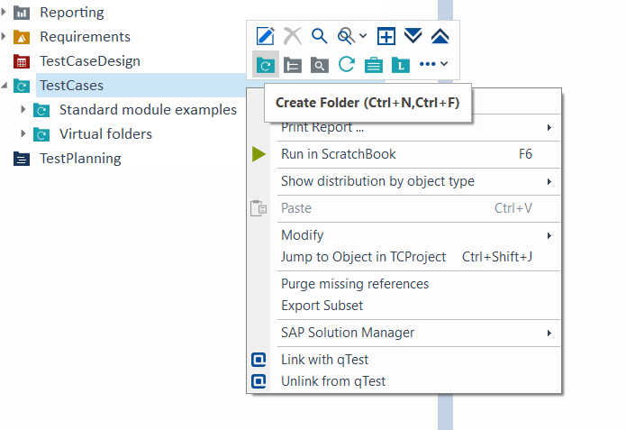
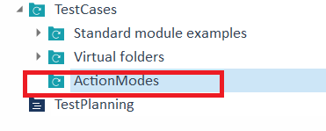
Create TestCase Folder - ActionModes

Slide 6
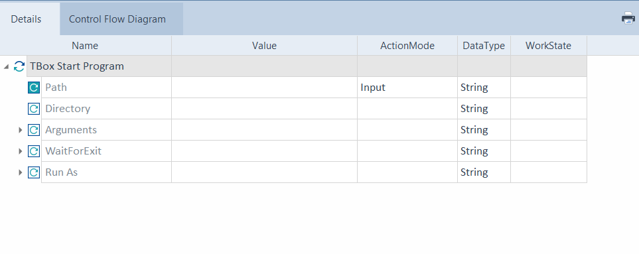
View the Details of TestCase
This Standard Module will run any .exe based on the path that is provided so our application be opened.

Slide 7
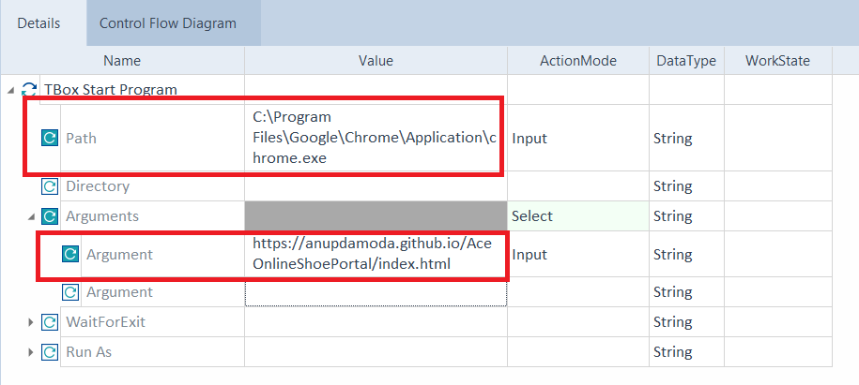
Add the Details of TestCase - Chrome
Path == location of the chrome.exe
Argument == application index.html ie URL

Slide 8
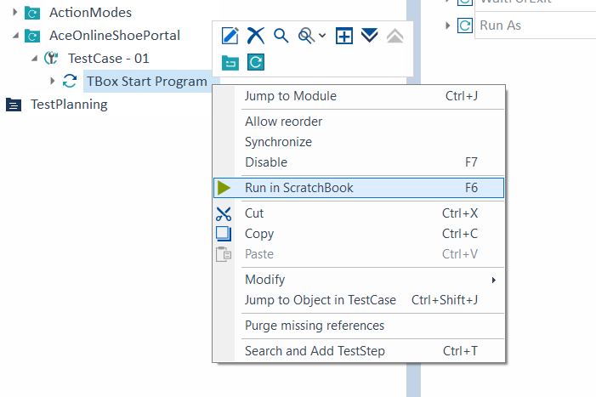
Run the TestCase

Slide 9
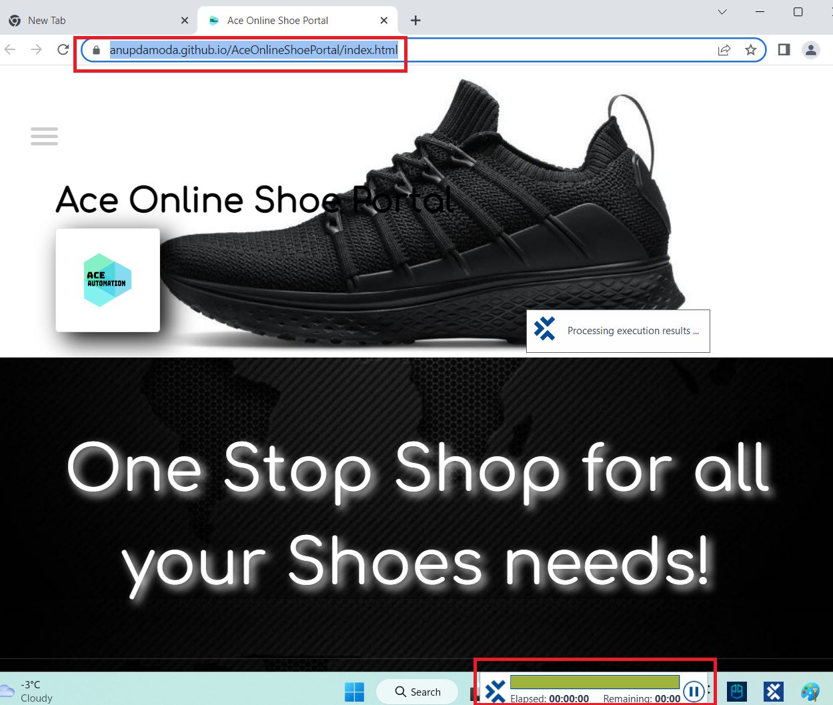
Result

Slide 10
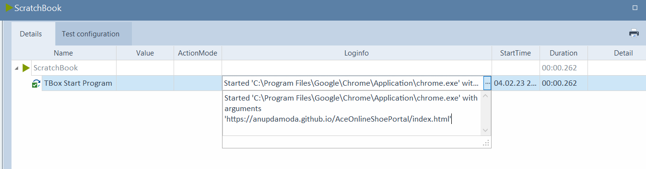
Result

Slide 11
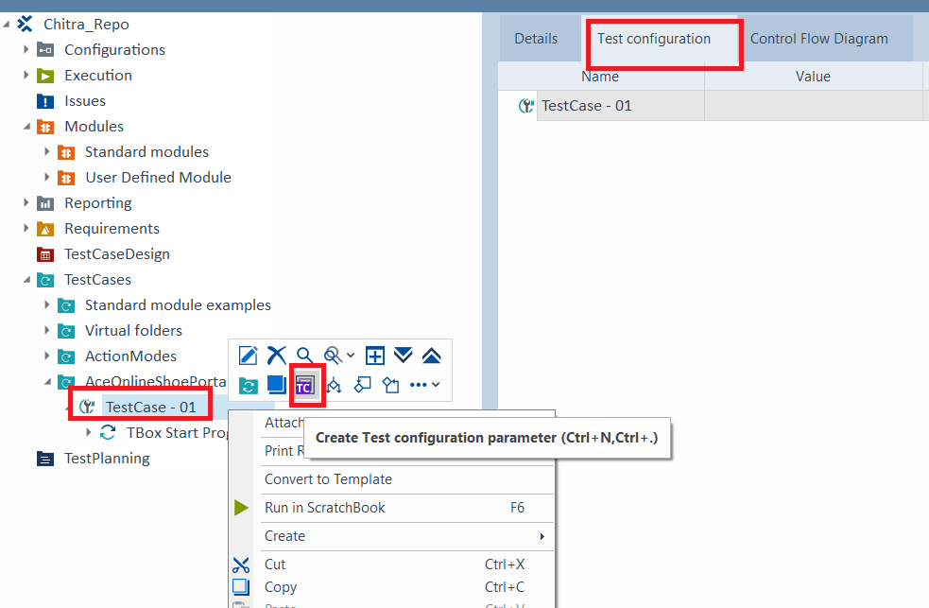
Create TCP

Slide 12
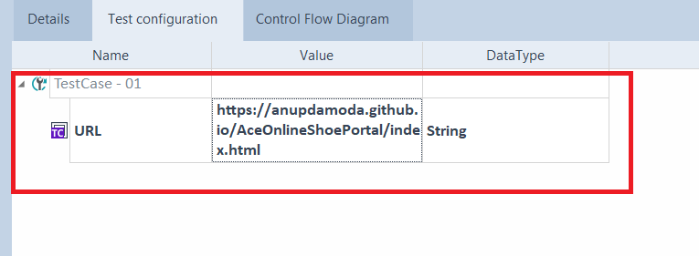
Create URL
Add a TCP called URL and the value as application URL.
Scope is limited to the TestCase only. Can change the scope to folder level too.

Slide 13
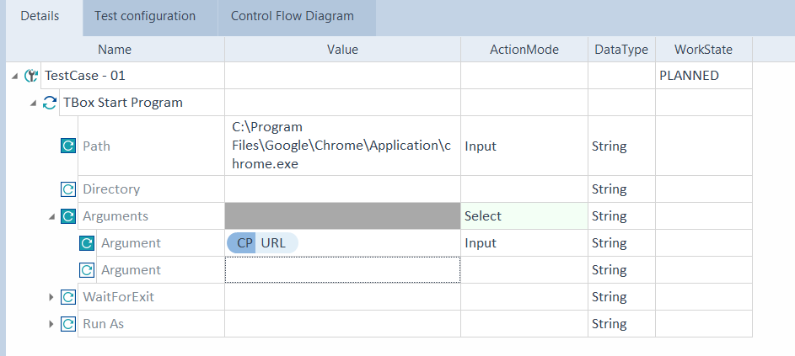
Use TCP

Slide 14
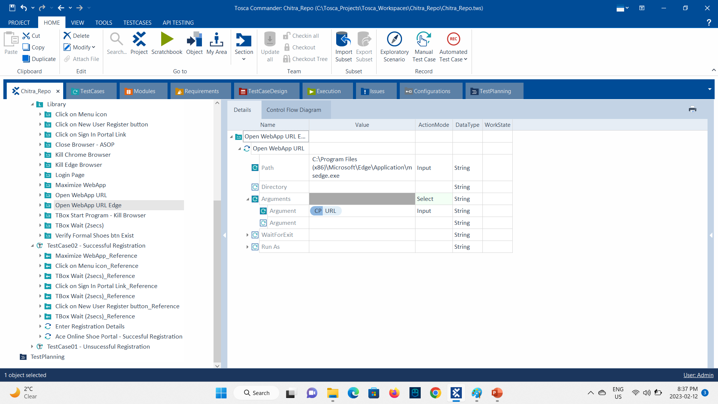
Add the Details of TestCase – MS Edge
Path == location of the msedge.exe
C:\Program Files (x86)\Microsoft\Edge\Application\msedge.exe
Argument == application index.html ie URL

Slide 15
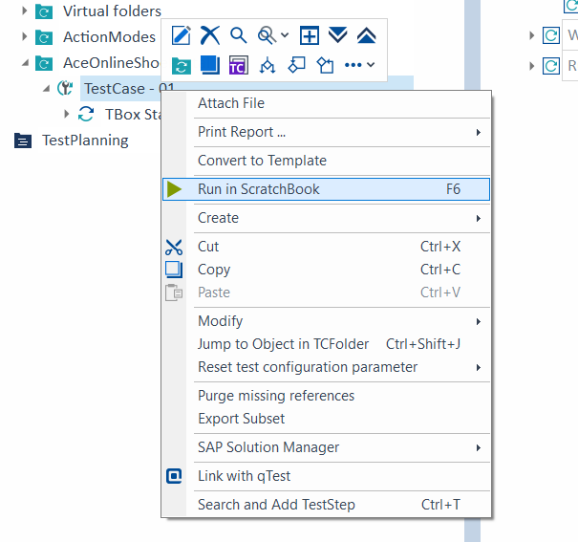
Run the TestCase

Slide 16
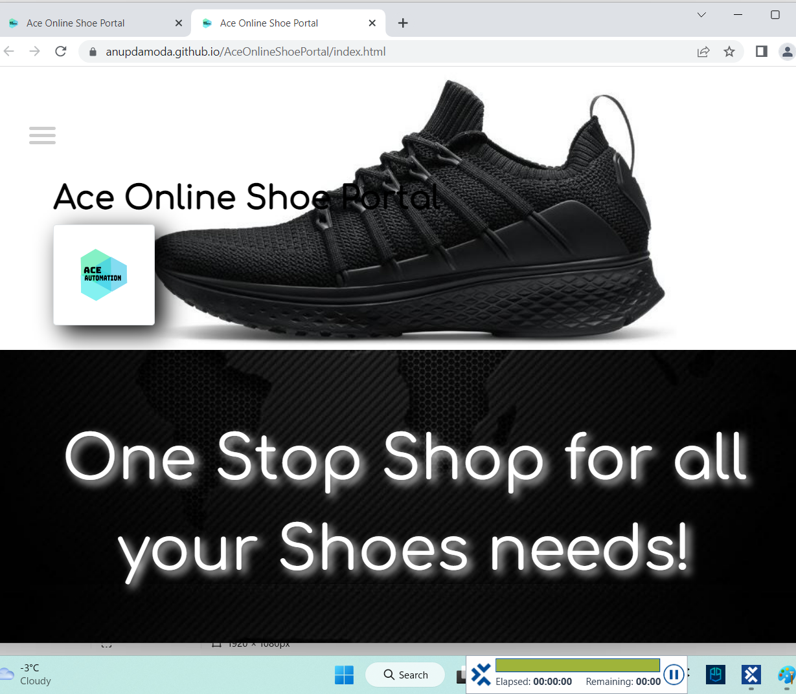
Result

Slide 17
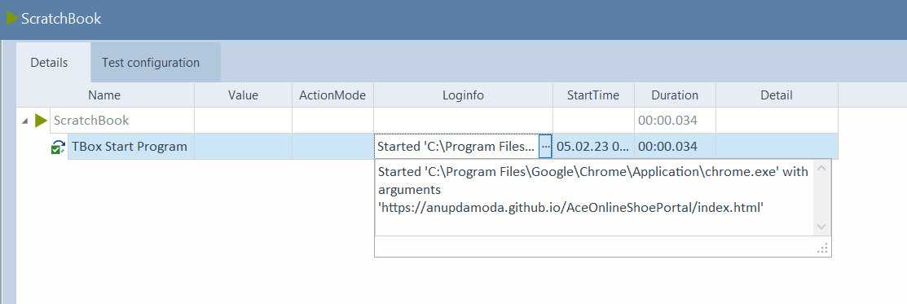
Result

Slide 18
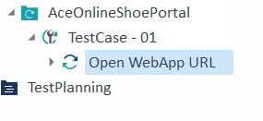
Rename the TBOX Start Program

