Slide 1
Lab 5
Reusable Test Blocks (RTB)

Slide 2
RTB

Slide 3
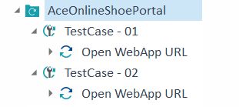
Duplicate TestCase -01

Slide 4
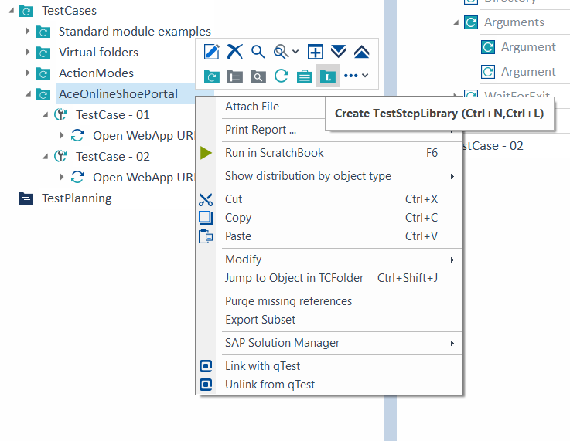
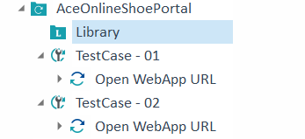
Create the Library

Slide 5
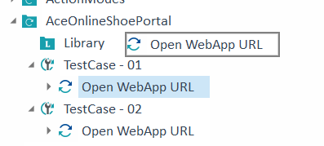
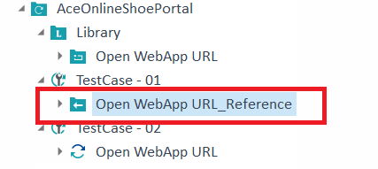
Move the Testcase – 01 to the Library

Slide 6
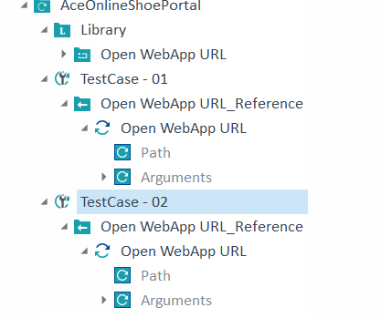
Move the Testcase – 02 to the Library

Slide 7
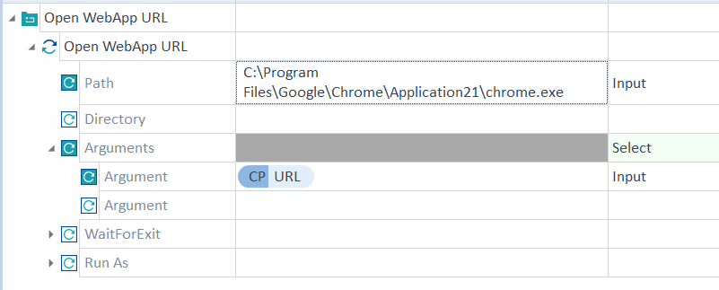
Rename the URL in the Library
The change is visible in all the TestCases referenced to it

Slide 8
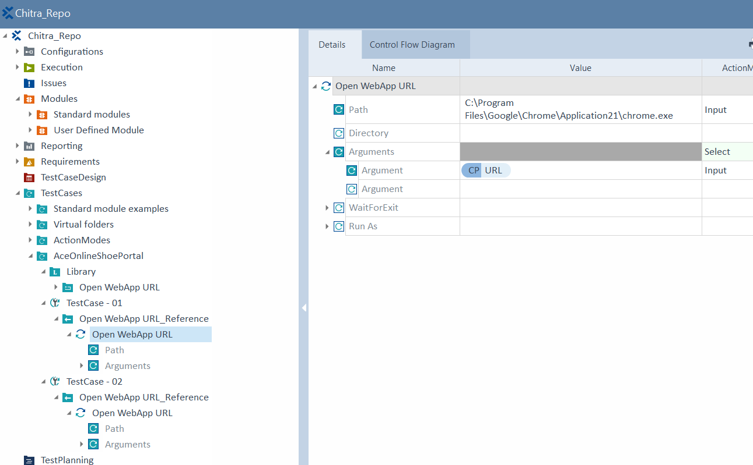
Result

