Slide 1
Lab 6
TCP, RTB and Business Parameter

Slide 2
RTB

Slide 3
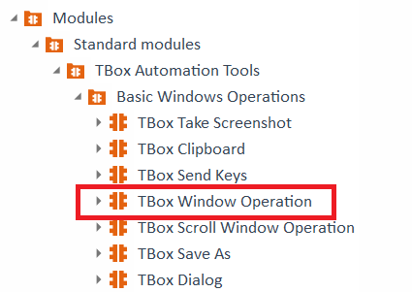
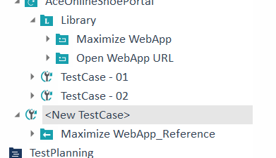
Create a TestCase from Tbox Window Operation
Drag and drop the Standard Module in the TestCase Module.
Rename TBOX Window Operation to Maximise WebApp

Slide 4
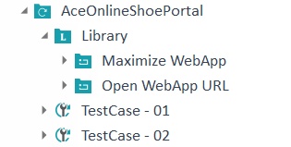
Make Tbox Window Operation a RTB
Drag and Drop in Library.
Delete the <New Test Case> folder

Slide 5
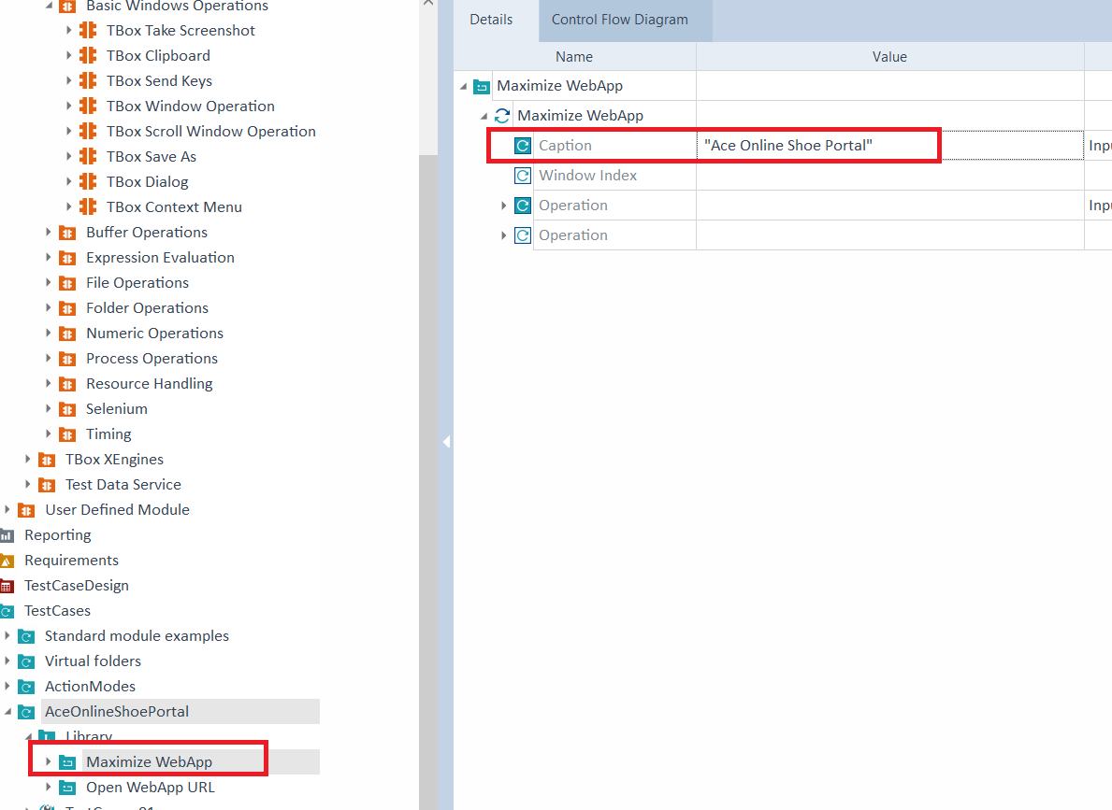
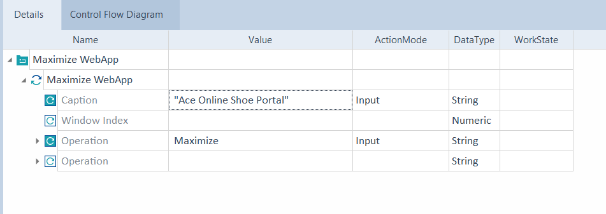
Add the Caption in the Maximize WebApp TestCase
Add the caption == “Ace Online Shoe Portal”

Slide 6
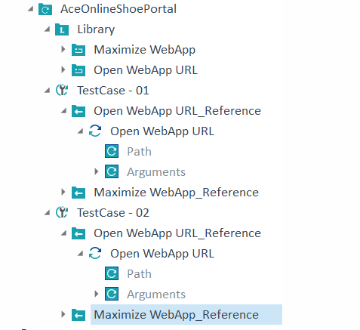
Move the Maximize WebApp into both the TestCases

Slide 7
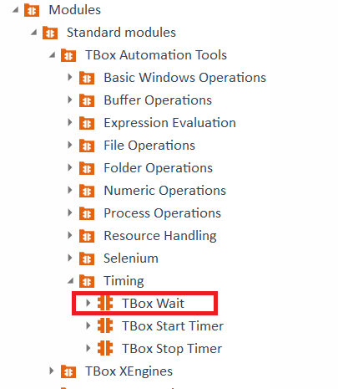
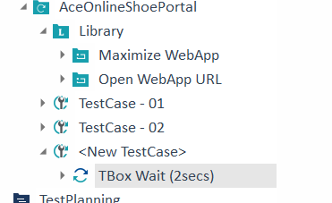
Create a TestCase from Tbox Wait
Drag and drop the Standard Module in the TestCase Module.
Rename TBOX Window Operation to Maximise WebApp

Slide 8
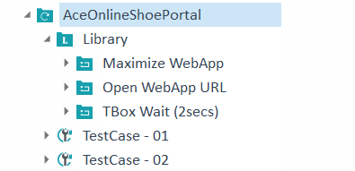
Make Tbox Wait a RTB
Drag and Drop in Library.
Delete the <New Test Case> folder

Slide 9
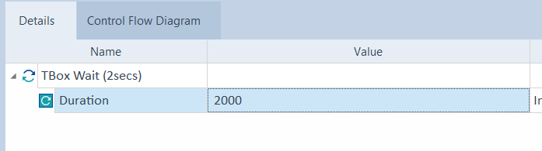
Add Duration in the Details in Tbox Wait
Duration == 2000 ms

Slide 10
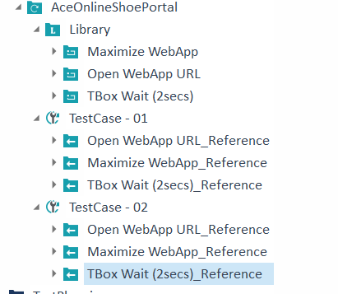
Move the Tbox Wait into both the TestCases

Slide 11
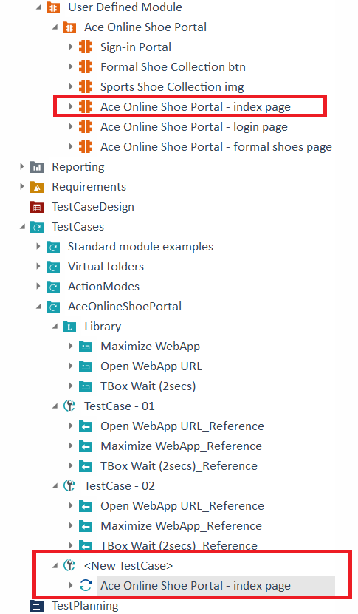
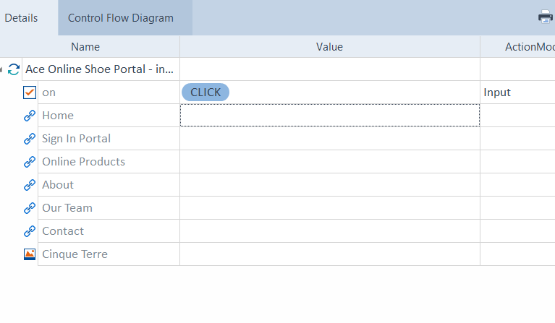
Create a TestCase from Index Page Module
Drag and drop the Index page from User Defined Module in the TestCase Module.
Add Input Action Mode

Slide 12
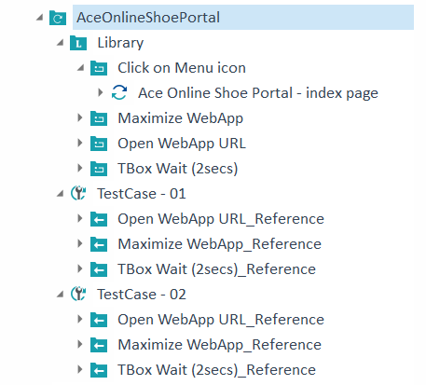
Make Index Page a RTB
Drag and drop the Index page into Library
Rename
Delete the <New Test Case>

Slide 13
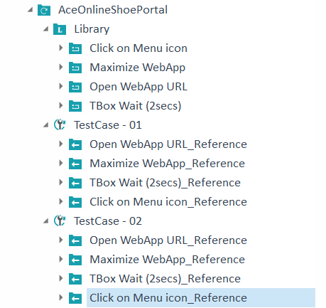
Move the Index Page into both the TestCases

Slide 14
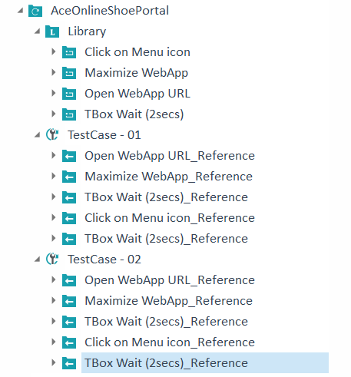
Move the TboX Wait into both the TestCases again

Slide 15
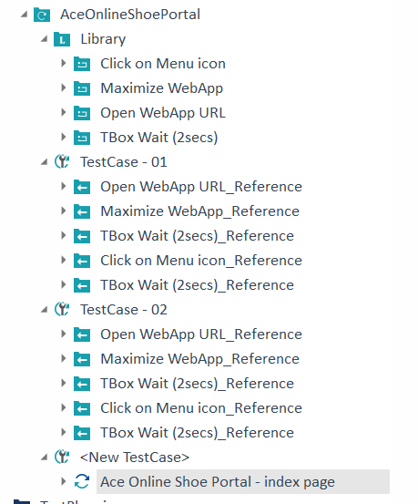
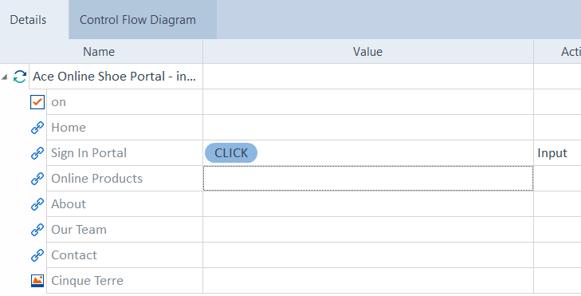
Create a TestCase from Index Page Module
Drag and drop the Index page from User Defined Module in the TestCase Module.
Add Input Action Mode for Sign In Portal

Slide 16
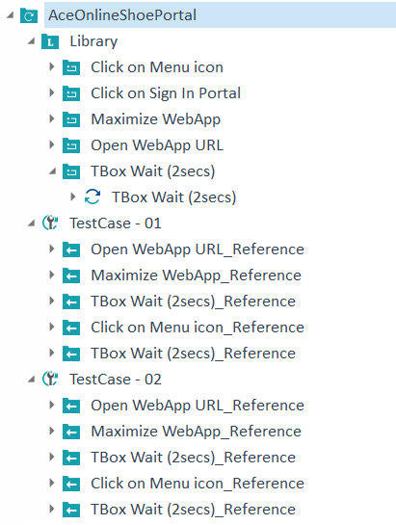
Make Index Page a RTB
Drag and drop the Index page into Library
Rename
Delete the <New Test Case>

Slide 17
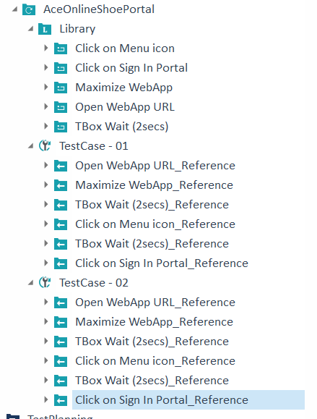
Move the Index Page into both the TestCases

Slide 18
TCP

Slide 19
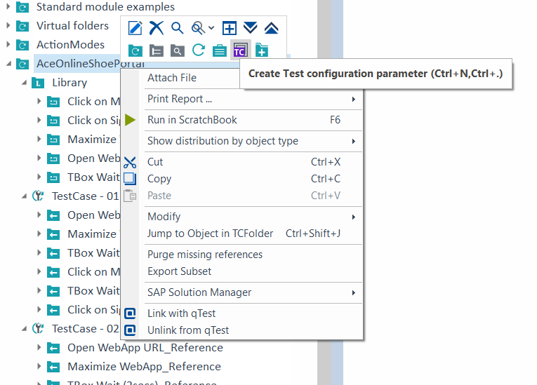
Create TCP on TestCase Folder
Username = cvel
Password = cvel
URL =
https://anupdamoda.github.io/AceOnlineShoePortal/index.html
Notes:
Ace Online Shoe Portal (anupdamoda.github.io)

Slide 20
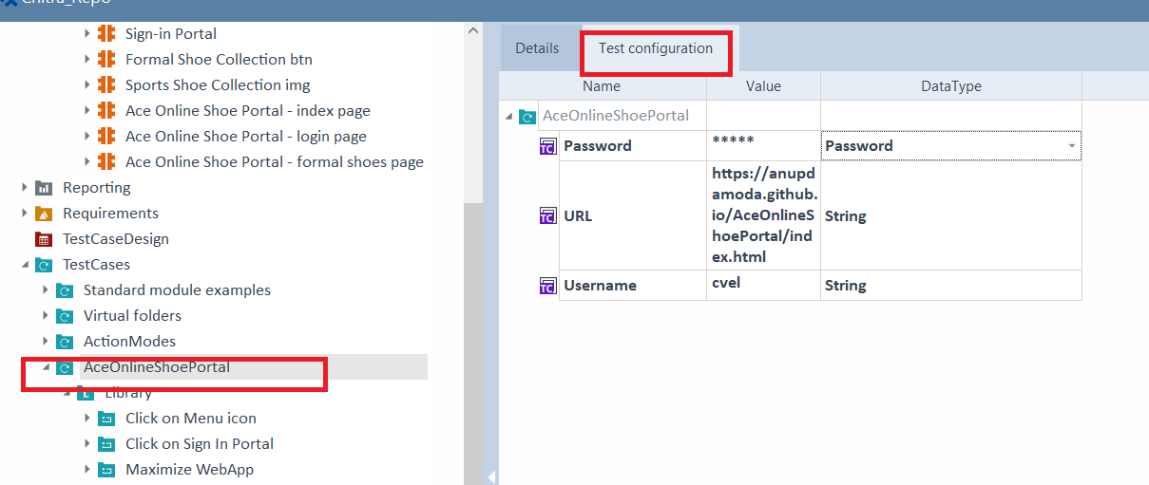
Create TCP on TestCase Folder
Notes:
Ace Online Shoe Portal (anupdamoda.github.io)

Slide 21
Create TCP on TestCase Folder
Notes:
Ace Online Shoe Portal (anupdamoda.github.io)

Slide 22
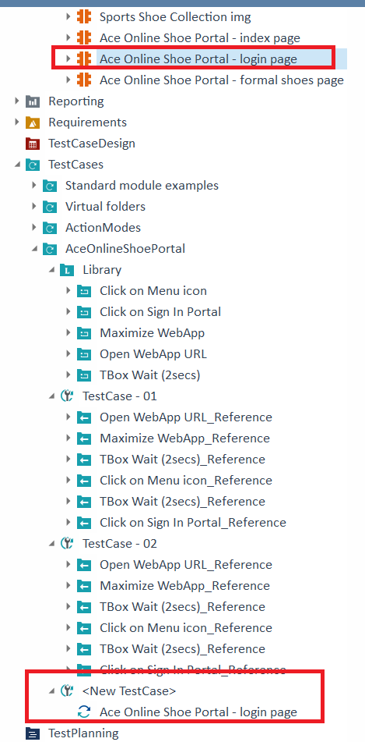
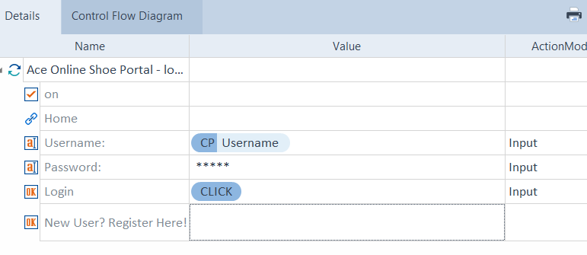
Create a TestCase from Login Page Module
Drag and drop the Login page from User Defined Module in the TestCase Module.
Add Input Action Mode for Username and Password using TCP

Slide 23
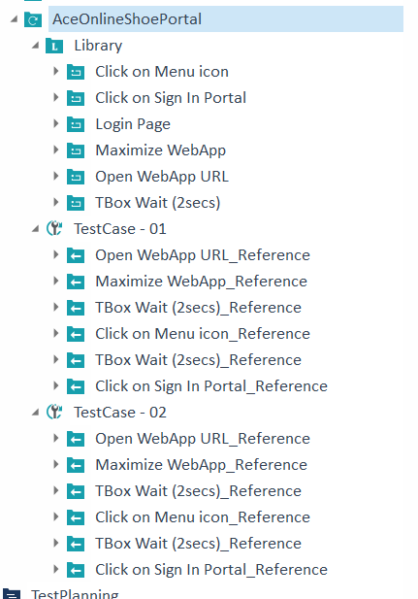
Make Login Page a RTB
Drag and drop the Login page into Library
Rename
Delete the <New Test Case>

Slide 24
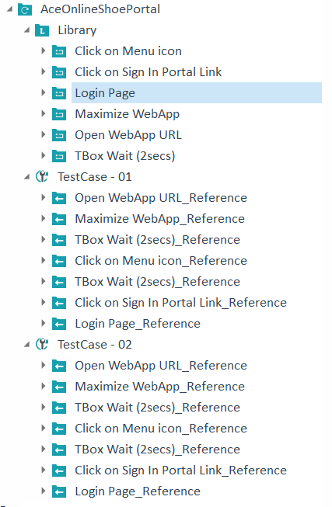
Move the Login Page into both the TestCases

Slide 25
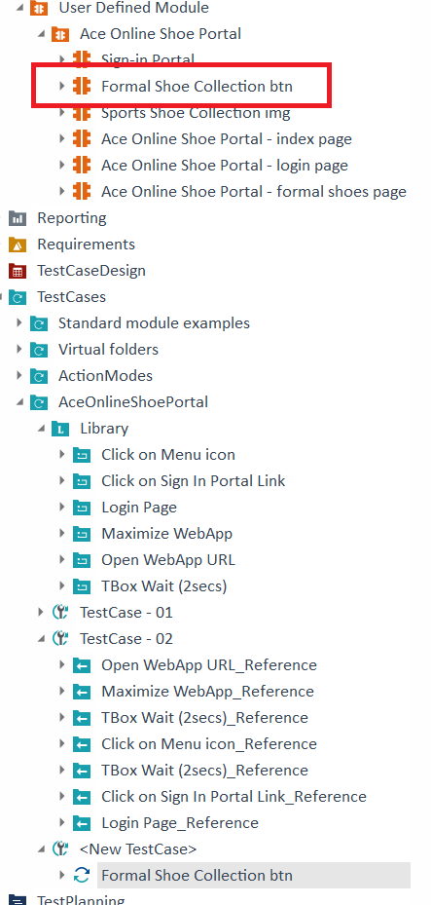
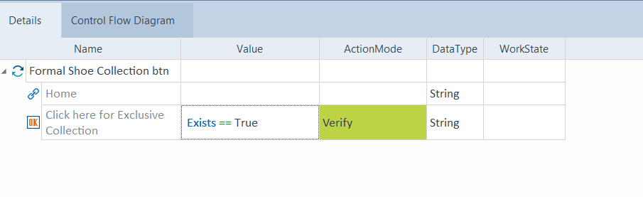
Create a TestCase from Formal Shoes Collection btn Module
Drag and drop the Login page from User Defined Module in the TestCase Module.
Add Verify Action Mode for the Formal Shoes Collection button

Slide 26
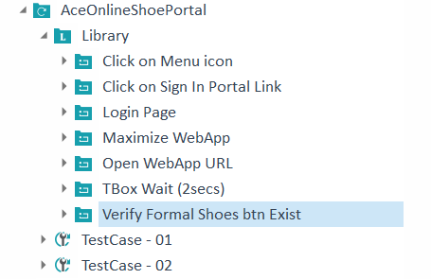
Make Formal Shoes Collection btn a RTB
Drag and drop the Formal Shoes
Collection btn into Library
Rename
Delete the <New Test Case>

Slide 27
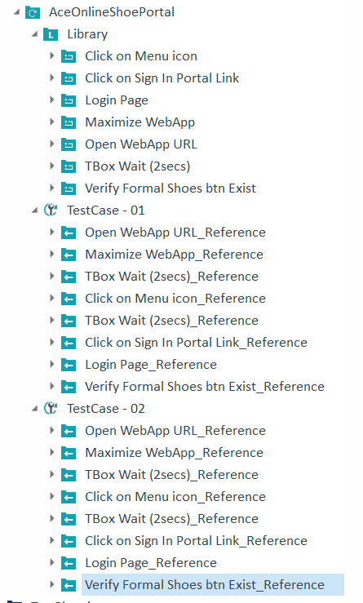
Move the Formal Shoes Collection btn into both the TestCases

Slide 28
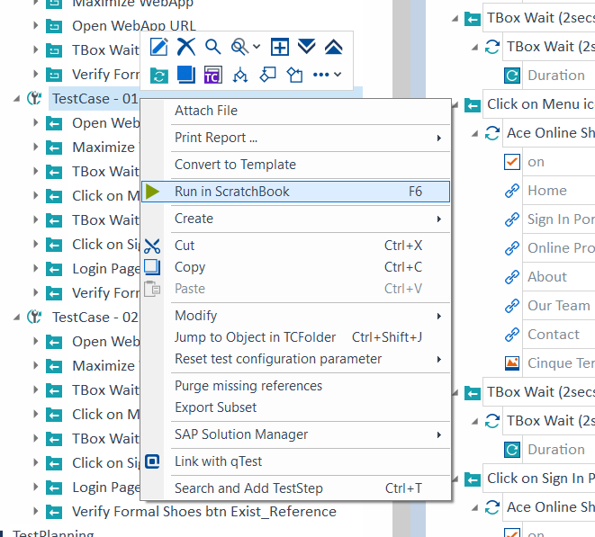
Run the TestCase - 01

Slide 29
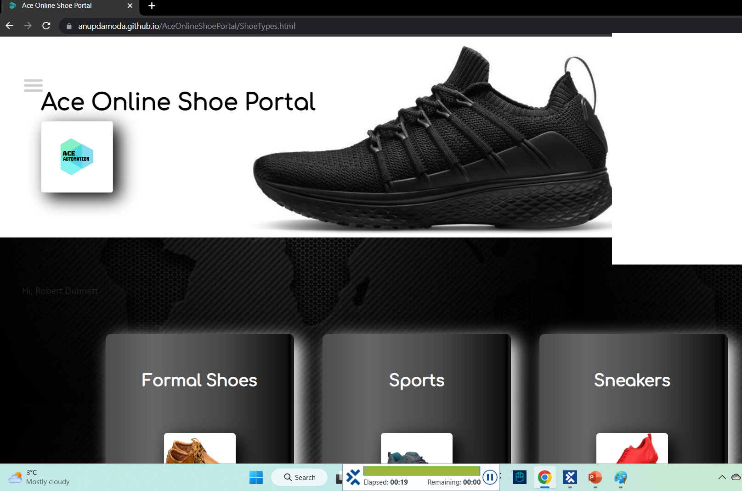
Result of TestCase - 01

Slide 30
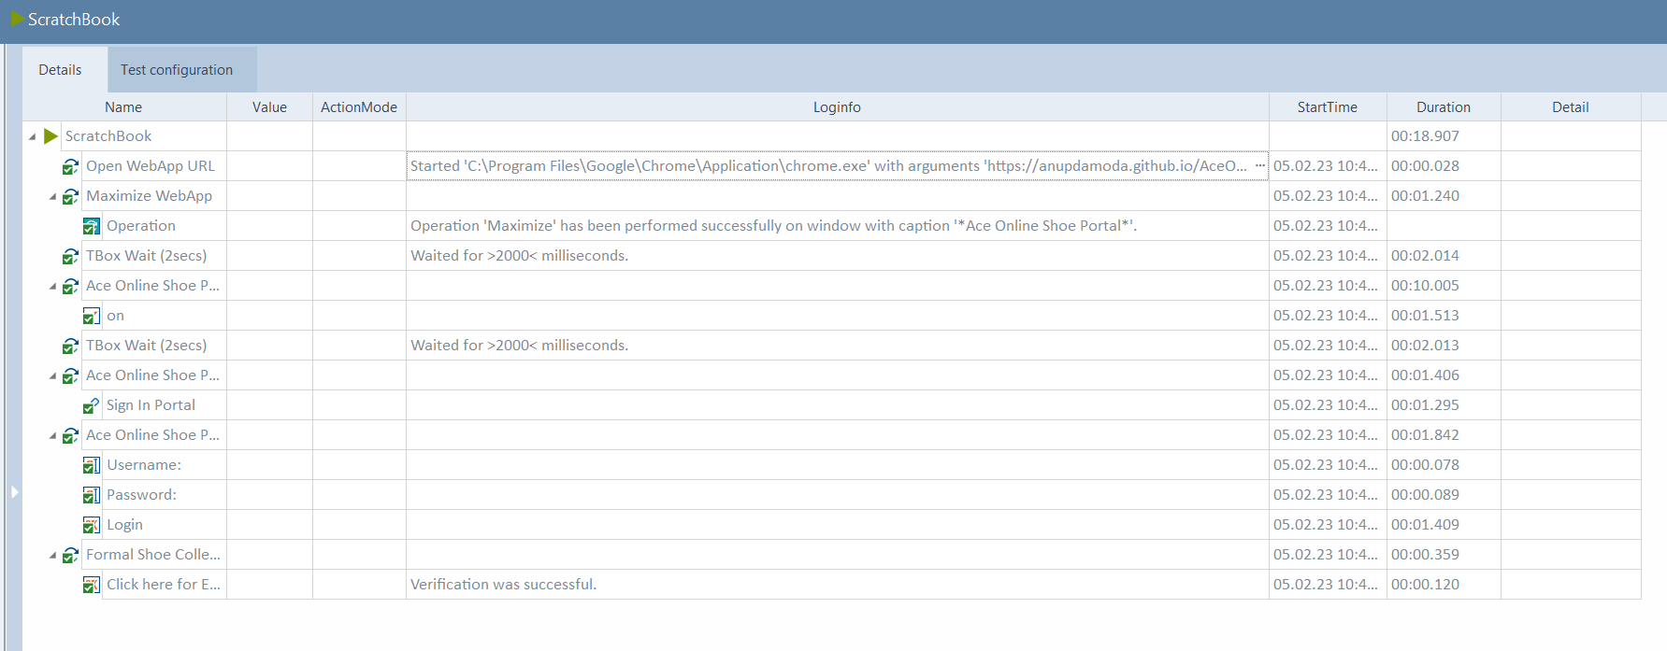
Logs of TestCase - 01

Slide 31
BP

Slide 32
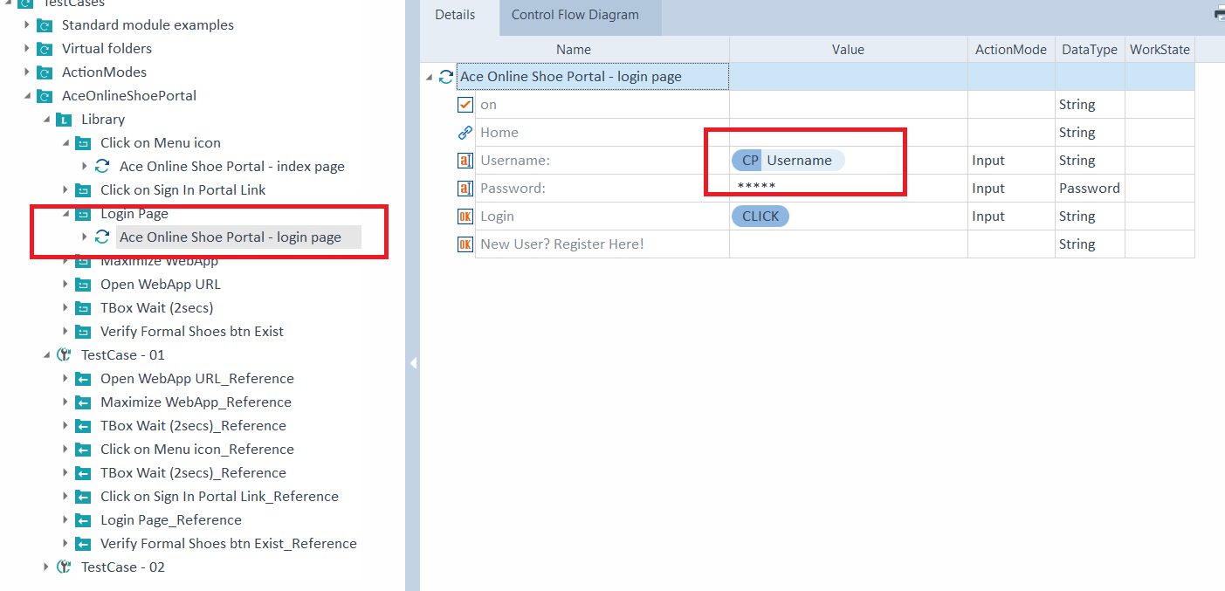
Convert TCP to Business Parameter in Login Page TestCase

Slide 33
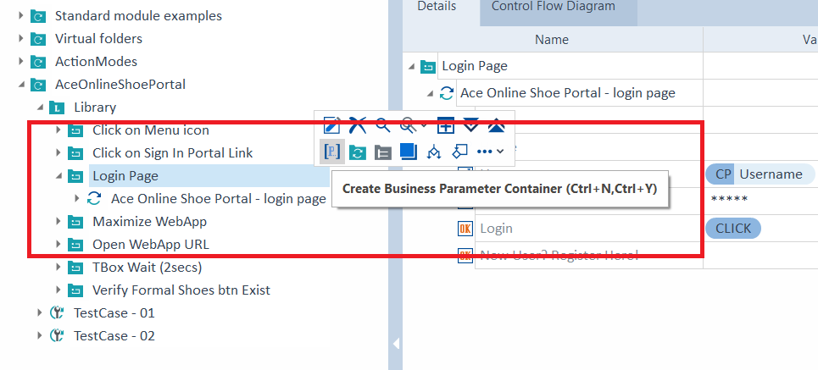
Create a BP Container in the Login Page Library TestCase
Create BP for Username and Password. BP can be created only for Libraries.

Slide 34
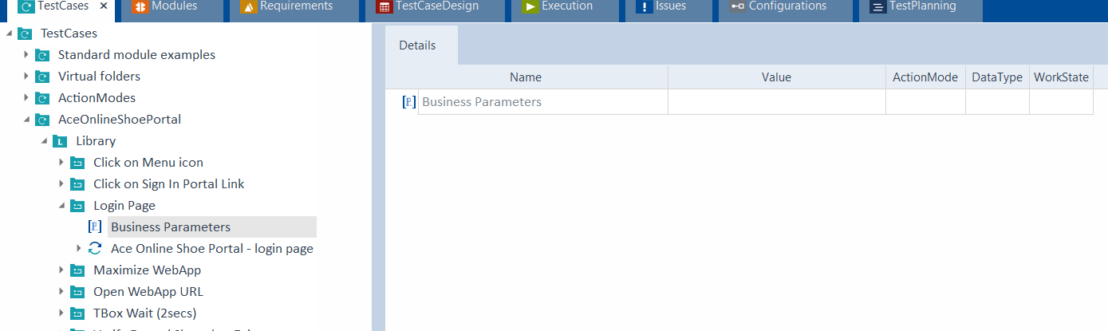
BPC in the Login Page Library TestCase
BPC is created.

Slide 35
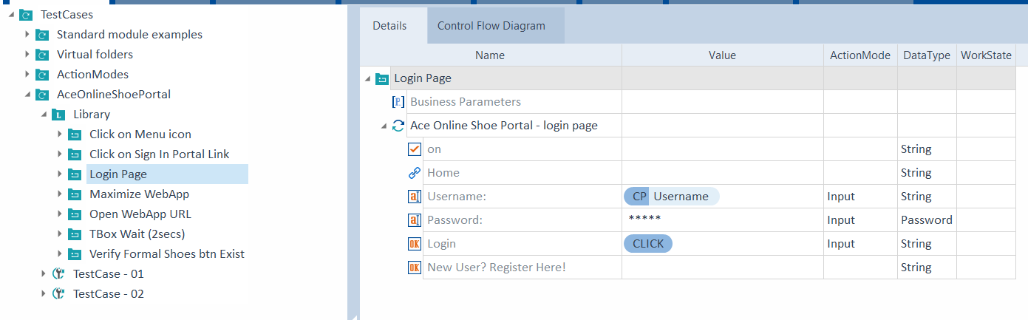
View the BP

Slide 36
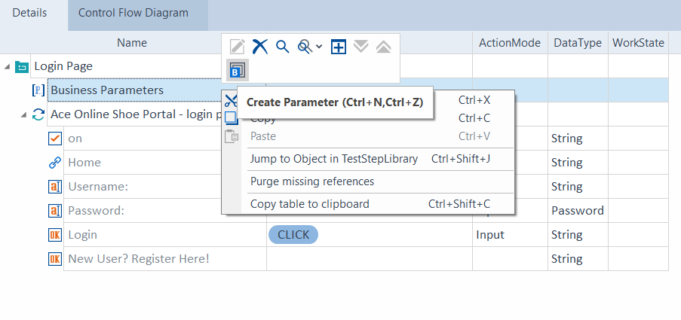
Create a Parameter in the Business Parameter Container
Create 2 Parameters

Slide 37
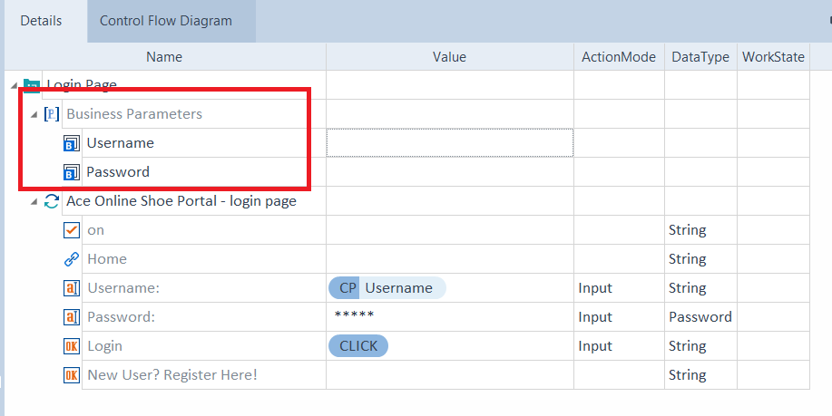
TestCase -01 - View the Parameters
Rename the BPs. You cannot add Value here. Only in the Login Page TestCase in the Test Case - 01 folder

Slide 38
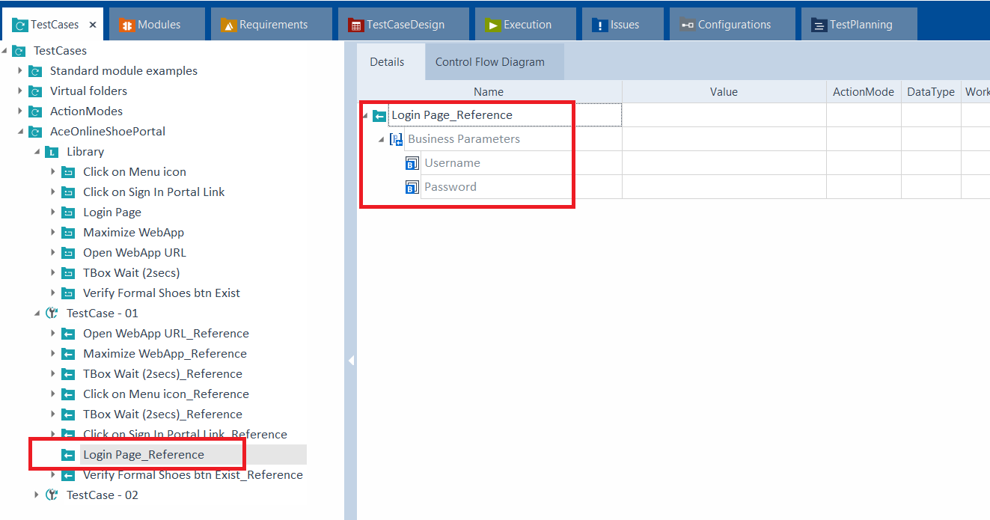
TestCase – 01 - View the Parameters in the Login Page TestCase

Slide 39
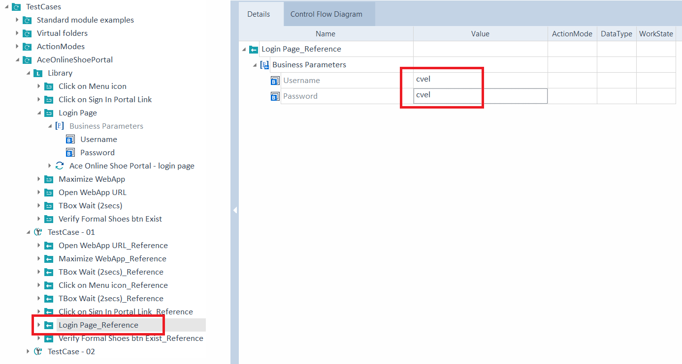
TestCase – 01 - Add the Values for the Parameters
Add Value in the Login Page TestCase in the Test Case - 01 folder

Slide 40
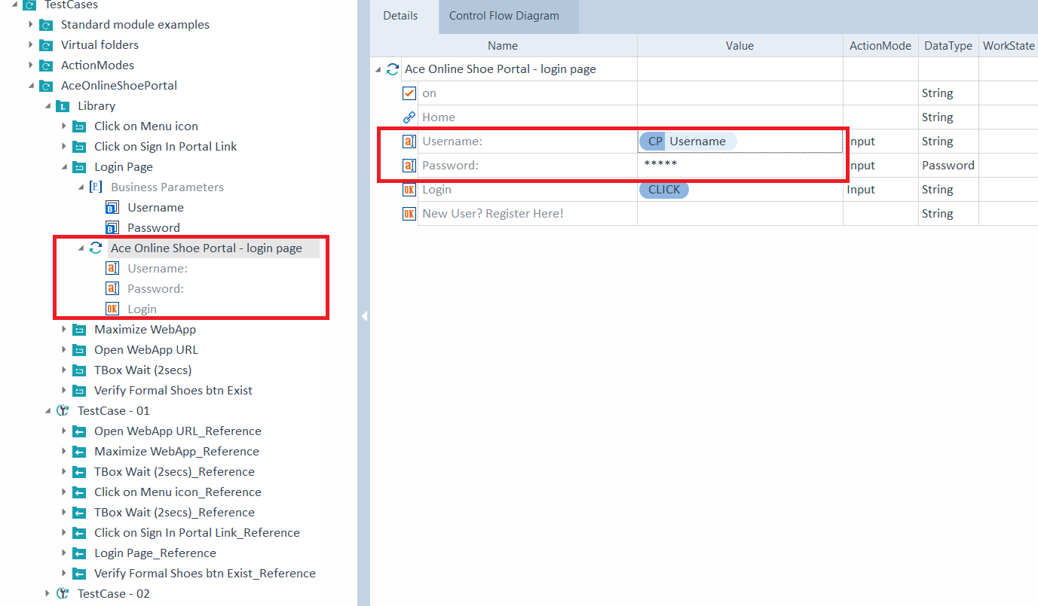
Modify the Values for the Parameters in the Login Page Library

Slide 41
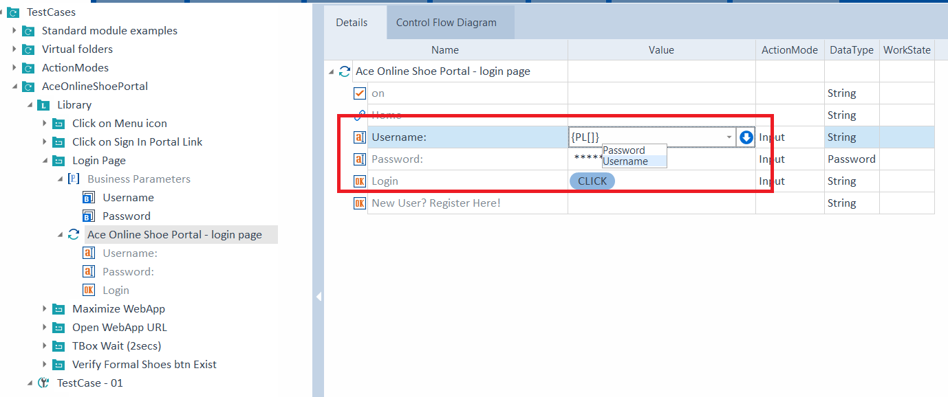
Modify the Values using PL

Slide 42
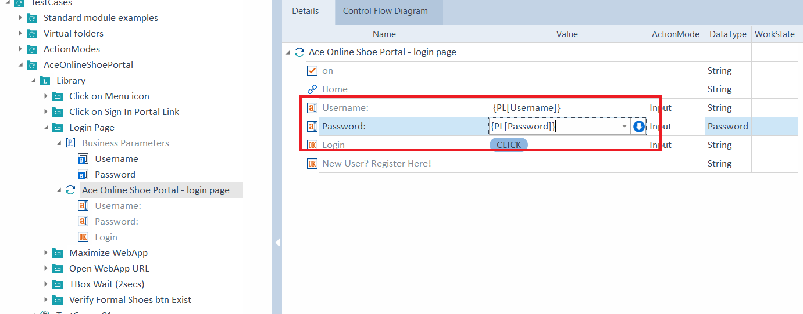
Modified the Values for the Parameters

Slide 43
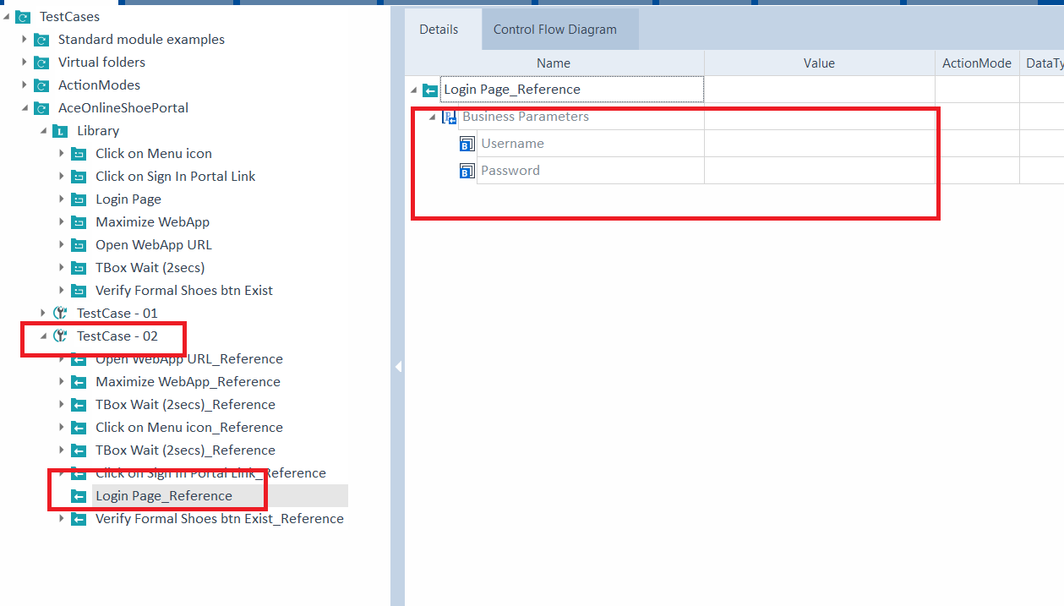
TestCase – 02 - View the Parameters in the Login Page TestCase

Slide 44
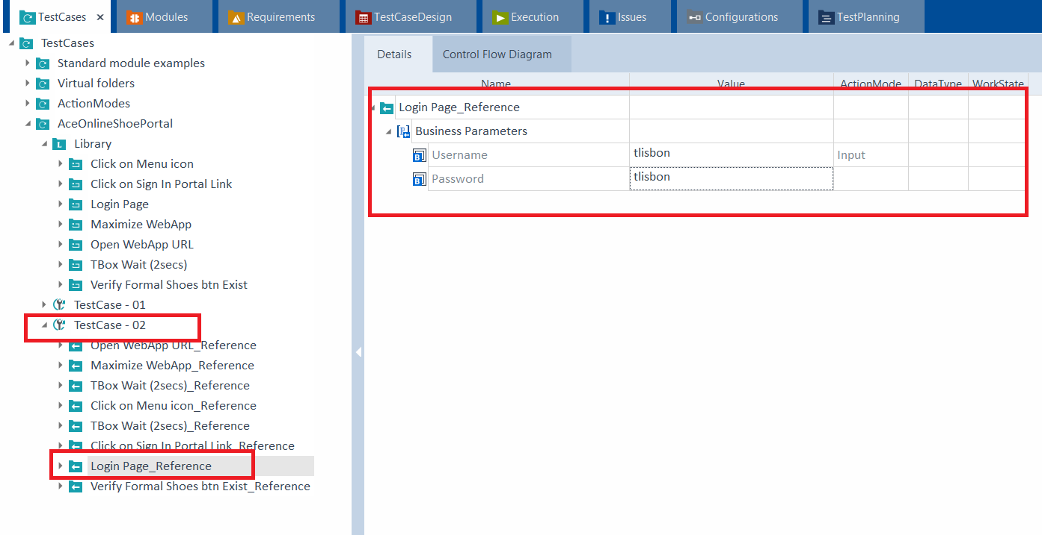
TestCase – 02 - Add the Values for the Parameters
Add Value in the Login Page TestCase in the Test Case - 02 folder

Slide 45
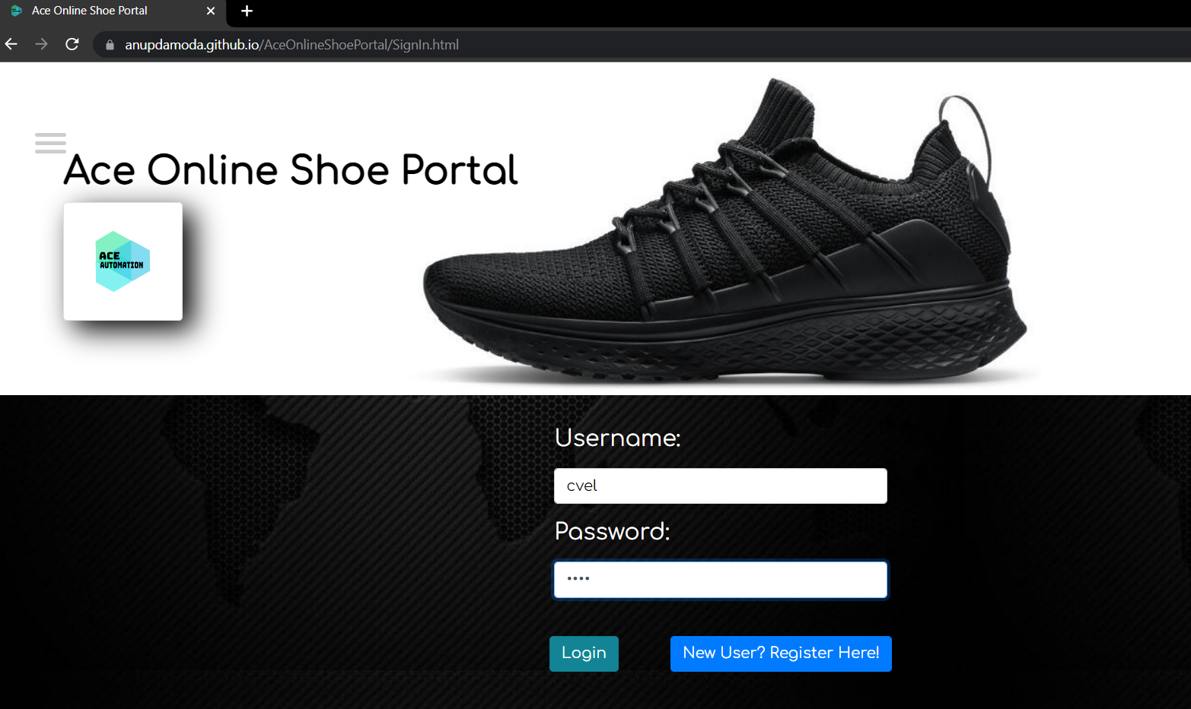
Run TestCase – 01

Slide 46
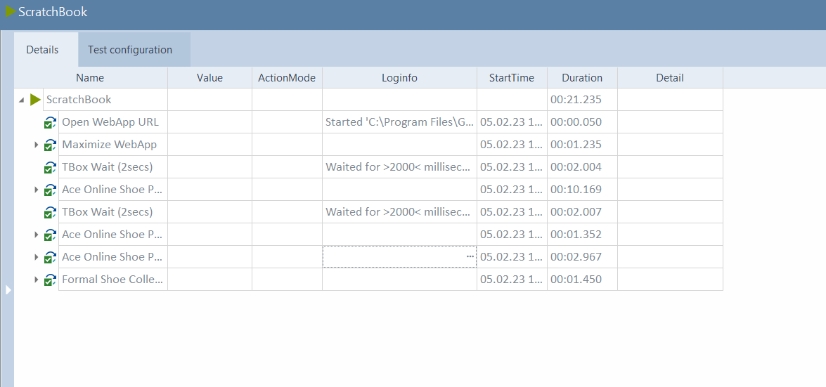
Logs of TestCase – 01

Slide 47
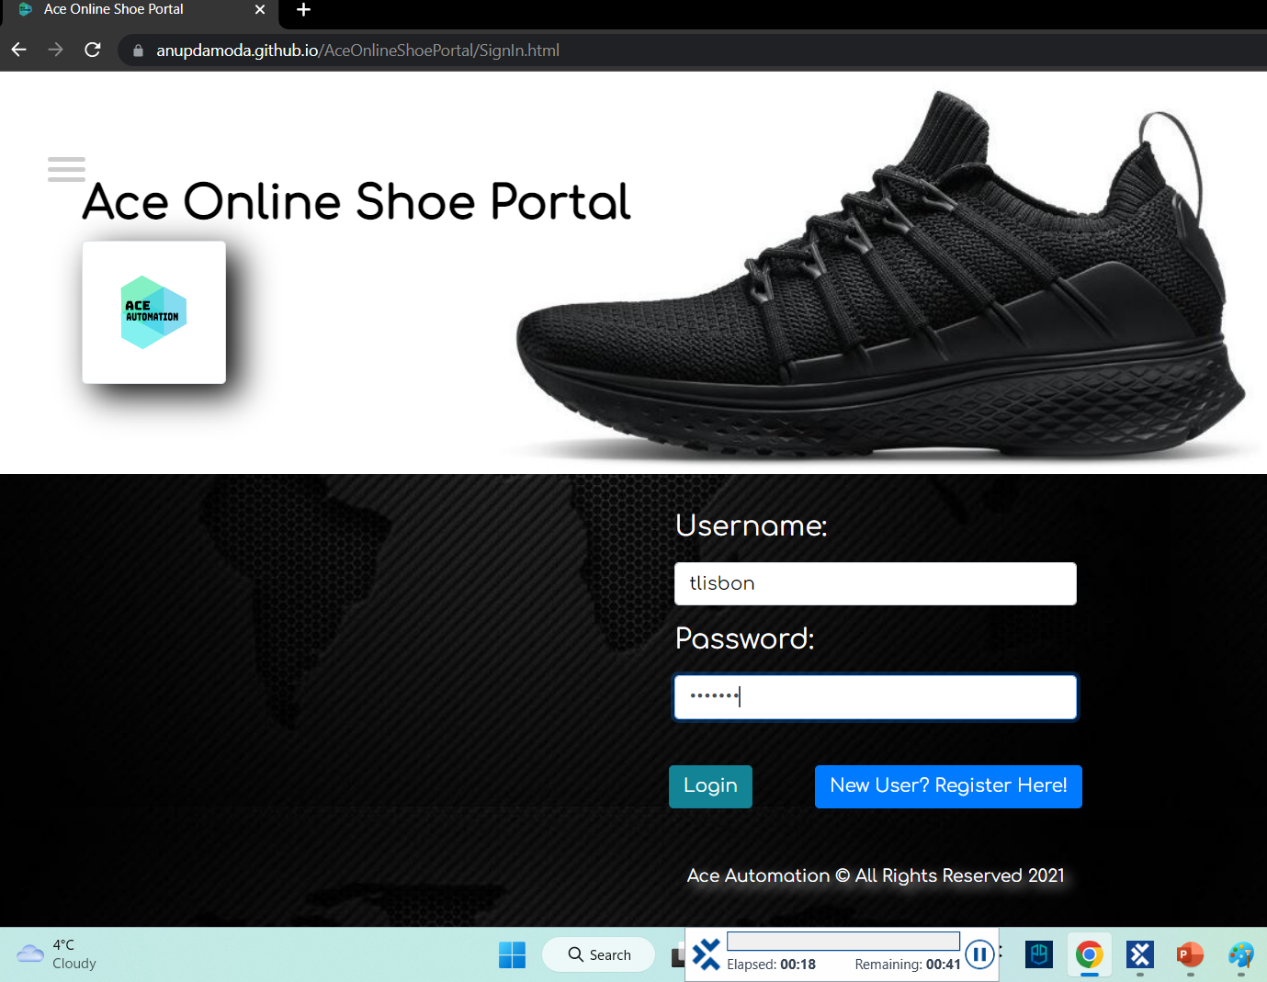
Run TestCase – 02
Username: tlisbon

Slide 48
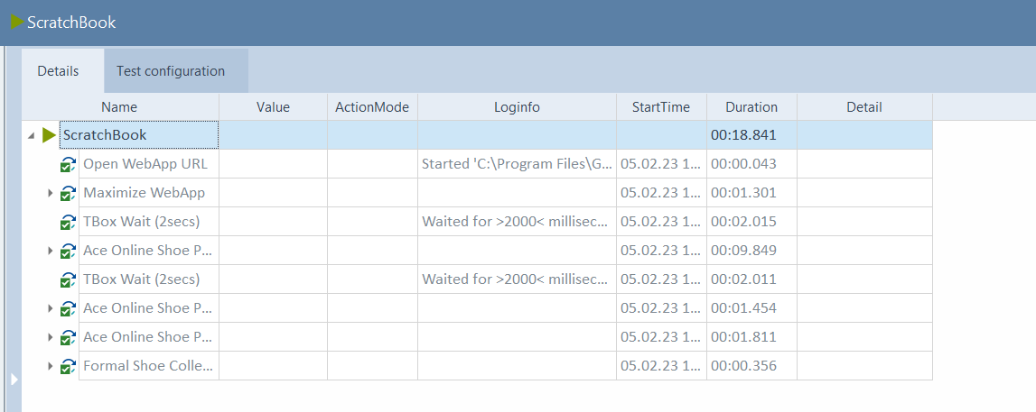
Logs of TestCase – 02

