Slide 1
Lab 8
ExecutionLists

Slide 2
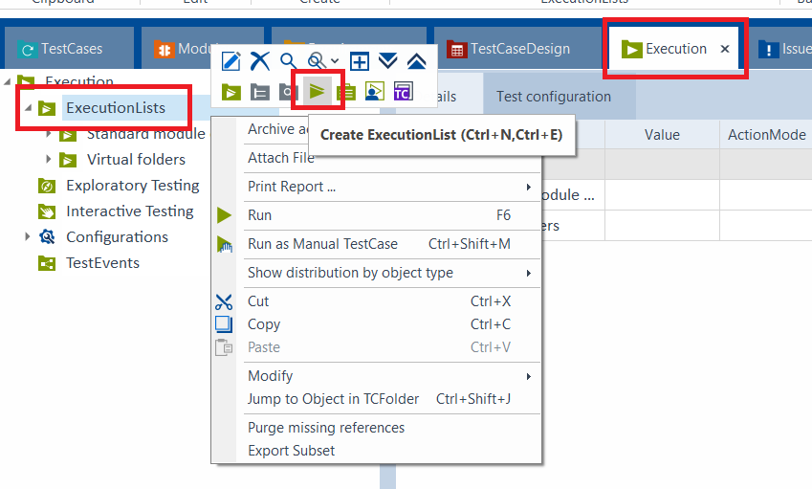
Create an ExecutionList

Slide 3
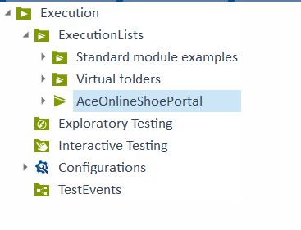
Rename the ExecutionList

Slide 4
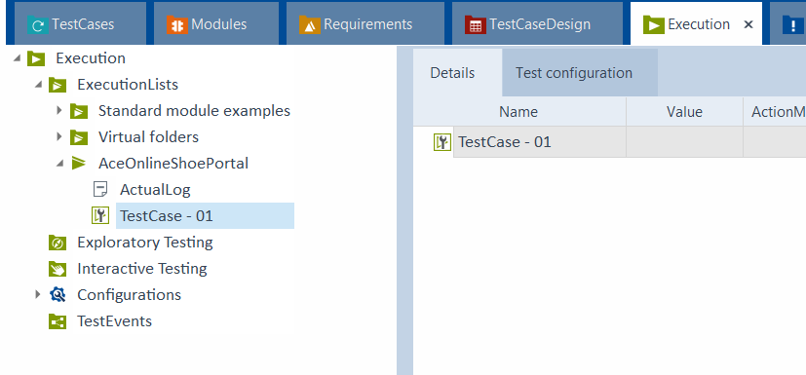
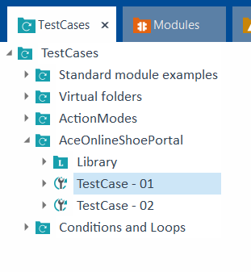
Drag and Drop TestCase – 01

Slide 5
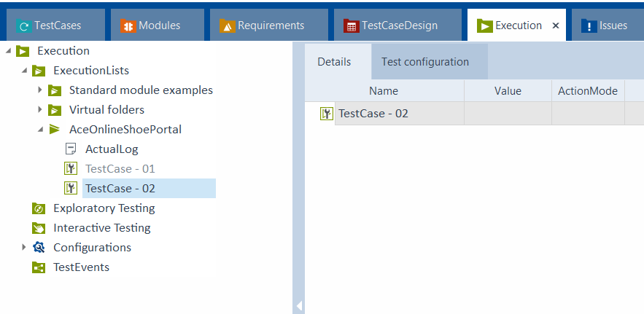
Drag and Drop TestCase – 02

Slide 6
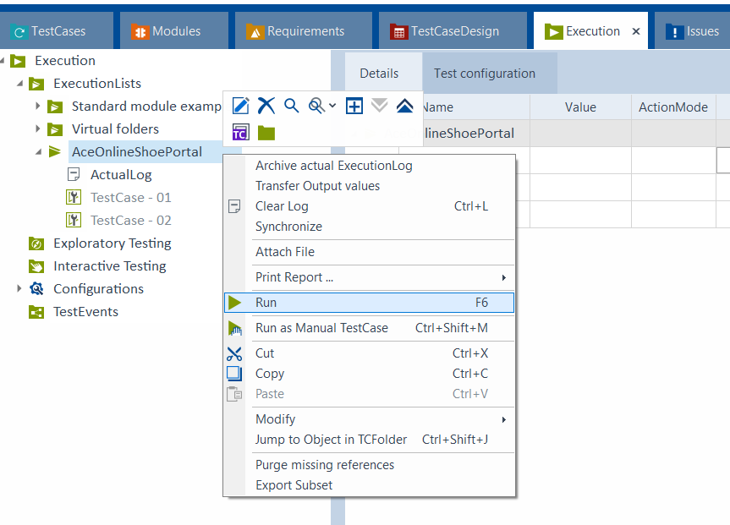
Run the ExecutionList

Slide 7
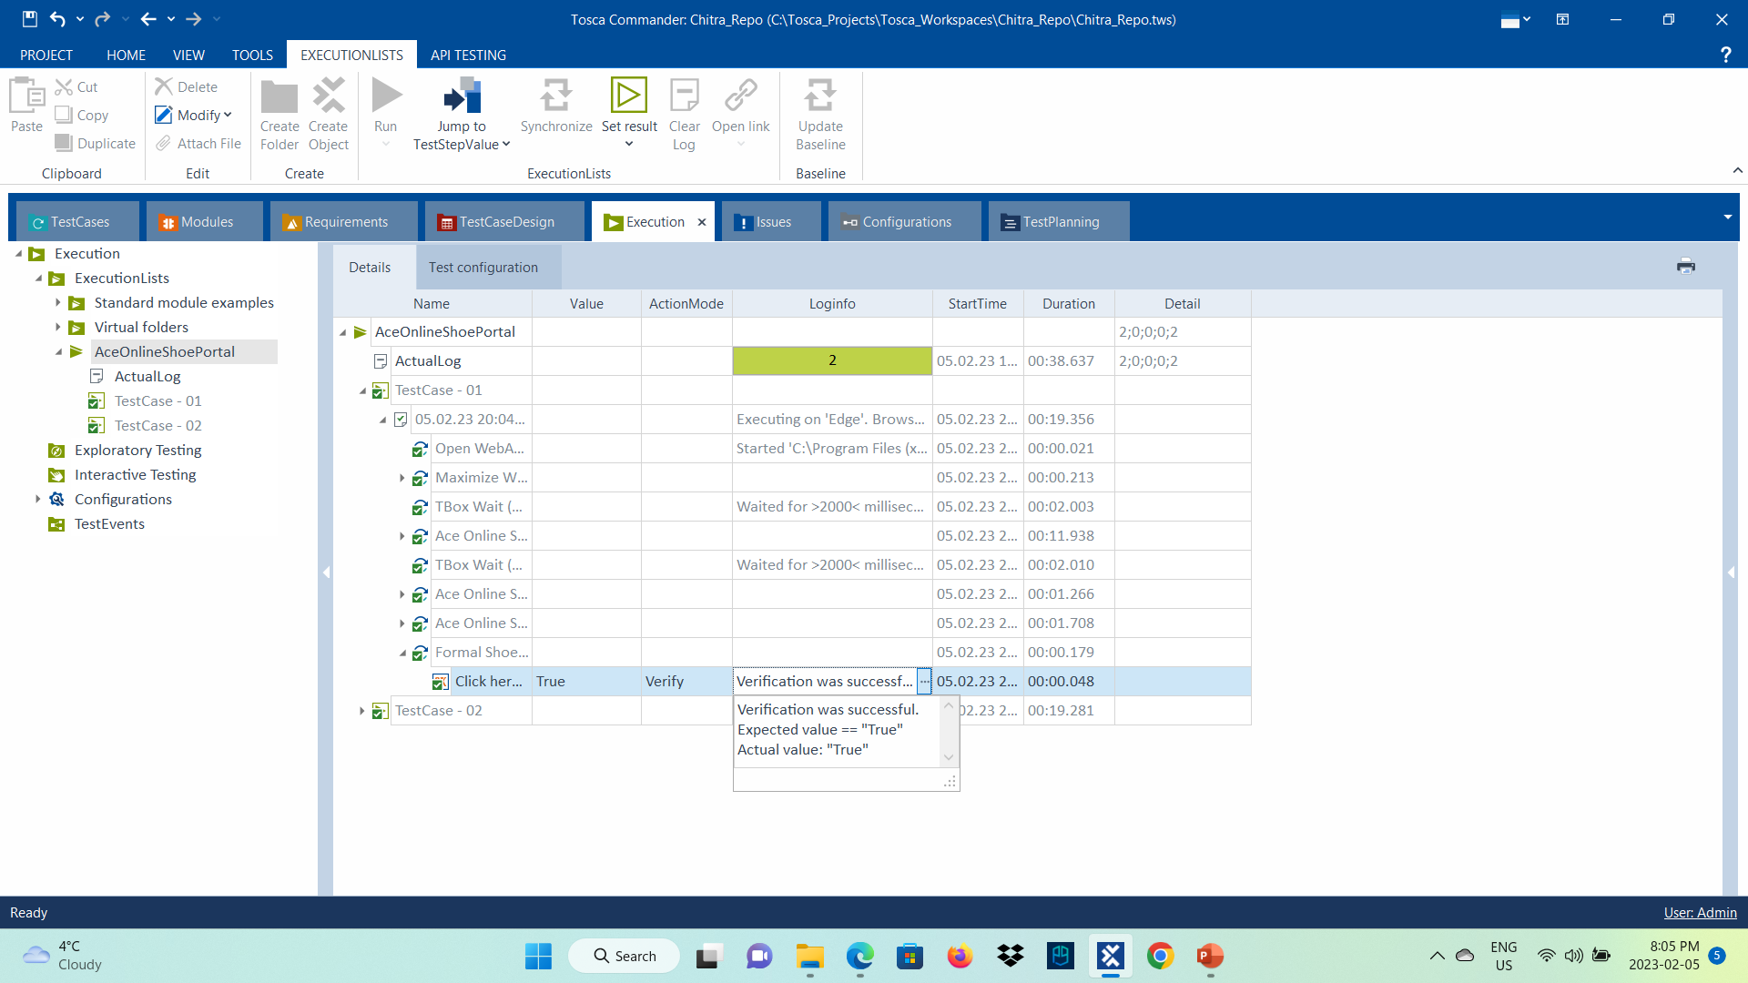
Run the ExecutionList

Slide 8
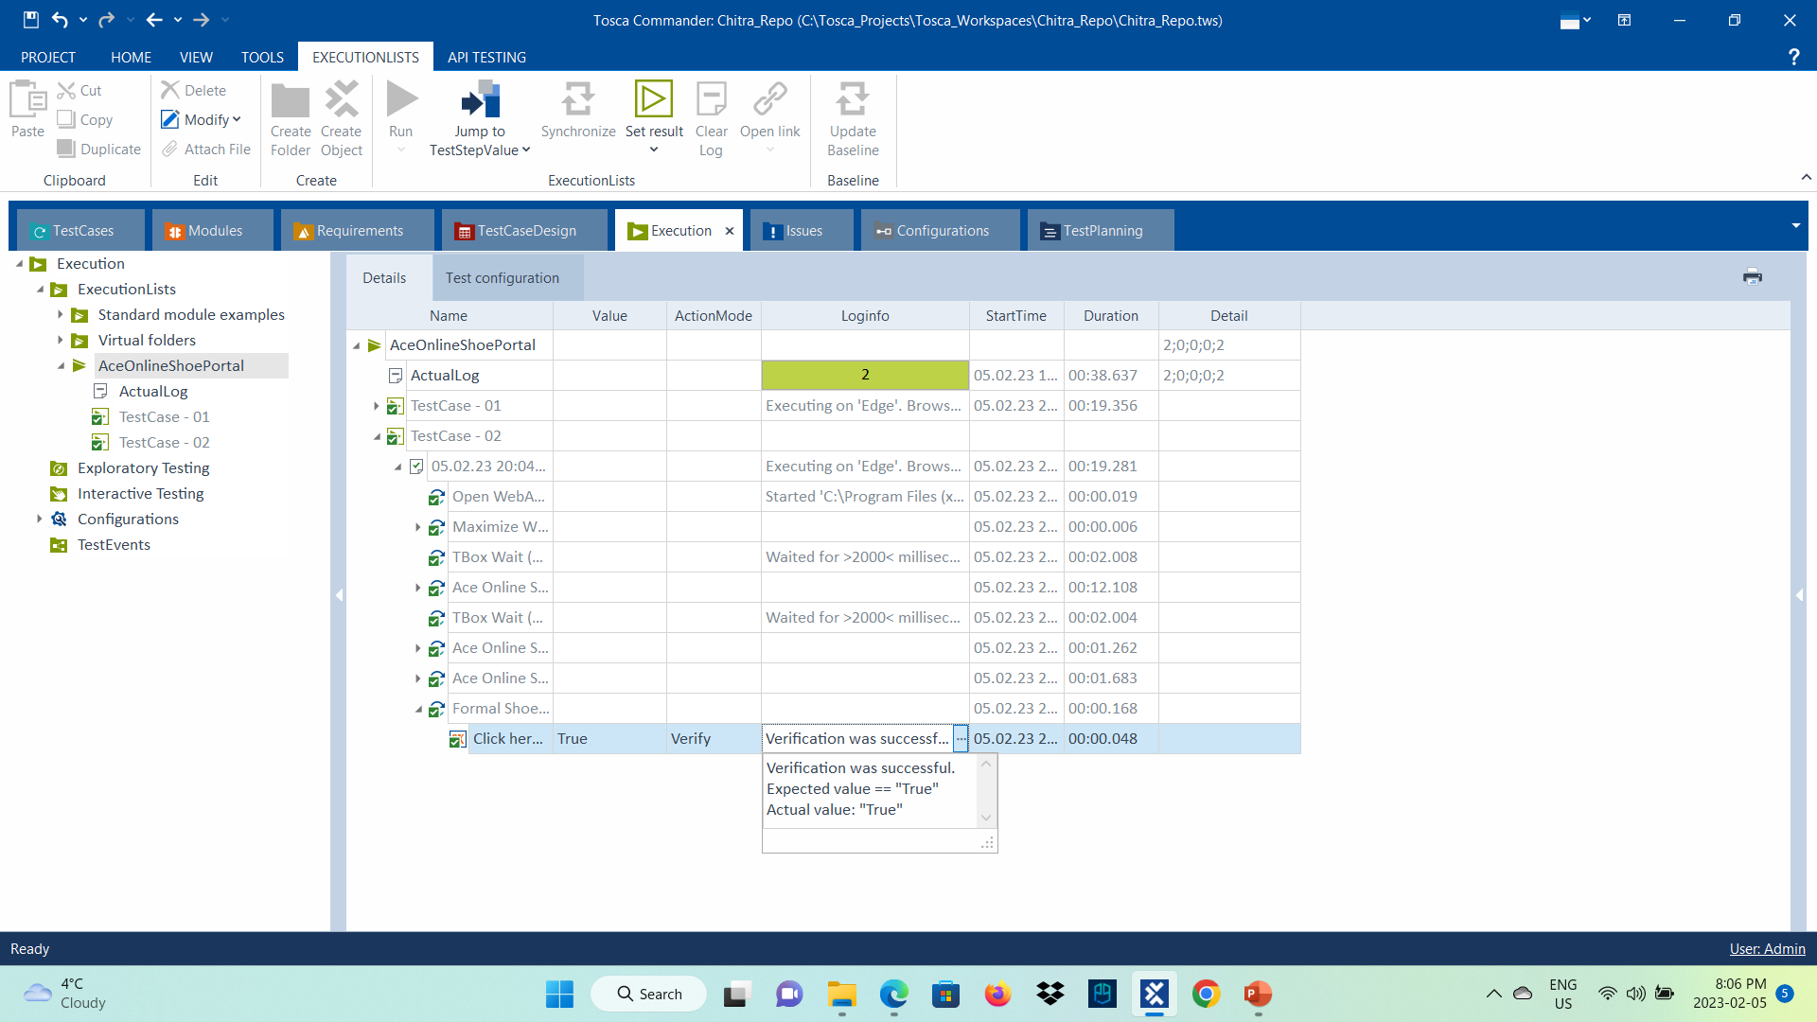
Run the ExecutionList

