Slide 1
Predicting cognitive outcomes in one survey using cognitive trajectory from another survey
Wenshan Yu

Slide 2
Motivation
Longitudinal surveys are crucial for capturing life course data and understanding how early- and mid-life factors influence aging outcomes
However, such research is often limited by data availability. Rarely a longitudinal study can cover the full life stages.
Yet, there are surveys that cover certain life stages. For example, NLSY79 covers early- and mid-life (but they have sparse cognitive measurements). HRS provides rich later-life measurements.
Can we link two surveys that cover overlapping cohorts but in different life stages so that we make best use of both data sources?

Slide 3
Two surveys
NLSY79 (National Longitudinal Survey of Youth 1979)
  Follows individuals born 1957–1964 from adolescence to midlife.
  A biennial longitudinal study from 1979 to 2022 (ongoing).
  Rich prospective data on education, employment, family, and health behaviors.
HRS (Health and Retirement Study)
  Covers U.S. adults over age 50 with biennial follow-up from 1992 to 2022 (ongoing).
  Rich data on physical, mental, and cognitive health, demographics, employment, retirement, and family arrangements.

Slide 4
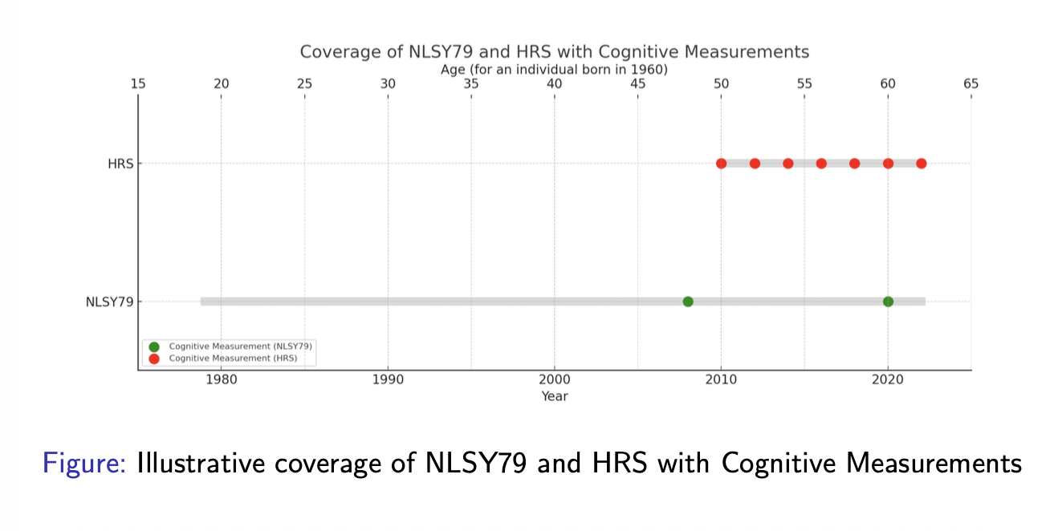
Consider an individual born in 1960, their presence in the data sets will be like
We will use the red dots from HRS and the first green dot from NLSY to predict the second dot

Slide 5
Can we use models trained in HRS to predict NLSY later-life cognitive outcome?
Prepare the HRS longitudinal dataset and use ML to train a prediction model which take Baseline cognition, baseline age, elapsed follow-up time, birth cohort, and common baseline predictors as input, outcome as cognition at follow-up.
Fit the model to NLSY79 cohort to predict the outcome for 2020 measurement and evaluate the prediction accuracy

Slide 6
Can HRS predictions improve the prediction of NLSY later-life cognitive outcome?
Fit a longitudinal trajectory model in HRS
For each NLSY79 participant, calculate expected cognitive change from their actual baseline age to their 2020 assessment age.
Build an NLSY79 prediction model using baseline cognition, baseline variables, follow-up duration, and the HRS-derived expected change
Compare the performance with the same model without the HRS derived feature.

Slide 7
Dataset and variables: initial thoughts
For cohort born in 1957-1964, by 2020, they aged 56-63 years old. That means, if we have their cognitive measurement at 48, we are predicting their cognitive outcome 8-15 years later.
We can choose participants from HRS waves 2004, 2006, 2010, 2014, 2016, 2018, 2020, 2022. Select individuals based on their birth year (1948-1964), baseline age (e.g., 48-55), non-missing baseline cognition, follow-up.
Cognitive outcome: 27-point measure
Some common variables

