Slide 1
ResilientSDN
Congestion- and attack-aware rerouting for Software-Defined Networks
Doni Adithya
Project status: 2026-10-01

Slide 2
The Problem
SDN centralizes routing in one controller. That's flexible -- and a weak point: an attacker can flood a link to force congestion, and a routing scheme that reacts carelessly makes it worse -- flapping between paths, pushing traffic onto other busy links, or reacting too slowly.
ResilientSDN is a Ryu controller that detects congestion from DDoS / link-flooding attacks and reroutes only the traffic that needs to move, onto paths that can absorb it, without flapping.
Benchmarked against
Static routing
Simple reactive
ResilientSDN
Shortest path fixed at startup. Never adapts.
Reroutes on one threshold crossing. No capacity check, no hysteresis.
Scores candidates on capacity, latency, rule cost. Hysteresis prevents flapping.
Notes:
Problem statement: congestion-and-attack-aware rerouting for SDN, benchmarked against static routing and a simple reactive controller.

Slide 3
How It Works — The Control Loop
Every switch reports its link load every 2 seconds. On each poll, the controller runs this loop:
1
2
3
4
5
6
Monitor
Detect
Path Engine
Score
Hysteresis
Install
Reads link load & latency from every switch.
3 high polls in a row = real congestion, not a blip.
Finds alternates; drops any that would overload.
Ranks survivors: capacity, latency, rule-change cost.
Moves only if clearly better and cooldown has passed.
Writes the new OpenFlow rule; old one removed after.
→
→
→
→
→
Static skips this whole loop (never reroutes). Simple reactive stops after step 2 — no capacity check, no scoring, no hysteresis. Steps 3–5 are the entire difference.

Slide 4
How It Works — Why Each Mechanism Matters
N3
Trend detector (3 polls)
A single high poll could just be a normal traffic burst. Requiring 3 in a row filters out noise and fires only on sustained congestion -- confirmed by the ablation: without it, the controller makes false-alarm reroutes even when nothing is attacking.
Why not react to one bad reading?
CF
Capacity filter
Simple reactive just grabs a nearby alternate path with no check -- it can send a flow right back onto a path it already tried (95% of its reroutes do this), or overload a second link. The filter refuses any path that can't actually take the traffic.
Why check the new path before moving traffic?
Sc
Multi-objective scorer
Shortest isn't always safest -- it might be nearly full, or need more switch rule changes. Scoring on capacity headroom, latency and rule cost together picks the best trade-off, not just the nearest.
Why not just take the shortest path?
Hy
Hysteresis (cooldown + deadband)
Every move is itself disruptive (resets flows, changes latency). Hysteresis only reroutes when the gain is clearly worth it and enough time has passed -- this is what takes simple reactive's ~198 reroutes per run down to ResilientSDN's 2.6.
Why not reroute the instant a better path appears?

Slide 5
Test Conditions
Four topologies
Fat-tree
Internet2
GEANT
NSFNET
Datacenter, k=4
US research backbone (OS3E)
European research network
13-node WAN (Topology Zoo)
Eleven attack scenarios (S1–S11)
S1–S6
Floods: none, low, high, distributed, heavy, sustained 10 min
S7
Pulse -- stays just under the detector's threshold
S8
Cooldown exploit -- timed to the controller's cooldown window
S9
Capacity presaturation -- fills detour paths before attacking
S10–S11
Randomised thresholds; long 2-min overload

Slide 6
Tech Stack -- Network & Control
Ry
Ryu
Implements monitoring, detection, path scoring and flow-rule installation. Pure Python, so the scoring/hysteresis logic is unit-testable with no network running, and it speaks OpenFlow 1.3 directly to switches.
SDN controller framework (Python)
Mn
Mininet
Emulates hosts, switches and links with real bandwidth/latency for every topology and run. Gives a real, repeatable network to attack and measure -- not a pure simulation.
Network emulation
OVS
Open vSwitch
The actual switch software Mininet uses; executes the flow rules the controller installs. Production-grade, so the rules tested here match a real deployment.
Software SDN switch
NX
NetworkX
Represents each topology as a graph and computes candidate paths. Path enumeration is already solved correctly here -- no reason to hand-roll graph search.
Graph / path computation

Slide 7
Tech Stack -- Traffic, Analysis & Environment
Tr
iperf3 / tcpreplay / hping3
Generates legitimate traffic, replays real-world traces, and generates attack floods -- real TCP/UDP flows and real attack traffic, not synthetic packet counters.
Traffic & attack generation
Pd
Pandas / SciPy
Turns thousands of per-run CSV rows into means, 95% confidence intervals and paired significance tests (Welch's t-test, sign tests) -- the claims rest on real statistics.
Statistics
Mp
Matplotlib
Generates every result figure (throughput, loss, recovery-time CDF, ablation, Pareto front), scripted so it reproduces identically on every re-run of the campaign.
Figures
Dk
Docker / WSL2
Two interchangeable ways to run Mininet + Open vSwitch + Ryu, since they need a Linux kernel Windows can't provide natively. WSL2 became the main path -- faster for long campaigns.
Run environment

Slide 8
Progress
11 / 11
127
610
implementation phases complete
unit tests passing
experiment runs, 0 failed
All 11 phases: environment, topologies, monitoring, detector, path engine, flow manager, controller, baselines, attack simulation, evaluation automation, results & figures.
1
2
3
4
5
6
7
8
9
10
11
Env
Topo
Mon
Detect
Path
Score
Flow
Ctrl
Base
Attack
Eval
Full release check passed (lint, image build, connectivity, security review, dependency audit). Two Medium security findings found and fixed (forged latency probes, packet-in flood).

Slide 9
Headline Results
Fat-tree, high attack (S3)
WAN presaturation (S9)
Pulse attack, evasive (S7)
~8s
0%
0
ResilientSDN recovery time
ResilientSDN legitimate loss
ResilientSDN reroutes
Static never recovers. Simple reactive: 27 oscillations, 7 secondary congestion events.
Simple reactive loses 12.6-18.3% (200-270 reroutes). Capacity filter refuses pre-filled detours.
Correctly does nothing -- 0 loss either way. Simple reactive still makes 48 pointless reroutes.

Slide 10
Known Limits & Next Steps
Internet2 WAN, scenario S11: target link stays above threshold.
The scorer sums utilisation over every hop; Internet2's detours are 7-13 hops, so every detour scores worse than leaving the attack flow in place. Two fix attempts were tried and rejected -- each traded this problem for worse loss elsewhere. Decision: keep the current behaviour (legitimate loss stays at 0.6% vs. 9.4% for static) and report the limit honestly.
Next steps
Decide: pursue another fix for the Internet2 limit, or keep as documented (recommended: keep)
Attack-flow classifier -- not yet built
ECMP-based static baseline -- not yet built
Trained QoSentry policy -- interface only today
Real CAIDA / MAWI trace replay -- needs a trace file

Slide 11
Next Progress — Live Dashboard (Frontend + Backend)
The controller and the 610-run evaluation already exist and are tested. The next planned step is a simple way to watch the controller work live, instead of reading CSVs and PDFs after the fact.
API
Backend
UI
Frontend
Small Flask / FastAPI service that reads the controller's live link-utilisation and reroute events -- or replays a saved run from results/. Read-only: it does not change routing or the evaluation pipeline.
A web page charting link load over time and marking reroute events live -- the same data as the Appendix A2 timeline chart, but interactive instead of a static image.
Scope: visualisation only — it would not touch the controller logic or the results already collected. Not started yet; to be scoped after this presentation.

Slide 12
Appendix — Supporting Data
Full campaign: correctness checks, result figures, ablation study. Kept for Q&A.

Slide 13
Appendix A1 — Campaign Scope & Correctness
610
0
4 × 11
total runs across the full campaign
failed runs
topologies × attack scenarios, 3 systems each
Correctness checks (all PASS, every topology)
Static routing never reroutes (0 reroutes, by design) on every topology
No attack (S1): 0 reroutes, measured load stays below the 80% threshold on every topology
Measured target-link load matches the theoretical value within tolerance for every scenario checked (e.g. S3: theory 90%, measured 93% on fat-tree, GEANT and Internet2)
Legitimate throughput stays near the offered 10 Mbps rate whenever loss is under 1%, on every topology
Run time: the full 610-run campaign takes 17–19 hours (each run plays out in real time, ~1.5 min, and cannot overlap). ./demo.sh gives a 6-minute live check that reproduces this correctness table on one topology.

Slide 14
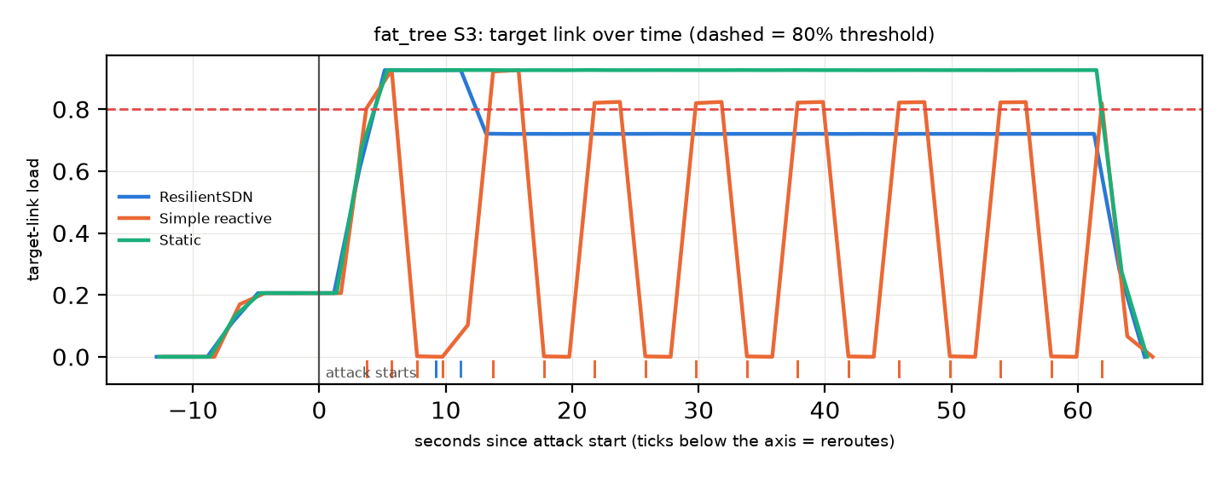
Appendix A2 — Target Link Over Time (Fat-tree, S3)
Static never moves the flow off the congested link. Simple reactive reroutes on every poll that shows congestion, with no memory — it oscillates the link above and below threshold repeatedly. ResilientSDN moves once, settles just under threshold, and stays there for the rest of the attack.

Slide 15
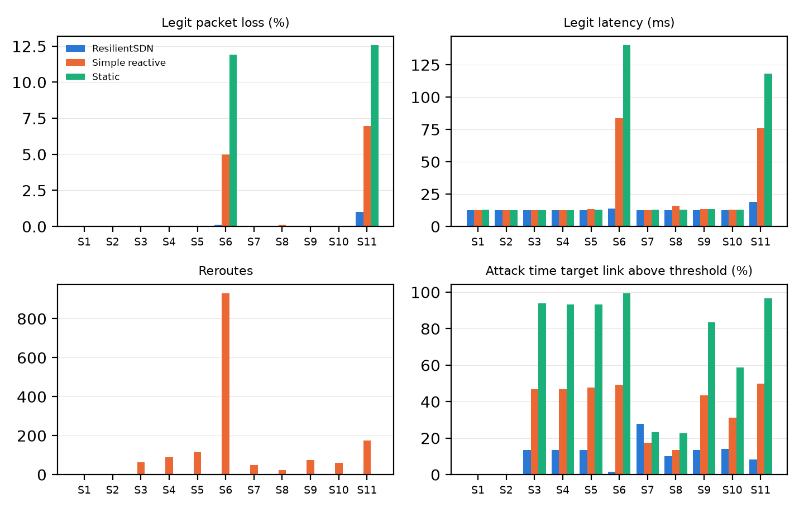
Appendix A3 — All 11 Scenarios at a Glance (Fat-tree)
Loss only shows up in overload cases (S6, S11). Reroutes concentrate almost entirely in simple reactive (up to 930 on S6). ResilientSDN holds the lowest time-above-threshold in all but two scenarios (S7, S8 — see Known Limits).

Slide 16
Appendix A4 — Ablation Study: Does Each Mechanism Earn Its Place?
A
Capacity filter
Yes on S4 (1.2→0.0, p<0.001) and S11 (3.0→0.8, p=0.016); no measurable effect on S3.
Reduces secondary congestion vs. simple reactive?
B
Hysteresis
Yes — S3 oscillations 7.0 → 0.1 (p<0.001). S7/S8 had nothing to compare (zero either way).
Reduces oscillation (flows bounced back to a used path)?
C
Multi-objective scoring
No measurable difference (p=0.75–0.93) — on fat-tree the two often pick identical paths.
Beats plain shortest-alternate-path on time-above-threshold?
D
Trend trigger (N=3 polls)
Yes — 1 false reroute → 0 on S1 (no attack), at the cost of ~8s slower reaction to a real burst.
Cuts false-alarm reroutes vs. single-threshold?
p-values are per-scenario Welch t-tests, uncorrected and descriptive — treated as signal, not proof.

