Slide 1
Hemodialysis Reservation App
Yusuf AlSawah 202002469
Antony Emil Kiroles 202000897
Donia Khaled Metwalli 202001875
Amr Mahmoud Mohamed 019200010
Omar Shoaib 202001663
Haidy Hosny 202000197

Slide 2
TABLE OF CONTENTS
01.
Business Rules
02.
ERD and Database
03.
App Functionality
04.
Implementation

Slide 3
INTRODUCTION
Patients with kidney chronic dieaseses need hemodialysis appointments at least on a weekly basis.
They also need a way to quickly access their history to help doctors understand their needs

Slide 4
INTRODUCTION
On the other hand, hospitals need a method to manage their dialysis machines and get reports on their usage and status

Slide 5
01.
Business Rules

Slide 6
Business Rules
Patient
Patient
Patient
A patient should be able to register using their name, phone number, email, gender
The patient should be able to log in with a UserName and Password
Patient should be able to request a dialysis appointment for a specific dialysis machine at a certain day and time slot

Slide 7
Business Rules
Patient
Patient
Patient
A patient should be able to view all of the appointment booking history even for cancelled appointments
A patient should have a medical history linked to their appointments that can have a doctor’s diagnosis attached
A patient should be able to only view their medical record

Slide 8
Business Rules
Doctor
Doctor
Doctor
A doctor should be able to be registered by the hospital adminstrator using their name, phone number, email, gender, and the hospital where they work
A doctor should be able to log in with a UserName and Password
A doctor should be able to accept or reject appointments requested by a patient

Slide 9
Business Rules
Doctor
Hospital
Hospital
A doctor should be able edit and append to the medical record of a patient
A hospital could be registered to the system using the hospital name, Email, Phone Number, Address, City, and area
A hospital admin should be able to log in and manage the hospital’s resources using a UserName and a Password

Slide 10
Business Rules
Hospital
Hospital
A hospital can own multiple dialysis machines where each machine has a number of appointment slots per day, slot duration, booking price, and machine availability
A hospital could accept or reject an appointment and can view all appointments related to its dialysis machines

Slide 11
02.
ERD and Database

Slide 12
ERD
Database Schema
Functional Dependencies

Slide 13
ERD

Slide 14
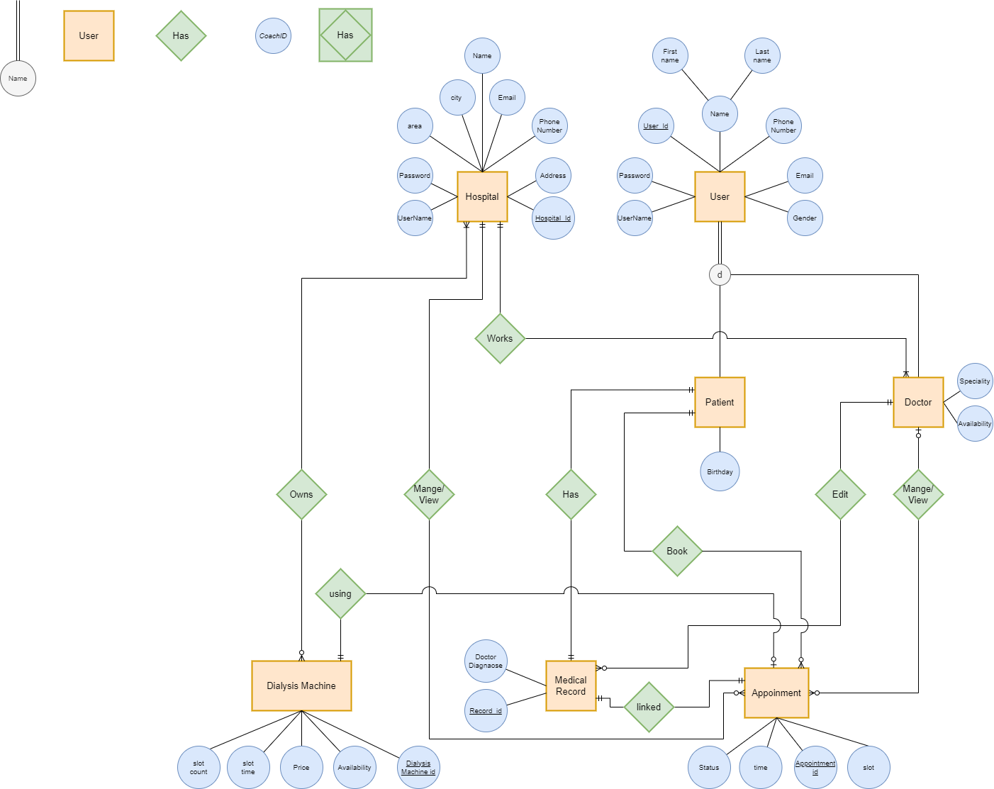

Slide 19
Database Schema

Slide 20
hospital
hospital_id | hospital_name | address | phone_number | email | city | area | username | password
app_user
user_id | first_name | last_name | phone_number | email | gender | user_type | username | password
patient
patient_id | birthday
doctor
doctor_id | hospital_id

Slide 21
hospital
hospital_id | hospital_name | address | phone_number | email | city | area | username | password
dialysis_machine
Dialysis_machine_id | hospital_id | start_time | time_slot | slots_number | price | availability
patient
patient_id | birthday
doctor
doctor_id | hospital_id
appointment
appointment_id | dialysis_machine_id | hospital_id | patient_id | doctor_id | status | time | slot

Slide 22
medical_record
record_id | doctor_diagnosis | appointment_id | patient_id | doctor_id
patient
patient_id | birthday
doctor
doctor_id | hospital_id
appointment
appointment_id | dialysis_machine_id | hospital_id | patient_id | doctor_id | status | time | slot

Slide 23
Functional Dependencies

Slide 24
hospital
hospital_id | hospital_name | address | phone_number | email | city | area | username | password
app_user
user_id | first_name | last_name | phone_number | email | gender | user_type | username | password
patient
patient_id | birthday
doctor
doctor_id | hospital_id

Slide 25
medical_record
record_id | doctor_diagnosis | appointment_id | patient_id | doctor_id
dialysis_machine
Dialysis_machine_id | hospital_id | start_time | time_slot | slots_number | price | availability
appointment
appointment_id | dialysis_machine_id | hospital_id | patient_id | doctor_id | status | time | slot

Slide 26
App Functionality
03.

Slide 27
App Views:
Patient’s View
Doctor’s View
Hospital’s View
Allows the patient to:
View their upcoming appointments
Reserve an appointment, as well as cancel
View medical history
Allows the doctor to:
View his upcoming appointments
Cancel a patient’s appointment
Add a diagnosis after the appointment is complete
View his/her appointment history
Allows the hospital to:

Slide 28
Implementation
04.

Slide 29
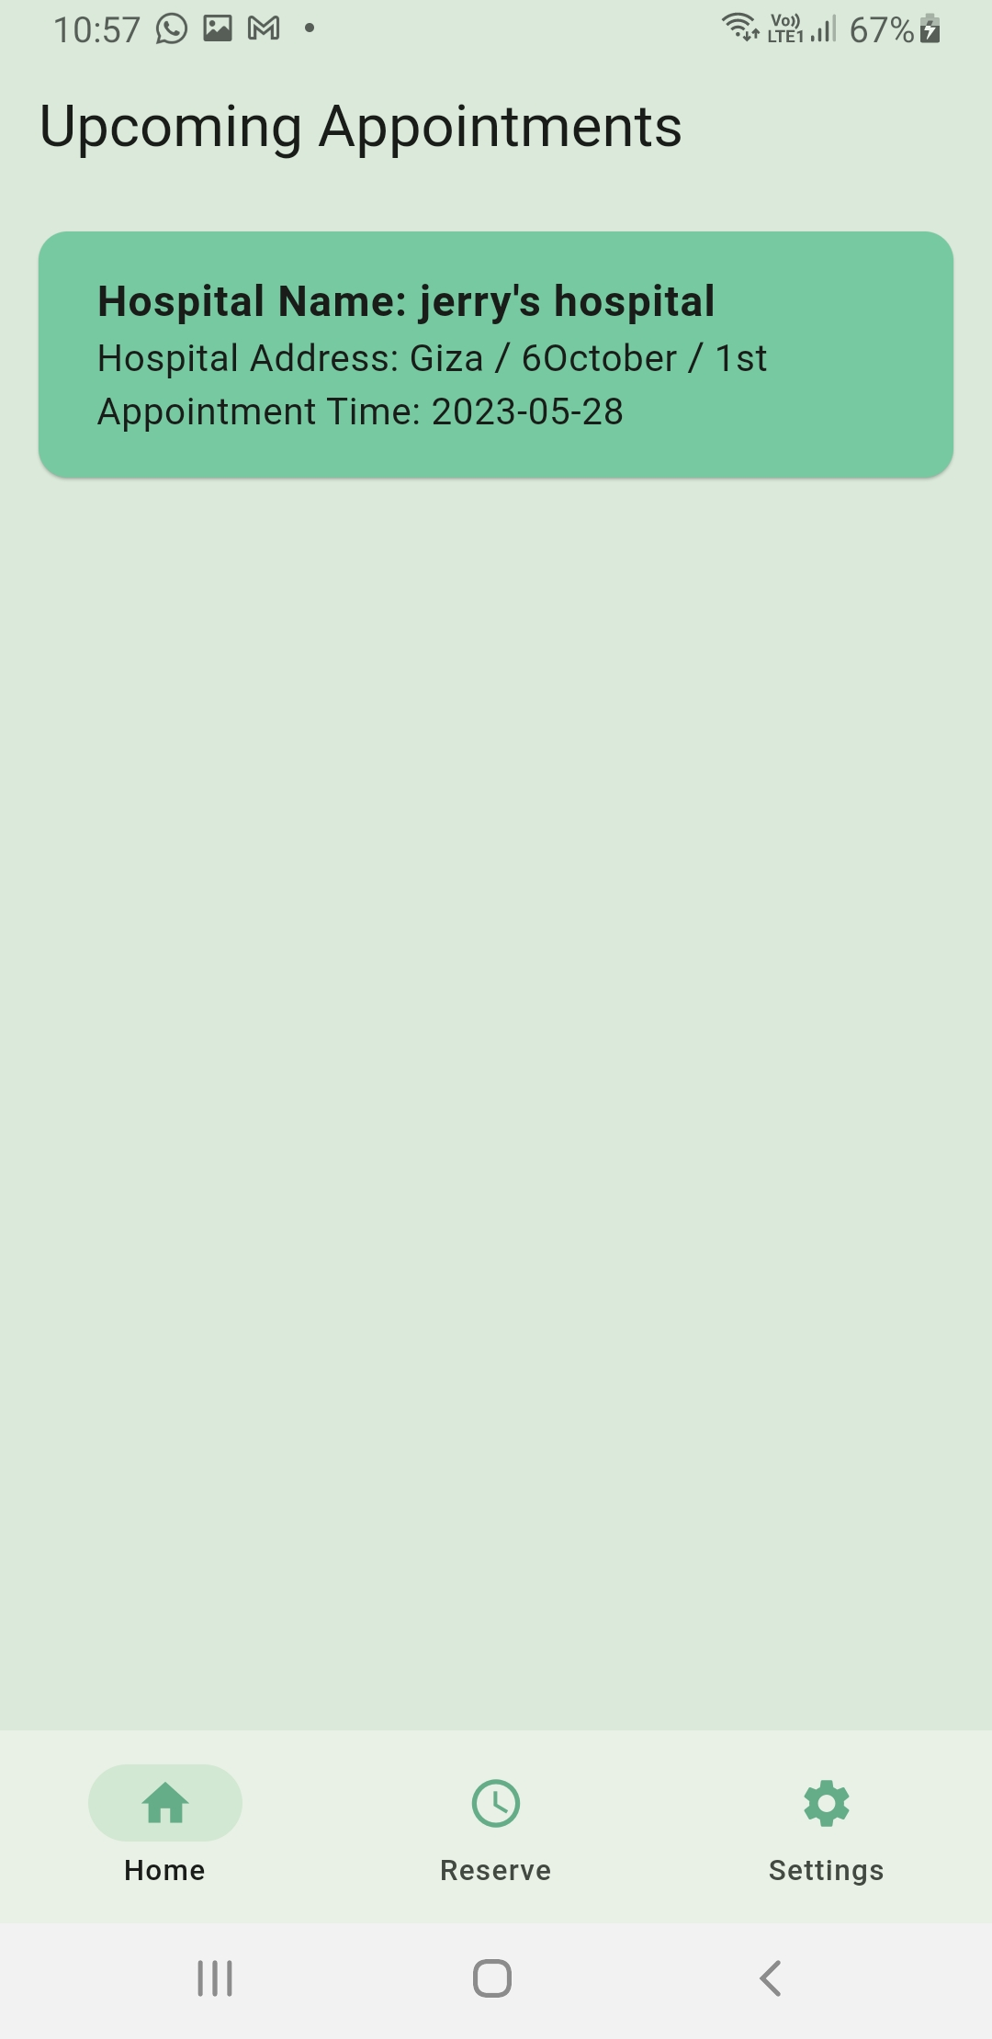
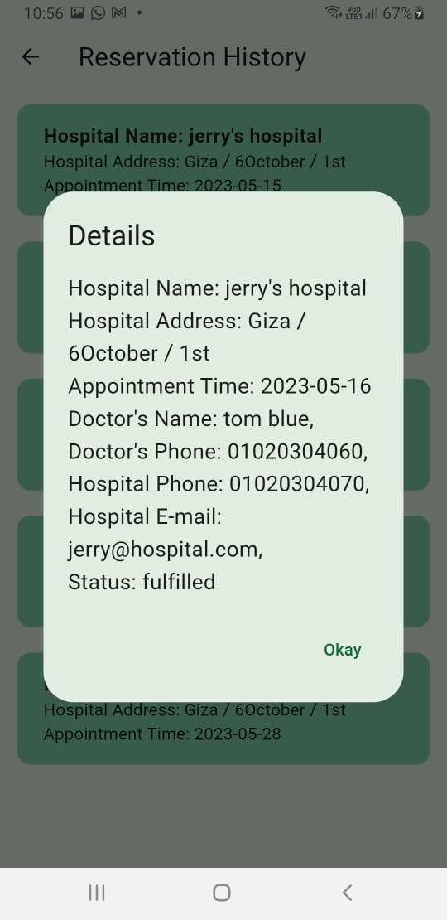
Patient’s View

Slide 30
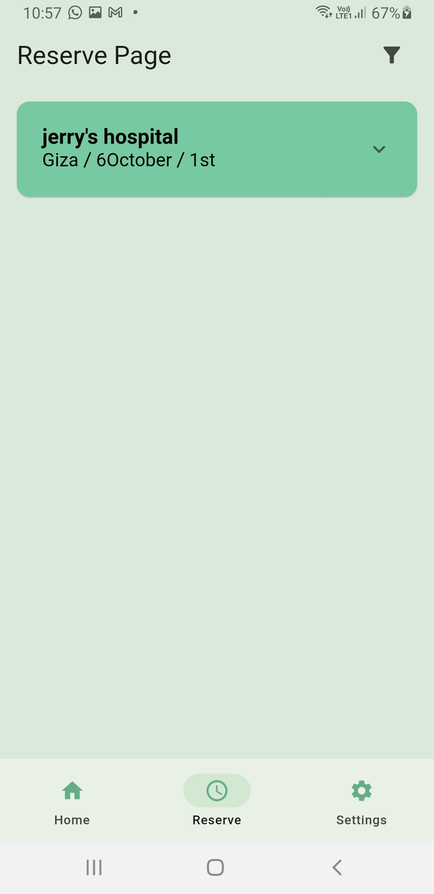
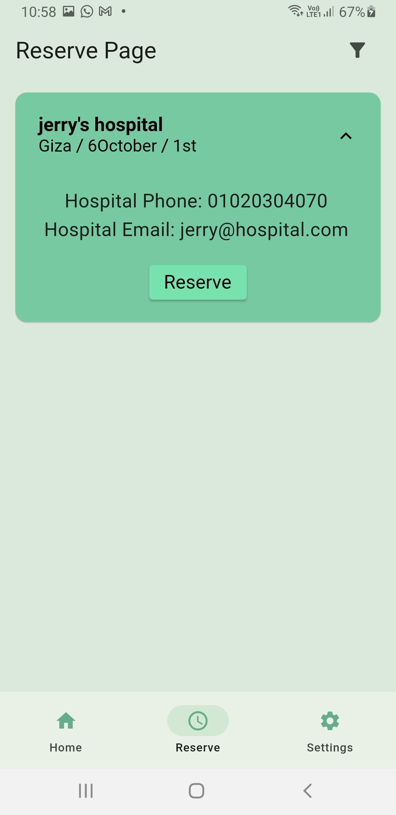
Patient’s View

Slide 31
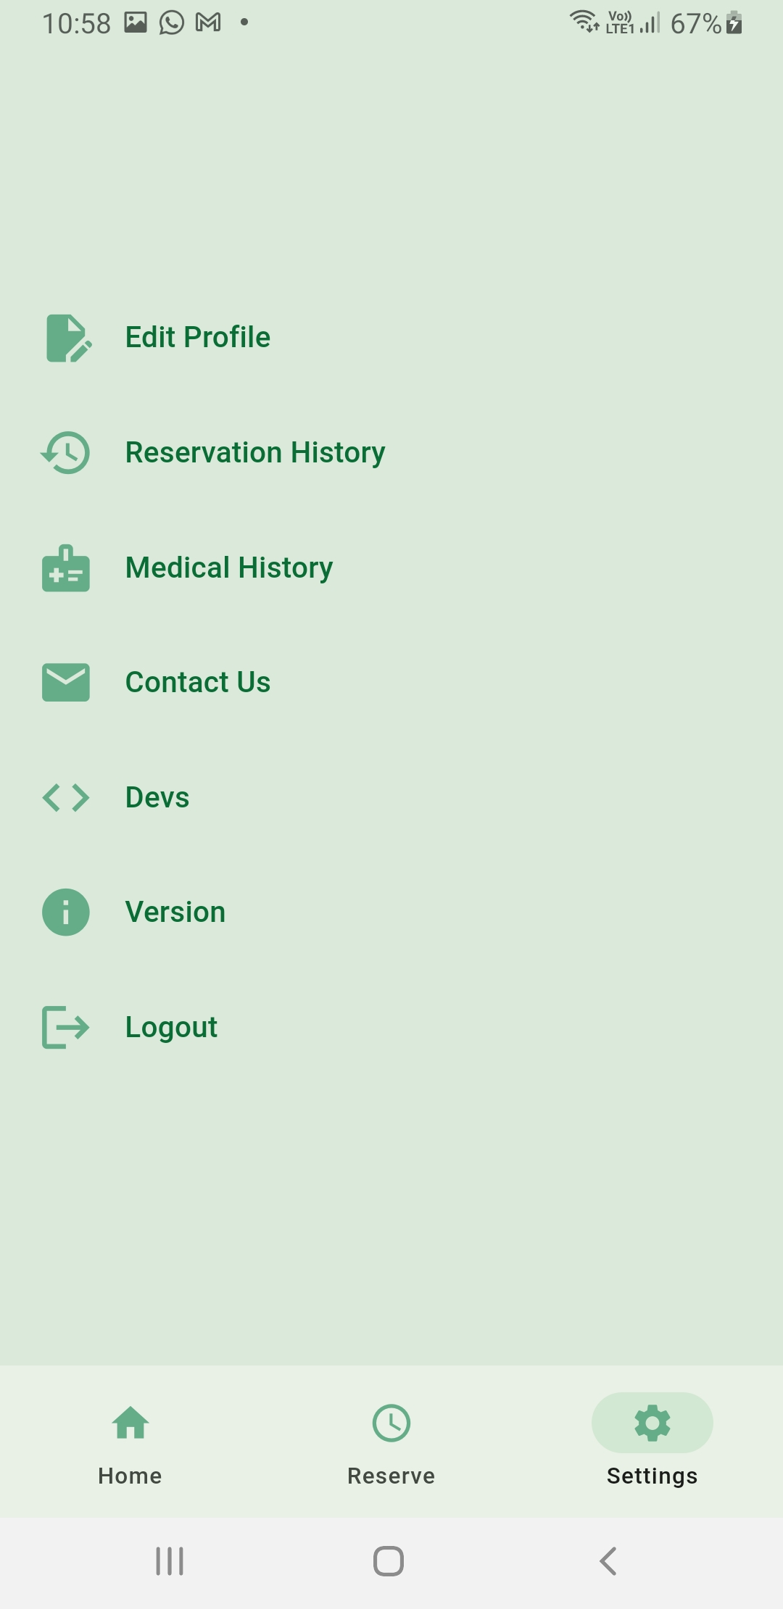
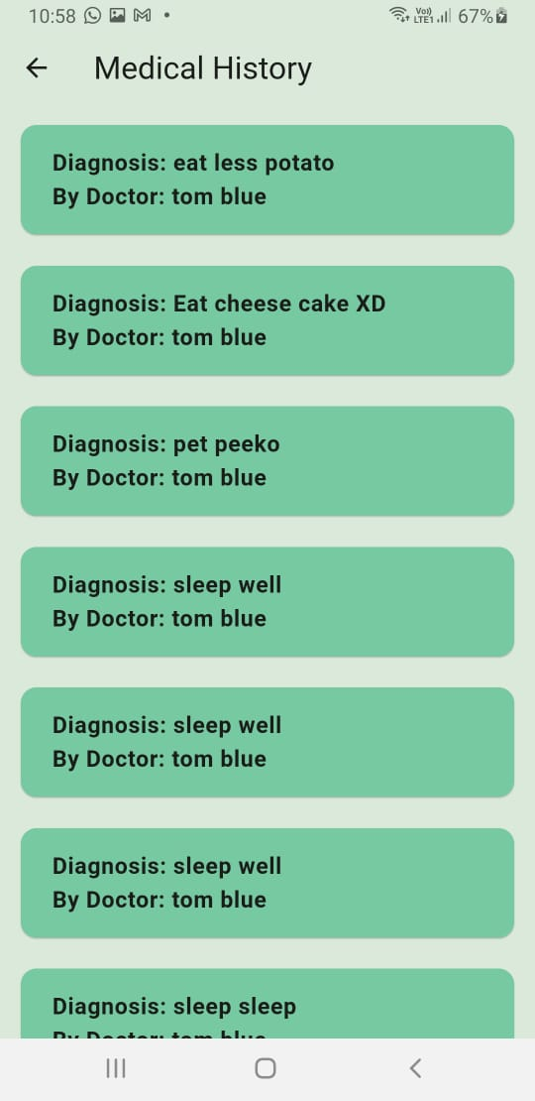
Patient’s View

Slide 32
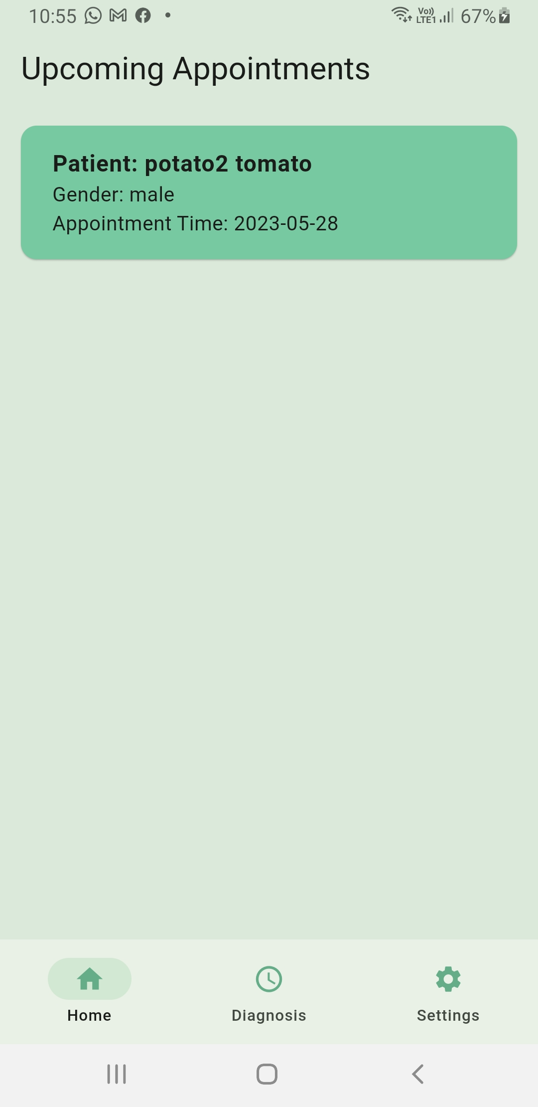
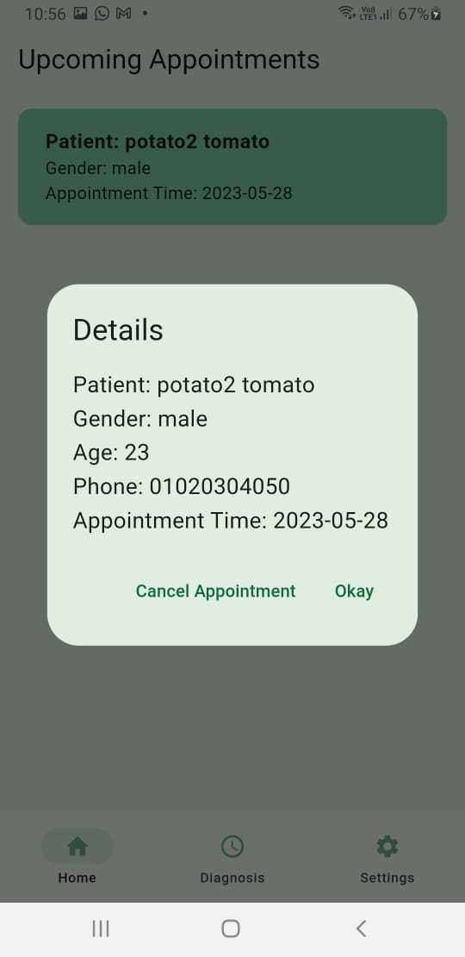
Doctor’s View

Slide 33
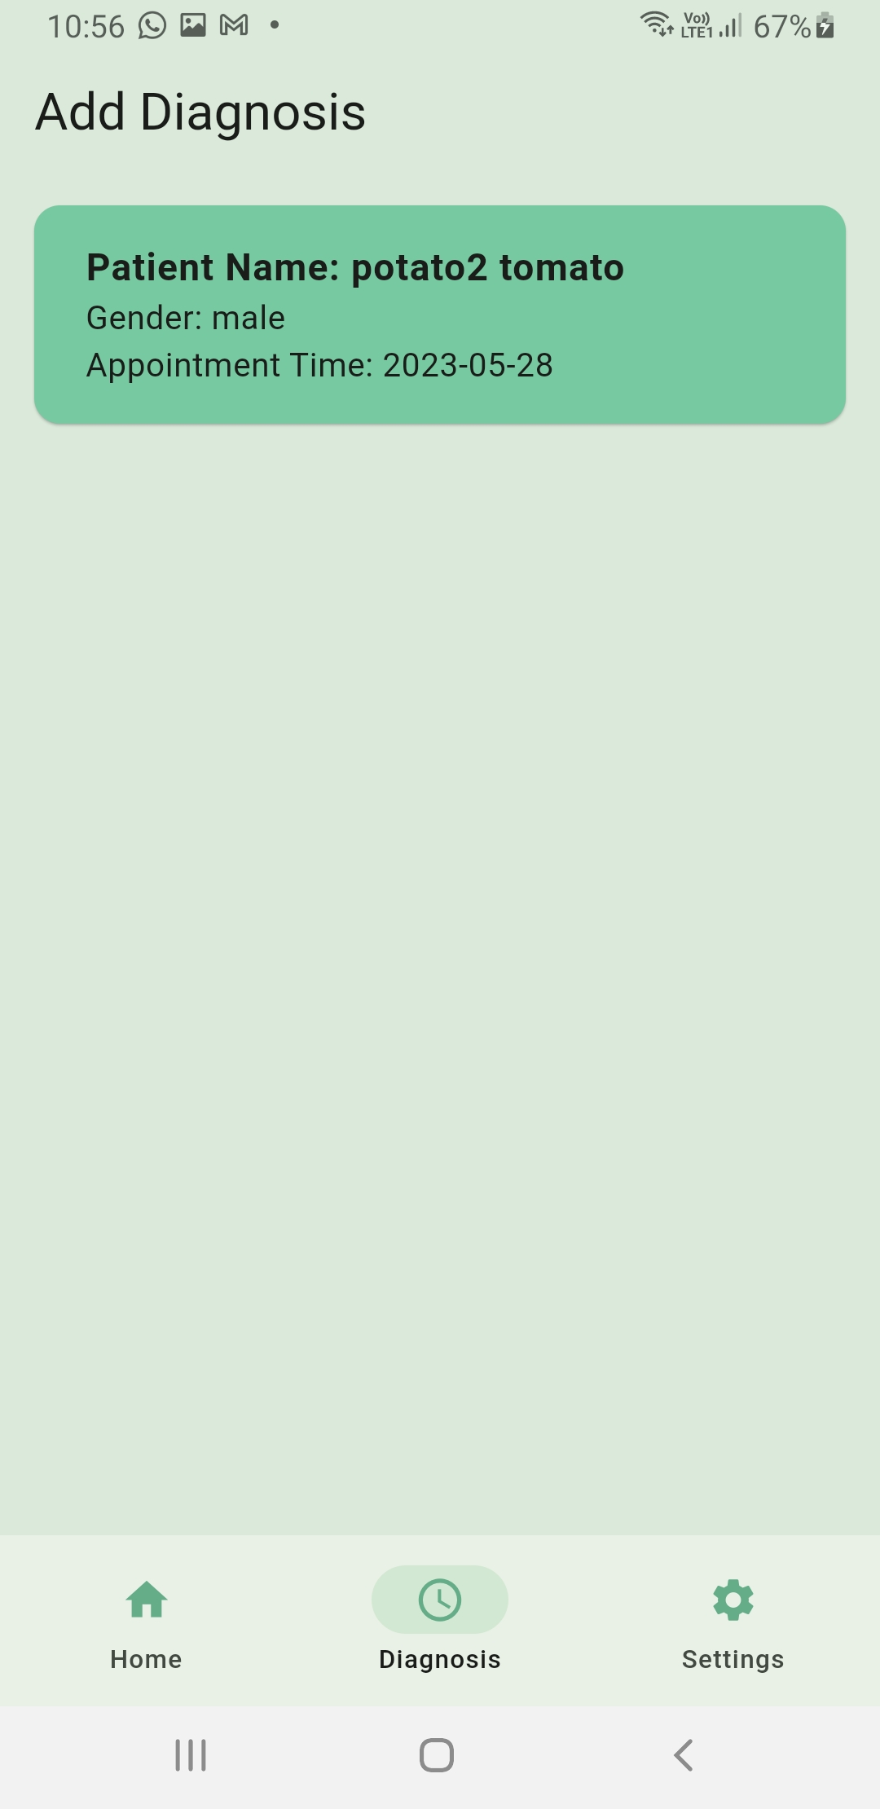
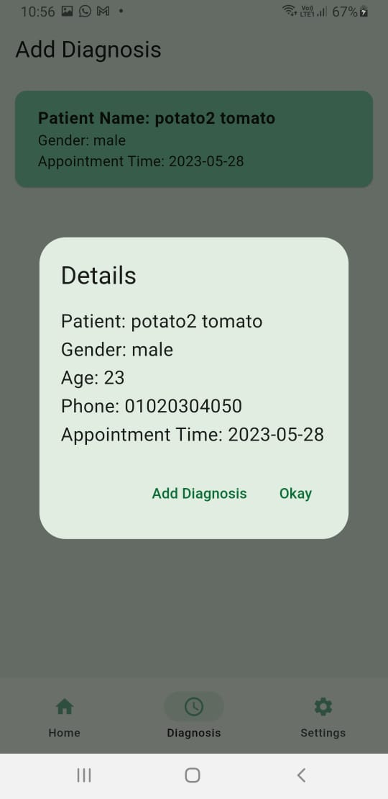
Doctor’s View

Slide 34
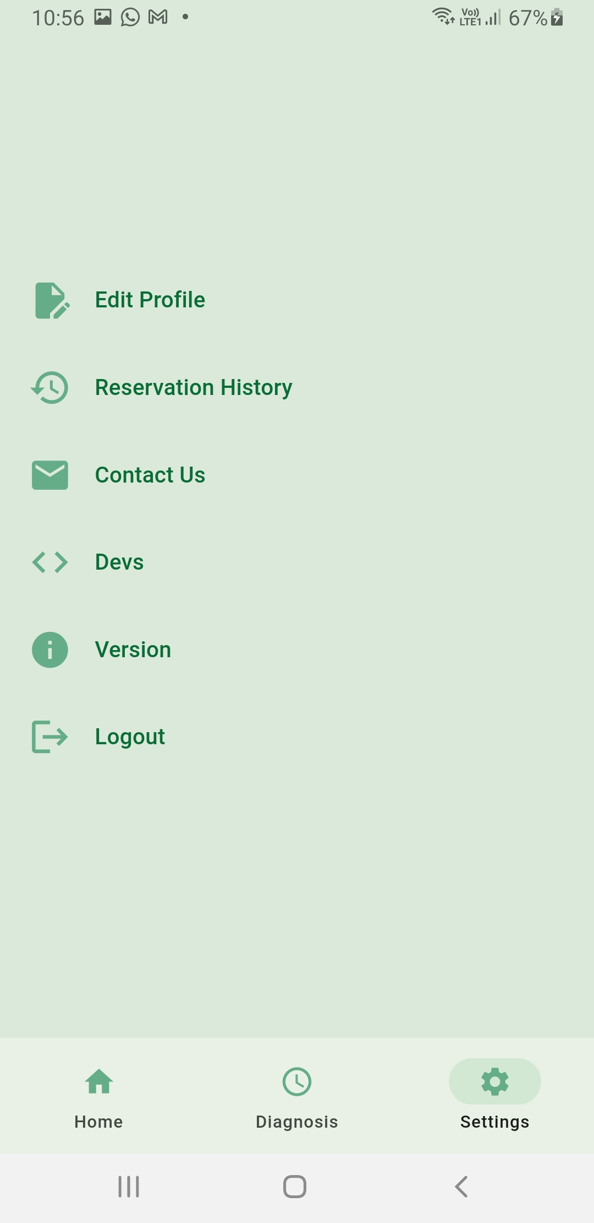
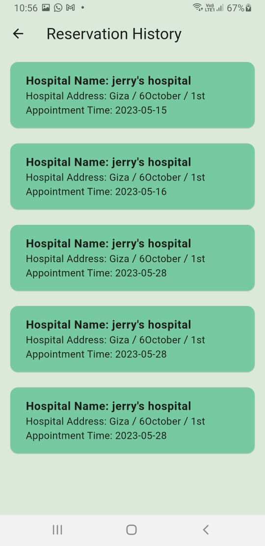
Doctor’s View

Slide 35
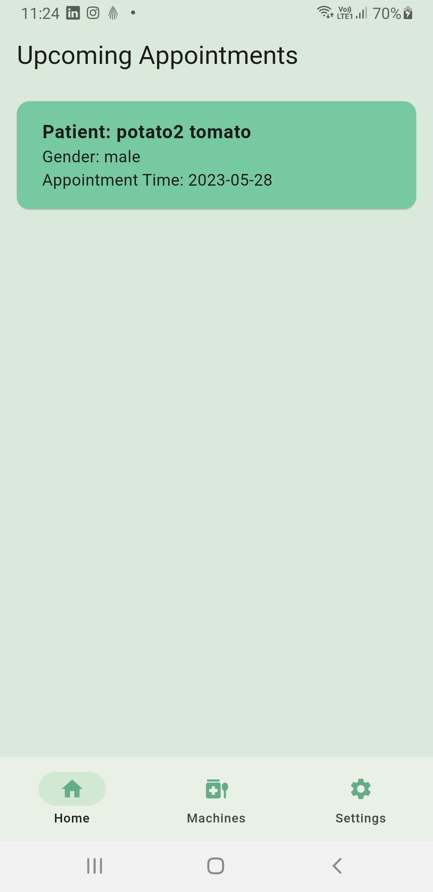
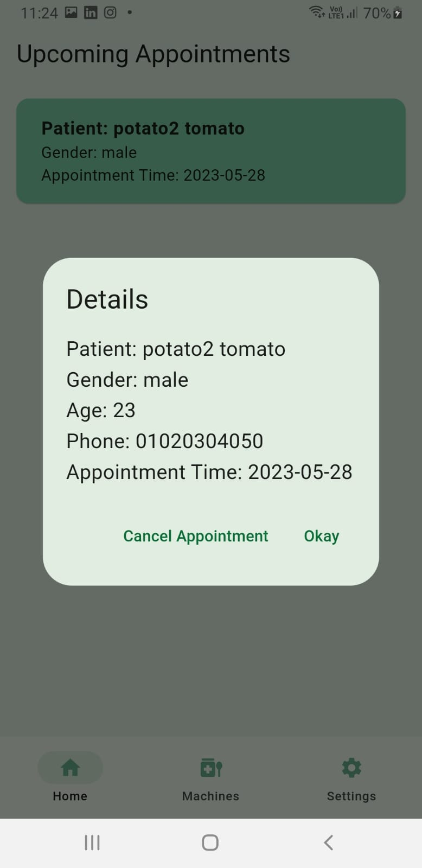
Hospital’s View

Slide 36
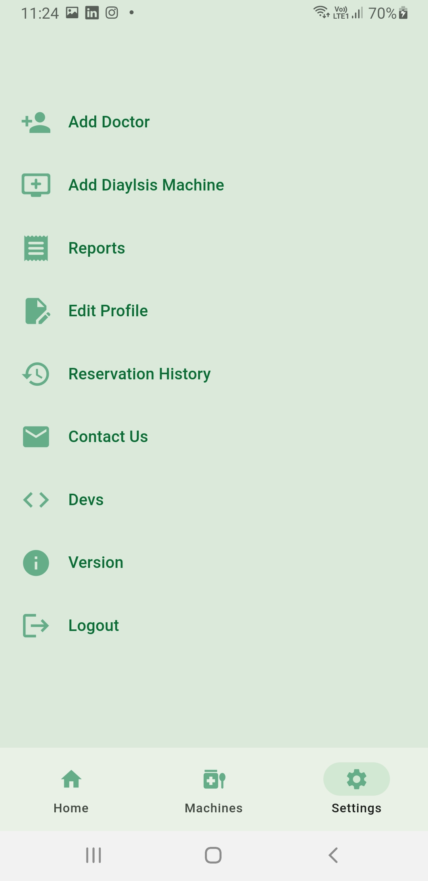
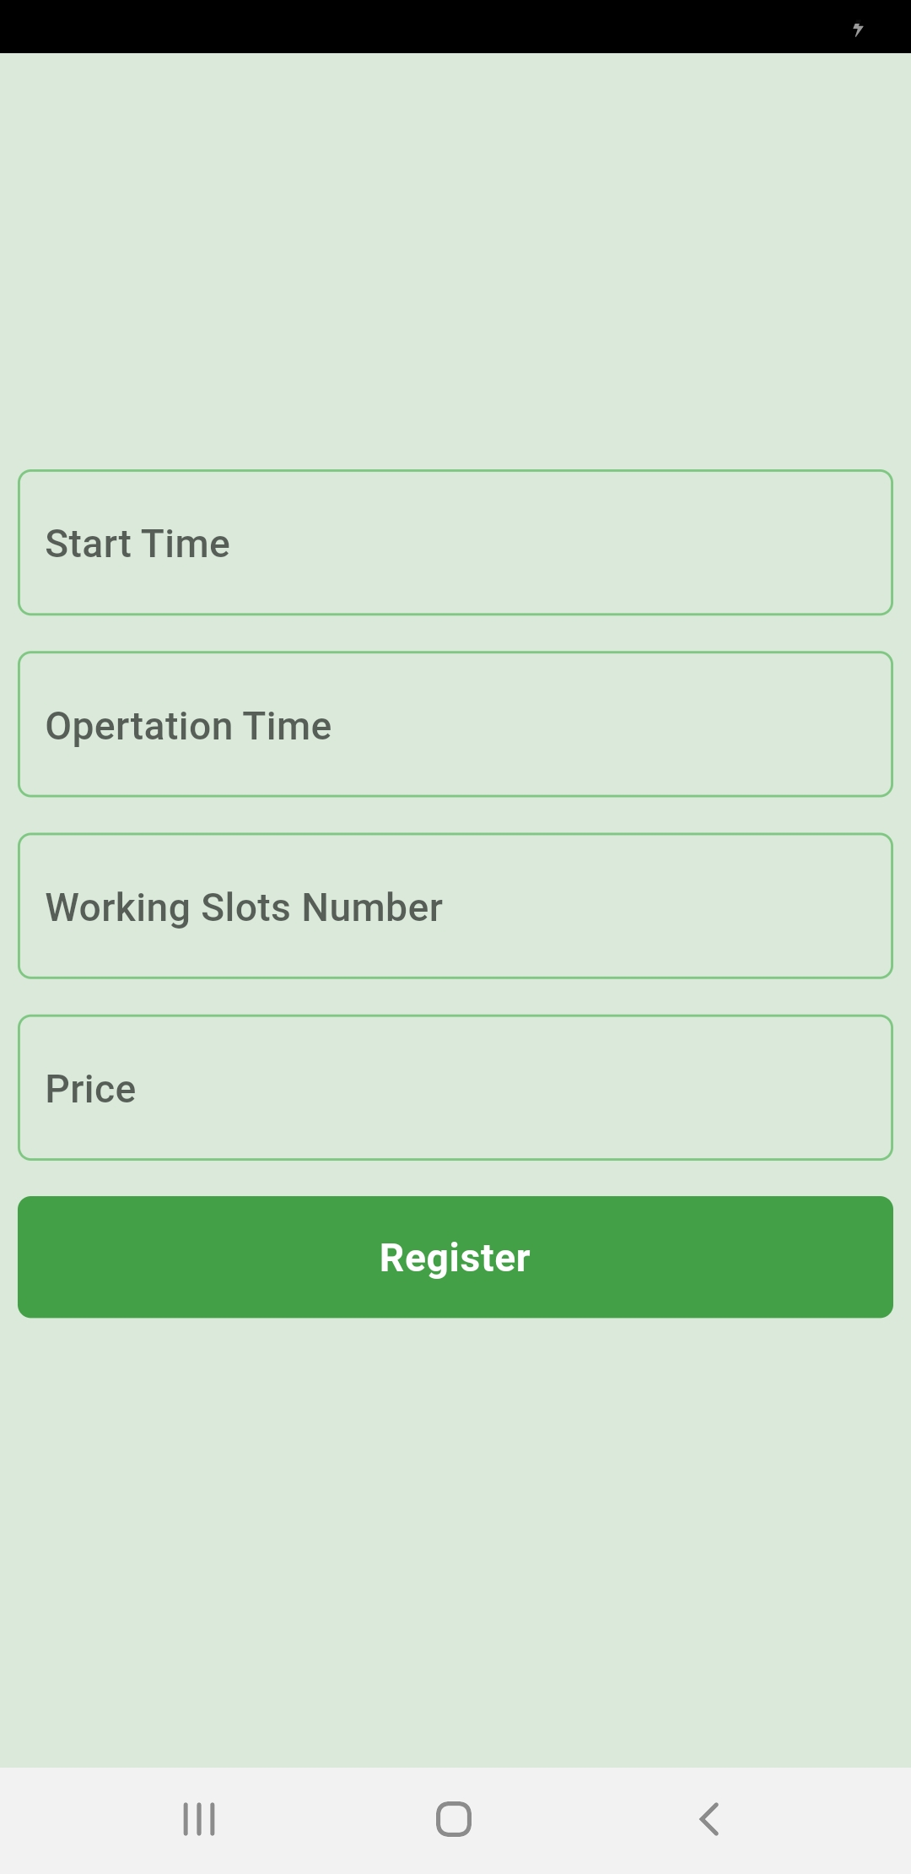
Hospital’s View

Slide 37
Thank you!
Any Questions?

