Slide 1
Introduction to Data Structures and Algorithms
Lecture 13-1

Slide 2
Objectives
Data Structures
Algorithms

Slide 3
Data structure
Data structure – method to store information

Slide 4
Algorithms
Algorithm – method for solving a problem
Algorithm – a process or set of rules to be followed in calculations or other problem-solving operations

Slide 5
Algorithms
Algorithms are at the heart of computing. Any system, be it software or hardware, will have algorithms (and data structures) as its basic building blocks.
Schneider F.B. Rodd M (Eds)
‘International Review of UK Research in Computer Science’, (2001)
http://www.iee.org/policy/csreport/cs_report.pdf

Slide 6
Why study Algorithms?
If you know about available algorithms you can:
avoid re-inventing the wheel.
select best algorithm based on information on complexity for different tasks.
develop new algorithms more easily.

Slide 7
Algorithms
Web searching
Human genome project
Airline crew scheduling
GPS navigation
Financial prediction systems
Timetabling

Slide 8
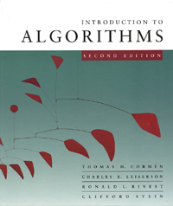
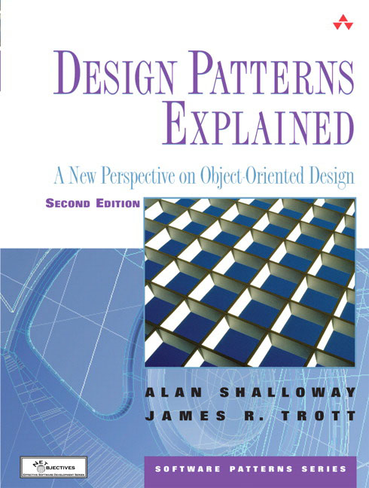
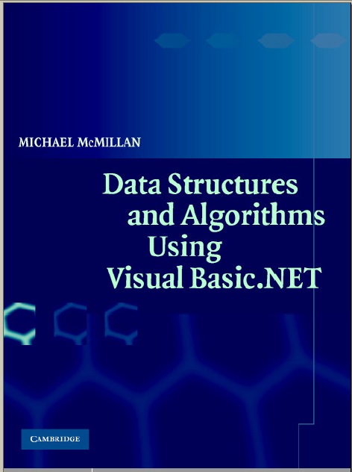
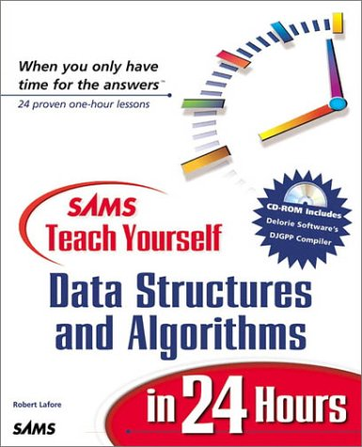
Books

Slide 9
The End

