Slide 2
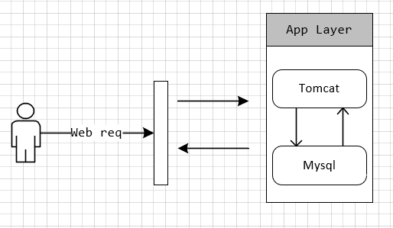

Slide 3
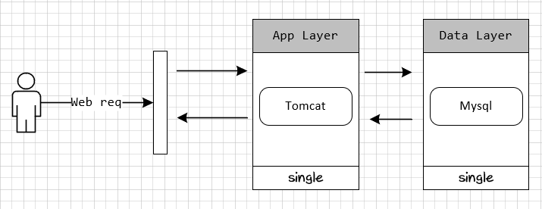

Slide 4
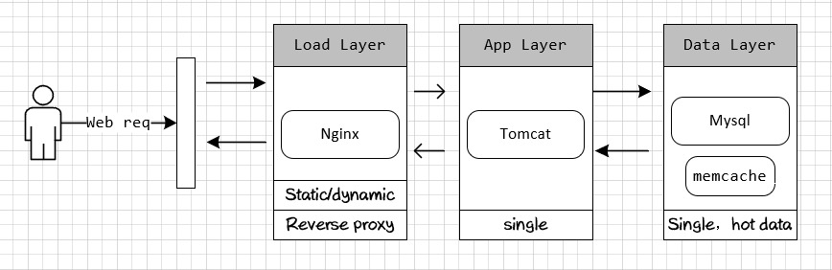

Slide 5
Single point of failure

Slide 6
Cluster mode:
Leader-Follow
Leader-Stand By
Leader-Leader

Slide 7
