Slide 1
Flink SQL

Slide 2
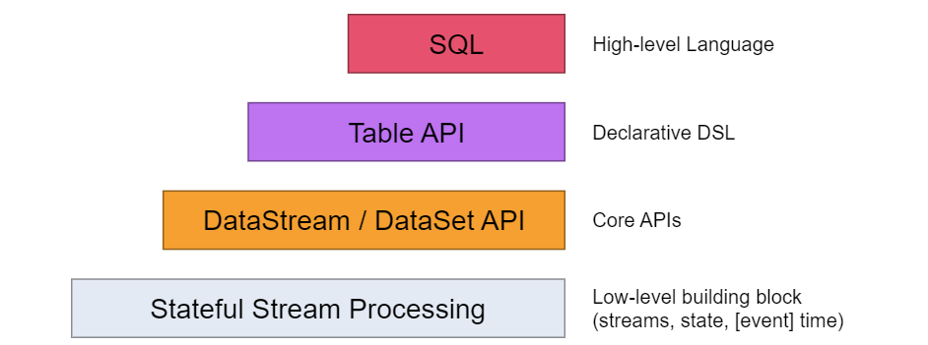
What?
The highest level abstraction offered by Flink is SQL
Flink SQL is based on Apache Calcite which implements the SQL standard

Slide 3
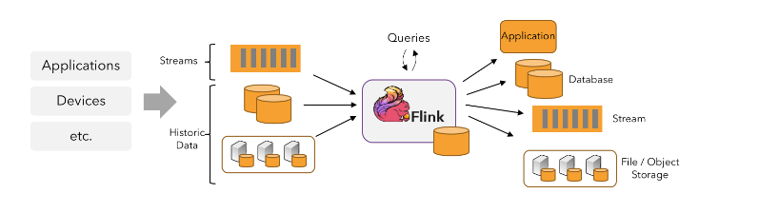
User Cases
Data Pipeline
Data Analytics
Data Drive

Slide 4
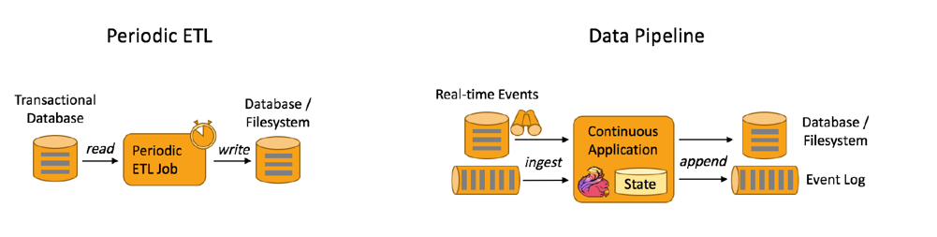
Data Pipeline
Real time stream ETL

Slide 5
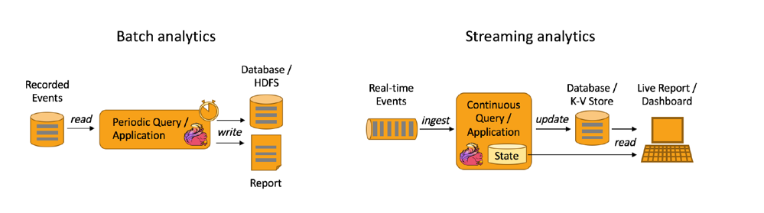
Data Analytics
Real time stream report

Slide 6
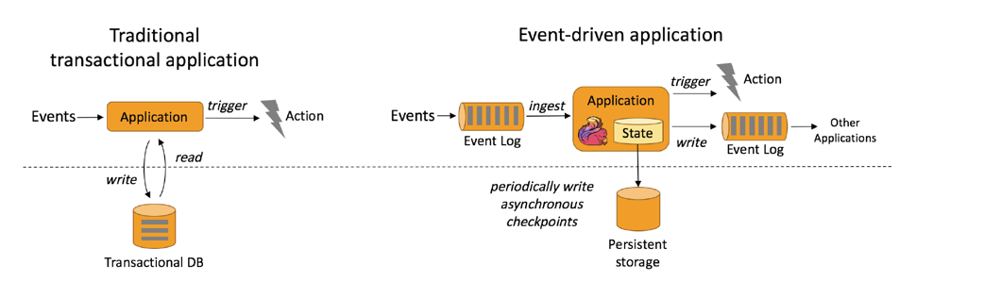
Data Drive
Real time risk control system

Slide 7
Demo One
Flink CDC (Change Data Capture)

Slide 8
Flink SQL Platform
Workspace
Script
Connector
Function
CI/CD

