Slide 1
Morandi
简约莫兰迪色PPT模板
汇报人：PPT汇

Slide 2
目录
CONTENTS
1
2
3
4
标题文字
标题文字
标题文字
标题文字

Slide 3
https://www.ypppt.com/

Slide 4
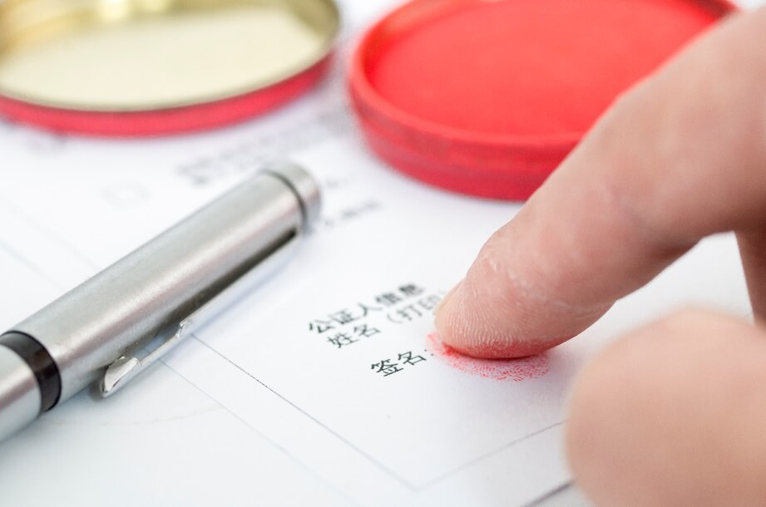

标题文字
20XX
20XX
标题文字添加
标题文字添加
The user can demonstrate on a projector or computer, or print the presentation and make it into a film to be used
The user can demonstrate on a projector or computer, or print the presentation and make it into a film to be used

Slide 5
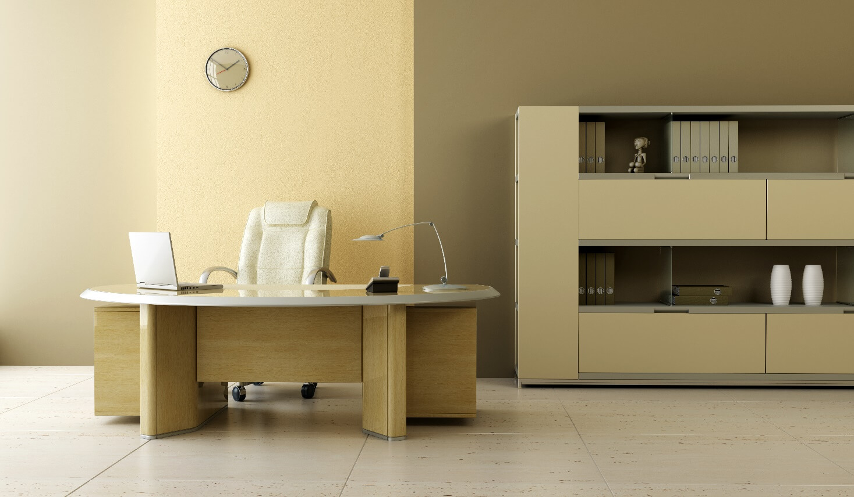
标题文字
标题文字添加
The user can demonstrate on a projector or computer, or print the presentation and make it into a film to be usedThe user can demonstrate on a projector or computer, or print the presentation and make it into a film to be used

Slide 6
标题文字
100%
标题文字添加
The user can demonstrate on a projector or computer, or print the presentation and make it into a film to be used
75%
60%
45%
标题文字添加
The user can demonstrate on a projector or computer, or print the presentation and make it into a film to be used
25%
15%
20%
2013
2014
2015
2016
2017
2018
2019

Slide 7
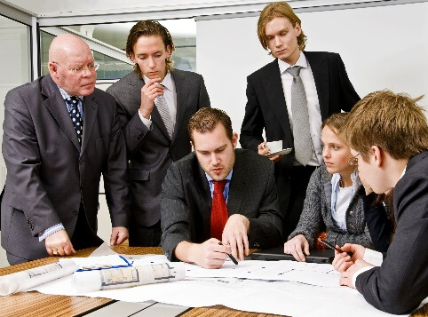


标题文字
标题文字添加
标题文字添加
标题文字添加
The user can demonstrate on a projector or computer, or print the presentation and make it into a film to be used
The user can demonstrate on a projector or computer, or print the presentation and make it into a film to be used
The user can demonstrate on a projector or computer, or print the presentation and make it into a film to be used

Slide 9
标题文字
标题文字添加
标题文字添加
The user can demonstrate on a projector or computer, or print the presentation and make it into a film to be used
The user can demonstrate on a projector or computer, or print the presentation and make it into a film to be used
标题文字添加
标题文字添加
The user can demonstrate on a projector or computer, or print the presentation and make it into a film to be used
The user can demonstrate on a projector or computer, or print the presentation and make it into a film to be used

Slide 10
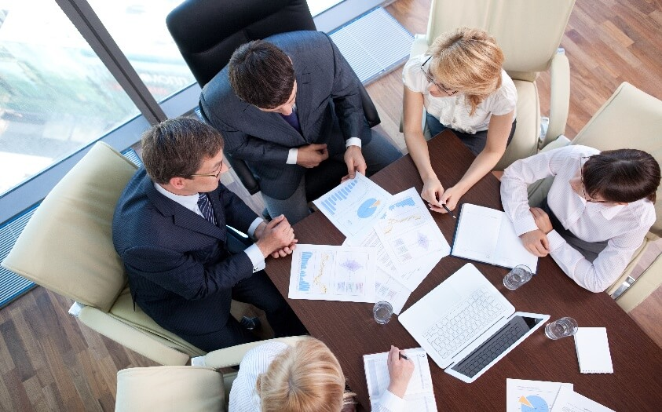


标题文字
标题文字添加
标题文字添加
The user can demonstrate on a projector or computer, or print the presentation and make it into a film to be used
The user can demonstrate on a projector or computer, or print the presentation and make it into a film to be used
标题文字添加
The user can demonstrate on a projector or computer, or print the presentation and make it into a film to be used

Slide 11

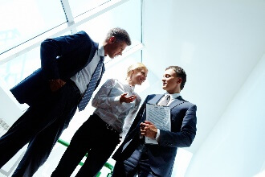

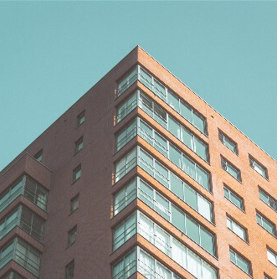
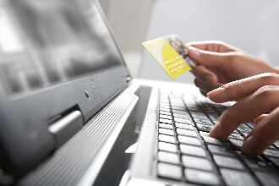
标题文字
标题
文字添加
标题
文字添加
标题
文字添加
标题
文字添加
标题
文字添加
PPT模板 http://www.1ppt.com/moban/
Notes:
https://www.ypppt.com/

Slide 13
标题文字
The user can demonstrate on a projector or computer,
文字添加
The user can demonstrate on a projector or computer, or print the presentation and make it into a film to be used
文字添加
The user can demonstrate on a projector

Slide 14
标题文字
Morbi dignissim nisl in diam sagittis, id dapibus nulla pretium. Sed vitae quam metus. Morbi dignissim nisl in diam sagittis, id dapibus nulla pretium. Sed vitae quam metus.
2015
2016
2017
2018
2019
2020
TEXT
TEXT
TEXT
TEXT
TEXT
TEXT

Slide 15
标题文字
Venus has a beautiful name
Neptune is the farthest planet
A
Venus
1ST SCENARIO
B
Earth
Earth is the planet we live on
SCENARIO OPTIONS
Mercury is the closest to the Sun
A
Mercury
2ND SCENARIO
Mars is a very cold place
B
Saturn
Saturn is a gas giant and has rings

Slide 16
标题文字
DEFINE
Neptune is the farthest planet from the Sun
Saturn
SCENARIO 01
Jupiter
EXPLORE
SCENARIO STUDY
CREATE
Mars
SCENARIO 02
Saturn is a gas giant and has several rings
Neptune
COMMUNICATE

Slide 18
标题文字
RESEARCH
METHOD
CRITERIA
ENDING
Mercury is the smallest planet of them all
Despite being red, Mars is actually a cold place
Jupiter is a gas giant and the biggest one
Neptune is the eighth and farthest-known one

Slide 19
标题文字
Morbi dignissim nisl in diam sagittis, id dapibus nulla pretium. Sed vitae quam metus. Morbi dignissim nisl in diam sagittis, id dapibus nulla pretium. Sed vitae quam metus.
S
T
A
R
Despite being red, Mars is a very cold place
Jupiter is a gas giant and the biggest planet
Venus is the second planet from the Sun
Planet Mercury is the closest one to the Sun
Situation
Task
Action
Results

Slide 20
标题文字
Morbi dignissim nisl in diam sagittis, id dapibus nulla pretium. Sed vitae quam metus. Morbi dignissim nisl in diam sagittis, id dapibus nulla pretium. Sed vitae quam metus.
Yes
Venus is the second planet from the Sun
What could happen?
SCENARIO 01
GROWTH PLAN
No
Yes
Saturn is a gas giant and has rings
What could happen?
SCENARIO 02
DEFENSIVE PLAN
No

Slide 21
THANKS FOR YOUR COMING
Morbi dignissim nisl in diam sagittis, id dapibus nulla pretium. Sed vitae quam metus. Etiam fermentum turpis vel lectus dignissim consectetur.

Slide 22

上万精品PPT模板全部免费下载
PPT汇 www.ppthui.com
PPT模板下载：www.ppthui.com/muban/ 行业PPT模板：www.ppthui.com/hangye/
工作PPT模板：www.ppthui.com/gongzuo/ 节日PPT模板：www.ppthui.com/jieri/
PPT背景图片:
Notes:
模板来自于 https://www.ppthui.com 【PPT汇】

