Slide 1
Quantification of Map Matching Credibility based on GNSS Positioning Covariance
Reporter: Chenzhang Ning
GNC Lab, SJTU
ICASSE 2025, SINGAPORE
July. 31st, 2025
Notes:
Nice to meet each professors and researchers! This work has proposed a credibility monitoring architecture for GNSS positioning method named map matching. I am reporter today from GNC Lab, SJTU. This work is instructed by Prof. Zhan and Mr. Zhai.

Slide 2
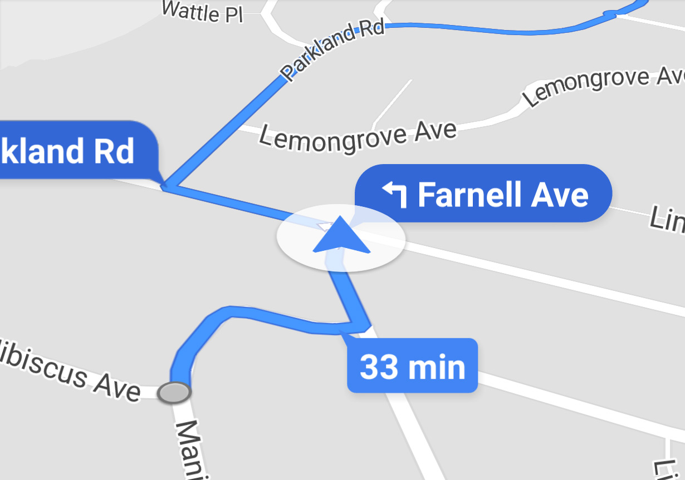

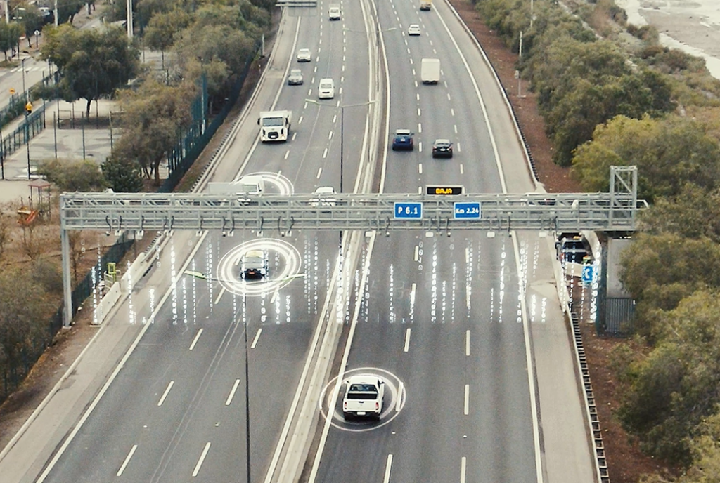
Application Scenario
Location based service (LBS)
Navigation on Google Map
Topology Positioning for Auto Driving
Free Flow Toll by GNSS Trajectories
One crucial assumption of those applications is that the tracking points represent the true locations, which comes from GNSS.
Notes:
While today’s session is about control system; this research is focusing on how to make navigation system more reliable. Even though the research background may be unfamiliar with most listeners, I will try my best to make my lecture straight forward.
Navigation on Google map or autonomous driving system needs to know the position w.r.t. the road map, for the decision maker both human or algorithm, so they can know the exact time for turning. Free flow toll which is already carried on in Germany and Singapore, is relied on the correct trajectory to make sure the charge is fair enough.

Slide 3
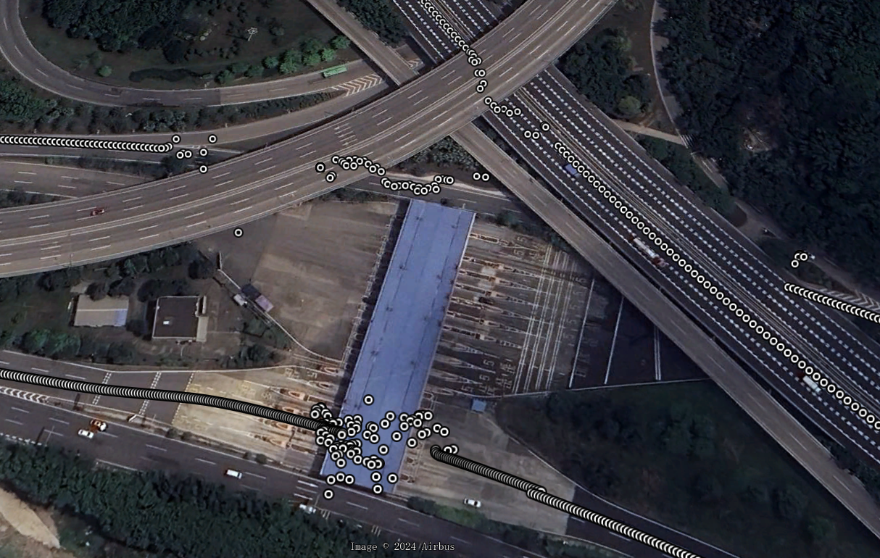
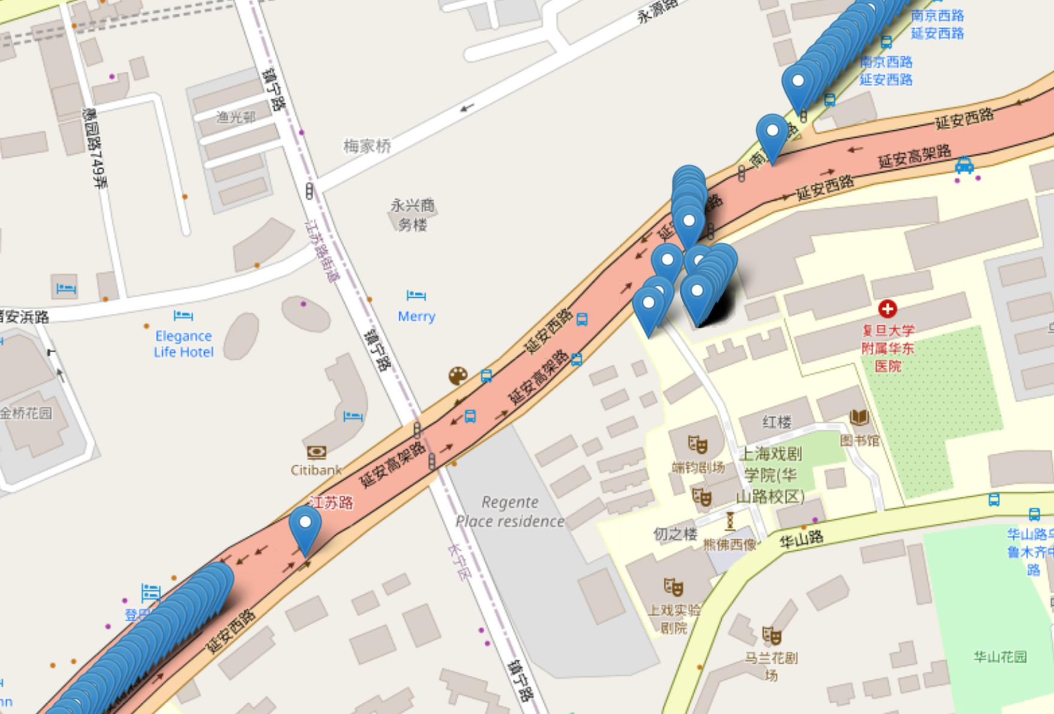
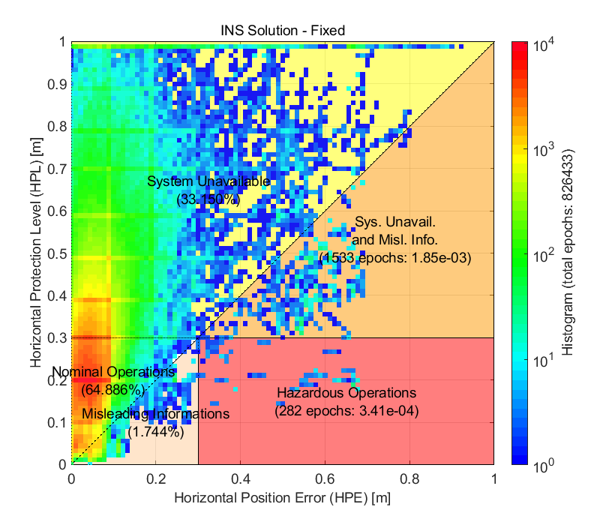
Problem to Address
Current problems of LBS:
GNSS is prone to non-line of sight signals and obstacles
Integrity monitor is faced with inflation of PLs, causing loss of availability
Pos using NRTK in satellite view
Pos using NRTK in osm map
IM results in urban environment
Notes:
However, GNSS can be misleading in many circumstances such as city canyon, where non-line of sight signals and obstacles would affect the correctness of GNSS positioning, which is shown in the first and second picture. You can see huge bias of the trajectory, or even missing points due to signal obstacles.
Traditional reliability monitoring system is established to over bound the positioning error, which is called integrity monitor. The third picture shows an instance of this system. As the horizontal and vertical axis stands for errors and its guess respectively, dots under the black diagnol means misleading positions, while the opposite would trigger an alert, causing system unavailable. As shown in the figure, the performance can not meet the requirement in fore-mentioned applications.

Slide 4
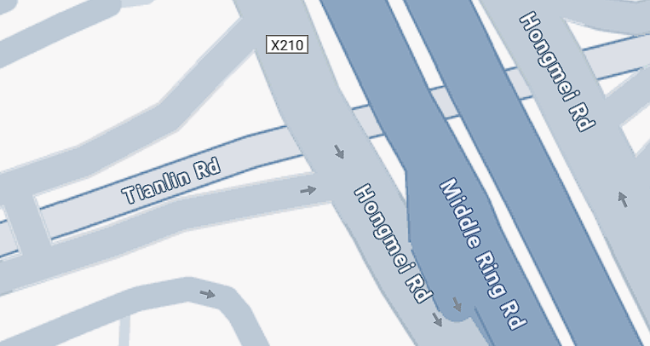



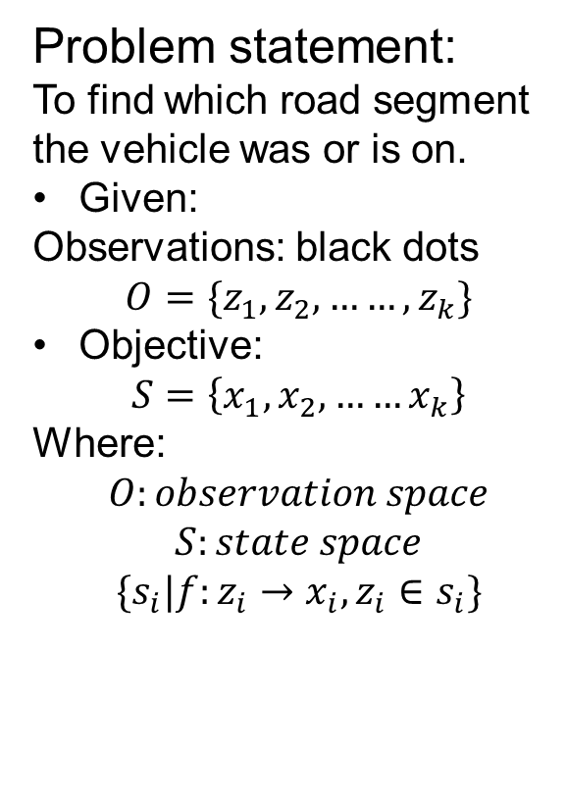












Objective and Significance
Improve the quality by utilizing the map information
Pre-processing: vehicle can only travel alone the road, which serves as priori constrain--Map Matching
Attempt to give warning when system providing mis-leading information
Adjusting the likelihood and give warning when it is low—Quantification of Map Matching Credibility
$$r_{3}$$
$$r_{4}$$
Problem statement:
To find which road segment the vehicle was or is on.
Given:
Observations: black dots
$$O=\{z_{1},z_{2},……, z_{k}\}$$
Objective:
$$S=\left\{x_{1}, x_{2}, ……x_{k}\right\}$$
Where:
$$O:observation space$$
$$S:state space$$
$$\{s_{i}|f:z_{i}→x_{i}, z_{i}∈s_{i}\}$$
$$z_{2}$$
$${path}_{2}$$
$$x_{2,1}$$
$$x_{1,2}$$
$$r_{1}$$
$$x_{2,2}$$
$$x_{1,1}$$
$${path}_{1}$$
$$x_{3,2}$$
$$r_{2}$$
$$x_{3,1}$$
$$z_{3}$$
$$z_{1}$$
Notes:
To solve the bias and missing points problem, more information is needed such as road network constraints. For vehicles can only travel alone the road, the black dots which is GNSS observations can be matched to nearby road segments to correct the bias and completing missing trajectory points.
For the example shown in figure, blue dots which stands for the possible position called candidates is generated by projecting the GNSS results to the roads, which consist the state space. By arranging and combining candidate points from each epoch in chronological order, we can generate multiple possible trajectories/paths, such as the two yellow lines illustrated in the figure. The objective is thereby finding the most reasonable path given the observations of GNSS. This method is called map matching. By doing so, the quality of positioning is improved, and alerts will arise when the possibility of the path is low, which is the core contributions of this work.

Slide 5
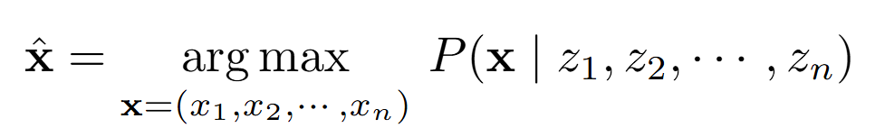
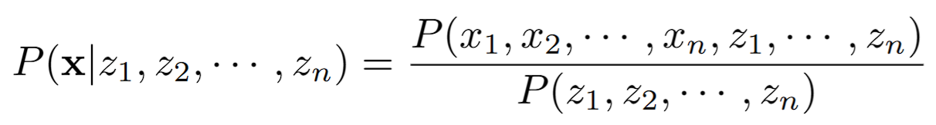
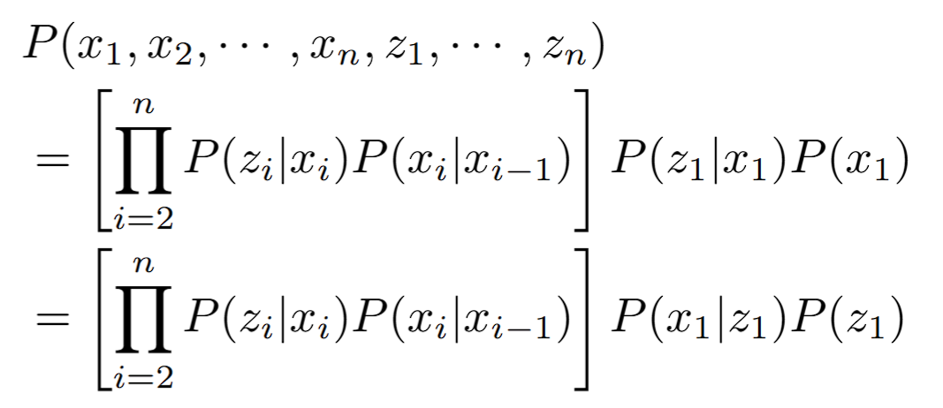





Methology Derivation
GNSS observation$z_{i}$
Road segment $r_{i}$
Optimal objective
Possible candidates$x_{i,j}$
Possible path ${path}_{i}$
$$r_{3}$$
$$r_{4}$$
By condition probability equation
$$z_{2}$$
$${path}_{2}$$
where:
$$x_{2,1}$$
$$x_{1,2}$$
$$r_{1}$$
$$x_{2,2}$$
$$x_{1,1}$$
$${path}_{1}$$
$$x_{3,2}$$
$$r_{2}$$
$$x_{3,1}$$
$$z_{3}$$
$$z_{1}$$
Notes:
Firstly, math. To find the optimal result, likelihood probability is defined as the conditional probability of the possible path given the observation series. The conditional probability can be expressed as the product of measurement probability and transfer probability. This is because the movement of vehicles travels from one segment to another follows the Markov process considering the road segment as state, meaning current state is only dependent to last state, and the GNSS observation is assumed to be only dependent to current state.
Now the optimal question becomes to finding the possible path which maximize the product of measurement probability and transfer probability, as indicated in the red and blue squares respectively.

Slide 6
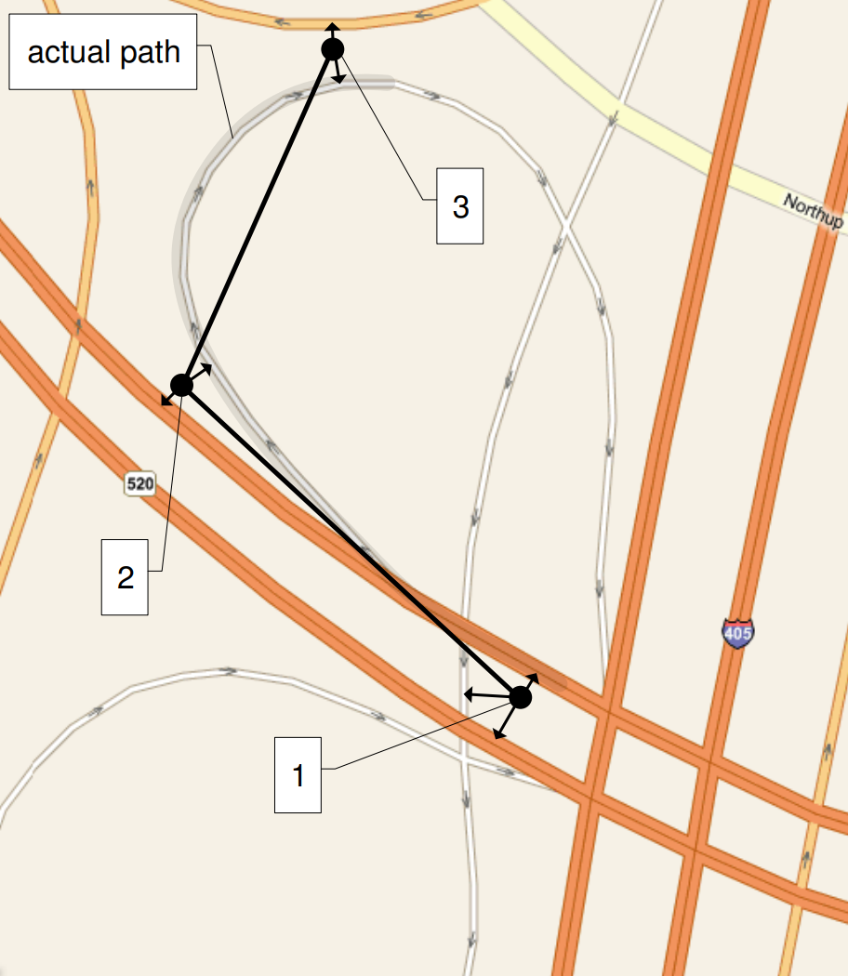
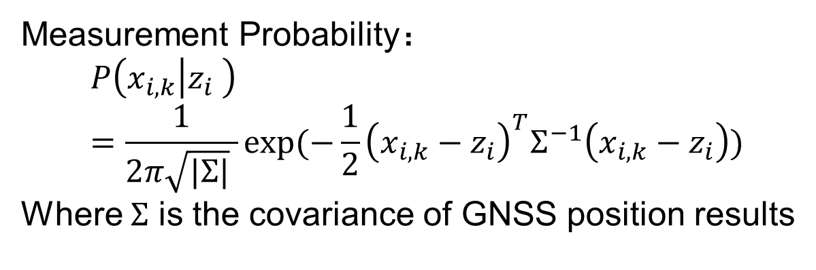


Methology Derivation
$$x_{2,1}$$
$$x_{2,2}$$
Measurement Probability：
$$P\left(x_{i,k} | z_{i} \right)=\frac{1}{2π\sqrt{|Σ|} }exp⁡(−\frac{1}{2}{\left(x_{i,k}−z_{i}\right)}^{T}Σ^{−1}\left(x_{i,k}−z_{i}\right))$$
Where $Σ$ is the covariance of GNSS position results
Notes:
The next step is to derive the two mentioned probability. Measurement probabilities actually represents the error model of navigation sensors. In traditional map matching algorithm, one dimensional gaussian distribution is used based on the assumption of the positioning error follows zero mean gaussian distribution with fixed derivation. By contrast, a more accurate model exploiting the GNSS covariance matrix is developed in this research, makes the results better.
As shown in the figure, while traditional model, represented by the dashed circle, would indicate the yellow candidate as the most possible result, our model gives more confidence on the green candidate because of the ellipse feature of GNSS covariance, which is illustrated by the black line ellipse.

Slide 7

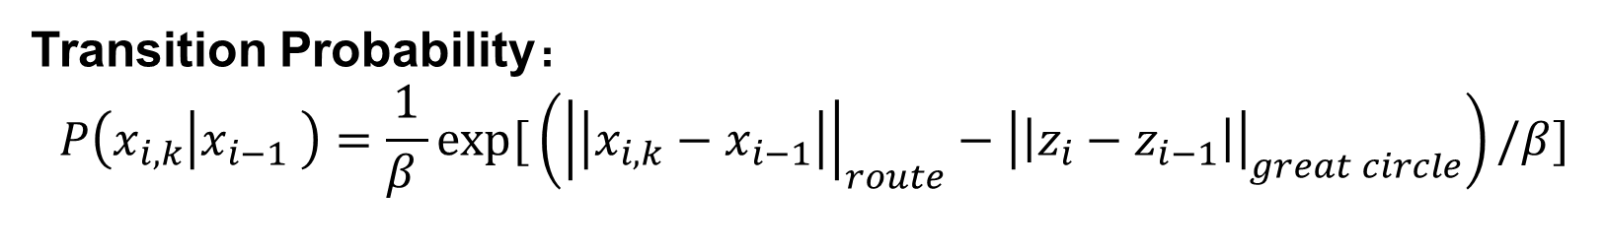








Methology Derivation
Transition Probability：
$$P\left(x_{i,k} | x_{i−1} \right)=\frac{1}{β }exp⁡[\left({\left|\left|x_{i,k}−x_{i−1}\right|\right|}_{route}−{\left|\left|z_{i}−z_{i−1}\right|\right|}_{great circle}\right)/β]$$
$$x_{2,2}$$
$${\left|\left|x_{2,2}−x_{1,2}\right|\right|}_{route}$$
$${\left|\left|z_{2}−z_{1}\right|\right|}_{great circle}$$
$$x_{2,1}$$
$$z_{2}$$
$$z_{1}$$
$${\left|\left|x_{2,1}−x_{1,1}\right|\right|}_{route}$$
$$x_{1,2}$$
$$x_{1,1}$$
Notes:
The transition probability encodes driving behavior patterns. The nature of the behavior pattern is the preference on certain roads or expends avoidance both for time and cost. The transition probability is established as exponential distribution. Here the decision parameter is the difference of distance between neighboring GNSS measurements and the road distance of the vehicle needs to travel from one candidate to another. Beta is used as normalization factor to make the sum of probability equals to one.

Slide 8


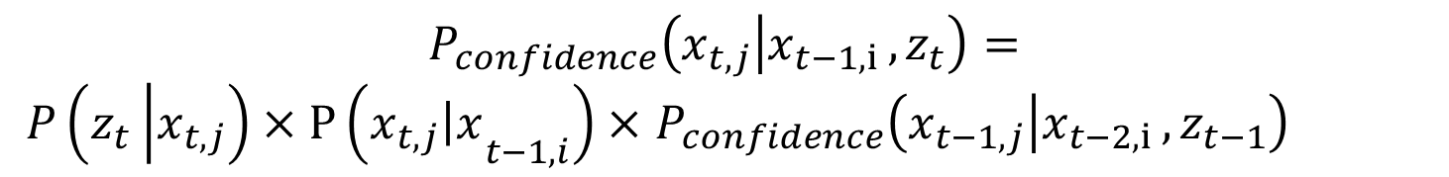

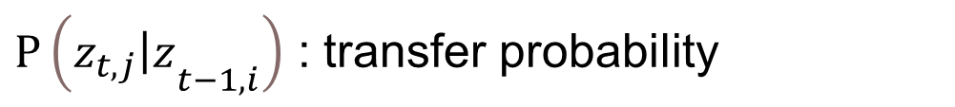

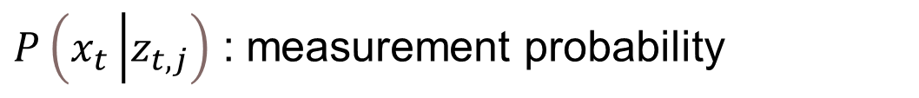





Methodology Derivation
Definition of Credibility
$$P_{confidence}\left(x_{t,j} | {x_{t−1,i },z}_{t}\right)=$$
$P\left(z_{t}\left|x_{t,j}\right.\right)×P\left({x_{t,j}\left|x\right.}_{t−1,i}\right)×$ $P_{confidence}\left(x_{t−1,j} | {x_{t−2,i },z}_{t−1}\right)$
epochs
$P\left(x_{t}\left|z_{t,j}\right.\right)$ : measurement probability
Candidates
number
$$z_{1}$$
$$z_{2}$$
$$z_{3}$$
$P\left({z_{t,j}\left|z\right.}_{t−1,i}\right)$ : transfer probability
$$x_{1,1}$$
$$x_{2,1}$$
$$x_{3,1}$$
1
$P_{confidence}\left(z_{t,j} | {z_{t−1,i },x}_{t}\right)$: likelihood probability
2
$$x_{1,2}$$
$$x_{2,2}$$
$$x_{3,2}$$
Notes:
By substituting the fore defined measurement probability and transition probability, the credibility, which is defined as the posterior probability of the path, can be obtained in iterative form.
For the example given in previous slides, all possible transfer paths are listed on the left. The objective now is to calculate the credibility of each path and choose one with the maximum probability. The problem now is pretty straight forward.

Slide 9
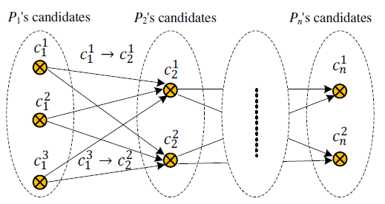
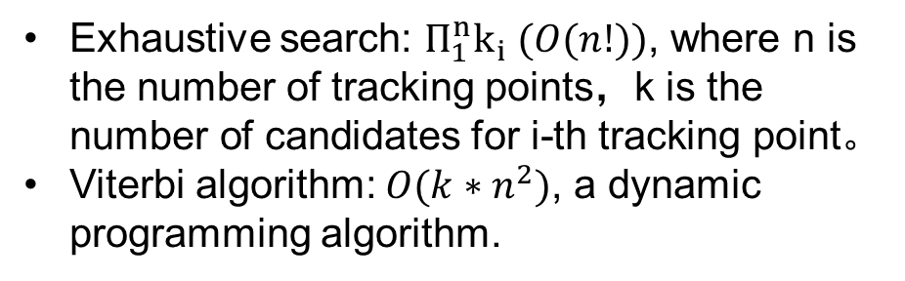
Optimal path
Viterbi Algorithm
3
4
2
Exhaustive search: $Π_{1}^{n}k_{i} (O(n!))$, where n is the number of tracking points，k is the number of candidates for i-th tracking point。
Viterbi algorithm: $O(k∗n^{2})$, a dynamic programming algorithm.
GNSS Results
Candidates
1
Notes:
However, if the exhaustive search is deployed, the time consuming would be unacceptable. By O order expression, the complexity of would be the n factorial.
Here the dynamic programming algorithm called Viterbi is used to find the most optimal results. the complexity of this method can lead to a complexity of n square, meaning a real-time level.

Slide 10









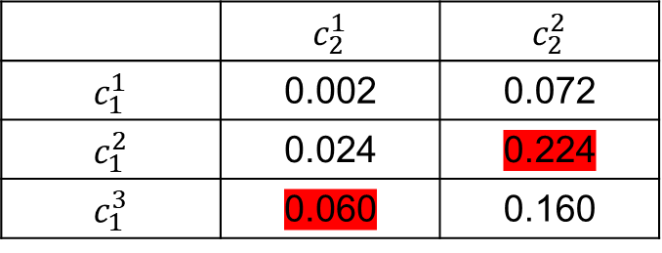






Viterbi Algorithm
$$c_{1}^{1}=0.1$$
$$c_{2}^{1}=0.2$$
$$c_{1}^{1}=0.1$$
0.1
$$c_{1}^{1}$$
$$c_{1}^{2}=0.4$$
0.3
$$c_{1}^{2}=0.4$$
0.9
$$c_{2}^{1}$$
$$c_{2}^{2}=0.8$$
0.6
0.7
$$c_{1}^{2}$$
……
$$c_{1}^{3}=0.5$$
$$c_{1}^{3}=0.5$$
$$c_{2}^{2}$$
0.4
$$c_{1}^{3}$$
 | $$c_{2}^{1}$$ | $$c_{2}^{2}$$
$$c_{1}^{1}$$ | 0.002 | 0.072
$$c_{1}^{2}$$ | 0.024 | 0.224
$$c_{1}^{3}$$ | 0.060 | 0.160
At each epoch, find the path from candidates of last epoch which would reach current candidate with highest confidence probability
${P(c}_{1}^{3}→c_{2}^{1}$)=0.060
${P(c}_{1}^{2}→c_{2}^{2}$)=0.224
Notes:
Here is the detailed process of the Viterbi algorithm. Assuming there are three candidates in the first epoch with two candidates following in the next epoch, causing six transfer groups in total. Firstly, we list the transition matrix of the two neighboring epoch. Filling all the blanks, the transition path terminated at each candidates in the second epoch with maximum credibility can be determined. Here the optimal path is highlighted in red. Then, a branch pruning is carried, keeping only two optimal path for each candidate. This means at each epoch, find the path from candidates of last epoch which would reach current candidate with highest confidence probability.

Slide 11









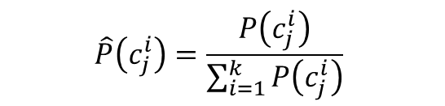










Normalization
$$c_{1}^{1}=0.1$$
$$c_{2}^{1}=0.2$$
$$c_{1}^{1}=0.1$$
$$c_{1}^{2}$$
$$c_{2}^{1}$$
0.1
$P(c_{2}^{1}$) = 0.060
$$c_{1}^{2}=0.4$$
0.3
$$c_{1}^{2}=0.4$$
0.9
$$c_{1}^{3}$$
$$c_{2}^{2}$$
$$c_{2}^{2}=0.8$$
$P(c_{2}^{2}$) = 0.224
0.6
0.7
$$c_{1}^{3}=0.5$$
$$c_{1}^{3}=0.5$$
0.4
For the remaining candidate states, the confidence probability sum of them should equals to 1.
 | $$c_{2}^{1}$$ | $$c_{2}^{2}$$
$$c_{1}^{1}$$ | 0.002 | 0.072
$$c_{1}^{2}$$ | 0.024 | 0.224
$$c_{1}^{3}$$ | 0.060 | 0.160
$$\hat{P}\left(c_{j}^{i}\right)=\frac{P\left(c_{j}^{i}\right)}{\sum_{i=1}^{k}{P\left(c_{j}^{i}\right)}}$$
${P(c_{2}^{1}|c}_{1}^{3}→c_{2}^{1}$)=0.060
$P(c_{2}^{1}$) = 0.060/0.284=0.211
${P(c_{2}^{2}|c}_{1}^{2}→c_{2}^{2}$)=0.224
$P(c_{2}^{2}$) = 0.224/0.284=0.789
Notes:
However, pruning causes the sum of the probability doesn’t equal to one. A normalization process is needed to make the credibility valid. For the remaining candidate states, credibility would be divided by normalization factor, which is the sum of all likelihood probability. Up to now, the detailed process of proposed map matching and credibility calculation is done.

Slide 12
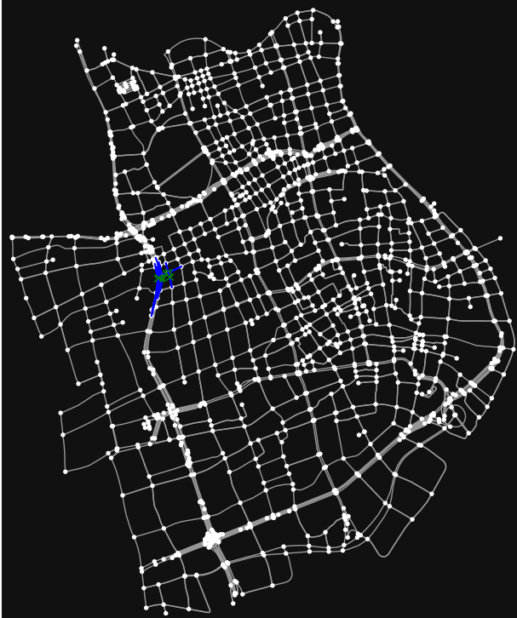
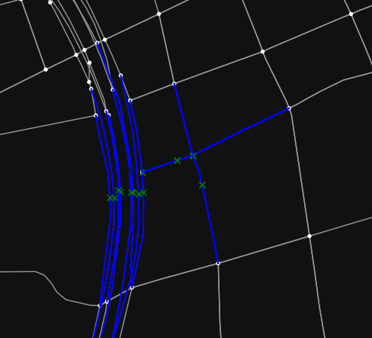
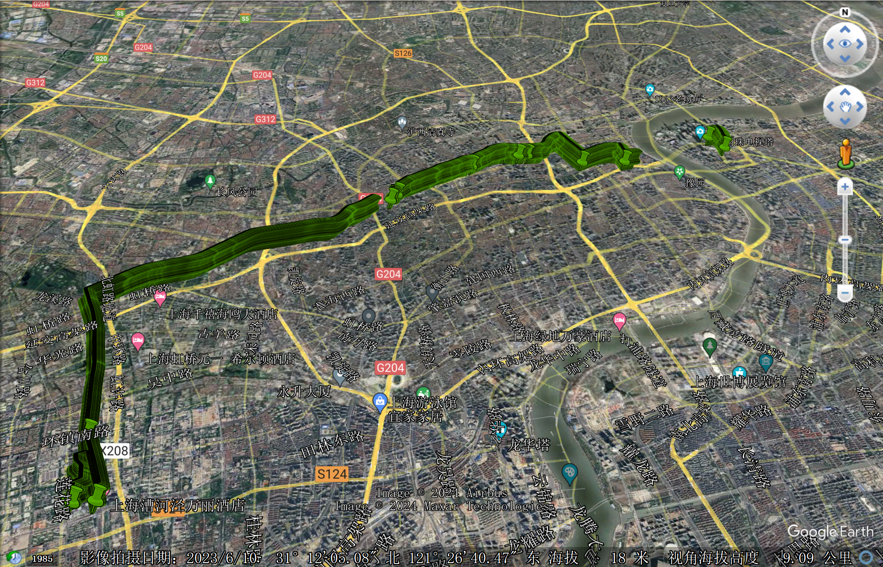
Framework
Map converter
Finding candidate segments
Transfer probabilities
Map file
Resampling and preprocess
Measurement probabilities
Optimal path with confidence probability
Viterbi: finding optimal path
Tracking points file
Notes:
Here is a framework of proposed algorithm. Inputs includes the map file containing the graph a road network and trajectories. By resampling and preprocessing, GNSS observation is matched to the roads to get candidates, thus obtain the transfer probability and measurement probability. Finally, Viterbi algorithm is carried, which outputs the optimal path with corresponding probability.

Slide 13
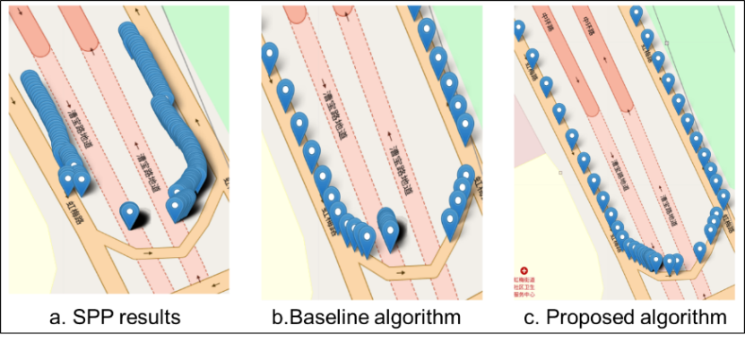
Experiments
$$x_{2,1}$$
$$x_{2,2}$$
Baseline algorithm: one dimensional Gaussian
Proposed method: Exploiting GNSS covariance
Notes:
Our algorithm shows better performance in the dataset of a 2-hour real vehicle test in shanghai, with 1 herz sampling rates. There’s less mis-matching events and higher credibility probability as shown in the right.

Slide 14
Thank you for your attention!
Questions? More Information?
Email: ncz139@sjtu.edu.cn
Phone: +86 18621528151
Website: http://gnc.sjtu.edu.cn/
Notes:
Further we will explore more information such as inertial navigation system, doppler shifts and so on. That’s all for my presentation, Thank you for listening!

