Slide 1
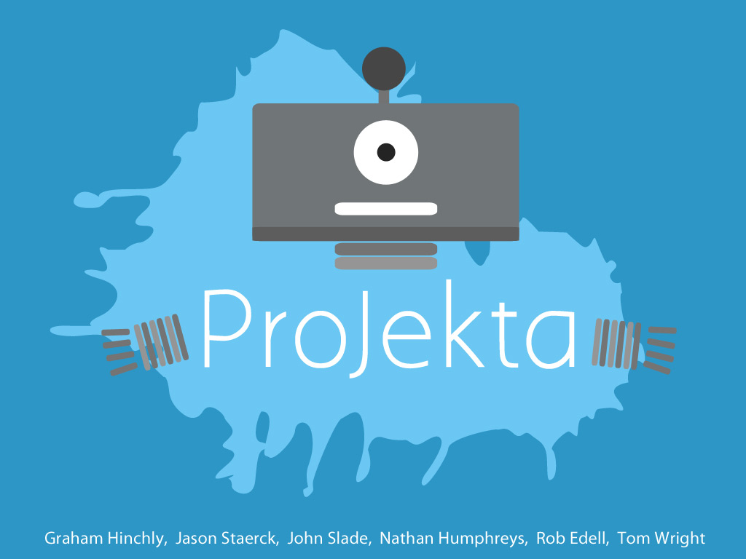
Notes:
Pijector
Pi Projector
Cloudjector
Maybe something about throwing away adapters/connectors?

Slide 2
Preview
Problem
Solution
Market Opportunity
Monetization Strategy

Slide 3
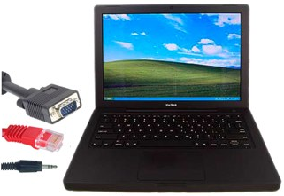

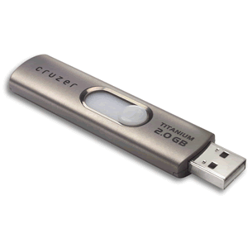
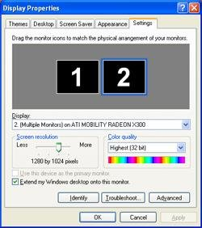
Problem
The current practice of using various connectors and flash drives to display presentations is inefficient and problematic.
No input signal
Notes:
“As if standing up here isn’t bad enough, presenters also have to deal with the stress of wondering whether or not their presentation will work. Currently, presenters fumble with flash drives and various connectors just to get their presentation on a screen, which always seems to be a problem. There is nothing worse than dealing with technological issues in front of a large crowd.”
Security issue

Slide 4
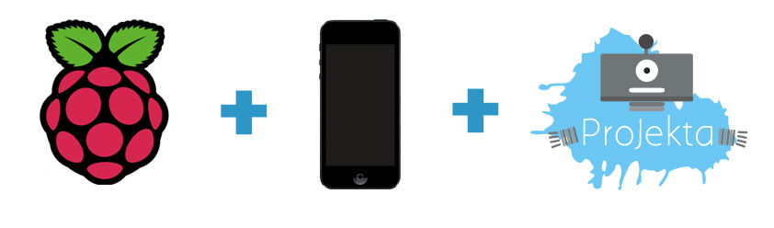
Solution

Slide 5
Market Opportunity
PMA Research estimates the projector market to hit 9.5 million units in 2013.
We will sell to businesses and universities with existing projectors, as well as establish channel partnerships with projector manufacturers.
Notes:
Specifically, Asia and emerging markets have displayed significant unit shipment growth, which is expected to continue in the future. (from Epson 2012 Annual Report).
In 2012, Epson dominated the US projector market with 34% of unit sales.

Slide 6
Monetization Strategy
Full-service monthly subscriptions
Advertise fees as low as £10-15 per month
Give customers peace of mind guarantee
Enable steady revenues with low expenses
Establish channel partners
Notes:
Viableware, the U.S. based software and hardware manufacturer that created the Rail, a digital billfold that enables at-the-table payments, raised $1M in seed funding and has experienced substantial growth by providing full-service hardware and software support for a single monthly charge.

