Slide 1
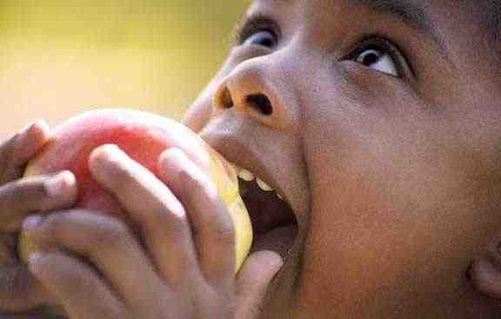

Childhood Hunger in Ithaca
Tejvir Basra
Rob Edell
Todd Feldman
Chase Tarantino
Share Our Strength

Slide 2
Preview
What is Share Our Strength?
What impact has Share Our Strength had at Cornell?
How can Share Our Strength be improved at Cornell?

Slide 3
What is Share Our Strength?

Slide 4
Share Our Strength helps fight childhood hunger
Access: connects kids to effective nutrition programs
Education: educates and empowers low-income families to purchase and cook healthy meals
Awareness: works to shine a national spotlight on childhood hunger in America
Notes:
PICTURE OF BOBBY FILLET AND JEFF BRIDGES

Slide 5

Many kids come to school too hungry to learn
“Hungry children are distracted children. We want to make sure nothing gets in the way of our children performing well academically, including hunger.”
- Arne Duncan, U.S. Secretary of Education
1
Notes:
“Teacher survey results show 62% of teachers say they see children who regularly come to school hungry each week because they are not getting enough to eat at home”

Slide 6

American children don’t have proper access to food
The Crisis: Childhood Hunger
More than 16 million, one in five, American children don’t know when their next meal will come
Almost one-third are under five years old
The Problem: Access to Food
There is enough food in America to feed all children, yet:
10 million eligible kids don’t get free or reduced price school breakfast
16.3 million children qualify for summer meals but
don’t receive them
1
Notes:
“Undernourished children suffer from impaired cognitive development and long-term emotional and health problems.”

Slide 7
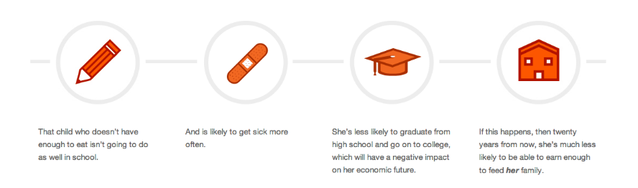
Childhood hunger is cyclical
Notes:
Nokidhunger.com

Slide 8

Share Our Strength’s Vision…
Childhood hunger needs to be reduced
...for the future is one where children are surrounded with nutritious food where they live, learn, and play.

Slide 9
What impact has Share Our Strength had at Cornell?
1

Slide 10
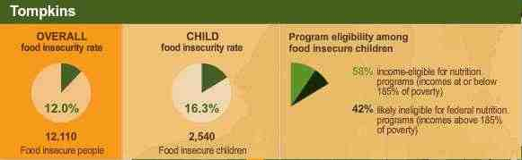
Childhood hunger is high in Tompkins County
Notes:
Bring up points from website
http://www.ithaca.com/opinion/article_fe05ed6c-aa69-11e1-b79b-001a4bcf887a.html

Slide 11
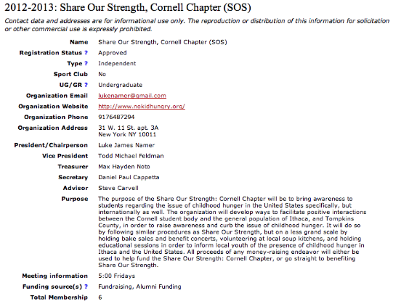
Share Our Strength Cornell Chapter needs to improve membership
Notes:
However, I do want to point out that the Cornell Chapter was founded only two years ago, and we strongly believe that with the correct action (explained later etc.), we can improve our membership.

Slide 12




Share Our Strength at Cornell currently only targets the Greek community

Slide 13
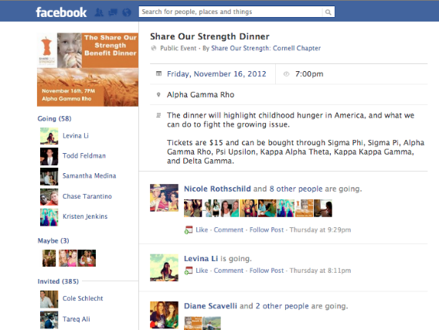
Current fundraising efforts are insufficient

Slide 14
How can Share Our Strength be improved at Cornell?
1

Slide 15
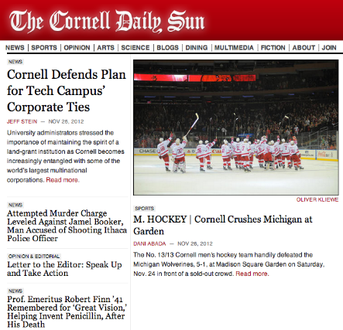
Cornell Daily Sun Articles
Notes:
Good way to target individuals outside the greek comm. (administrators, alumn, etc.)

Slide 16
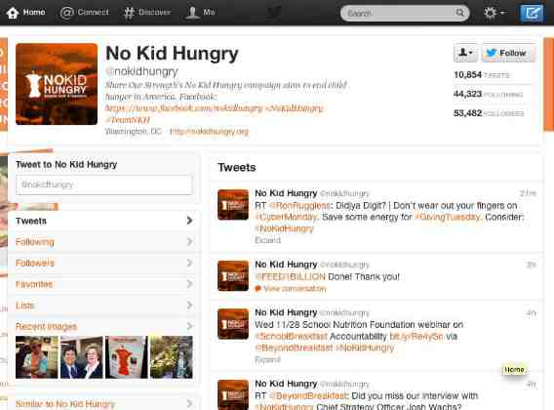
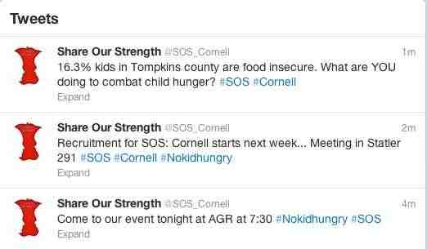
Using Twitter will improve Share Our Strength’s marketing strategy

Slide 17
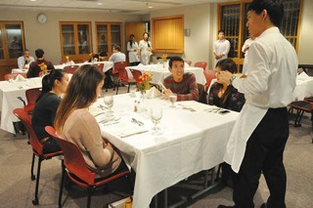

Share Our Strength will partner with restaurants
Notes:
ADD IN POSTERS? WTF.

Slide 18
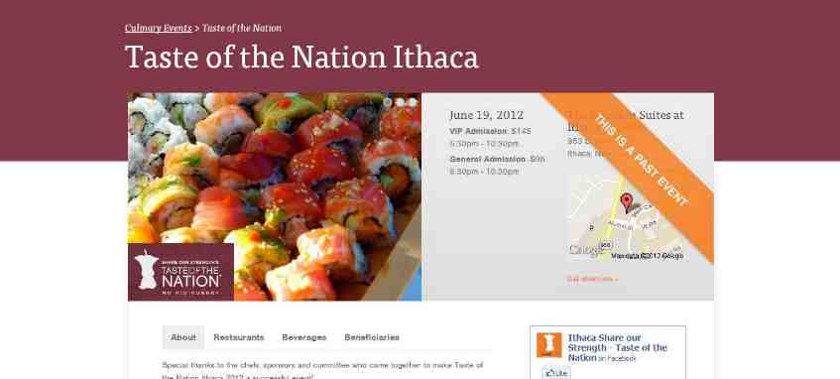
Hosting an upscale event will help us diversify our fundraising efforts

Slide 19





























Our Corporate Partners

Slide 20
Questions
1

Slide 21
Our Approach to Ending
Childhood Hunger by 2015
State & City Campaigns
Public Awareness, OUTREACH
& Advocacy
Community Investment
Nutrition Education

Slide 22
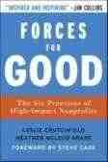






Our Recognition & Endorsements
>Identified as one of 12 “high impact nonprofits” in a survey of nonprofit executives
> Share Our Strength’s Cooking Matters featured on National Public Radio’s “Morning Edition” in a story with White House Assistant Chef Sam Kass.
>2009 non-profit Golden Halo Winner, for our leadership and outstanding efforts in the field of cause marketing.
> Chosen as a beneficiary of Oprah’s Live Your Best Life.
>“We wholeheartedly support Share Our Strength's mission to end childhood hunger
in America.”
- Dawn Sweeney,
President & CEO

