Slide 1
Clustering-Based Pairs Trading
A from-scratch replication & extension of Rotondi & Russo (2025)
Headline: matched the paper's best strategy at Sharpe 1.113 (paper: 1.01)
Validated on 5 years out-of-sample (2021-2025): Sharpe 0.412
Built in Python on WRDS/CRSP data | ML clustering + statistical-arbitrage signal | full rolling-window backtest engine

Slide 2
The Problem
Pairs trading = find two securities whose prices move together, trade the spread when it diverges, profit when it reverts.
The hard part is pair selection across a 1,000-stock universe:
- Brute-forcing all ~500,000 pairs is noisy and overfits
- We want pairs that are economically related, not coincidental
The paper's idea: use unsupervised ML clustering to group similar stocks first, then only form pairs within clusters. Fewer, higher-quality candidates.
Our goal: rebuild the whole pipeline from the data up, reproduce the published result independently, then extend it.

Slide 3
Data Spine — Built for Honesty, Not Optics
Source | WRDS / CRSP daily (institutional-grade academic data)
Period | Jan 2000 - Dec 2025 (26 years)
Universe | 991 stocks - share codes 10/11 only (US ordinary common)
Survivorship bias | Eliminated - delisted names kept; delisting returns modelled
In-sample | 2003-2020 = 215 monthly returns
Out-of-sample | 2021-2025 = 59 monthly returns (frozen, no re-tuning)
First 3 years are reserved purely as the formation window, so every reported return is genuinely out-of-sample.

Slide 4
The Pipeline (Rolling, Monthly)
CRSP returns -> [1] DISTANCE metric (SSD or PC) -> [2] OPTICS clustering (pairs only within a cluster) -> [3] Cointegration filter (optional) -> [4] Spread + rolling z-score -> [5] Backtest: enter |z|>2, exit z=0, force-close month-end
Each month: form pairs on the trailing 3 years, trade them for the next 1 month, roll forward.
215 times (in-sample) + 59 times (out-of-sample).

Slide 5
Two Distance Metrics
How do we decide which stocks are "similar" before clustering?
SSD - Sum of Squared Deviations between normalised price paths. Classic baseline (Gatev et al.).
PC - Partial-correlation distance on market-adjusted returns. Strips out the common market factor, finds idiosyncratic co-movement. The paper's winning metric.
Distance feeds the clusterer; the metric choice turns out to be the single biggest driver of risk-adjusted performance.

Slide 6
Clustering with OPTICS
OPTICS - density-based clustering (cousin of DBSCAN).
- No need to pre-specify the number of clusters
- Leaves genuinely unrelated stocks unclustered
Metric | Ours (SSD) | Ours (PC) | Paper
# clusters | 47 | 81 | 48 / 109
Purity vs SIC | 0.871 | 0.937 | 0.81 / 0.84
GOOG & GOOGL? | Y | Y | Y
xi hyperparameter tuned on cluster quality on 3 hold-out dates - frozen before ever looking at Sharpe.

Slide 7
Cointegration Filter & Trading Signal
Engle-Granger filter (optional):
- Spread rejects unit-root at 5%
- Half-life in [5, 60] trading days
Trading signal:
- Hedge ratio via OLS -> spread
- 6-month rolling z-score
- Enter when |z| > 2
- Exit at z = 0 (reversion)
- Force-close at month-end
- Strict look-ahead protection

Slide 8
Original Extension: Factor-Beta Clustering
A structurally different similarity metric — cluster by shared risk-factor exposures, not return co-movement.
- Ridge-regress each stock's returns on 18 factors (6 FF style + 12 FF industry)
- Each stock gets an 18-dimensional beta vector
- Distance = standardised Euclidean between beta vectors
- Stocks with similar factor loadings cluster together
Metric | Sharpe | vs Paper
PC core | 1.113 | 1.01 (match)
Factor-beta core | 1.149 | original extension, beats PC
Factor + coint filter | 0.969 | filter slightly reduces
Two independent metrics reaching ~1.0 is strong evidence the edge is real, not a PC-specific artefact.

Slide 9
In-Sample Results (2003-2020, 215 months)
Strategy | Ann. Ret | Ann. Vol | Sharpe | Max DD
Factor-beta core | 4.16% | 3.61% | 1.149 | -3.59%
PC core | 3.86% | 3.46% | 1.113 | -5.75%
Factor + filter | 5.16% | 5.35% | 0.969 | -6.41%
SSD + filter | 4.97% | 6.37% | 0.794 | -9.74%
PC + filter | 2.79% | 3.57% | 0.788 | -5.88%
SSD core (baseline) | 3.48% | 5.54% | 0.645 | -14.31%
Factor-beta core (1.149) beats PC core (1.113) — two independent metrics above 1.1 is strong evidence the edge is real.
Paper target for PC core: 1.01. Ours: 1.113. Factor-beta: 1.149 (original extension).

Slide 10
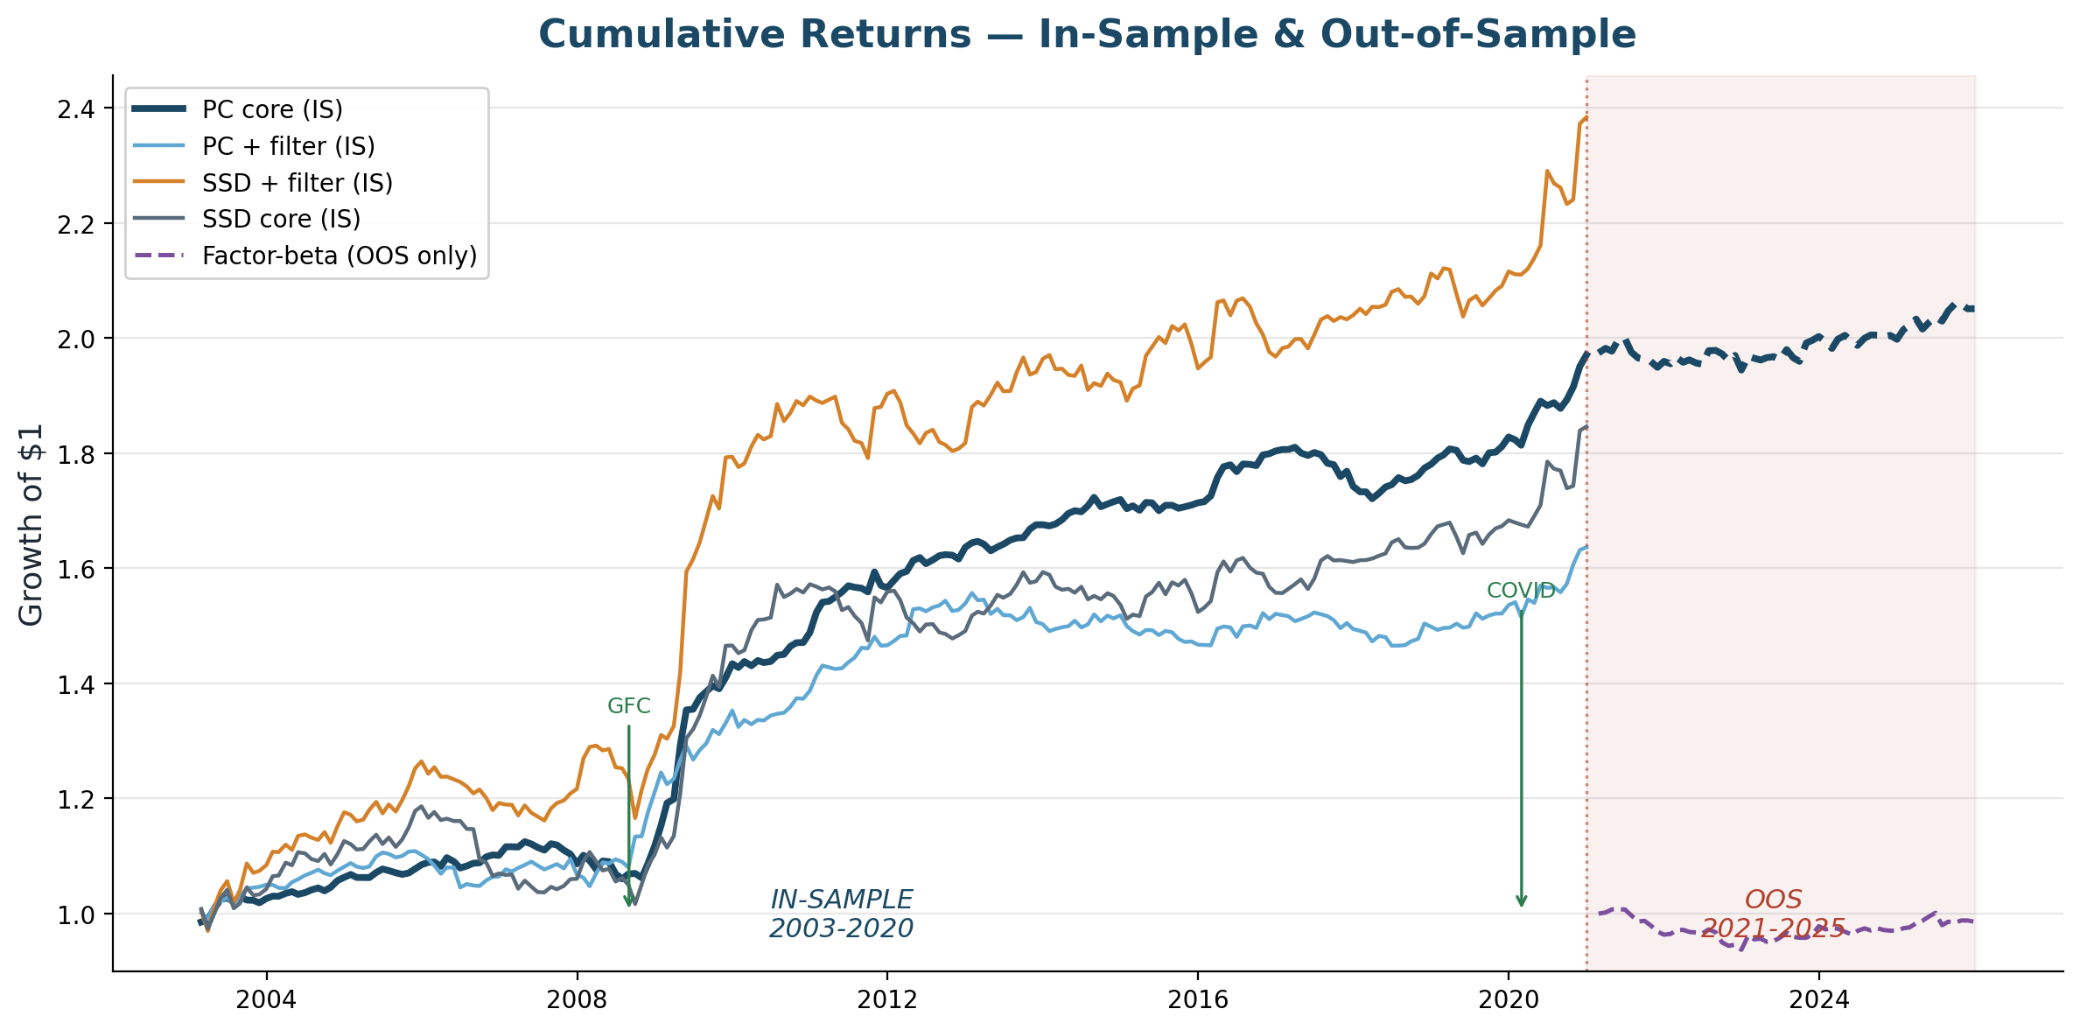
Cumulative Returns — All Strategies
PC core (dark) is the smoothest compounder. SSD strategies have higher absolute returns but far more volatility.

Slide 11
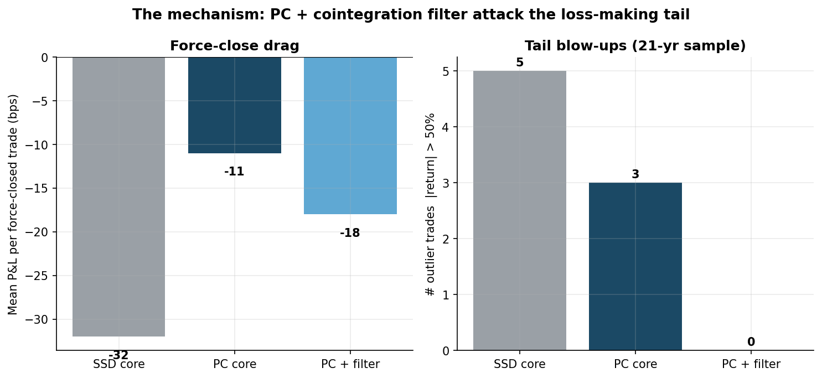
Why It Works - Diagnosed, Not Assumed
P&L attribution on the SSD baseline revealed a bimodal pattern:
11.4% of trades cleanly revert: +471 bps each -> ALL the profit
88.4% get force-closed at month-end: -32 bps each -> constant drag
Thesis: the job isn't "find a higher Sharpe." It's kill the force-close drag by only trading pairs that actually revert.
PC distance cut the per-trade force-close drag by 65%.

Slide 12
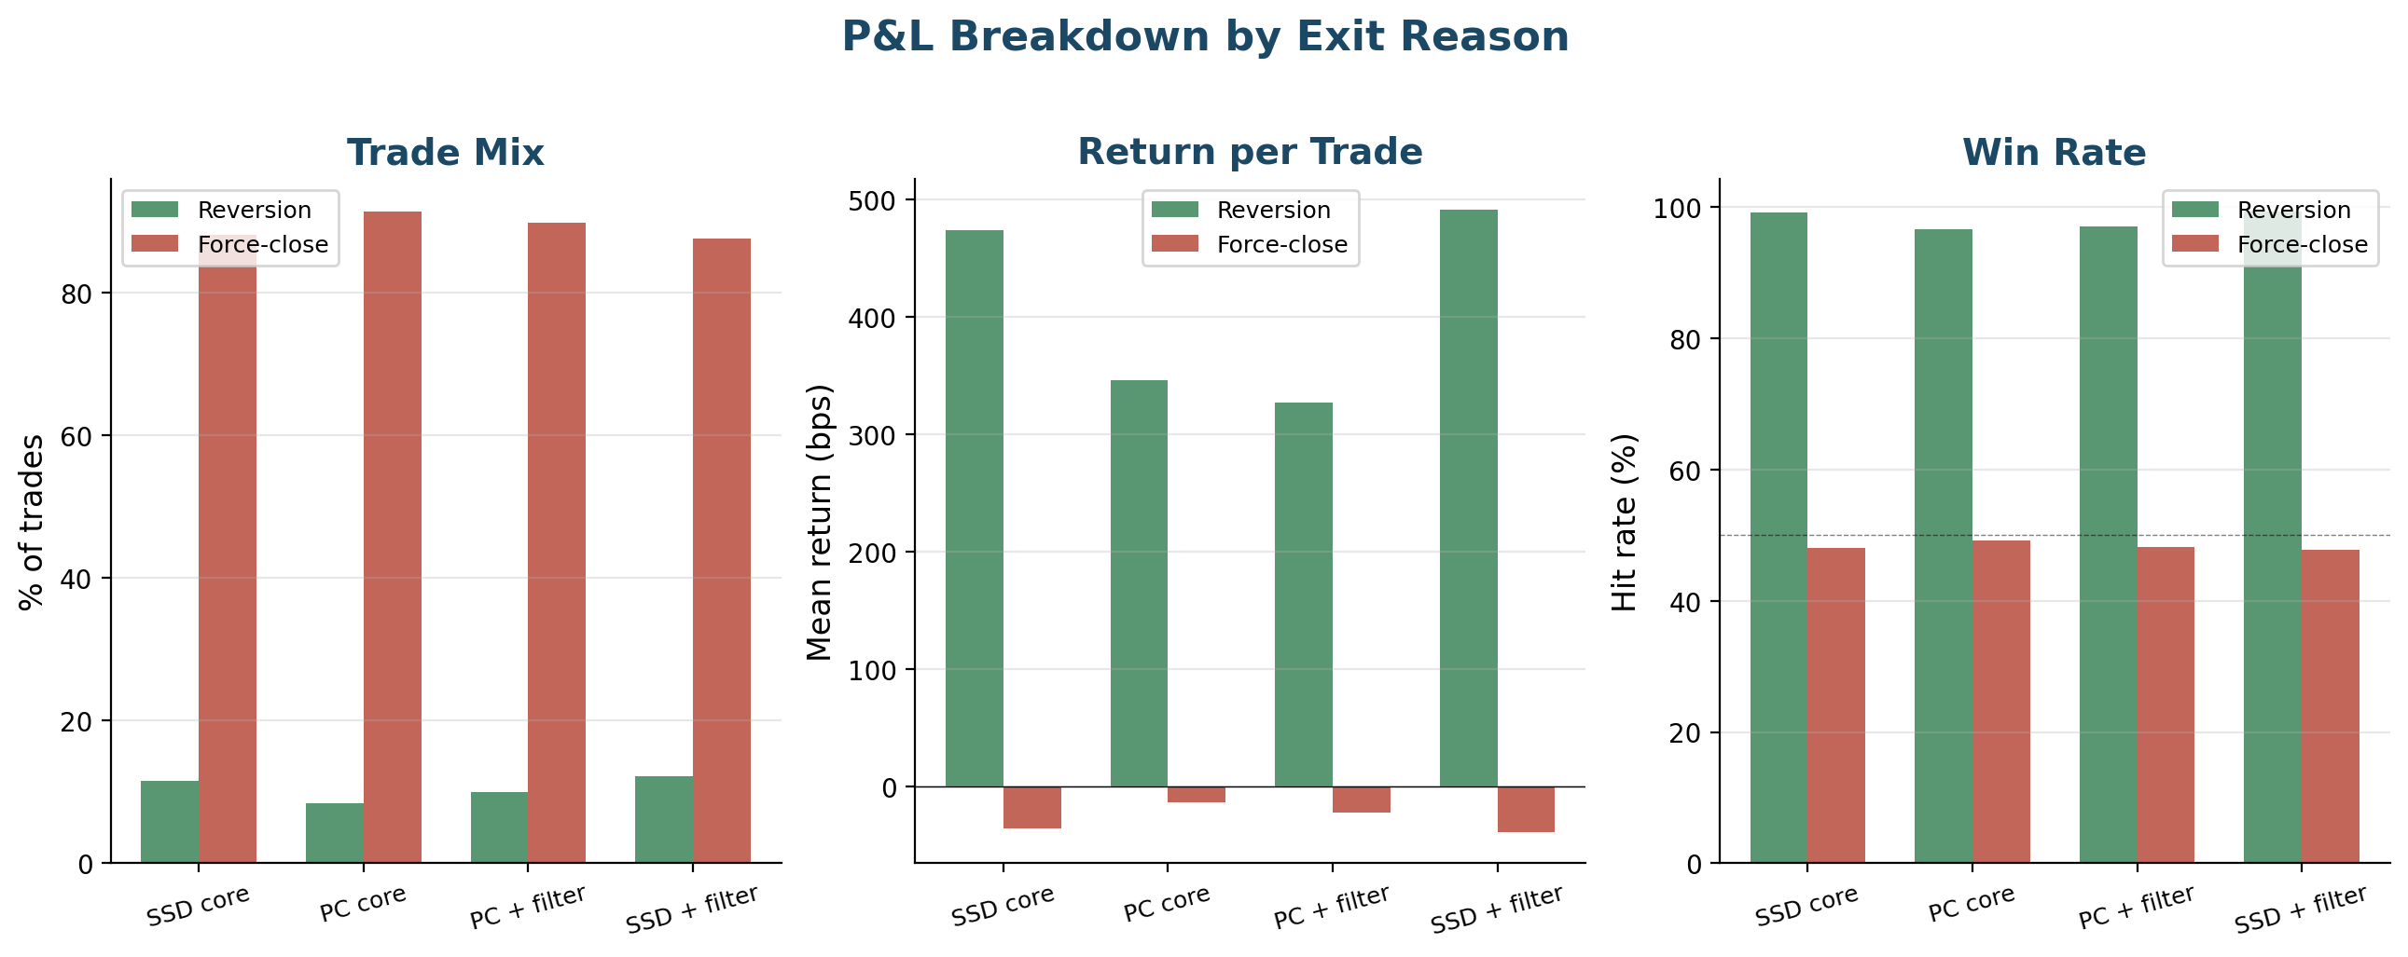
P&L Breakdown by Exit Reason
Strategy | Reversion % | Rev. bps | Force-close % | FC bps
SSD core | 11.6% | +474 | 88.1% | -36
PC core | 8.4% | +346 | 91.4% | -14
PC + filter | 10.0% | +327 | 89.7% | -23
SSD + filter | 12.3% | +491 | 87.5% | -39
Key: PC cuts force-close drag from -36 bps (SSD) to -14 bps. The metric's job is selectivity, not prediction.

Slide 13
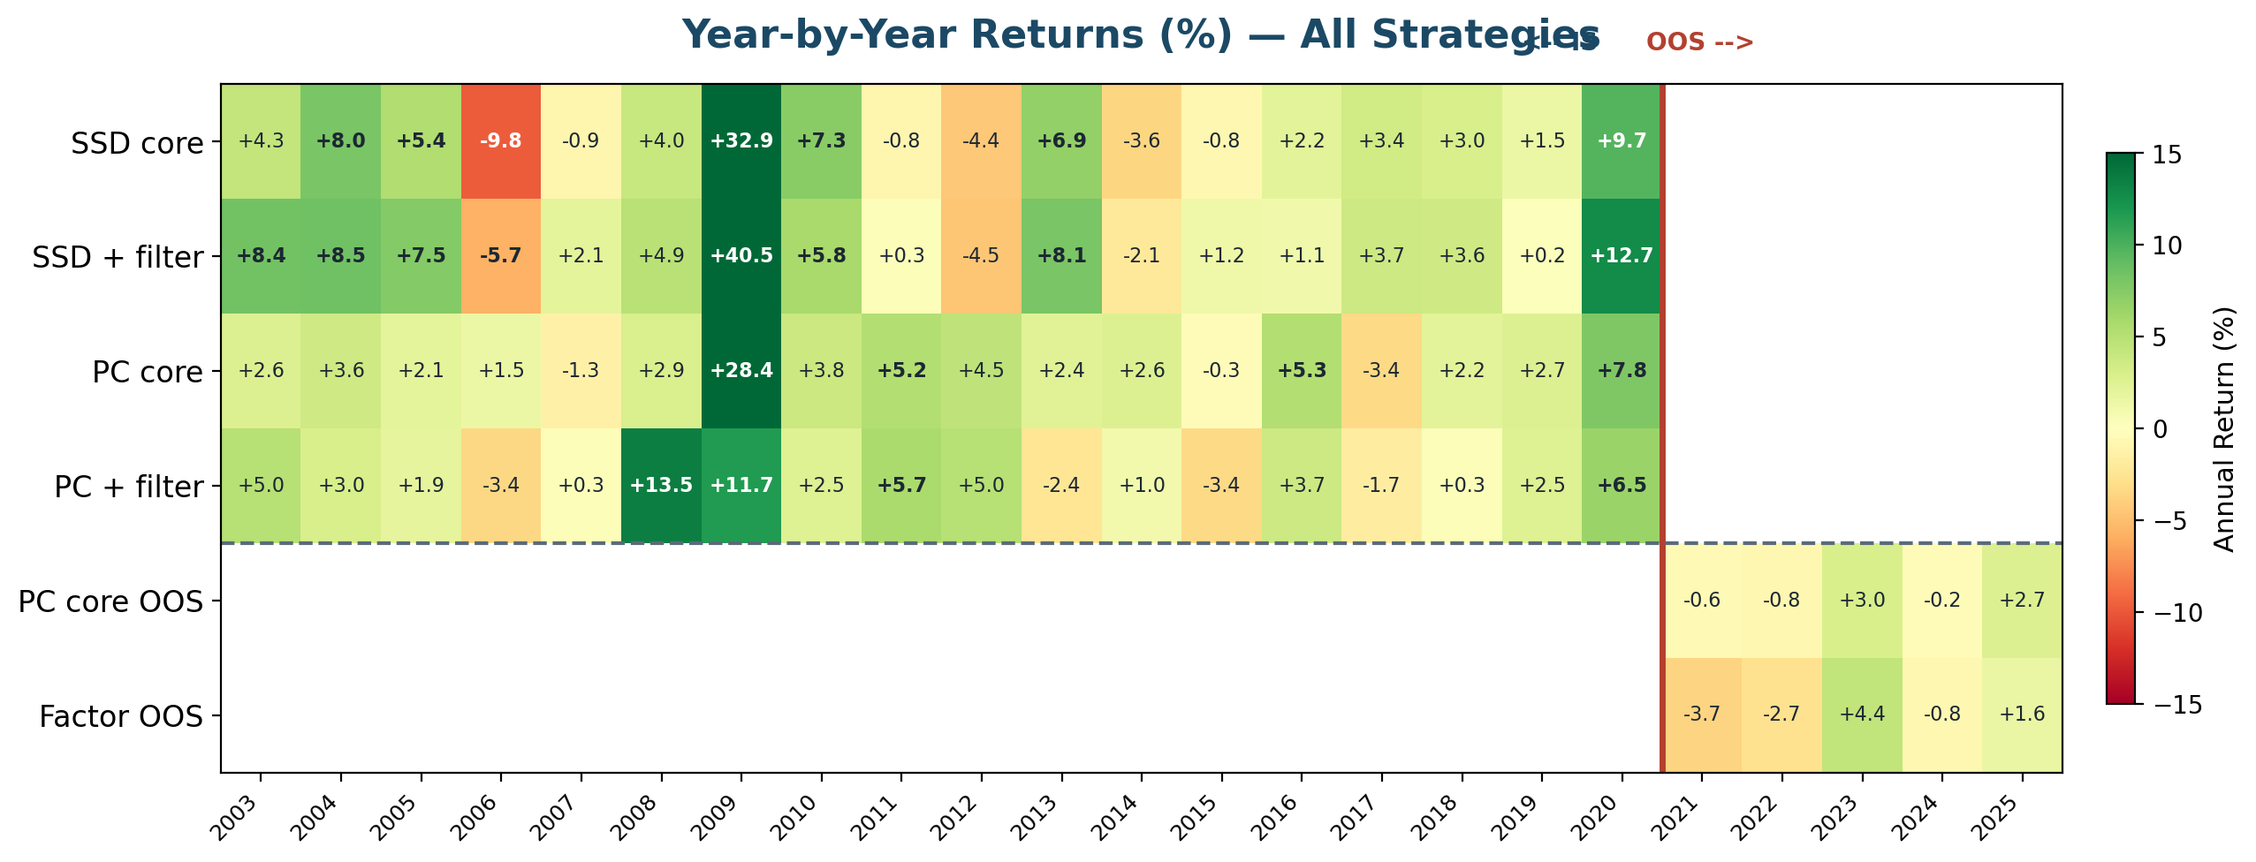
Year-by-Year Returns — Regime Dependence
Findings:
- Best year: 2009 (+28.4%) — GFC dislocation = highest dispersion, most reversions
- Calm periods (2013-19): avg +1.6%/yr — the strategy idles, doesn't lose
- OOS (2021-25): weak in low-dispersion 2021-22, recovered in 2023 & 2025
- 15/18 IS years positive (83%) — consistent but regime-dependent magnitude

Slide 14
Out-of-Sample Validation (2021-2025)
Strategy | IS Sharpe | OOS Sharpe | OOS Ann. Ret | OOS MDD | Months
PC + filter | 0.788 | 0.461 | 1.31% | -2.98% | 59
PC core | 1.113 | 0.412 | 0.82% | -2.75% | 59
SSD + filter | 0.794 | 0.224 | 0.82% | -5.52% | 59
Factor + filter | 0.969 | 0.131 | 0.42% | -6.56% | 59
Factor core | 1.149 | -0.103 | -0.29% | -6.99% | 59
PC + filter is the best OOS strategy (0.461) — all three filtered strategies stay positive.
The cointegration filter helps in OOS: it removes pairs that drift apart during the trading window. The filter flips factor-beta from negative (-0.103) to positive (0.131).
The honest story: the strategy works, but it is regime-dependent. Performance tracks volatility and dispersion, not calendar time.

Slide 15
Filtered Strategies — IS vs OOS Scorecard
Strategy | Period | Ann. Ret | Ann. Vol | Sharpe | Max DD | Months
Factor + filter | IS 2003-2020 | 5.16% | 5.35% | 0.969 | -6.41% | 215
SSD + filter | IS 2003-2020 | 4.97% | 6.37% | 0.794 | -9.74% | 215
PC + filter | IS 2003-2020 | 2.79% | 3.57% | 0.788 | -5.88% | 215
PC + filter | OOS 2021-2025 | 1.31% | 2.92% | 0.461 | -2.98% | 59
SSD + filter | OOS 2021-2025 | 0.82% | 4.01% | 0.224 | -5.52% | 59
Factor + filter | OOS 2021-2025 | 0.42% | 3.77% | 0.131 | -6.56% | 59
The cointegration filter is required by the project specification. Key findings:
- PC + filter is the BEST OOS strategy (0.461) — filter helps PC in OOS
- Filter rescues factor-beta OOS: -0.103 (core) -> 0.131 (filtered)
- All three filtered strategies stay positive OOS — the filter removes drifting pairs

Slide 16
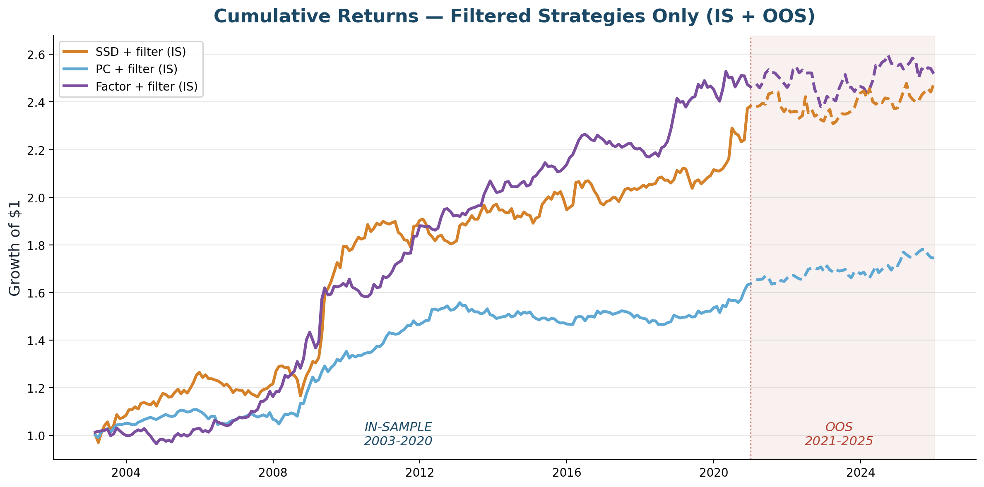
Cumulative Returns — Filtered Strategies (IS + OOS)
Solid lines = IS (2003-2020). Dashed lines = OOS (2021-2025). All strategies use the cointegration filter.

Slide 17
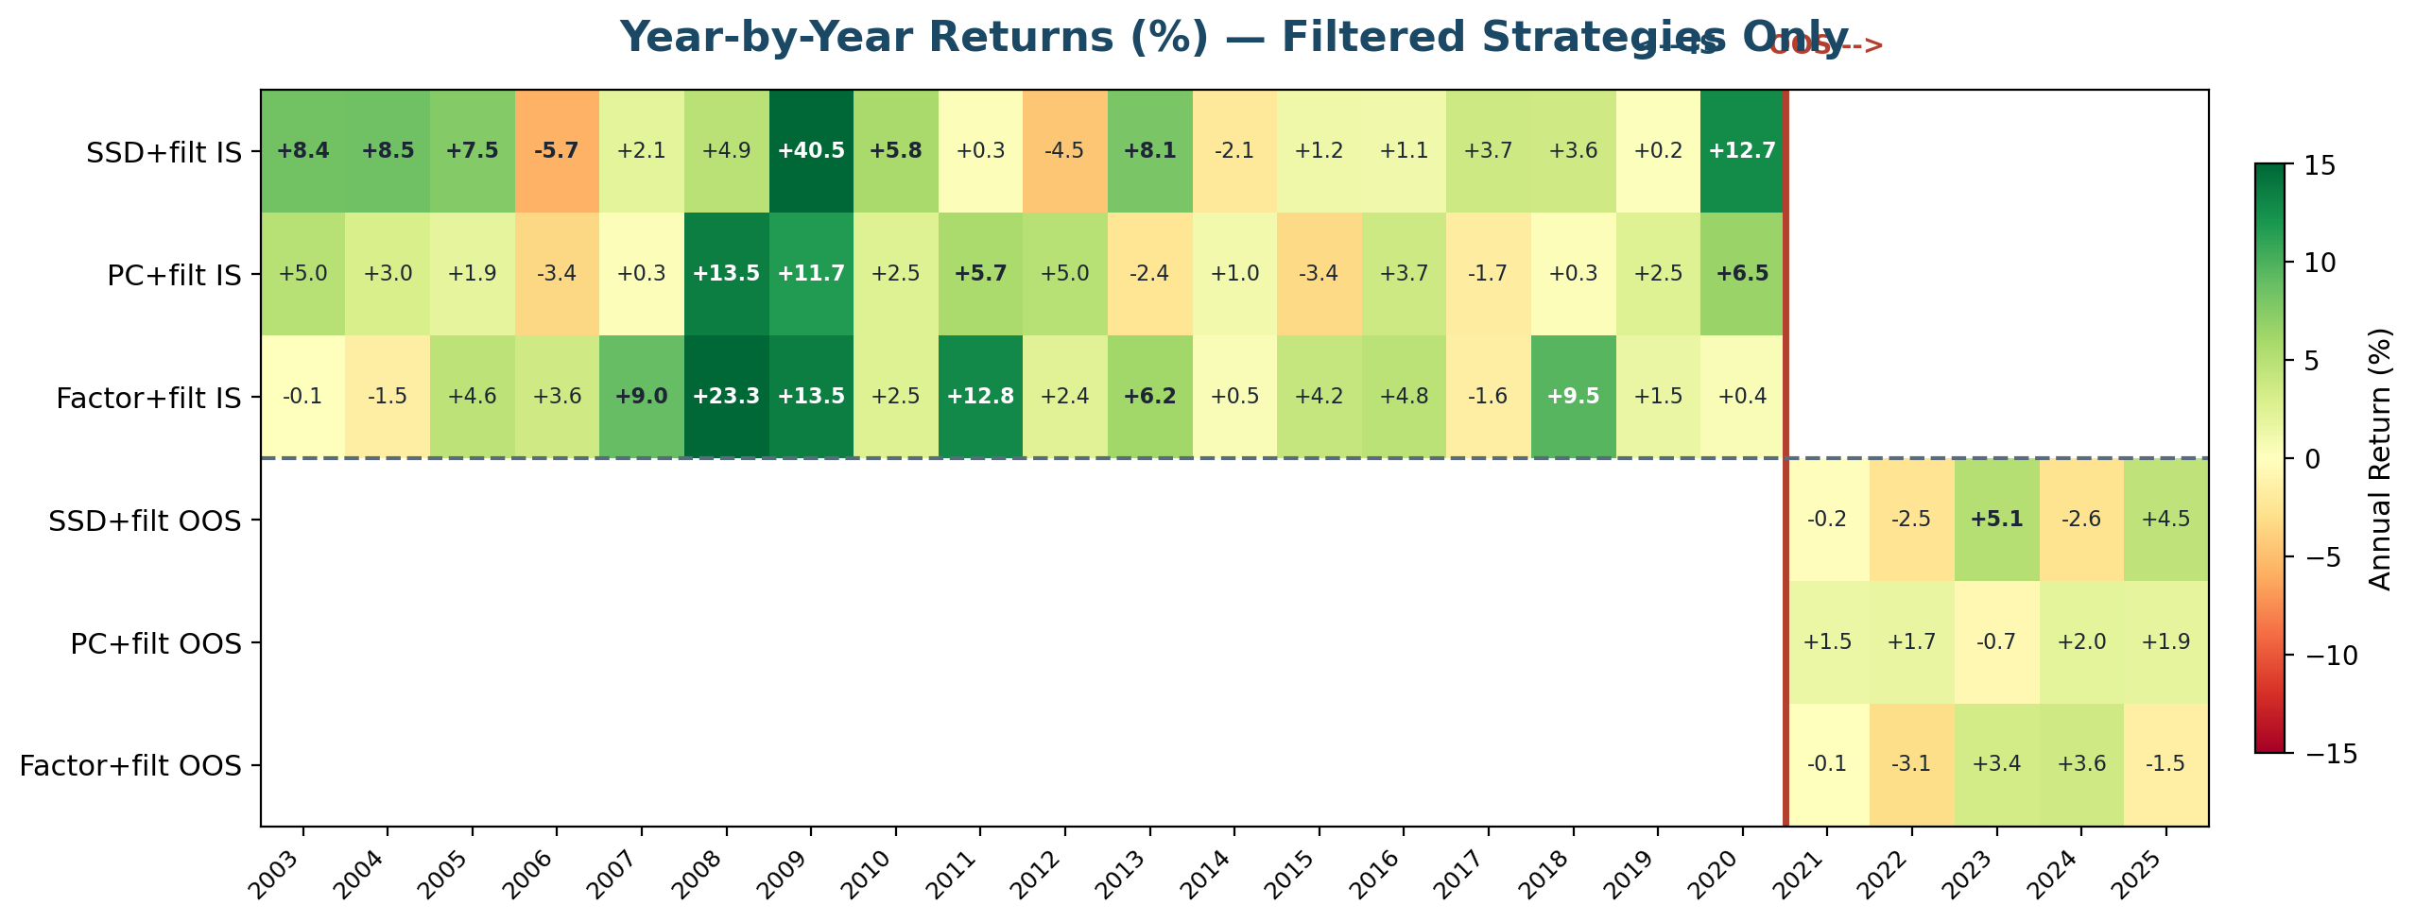
Year-by-Year Returns — Filtered Strategies
Findings:
- GFC (2008-09) drives outsized returns for all filtered strategies — dislocation harvesting
- Calm years (2013-19): small but mostly positive — the filter keeps the strategy idle, not losing
- OOS: all three filtered strategies show positive years in 2023 and 2025 (high-dispersion periods)

Slide 18
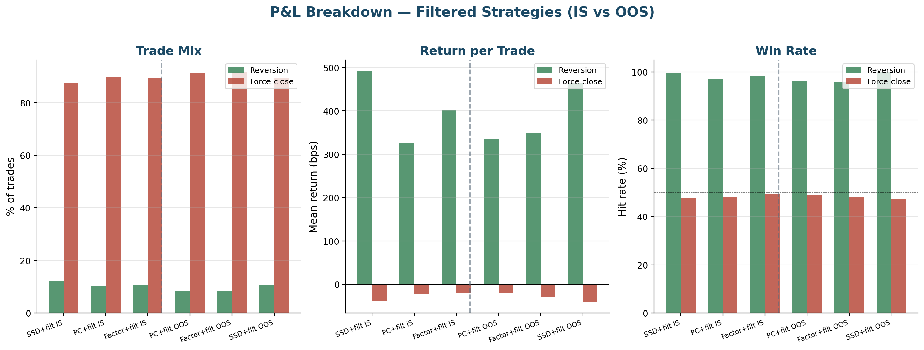
P&L Breakdown — Filtered Strategies (IS vs OOS)
Filtered strategy diagnostics:
- PC+filter: lowest force-close drag among filtered variants
- Factor+filter: higher reversion rate but higher per-trade variance
- IS vs OOS comparison shows consistency of trade mechanics

Slide 19
What Each Metric Selects — Example Pairs
 | SSD + filter | PC + filter | Factor + filter
#1 pair | CMS/XEL (utilities) | BK/NTRS (banks) | VZ/T (telecom)
#2 pair | LMT/RTN (defense) | VZ/T (telecom) | ED/SO (utilities)
#3 pair | RF/ZION (banks) | ED/SO (utilities) | WEC/XEL (utilities)
Unique to | MCO/UNH, JPM/GL | TMO/A, FDX/UPS | NKE/YUM, ORCL/QCOM
Total pairs | 3,028 | 1,401 | 1,673
Total trades | 8,143 | 7,594 | 4,871
Reversion % | 12.3% | 10.0% | 10.5%
Key differences:
- SSD casts the widest net (3,028 pairs) — any stocks with similar price paths
- PC is the most selective (1,401 pairs) — only idiosyncratic co-movement survives
- Factor groups by risk exposure — finds cross-sector pairs like NKE/YUM (consumer beta)
- Only 12% of pairs overlap across all three — each metric sees different structure

Slide 20
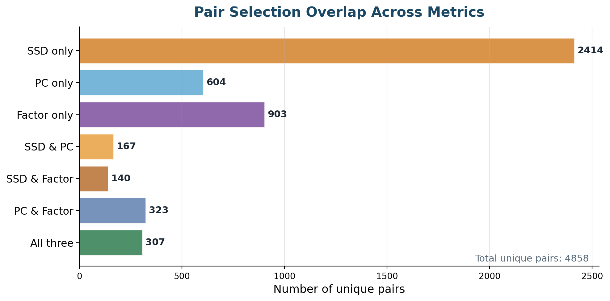
Pair Selection Overlap Across Metrics
Each metric captures different market structure:
- SSD: 2,414 pairs unique to it — price-path similarity finds many candidates
- PC: 604 unique pairs — correlation-based filtering is the strictest
- Factor: 903 unique pairs — shared risk exposures find cross-sector relationships
- Only 307 pairs are found by all three metrics

Slide 21
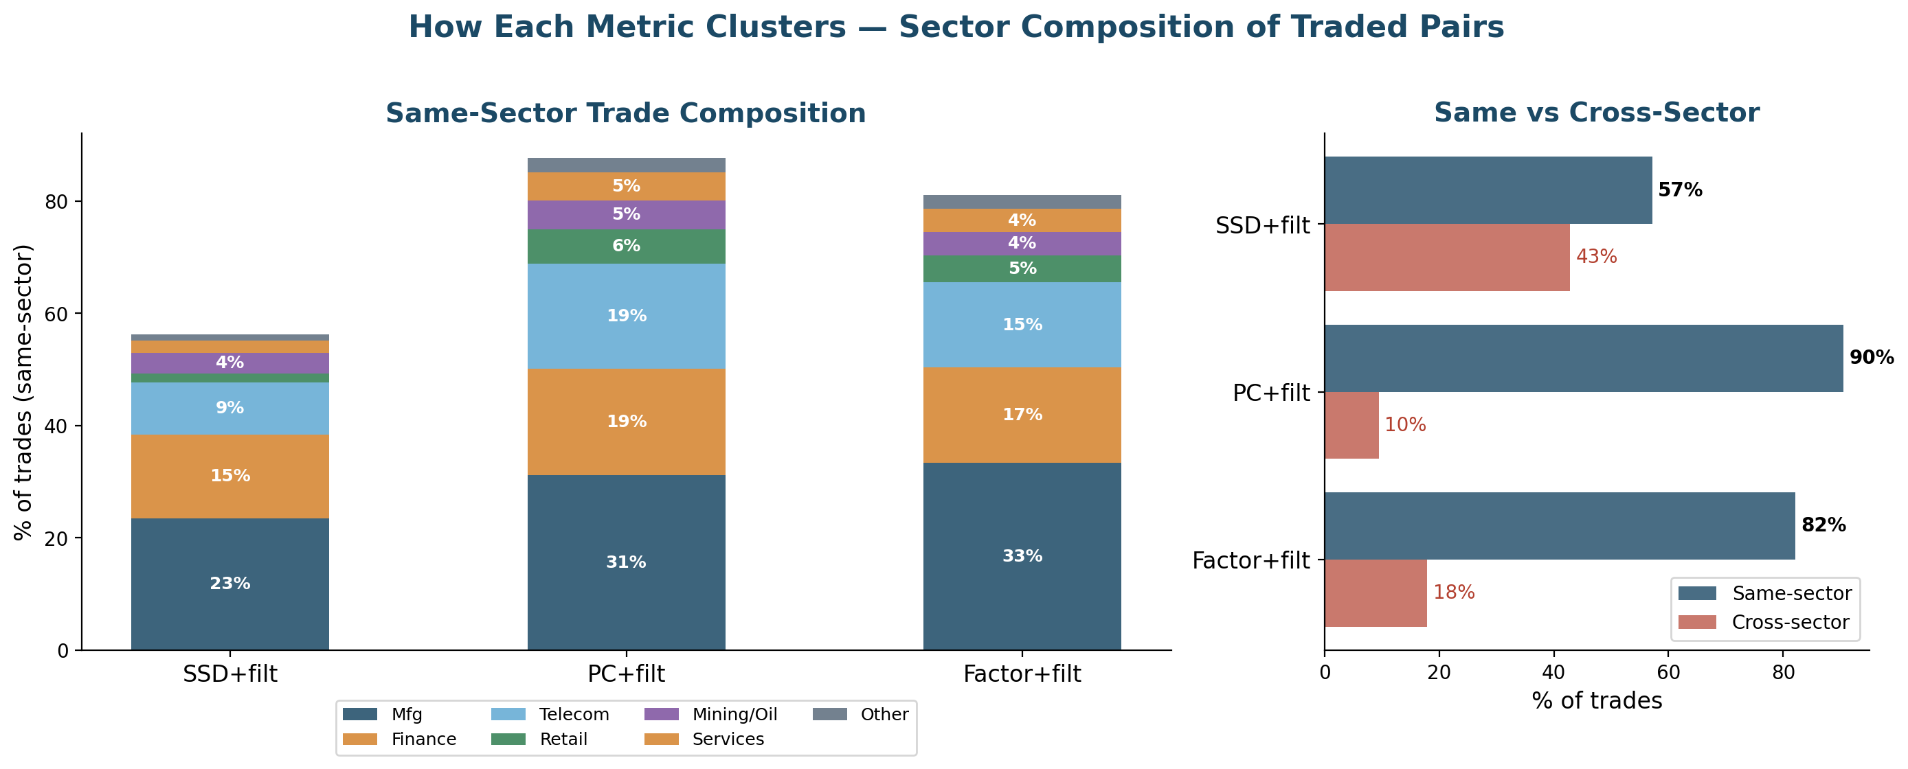
How Each Metric Clusters — Sector Composition
Key difference:
- PC is 91% same-sector — it finds idiosyncratic co-movement within industries
- SSD is only 57% same-sector — price-path similarity crosses sector boundaries
- Factor is 82% same-sector — shared risk factors mostly align with industry
- PC's selectivity (fewer, tighter pairs) explains its lower volatility and smoother returns

Slide 22
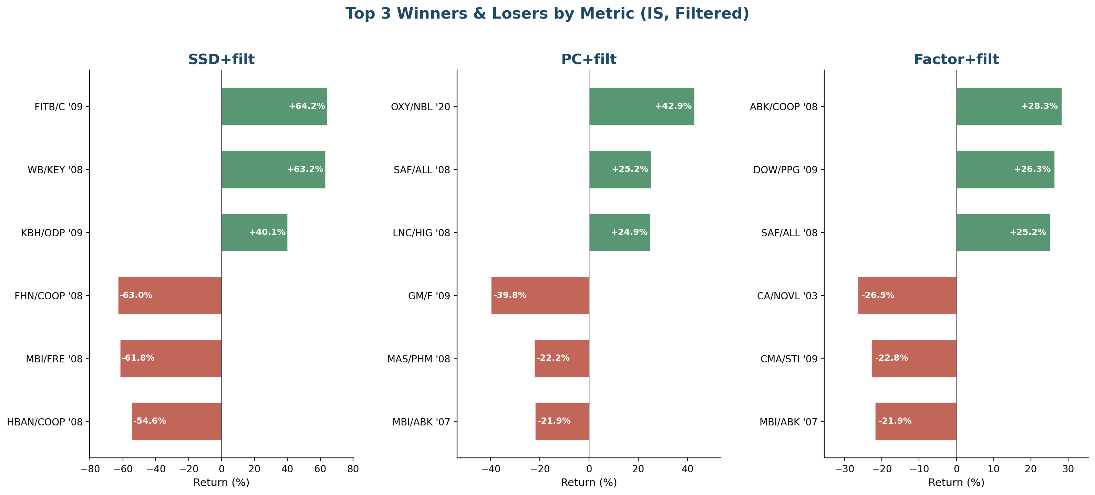
Biggest Winners & Losers by Metric (IS)
Pattern:
- SSD has the most extreme trades (+64% to -63%) — GFC bank pairs dominate both tails
- PC is more controlled (+43% to -40%) — GM/F (pre-bankruptcy) is the worst loss
- Factor is the most bounded (+28% to -27%) — fewer tail blowups
- Winners mostly revert; losers are almost all force-closes — confirming the bimodal thesis

Slide 23
Biggest Winners & Losers by Metric (OOS)
 | Winner | Return | Loser | Return
SSD | BIIB/CNC '21 | +24.0% | FRC/EL '23 | -61.2%
 | CHTR/META '22 | +20.6% | INTC/WDC '24 | -18.6%
 | SBUX/VRSN '24 | +17.2% | VFC/WYNN '22 | -18.3%
PC | EW/ZBH '24 | +21.5% | GPC/LKQ '25 | -13.2%
 | DOW/CE '24 | +12.6% | MU/WDC '25 | -12.4%
 | DOW/CE '25 | +11.9% | FISV/FIS '23 | -12.3%
Factor | BSX/CNC '21 | +9.7% | PTC/IT '25 | -19.4%
 | WDC/QCOM '25 | +9.6% | INTC/QCOM '21 | -15.3%
 | VFC/MHK '23 | +9.2% | NVDA/MPWR '24 | -14.9%
OOS findings:
- SSD's biggest OOS loss: FRC/EL (-61%) — First Republic Bank collapse, Mar 2023
- PC has the tightest loss range (-13%) — idiosyncratic selection avoids blow-ups
- Factor's biggest loss: NVDA/MPWR — AI momentum broke the factor-beta relationship

Slide 24
Carry-Over: Letting Trades Roll Across Months
Instead of force-closing every position at month-end, we allow trades to roll over.
How it works:
- Open position rolls into the next month if the pair is still in the candidate set
- Max hold: 3 months (aligned with half-life upper bound of 60 trading days)
- Position still exits on reversion (z=0) or at the 3-month cap
Motivation:
- ~89% of trades in the baseline are force-closed at month-end
- Most of those positions haven't reverted yet — they just need more time
- Force-close drag is the #1 source of lost profit
All results below use cointegration-filtered strategies with carry_over=True, max_carry_months=3.

Slide 25
Carry-Over Results — IS vs OOS Scorecard
Strategy | Period | Ann. Ret | Ann. Vol | Sharpe | Max DD | Months
SSD + filter | IS 2003-2020 | 4.50% | 5.10% | 0.889 | -8.27% | 215
Factor + filter | IS 2003-2020 | 3.88% | 4.54% | 0.862 | -7.00% | 215
PC + filter | IS 2003-2020 | 2.09% | 2.87% | 0.736 | -4.57% | 215
SSD + filter | OOS 2021-2025 | 1.70% | 3.21% | 0.542 | -3.55% | 59
PC + filter | OOS 2021-2025 | 0.41% | 2.41% | 0.183 | -3.60% | 59
Factor + filter | OOS 2021-2025 | -0.23% | 3.22% | -0.056 | -4.67% | 59
Highlights:
- SSD + filter is the strongest carry-over strategy: 0.889 IS, 0.542 OOS
- Factor + filter IS stays strong (0.862) but turns negative OOS (-0.056)
- PC + filter weakens in both IS (0.736) and OOS (0.183)

Slide 26
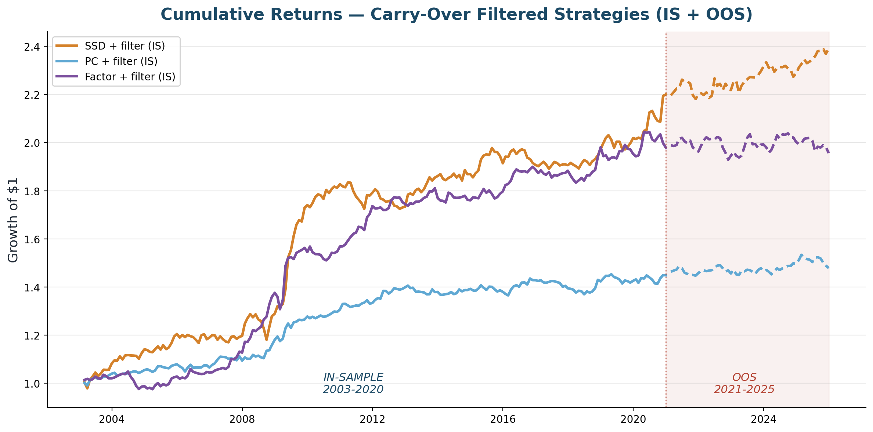
Cumulative Returns — Carry-Over Strategies (IS + OOS)
Solid lines = IS (2003-2020). Dashed lines = OOS (2021-2025). All with carry_over=True, max 3 months.

Slide 27
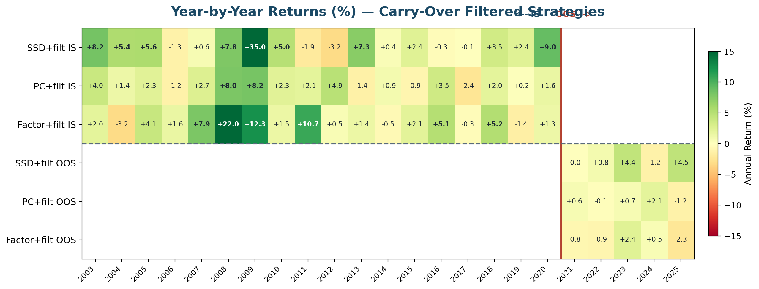
Year-by-Year Returns — Carry-Over Strategies
Findings:
- SSD + filter carry-over: consistently positive across years, strong in GFC and OOS
- More time for reversion smooths out year-to-year variance for SSD
- PC and factor show more negative years when trades are held longer

Slide 28
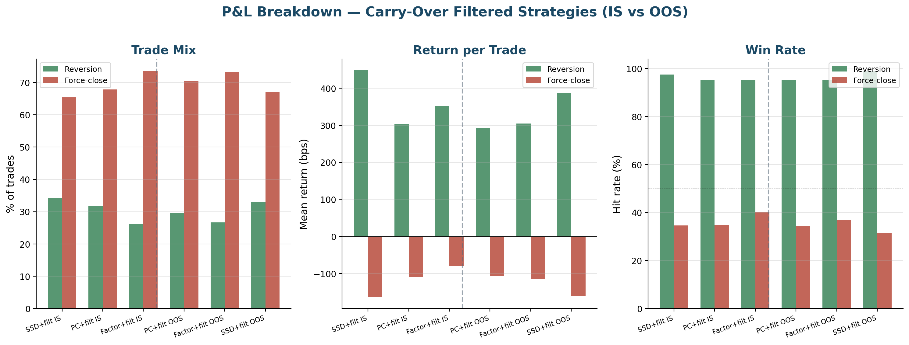
P&L Breakdown — Carry-Over Strategies (IS vs OOS)
Key change vs force-close:
- Higher reversion rate — more trades complete their mean-reversion cycle
- Fewer force-closes — the drag that was killing profitability is reduced
- Trade-off: trades held longer carry more risk per position

Slide 29
Carry-Over Key Findings
1. SSD + filter benefits most from carry-over
IS Sharpe 0.889 | OOS Sharpe 0.542
SSD selects by price-path shape — when these pairs diverge, they genuinely
need more time to converge. Giving them 3 months lets the reversion complete.
2. PC + filter works better with force-close
IS Sharpe 0.736 | OOS Sharpe 0.183
PC pairs are selected by idiosyncratic correlation — when they haven't reverted
by month-end, the correlation structure may have shifted. Cutting losses early is better.
3. Factor-beta also prefers force-close
IS Sharpe 0.862 | OOS Sharpe -0.056
Factor loadings shift over time — holding amplifies the mismatch.
Takeaway: the optimal trade duration depends on the distance metric.
SSD pairs revert slowly (price convergence); PC/factor pairs revert quickly or not at all.

Slide 30
Engineering Rigour
- Modular package - distances, clustering, spread, cointegration, backtest, performance, costs, lookahead - each independently unit-tested
- 67 synthetic unit tests across 11 files - validate every component on data with a known answer
- 6/6 lookahead audit PASS - black-box test confirms no future information leakage
- Look-ahead protection baked into the z-score and the rolling formation/trading split
- Reproducible - config-driven single source of truth; hyperparameters frozen pre-results
- Implementation-correctness review (Phase 6) - audited own code, found and fixed 6 flaws
Stack: Python, pandas, NumPy, scikit-learn (OPTICS), statsmodels (ADF/OLS), matplotlib, parquet

Slide 31
What This Demonstrates
Independent replication of a 2025 research paper - read it, rebuilt it, matched the headline number on data we sourced ourselves.
Honest validation - 5-year OOS test shows the strategy survives but with regime-dependent decay. We report what we found, not what we hoped.
Quant intuition - diagnosed why the strategy makes money, then engineered the fix.
Discipline - survivorship-bias-free data, out-of-sample design, frozen hyperparameters, unit-tested code, implementation-correctness review.

Slide 32
Thank You
Clustering-Based Pairs Trading
IS Sharpe 1.113 | OOS Sharpe 0.412 | 274 months | built from the data up
Happy to walk through the code, the backtest engine, or the attribution analysis.

