Slide 1
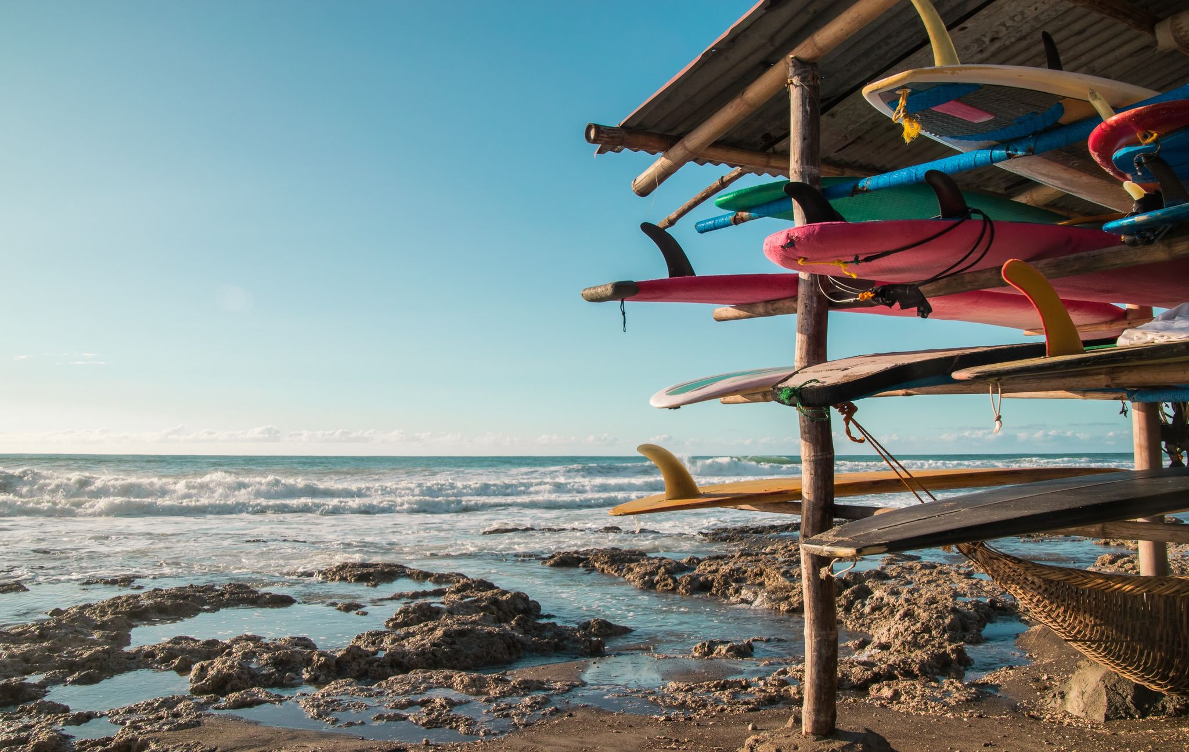

EXPLORE LA UNION HOME ABOUT
EXPLORE ELYU
“ THE BEAUTY WITHIN “
SEARCH BUTTON
MORE

Slide 2
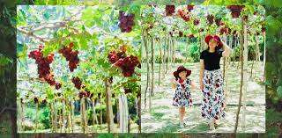
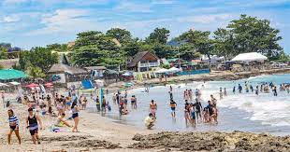
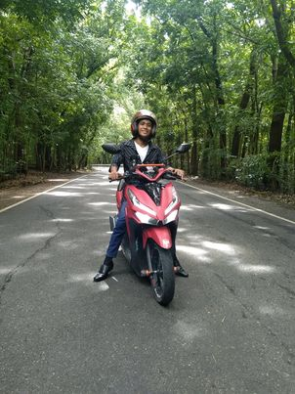
GRAPES FARM
SAN JUAN BEACH
MAN MADE FOREST

Slide 3
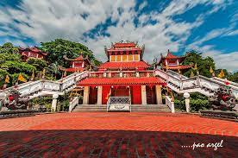

MACHO TEMPLE
MAN MADE FOREST LUNA
BILAGAN ROAD SANTOL

Slide 4
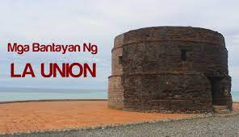
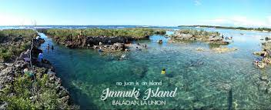
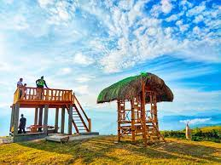
WATCH TOWER
IMMUKI ISLAN
TOP ALLAN

Slide 5
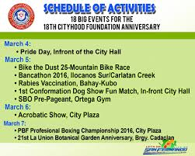
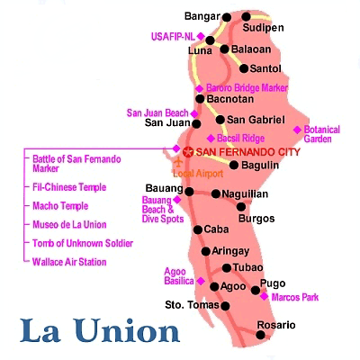
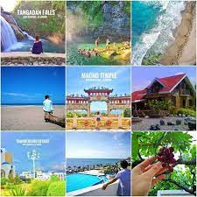

NAVIGATION EVENT CALENDAR
HOTELS AND RESTAURANT LGU OF LA UNION
LIKE FB Account:designcreative@yahoo.com
COMMENTS Tourism handline:09123456789
SHARE Contact Number: 09123456789

