Slide 1
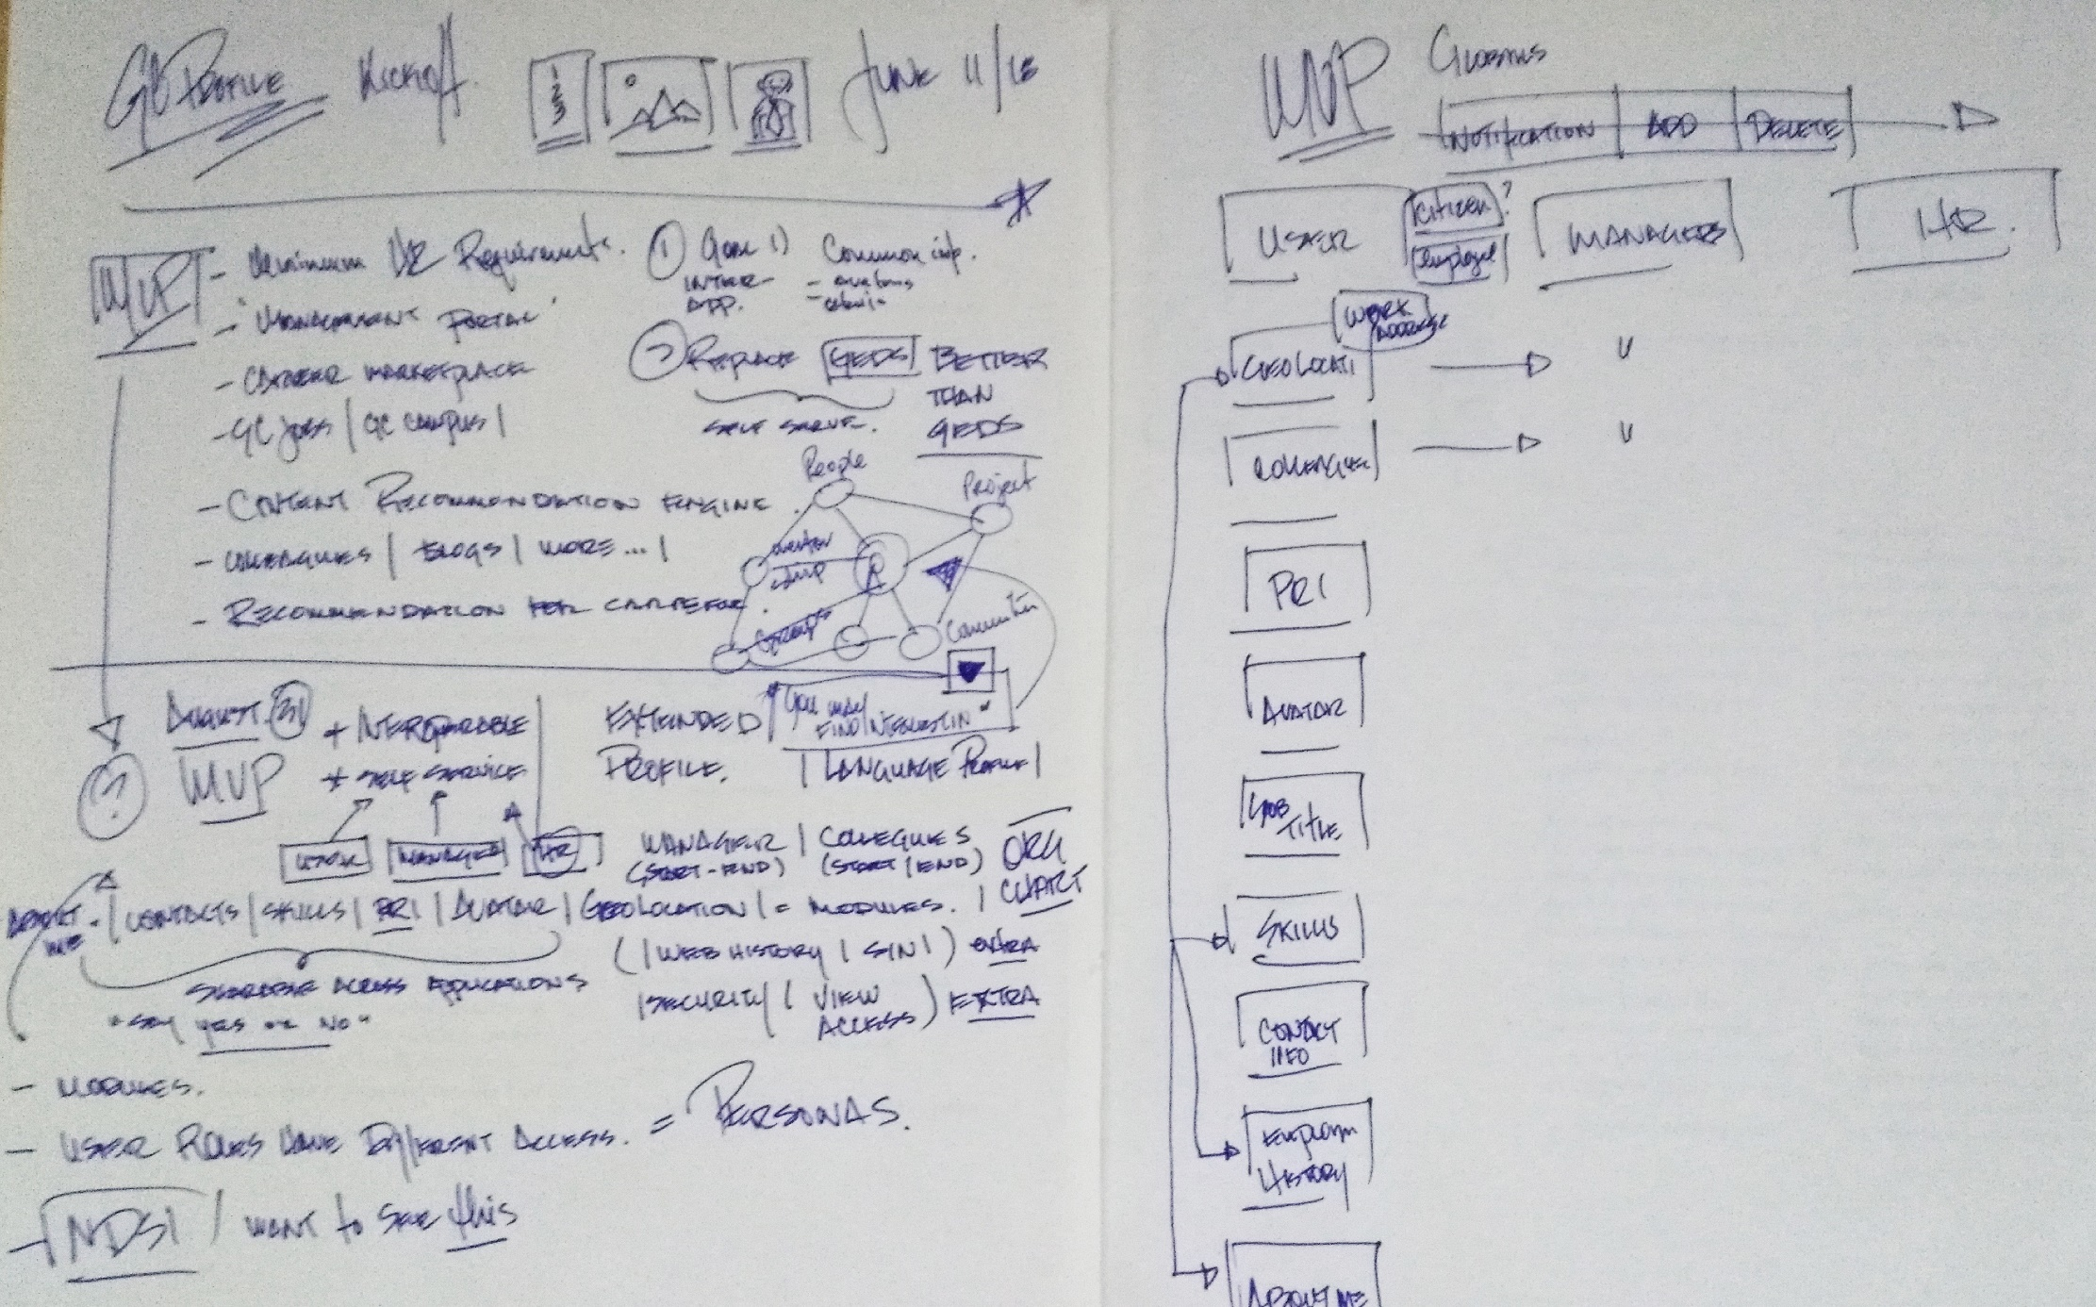
June 11 Kickoff Notes

Slide 2
Barriers to adoption & solutions:
Profile fatigue:
People don’t want to have to fill in the same detailed Profile too often. 2 times on GoC social media Platforms is 1 too many times
People don’t feel they are getting clear value in return for the effort of filling in a detailed Profile
People already have had to create detailed Profiles to participate in social media and ecommerce sites
Solutions:
Gamefication – when done correctly, could increase participation, although Gamefication is on the decline overall
Create perception of instantaneous value for as little effort as possible
Use engaging interaction techniques and visual design compositions that are enticing

Slide 3
Metaphor & Purpose Questions:
Q: How would you define, in your own work, of a profile? Can you provide me a definition of what is a profile from your point of view?
A: A profile serves the need to inform others about your usefulness to them. Its a teaching tool. A small autobiography. It can also serve the creator of the profile as a reminder of who they are and what they care about. Depending on context (work) - What are the services you provide (job title & description), from where (for & from what team and location and contact coordinates), and why you provide them (personal experience, additional place where reliability can be proven).
Q: Which metaphor would you use to explain to somebody what is a profile?
A: Fun metaphor = Trading Cards (think baseball cards) or a Movie Poster or Concert/Event Poster (however that places heavy emphasis on physical image, for shy or modest people it could be an issue)
A: Traditional metaphor = rolodex card, medical bio and/or drivers license (more official)
Q: Just say that you need to explain what you understand from profile to your wife; what would be the story or metaphore to explain what a profile is?
A: I would say its an autobiographical teaching tool to help others learn about you and how you can help, and where you fit in the world (work world = linkedIn, private world = facebook, etc).

