Slide 1
Inventory Management System
Team # 10
Ibukunoluwa “Abby” Aboderin
Mason Beckham
Raghad Safauldeen
Siddharth Vadgama

Slide 2
Vision statement
Inventory management system website for small businesses
The software is intuitive, user-friendly, and convenient
The user scans the barcode and it updates the stock items in the inventory and uses a third party software to handle payments to the business
It does not handle large data management and revenue generation

Slide 3
Features
Primary:
Open source and free to use
Different style of scanning compared to competitors
User friendly and Simple
Secondary:
Usable on any modern browser
Usable on the LAN
Ability to split products into different bins for easy location lookup
Tertiary:
Ability to differentiate between different business locations

Slide 4
Risks
Website might not work on certain browser
Risk Exposure: 70% * 6 Hours = 4.2 Hours
Lack of programming language knowledge and skills
Risk Exposure: 60% * 6 Hours = 3.6 Hours
Time management and communication
Risk Exposure: 40% * 5 Hours = 2 Hours
Our software is free, open source so all libraries used must be open source
Risk Exposure: 30% * 4 Hours = 1.2 Hours
Data storage on our server
Risk Exposure: 25% * 4 Hours = 1 Hour

Slide 5
Competitors According to business.org “6 Best Inventory Management Software of 2019”
Company | Starting price per month
Ordoro | $25
Tradegecko | $79
Unleashed | $85
Veeqo | $200
Cin7 | $299
Fishbowl | $399

Slide 6
Competitors
Cin7
Tutorials & account manager
Starting price $299/month
Cin7 payment portal
IM system has a third party for payment portal & easy to manage
Ordoro
Dropshipping with FedEx, UPS, DHL
Financial analytics
Open API
Starting price $25
IM system is simple and helps save user’s time

Slide 7
Assumptions
We will not pay for our host server
Our software is not customized for businesses like catering industry
Access to Local Area Network
Constraints
Since we are not paying for the server, only a limited amount of people can use our software
Team lacks website development skills
Team is unable to provide sole focus to this project
English is not the native language of the entire team

Slide 8
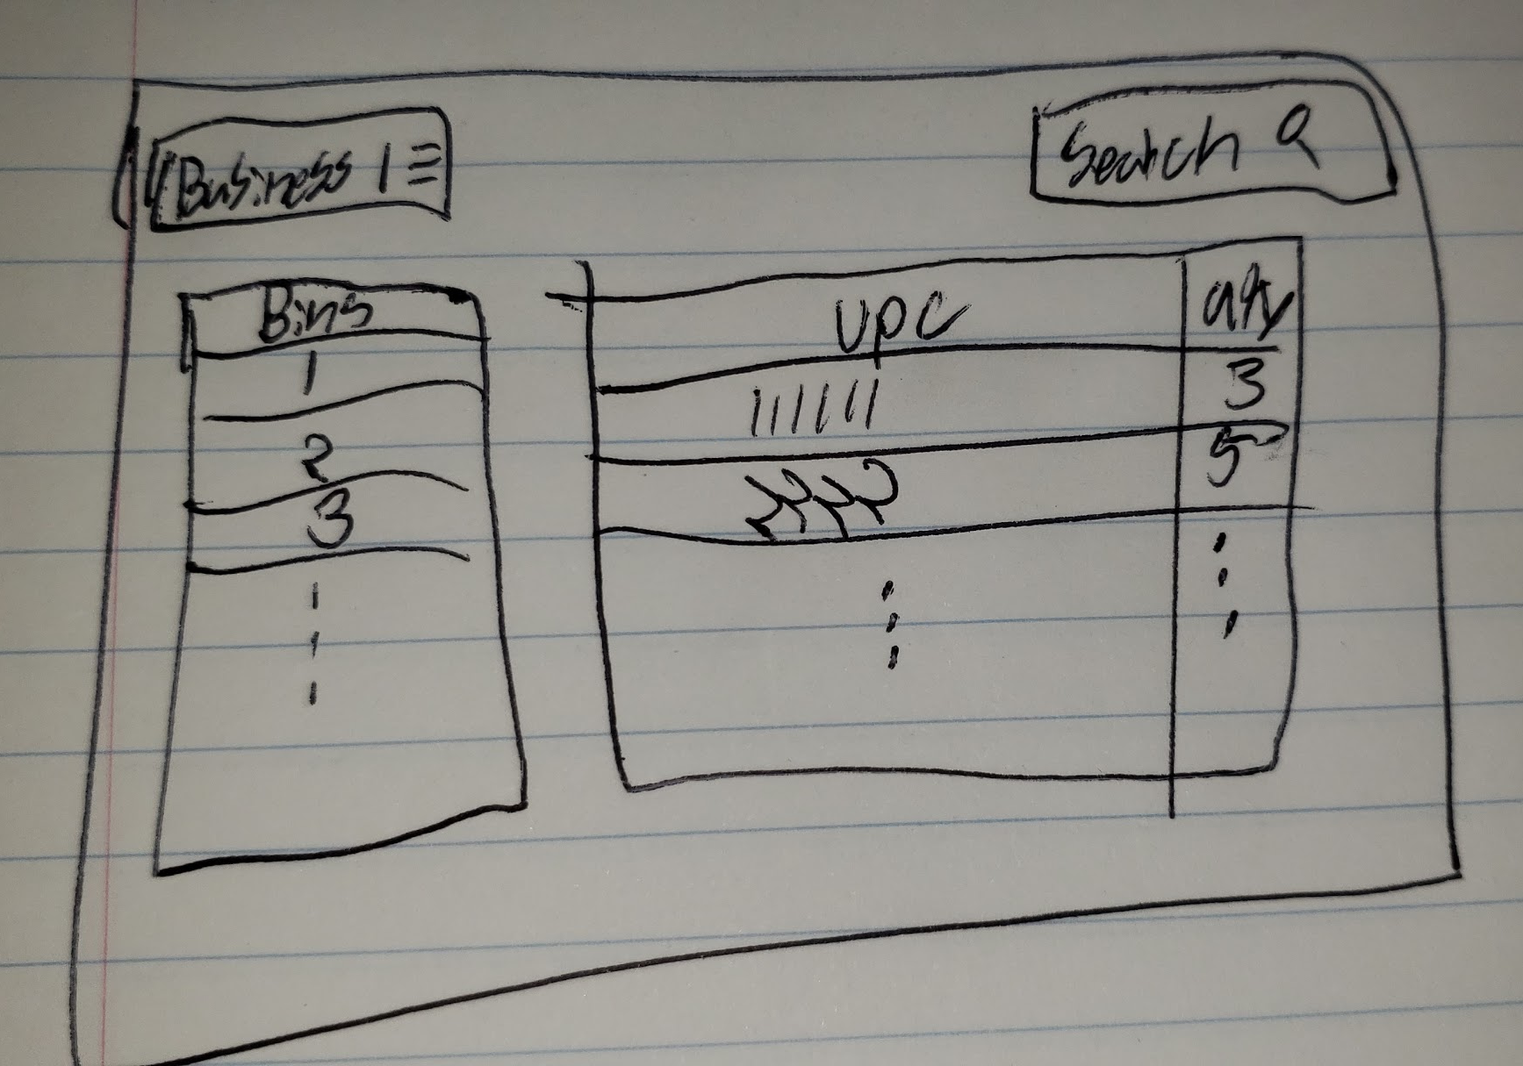
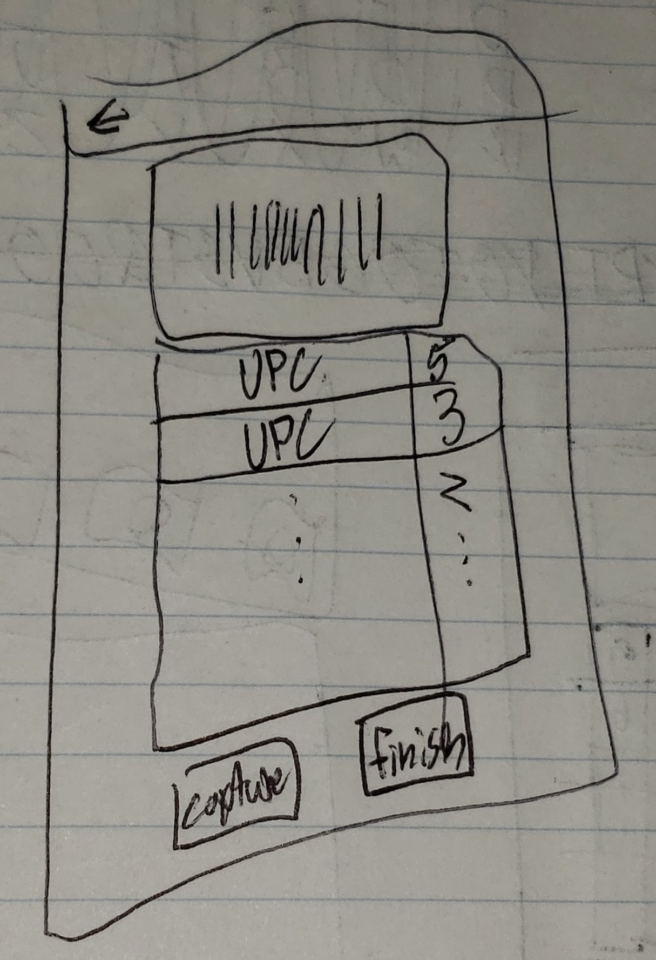
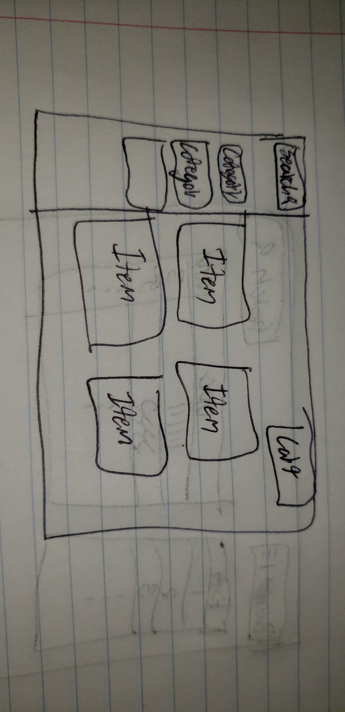
UI Prototype
Inventory Scanning Shopping Page Website Inventory Management

Slide 9
Software Development Plan
Iteration Plan
Tools
Programming application: JavaScript, MongoDB, HTML, CSS, bootstrap, NodeJS
Cloud: amazon web service
Agile Scrum software development: implementation and unit testing
Github: https://github.com/siddharth1410/inventory_management
People: Team members, Review Team 11, Professor Christoph Csallner and TA Soumik Mohian
Education: Members have a foundational knowledge of programming and computer science, but education is needed on the some of the languages being used.

Slide 10
Sources
“6 Best Inventory Management Software of 2019.” Business.org, Business.org, 16 Jan. 2019, www.business.org/finance/cost-management/best-inventory-management-software/.

Slide 11
Thank You, Any Questions?

