Slide 1
Speeded-Up Robust Features (SURF)
Donnie Newell
Image Processing
University of Virginia

Slide 2
SURF Overview
Find interest points
Determine direction of max gradient
Build descriptor using local gradients

Slide 3
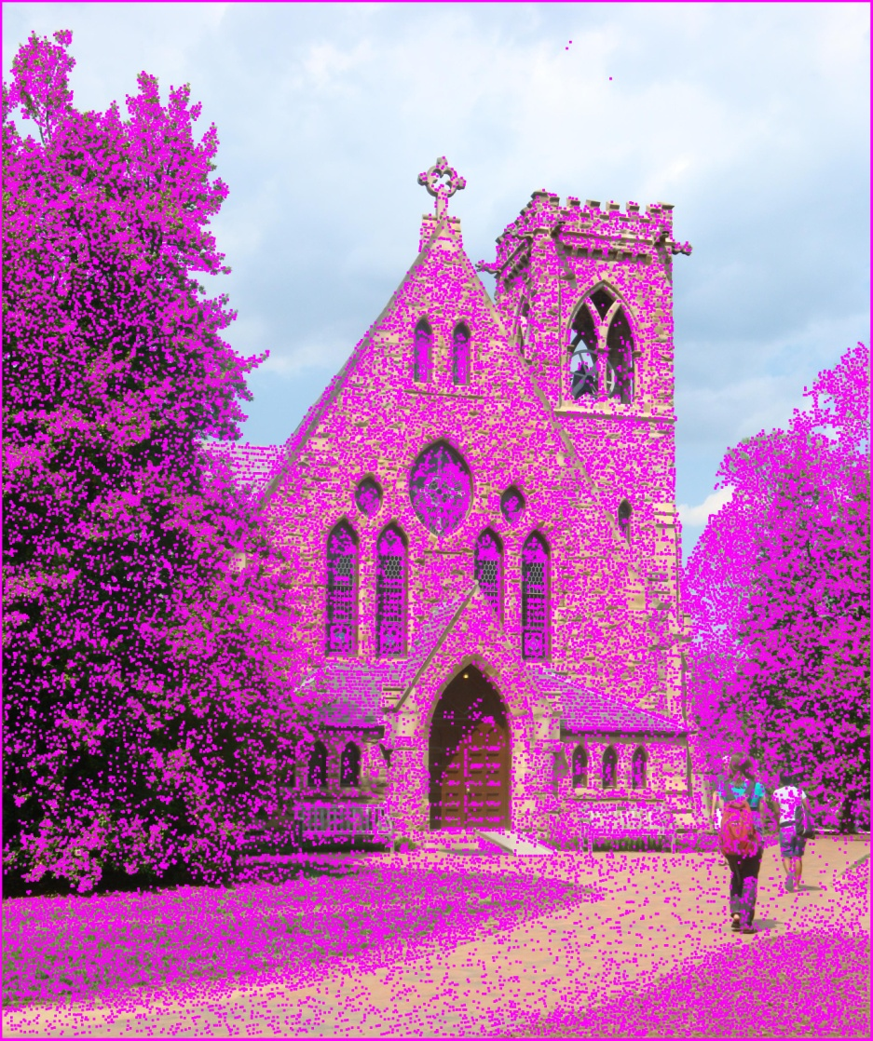
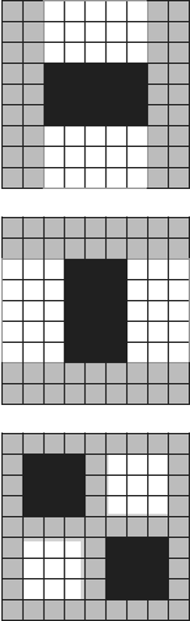
Interest Points

Slide 4
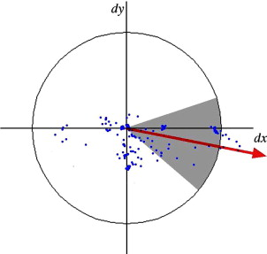
Direction
Plot local gradients
Slide π/3 window
Max window sum is orientation

Slide 5
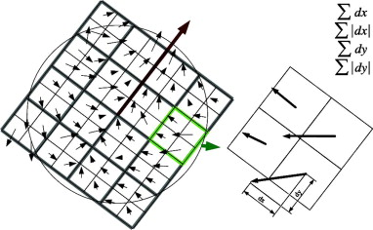
Descriptor

Slide 6
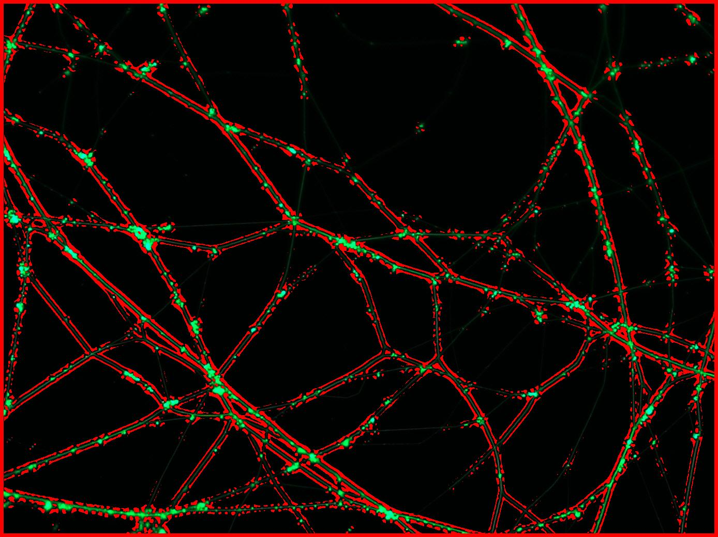
Determinant of Hessian Approximation

Slide 7
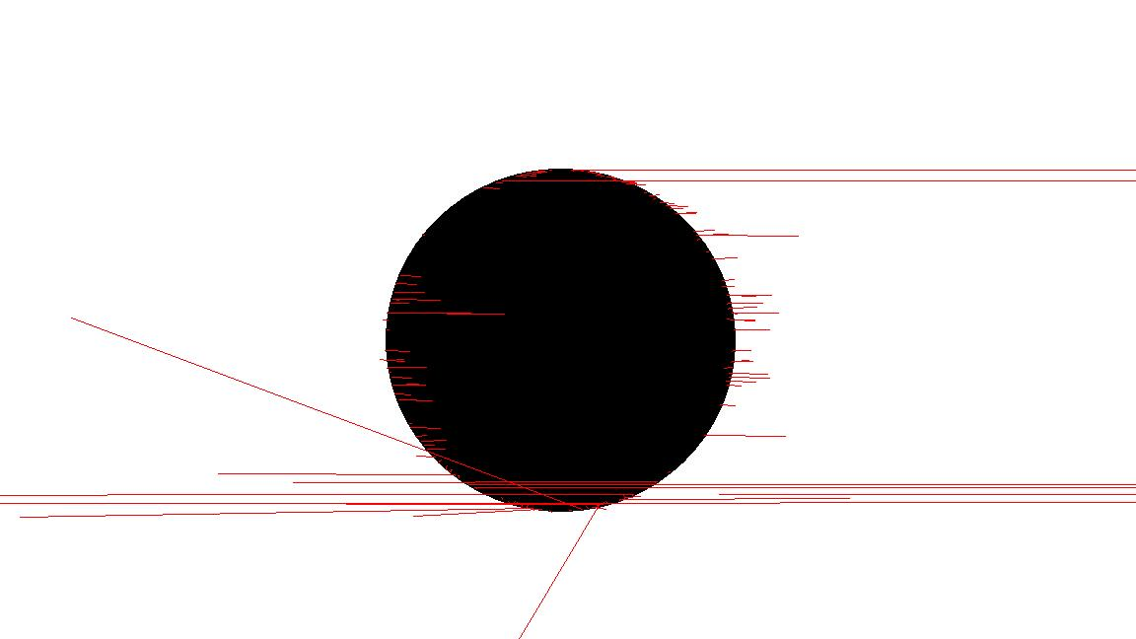
Orientation Vectors?

