Slide 1
C# Methods
IT-1050, November 2021
D. Santos

Slide 2
Method Concepts
What is a Method?
Access Levels and Encapsulation
Method Patterns and Variations
Method “Signature” vs. Method “Implementation”
Method Invocation and Passing Parameter Values
Managing Object State Mutability
SOLID and Single Responsibility

Slide 3
What is a Method?
A method in object-oriented programming (OOP) is a procedure associated with a message and an object. An object consists of data and behavior; these comprise an interface, which specifies how the object may be utilized by any of its various consumers. Data is represented as properties of the object, and behaviors are represented as methods. -Wikipedia
In other words…
Classes define variables and methods that belong to itself or its instances.
The variables are the state. (attributes, nouns, etc.)
The methods are the behaviors. (actions, verbs, etc.)

Slide 4
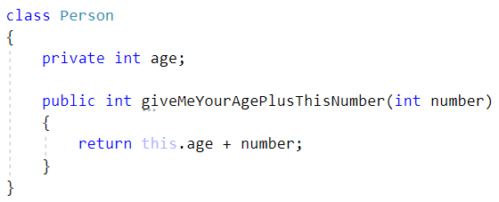
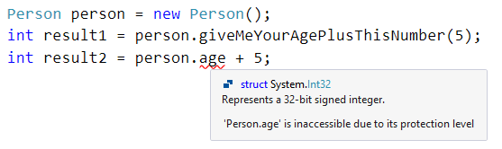
A Method as a Function with Context
person
Internal
State
Public Interface (API)
0

Slide 5
Access Levels and Encapsulation
Internal Implementation
Public Interface
Simple Interface Exposed to the User to Achieve Functionality
Complex Inner State and Logic which Makes Everything Work

Slide 6
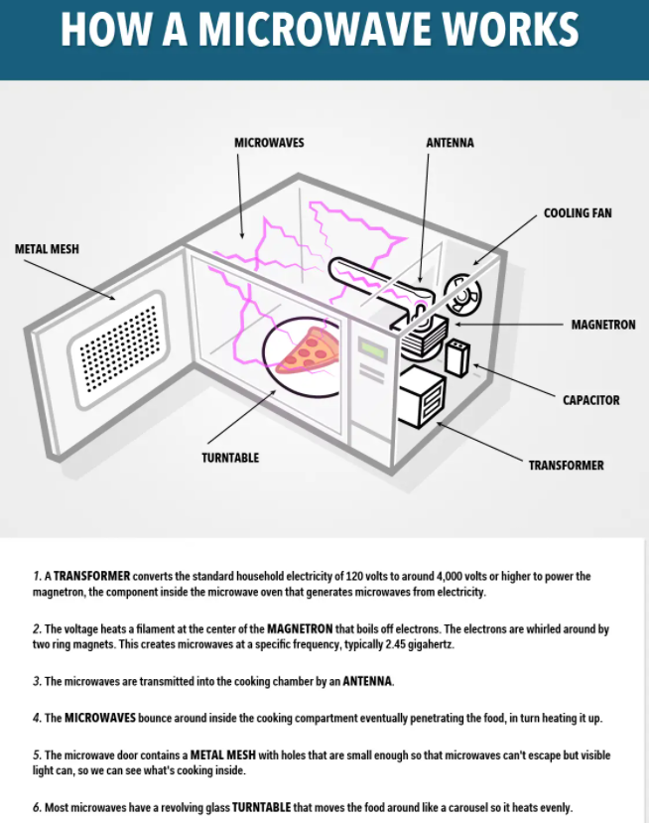

Public Interface
Internal Implementation

Slide 7
Method Patterns and Variations
Getters (public access to retrieve internal state)
Computed Values (get an output value computed from internal state and/or parameters)
Pure Functions (get an output value computed from parameters alone without relying on or changing state)
Setters (public access to change internal state… no output)
Subroutines (any void method… may or may not change state of itself and other objects)

Slide 8
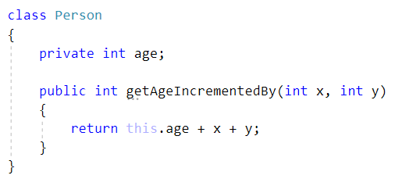
Function Variant
Method Example – Function
Has Inputs (Parameters)
Has Output (Return Value)
note: may or may not be a function of internal state
(this example method is a function of x, y, and age)

Slide 9
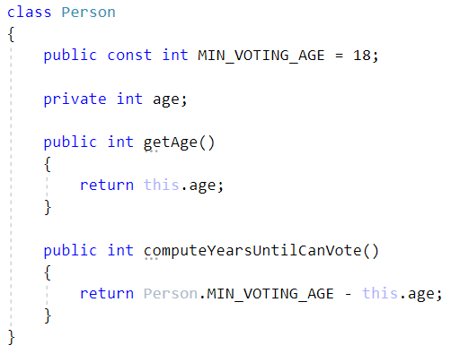
Value Variant
Method Example – Value
Does Not Have Inputs (Parameters)
Does Have Output (Return Value)
Retrieved Value / “Getter”
“Computed Value”
note: you can, but should not alter state when there is a return value

Slide 10
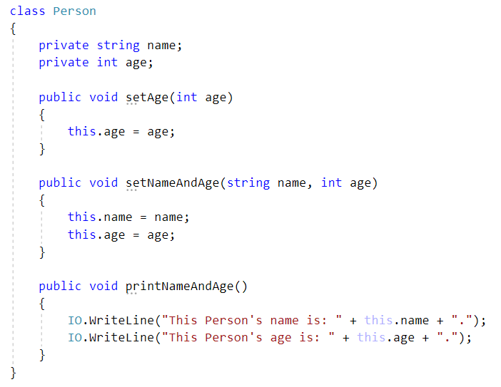
Subroutine Variant
Method Example – Subroutine (void)
Does not have an output
Might have inputs
Might modify internal object state
Modify Single Internal Value (“Setter”)
Modify Multiple Internal Values (“State Mutation”)
Doesn’t Change Any Values (“Non-Mutating”)

Slide 11
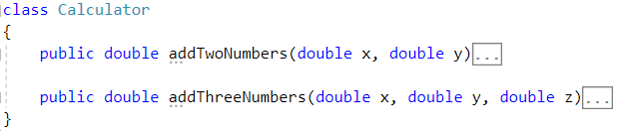
Method Signature
Method Signature Consists Of
Method Name
Return Value
Parameter Type List
The Method Signature is the “What”.
Public Interface (API)
double addTwoNumbers(double, double)
State
double addThreeNumbers(double, double, double)

Slide 12
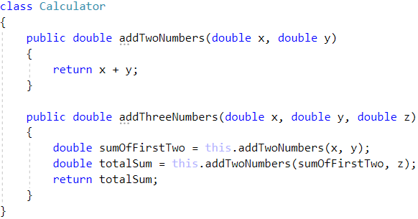
Method Body / Implementation
Method Body/Implementation
Has a Local Scope
Has Access to passed parameter values
Has Access to all Members
Has Access to external public statics
The Method Implementation is the “How”.

Slide 13
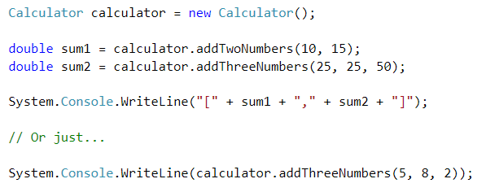
Method Invocation
Method Invocation
Has Context (Object or Class)
May take parameter values
May return a value
The Method Invocation Executes the Code which is Defined in the Method Body.

Slide 14
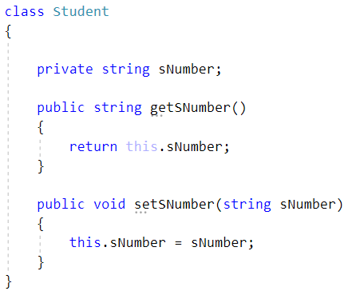



Managing Object State Mutability
student
Internal
State
Public Interface (API)

Slide 15
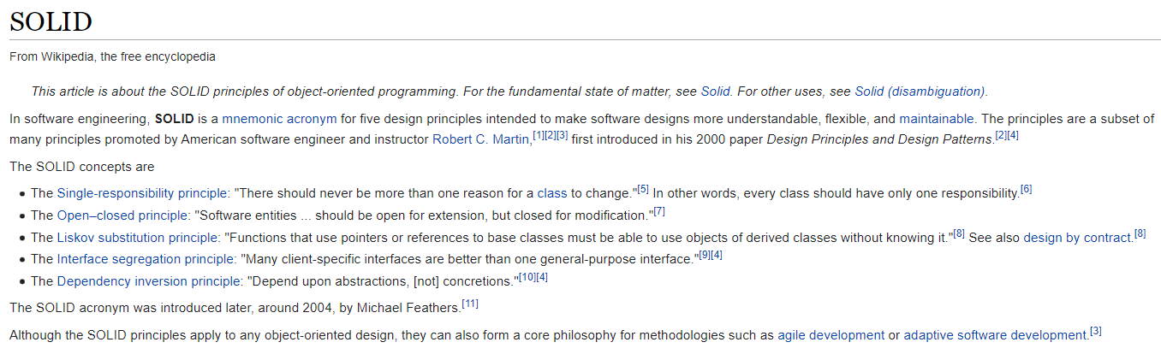
Single Responsibility
- Methods should be succinct to one purpose, as opposed to monolithic and multi-purposed.
- For complex behavior, you chain methods together by invoking each other, forming a larger composite.
- This is comparable to a complex circuit consisting of individual tiny logic gates.
- Combination of small components into a larger composite occurs in many programming design patterns.
- The metric which quantifies the lack of coupling and amalgamation is called “Cohesion”.

Slide 16
Links To Material
https://github.com/DonnieSantos
https://dotnetfiddle.net/lfCg0C (quick introduction)
https://dotnetfiddle.net/gLt1QD (in-depth examples)
https://github.com/DonnieSantos/IT-1050/tree/master/2022
https://github.com/DonnieSantos/IT-1050/tree/master/2022/Part8_Methods
https://github.com/DonnieSantos/IT-1050/blob/master/2022/Part8_Methods/PowerPoint/Methods.pptx

