Slide 1
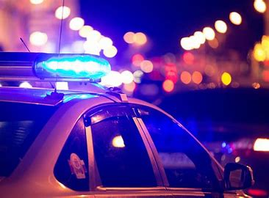
Police Incident Coverage Time Capstone
by Donovan Knight
Nashville Software School DA10

Slide 2
Motivation
To identify if the Nashville Police Department reputedly respond slower or faster in certain areas based on the demographic of people living there
To possibly shed light onto misinformation about the police in our city
To aid in lessening the hostility between on-duty officers and citizens

Slide 3
What is Police Incident Coverage Time ?
Time between the incident occurred and the incident reported by the police
Incident occurred = instance in which a call is made for dispatch to make their way to the scene
Incident reported = instance in which the call has been handled and put in the Metro Nashville Police Department system

Slide 4


Parameters
Race (in 2023)
Income (in 2023)

Slide 5
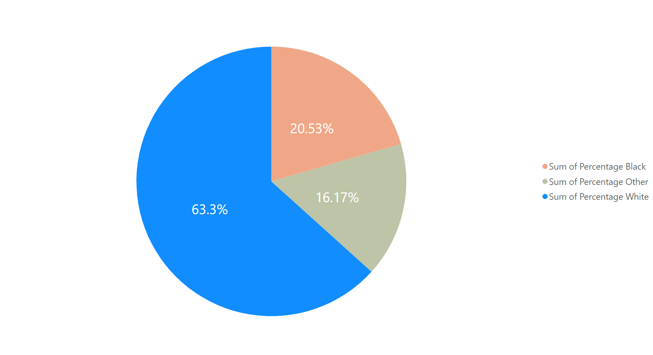
Race in Nashville
Blue – White Population
Peach – Black Population
Olive – All Other Populations

Slide 6
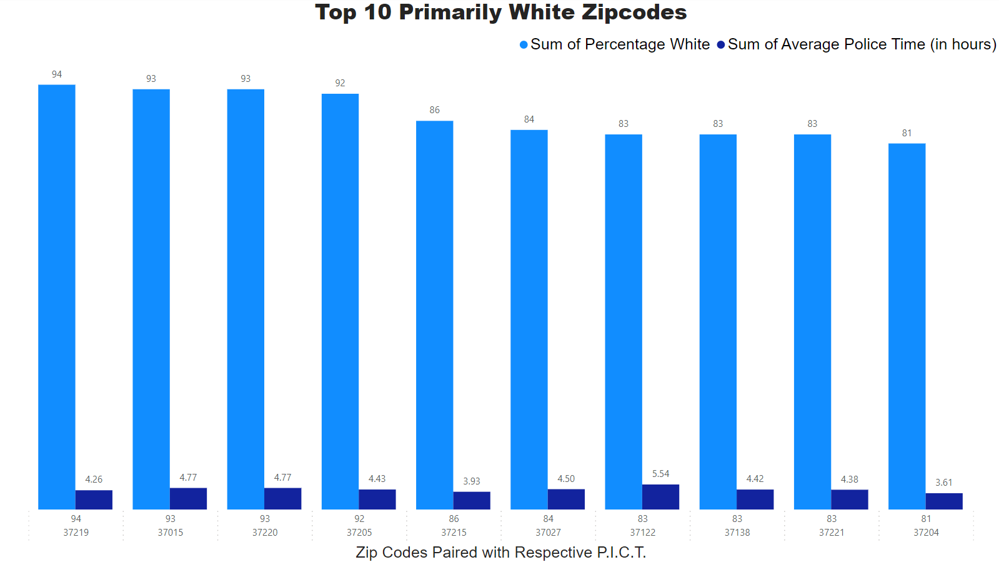
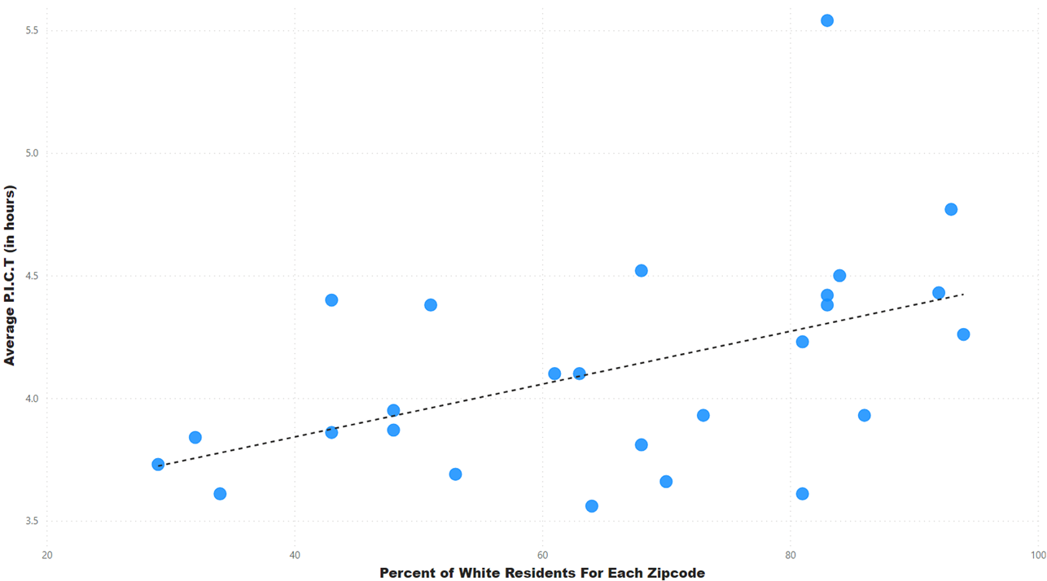
Primarily White Zip Codes With Correlation

Slide 7
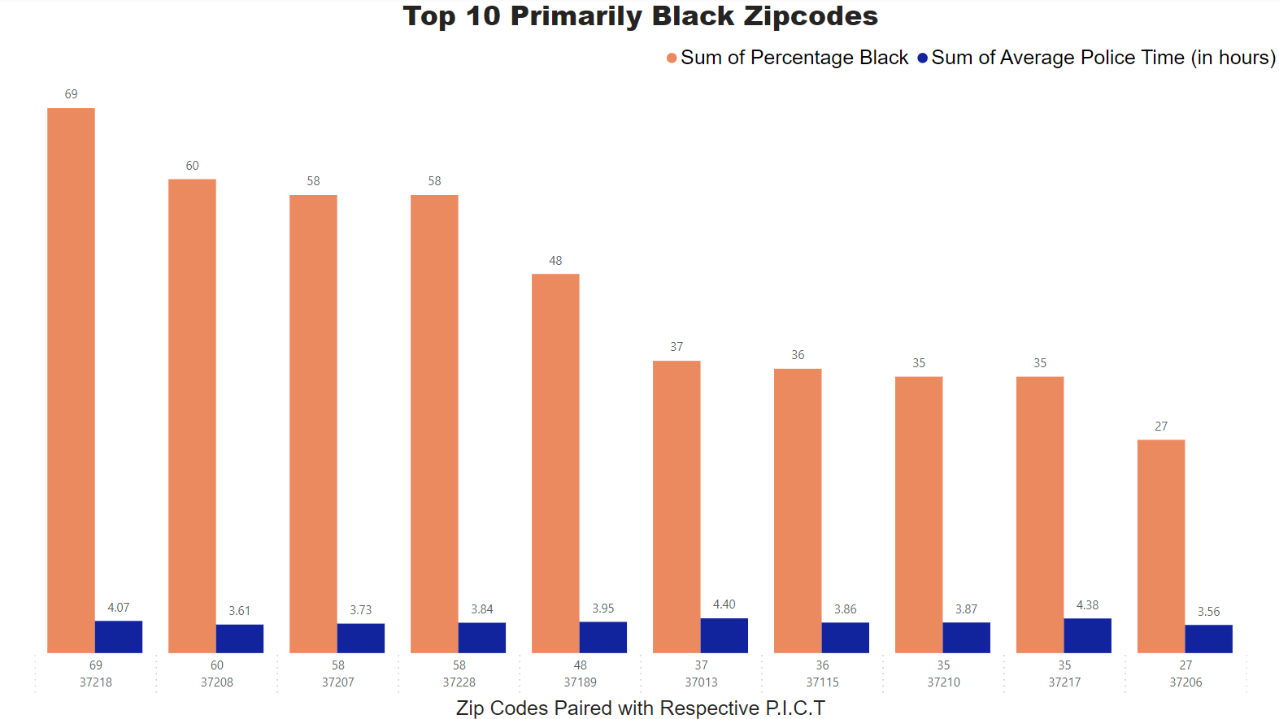
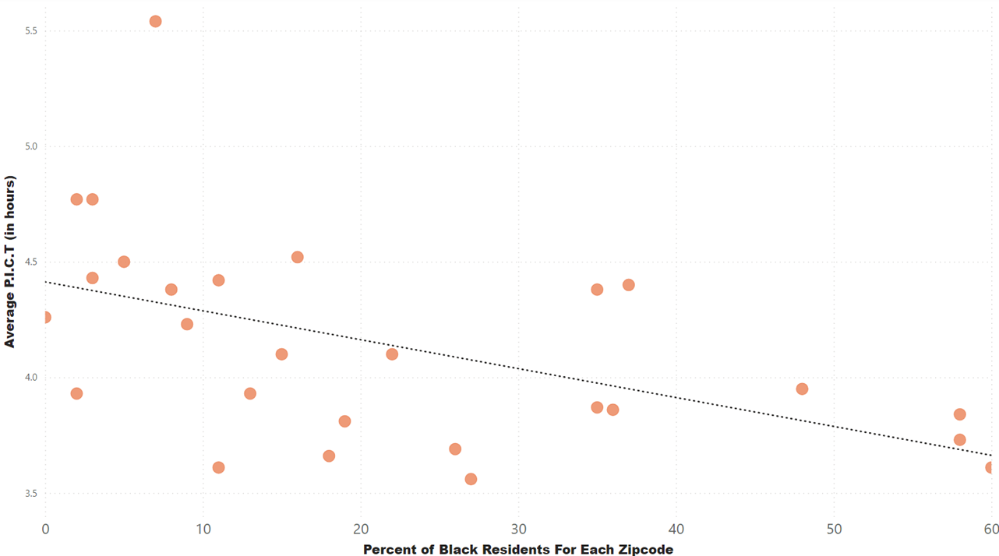
Primarily Black Zip Codes With Correlation

Slide 8
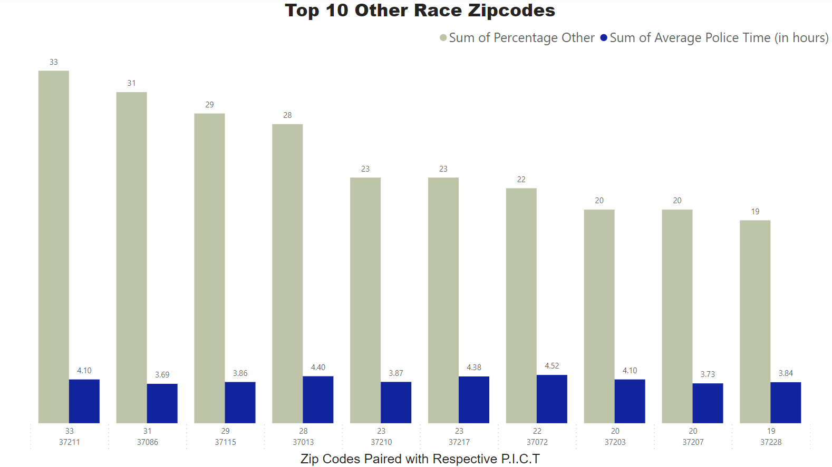
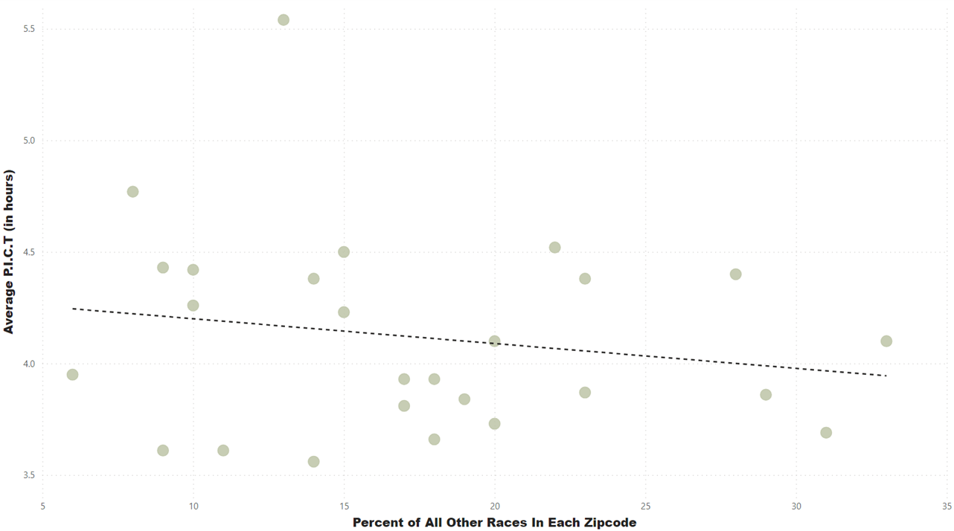
All Other Residents With Correlation

Slide 9
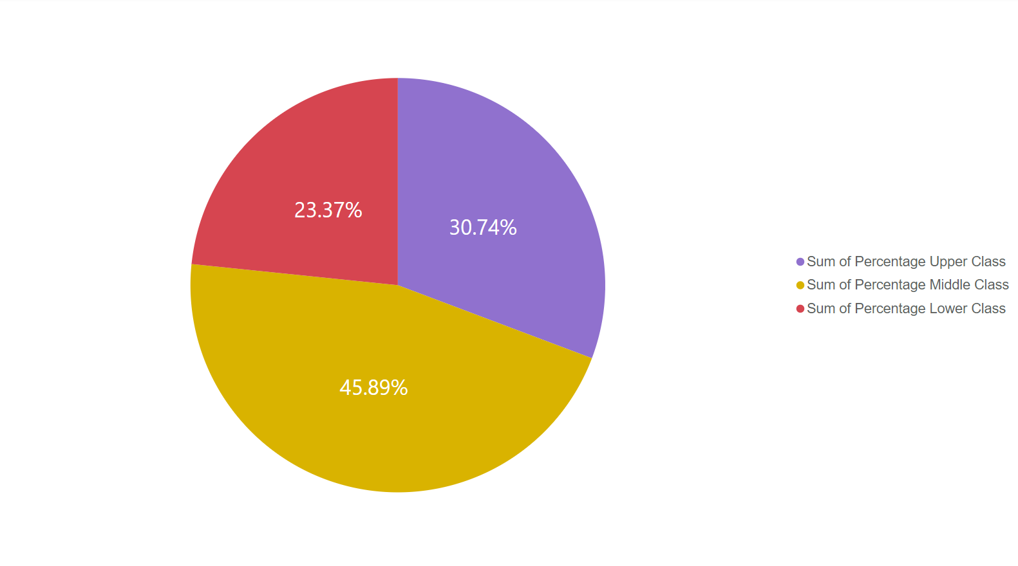
Income In Nashville
Lower Class – approx. 40k or less
Middle Class – 40k to 120k
Upper Class – more than 120k
Purple – Upper Class
Yellow – Middle Class
Red – Lower Class

Slide 10
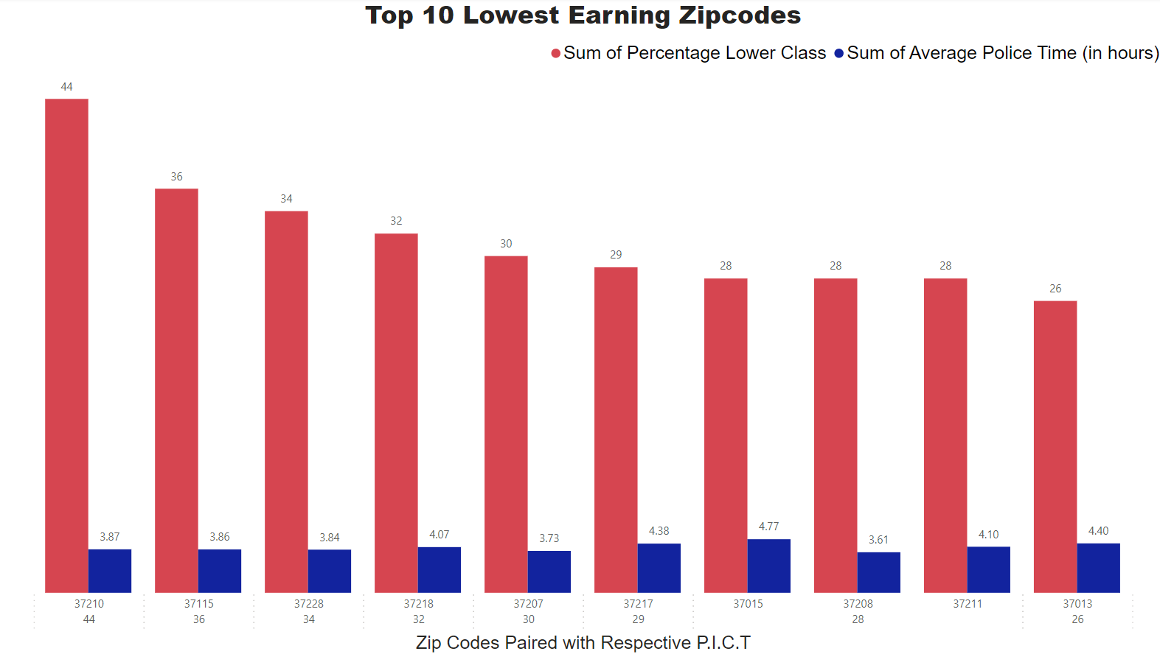
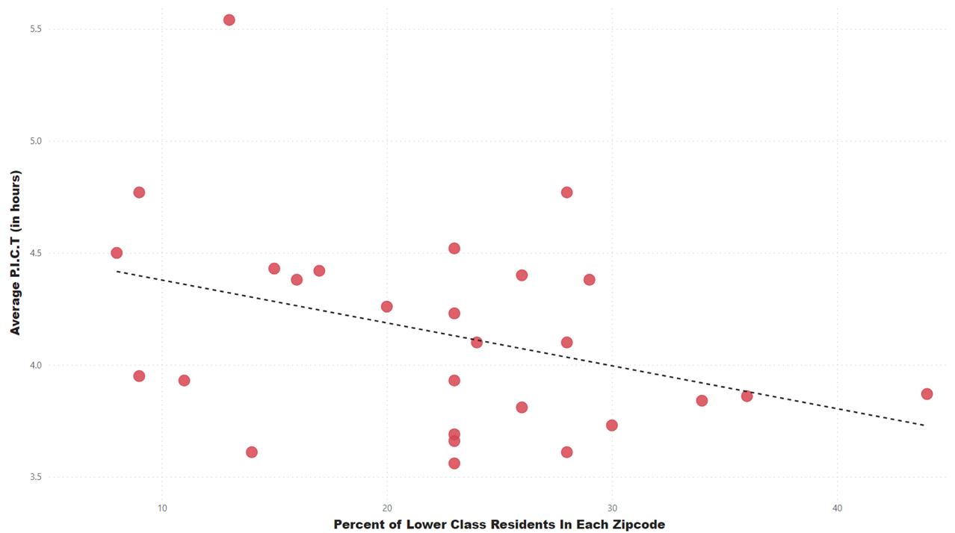
Lower Class Earners With Correlation

Slide 11
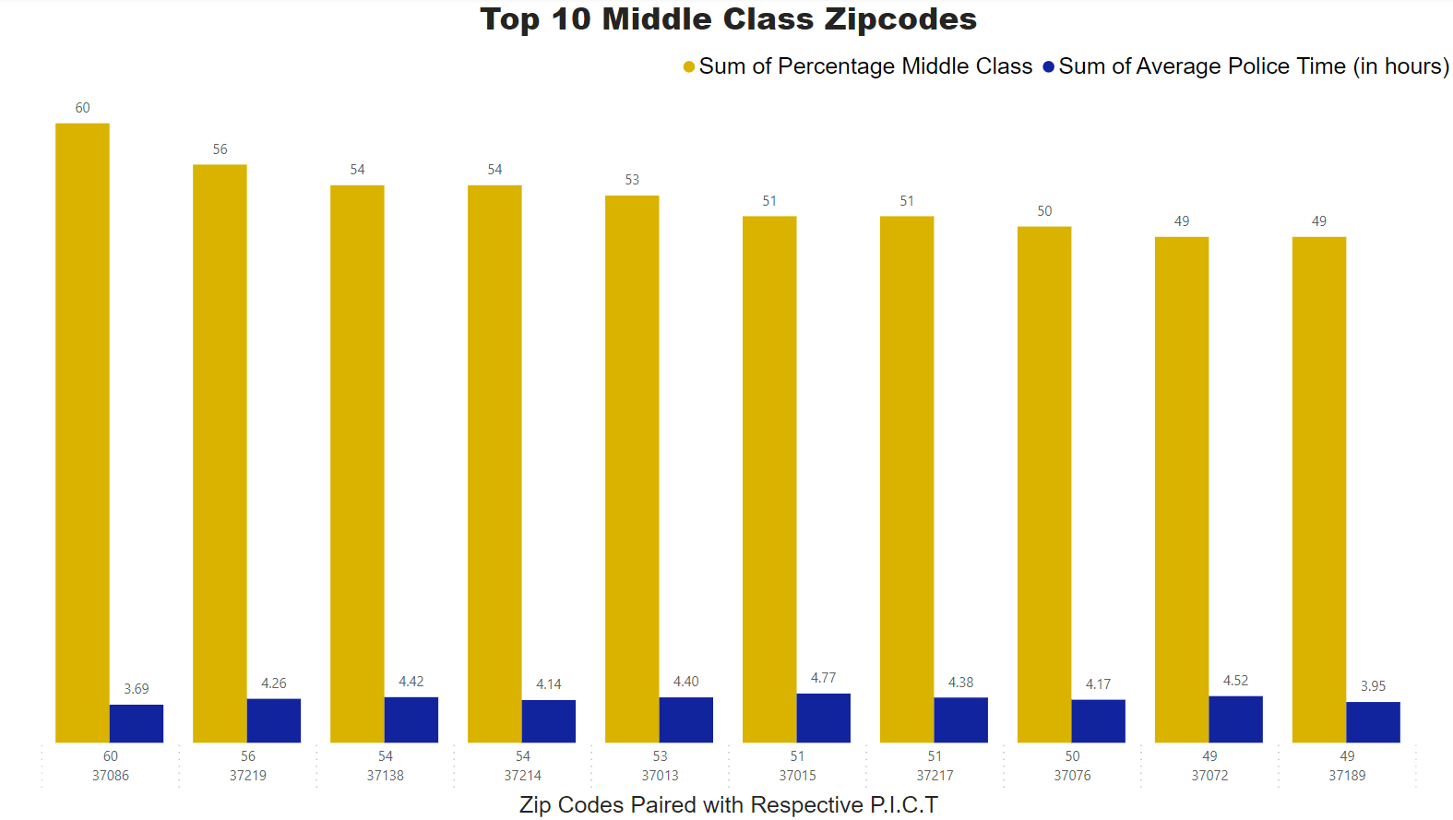
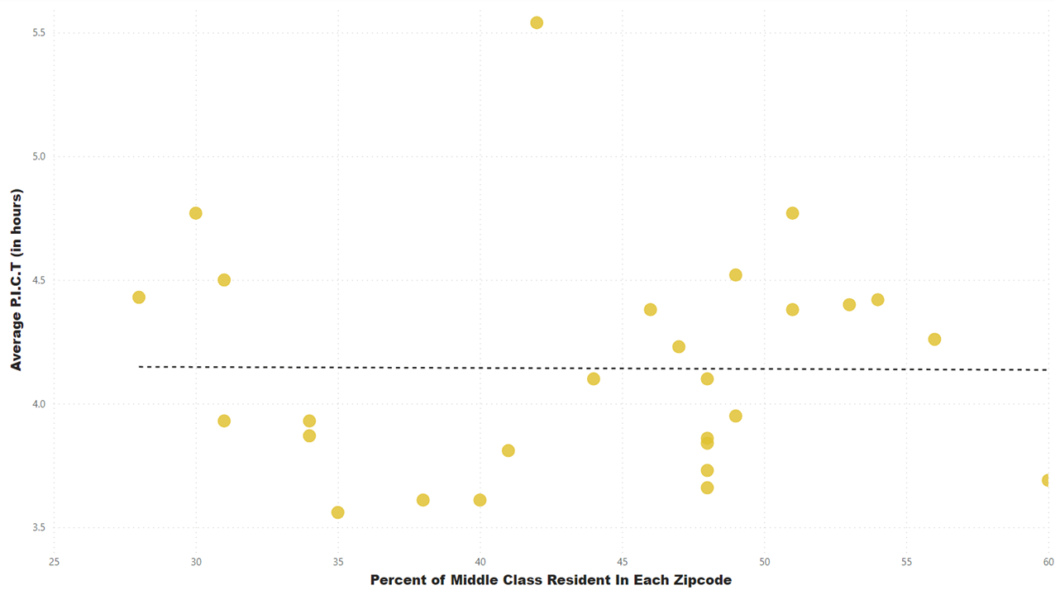
Middle Class Earners With Correlation

Slide 12
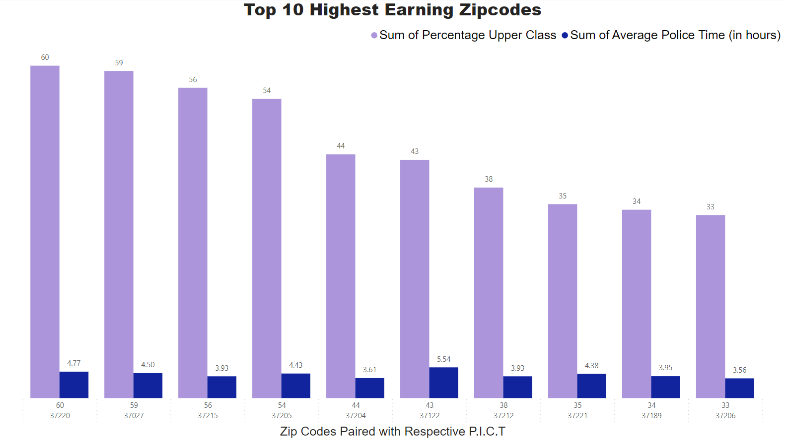
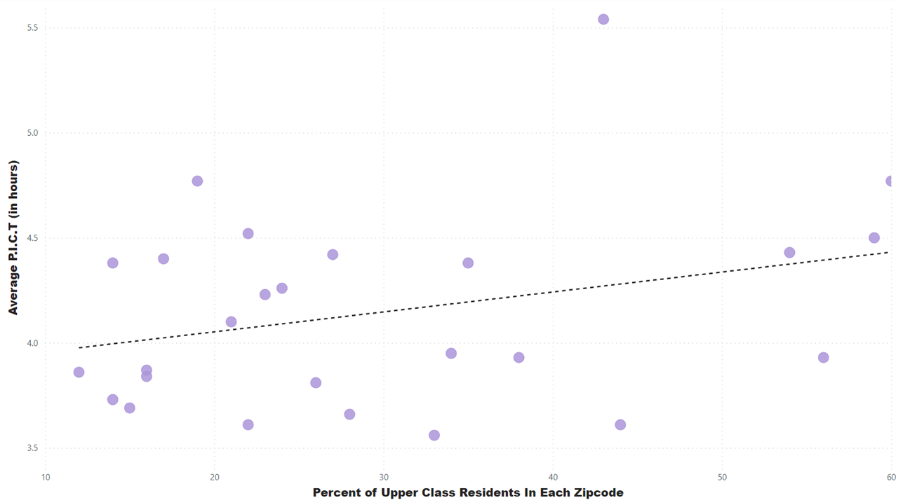
Upper Class Earners With Correlation

Slide 13
Additional Parameters
What are the top types of calls per zip code?
Do the type of calls affect the time it takes for police to cover a call?

Slide 14
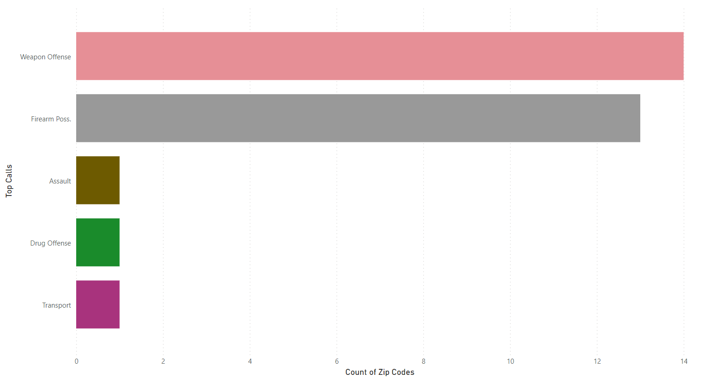
Top Types of Calls Per Zip Code in 2023

Slide 15
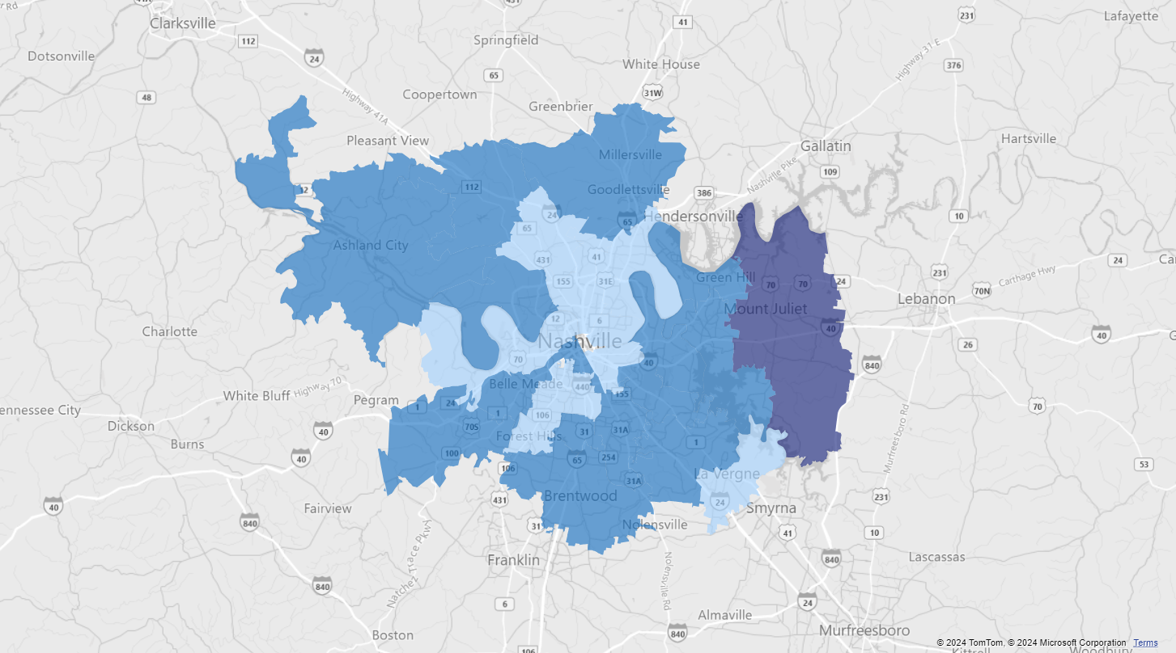
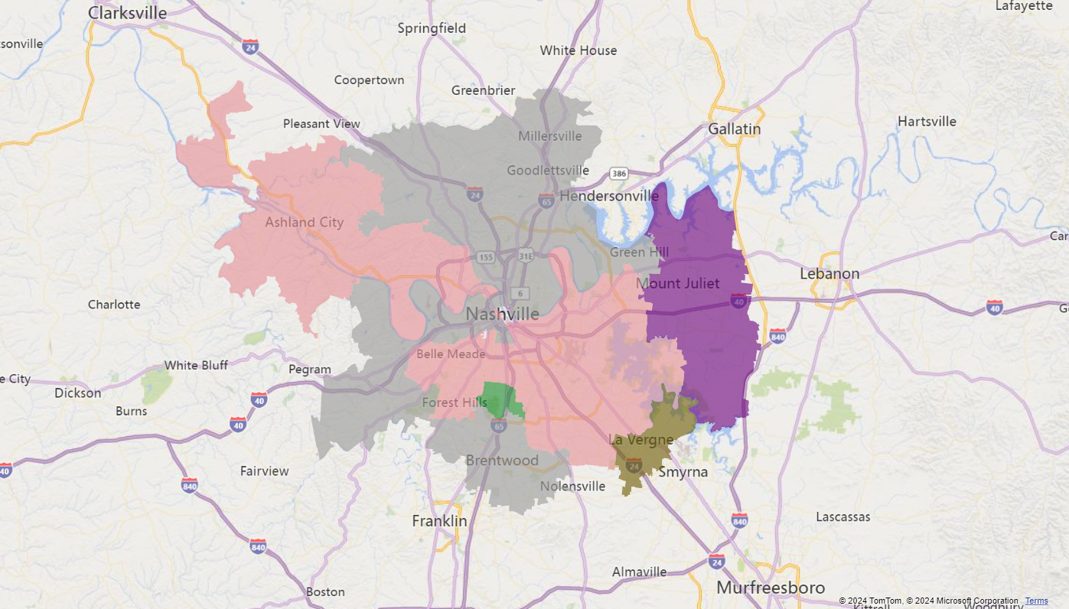
Average Police Times & Top Calls Per Zip Code in 2023
Weapon Offense – Light Pink
Firearm Possession - Grey
Assault - Brown
Drug Offense - Green
Transport - Purple
Light Blue - 3-4 Hours on Average
Median Blue - 4-5 Hours on Average
Dark Blue - +5 Hours on Average

Slide 16
Conclusion Based on Results
Police in Nashville DO NOT discriminate against those of different races or incomes
ALL times for complete coverage of ALL crimes (apart from suspects on the run) averaged between about 4 and 6 hours.
It also appears that calls on situations that have the potential to become violent(weapon and firearms incidents), are dealt with faster
Nashville police appear to be slightly quicker in low income and areas with minorities areas even though there is not a large spread of time taken

Slide 17
Additional Police and Personal Data Information
Only 1,050 officers spread across 8 precincts/districts that span across Nashville
Not evenly divided across each precinct, but based on budget and calls for service
Some data was eliminated from my work because of irrelevant zipcodes, nonexistent zipcodes, etc.
Suspects on the run for more than a day were not included in the incidents reported
The outlier on the scatterplots was the same zipcode, in Mount Juliet, TN

Slide 18
Data Used
https://censusreporter.org/
https://data.nashville.gov/Police/Metro-Nashville-Police-Department-Incidents/2u6v-ujjs/about_data
https://www.nashville.gov/departments/police
Study: How much do you need to make to be middle class in Nashville? (wsmv.com)

Slide 19
QUESTIONS ???

