Slide 1

PowerShell Crescendo

Slide 2


Slide 3

PowerShell Crescendo
A framework and solution accelerator that lets you amplify traditional console commands to turn them into PowerShell cmdlets.

Slide 4

Quick Demo Crescendo

Slide 5
Native commands work great in PowerShell
Using Crescendo:
Clear naming and usage patterns
Verb-Noun command
Consistent parameter naming for similar uses
Common method to get help
Output objects to the pipeline
Easy to share using Modules
Improves discoverability
Declarative composition model vs. custom wrapper coding
Define the cmdlets and parameters
Only need to write code to handle the output
Without Crescendo:
Obscure syntax
Different for every tool
Difficult to pipeline for automation
Difficult to discover available tools
Re-implement the tool in managed code or script
Call web APIs
Swagger (OpenAPI) REST APIs
SOAP
Etc.
Roll your own PowerShell wrapper script
Just use the tool as is without change

Slide 6

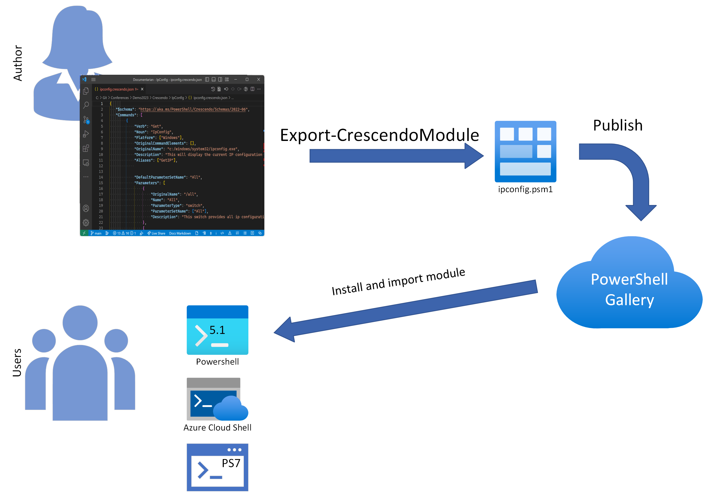
Crescendo workflow

Slide 7
Demo Crescendo + Elevation

Slide 8
Demo Multi-Command, Easy objects

Slide 9
What's new in Crescendo 1.1
Docs - What's new in Crescendo 1.1 - PowerShell | Microsoft Learn
New cmdlet - Export-CrescendoCommand
New parameter –NoClobberManifest (Thanks @tbergstedt)
Bypass output handler (Thanks @potatoqualitee)
Argument transformation (Thanks @cdhunt)
Error handling (Thanks @draproctor)

Slide 10
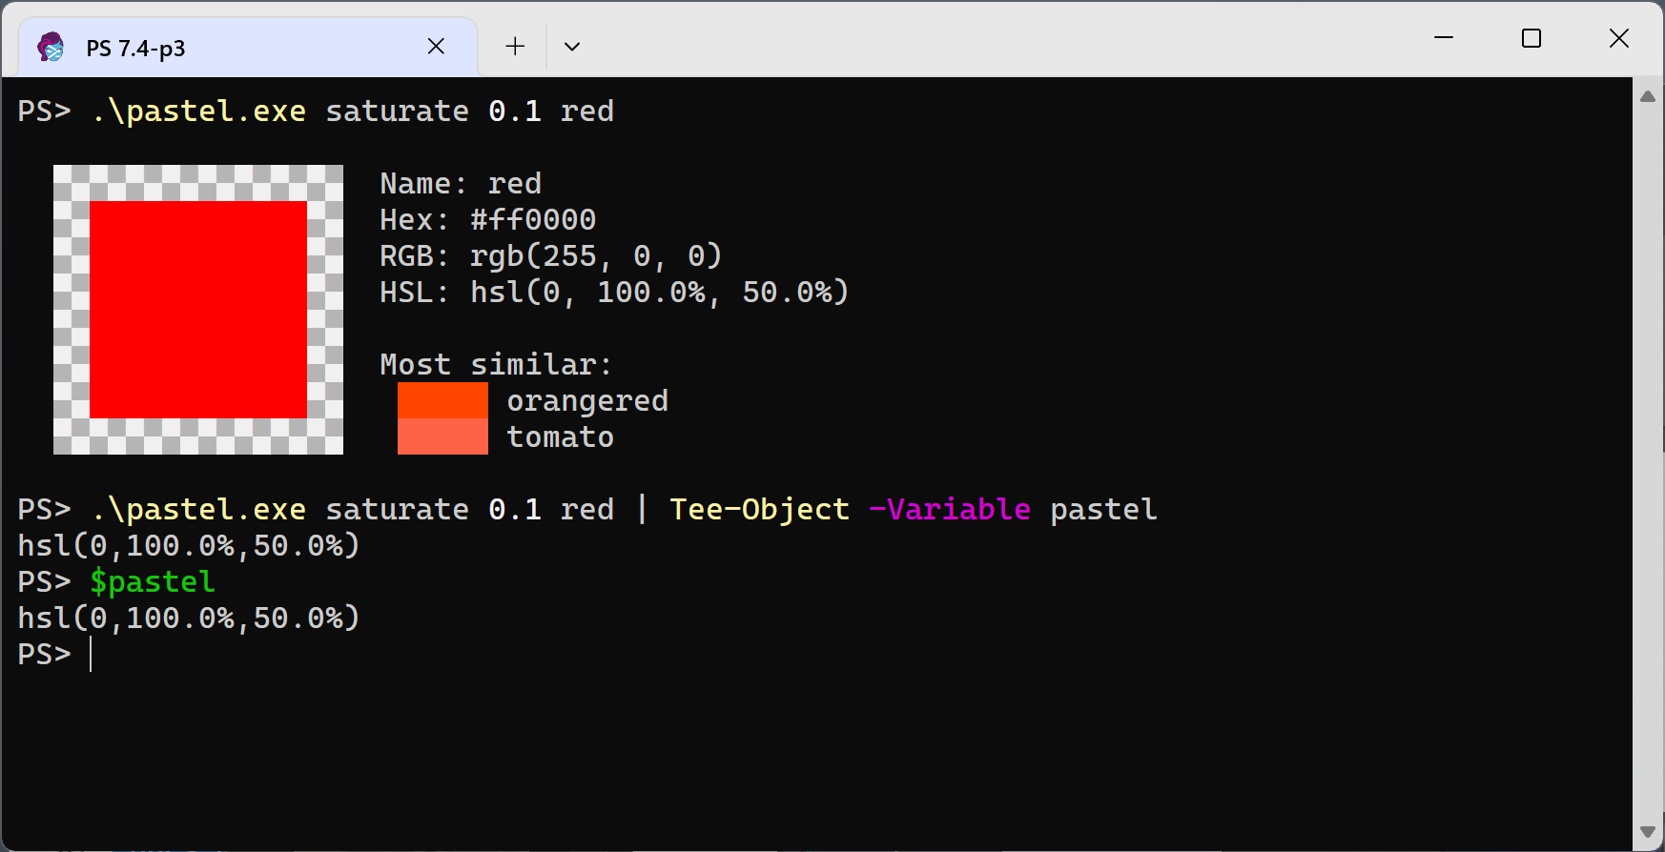
Problem Some tools behave differently when you pipe the output
Solution
The new ByPass output handler

Slide 11
Demo Argument Transformation

Slide 12
Demo Native Error Handling

Slide 13

Call to Action
Try it - https://www.powershellgallery.com/packages/Microsoft.PowerShell.Crescendo
Read about it - https://learn.microsoft.com/powershell/utility-modules/crescendo/overview
Give us feedback - https://github.com/PowerShell/Crescendo/issues
Join the Discussion - https://github.com/PowerShell/Crescendo/discussions
Our plan – RC/GA v1.1

Slide 14




