Slide 1
A year of improvements to your PowerShell Editing Experience
Andy (they/them) and Sydney (she/her)

Slide 2
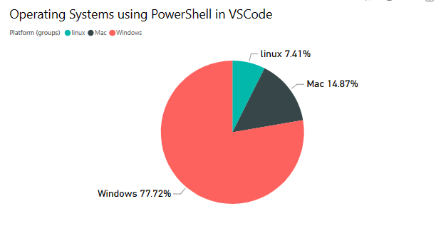
At a high level
12 stable releases
36 preview releases
380,000 monthly users (13,000 preview users)
8.1 million total installs

Slide 3
Features At a high level
Rewrite of PowerShell pipeline execution with cancellable and ordered tasks
Improved user interface with built-in Codicons
Loads of debugger reliability and usability improvements
Variable expansion in debugger is significantly improved
ReadKey fix (including better pasting on macOS and Linux, and a whole bunch of other bugs!)
Tons of testing improvements (lots of regression tests)
Modernized built in snippets

Slide 4
Features At a high level – Continued
IntelliSense improvements
Rename the “PowerShell Integrated Console” to the “PowerShell Extension Terminal”
A walkthrough experience for getting started with PowerShell in VS Code
A major LSP client library update (and other important compliance work)
Major performance improvements across all features
Rewrite of all symbol logic
Deprecated preview extension with a pre-release option in the marketplace

Slide 5
Demo time

Slide 6
Upcoming Work
Continued work on Intellisense
Startup failure handling
Simpler usage of PSES for non VSCode hosts
5.1 Write-Output support
PSReadLine Preview incorporation
Debugging breakpoint sync

Slide 7

How to stay in touch
Github.com/powershell/vscode-powershell
Github.com/powershell/powershelleditorservices
https://devblogs.microsoft.com/powershell/
https://aka.ms/psdiscord

