Slide 1
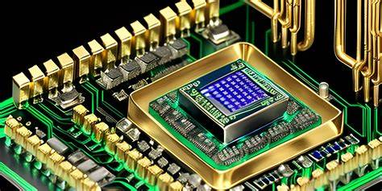
Design of a 16-bit RISC CPU
Presenters: GuZhaoming Kuanghao Zuoyue HeDongchen LiaoMnghao
01

Slide 2
Content
Top Specification
ISA
Encoding
Datapath
Modules
Top
Specification
Memory interface and handshake
Execution
Flow
Next
Work
01

Slide 3
Top Specification

Slide 4
Top Specification: the shared design contract
Item
Top-level specification
Architecture
16-bit RISC;16-bit instruction length
Register file
4 × 16-bit general-purpose registers: R0–R3
Instruction format
Opcode[15:12] + Rd[11:10] + Rs[9:8] + Imm [7:0]
ISA scope
13 encodings including LDR, STR, CMP, JZ, HALT
Opcode
13 of 16 opcode used; 3 for further extension
Execution model
Fetch → Decode → Execute → Memory → Write-back
Memory
Instruction ROM and data-memory
Overview
16
4
4+2+2+8
13/16
F-D-X-M-W
data & instruction
registers
field layout
opcodes used
execution stages
02

Slide 5
Design Trade-offs: simple and complete
Design principle
Keep the CPU simple enough to implement now, but complete enough to demonstrate real execution.
Choice
Reason
2-bit register field
3 bits would waste instruction bits and imply a larger register file and decoder
8-bit immediate
supporting constants, jump targets and memory offsets, making programs easier to express
16-bit instruction
Decoding stays regular and PC update is simple
Reserved opcodes D–F
use 13/16 and reserve the rest for FAULT handling or future ISA extensions.
11

Slide 6
ISA Encoding
01

Slide 7
ISA design: format and compatibility
15
12
11 10
9 8
7
0
Opcode
Rd
Rs
Imm
4 bits
2 bits
2 bits
8 bits
16 opcode encodings R0–R3 register indices Fixed 16-bit length
Category | Baseline opcodes 0–7 (hex)
Data transfer | 0 MOV Rd,#u8 1 MOV Rd,Rs
Arithmetic | 2 ADD Rd,#u8 3 ADD Rd,Rs 4 SUB Rd,Rs
Logic | 5 AND Rd,Rs 6 OR Rd,Rs
Control | 7 JUMP #u8 Absolute target: PC ← ZExt(u8)
Preserve all baseline encodings unchanged
Sources: Course Introduction, slides 13–14; CHA Lecture 01-B, slides 20–21..
01
Notes:
Suggested delivery: about 50 seconds.
Our ISA is the contract between the program and the CPU. Each instruction has a fixed length of sixteen bits: four for the opcode, two for each register index, and eight for the immediate. This gives sixteen possible opcode encodings and four registers, R zero to R three. We preserve opcodes zero through seven. MOV and ADD each have immediate and register forms. SUB, AND and OR use registers, while JUMP uses an absolute immediate target. Keeping these encodings unchanged allows existing baseline programs to retain their meanings as we add new instructions.
中文提示：先指字段图，再概括四类指令，不逐行念表。这里是8种基础编码，不是8个不同助记符。R0也可写。JUMP是零扩展的绝对地址0…255，与后面的JZ相对分支区分。
答辩备用：数据结果保留低16位；固定字段位置便于译码，但本页不承诺性能提升。
来源：CHA Lec00-Cource Introduction.ppt 第13页；CHA Lec 01-B.pptx 的ISA部分；项目 CPU设计文档_v2.md 第2、3章。项目原稿将基础编码归于Lec17第18页，此文件未包含于本次上传资料，具体编码以项目v2规格为依据。

Slide 8
ISA extensions: memory and control
Memory access
Conditional flow
Program end
LDR / STR
CMP / JZ
HALT
Store and reload results
Exit a loop when equal
Stop and preserve state
Hex | Instruction | Architectural effect
8 | LDR Rd,[Rs+s8] | Rd ← MEM[Rs + SExt(s8)]
9 | STR Rd,[Rs+s8] | MEM[Rs + SExt(s8)] ← Rd
A | CMP Rd,Rs | Z ← (Rd == Rs)
B | JZ #s8 | If Z: PC ← PC + 1 + SExt(s8)
C | HALT | Stop instruction fetch
13 of 16 opcode encodings in use
STR: Rd holds the store data; Rs holds the address base.
Group proposal: opcodes 8–C extend the baseline within the same 16-bit format.
02
Notes:
Suggested delivery: about 60 seconds.
The five proposed extensions address three needs in our example program. Load and store let the program save the sum to memory and read it back. Both calculate an address from the source register plus a signed displacement. For STR, the Rd field selects the data to store, while Rs selects the address base. CMP and JZ support conditional loop exit. CMP records whether two registers are equal in the Z flag. JZ uses this flag to decide whether to branch. Finally, HALT gives the program a defined end while preserving its state. These additions use opcodes eight through C, so the complete design uses thirteen of the sixteen available encodings.
中文提示：按“算完要存、循环要退出、程序要停止”讲扩展动机，再对应五条指令。不逐格念公式。CMP只更新Z，不写通用寄存器；JZ未跳转时PC加1。HALT保持PC与数据，只能复位恢复。
答辩备用：此处为本组ISA提案，不能说已经完成RTL或FPGA验证。MEM为16位数据字，地址运算保留低16位。
来源：CPU设计文档_v2.md 第2、3、4章；原Pre1第4页。

Slide 9
ISA rules and one machine-code example
Immediate rules
ISA rules
MOV / ADD / JUMP: ZExt(u8)
Only CMP updates Z
Memory / branch offsets: SExt(s8)
D–F reserved: enter FAULT
u8: 0…255 s8: −128…127
Unused fields: encode 0, hardware ignores
0xB001 = JZ +1
1011
00
00
00000001
Opcode B: JZ
Rd ignored
Rs ignored
Signed offset: +1
Z = 1: PCnext = PC + 1 + 1
At PC = 6: branch to 8 if equal; otherwise continue to 7.
PC + 1 is the next instruction, so JZ +1 skips one instruction.
Sources: Course Introduction, slides 13–14; CHA Lecture 01-B, slides 20–21..
03
Notes:
Suggested delivery: about 60 seconds.
Two rules make the encodings precise. MOV, ADD and the absolute JUMP zero-extend their immediate, while memory and branch offsets use signed extension. Only CMP changes Z. Unused fields are written as zero and ignored by hardware, and reserved opcodes enter FAULT. The example zero-x-B-zero-zero-one is JZ plus one. Its fields are binary 1011, 00, 00 and 00000001. The register fields are unused. If Z is one, the next PC is the current PC plus one plus the displacement. In our sum program, this instruction is at address six, so it branches to eight. Otherwise it continues to seven. That completes the ISA contract for the datapath and controller.
中文提示：前半页规则快速带过，重点指下面的机器码和PC公式。强调字段宽度4+2+2+8，不能把B|0|0|01误当作4个字段。JZ的偏移基准是本条指令的PC+1。PC按16位指令字编址，因此顺序前进是+1，不是+2。
答辩备用：0xFF零扩展为0x00FF（255），符号扩展为0xFFFF（地址位移−1）。JZ的有符号8位偏移范围为−128…127。所有地址计算保留低16位。复位清零Z并恢复运行。
来源：CPU设计文档_v2.md 第3章扩展模式、第4章求和程序，PC=6处的B001。

Slide 10
Datapath Modules

Slide 11
Datapath with explicit write-back
PC + select
Instruction port
IR
CU
Program Counter+1 / jump
Instruction Register
Write enables / MUX selects
Reg file
ALU input
Result / EA
A / B
ALU
4 × 16
MUXes
registers
RegWrite + IR.Rd
X = A or B; Y = B or Imm
RESULT
EA
Write-back MUX
MDR
Data memory port
RESULT or MDR to Rd
EA address / A store data
05
Notes:
The datapath now shows an explicit write-back route. The PC supplies the instruction address, and the instruction response enters IR. IR provides register addresses, immediate bits and the opcode. During decode, A and B capture the two register values. The ALU input multiplexers choose the inputs required by each instruction. Arithmetic normally uses A and B, while a memory address uses B plus the sign-extended displacement. The result or effective address is stored after execution. A store uses the saved value in A as its write data. A load captures the memory response in MDR. The write-back multiplexer selects either the arithmetic result or MDR and returns it to the destination register. Matching network labels represent connections that would otherwise cross the diagram. The control unit drives the write enables and selection signals. PC selection and the comparison flag follow the same instruction contract.
中文辅助：C沿显式反馈线讲回写；RESULT、EA、IR.Rd、IR.Rs、Imm为网络标签，详细连接见技术文档。A/B均为上升沿寄存器。适配器不属于CPU核心。

Slide 12
CPU module boundaries
Module
Multiplexer: 16-bit 2:1 bus selection for ALU and write-back inputs
Adder and subtractor: 16-bit ripple-carry path with carry output
Register file: 4 × 16 bits, two read ports, one write port, R0 writable
ALU: PASS_B, ADD, SUB, AND, OR and effective-address addition
PC logic: hold, increment, absolute jump and signed relative jump
Immediate extender: explicit zero and sign extension from 8 to 16 bits
Intermediate registers: A, B, Result, EA and MDR with rising-edge write enables
Source: CPU Preliminary Design Technical Document v2, Sections 6 and 8.
06
Notes:
This slide defines the CPU module boundaries.
The 16-bit multiplexer selects inputs for the ALU and write-back path.
The ripple-carry adder and subtractor exposes the carry output as well as the 16-bit result.
The register file contains four writable 16-bit registers with two read ports and one write port.
The ALU supports PASS_B, ADD, SUB, AND, OR and effective-address addition.
The PC logic can hold, increment, load an absolute jump target or apply a signed relative displacement.
The immediate extender provides explicit zero extension and sign extension from eight to sixteen bits.
A, B, Result, EA and MDR are rising-edge intermediate registers controlled by write enables.

Slide 13
Memory interface and handshake
01

Slide 14
Memory interface and handshake
Separate instruction and data ports. Same clock. One request–ready rule.
Proposed FPGA boundary
CPU core
req, addr[15:0]
IM adapter
Instruction
Instruction
Memory timing
memory
rdata[15:0], ready, err
req, we, addr, wdata
DM adapter
Data
Data
Memory timing
memory
rdata, ready, err
Accept at a rising clock edge
Edge | 1 | 2 | 3
req | 1 | 1 | 1
ready | 0 | 0 | 1
Action | Wait | Wait | Accept
req && ready
Hold request and address; also hold write data / we.
At acceptance: err = 0 succeeds; err = 1 faults.
Illustrative edge samples, not HDL simulation.
Core interface: 35 + 52 + 4 = 91 logical signal bits, not 91 FPGA package pins.
Candidate EES331: XC7Z020, 8 LEDs + PL button. Its 100 MHz source is not verified CPU Fmax.
07
Notes:
With the datapath defined, I will explain how our CPU communicates with memory.
The instruction port is read-only, while the data port supports reads and writes. The CPU asserts a request when it needs a memory access. The adapter asserts ready when it can complete that access at the handshake edge. Both ports use the same request–ready rule.
At a rising clock edge, a memory transaction is accepted when request and ready are both high. Until then, the CPU holds the request and address stable. For a store, it also holds the write-enable signal and write data.
In the example, ready is low at the first two edges. At the third edge, request and ready are both one, so the transaction is accepted. At that edge, the error signal determines success or fault.
The dashed boundary shows our proposed on-chip implementation. Memory may take time, so the controller must support waiting.

Slide 15
Multicycle control with memory waits
One instruction at a time. Memory not ready means stay in the current state.
Non-memory instructions: skip M
im_ready = 0
dm_ready = 0
F
OK
D
X
L/S
M
OK
W
Fetch
Decode
Execute
Memory
Write-back
Next instruction, unless HALT
OK = ready = 1 and err = 0, with req asserted. L/S = LDR or STR.
HALT
Fault conditions
F/M: accepted error response
E
H
D: illegal opcode
Fault
Halt
Non-memory: 4 + wF cycles
LDR / STR: 5 + wF + wM cycles
H/E: no requests; reset returns to F.
wF/wM: extra Fetch/Memory waits. PC updates in W except HALT; reset is separate. STR writes on accepted M.
08
Notes:
This handshake explains the two wait loops.
In Fetch, the CPU asserts the instruction request and stays in F until a successful transfer. Non-memory instructions skip M. LDR and STR enter M, assert a data-memory request and wait. After a successful access, they advance to W. Normal execution returns to Fetch after W; HALT is the exception.
Without extra waits, non-memory instructions take four cycles and load/store take five. Both may wait in F; load/store may also wait in M. The terms wF and wM count these extra cycles.
W is the final commit stage. Register writes, flag updates and PC updates occur here as required by the instruction. For STR, the memory side effect has already completed in M. HALT and fault paths stop further requests until reset.
Next, we will use specific instructions to show how these rules control data movement.

Slide 16
Execution
Flow
01

Slide 17
Typical Instruction Execution
F
D
X
M
W
Fetch
Decode
Execute
Memory
Write-back
ADD
Fetch
R1 → A
R2 → B
A + B → Result
(R1 + R2)
skip M
Result → R1
PC + 1
R1, R2
LDR
Fetch
R3 → B
B + offset → EA
(R3 + 0)
MEM[EA] → MDR
MDR → R2
PC + 1
R2, [R3+0]
STR
Fetch
R0 → A
R3 → B
B + offset → EA
(R3 + 0)
A → MEM[EA]
(store R0)
PC + 1
No register write
R0, [R3+0]
CMP
Fetch
R1 → A
R2 → B
Compare A / B
(R1 vs R2)
skip M
Z ← (R1 = R2)
PC + 1
R1, R2
Next instruction
JZ
Fetch
offset = 1
Test Z
skip M
Z=1: PC+2
Z=0: PC+1
#1
09

Slide 18
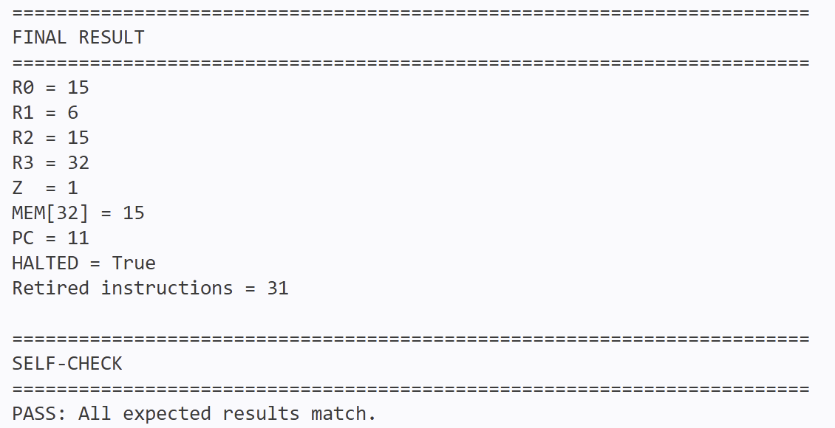
Example Program Flow
Initialize: R0=0, R1=1, R2=6
R0 = R0 + R1
PC | Machine word | Assembly
00 | 0000 | MOV R0, #0
01 | 0401 | MOV R1, #1
02 | 0806 | MOV R2, #6
03 | 3100 | ADD R0, R1
04 | 2401 | ADD R1, #1
05 | A600 | CMP R1, R2
06 | B001 | JZ #1
07 | 7003 | JUMP #3
08 | 0C20 | MOV R3, #32
09 | 9300 | STR R0, [R3+0]
10 | 8B00 | LDR R2, [R3+0]
11 | C000 | HALT
R1 = R1 + 1
JUMP #3
CMP R1, R2
No
Z = 1?
JZ
Yes
R3=32 → STR → LDR → HALT
Python ISA Reference Model Result：
2401 = 0010 0100 0000 0001
0010
01
00
00000001
Opcode
Rd
Rs
Imm [7:0]
ADD immediate
R1
Unused
#1
10

Slide 19
Next Work
01

Slide 20
Next Steps: from top specification to verified modules
Next week: core datapath modules
1
MUX design
2
Adder design
Manual: true table and Boolean behavior
EDA: Verilog module, TestBench and waveform check
Manual: connection of multiple full-adder
EDA: boundary values, carry and overflow simulation test
Longer-term path
Confirm specification
RTL modules
System TestBench
Synthesis / FPGA
ISA / module interfaces
MUX / adder / ALU / RF / PC
run complete example program
prepare hardware verification
12

Slide 21
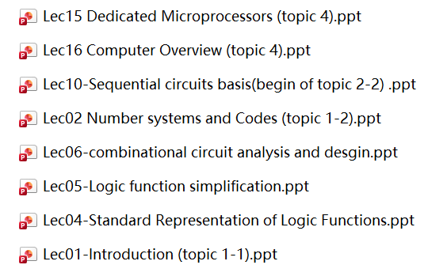
Reference:
Thanks!

