Slide 1
From Manual Structure to EDA Behavior
Manual design
EDA design
Derive XOR / AND / OR gates
Build a 1-bit full adder
Connect 16 carry stages
Describe the arithmetic function
{cout, sum}
= a + b + cin
Describe WHAT; synthesis chooses HOW
One arithmetic description replaces explicit gate-level construction.
01 PRE2 EDA / 0:35
Notes:
Presenter EDA. Target 0:35.
My teammate has shown how to derive the full-adder gates and connect sixteen stages. My part starts from the same required function, but uses a different design approach. Instead of specifying those gate connections, we describe addition directly in HDL. In short, we specify what the module must calculate, and let Vivado choose the implementation. Both approaches target the same interface and addition function.
Sources: Peer pre2-adder-人工.pptx slides 1–3; tested adder_rtl in modules.v; CPU specification §10. Manual design shown by peer uses direct three-term carry gates, not two half-adder instances. The unextended equation on this slide is a mathematical contract; actual HDL on slide 2 extends operands.

Slide 2
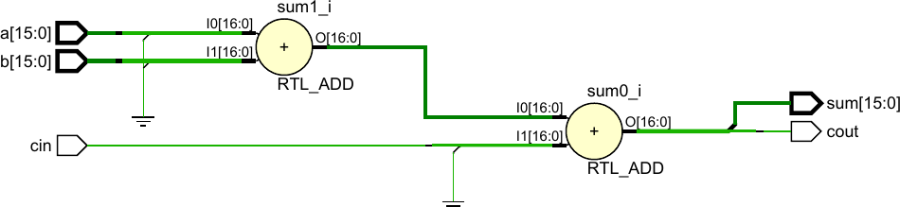
RTL Design and Elaboration
always @* begin
{cout,sum} = {1'b0,a} + {1'b0,b} + {16'b0,cin};
end
1 a + b
2 + cin
Output split: [16] = cout [15:0] = sum
Vivado represents the expression as 17-bit addition logic.
02 PRE2 EDA / 0:45
Notes:
Presenter EDA. Target 0:45.
This is how Vivado elaborates that arithmetic expression. We explicitly extend a, b and carry-in to seventeen bits. The elaborated schematic then shows two logical additions: first a plus b, then plus carry-in. Follow the marked output: bit sixteen is carry-out, and bits fifteen through zero form sum. This confirms the intended width and arithmetic interpretation. The two RTL ADD symbols are a logical view; synthesis can optimize them rather than preserving two separate physical adders.
Sources: User adderrtl analysis.pdf. Code is W=16 specialization of tested adder_rtl. Labels annotate source diagram without changing it.

Slide 3
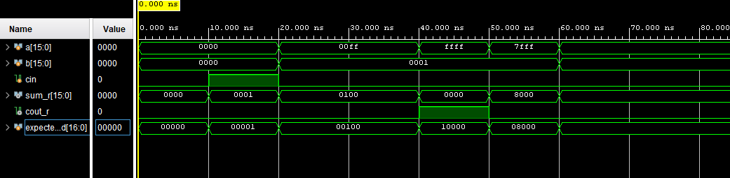
Functional Verification
TB: 17-bit expected = a + b + cin
Compare {cout_r, sum_r} with expected_add; report a mismatch.
Carry-in · 10–20 ns
Cross-bit carry · 20–40 ns
Carry-out · 40–50 ns
0000 + 0000 + 1
= 0_0001
00FF + 0001 + 0
= 0_0100
FFFF + 0001 + 0
= 1_0000
All displayed results match the expected 17-bit sum.
03 PRE2 EDA / 1:05
Notes:
Presenter EDA. Target 1:05.
The testbench computes a seventeen-bit expected result and compares it with carry-out joined to sum. Any mismatch triggers an error. Here is the original Vivado waveform for the behavioral adder. Between ten and twenty nanoseconds, zero plus zero with carry-in one gives one. Between twenty and forty nanoseconds, hexadecimal 00FF plus one gives 0100, testing carry across bit positions. Between forty and fifty nanoseconds, FFFF plus one gives a zero sum and carry-out one. In all three cases, the full observed result matches expected_add. These are representative short-test waveforms. Separately, the exhaustive binary-input check completed with zero mismatches; the detailed coverage logs are included for inspection.
Sources: Original screenshot codex-clipboard-74629f41-0443-4163-b259-ab591a98422e.png, cursor remains at 0ns. TB excerpt simplified; actual short TB waits 10ns before comparing, full TB waits 1ns. Exhaustive coverage is two contiguous ranges [0,1207959552) and [1207959552,8589934592), verified source hashes. No netlist/board equivalence claim.

Slide 4
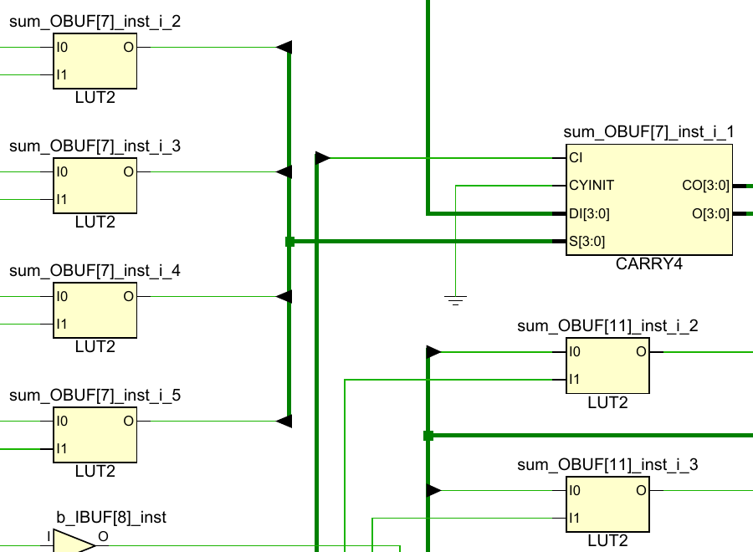
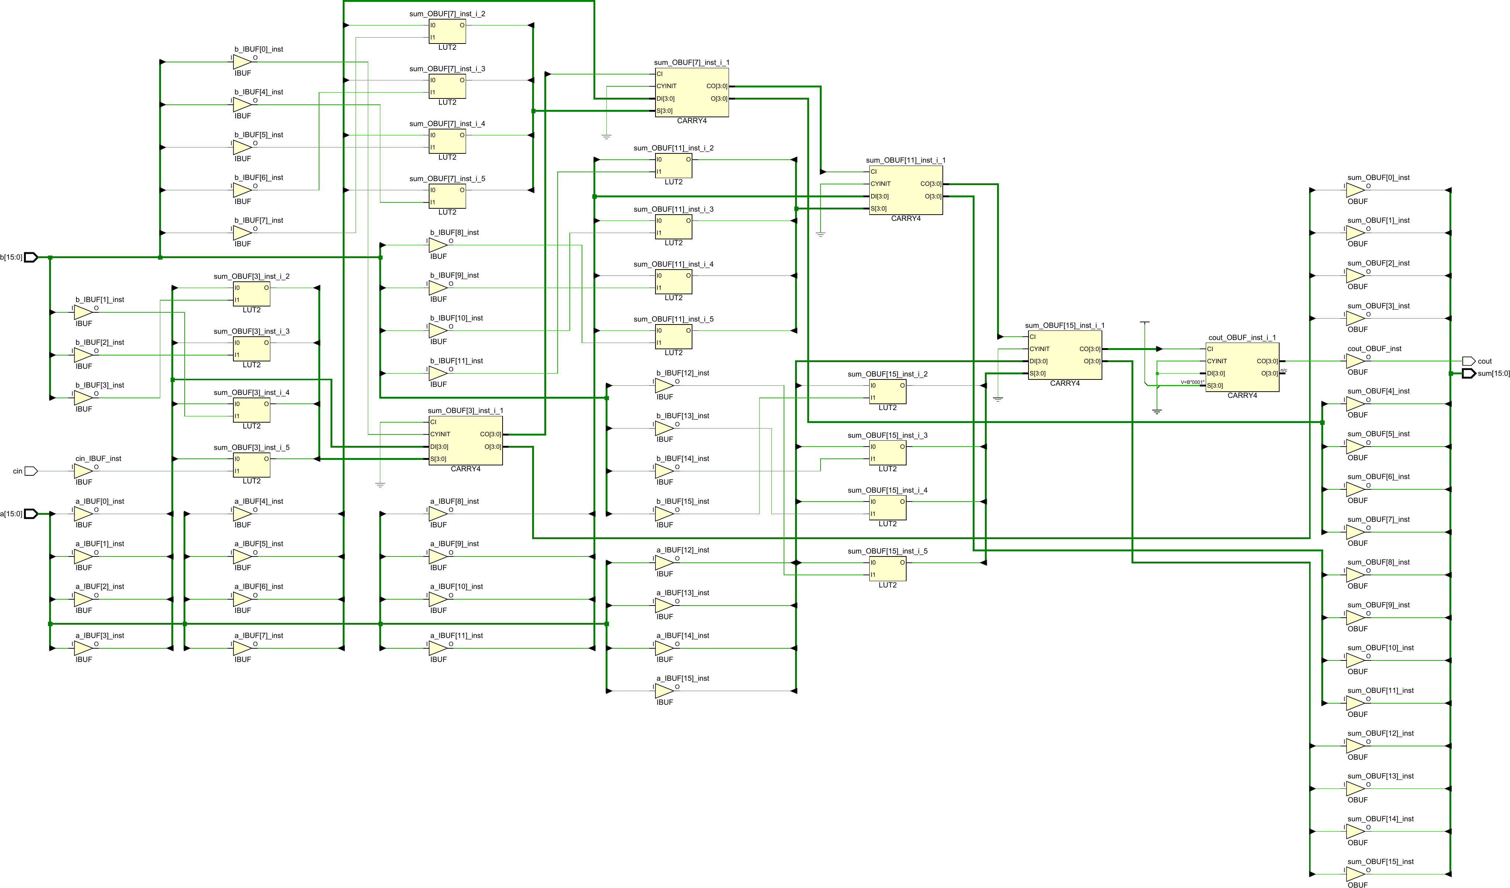
From RTL to FPGA Hardware
Synthesis overview
Zoom region
LUT
Local logic
CARRY4
Dedicated
carry chain
Arithmetic HDL maps to LUT and carry-chain resources.
Self-checking verification: 0 mismatches
Exhaustive HDL check: 2^33 inputs
04 PRE2 EDA / 0:35
Notes:
Presenter EDA. Target 0:35.
Finally, synthesis maps the arithmetic description onto FPGA resources. The small view provides context; the enlarged region shows the important parts. LUTs implement local logic, while CARRY4 provides dedicated carry-chain resources. Our takeaway is the full EDA path: describe the arithmetic, inspect the logical interpretation, verify the output, and inspect the hardware mapping. The self-checking HDL tests found zero mismatches. Timing and board-level performance require separate evidence.
Sources: User adderrtl.pdf; mapped schematic only, source project and constraints not independently bound. Functional coverage of tested HDL: 2^33 binary inputs, two contiguous runs, completion 2026-09-15 15:03:13, not a post-synthesis netlist test.

