Slide 1
PRE2
16-bit MUX and Adder
Manual Design, EDA Implementation and Functional Verification
Digital Logic Design Group Presentation
PRE2 OPENING

Slide 2
Report Structure
Scope: reusable combinational modules for the CPU datapath
01
MUX Manual Design
Truth table, Boolean expression and gate-level structure
02
MUX EDA Design
Verilog implementation and functional verification
03
Adder Manual Design
Full-adder derivation and 16-bit ripple-carry structure
04
Adder EDA Design
RTL behavior, verification and FPGA mapping
PRE2 OVERVIEW

Slide 3
01
MUX Manual Design
Truth table, Boolean expression and 16-bit gate-level structure
PRE2 SECTION 01

Slide 4
Multiplexer logic
sel | a | b | y
0 | 0 | 0 | 0
0 | 0 | 1 | 0
0 | 1 | 0 | 1
0 | 1 | 1 | 1
1 | 0 | 0 | 0
1 | 0 | 1 | 1
1 | 1 | 0 | 0
1 | 1 | 1 | 1
y
Manual gate connections
ab
 | 00 | 01 | 11 | 10
0 | 0 | 0 | 1 | 1
1 | 0 | 1 | 1 | 0
sel
p
a
AND
sel
NOT
OR
y
Kmap
AND
b
q
y = sel’·a + sel·b
True Table
03 PRE2 B / 1:20

Slide 5
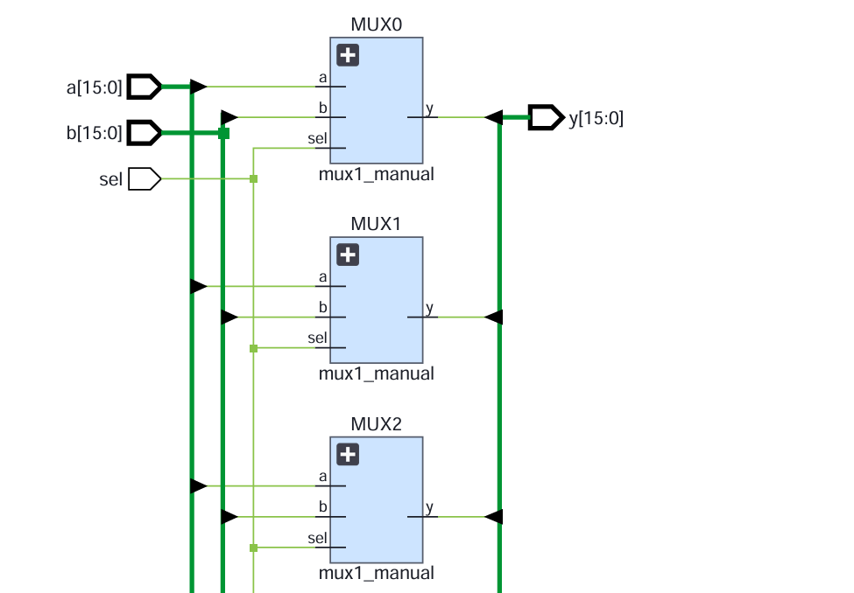
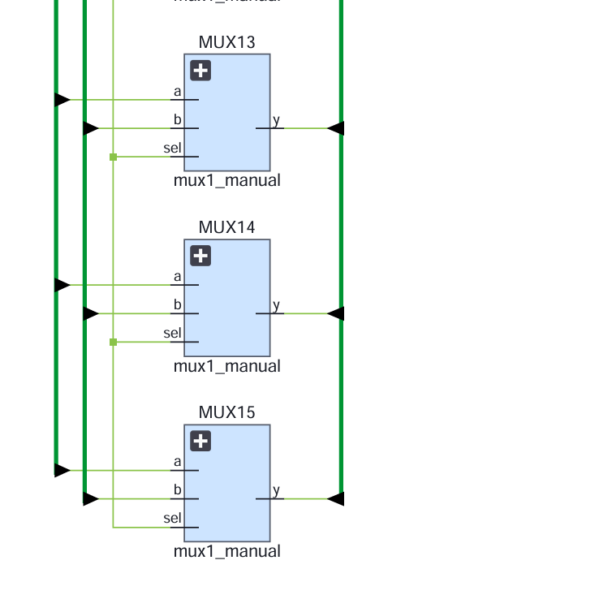
16-bit multiplexer Design——Manual
04 PRE2 B / 1:10

Slide 6
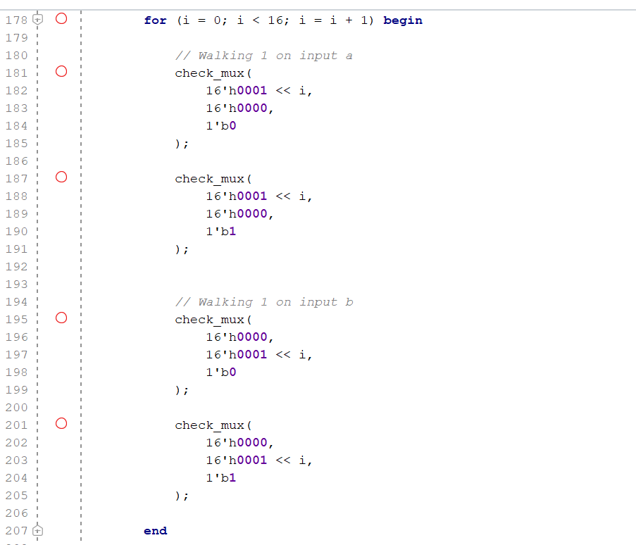
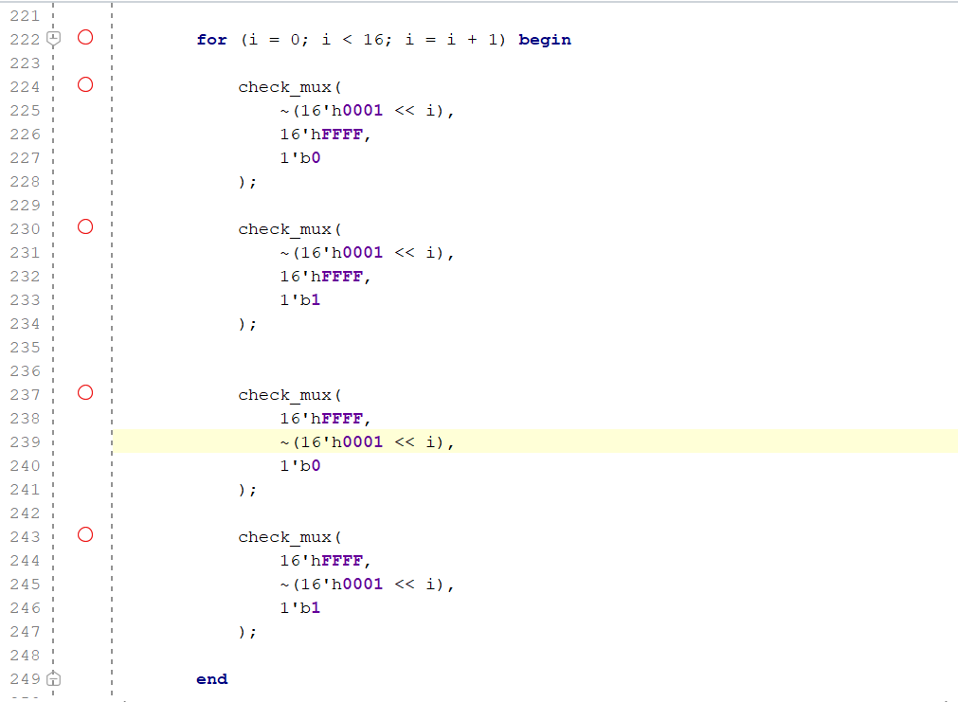
16-bit multiplexer Verification——Manual
TestBench（walking part）
Test Range：
boundary cases
walking-1
walking-0
1,000 random input pairs
a | b | sel | Expected y
XXXX | XXXX | 0 | a
XXXX | XXXX | 1 | b
04 PRE2 B / 1:10

Slide 7
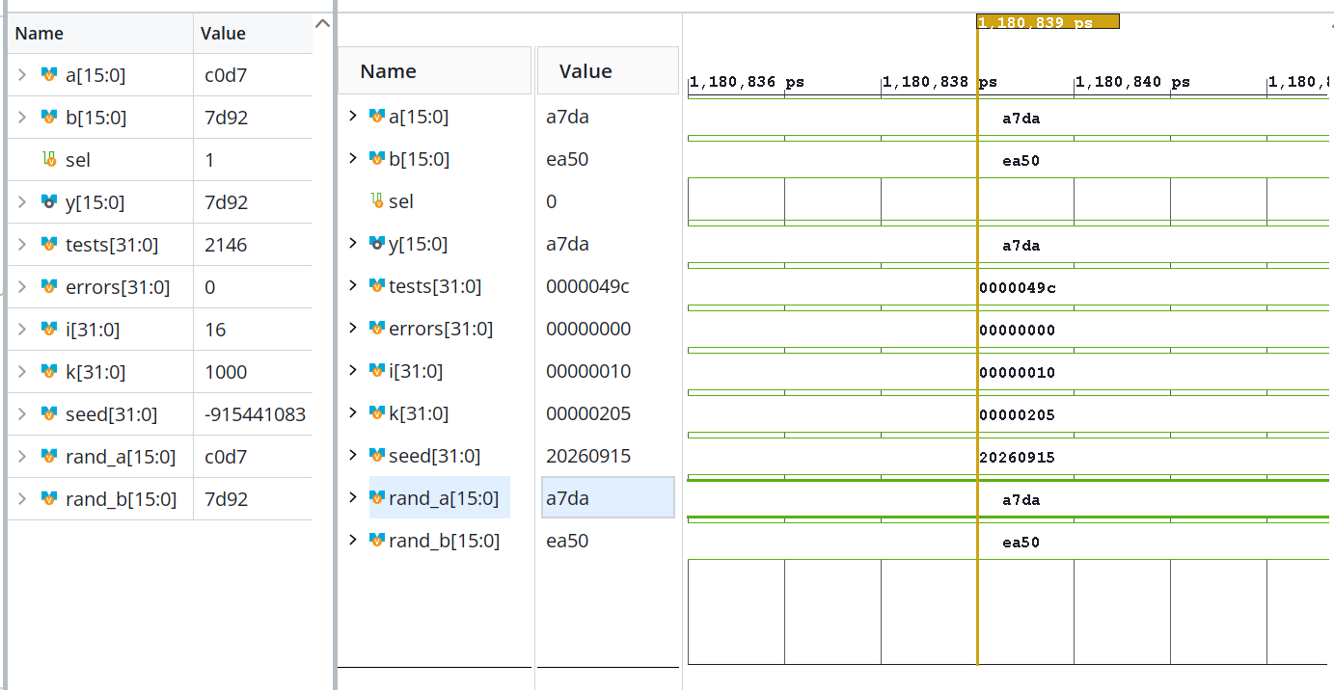
Multiplexer verification Result——Manual
No error founded in 2146 tests
06 PRE2 C / 1:30

Slide 8
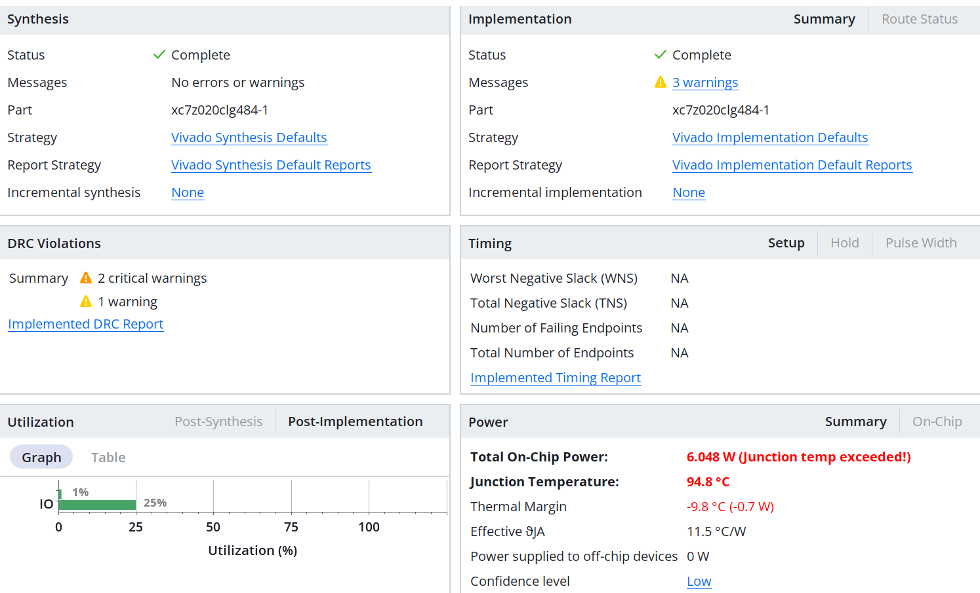
Multiplexer verification Result——Manual
Virtural I/O can be used for improvement
06 PRE2 C / 1:30

Slide 9
02
MUX EDA Design
Verilog implementation and XSim functional verification
PRE2 SECTION 02

Slide 10
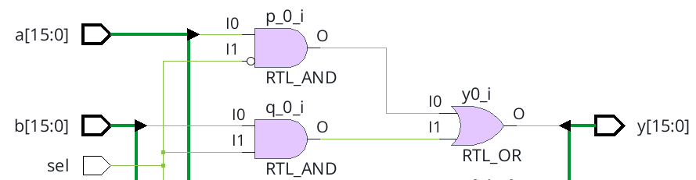
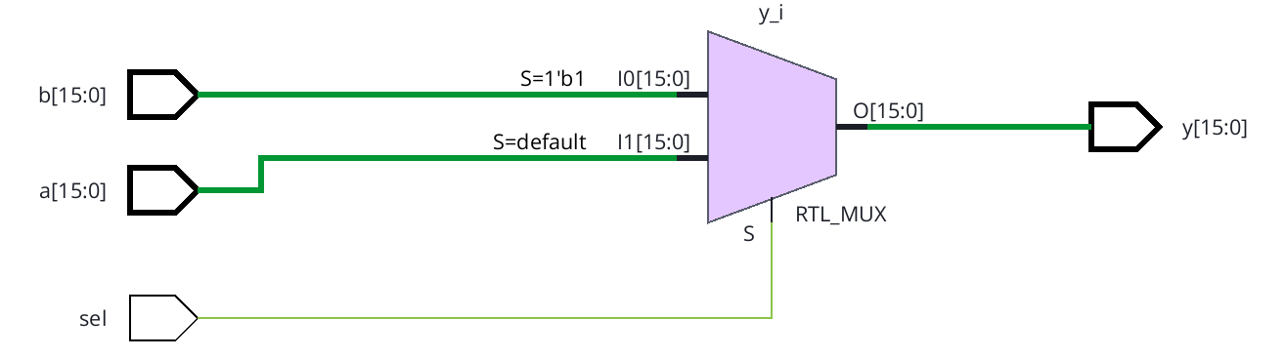
Multiplexer HDL
Structural description
Behavioural description
not(ns, sel);
// inside each bit slice
and(p, a[i], ns);
and(q, b[i], sel);
or(y[i], p, q);
always @* begin
if (sel) y = b;
else y = a;
end
Same ports, same inputs, independent expected output
05 PRE2 C / 1:00
Notes:
Presenter C. Target 1:00.
Our first version directly instantiates the gates in the manual design. A generate loop repeats the gates for all sixteen bits. Our second version describes the selected output using an always block. Every path assigns y, so the process describes combinational behaviour without a latch. We use always star to include every input in the sensitivity set. The two modules have identical ports and receive the same test inputs. Their names describe source-level modelling styles. We do not assume that synthesis will preserve every manually instantiated gate or that one coding style automatically produces faster hardware.
Sources: CHA Lec02 Introduction to HDL, pp.10–12,16–21; Lec09 Verilog for combinational circuits, pp.21,25–27

Slide 11
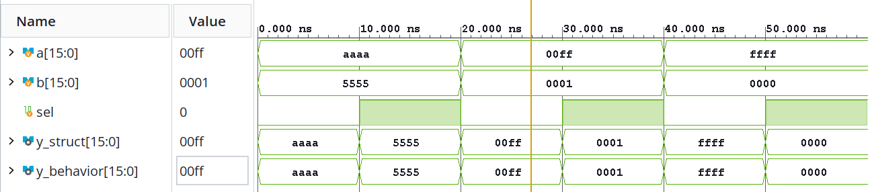
Multiplexer verification
Structural output = Behavioural output = Expected output
All 6 directed test cases passed.
06 PRE2 C / 1:30
Notes:
Presenter C. Target 1:30.
This waveform comes from the VCD recorded by Vivado XSim 2025.2. We have reformatted it for readability, rather than presenting it as a screenshot of the application. The horizontal axis is simulation time in nanoseconds, and bus values are hexadecimal. At twenty nanoseconds a is 00FF, b is 0001 and select is zero, so both outputs are 00FF. At thirty nanoseconds the inputs stay the same and select becomes one. Both outputs become 0001. The expected signal comes from the testbench contract. Beyond this excerpt, we checked every one-bit combination and 2040 sixteen-bit vectors. These consist of eight boundary vectors, thirty-two walking-bit vectors and one thousand pseudorandom pairs tested under both select settings. All comparisons passed.
Sources: Recorded pre2.vcd; tb_pre2.sv; xsim.log, 2026-09-14. CPU specification §10

Slide 12
03
Adder Manual Design
One-bit full-adder derivation and 16-bit ripple-carry structure
PRE2 SECTION 03

Slide 13
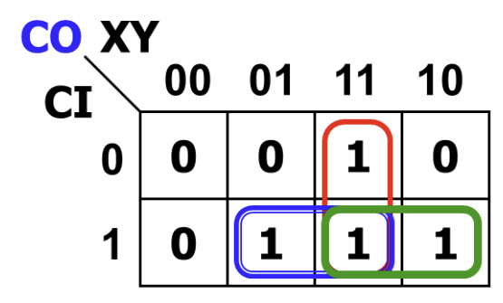
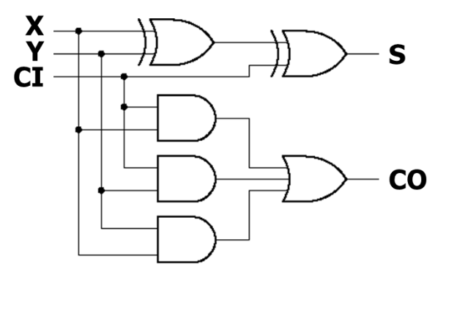
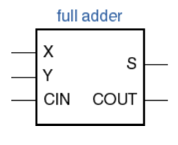
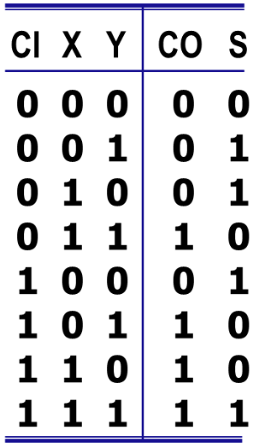
Manual Design of a 1-Bit Full Adder
Function and Truth Table
Carry Derivation
Gate-Level Circuit
X, Y: input bits
CI: carry in
S: sum bit
CO: carry out
CO = XY + YCI + XCI
S = X ⊕ Y ⊕ CI
2 XOR + 3 AND gates
1 three-input OR gate

Slide 14
Connecting 1-Bit Full Adders
A[0]
B[0]
A[1]
B[1]
Carry C[1]
C[2]
Cin
FA0
FA1
… FA15
FA0.Cout = FA1.Cin
S[0]
S[1]
The carry-out of one bit becomes the carry-in of the next higher bit
Repeat this connection for all 16 bits.

Slide 15
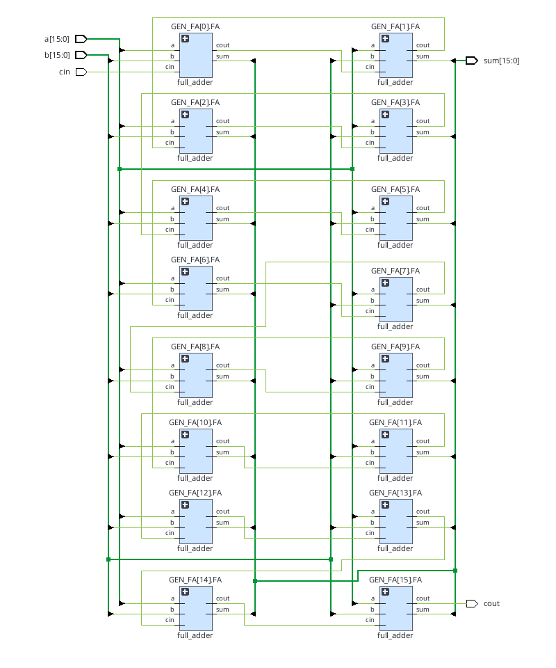
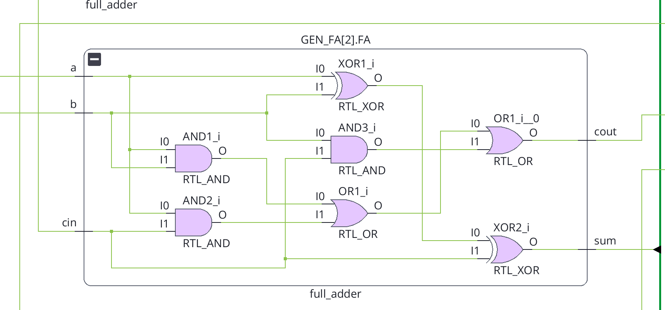
16-Bit Adder: Full RTL Structure
Verification of the Manual Design Using EDA
Verilog design style： structural level
（instantiate the built in gates）
03

Slide 16
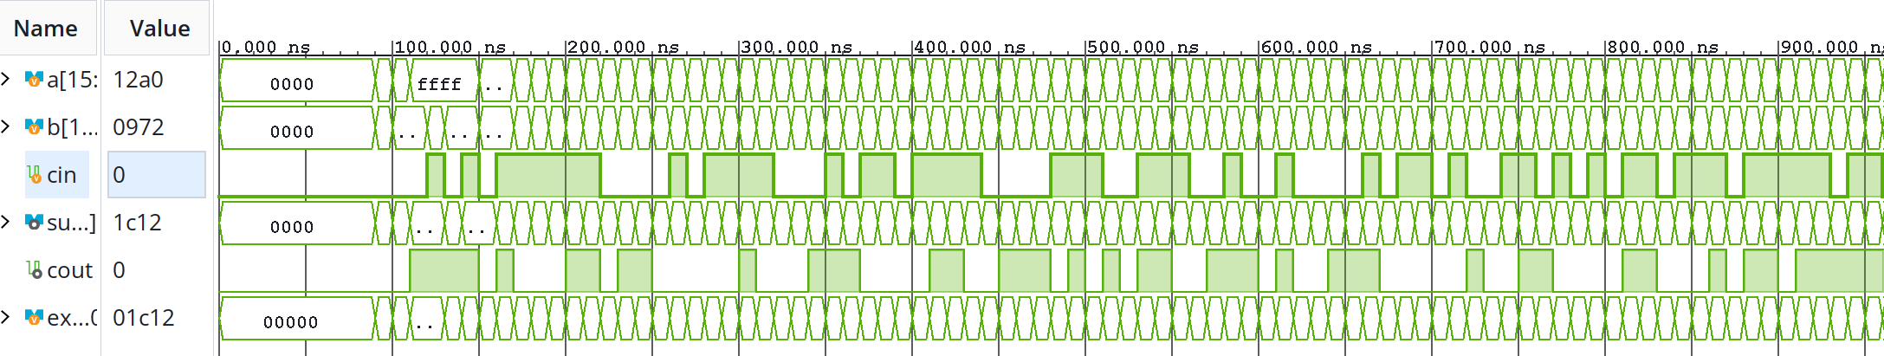
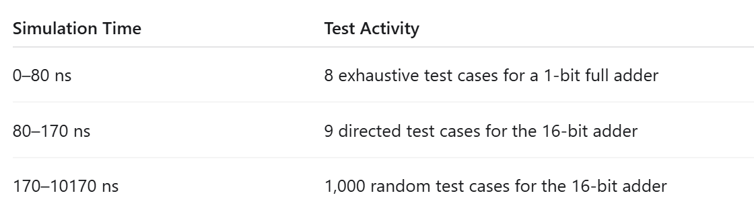

EDA Verification and Overall Results
Test Coverage：
8 full-adder cases + 9 typical + 1,000 random

Slide 17
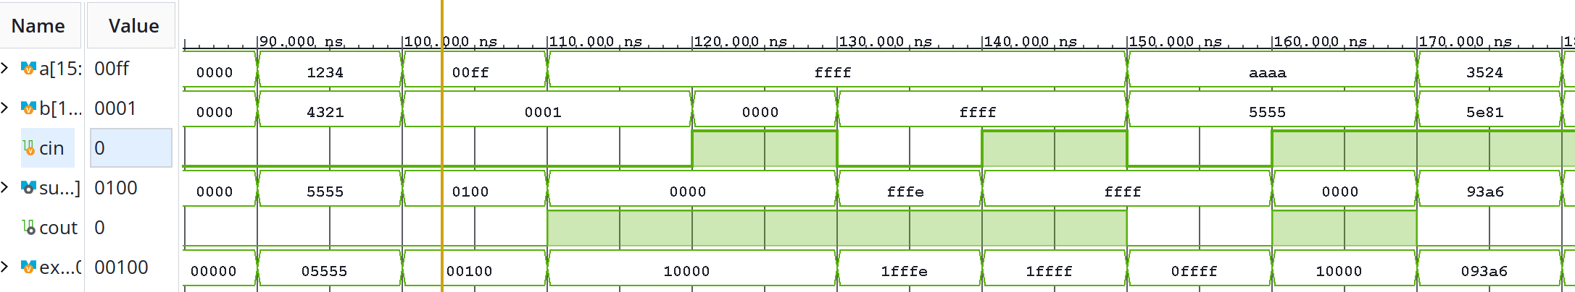

Waveform Checks for Key Carry Cases
Read a, b, and cin; compare the full output {cout, sum} with expected
① 100–110 ns
② 110–120 ns
③ 120–130 ns
00FF + 0001 + 0
= 0_0100
FFFF + 0001 + 0
= 1_0000
FFFF + 0000 + 1
= 1_0000
Carry across bit positions
Carry out of the top bit
Carry-in included correctly

Slide 18
04
Adder EDA Design
Behavioral RTL, functional verification and FPGA mapping
PRE2 SECTION 04

Slide 19
From Manual Structure to EDA Behavior
Manual design
EDA design
Derive XOR / AND / OR gates
Build a 1-bit full adder
Connect 16 carry stages
Describe the arithmetic function
{cout, sum}
= a + b + cin
Describe WHAT; synthesis chooses HOW
One arithmetic description replaces explicit gate-level construction.
01 PRE2 EDA / 0:35

Slide 20
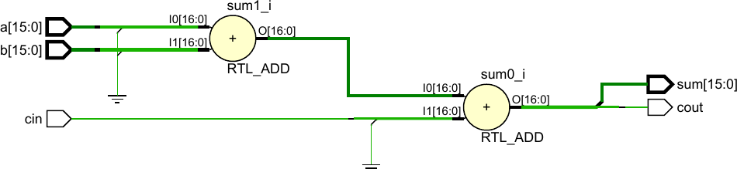
RTL Design and Elaboration
always @* begin
{cout,sum} = {1'b0,a} + {1'b0,b} + {16'b0,cin};
end
1 a + b
2 + cin
Output split: [16] = cout [15:0] = sum
Vivado represents the expression as 17-bit addition logic.
02 PRE2 EDA / 0:45

Slide 21
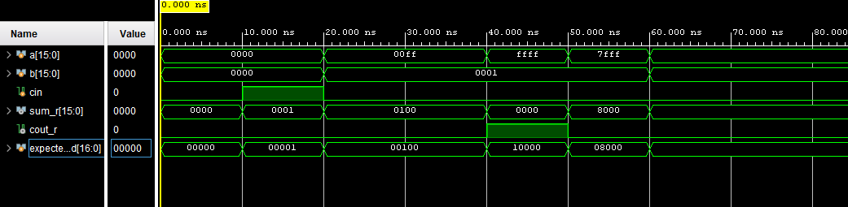
Functional Verification
TB: 17-bit expected = a + b + cin
Compare {cout_r, sum_r} with expected_add; report a mismatch.
Carry-in · 10–20 ns
Cross-bit carry · 20–40 ns
Carry-out · 40–50 ns
0000 + 0000 + 1
= 0_0001
00FF + 0001 + 0
= 0_0100
FFFF + 0001 + 0
= 1_0000
All displayed results match the expected 17-bit sum.
03 PRE2 EDA / 1:05

Slide 22
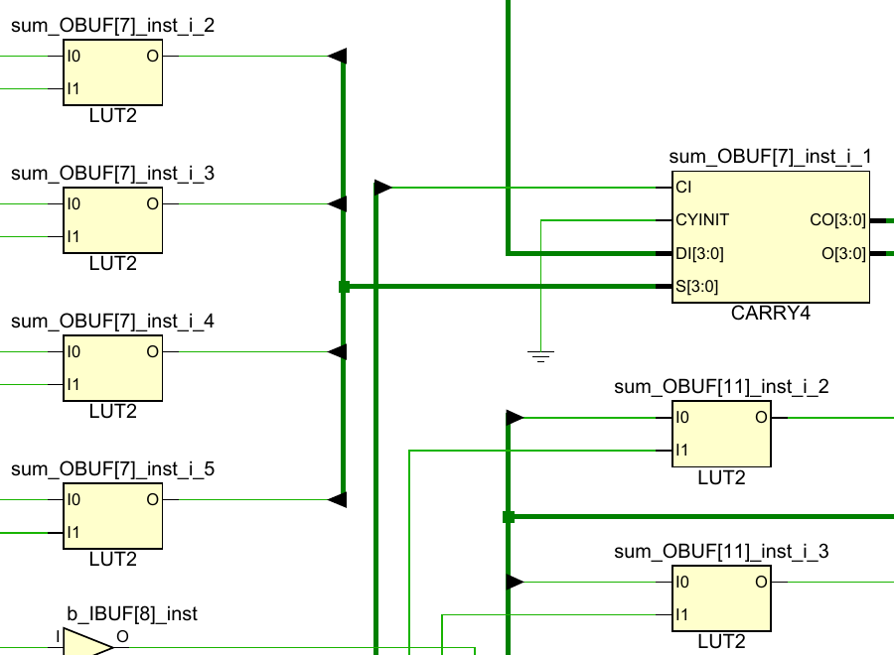
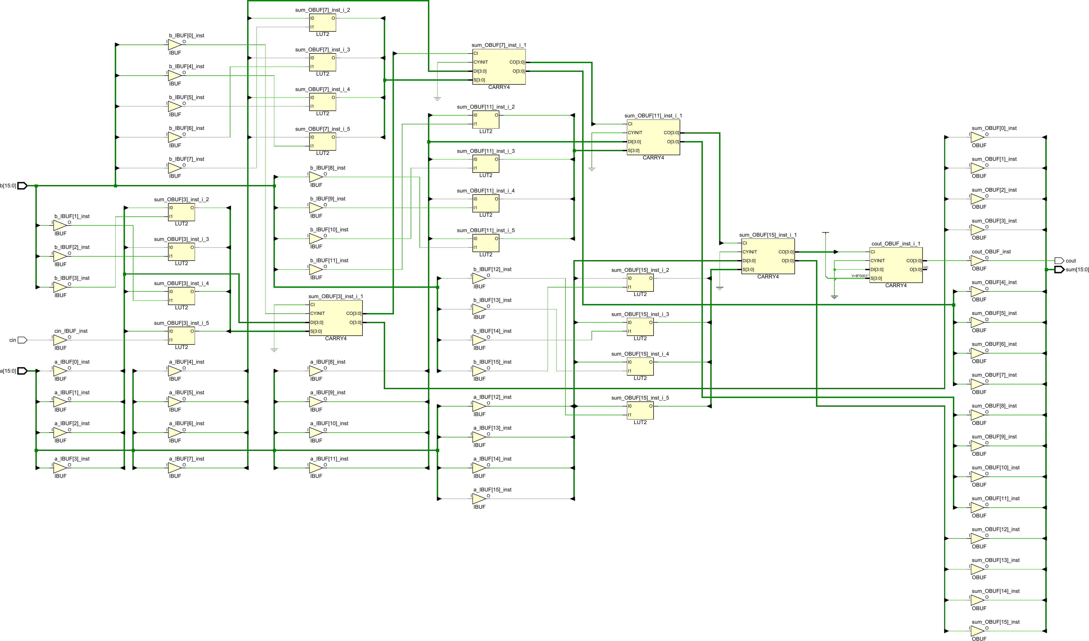
From RTL to FPGA Hardware
Synthesis overview
Zoom region
LUT
Local logic
CARRY4
Dedicated
carry chain
Arithmetic HDL maps to LUT and carry-chain resources.
Self-checking verification: 0 mismatches
Exhaustive HDL check: 2^33 inputs
04 PRE2 EDA / 0:35

Slide 23
Manual Design vs. EDA Design
Different design approaches, same functional objective
Manual Design
Common Goal
EDA Design
Focus: HOW the circuit is built
Same specification
Focus: WHAT the circuit should do
• Start from truth tables
• Derive Boolean expressions
• Build gate-level structures
• Reveal the internal logic
Same input/output interface
Same functional specification
Same expected behavior
Verified by Testbench
• Describe behavior in HDL
• Let synthesis optimize logic
• Map logic to FPGA resources
• Easier to scale and reuse
MUX
MUX
a ─┐
b ─┘ → MUX → y
↑
sel ×16
MUX
assign y = sel ? b : a;
sel = 0 → y = a
sel = 1 → y = b
Synthesized into LUT-based logic
Adder
Adder
Adder
FA0 → FA1 → FA2 → … → FA15
carry →
{cout, sum} = a + b + cin
{cout, sum} = a + b + cin;
Mapped to LUTs and CARRY4
Same function ≠ Same internal hardware structure
Manual design explains HOW the circuit works; EDA design describes WHAT the circuit should do and lets synthesis choose the implementation.

