Slide 1
Multiplexer logic
sel | a | b | y
0 | 0 | 0 | 0
0 | 0 | 1 | 0
0 | 1 | 0 | 1
0 | 1 | 1 | 1
1 | 0 | 0 | 0
1 | 0 | 1 | 1
1 | 1 | 0 | 0
1 | 1 | 1 | 1
y
Manual gate connections
ab
 | 00 | 01 | 11 | 10
0 | 0 | 0 | 1 | 1
1 | 0 | 1 | 1 | 0
sel
p
a
AND
sel
NOT
OR
y
Kmap
AND
b
q
y = sel’·a + sel·b
True Table
03 PRE2 B / 1:20
Notes:
Presenter B. Target 1:20.
We begin with the complete truth table for a one-bit multiplexer. The select signal divides it into two groups. When select is zero, the output follows a regardless of b. When select is one, it follows b regardless of a. We therefore obtain two product terms: not select AND a, and select AND b. Their OR gives the output. The manual circuit consists of one inverter, two AND gates and one OR gate. For example, a equals one and b equals zero gives output one at select zero, and output zero at select one. These cases confirm that selection follows the control signal rather than the numerical size of the inputs.
Sources: Lec07 Standard Combinational Components, pp.27–29; CPU specification §10

Slide 2
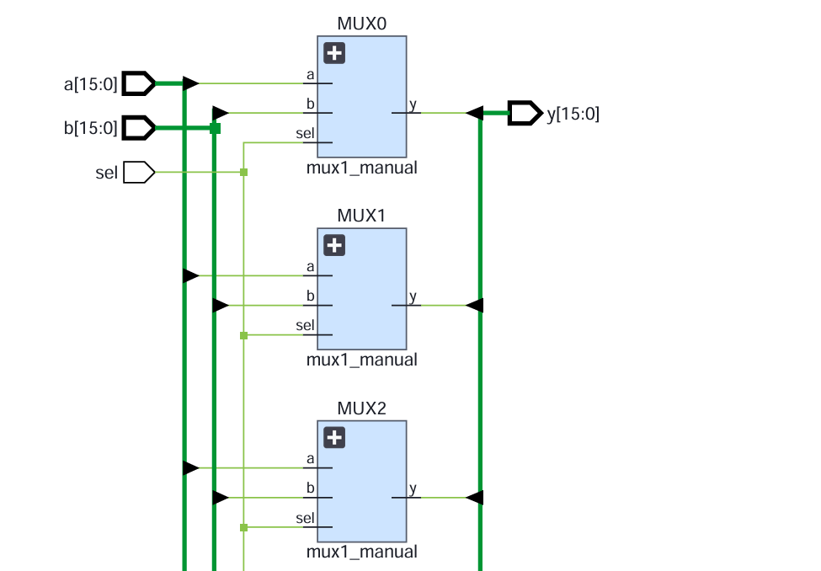
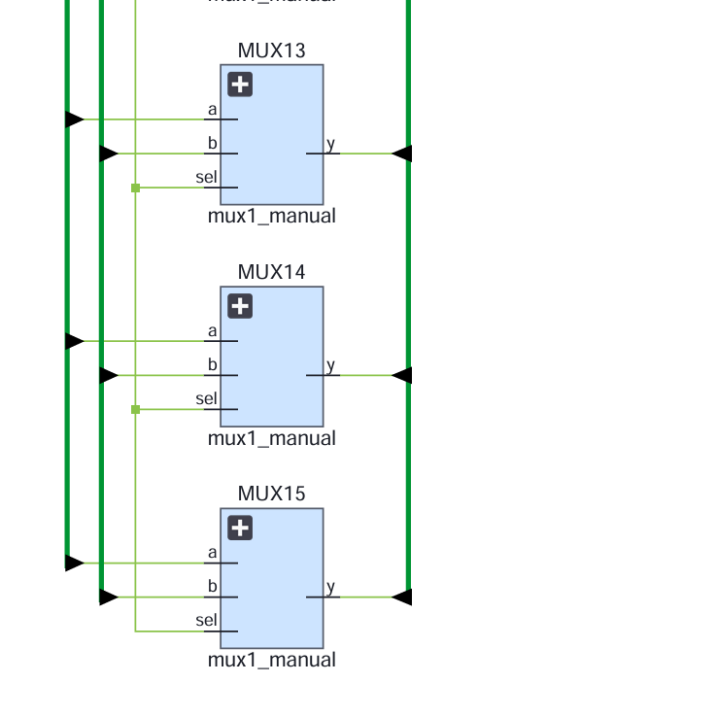
16-bit multiplexer Design——Manual
04 PRE2 B / 1:10
Notes:
Presenter B. Target 1:10.
The sixteen-bit design repeats the same one-bit function for each output bit. Every slice shares the select signal, but there is no carry or dependency between neighbouring slices. The relationship is y i equals not select AND a i, OR select AND b i, for bits zero through fifteen. Our manual example uses complementary alternating patterns. With select zero, the whole output is hexadecimal AAAA. With select one, the whole output is 5555. A single select bit chooses between two sixteen-bit buses. It does not select one bit out of sixteen. This distinction also explains why a future three-source forwarding selector needs additional selection logic.
Sources: CPU specification §§6,10; Lec09 Verilog for combinational circuits p.21

Slide 3
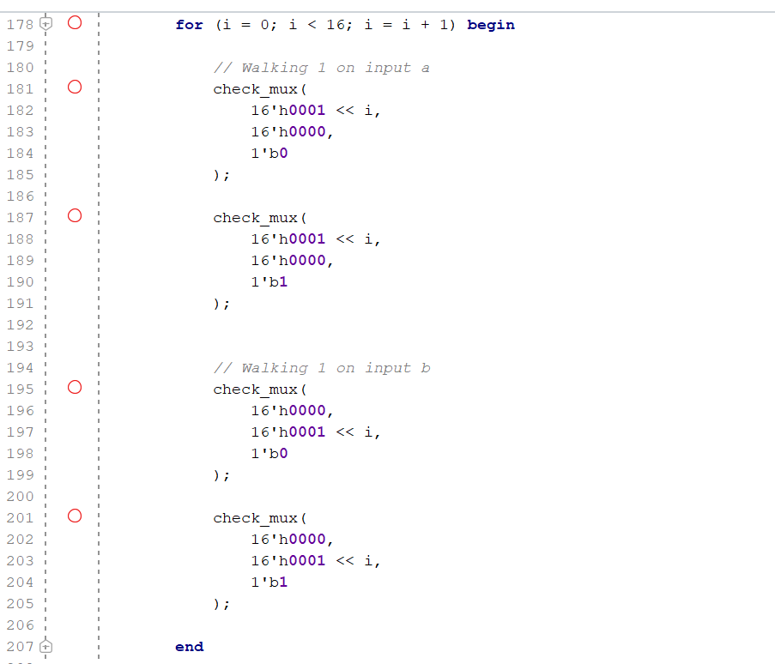
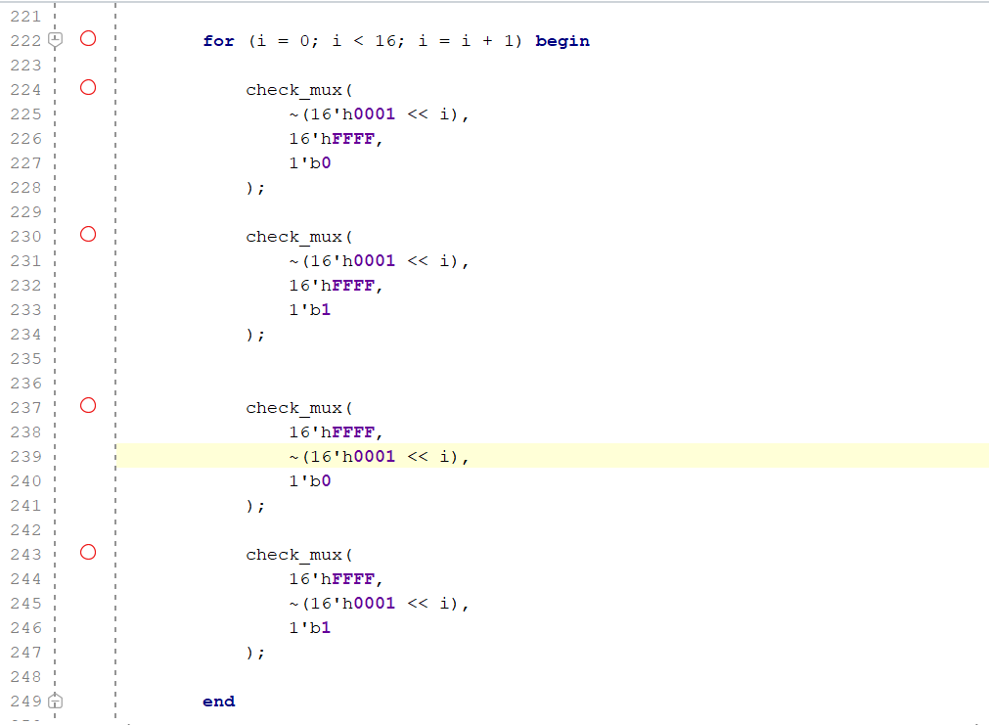
16-bit multiplexer Verification——Manual
TestBench（walking part）
Test Range：
boundary cases
walking-1
walking-0
1,000 random input pairs
a | b | sel | Expected y
XXXX | XXXX | 0 | a
XXXX | XXXX | 1 | b
04 PRE2 B / 1:10
Notes:
Presenter B. Target 1:10.
The sixteen-bit design repeats the same one-bit function for each output bit. Every slice shares the select signal, but there is no carry or dependency between neighbouring slices. The relationship is y i equals not select AND a i, OR select AND b i, for bits zero through fifteen. Our manual example uses complementary alternating patterns. With select zero, the whole output is hexadecimal AAAA. With select one, the whole output is 5555. A single select bit chooses between two sixteen-bit buses. It does not select one bit out of sixteen. This distinction also explains why a future three-source forwarding selector needs additional selection logic.
Sources: CPU specification §§6,10; Lec09 Verilog for combinational circuits p.21

Slide 4
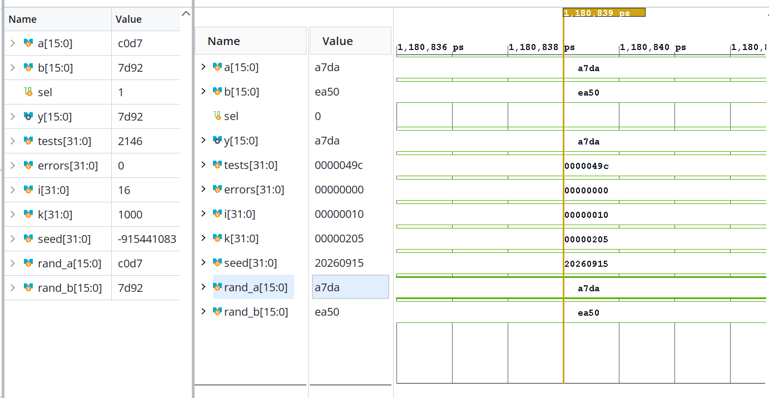
Multiplexer verification Result——Manual
No error founded in 2146 tests
06 PRE2 C / 1:30
Notes:
Presenter C. Target 1:30.
This waveform comes from the VCD recorded by Vivado XSim 2025.2. We have reformatted it for readability, rather than presenting it as a screenshot of the application. The horizontal axis is simulation time in nanoseconds, and bus values are hexadecimal. At twenty nanoseconds a is 00FF, b is 0001 and select is zero, so both outputs are 00FF. At thirty nanoseconds the inputs stay the same and select becomes one. Both outputs become 0001. The expected signal comes from the testbench contract. Beyond this excerpt, we checked every one-bit combination and 2040 sixteen-bit vectors. These consist of eight boundary vectors, thirty-two walking-bit vectors and one thousand pseudorandom pairs tested under both select settings. All comparisons passed.
Sources: Recorded pre2.vcd; tb_pre2.sv; xsim.log, 2026-09-14. CPU specification §10

Slide 5
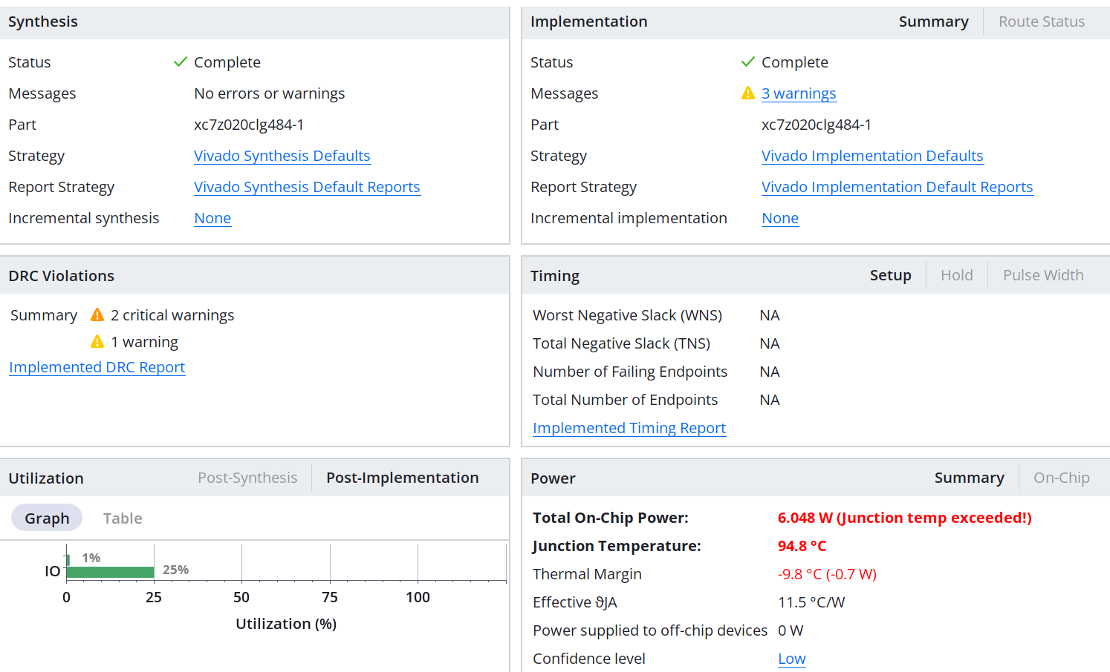
Multiplexer verification Result——Manual
Virtural I/O can be used for improvement
06 PRE2 C / 1:30
Notes:
Presenter C. Target 1:30.
This waveform comes from the VCD recorded by Vivado XSim 2025.2. We have reformatted it for readability, rather than presenting it as a screenshot of the application. The horizontal axis is simulation time in nanoseconds, and bus values are hexadecimal. At twenty nanoseconds a is 00FF, b is 0001 and select is zero, so both outputs are 00FF. At thirty nanoseconds the inputs stay the same and select becomes one. Both outputs become 0001. The expected signal comes from the testbench contract. Beyond this excerpt, we checked every one-bit combination and 2040 sixteen-bit vectors. These consist of eight boundary vectors, thirty-two walking-bit vectors and one thousand pseudorandom pairs tested under both select settings. All comparisons passed.
Sources: Recorded pre2.vcd; tb_pre2.sv; xsim.log, 2026-09-14. CPU specification §10

