Slide 1
Datapath Core Modules
16-bit MUX and adder
Manual design and Vivado functional verification
16-bit CPU project
Group presentation · 15 minutes
01 PRE2 A / 0:20
Notes:
Presenter A. Target 0:20.
Today we present the multiplexer and adder for our sixteen-bit CPU. We will explain the manual logic, compare two HDL descriptions, and examine functional simulation evidence from Vivado XSim. Our focus is the two reusable combinational modules, rather than the complete processor.
Sources: CPU specification (2026-09-09), sections 6, 10 and 13

Slide 2
Module specifications
Module | Inputs | Outputs | Contract
MUX | a[15:0], b[15:0], sel | y[15:0] | sel=0: a sel=1: b
Adder | a[15:0], b[15:0], cin | sum[15:0], cout | 17-bit a+b+cin
Combinational modules: no clock and no reset
CPU uses: operand selection, arithmetic and address calculation
Scope: module-level functionality, plus a MUX–adder connection
02 PRE2 A / 1:00
Notes:
Presenter A. Target 1:00.
Our CPU specification uses sixteen-bit operands. The multiplexer accepts two buses and one select signal. Select zero chooses a, and select one chooses b. The adder accepts two buses and a carry input. Its complete unsigned output is seventeen bits, split into sum and carry-out. Both modules are combinational: they have no clock or reset. The CPU will place registers at pipeline boundaries later. MUX instances can select a register operand or an immediate, and adders can support arithmetic and address calculations. This does not mean that one physical adder is shared by every pipeline stage. For Pre2 we validate standalone components and a small connection. Full register-file, ALU and control integration remain outside this presentation.
Sources: CPU specification (2026-09-09), sections 6, 10 and 13

Slide 3
Multiplexer logic
sel | a | b | y
0 | 0 | 0 | 0
0 | 0 | 1 | 0
0 | 1 | 0 | 1
0 | 1 | 1 | 1
1 | 0 | 0 | 0
1 | 0 | 1 | 1
1 | 1 | 0 | 0
1 | 1 | 1 | 1
y = (~sel & a) | (sel & b)
Manual gate connections
AND
p
a
sel
NOT
OR
y
AND
b
q
03 PRE2 B / 1:20
Notes:
Presenter B. Target 1:20.
We begin with the complete truth table for a one-bit multiplexer. The select signal divides it into two groups. When select is zero, the output follows a regardless of b. When select is one, it follows b regardless of a. We therefore obtain two product terms: not select AND a, and select AND b. Their OR gives the output. The manual circuit consists of one inverter, two AND gates and one OR gate. For example, a equals one and b equals zero gives output one at select zero, and output zero at select one. These cases confirm that selection follows the control signal rather than the numerical size of the inputs.
Sources: Lec07 Standard Combinational Components, pp.27–29; CPU specification §10

Slide 4
16-bit multiplexer
16 independent bit slices share one select signal
y[i] = (~sel & a[i]) | (sel & b[i])
i = 0 ... 15
a | b | sel | Expected y
AAAA | 5555 | 0 | AAAA
AAAA | 5555 | 1 | 5555
04 PRE2 B / 1:10
Notes:
Presenter B. Target 1:10.
The sixteen-bit design repeats the same one-bit function for each output bit. Every slice shares the select signal, but there is no carry or dependency between neighbouring slices. The relationship is y i equals not select AND a i, OR select AND b i, for bits zero through fifteen. Our manual example uses complementary alternating patterns. With select zero, the whole output is hexadecimal AAAA. With select one, the whole output is 5555. A single select bit chooses between two sixteen-bit buses. It does not select one bit out of sixteen. This distinction also explains why a future three-source forwarding selector needs additional selection logic.
Sources: CPU specification §§6,10; Lec09 Verilog for combinational circuits p.21

Slide 5
Multiplexer HDL
Structural description
Behavioural description
not(ns, sel);
// inside each bit slice
and(p, a[i], ns);
and(q, b[i], sel);
or(y[i], p, q);
always @* begin
if (sel) y = b;
else y = a;
end
Same ports, same inputs, independent expected output
05 PRE2 C / 1:00
Notes:
Presenter C. Target 1:00.
Our first version directly instantiates the gates in the manual design. A generate loop repeats the gates for all sixteen bits. Our second version describes the selected output using an always block. Every path assigns y, so the process describes combinational behaviour without a latch. We use always star to include every input in the sensitivity set. The two modules have identical ports and receive the same test inputs. Their names describe source-level modelling styles. We do not assume that synthesis will preserve every manually instantiated gate or that one coding style automatically produces faster hardware.
Sources: CHA Lec02 Introduction to HDL, pp.10–12,16–21; Lec09 Verilog for combinational circuits, pp.21,25–27

Slide 6
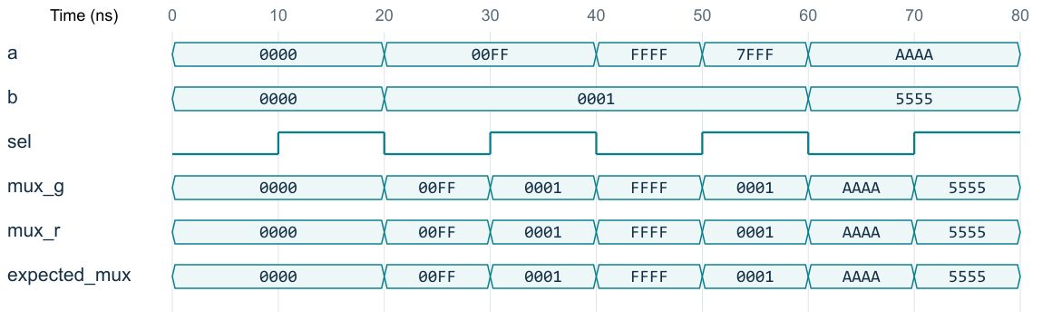
Multiplexer verification
8 exhaustive one-bit cases + 2,040 bus vectors: PASS
Recorded XSim VCD, reformatted. 10 ns stimulus spacing is not gate delay.
06 PRE2 C / 1:30
Notes:
Presenter C. Target 1:30.
This waveform comes from the VCD recorded by Vivado XSim 2025.2. We have reformatted it for readability, rather than presenting it as a screenshot of the application. The horizontal axis is simulation time in nanoseconds, and bus values are hexadecimal. At twenty nanoseconds a is 00FF, b is 0001 and select is zero, so both outputs are 00FF. At thirty nanoseconds the inputs stay the same and select becomes one. Both outputs become 0001. The expected signal comes from the testbench contract. Beyond this excerpt, we checked every one-bit combination and 2040 sixteen-bit vectors. These consist of eight boundary vectors, thirty-two walking-bit vectors and one thousand pseudorandom pairs tested under both select settings. All comparisons passed.
Sources: Recorded pre2.vcd; tb_pre2.sv; xsim.log, 2026-09-14. CPU specification §10

Slide 7
Full-adder logic
a | b | cin | sum | cout
0 | 0 | 0 | 0 | 0
0 | 0 | 1 | 1 | 0
0 | 1 | 0 | 1 | 0
0 | 1 | 1 | 0 | 1
1 | 0 | 0 | 1 | 0
1 | 0 | 1 | 0 | 1
1 | 1 | 0 | 0 | 1
1 | 1 | 1 | 1 | 1
Two half adders + OR
p = a XOR b
g = a AND b
sum = p XOR cin
h = p AND cin
cout = g OR h
Manual check: 1 + 1 + 1 = 11₂
a,b
p
cin
sum
HA1
HA2
OR
cout
g
h
07 PRE2 D / 1:20
Notes:
Presenter D. Target 1:20.
A full adder has three one-bit inputs: a, b and carry-in. The sum is the low bit of their total, and carry-out is its high bit. The complete truth table therefore has eight rows. The sum expression is a XOR b XOR carry-in. For carry, we use a AND b OR carry-in AND a XOR b. This leads directly to a circuit using two half adders and one OR gate. The first half adder produces partial sum p and carry g. The second adds p to carry-in and produces the final sum and carry h. The OR of g and h is the final carry-out. For three input ones, the total is binary eleven: sum one and carry one.
Sources: Lec09 Verilog for combinational circuits pp.25–26; Lec08 Standard Components p.15; CPU specification §10

Slide 8
16-bit ripple-carry adder
c[0] = cin c[16] = cout
Stage | Inputs | Outputs
FA[0] | a[0], b[0], c[0] | sum[0], c[1]
FA[i] | a[i], b[i], c[i] | sum[i], c[i+1]
FA[15] | a[15], b[15], c[15] | sum[15], c[16]
00FF + 0001 = 0100 FFFF + 0001 = 1_0000
CPU extension: b_mod = b XOR {16{sub}}, cin = sub (not tested here)
08 PRE2 D / 1:40
Notes:
Presenter D. Target 1:40.
We connect sixteen full adders. The least significant stage receives external carry-in. Every stage passes its carry-out to the next more significant stage, and the last carry is the external carry-out. The sum bits form a sixteen-bit bus. Consider 00FF plus 0001 with carry-in zero. The carry propagates through the low eight stages and sets bit eight, giving 0100. With FFFF plus 0001, the complete seventeen-bit result is 10000, so the stored sum is zero and carry-out is one. Our CPU keeps the low sixteen bits as the arithmetic result. The same carry network can later support subtraction by complementing b and setting the initial carry to one. We describe that extension here but do not include subtraction in the present test-pass count. A ripple structure provides a clear manual reference; implementation speed still requires synthesis and timing analysis.
Sources: CPU specification §10; Lec08 Standard Components pp.16,22,30–31

Slide 9
Adder HDL
Structural: full-adder instances
full_adder fa(.a(a[i]), .b(b[i]), .cin(c[i]),
.sum(sum[i]), .cout(c[i+1]));
Behavioural: explicit 17-bit arithmetic
{cout,sum} = {1'b0,a} + {1'b0,b}
+ {16'b0,cin};
Test oracle checks the entire {cout, sum} result
09 PRE2 E / 1:10
Notes:
Presenter E. Target 1:10.
The structural version repeats our full-adder module in a generate loop and connects the carry vector explicitly. Named port connections make the wiring easy to compare with the manual circuit. The behavioural version uses arithmetic addition. We extend both operands and carry-in to seventeen bits explicitly, preserving carry-out in the assignment. Without a clearly defined width, it is easy to validate the low sum while accidentally ignoring carry. The testbench uses the mathematical contract as its expected result and compares both implementations against it. We use case inequality in the checker so that unknown output bits cause a failure instead of escaping the comparison.
Sources: CHA Lec02 Introduction to HDL, pp.10–12,16–21; Lec09 Verilog for combinational circuits, pp.21,25–27; rtl/modules.v

Slide 10
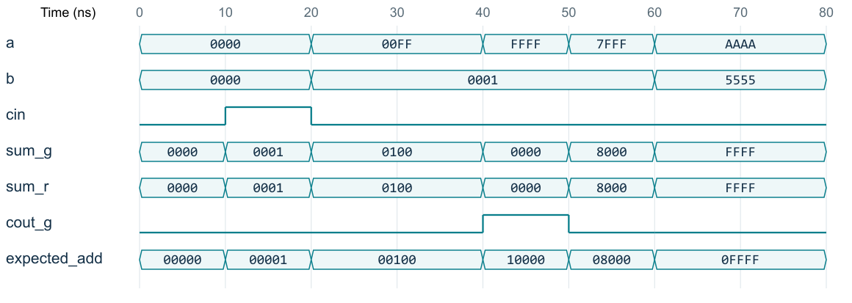
Adder verification
8 FA cases + 512 four-bit cases + 2,040 16-bit vectors: PASS
XSim VCD, reformatted. 7FFF + 1: signed overflow with cout=0.
10 PRE2 E / 1:50
Notes:
Presenter E. Target 1:50.
Read the waveform as three distinct examples. At twenty nanoseconds, 00FF plus one gives 0100 with no carry-out. At forty nanoseconds, FFFF plus one produces sum zero and carry-out one. At fifty nanoseconds, 7FFF plus one produces 8000 with carry-out zero. The last example would overflow a signed sixteen-bit positive range, which shows why carry-out and signed overflow must remain distinct. Our current CPU instruction set does not add a carry flag or overflow exception. Both HDL outputs match the seventeen-bit expected signal throughout the recorded tests. We exhaustively tested eight one-bit cases and all 512 combinations of the four-bit adder. The sixteen-bit test uses 2040 vectors, including directed boundaries and reproducible pseudorandom inputs. Finite random testing does not prove every sixteen-bit input combination, and these waveforms measure functionality only.
Sources: pre2.vcd, xsim.log and tb_pre2.sv; CPU specification §§2,10; Lec09 p.27

Slide 11
MUX–adder connection
selected = sel ? b : a
{carry, result} = a + selected
a | b | sel | selected | result
00FF | 0001 | 0 | 00FF | 01FE
00FF | 0001 | 1 | 0001 | 0100
2,040 connection checks: PASS
A combinational integration harness. Full CPU execution remains future work.
11 PRE2 A / 1:00
Notes:
Presenter A. Target 1:00.
We also connect the structural multiplexer to the structural adder. This small harness computes a plus the selected operand, with carry-in fixed at zero. Select zero makes the second operand a, so the operation is a plus a. Select one makes it b, giving a plus b. For a equal to 00FF and b equal to 0001, the outputs are 01FE and 0100 respectively. The testbench independently calculates the selected operand and the complete seventeen-bit total. It checked this connection for the same 2040 vectors and found no mismatch. In the CPU, similar wiring will choose register or immediate operands. This harness demonstrates compatible module interfaces; it does not include instruction decode, a register file or pipeline control.
Sources: rtl/tb_pre2.sv: link instance and expected_link; vectors.csv; CPU specification §6

Slide 12
Results and verification boundary
Evidence | Result
MUX1 / full adder | 8 / 8 cases passed
4-bit adder | 512 cases passed
16-bit MUX / adder / connection | 2,040 vectors each passed
Tool and reproducibility | XSim 2025.2; seed 0x20260914
Functional simulation complete for the listed tests
Not yet measured: synthesis resources, routed timing, Fmax, FPGA operation
12 PRE2 A / 0:40
Notes:
Presenter A. Target 0:40.
The complete run finished in Vivado XSim 2025.2 with no failed comparison. The log reports 6648 checks. This total combines sixteen one-bit checks, 512 four-bit checks and three comparisons for each of the 2040 sixteen-bit vectors. These comparisons are related, so we also report the breakdown instead of using the total as a coverage percentage. The deliverable retains the RTL, testbench, seed, simulator log, VCD and WDB so that the group can reproduce the results. We have demonstrated the specified combinational functions and their small connection. We have not measured routed delay, maximum clock frequency or FPGA behaviour. The next implementation step is to incorporate these modules into the datapath and verify the new sequential boundaries separately.
Sources: xsim.log, 2026-09-14; CPU specification §13

