Slide 1
ALU Behavioural Design
op (binary) | Function
000 | PASS_B
001 | ADD
010 | SUB
011 | AND
100 | OR
101–111 | Illegal
always @* begin
result=16'h0000; illegal=1'b0;
case (op)
PASS_B: result=b;
ADD: result=a+b;
SUB: result=a-b;
AND_OP: result=a&b;
OR_OP: result=a|b;
default: begin
result=16'h0000; illegal=1'b1;
end
endcase
end
localparam: PASS_B=3'd0, ADD=3'd1, SUB=3'd2, AND_OP=3'd3, OR_OP=3'd4
eq = (a == b) CMP qualifies the later Z update
Combinational module: no clock or state
C1 PRE3 ALU / 0:30
Notes:
Placement: replace original group slide 7 with C1–C2. Main C-section totals 2:40 across C1–C4; C5 is backup.
English: Our ALU has two sixteen-bit inputs and a three-bit control. The local parameters define the operation codes. PASS_B sends b directly to result for MOV. ADD, SUB, AND and OR provide the other results. Codes five through seven return zero and set illegal. Equality is independent of op, and only later CMP control decides whether to update Z.
中文提示：先说功能，再指完整case；3位op不是4位指令Opcode；output reg不代表触发器。
Sources: user-supplied alu16 code; delivered rtl/alu16.v. No clock or reset ports. Binary input semantics.

Slide 2
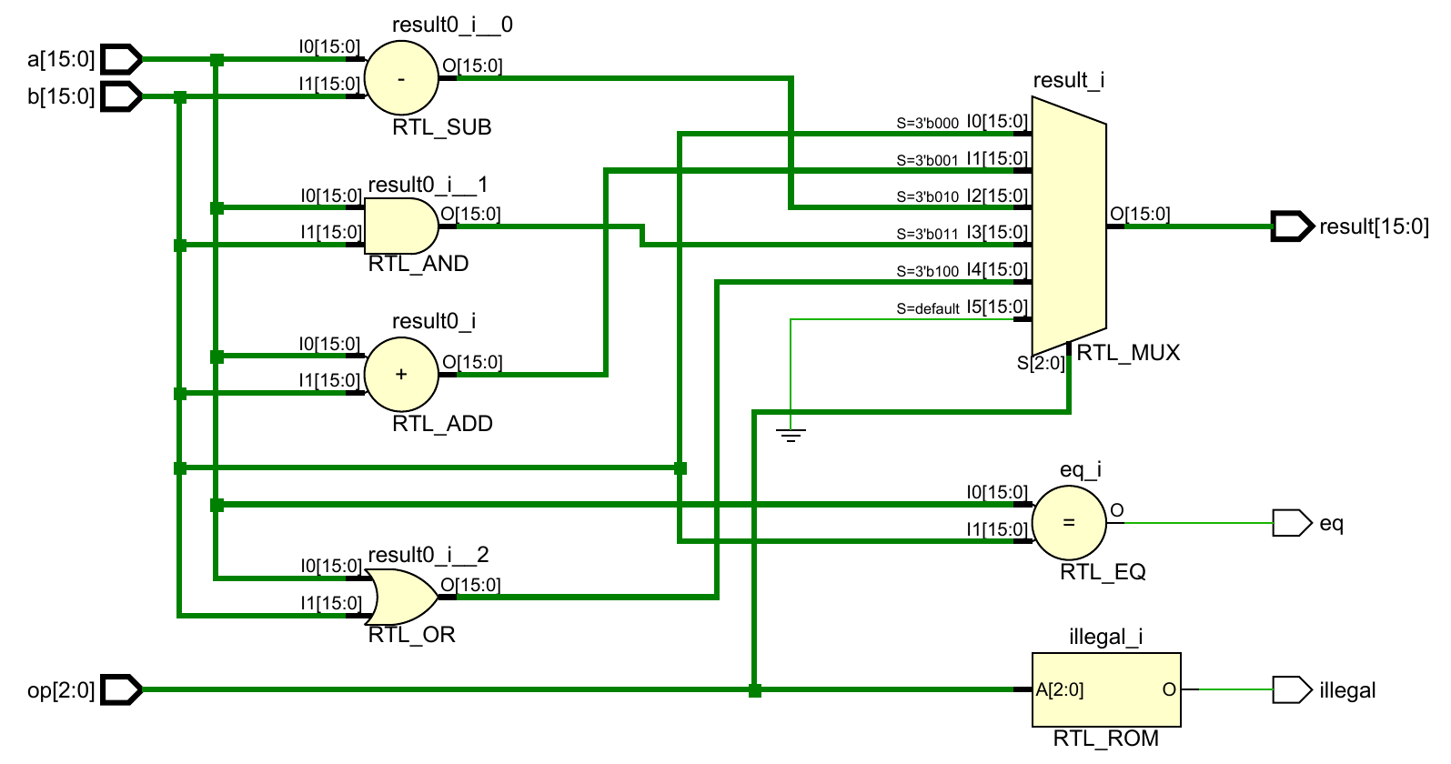
RTL Elaboration: Three Output Paths
1 result
op selects one
16-bit result
1
2 eq
Independent
a == b
2
3 illegal
3
op = 5, 6 or 7
RTL_ROM here represents decode logic, not a demonstrated memory block
C2 PRE3 ALU / 0:50
Notes:
English: Follow three paths in this diagram. First, the arithmetic and logic blocks produce candidate results. At marker one, op selects the output. The case statement in our Verilog code is represented by the multiplexer in this RTL schematic. PASS_B connects b directly. Marker two is the independent equality comparator. Marker three decodes illegal from op. Vivado calls it RTL_ROM, but this is a logical truth-table representation, not proof of a physical memory. RTL elaboration shows the logic; synthesis determines its device mapping.
中文指图：先指ADD/SUB/AND/OR，再指RTL_MUX；然后独立指RTL_EQ与RTL_ROM。PASS_B没有专门算术单元，直接走b；非法选择默认零。
Source: C:/Users/Donson/Downloads/schematic.pdf, one page supplied by user. Image crop removes page margins only, preserves all ports and complete logic. RTL abstraction, not mapped hardware.

Slide 3
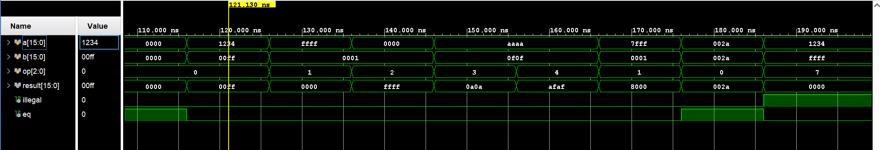
Functional Verification in Vivado
TB compares result, illegal and eq after a 1 ns simulation wait
Time (ns) | 126–136 | 136–146 | 186–196
Check | FFFF + 0001 | 0000 − 0001 | op = 111
Observed | 0000: low 16 bits | FFFF: −1 in two’s complement | result=0; illegal=1
Saved regression: 2,177,160 cases passed; not exhaustive ALU coverage
C3 PRE3 ALU / 1:00
Notes:
English: The testbench calculates expected outputs and compares result, illegal and eq. Its one-nanosecond wait is a simulation checking interval, not hardware delay. Here are three cases. Between 126 and 136 nanoseconds, FFFF plus one gives zero because result keeps only sixteen bits. Between 136 and 146, zero minus one gives FFFF, the sixteen-bit two’s-complement representation of minus one. Between 186 and 196, op seven gives zero and raises illegal. Read these intervals, not the Value column at the yellow cursor. Separately, the saved regression passed 2,177,160 cases. This is pattern and random testing, not exhaustive ALU coverage.
中文提示：先TB一句，再指时间段，不念左侧Value列作为后续结果。截图只是典型用例；数量来自已有完整日志，而非截图证明。所有总线为十六进制。
Sources: user waveform codex-clipboard-005cd36e-84ca-49fc-9dcd-530081eb0678.png; TB screenshot codex-clipboard-6ea25297-f55f-46ad-aec0-51a8dbb04876.png; local Vivado验证/tb/tb_modules.sv, modules.log and results.json from 2026-09-20. No new regression run claimed.

Slide 4
ALU Synthesis Results
ALU resource | Used | Interpretation
Slice LUTs | 71 | Combinational logic and selection
CARRY4 | 10 | Dedicated carry-chain resources
Flip-flops | 0 | No stored state in this ALU
RTL structure Functional correctness Hardware mapping
C4 PRE3 ALU / 0:20
Notes:
Placement: use in place of original group slide 15 for C's synthesis contribution. Other modules' resource explanations remain with their owners.
English: These are saved reference results for Z010, not measurements of your Z020 project. The ALU uses seventy-one LUTs, ten CARRY4 cells and zero flip-flops. Zero storage agrees with its combinational code. The Verilog type reg does not itself imply a flip-flop. No implemented timing or board-performance claim follows from these counts.
中文提示：这里只讲ALU，不替其他同学汇报其模块。RTL图不是综合图，不能把RTL_ADD数量等同CARRY4数量。
Sources: Vivado验证/synthesis/alu16_utilization.rpt and alu16_schematic.pdf in the Pre3 package. Vivado 2025.2, reference target xc7z010clg400-1, independent synthesis. No timing constraints, placement/routing, board or synthesized-netlist functional verification. Original group slide 15 counts freshly read, no new synthesis run.

Slide 5
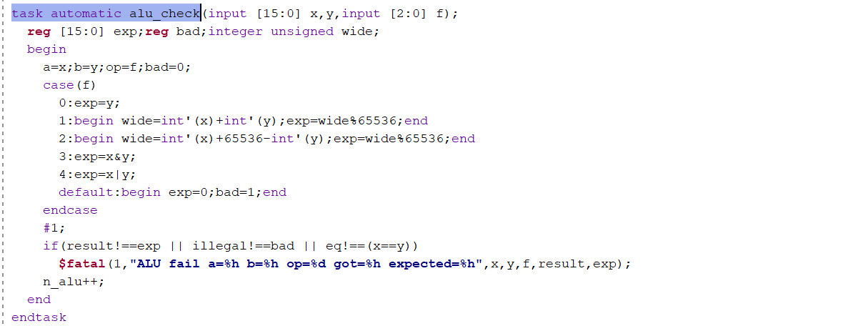
Backup: Self-Checking Testbench
Drive inputs
Compute expected
result and flags
#1 then compare
!== detects mismatch
and unknown outputs
$fatal on failure
65,536 × 4 × 8 + 10,000 × 8 + 8 = 2,177,160 checks
C5 PRE3 ALU / Q&A
Notes:
Backup, outside the 2:40 main delivery.
English: This is the actual alu_check task from our testbench. It drives the DUT, derives an expected value and an invalid-operation flag, allows a one-nanosecond simulation settling interval, and compares all three outputs with case inequality. The arithmetic oracle widens the integer calculation and reduces modulo 65536. Case inequality also flags unknown outputs. One nanosecond is a stimulus/checking interval, not measured hardware delay. The pattern sweep is 65536 values of a, four b patterns and eight selectors. Adding 10000 random pairs under eight selectors and eight directed cases gives 2177160. This does not enumerate all input pairs.
中文提示：已有RTL代码的完整实现不变；期望函数也需手算核对，不能把测试数量当形式证明。
Source: user TB screenshot and local tb_modules.sv lines22–39, 93–100. Screenshot crop retains the complete alu_check task; tool chrome and unrelated modules omitted.

