Slide 1
Pre3: ISA and Datapath Modules
Register file. ALU. PC. Immediate extension.
ISA semantics determine the hardware contracts
Behavioural Verilog and Vivado XSim 2025.2
Group presentation · Week 4
01 PRE3 A / 0:20
Notes:
Presenter A. Target 0:20.
Today we move from the MUX and adder to the remaining datapath modules. We start with a clarified instruction set, derive four module contracts, and show the HDL and verification evidence. The scope is module design and validation, rather than a completed pipelined CPU.
Sources: Pre1_CPU技术规格/CPU技术规格正文.md §§2,3,6,9–13; Pre3 logic-chain specification

Slide 2
ISA revision: what changed
Earlier ambiguity | Pre3 contract
Immediate interpretation | MOV/ADD/JUMP: zero extension; offsets: sign extension
Z and arithmetic results | Only CMP writes Z; eq is a candidate, not a write enable
STR register roles | Rd = store data; Rs = address base; no RF write
PC and branch base | Word address +1; JZ uses branch_pc+1+signed offset
Encoding compatibility | 13 existing codes retained; D/E/F are illegal
A semantic and interface revision, with unchanged machine encodings
02 PRE3 A / 0:55
Notes:
Presenter A. Target 0:55.
We retain the thirteen instruction encodings from our reviewed CPU specification. The revision clarifies their semantics and translates them into implementable interfaces. R0 remains a normal writable register. We distinguish unsigned immediate constants from signed displacements. Only CMP writes the architectural Z flag. A store reads Rd as its data and Rs as its base, and has no register write-back. The PC is word addressed. A relative branch uses its own instruction PC plus one, not the advanced fetch PC. These are corrections and clarifications compared with the early presentation, not newly invented opcodes. Relative to the September ninth specification, binary compatibility is unchanged.
Sources: Pre1_CPU技术规格/CPU技术规格正文.md §§2,3,6,9–13; Pre3 logic-chain specification

Slide 3
Revised ISA encoding
[15:12] Opcode [11:10] Rd [9:8] Rs [7:0] imm
Hex | Instruction
0 | MOV Rd,#u8
1 | MOV Rd,Rs
2 | ADD Rd,#u8
3 | ADD Rd,Rs
4 | SUB Rd,Rs
5 | AND Rd,Rs
6 | OR Rd,Rs
Hex | Instruction
7 | JUMP #u8
8 | LDR Rd,[Rs+s8]
9 | STR Rd,[Rs+s8]
A | CMP Rd,Rs
B | JZ #s8
C | HALT
D–F | Illegal: no writes
03 PRE3 A / 1:00
Notes:
Presenter A. Target 1:00.
The instruction remains sixteen bits, divided into four opcode bits, two destination bits, two source bits and eight immediate bits. This slide lists all thirteen defined encodings. The same Rd field can mean a destination, an arithmetic input or store data. The decoder must therefore produce actual source-use information rather than assuming every field is always read. Opcodes zero to six produce register results. Load also writes a register, while store writes memory. CMP writes only Z. Jump, conditional jump and HALT have no general-register result. Unused fields are zero in the program image but ignored by this decoder. D, E and F request no writes and report illegal.
Sources: Pre1_CPU技术规格/CPU技术规格正文.md §§2,3,6,9–13; Pre3 logic-chain specification; rtl/isa_decode.v

Slide 4
ISA requirements become module contracts
ISA requirement | Module | Contract
R0–R3, two source values | Register file | 4 × 16 bits; two reads, one write
MOV / arithmetic / logic | ALU | PASS_B, ADD, SUB, AND, OR; independent eq
Sequential fetch / branch | PC | Reset > redirect > hold > increment
u8 constant / s8 displacement | Immediate extension | Explicit zero/sign mode
Decoder outputs express intent; pipeline valid/kill qualification comes later
04 PRE3 A / 0:40
Notes:
Presenter A. Target 0:40.
The hardware follows from the instruction semantics. Two-source arithmetic and store instructions require two register reads. A destination result requires one write port. MOV, ADD, SUB, AND and OR determine the ALU functions. Signed offsets and unsigned constants require an explicit extension mode. Sequential execution, stalls and taken branches require a PC with increment, hold and redirect. Our decoder connects these decisions at the interface level. This is not yet the pipeline controller: valid bits, forwarding, flush and memory timing remain integration work.
Sources: Lec17 ISA & Datapath, actual pp.18,25–31; Lec12 Verilog sequential circuits pp.4–6; Lec09 Verilog combinational circuits p.30; Pre1_CPU技术规格/CPU技术规格正文.md §§2,3,6,9–13; Pre3 logic-chain specification

Slide 5
Register file: two reads and one write
waddr[1:0]
wdata[15:0]
we, clk, rst
Four 16-bit registers
R0 R1 R2 R3
raddr_a[1:0]
raddr_b[1:0]
Read MUX + WB bypass
rdata_a[15:0]
rdata_b[15:0]
posedge: rst clears all; else we writes one register
Read bypass: we && !rst && (waddr == raddr)
05 PRE3 B / 0:55
Notes:
Presenter B. Target 0:55.
The register file contains four sixteen-bit registers. A rising clock edge performs a write, unless synchronous reset clears every register first. R0 uses the same write path as the other registers. Both read ports are combinational. An explicit bypass returns the current write data when a read address equals the enabled write address. This supports WB-to-ID read behaviour later, without relying on simulator process ordering. Bypass can change the output before the edge while the stored register changes only at the edge. During reset we disable the bypass. The caller must qualify write enable with the appropriate pipeline validity and cancellation controls.
Sources: Pre1_CPU技术规格/CPU技术规格正文.md §§2,3,6,9–13; Pre3 logic-chain specification; rtl/regfile4x16.v; Lec17 p.27; Lec12 pp.4–6

Slide 6
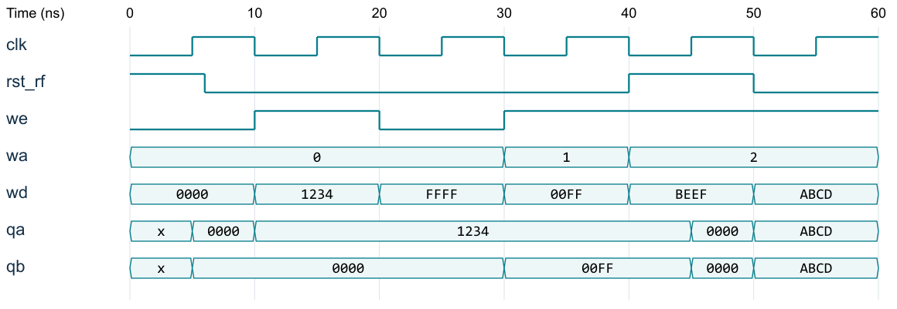
Register-file verification
263,405 checked transactions: PASS
Pre-edge bypass and post-edge state checked separately. VCD reformatted.
06 PRE3 B / 1:00
Notes:
Presenter B. Target 1:00.
This is a reformatted plot of the actual XSim VCD. At ten nanoseconds the write path selects R0 and data 1234. The read bypass exposes that data before the fifteen-nanosecond storage edge. At twenty nanoseconds write enable becomes zero and R0 retains its value. The next transaction writes R1 with 00FF. Reset is asserted at forty nanoseconds, and both stored values clear at the forty-five-nanosecond edge. Reset also defeats the attempted write. The final directed transaction writes R2 and reads it on both ports. The regression includes every sixteen-bit write value at each of four destinations, all address/control combinations in the defined matrix and one thousand reproducible random transactions. It does not exhaust the entire sixty-four-bit register-file state space.
Sources: tb/tb_modules.sv; modules.vcd 0–60 ns; results.json

Slide 7
ALU functions and behavioural HDL
op | Action | Result
0 | PASS_B | b
1 | ADD | low16(a+b)
2 | SUB | low16(a-b)
3 | AND | a & b
4 | OR | a | b
5–7 | Illegal | 0; illegal=1
always @* begin
result=0; illegal=0;
case (op)
1: result=a+b;
2: result=a-b;
// PASS_B, AND, OR
default: illegal=1;
endcase
end
Excerpt: other valid cases are in alu16.v
eq = (a == b) CMP controls the later Z write
07 PRE3 C / 0:50
Notes:
Presenter C. Target 0:50.
The ALU has a three-bit internal function selector, distinct from the four-bit instruction opcode. PASS_B supports MOV. ADD and SUB return the low sixteen bits, while AND and OR act bit by bit. A separate equality output supplies the CMP candidate. It never updates architectural Z on its own. The behavioural case statement assigns defaults before selecting an operation, preventing latches. Unsupported internal selectors five through seven return zero and raise illegal. A separate decoder handles unsupported instruction opcodes. This design does not expose a carry flag or overflow exception because our ISA does not define them.
Sources: rtl/alu16.v; CPU specification §§2,9,10; Lec09 combinational p.30

Slide 8
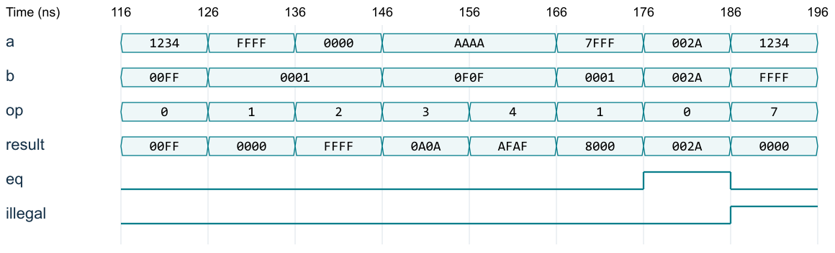
ALU verification
2,177,160 cases: PASS, including invalid selectors
Boundary/pattern/random coverage, not exhaustive 16-bit ALU input coverage.
08 PRE3 C / 1:05
Notes:
Presenter C. Target 1:05.
The directed excerpt exercises every supported function and an invalid selector. At 126 nanoseconds FFFF plus one wraps to zero. At 136 nanoseconds zero minus one returns FFFF. AND of AAAA and 0F0F returns 0A0A, while OR returns AFAF. At 176 nanoseconds the inputs are equal, so eq becomes one. At 186 nanoseconds selector seven returns zero and raises illegal. The full regression makes 2,177,160 comparisons. It sweeps every value of a against four selected b patterns under all eight selectors, then adds random pairs and directed cases. This is broad testing but not all possible sixteen-bit operand pairs. The previous adder result cannot establish correctness of the newly added selector, subtraction or equality path.
Sources: tb/tb_modules.sv; modules.vcd 116–196 ns; results.json

Slide 9
PC update priority
always @(posedge clk) begin
if (rst) pc <= 16'h0000;
else if (redirect) pc <= target;
else if (!hold) pc <= pc + 16'd1;
end
Target type | Combinational expression
JUMP | ZExt(imm8)
JZ when taken | low16(branch_pc + 1 + SExt(imm8))
09 PRE3 D / 0:50
Notes:
Presenter D. Target 0:50.
The PC is a sixteen-bit word address. Its sequential update has an explicit priority: synchronous reset, redirect, hold, and otherwise increment by one. Redirect wins over an ordinary front-end hold. The future control unit must suppress redirects when an older terminal fault takes priority. Our local PC register does not decide instruction age. A separate combinational target unit computes either an absolute zero-extended immediate or a relative target using the branch instruction PC plus one. Using PC_fetch for this relative base would be wrong once fetch has moved ahead. HALT drain, flush and memory range protection remain outside this unit.
Sources: rtl/pc16.v; rtl/branch_target16.v; CPU specification §§2,7,8; Lec17 pp.30–31

Slide 10
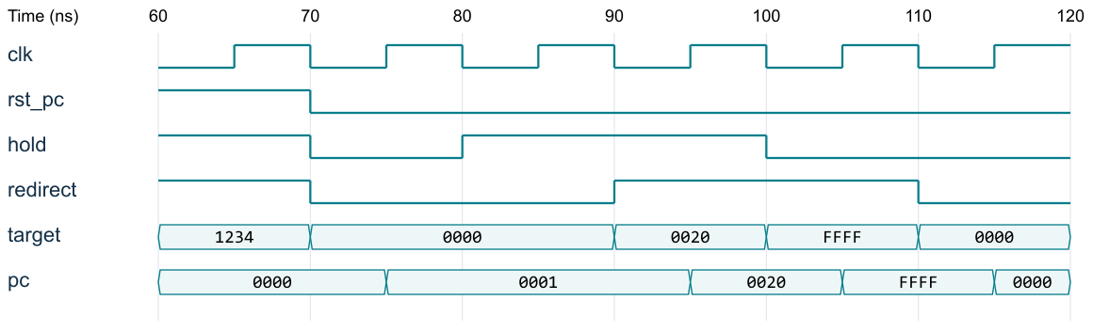
PC verification
65,536 PC values × 8 control combinations tested
1,048,582 checked transitions, including legal state setup and directed tests.
10 PRE3 D / 0:55
Notes:
Presenter D. Target 0:55.
The waveform demonstrates the priority and wraparound rules. At the sixty-five-nanosecond edge reset wins, even though hold and redirect are also asserted. The PC increments to one at seventy-five nanoseconds, then holds at eighty-five. At ninety-five nanoseconds redirect overrides hold and loads 0020. The next redirect loads FFFF, and the following increment wraps to zero. For regression we visit every possible initial PC value and all eight combinations of reset, hold and redirect. Each check first seeds the PC by a legal redirect, which is why the transition count includes setup actions. We also check that changing controls away from an active edge does not change the PC. Target calculations have their own absolute and relative-boundary tests.
Sources: tb/tb_modules.sv; modules.vcd 60–120 ns; results.json

Slide 11
Immediate extension follows the ISA
if (sign_mode) value = {{8{imm[7]}},imm};
else value = {8'h00,imm};
Instruction class | Mode | Interpretation
MOV #u8, ADD #u8, JUMP #u8 | 0 | Unsigned 0 … 255
LDR/STR offset, JZ #s8 | 1 | Signed −128 … +127
The decoder selects the mode; the extender does not decode opcodes
11 PRE3 E / 0:40
Notes:
Presenter E. Target 0:40.
The eight-bit field is not always a signed number. MOV immediate, ADD immediate and absolute JUMP use zero extension. Load/store displacements and JZ use sign extension. The implementation explicitly concatenates the appropriate upper eight bits. For 80, zero extension gives 0080 but sign extension gives FF80. For FF the two results are 00FF and FFFF. This rule must be chosen before ALU address calculation, not guessed from the final result or from the instruction text in the testbench.
Sources: rtl/imm_ext16.v; CPU specification §2; Lec17 p.29

Slide 12
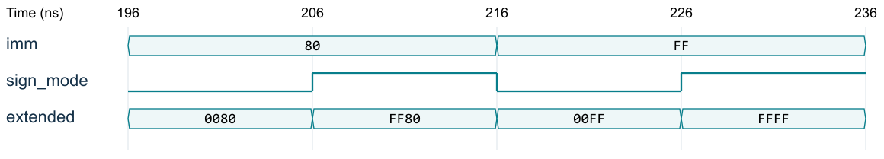
Immediate verification
256 immediate values × 2 modes = 512 / 512 PASS
Exhaustive for this module’s binary input space. All buses shown in hexadecimal.
12 PRE3 E / 0:45
Notes:
Presenter E. Target 0:45.
This short waveform shows the two values most likely to expose an extension error. With immediate 80 and sign mode zero, the output is 0080. Changing only the mode produces FF80. For immediate FF the output changes from 00FF to FFFF. Unlike the large ALU space, the extension module has only nine binary input bits. We test all 256 immediate values under both modes, so all 512 binary combinations pass. The test oracle uses integer interpretation of negative offsets rather than copying the concatenation expression. Unknown X or Z inputs are not part of this exhaustive binary claim.
Sources: tb/tb_modules.sv; modules.vcd 196–236 ns; results.json

Slide 13
Instruction examples connect the modules
Instruction / word | Module reasoning | Expected candidate
ADD R0,#1 / 2001 | R0=00FF; ZExt(01); ADD | RF write value = 0100
LDR R2,[R3−1] / 8BFF | R3=0020; SExt(FF); ADD | EA = 001F; wait for DM data
JZ −1 / B0FF | branch_pc=0006; Z=1; offset=FFFF | target = 0006
RF values, extended immediates and PC tags must stay with the instruction
Worked unit-level reasoning; full instruction execution is not claimed.
13 PRE3 E / 0:55
Notes:
Presenter E. Target 0:55.
Here we trace three instruction contracts through the modules. ADD R0 immediate one, encoded as 2001, reads the old R0, zero-extends one and selects ADD. If R0 is 00FF, the candidate write-back value is 0100. LDR R2 from R3 minus one is 8BFF. The extender produces FFFF, so base 0020 gives address 001F. This address is not the load data; the memory return must later write R2. Finally B0FF means JZ minus one. At branch PC six, the taken target is six plus one minus one, which is six. These are specification traces supported by unit tests, not claims that complete instructions already run in an integrated pipeline.
Sources: Pre1_CPU技术规格/CPU技术规格正文.md §§2,3,6,9–13; Pre3 logic-chain specification; worked examples in logic-chain document

Slide 14
Verification coverage and its limits
Object | Passed checks | Scope
Immediate extender | 512 | All binary input combinations
Instruction decoder | 65,536 | All instruction words; fields + controls
Register file | 263,405 transactions | Data sweep + control matrix + random
ALU | 2,177,160 cases | Patterns + random + invalid op
PC | 1,048,582 transitions | All PC values × controls, with setup
Target generator | 1,792 | All absolute imm + relative boundaries
All listed tests passed. No claim of full CPU or full sequential-state verification.
14 PRE3 B / 1:00
Notes:
Presenter B. Target 1:00.
Every reported count comes from this version of the HDL and self-checking testbench. Immediate extension and instruction-word decode have complete binary input enumeration. PC testing crosses every initial value with all control combinations, but it does not cross every initial value with every possible target. Register-file testing covers every write-data value at every destination and explicit read/write-control scenarios; it does not enumerate all sixty-four-bit storage states or arbitrary histories. ALU tests cover selected patterns and random pairs. These distinctions matter because a large number alone is not a coverage proof. The logs terminate on a mismatch. The package preserves the source files, seeds, logs, representative waveforms and executable scripts.
Sources: results.json; decode_results.json; tb/tb_modules.sv; tb/tb_decode.sv

Slide 15
Synthesis evidence
Module | Slice LUTs | Flip-flops | CARRY4
regfile4x16 | 54 | 64 | 0
alu16 | 71 | 0 | 10
pc16 | 17 | 16 | 4
imm_ext16 | 1 | 0 | 0
Reference target: xc7z010clg400-1 · independent synthesis
Mapped schematics and DCPs included. No routed timing or board-performance claim.
15 PRE3 C / 0:45
Notes:
Presenter C. Target 0:45.
We synthesized each module independently using the exact delivered HDL. The reference target is xc7z010clg400-1, an installed device used to demonstrate mapping, not a claim about our course board. The register file uses sixty-four flip-flops, matching four sixteen-bit words. The PC uses sixteen flip-flops. The combinational ALU and extender use no storage registers. The extender needs only one LUT because the upper bits share the same sign-enable expression. These are per-module synthesis counts; they should not be added as a final integrated CPU resource estimate. No timing constraints, placement or routing were used, so we do not report an Fmax.
Sources: synthesis/*_utilization.rpt; synthesis.log; Vivado 2025.2; reference device xc7z010clg400-1

Slide 16
Pre3 outcome and the integration boundary
ISA contracts are explicit
Four HDL modules have reproducible unit evidence
Next: pipeline integration and new cross-module tests
Not yet verified: forwarding, flush, memory-IP timing, Z commit and HALT drain
16 PRE3 E / 0:35
Notes:
Presenter E. Target 0:35.
We now have a clarified ISA, four behavioural modules and repeatable verification evidence. The source-level tests and independent synthesis results are complete within the reported scope. Integration is the next step: register pipeline payloads, carry controls alongside instructions, qualify writes with valid and kill, connect memory timing, and handle data and control hazards. CMP still needs a qualified architectural Z update, and HALT needs pipeline drain control. This keeps our conclusion precise: the modules are ready for integration experiments, while a complete CPU requires new tests.
Sources: Pre1_CPU技术规格/CPU技术规格正文.md §§2,3,6,9–13; Pre3 logic-chain specification; Pre3 test and synthesis logs

Slide 17
Appendix: decoder controls
Hex | Rd / Rs read | Ext | ALU | RF / DM / Z action
0 / 1 | No / No; No / Yes | Zero / unused | PASS_B | RF write
2 / 3 | Yes / No; Yes / Yes | Zero / unused | ADD | RF write
4–6 | Yes / Yes | unused | SUB / AND / OR | RF write
7 | No / No | Zero | unused | absolute redirect
8 | No / Yes | Sign | ADD | DM read; later RF write
9 | Yes / Yes | Sign | ADD | DM write; no RF write
A | Yes / Yes | unused | eq output | Z write only
B / C | No / No | Sign / unused | unused | conditional redirect / HALT
D–F | No / No | unused | safe default | illegal; no writes
17 PRE3 Backup / Q&A
Notes:
Presenter Backup. Target Q&A.
The source-use mask and side-effect requests follow the instruction. The table is unqualified decode intent. Pipeline valid, kill and age-priority qualification are integration responsibilities. alu_op is not the instruction opcode.
Sources: rtl/isa_decode.v; tb/tb_decode.sv

Slide 18
Appendix: self-checking testbench
Sequential checks
@(negedge clk); // drive input controls
#1; // inspect read bypass / stable PC
@(posedge clk); // advance independent state model
#1; // compare after DUT nonblocking updates
if (actual !== expected) $fatal(1, "mismatch");
Raw source, logs, seeds and VCD are delivered together
18 PRE3 Backup / Q&A
Notes:
Presenter Backup. Target Q&A.
The sequential checkers drive controls on a falling edge, inspect combinational bypass before the next rising edge, update the independent state model on the rising edge, and sample after nonblocking assignments settle. This prevents an active-region race. The combinational tests allow a one-nanosecond settling interval and use case inequality. Delays belong to the testbench, not synthesizable datapath logic.
Sources: tb/tb_modules.sv; Lec14 Testbench; CHA Lec02 pp.16–21

Slide 19
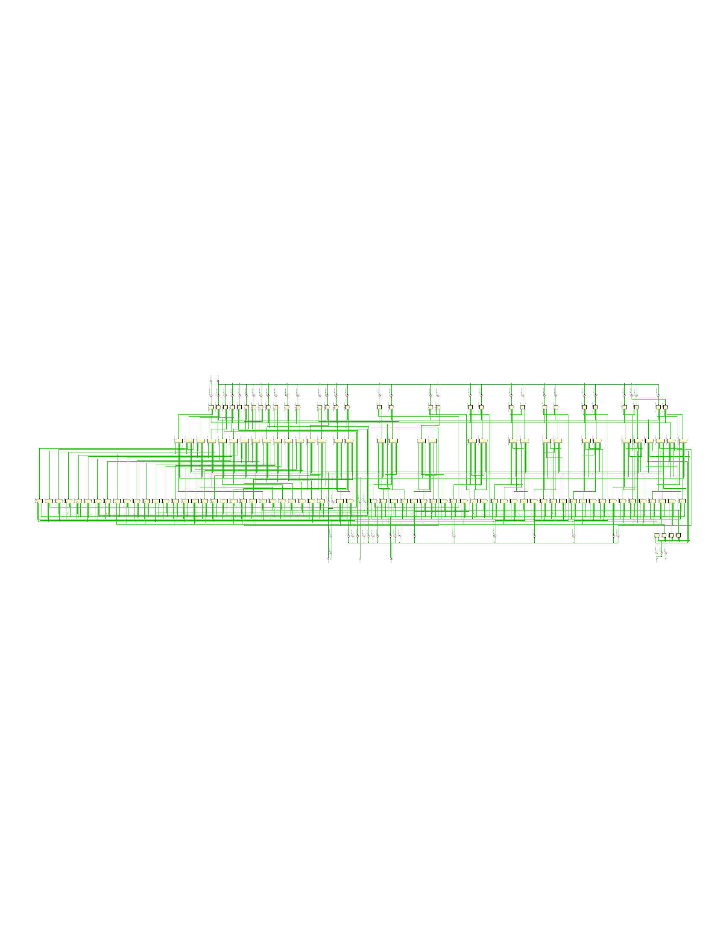
Appendix: Register file mapped schematic
regfile4x16
Post-synthesis
xc7z010clg400-1
Full PDF and DCP
in the review pack
19 PRE3 Backup / Q&A
Notes:
Presenter Backup. Target Q&A.
Actual Vivado schematic exported from the delivered synthesized checkpoint. Use the original PDF for detailed zoom. The reference part and synthesis conditions are stated in the reports. This diagram is not a timing result.
Sources: synthesis/regfile4x16_schematic.pdf; regfile4x16.dcp

Slide 20
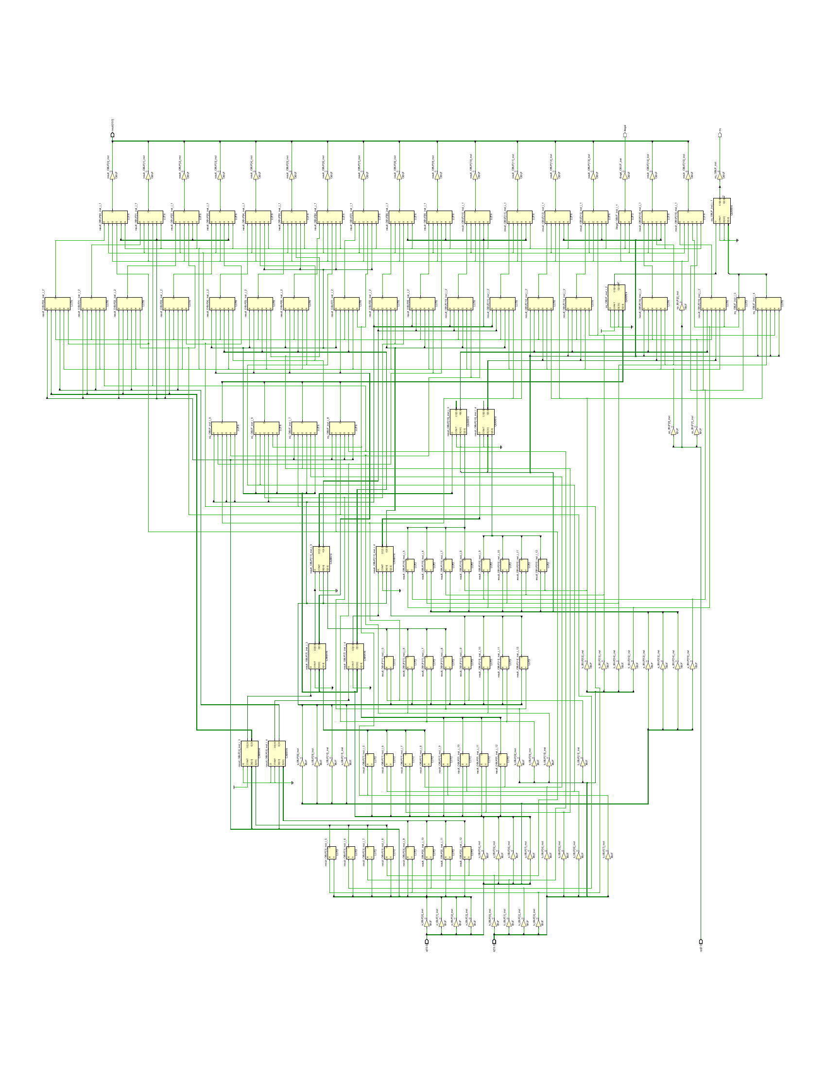
Appendix: ALU mapped schematic
alu16
Post-synthesis
xc7z010clg400-1
Full PDF and DCP
in the review pack
20 PRE3 Backup / Q&A
Notes:
Presenter Backup. Target Q&A.
Actual Vivado schematic exported from the delivered synthesized checkpoint. Use the original PDF for detailed zoom. The reference part and synthesis conditions are stated in the reports. This diagram is not a timing result.
Sources: synthesis/alu16_schematic.pdf; alu16.dcp

Slide 21
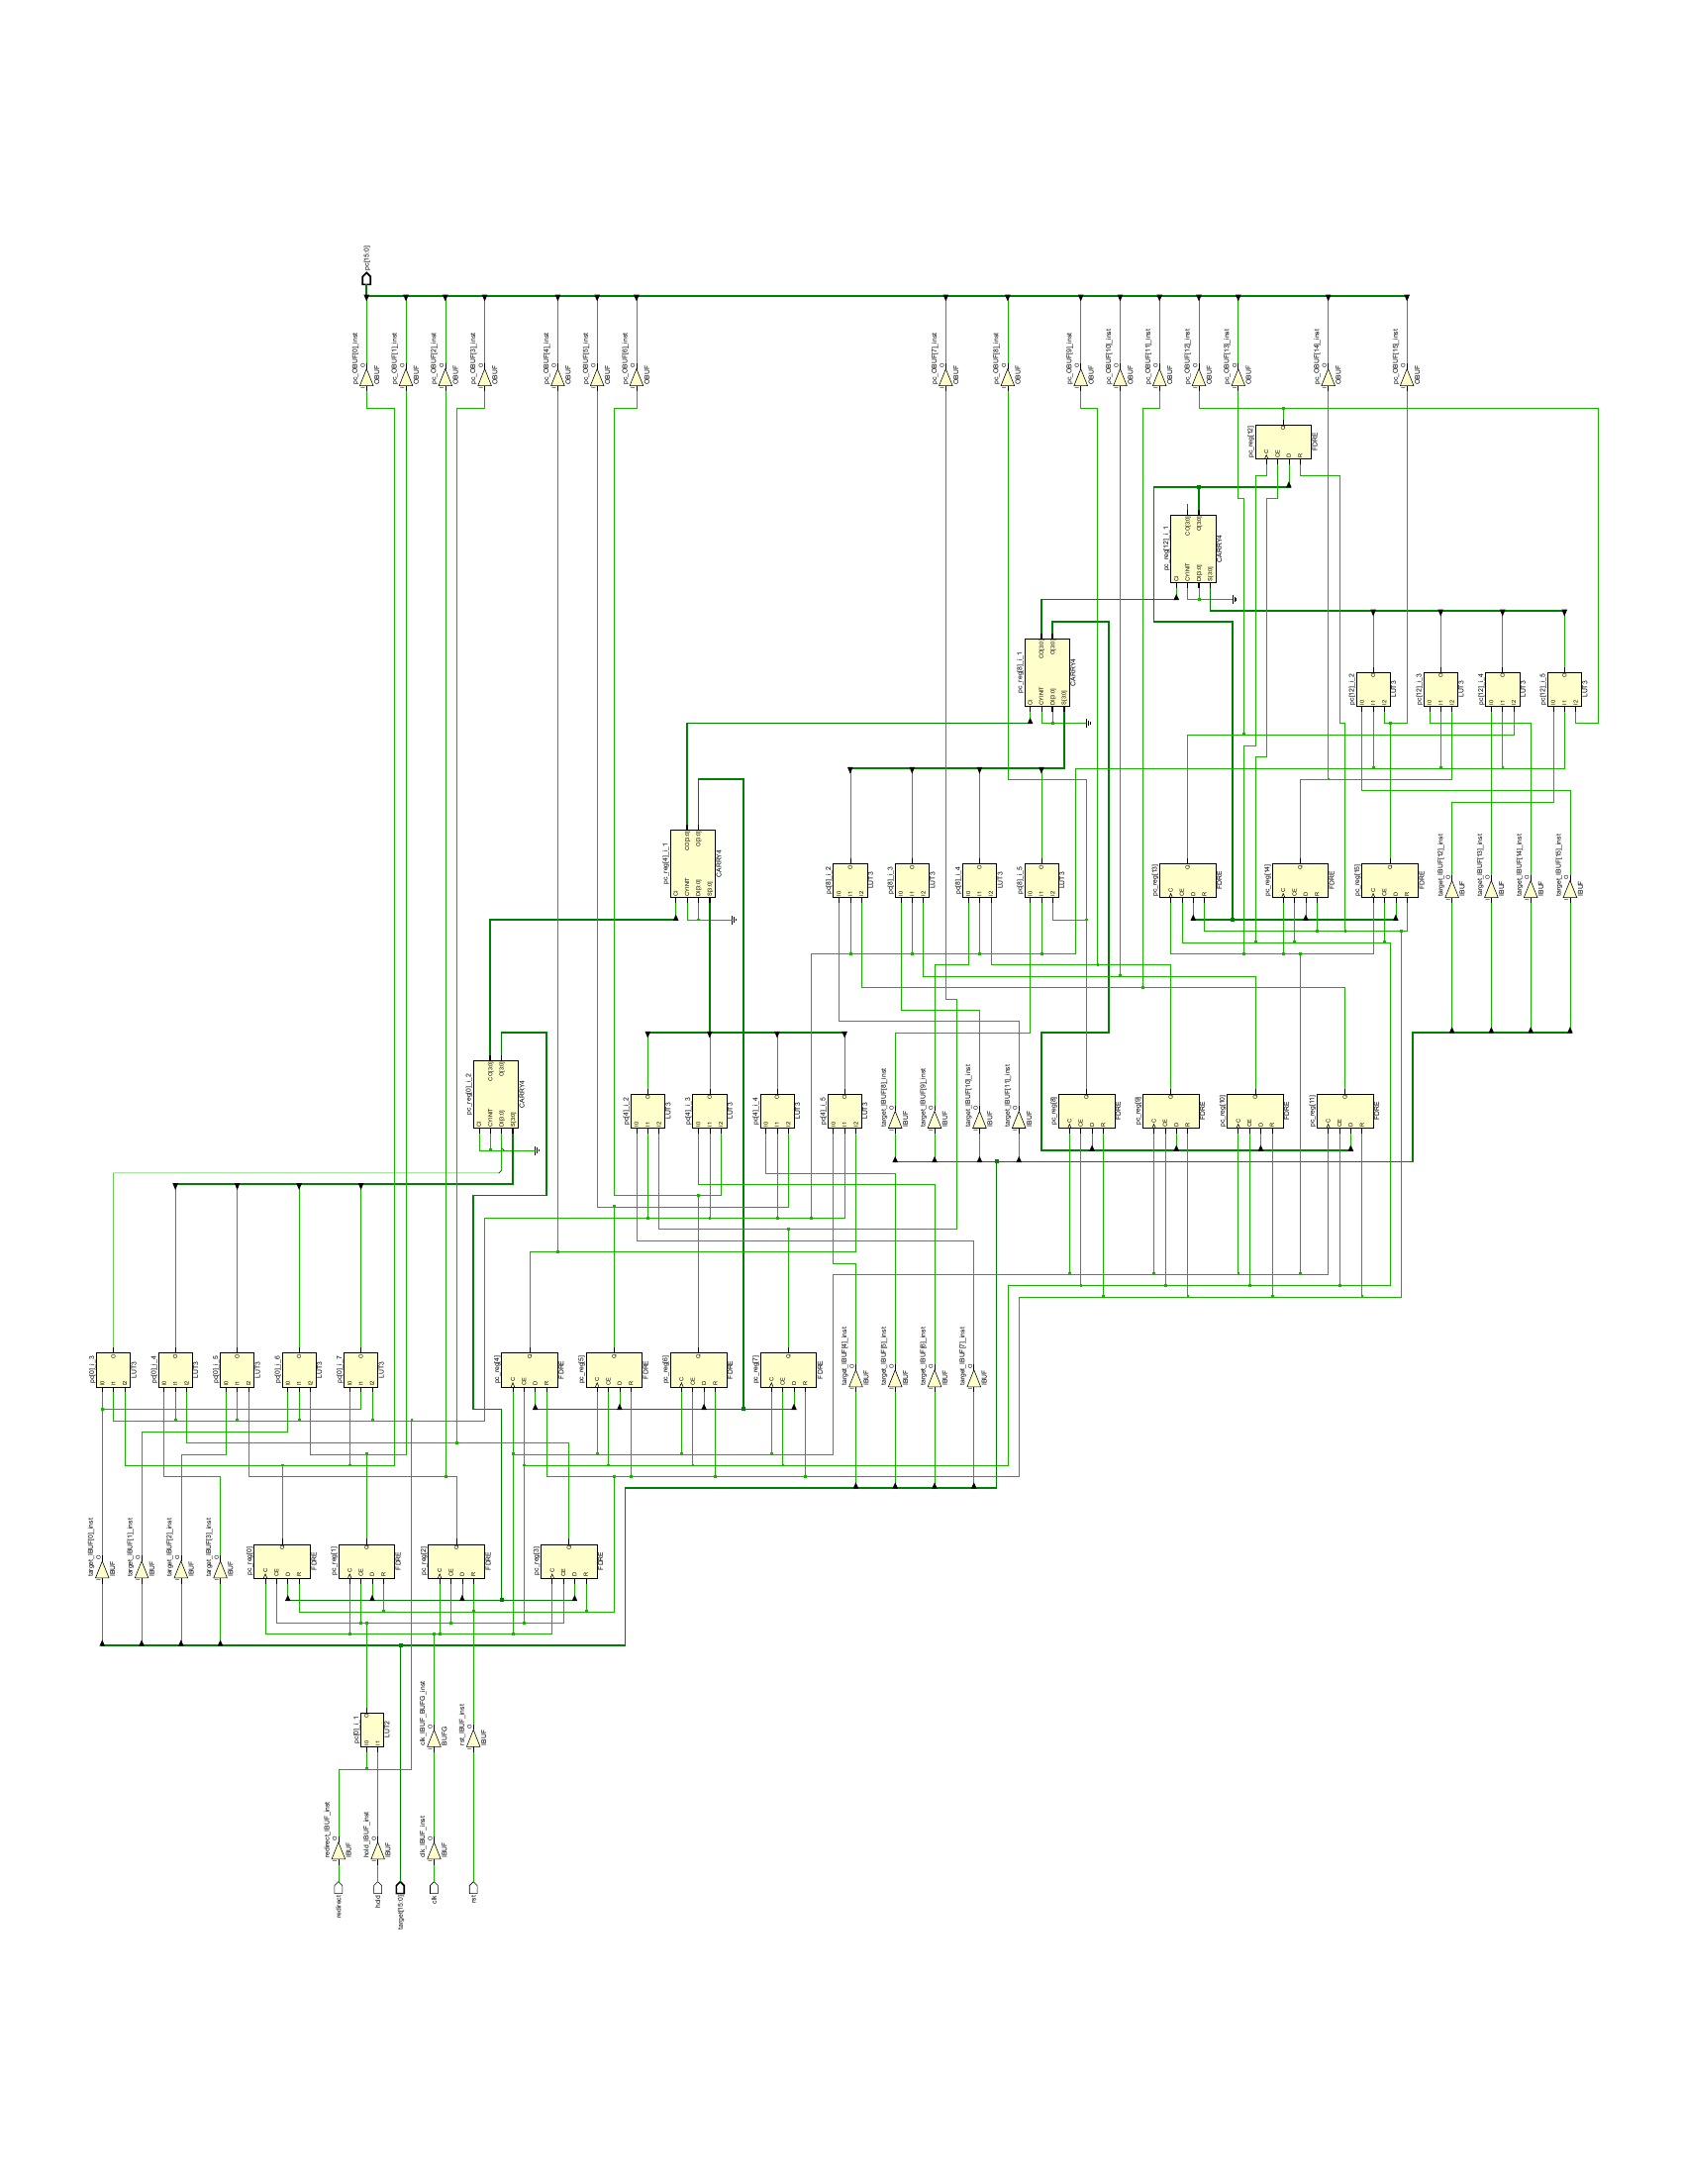
Appendix: PC mapped schematic
pc16
Post-synthesis
xc7z010clg400-1
Full PDF and DCP
in the review pack
21 PRE3 Backup / Q&A
Notes:
Presenter Backup. Target Q&A.
Actual Vivado schematic exported from the delivered synthesized checkpoint. Use the original PDF for detailed zoom. The reference part and synthesis conditions are stated in the reports. This diagram is not a timing result.
Sources: synthesis/pc16_schematic.pdf; pc16.dcp

Slide 22
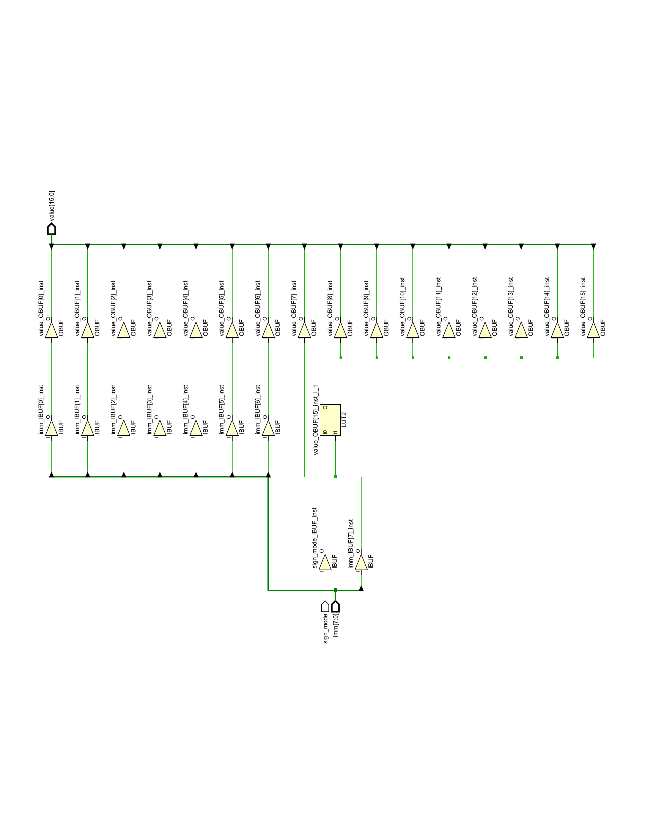
Appendix: Immediate extender mapped schematic
imm_ext16
Post-synthesis
xc7z010clg400-1
Full PDF and DCP
in the review pack
22 PRE3 Backup / Q&A
Notes:
Presenter Backup. Target Q&A.
Actual Vivado schematic exported from the delivered synthesized checkpoint. Use the original PDF for detailed zoom. The reference part and synthesis conditions are stated in the reports. This diagram is not a timing result.
Sources: synthesis/imm_ext16_schematic.pdf; imm_ext16.dcp

