Slide 1
Immediate extension follows the ISA
if (sign_mode) value = {{8{imm[7]}},imm};
else value = {8'h00,imm};
Instruction class | Mode | Interpretation
MOV #u8, ADD #u8, JUMP #u8 | 0 | Unsigned 0 … 255
LDR/STR offset, JZ #s8 | 1 | Signed −128 … +127
The decoder selects the mode; the extender does not decode opcodes
11 PRE3 E / 0:40
Notes:
Presenter E. Target 0:40.
The eight-bit field is not always a signed number. MOV immediate, ADD immediate and absolute JUMP use zero extension. Load/store displacements and JZ use sign extension. The implementation explicitly concatenates the appropriate upper eight bits. For 80, zero extension gives 0080 but sign extension gives FF80. For FF the two results are 00FF and FFFF. This rule must be chosen before ALU address calculation, not guessed from the final result or from the instruction text in the testbench.
Sources: rtl/imm_ext16.v; CPU specification §2; Lec17 p.29

Slide 2
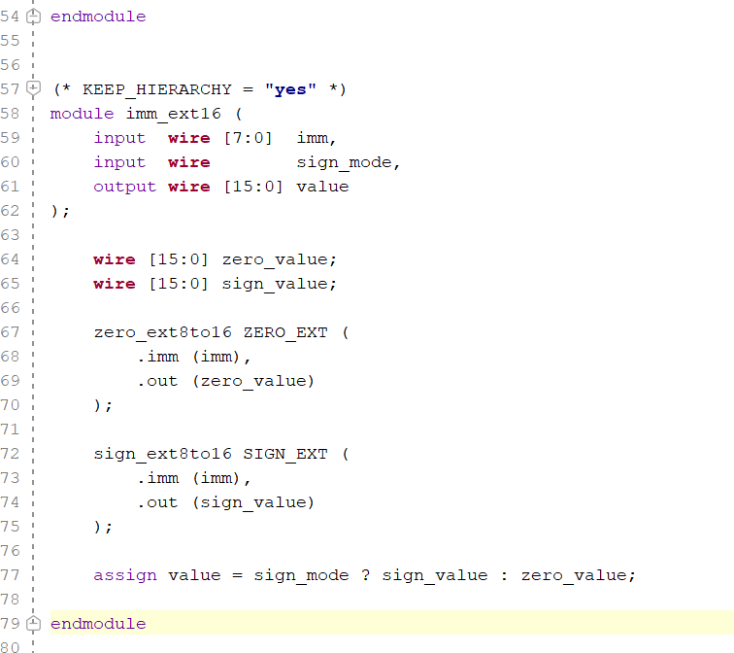
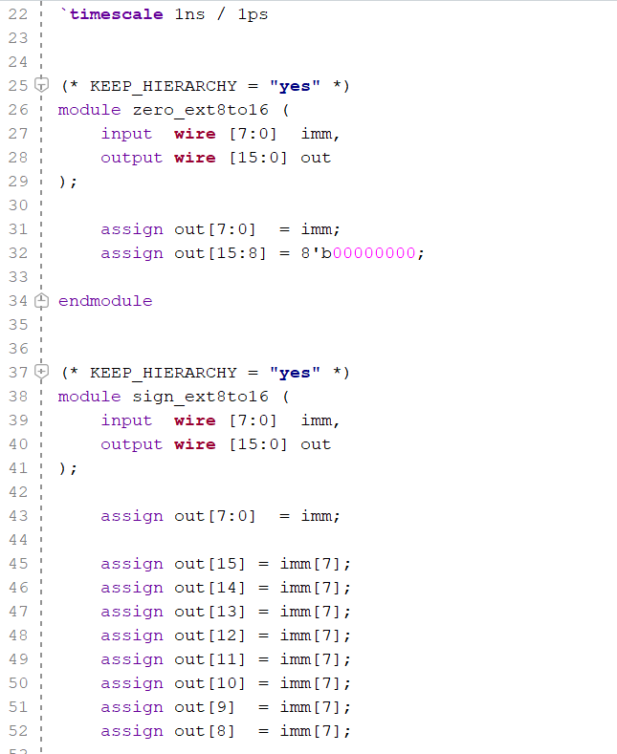
HDL Language
13 PRE3 E / 0:55
Notes:
Presenter E. Target 0:55.
Here we trace three instruction contracts through the modules. ADD R0 immediate one, encoded as 2001, reads the old R0, zero-extends one and selects ADD. If R0 is 00FF, the candidate write-back value is 0100. LDR R2 from R3 minus one is 8BFF. The extender produces FFFF, so base 0020 gives address 001F. This address is not the load data; the memory return must later write R2. Finally B0FF means JZ minus one. At branch PC six, the taken target is six plus one minus one, which is six. These are specification traces supported by unit tests, not claims that complete instructions already run in an integrated pipeline.
Sources: Pre1_CPU技术规格/CPU技术规格正文.md §§2,3,6,9–13; Pre3 logic-chain specification; worked examples in logic-chain document

Slide 3
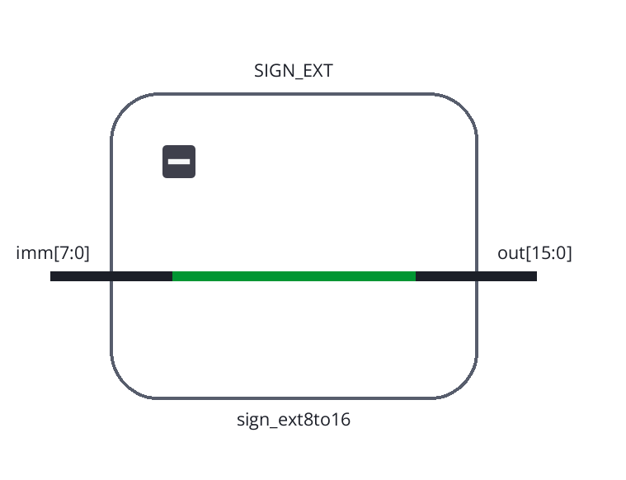
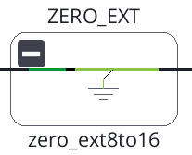
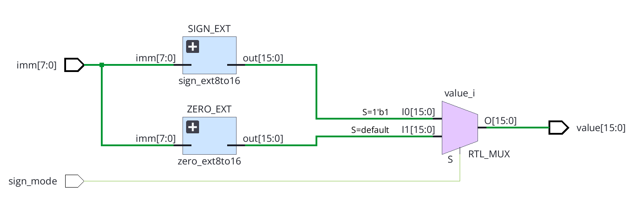
EDA structure
11 PRE3 E / 0:40
Notes:
Presenter E. Target 0:40.
The eight-bit field is not always a signed number. MOV immediate, ADD immediate and absolute JUMP use zero extension. Load/store displacements and JZ use sign extension. The implementation explicitly concatenates the appropriate upper eight bits. For 80, zero extension gives 0080 but sign extension gives FF80. For FF the two results are 00FF and FFFF. This rule must be chosen before ALU address calculation, not guessed from the final result or from the instruction text in the testbench.
Sources: rtl/imm_ext16.v; CPU specification §2; Lec17 p.29

Slide 4
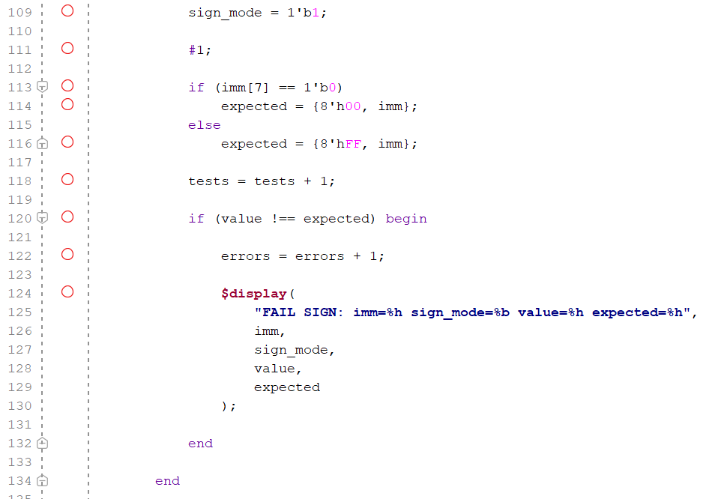
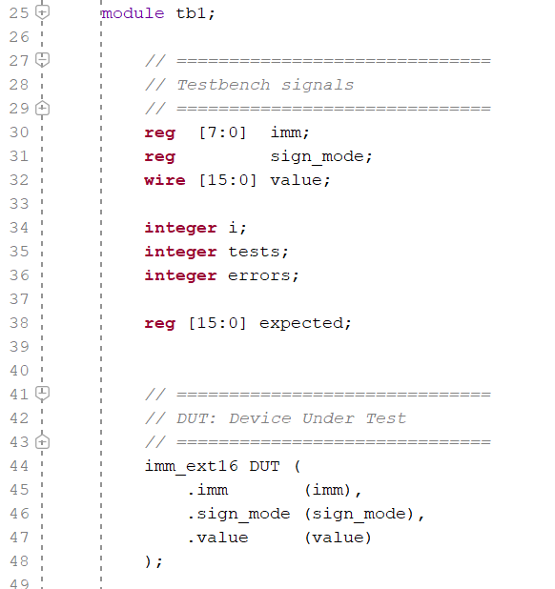
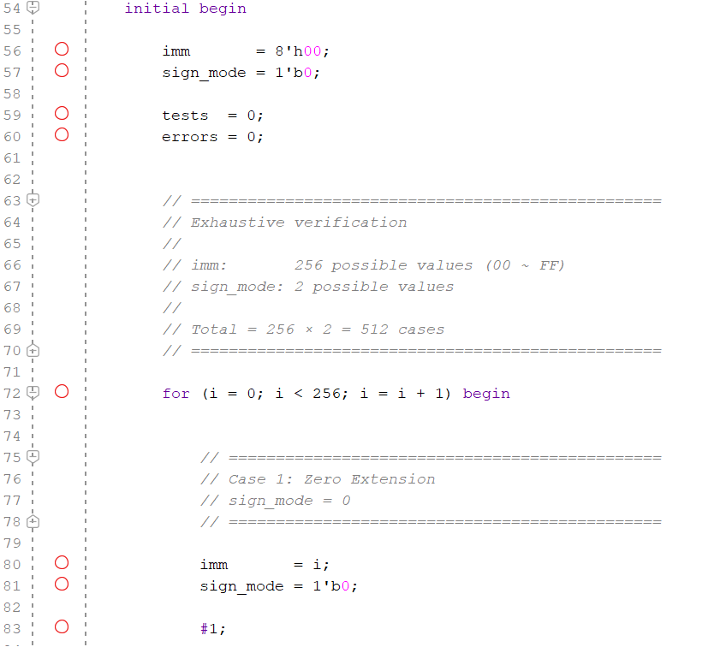
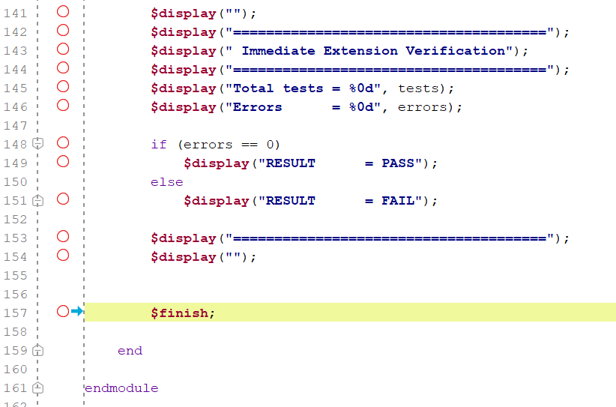
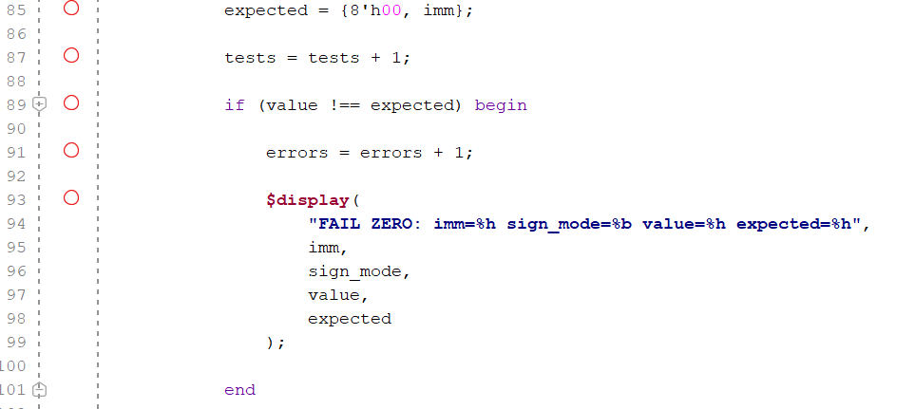
Verification TestBranch
Iterate through all possibilities
14 PRE3 B / 1:00
Notes:
Presenter B. Target 1:00.
Every reported count comes from this version of the HDL and self-checking testbench. Immediate extension and instruction-word decode have complete binary input enumeration. PC testing crosses every initial value with all control combinations, but it does not cross every initial value with every possible target. Register-file testing covers every write-data value at every destination and explicit read/write-control scenarios; it does not enumerate all sixty-four-bit storage states or arbitrary histories. ALU tests cover selected patterns and random pairs. These distinctions matter because a large number alone is not a coverage proof. The logs terminate on a mismatch. The package preserves the source files, seeds, logs, representative waveforms and executable scripts.
Sources: results.json; decode_results.json; tb/tb_modules.sv; tb/tb_decode.sv

Slide 5
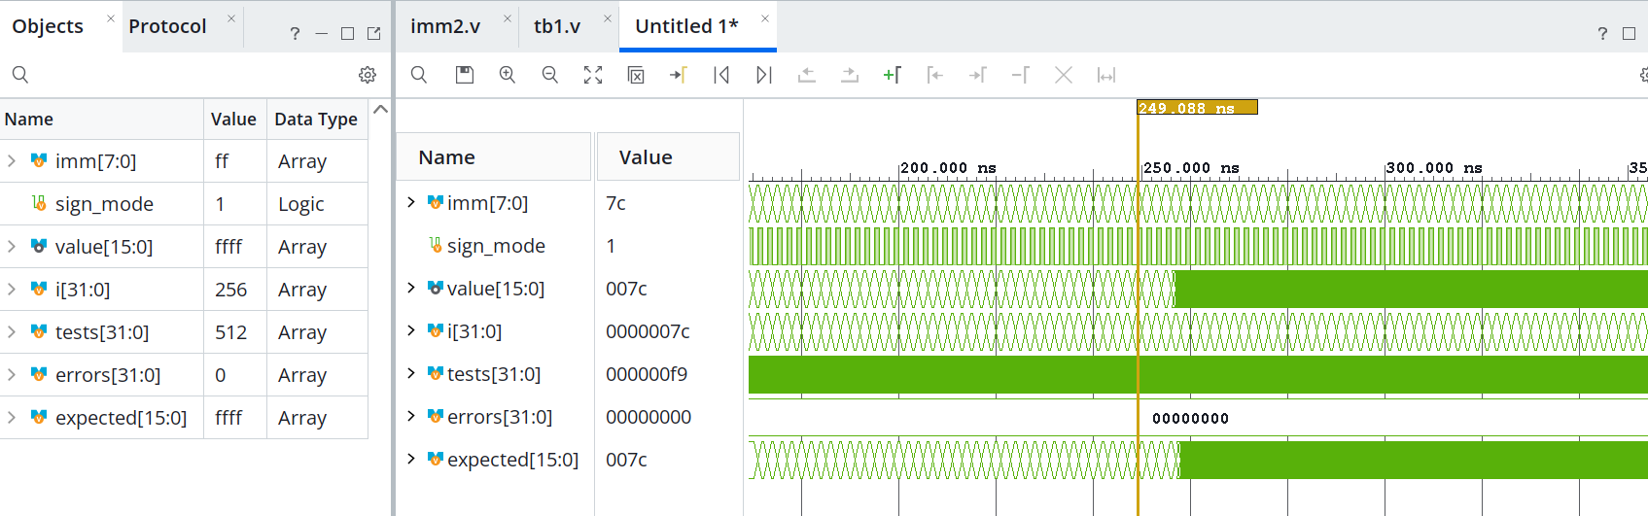
Verification Result
256 immediate values × 2 modes = 512 / 512 PASS
12 PRE3 E / 0:45
Notes:
Presenter E. Target 0:45.
This short waveform shows the two values most likely to expose an extension error. With immediate 80 and sign mode zero, the output is 0080. Changing only the mode produces FF80. For immediate FF the output changes from 00FF to FFFF. Unlike the large ALU space, the extension module has only nine binary input bits. We test all 256 immediate values under both modes, so all 512 binary combinations pass. The test oracle uses integer interpretation of negative offsets rather than copying the concatenation expression. Unknown X or Z inputs are not part of this exhaustive binary claim.
Sources: tb/tb_modules.sv; modules.vcd 196–236 ns; results.json

