Slide 1
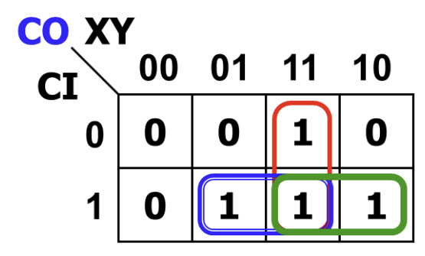
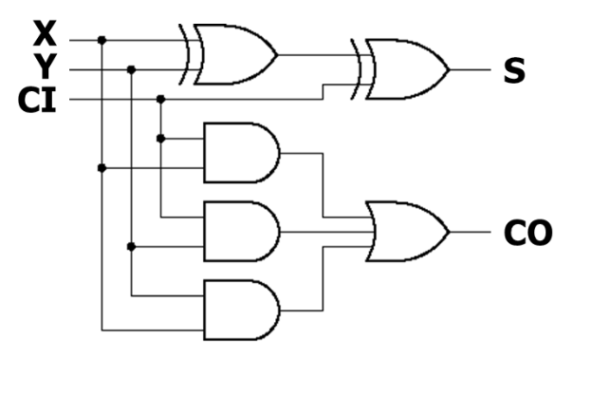
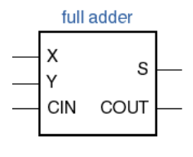
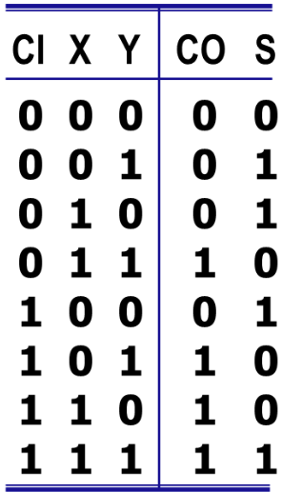
Manual Design of a 1-Bit Full Adder
Function and Truth Table
Carry Derivation
Gate-Level Circuit
X, Y: input bits
CI: carry in
S: sum bit
CO: carry out
CO = XY + YCI + XCI
S = X ⊕ Y ⊕ CI
2 XOR + 3 AND gates
1 three-input OR gate
Notes:
Source: user images7 and8, CHA Lec01-A slide13. Input order in the truth table is CI,X,Y. The carry K-map groups yield XY, YCI and XCI. Sum is the odd-parity function X XOR Y XOR CI. The carry expression uses Boolean OR, while X+Y+CI=2CO+S is an arithmetic identity. This is the direct three-term carry circuit, not the two-half-adder construction.

Slide 2
Connecting 1-Bit Full Adders
A[0]
B[0]
A[1]
B[1]
Carry C[1]
C[2]
Cin
FA0
FA1
… FA15
FA0.Cout = FA1.Cin
S[0]
S[1]
The carry-out of one bit becomes the carry-in of the next higher bit
Repeat this connection for all 16 bits.
Notes:
The two editable full-adder symbols show separate A and B input wires, individual Sum outputs, and one carry wire between stages. FA0 Cout equals FA1 Cin equals C1. Repeat the carry connection through FA15. Only carry passes to the next stage; S0 and S1 become separate bits of the output bus. The supplied screenshot below is image1 from the latest user message. This is explicitly described gate-level RTL, not evidence of post-route physical gate implementation.

Slide 3
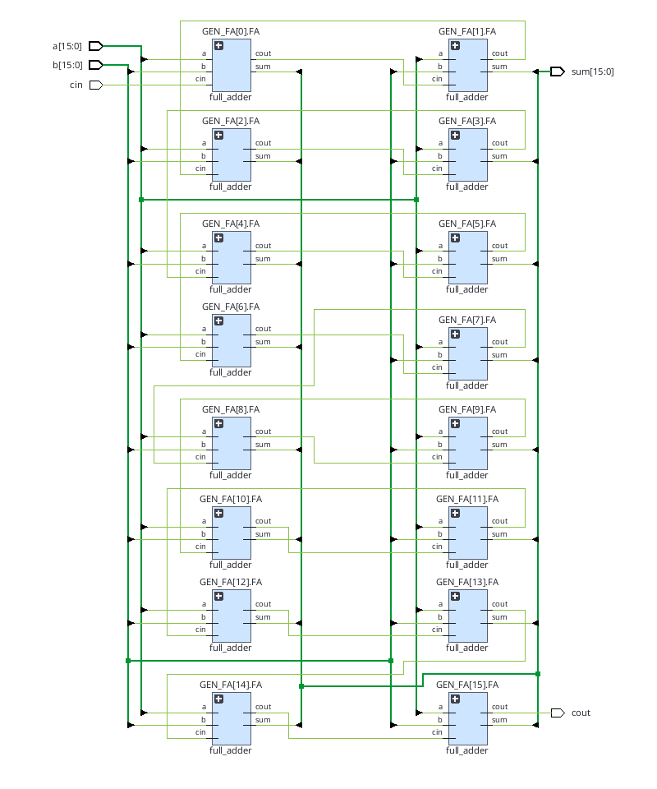
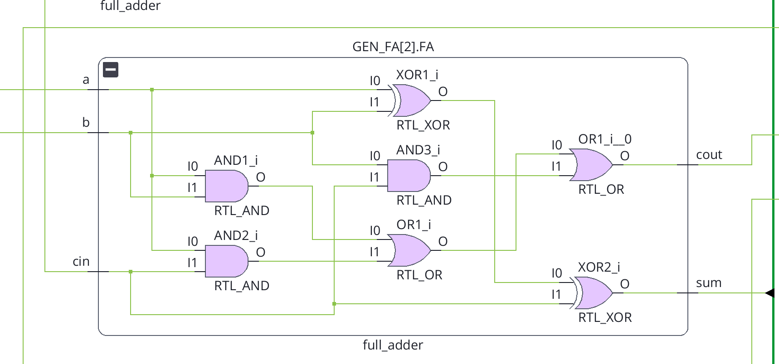
16-Bit Adder: Full RTL Structure
Verification of the Manual Design Using EDA
Verilog design style： structural level
（instantiate the built in gates）
03
Notes:
Source: image2 from the latest user message, shown in full. FA0 through FA15 are connected by carry signals. C0 is the external carry input, C16 is the carry output, and all 16 sum outputs form sum[15:0]. All stages are combinational and exist concurrently.

Slide 4
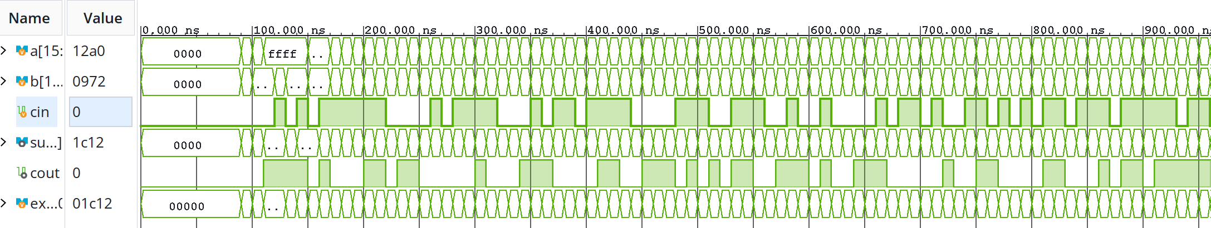
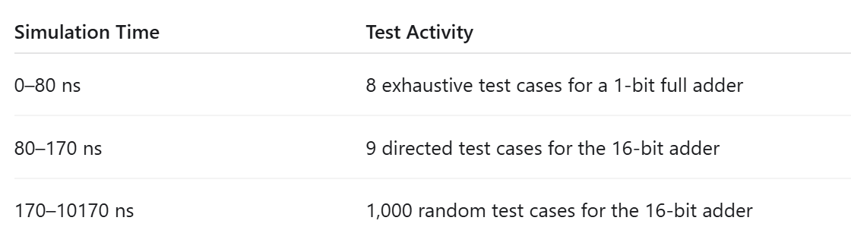

EDA Verification and Overall Results
Test Coverage：
8 full-adder cases + 9 typical + 1,000 random
Notes:
Source: user images6 and4. The actual console screenshot reports all 1017 cases passed at 10170ns. Test breakdown: 8 exhaustive cases for a separate 1-bit full adder, 9 directed 16-bit cases, and 1000 random cases. expected is independently calculated using 17-bit arithmetic. A 10ns interval is used before comparison. The 16-bit input space was not exhaustively tested. This is functional simulation, not hardware delay measurement.

Slide 5
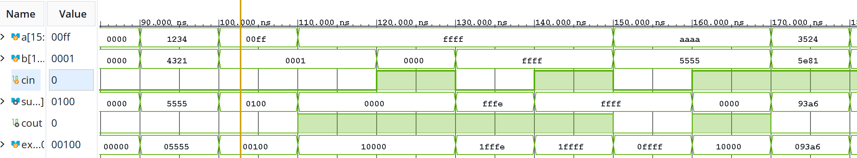

Waveform Checks for Key Carry Cases
Read a, b, and cin; compare the full output {cout, sum} with expected
① 100–110 ns
② 110–120 ns
③ 120–130 ns
00FF + 0001 + 0
= 0_0100
FFFF + 0001 + 0
= 1_0000
FFFF + 0000 + 1
= 1_0000
Carry across bit positions
Carry out of the top bit
Carry-in included correctly
Notes:
Source: user image5. At 100-110ns, 00FF+0001+0 yields cout=0,sum=0100. At 110-120ns, FFFF+0001+0 yields cout=1,sum=0000. At 120-130ns, FFFF+0000+1 yields the same result. Read inputs first, then compare the full concatenated output with expected. The cursor around102.733ns corresponds to the first example. Signal transitions do not demonstrate physical carry propagation delay.

