Slide 1
Pre3: ISA and Datapath Modules
Register file. ALU. PC. Immediate extension.
ISA semantics determine the hardware contracts
Behavioural Verilog and Vivado XSim 2025.2
Group presentation · Week 4
01 PRE3 A / 0:20

Slide 2
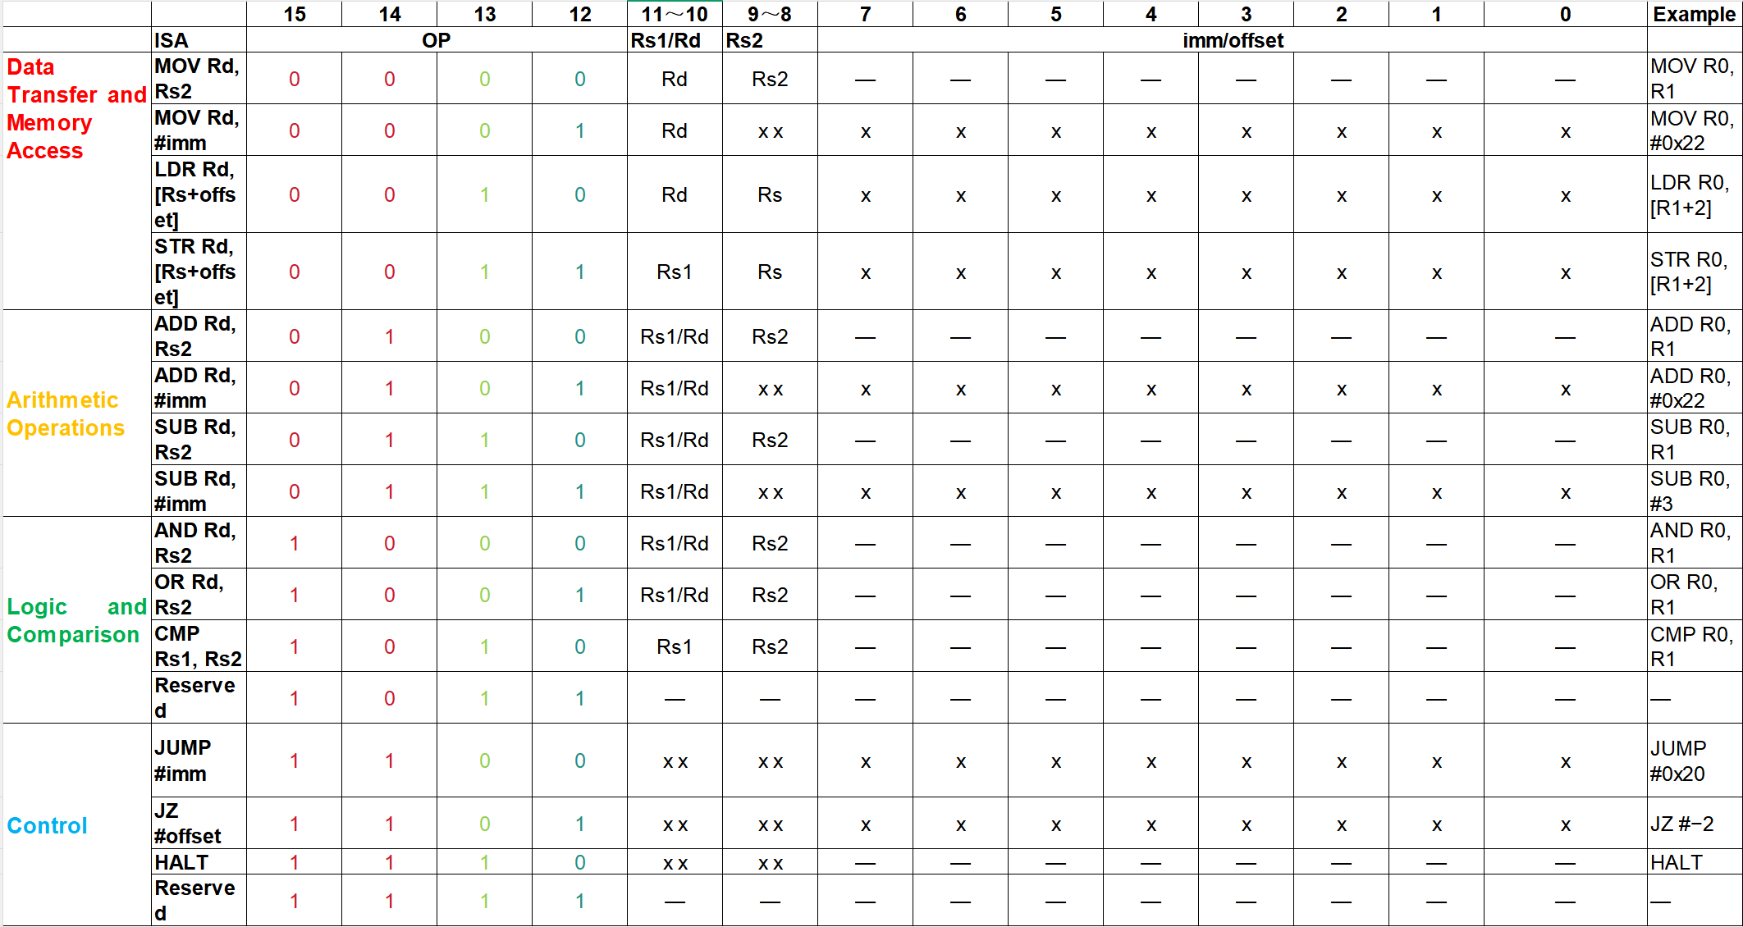

Slide 3
1
Register File
Two read ports, one write port, and a write-back bypass
Pre3 · ISA and Datapath Modules

Slide 4
Register file: two reads and one write
waddr[1:0]
wdata[15:0]
we, clk↑, rst
Four 16-bit registers
R0 R1 R2 R3
raddr_a[1:0]
raddr_b[1:0]
Read MUX + WB bypass
rdata_a[15:0]
rdata_b[15:0]
05 PRE3 B / 0:55

Slide 5
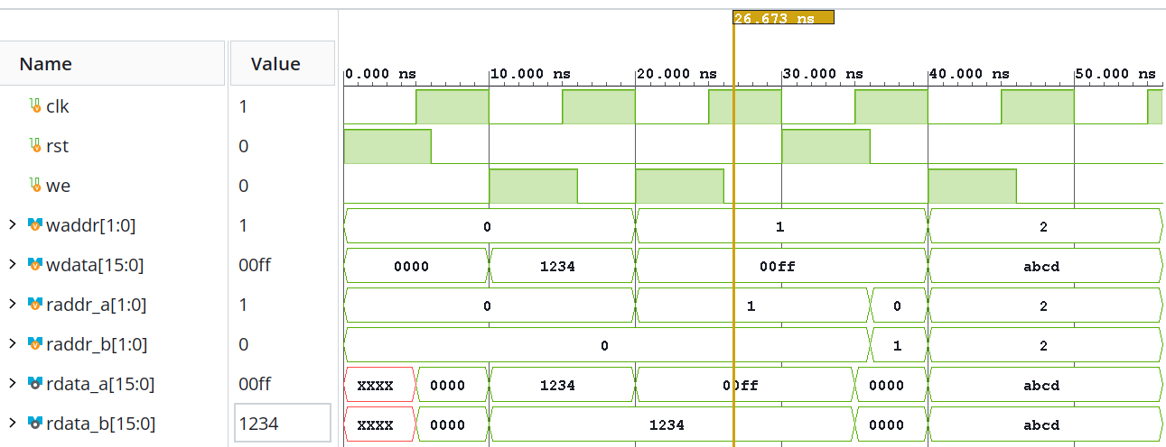
Register-file verification
6 checked transactions: PASS
06 PRE3 B / 1:00

Slide 6
Verification coverage and its limits
Object | Passed checks | Scope
Immediate extender | 512 | All binary input combinations
Instruction decoder | 65,536 | All instruction words; fields + controls
Register file | 6 transactions | Data sweep + control matrix + random
ALU | 2,177,160 cases | Patterns + random + invalid op
PC | 1,048,582 transitions | All PC values × controls, with setup
Target generator | 1,792 | All absolute imm + relative boundaries
All listed tests passed. No claim of full CPU or full sequential-state verification.
14 PRE3 B / 1:00

Slide 7
2
Arithmetic Logic Unit
Behavioural RTL, functional verification, and synthesis
Pre3 · ISA and Datapath Modules

Slide 8
ALU Behavioural Design
op (binary) | Function
000 | PASS_B
001 | ADD
010 | SUB
011 | AND
100 | OR
101–111 | Illegal
always @* begin
result=16'h0000; illegal=1'b0;
case (op)
PASS_B: result=b;
ADD: result=a+b;
SUB: result=a-b;
AND_OP: result=a&b;
OR_OP: result=a|b;
default: begin
result=16'h0000; illegal=1'b1;
end
endcase
end
localparam: PASS_B=3'd0, ADD=3'd1, SUB=3'd2, AND_OP=3'd3, OR_OP=3'd4
eq = (a == b) CMP qualifies the later Z update
Combinational module: no clock or state
C1 PRE3 ALU / 0:30

Slide 9
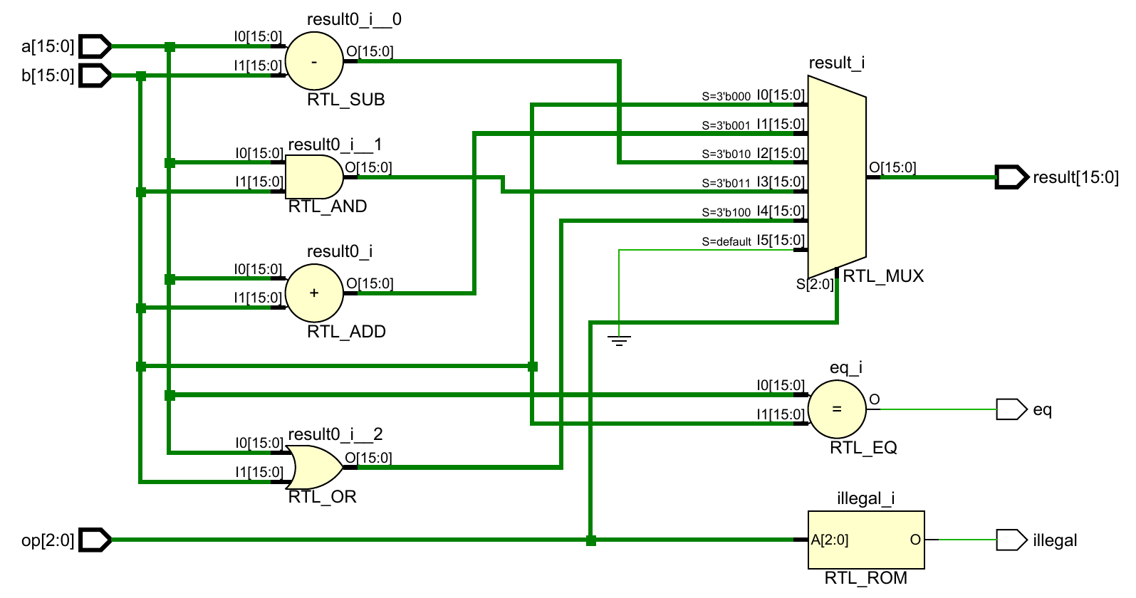
RTL Elaboration: Three Output Paths
1 result
op selects one
16-bit result
1
2 eq
Independent
a == b
2
3 illegal
3
op = 5, 6 or 7
RTL_ROM here represents decode logic, not a demonstrated memory block
C2 PRE3 ALU / 0:50

Slide 10
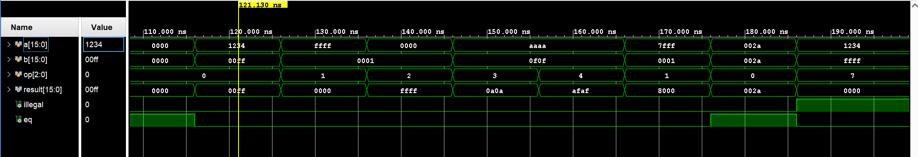
Functional Verification in Vivado
TB compares result, illegal and eq after a 1 ns simulation wait
Time (ns) | 126–136 | 136–146 | 186–196
Check | FFFF + 0001 | 0000 − 0001 | op = 111
Observed | 0000: low 16 bits | FFFF: −1 in two’s complement | result=0; illegal=1
Saved regression: 2,177,160 cases passed; not exhaustive ALU coverage
C3 PRE3 ALU / 1:00

Slide 11
ALU Synthesis Results
ALU resource | Used | Interpretation
Slice LUTs | 71 | Combinational logic and selection
CARRY4 | 10 | Dedicated carry-chain resources
Flip-flops | 0 | No stored state in this ALU
RTL structure Functional correctness Hardware mapping
C4 PRE3 ALU / 0:20

Slide 12
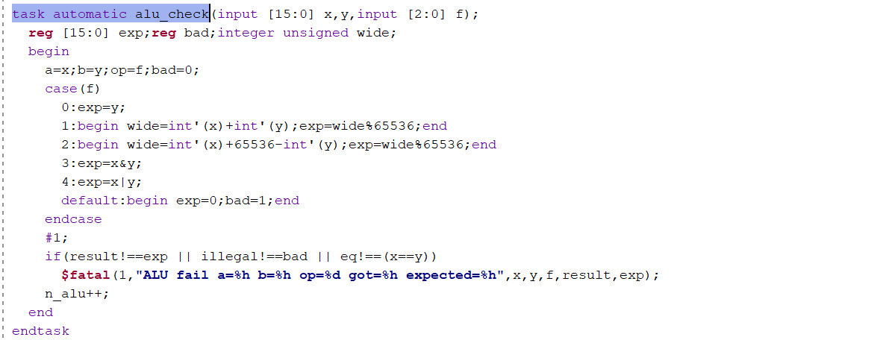
Backup: Self-Checking Testbench
Drive inputs
Compute expected
result and flags
#1 then compare
!== detects mismatch
and unknown outputs
$fatal on failure
65,536 × 4 × 8 + 10,000 × 8 + 8 = 2,177,160 checks
C5 PRE3 ALU / Q&A

Slide 13
3
Program Counter
Reset, redirect, hold, and sequential update
Pre3 · ISA and Datapath Modules

Slide 14
PC Design: Update Priority and Branch Addressing
Sequential PC control with explicit conflict resolution
UPDATE PRIORITY
NEXT-PC BEHAVIOUR
CORE RTL
RESET
Condition
Next PC
always @(posedge clk) begin
if (rst)
pc <= 16'h0000;
else if (redirect)
pc <= redirect_target;
else if (hold)
pc <= pc;
else
pc <= pc + 16'd1;
end
↓
rst = 1
16'h0000
REDIRECT
↓
redirect = 1
redirect_target
HOLD
hold = 1
keep current PC
↓
otherwise
PC + 1
PC + 1
Why Redirect > Hold?
A resolved control-flow address must override
a front-end stall.
Reset > Redirect > Hold > Sequential
0010 + hold + redirect(0030) → PC=0030
rst → reset | redirect → correction | hold → stall | else → fetch next
FFFF + 0001 = 1_0000
low 16 bits → 0000 (mod 2¹⁶)
09 PRE3 D

Slide 15
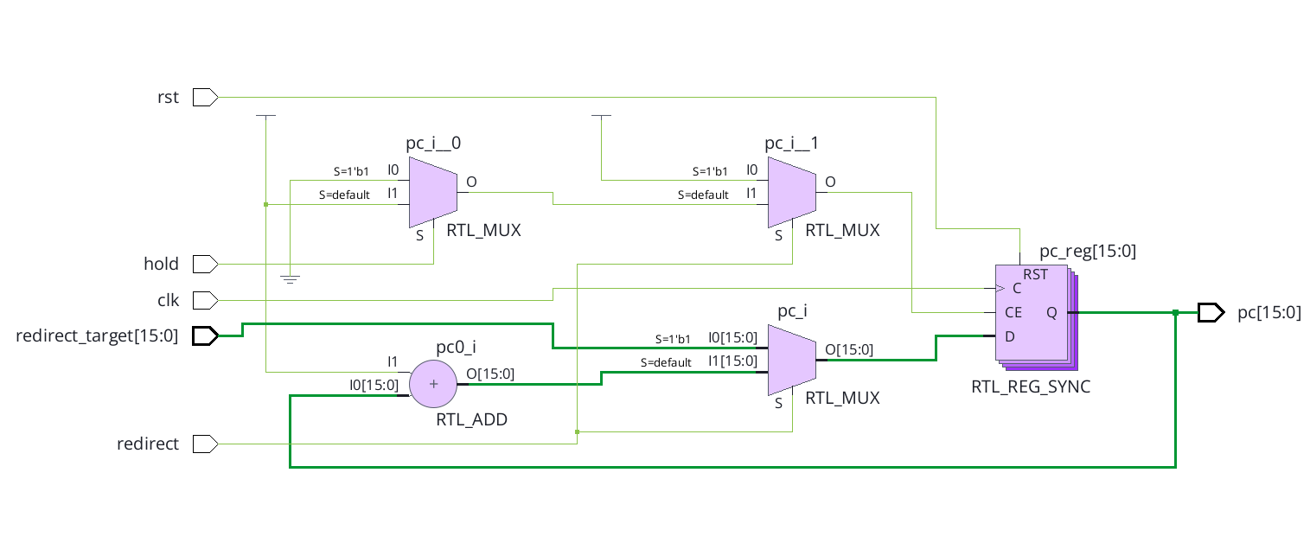
PC RTL Structure after Elaboration
The HDL directly becomes register, incrementer, and selection logic
RTL / technology-independent view
1 NEXT-PC DATA PATH
pc0_i: current PC → PC + 1
pc_i: redirect selects target or PC + 1
D = redirect ? redirect_target :
PC + 1
2 PC ENABLE CONTROL
CE = redirect | ~hold
hold only → CE=0 → retain PC
redirect + hold → CE=1 → take target
In this elaborated design, pc ≤ pc becomes register enable control.
3 STATE REGISTER
C ← clk
RST ← rst
CE ← redirect | ~hold
D ← next_pc
Q → pc[15:0]
posedge clk:
rst → PC=0
else if CE → Q←D
Elaboration shows functional intent — register, adder, selection and enable — before mapping to FPGA primitives.
10 PRE3 D

Slide 16
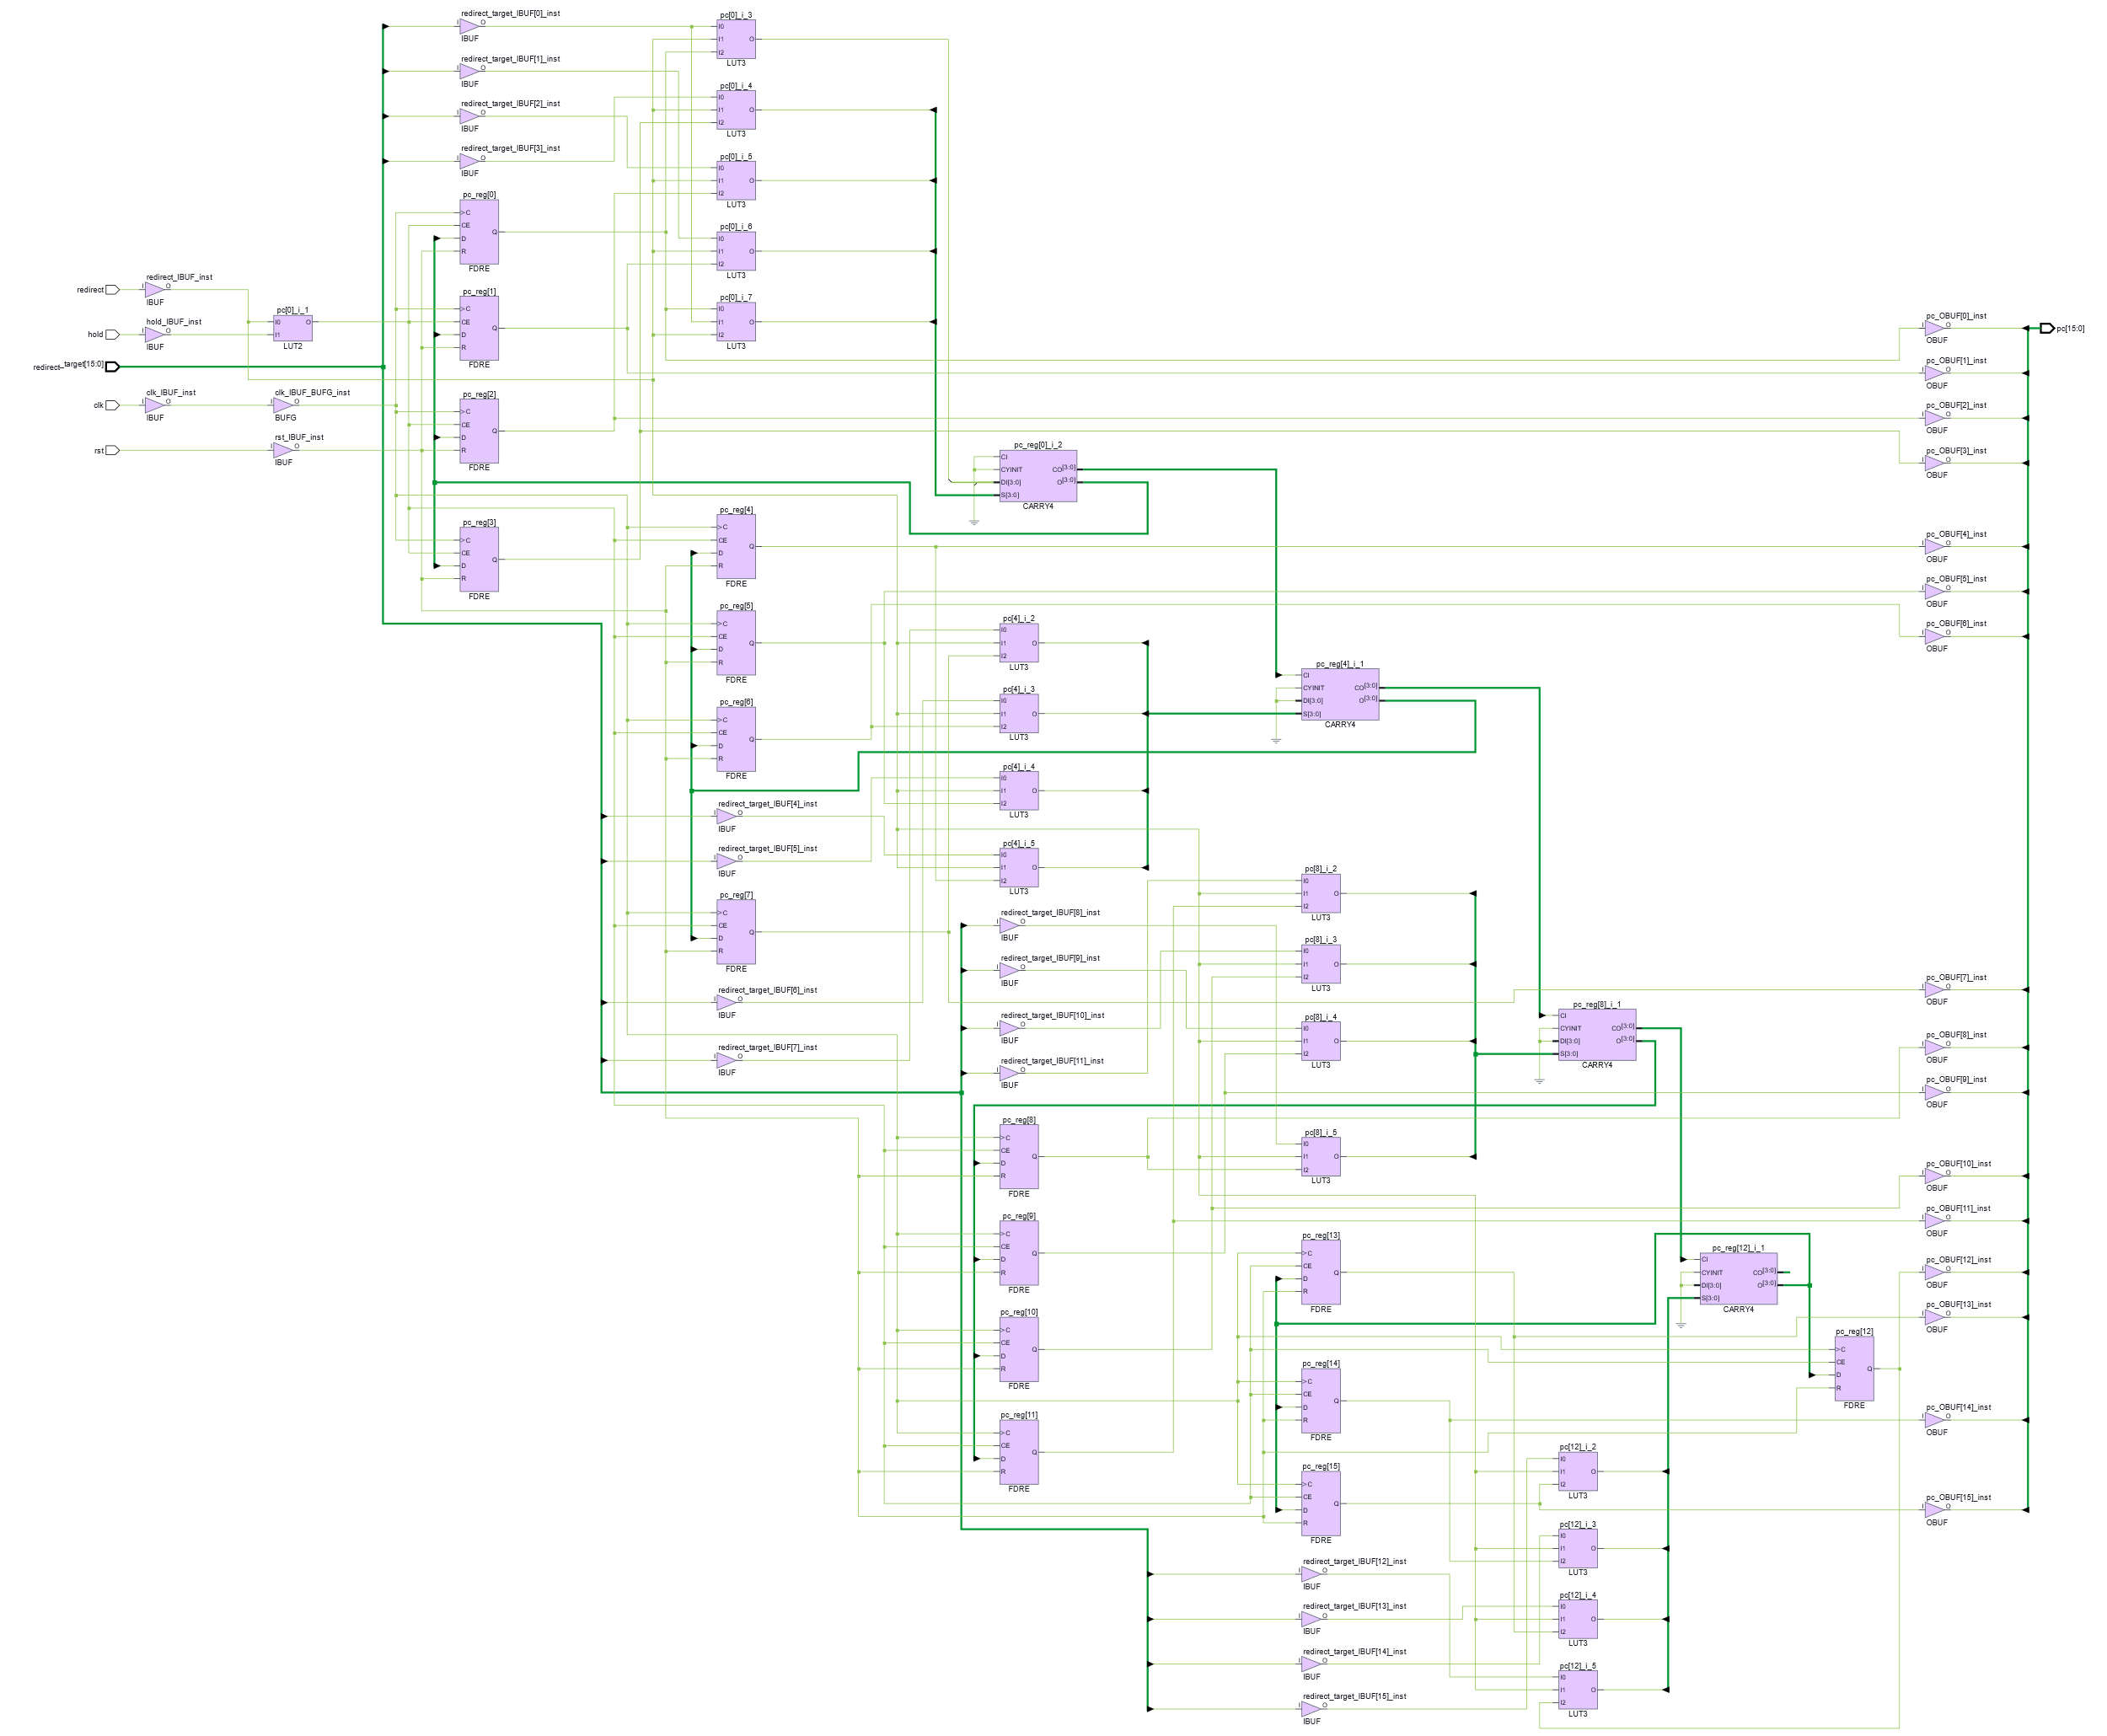
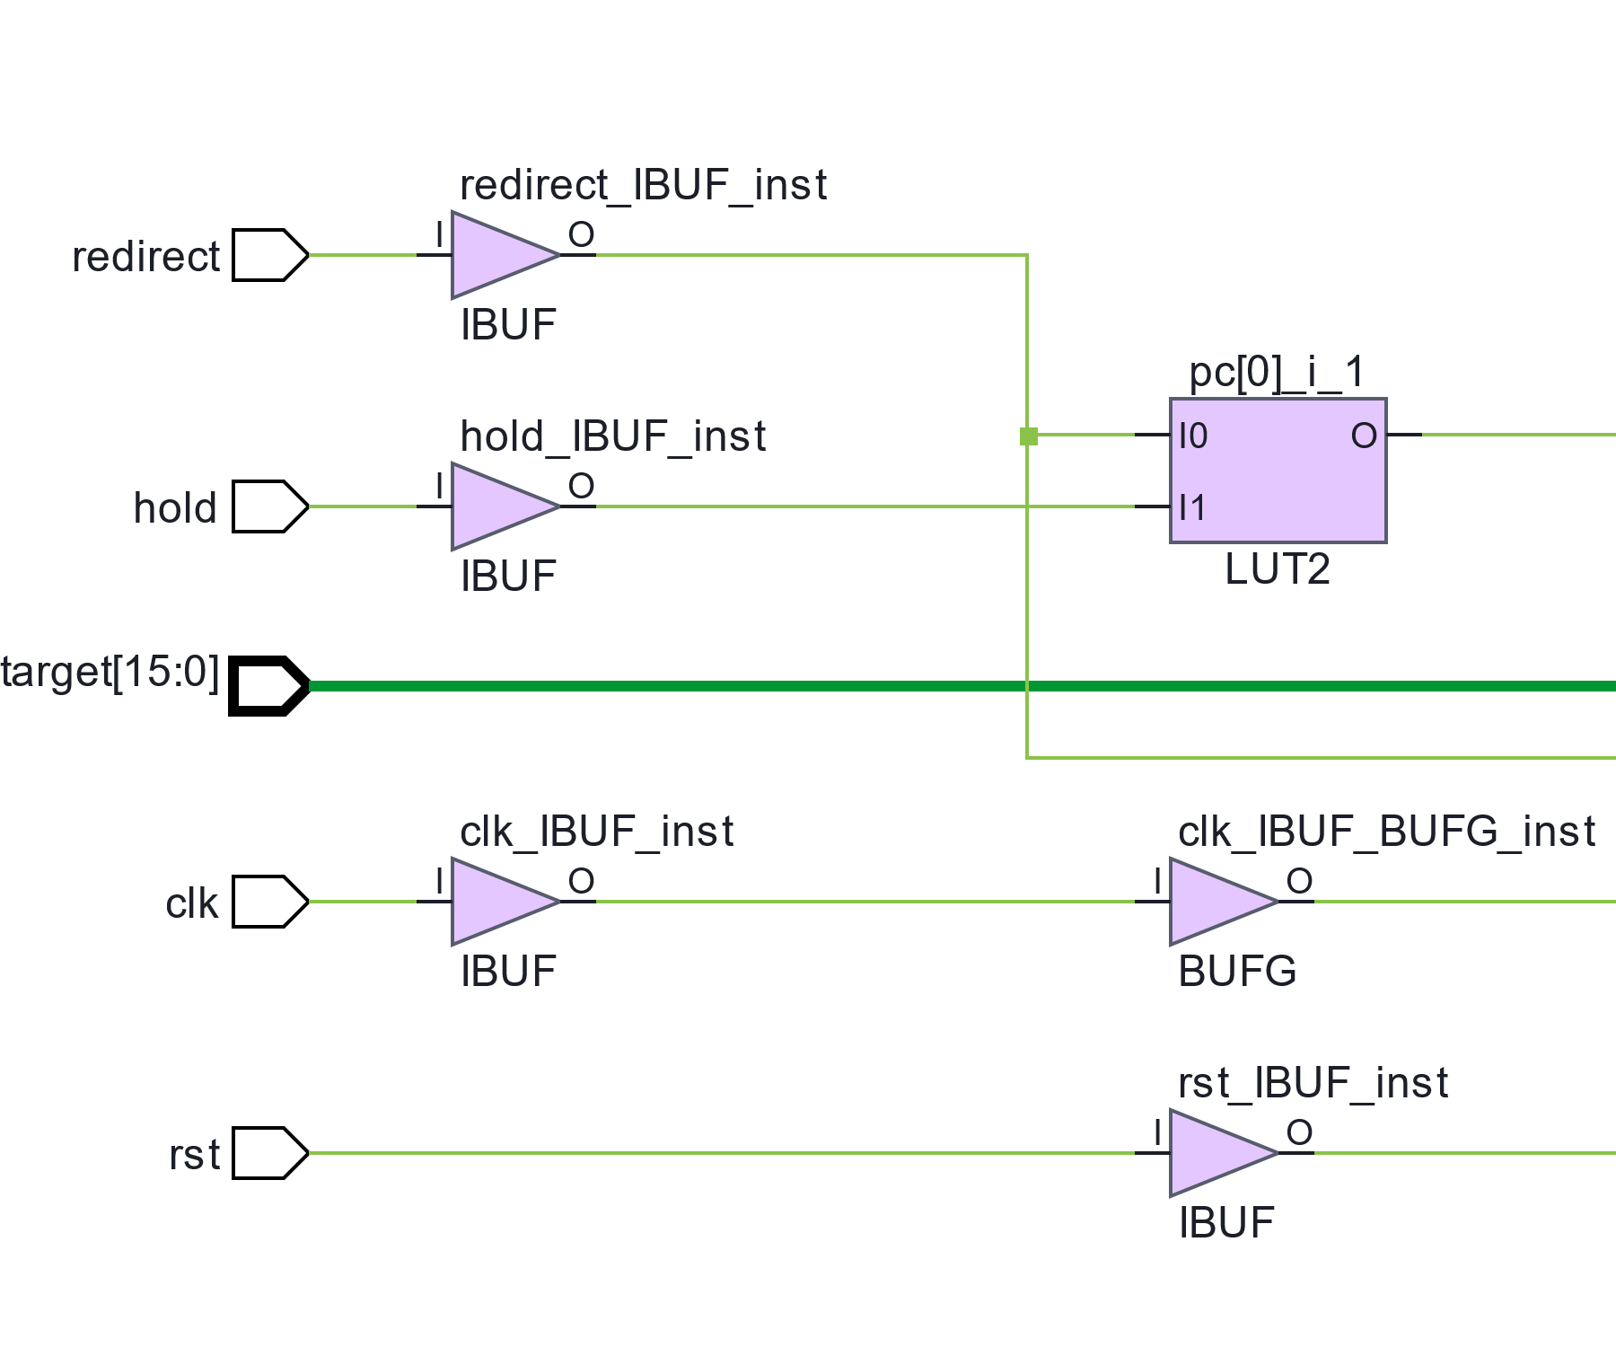
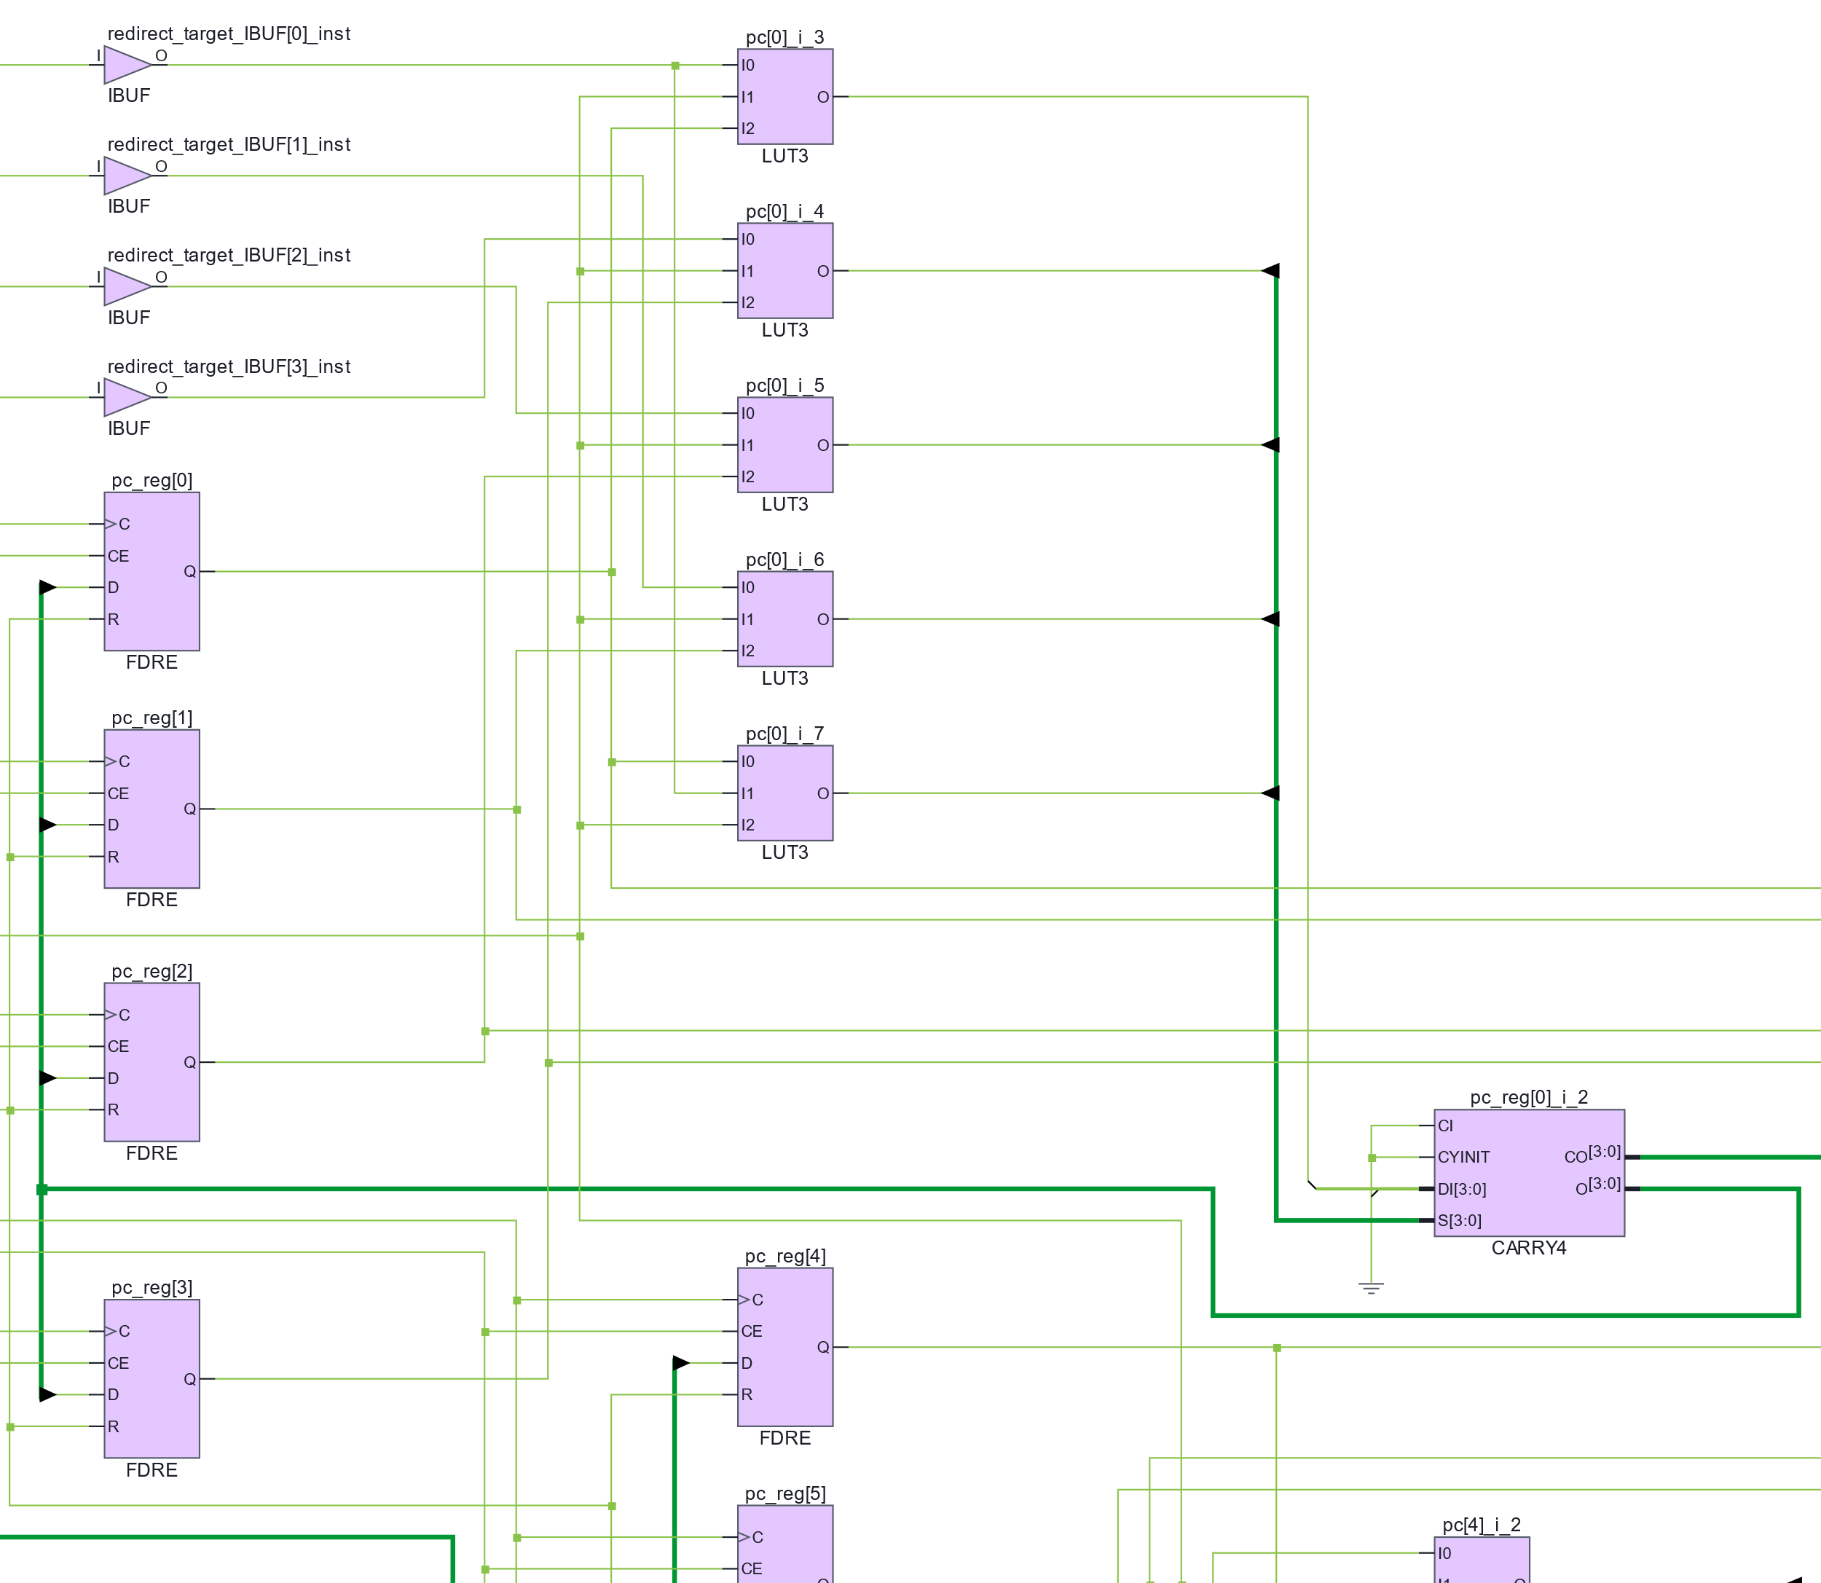
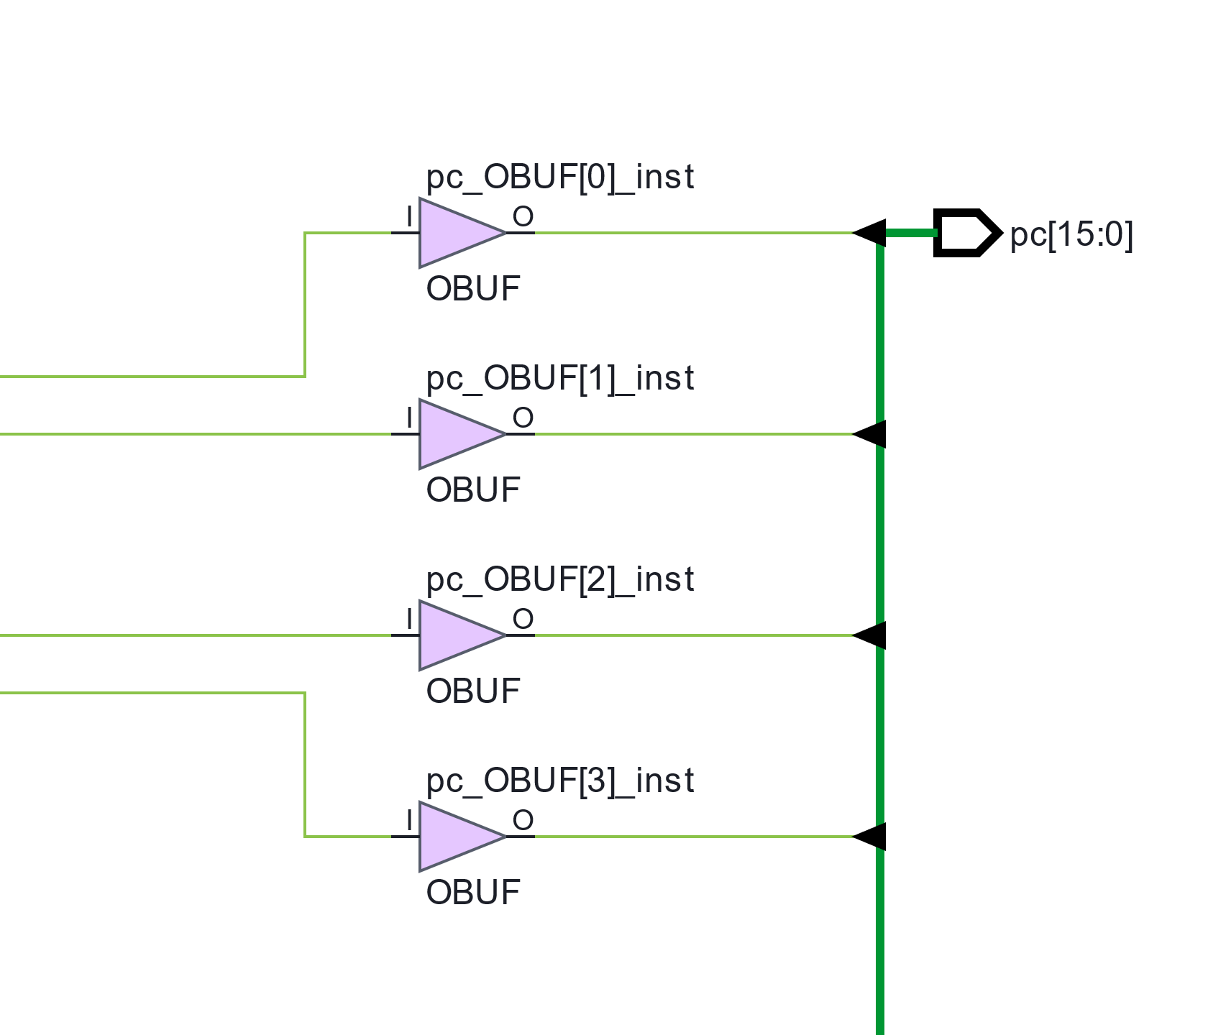
PC Post-Synthesis Mapping
Vivado 2026.1 maps the RTL to FPGA primitives
FPGA primitive / technology-mapped view
OVERALL NETWORK
A INPUT / CONTROL
B PC CORE
IBUF + LUT2: CE = redirect | ~hold
LUT3 preprocessing + CARRY4 carry path + FDRE state
C OUTPUT
16-BIT INCREMENTER
16 × FDRE → 16-bit PC state
4 × CARRY4 → 16-bit carry chain
HDL behaviour
Each CARRY4 handles 4 bits. CO[3] of the lower block feeds CI of the next; LUTs generate S/DI and selection preprocessing.
posedge clk
pc + 1
ports
→
FDRE
CARRY4 + LUT
IBUF / OBUF
FDRE.Q → OBUF → pc[15:0]
11 PRE3 D

Slide 17
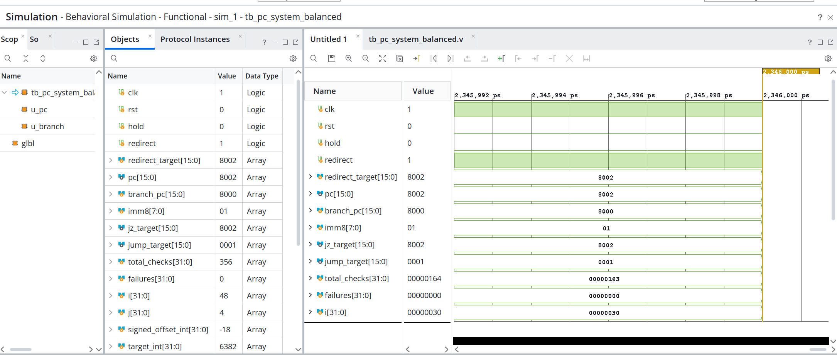
PC Verification: Test Strategy and Result
Deterministic vectors cover control priority, branch targets, boundaries, and integration
THREE VERIFICATION LAYERS
XSIM RESULT
216
PC / CONTROL
Reset 16 · Sequential 64 · Hold 40
Redirect 48 · Redirect > Hold 32 · Boundary 16
checks
116
BRANCH TARGET
Fixed vectors 20 · Systematic sweep 96
Both JZ and JUMP outputs are checked
checks
24
INTEGRATION
356
0
12 complete paths × 2 checks
JZ target calculation → PC redirect
checks
checked results
0x164 in XSim
failures
PASS condition satisfied
216 + 116 + 24 = 356 self-checking comparisons
Simulation completed at 2.346 µs — not a CPU timing measurement.
12 PRE3 D

Slide 18
PC Verification: Key Testbench Code
Explicit expected values, independent branch arithmetic, and end-to-end redirect checking
PC / CONTROL CHECK
BRANCH OUTPUT CHECK
task check_pc;
input t_rst, t_hold, t_redirect;
input [15:0] t_target, t_expected;
begin
@(negedge clk);
rst = t_rst;
hold = t_hold;
redirect = t_redirect;
redirect_target = t_target;
@(posedge clk); #1;
total_checks = total_checks + 1;
if (pc !== t_expected)
failures = failures + 1;
end
endtask
total_checks = total_checks + 2;
if (jz_target !== t_expected_jz)
failures = failures + 1;
if (jump_target !== t_expected_jump)
failures = failures + 1;
One vector checks both target outputs.
INDEPENDENT EXPECTED-VALUE ARITHMETIC
signed_offset_int =
(sweep_imm >= 8'h80) ? sweep_imm - 256
: sweep_imm;
target_int = sweep_pc + 1 + signed_offset_int;
sweep_expected_jz = target_int & 16'hFFFF;
sweep_expected_jump = sweep_imm;
Integer signed arithmetic avoids copying the DUT expression verbatim.
Expected PC comes directly from the test vector.
verify jz_target → redirect target into pc16 → verify PC
negedge: drive inputs → posedge + #1: compare after NBA update
Target calculation → PC redirect
13 PRE3 D

Slide 19
4
Immediate Extension
Zero extension and sign extension follow the ISA
Pre3 · ISA and Datapath Modules

Slide 20
Immediate extension follows the ISA
if (sign_mode) value = {{8{imm[7]}},imm};
else value = {8'h00,imm};
Instruction class | Mode | Interpretation
MOV #u8, ADD #u8, JUMP #u8 | 0 | Unsigned 0 … 255
LDR/STR offset, JZ #s8 | 1 | Signed −128 … +127
The decoder selects the mode; the extender does not decode opcodes
11 PRE3 E / 0:40

Slide 21
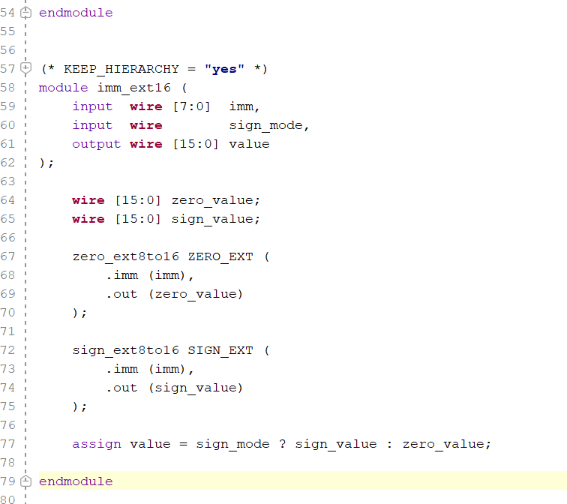
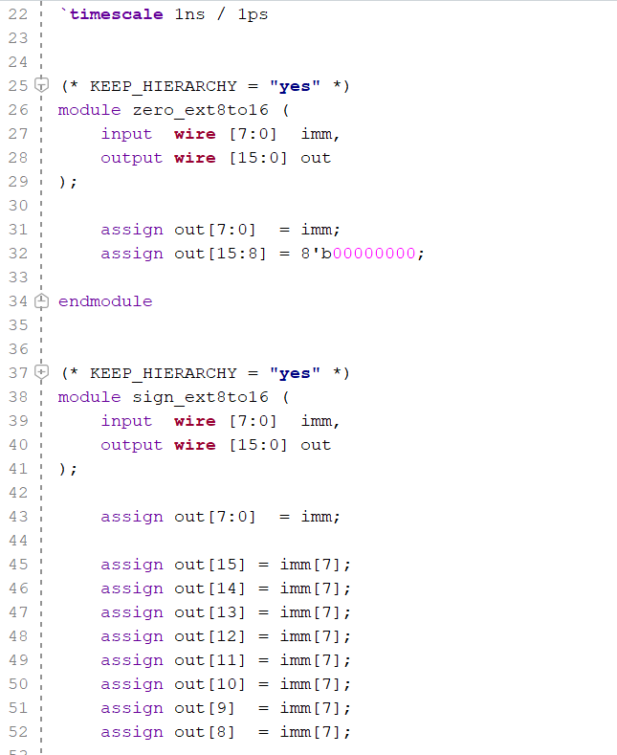
HDL Language
13 PRE3 E / 0:55

Slide 22
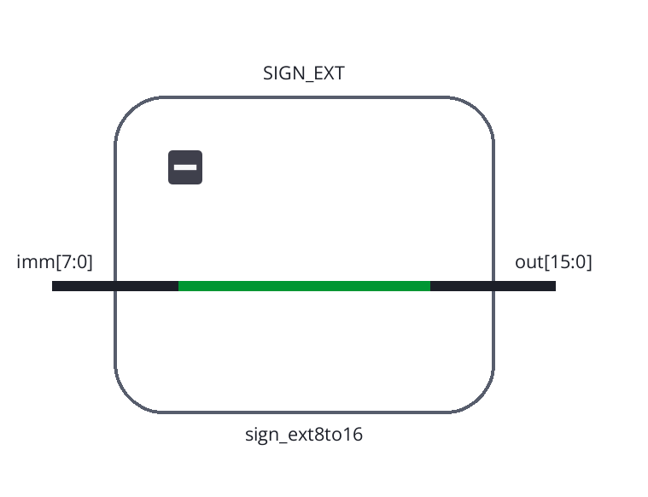
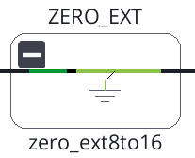
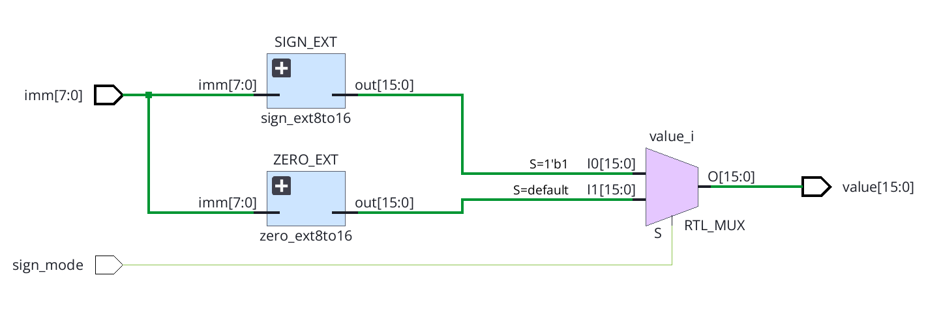
EDA structure
11 PRE3 E / 0:40

Slide 23
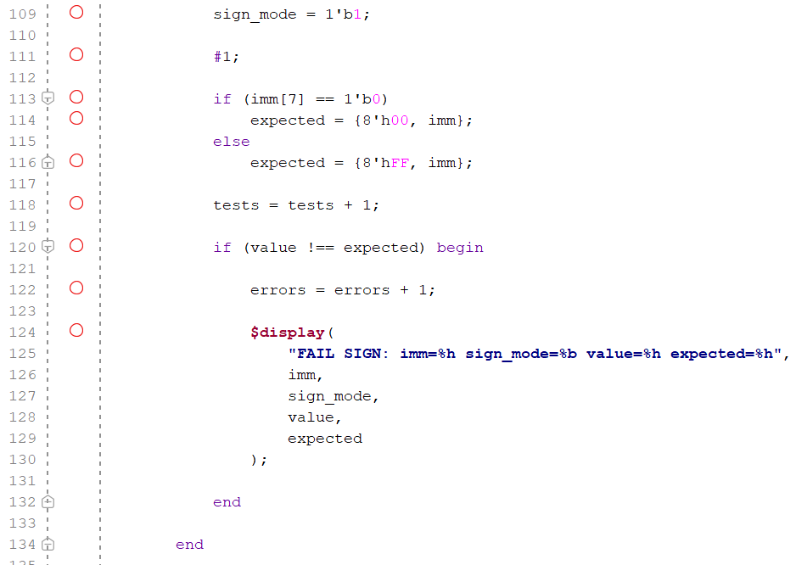
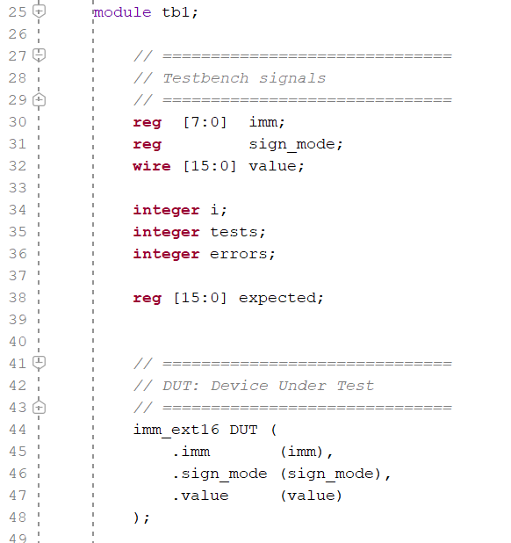
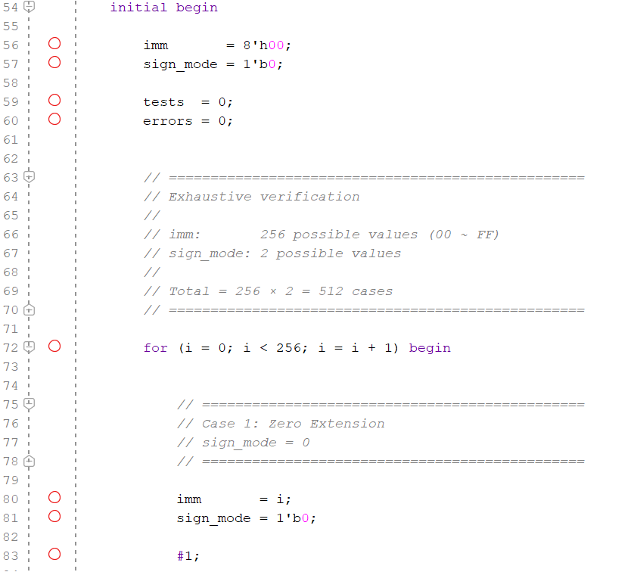
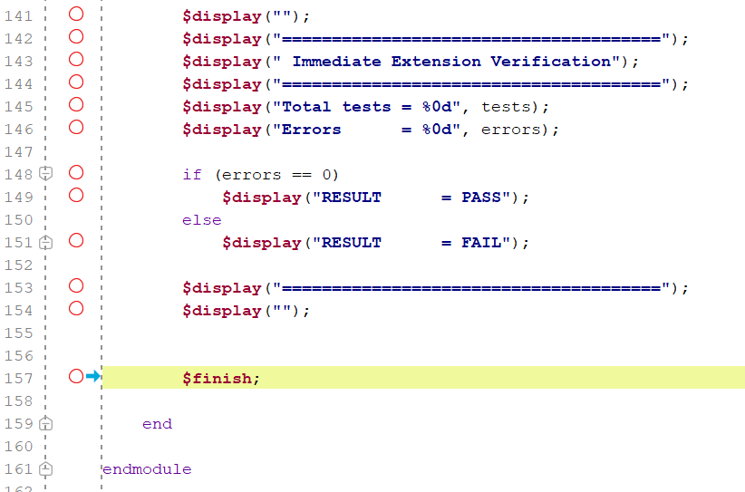
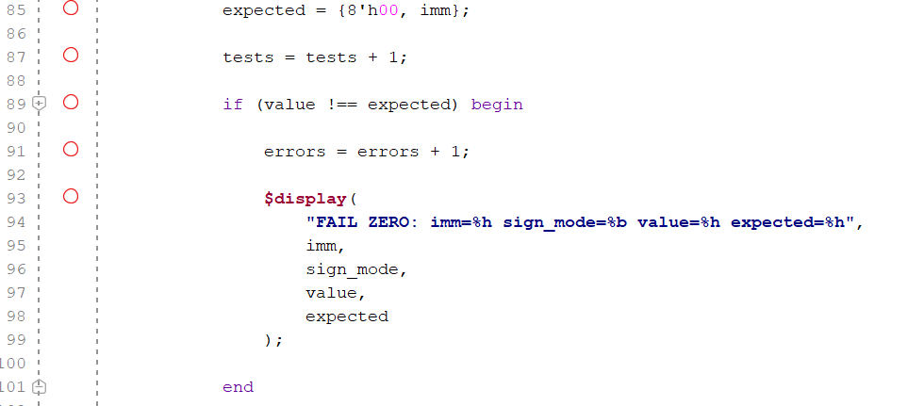
Verification TestBranch
Iterate through all possibilities
14 PRE3 B / 1:00

Slide 24
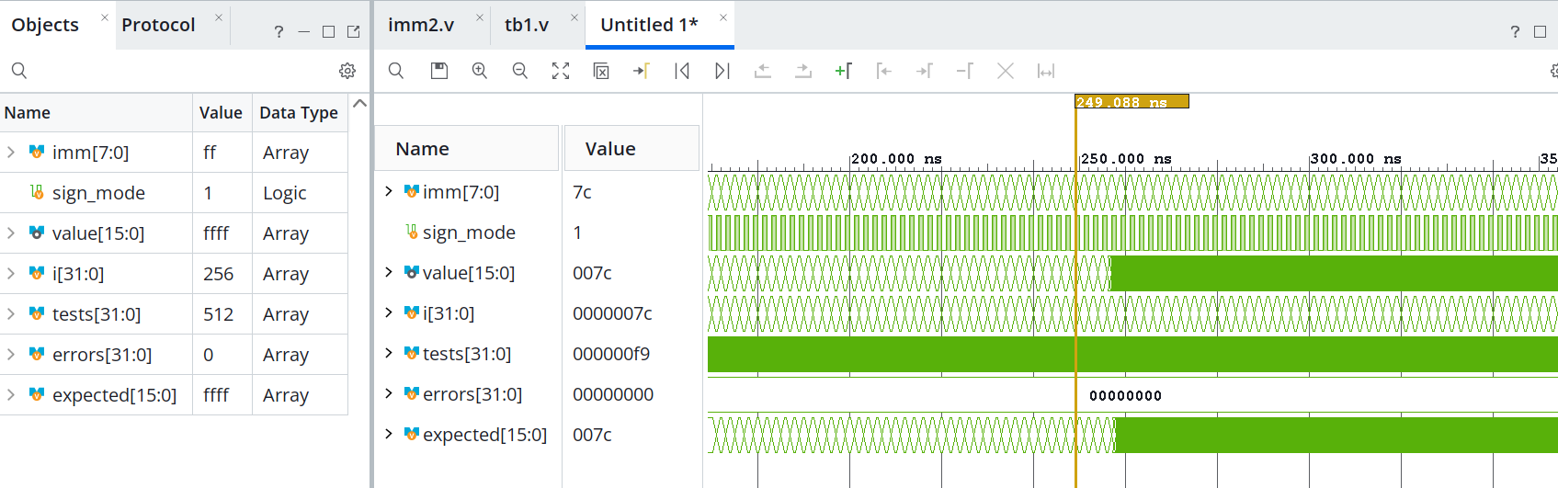
Verification Result
256 immediate values × 2 modes = 512 / 512 PASS
12 PRE3 E / 0:45

